Slide 1

NetSpeed Orion Low Power Product Overview Meeting
January 9th, 2015

Slide 2
Problem Statement & Introduction
Low Power Features
Low Power Flow
Low Power Verification
Tools
1412 LP Release and Status
IMG Customer feedback
Next Steps
Agenda

Slide 3
Introduction: Terms
Voltage Domain: Where the Vsupply to a collection of transistors can be varied independently of other Vsupply values on the chip.
Power Gated Domain: An area to which Vsupply can be interrupted by means of an on chip power switch. A voltage domain may have several power gated domains within it. A power gated domain is always wholly contained within a voltage domain.
Power Profile: An operating point which requires a set of power gated and always on domains to be in the ‘ON’ state.
Power Sequence: A sequence of operations to power gate or power enable domains.
Note: A power gated domain is always wholly contained within a Voltage domain

Slide 4
Problem Statement
SoCs have complex Low Power use cases
Multiple clock, power and voltage domains
Complex combinations of power domains can form a use case
SoC Power Management is a difficult problem
Not all masters & slaves are well behaved
Switching between use cases requires complex sequencing of operations by the PM – hangs etc
SoC bus network is distributed, and can be a major power drain for low power use cases
Low power use case analysis is hard to do pre-silicon
PM signaling commonly done via long global routes, which can be a significant timing closure problem.
Overall effect:
Often results in PM bug fixes or PM sequence changes, AFTER silicon is back
PM has appreciable effect on TTM and competitive position wrt battery life or power envelope

Slide 5
NetSpeed Solution ameliorates the PM problem
NocStudio intelligence and algorithms applied to PM
NocStudio Traffic Profiles specify communication patterns
NocStudio Power Profiles specify power domains that are active
In a given Power Profile, NocStudio knows the NoC elements / domains it does not need ON
Power Management using NocStudio
Tune-power efficiently assigns power domains to NoC elements for lowest leakage
NoC hardware manages holdoff or completion of traffic between masters and slaves gracefully
For switching between LP use cases, NocStudio generates robust PM sequences & compliance checks
A generalized register programming interface allows extensive changes to PM sequences post silicon
Synchronized Abort / Commit operation (needs L2FSM)
A structured PM communication interface designs out long global wires easing timing closure

Slide 6
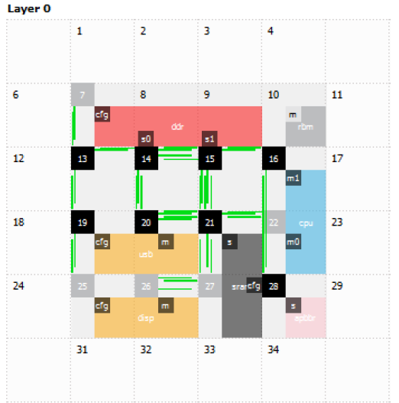
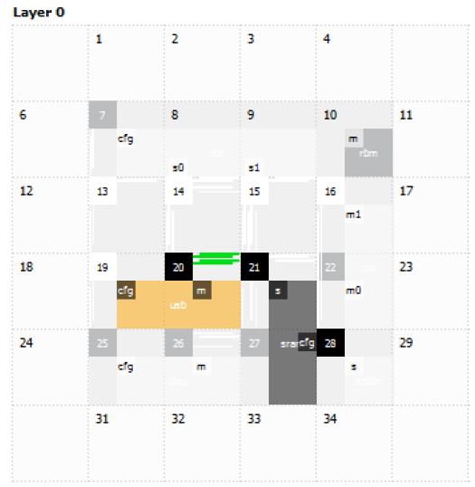
Introduction: Tune power
NocStudio creates routers while synthesizing the network
‘Tune power’ is a NocStudio optimization which auto assigns power domains to routers
Auto-assignment is based on adjacency, hardware cost, and on required traffic flows
Tune
power

Slide 7
Problem Statement & Introduction
Low Power Features
Low Power Flow
Low Power Verification
Tools
1412 LP Release and Status
IMG Customer feedback
Next Steps
Agenda

Slide 8
Low Power Features
Clock Gating
Fine Grained CG: Synthesis based
Coarse Grained CG: At NoC element level
System Level CG: External control of NoC element level clocks
Power Gating in single voltage NoC
Power gating of individual NoC elements or group of NoC elements
Today’s focus on Power Gating

Slide 9
Problem Statement & Introduction
Low Power Features
Low Power Flow
Low Power Verification
Tools
1412 LP Release and Status
IMG Customer feedback
Next Steps
Agenda

Slide 10
NetSpeed Low Power Flow
LP NoC Config
Input specification contains power domains and profiles
Understands Traffic and Power profiles
Does analysis/optimization for power domains
Generates low power collateral
NocStudio
Power Aware Design & Verif:
CPF - Power Intent
RTL with LP controls
Low Power Sequences
Assertions & Checkers
CPFs
LP aware RTL
LP Sequences
AIP

Slide 11
A Simple NoC
PDsystem NoC Top
PD4
PD0
PD1
s0
H2
m0
H1
AON
r
PD2
PD3
Primary
layers
s1
H3
PPLN
PPLN
REG
XTOR
RBM
RR
RM
RR
RM
REGBUS layer
Simple 1 Master and 2 Slave Config

Slide 12
Low Power Flow: Power intent spec in config
new_mesh 4 4 1 lp_example regbus_enabled
mesh_prop low_power_enabled yes
mesh_prop low_power_hw_fsm_l1_enabled yes
add_power_domain PD0
add_power_domain PD1
add_power_domain PD2
add_host m0 …….
add_traffic ………
add_range ………
bridge_prop m0/m power_domain PD0
bridge_prop s0/s power_domain PD1
bridge_prop s0/s power_domain_host PD1
bridge_prop s1/s power_domain PD2
add_power_profile m0_s0 PD0@ON PD1@ON
add_power_profile m0_s1 PD0@ON PD2@ON
add_power_profile s0_s1 PD1@ON PD2@ON
map
tune_power 1 1
gen_ip
Low power features will be enabled and controlled by REGBUS layer.
Creates new power domains for NoC elements.
Assign created power domains to NoC bridges. Host power domain can be set same as bridge.
Creates power mode conditions or power state tables. Only bridge power profiles are added.
Assigns power domains to routers and links based on the power profile info.

Slide 13
CPF Generation
Hierarchical CPFs (v1.1) generated with COMPLETE power intent specification
Generates Hierarchical CPFs for
Pre-Simulation for RTL simulations and
Pre-Synthesis for RCP including voltage nets, low power libs
Isolation rules with port level information, easier for post-synthesis integration
Testbench CPF for modeling host interface power domains (for Sanity bench)

Slide 14
Low Power aware RTL
Generates RTL for two types of low power architectures
SW controlled power sequencing assuming external PMC
Level-1 HW State machine assisted power sequence, reducing PMC tasks
LP configuration registers are generated in REGBUS layer elements to control power sequencing
NocStudio connects these control signals to respective RTL instances (Bridges/Routers) based on power profile specification in config
HW State machine based sequencing is (2-3)x lower instruction count

Slide 15
Power Sequencing
NocStudio creates power sequence generator - PERL package
Generates stimulus before invoking hardware simulator
Package invoked to generate register programming sequences for switching power profiles
Deadlock free sequences for power gate/enable operations
Generates both SW and HW based power sequencing stimulus
#!/usr/bin/env perl
use NocPowSeq;
NocPowSeq::change_power_profile(“all", “s0"); # Generate a SW sequence to go from all to s0
NocPowSeq::change_power_profile(“s0", “all"); # Generate a SW sequence to go from s0 to all

Slide 16
Assertion IP
NocStudio creates Assertion IP for LP features at various stage of collateral generation
SW Testing: Perl based static checks generated to verify testing of configs, CPFs, RTL and Sequences, these checks are performed during collateral generation by NocStudio
Intra element sequence Assertions: SV Assertion based checks written at per element (bridges/router) level to meet the LP functional behavior of power gating and enabling during dynamic simulations. NocStudio stitches these checks to the right LP controls of the elements
Inter element sequence Assertions: NocStudio generates SV Assertion checks to verify LP sequencing behavior of control signals across multiple NoC elements during dynamic simulations

Slide 17
Assertion IP
Power Profile Assertions: Stable Power profile state SV Assertion checks of NoC by parsing power intent specified from config to Power profile state switching during dynamic simulations
Power Profile Coverage: SV property based coverage to measure the switching all power profile states and triggering of respective LP control signals. This is estimated during dynamic simulations and useful for improving LP sequencing stimulus

Slide 18
Low Power Flow: LP sequencing
Powering DOWN sequence order
NocPowSeq::change_power_profile(“all", “s0");
Elements to power down :
m0 r s1
Elements to power up :
None (s0 is already ON)
PDsystem NoC Top
PD4
PD0
PD1
s0
H2
m0
H1
AON
r
PD2
PD3
s1
H3
PPLN
PPLN
NocPowSeq::change_power_profile(“s0", “all");
Elements to power down :
None
Elements to power up :
s1 r m0
REG
XTOR
RBM
RR
RM
RR
RM
Powering UP sequence order

Slide 19
Power Gating Sequence
SW Register Transactions
NoCPowSeq dumps register transactions with complete details. For e.g., master bridge m0/m powering down is shown for both SW and HW FSM
HW FSM sequencing does element level powering down in one go and polls for DONE, and hence (2-3)x faster than SW
Powering down Slave bridges, for e.g., s1/s also does the same after de-mapping of it’s address range and waiting for ZERO outstanding transactions in connected master bridges
CORE ID | OPERA-TION | REG NAME | ADDRESS | VALUE | RING ID | RM ID | ELEMENT ID NAME
0 | WRITE | PGReq | 0x80080408 | 0x00000001 | 1 | 2 | 1 | m0/m
0 | POLL | PGRdy | 0x80081208 | 0x00000001 | 1 | 2 | 1 | m0/m
0 | WRITE | IEN | 0x80080508 | 0x00000001 | 1 | 2 | 1 | m0/m
0 | WRITE | IENR | 0x80080708 | 0x00000001 | 1 | 2 | 1 | m0/m
0 | WRITE | CKEN | 0x80080908 | 0x00000000 | 1 | 2 | 1 | m0/m
0 | WRITE | PER | 0x80080b08 | 0x00000000 | 1 | 2 | 1 | m0/m
HW FSM Register Transactions
CORE ID | OPERA-TION | REG NAME | ADDRESS | VALUE | RING ID | RM ID | ELEMENT ID NAME
0 | WRITE | FIR | 0x80081408 | 0x0000fd73 | 1 | 2 | 1 | m0/m
0 | POLL | FIR | 0x80081408 | 0x00000000 | 1 | 2 | 1 | m0/m

Slide 20
Power Enable Sequence
SW register transactions
NocPowSeq dumping register transactions for master bridge m0/m powering up
HW FSM sequencing for power up is also (2-3)x faster than SW
Powering up slave bridges, for e.g., s1/s also does the same before mapping of it’s address range in connected master bridges
CORE ID | OPERA-TION | REG NAME | ADDRESS | VALUE | RING ID | RM ID | ELEMENT ID NAME
0 | WRITE | PER | 0x80080b08 | 0x00000001 | 1 | 2 | 1 | m0/m
0 | WRITE | PDR | 0x80080d08 | 0x00000001 | 1 | 2 | 1 | m0/m
0 | WRITE | CKEN | 0x80080908 | 0x00000001 | 1 | 2 | 1 | m0/m
0 | WRITE | PGR | 0x80080408 | 0x00000000 | 1 | 2 | 1 | m0/m
0 | - | NOP |  | 100 cycles
0 | WRITE | IENR | 0x80080708 | 0x00000000 | 1 | 2 | 1 | m0/m
0 | WRITE | PDR | 0x80080d08 | 0x00000000 | 1 | 2 | 1 | m0/m
0 | WRITE | IEN | 0x80080508 | 0x00000000 | 1 | 2 | 1 | M0/m
HW FSM register transactions
Power gate/enable sequences gracefully handle transactions that are in progress or outstanding.
CORE ID | OPERA-TION | REG NAME | ADDRESS | VALUE | RING ID | RM ID | ELEMENT ID NAME
0 | WRITE | FIR | 0x80081408 | 0x0000f171 | 1 | 2 | 1 | m0/m
0 | POLL | FIR | 0x80081408 | 0x00000000 | 1 | 2 | 1 | m0/m
0 | WRITE | PDR | 0x80080d08 | 0x00000000 | 1 | 2 | 1 | m0/m

Slide 21
Problem Statement & Introduction
Low Power Features
Low Power Flow
Low Power Verification
Tools
1412 LP Release and Status
IMG Customer feedback
Next Steps
Agenda

Slide 22
Low Power Flow: LP Verification
Static LP Verification
Conformal LP at Pre-Sim and Pre-Synth
Dynamic LP Verification: Functional LP RTL Sims verified internally with
AMBA Protocol and NS checkers
Bridge and Router LP functionality checkers
NocStudio LP sequence checkers
Power Profile switching checkers
Simulator tool LP Assertions and Coverage
Released Checkers for verification of Low Power behaviour
Power Profile Switching
LP Sequence per element and across NoC

Slide 23
Problem Statement & Introduction
Low Power Features
Low Power Flow
Low Power Verification
Tools
1412 LP Release and Status
IMG Customer feedback
Next Steps
Agenda

Slide 24
Tools
Power Format Supported: CPF 1.1
Static LP Verification: Conformal LP w/ LEC 14.1
Dynamic LP Verification: NCSIM w/ 13.1/13.2/14.1
Synthesis: RTL Compiler 12.1

Slide 25
Problem Statement & Introduction
Low Power Features
Low Power Flow
Low Power Verification
Tools
1412 LP Release and Status
IMG Customer feedback
Next Steps
Agenda

Slide 26
1412 LP Release & Status
LP Feature | Jan’15
Single VD NoC | ✓
Conformal LP w/ LEC | ✓
CDC on LP configs | ✓
Hierarchical CPF | ✓
LP Sequences (SW & L1 HW FSM) | ✓
Power aware AMBA and NS checkers* | ✓
NocWeaver for LP configs | ✓
LP Assertion IP
HW & NocStudio assertions | ✓
SW & Power Profile assertions | X
Sanity TB | ✓
LP flow for Synthesis | X
Documentation | ✓
LP Feature | Jan’15
Cold reset Power Profile | X
Clock cross to ratio fast and slow | X
RTL grouping | X
AHBLM in same Host PD | X
Power aware Host checkers and Scbds | X
*Power aware AHB2AXI checker | X
Dynamic clock frequency handling | X
Isolation and Idle value checks | X

Slide 27
Problem Statement & Introduction
Low Power Features
Low Power Flow
Low Power Verification
Tools
Nov’14 LP Release and Status
Customer feedback
Next Steps
Agenda

Slide 28
Customer feedback
Distributed AON cell regions have to be re-organized for layout reasons
REGBUS layer to be in gated domain
Driven by AON constraints for layout reasons
Strong requirement for L2 HW FSM, to simplify programming
Need support for a ‘signals’ interface in addition to register interface
OCP disconnect protocol-like

Slide 29
Problem Statement & Introduction
Low Power Features
Low Power Flow
Low Power Verification
Tools
1412 LP Release and Status
IMG Customer feedback
Next Steps
Agenda

Slide 30
Modifications to current scheme
‘Signals’ interface
Power Control Module (SoC)
Programmable Register Interface (L1)
Power Control Interface Signals
RBM / Other
L2 FSM
Simpler register Interface (L2)
L1 FSM
PD-A
PD-C
PD-D
PD-B
Ring / RBM interface
Power Domain A
Power Domain B
Bridge
Router
Router
Bridge
Bridge
Router
Router
Bridge
Power Domain D
Bridge
Bridge
Power Domain C
External Master/Slave Interface

Slide 31
Changes to current scheme
Signals interface per Power Domain
Remove power controls from regbus, thereby removing AO requirement for regbus. Wake event required.
Localize power controls to a block per power domain, reduces register count. Location TBD.
Use of HFNs to distribute signals, receive status. Functions as routing guides or repeaters/aggregators.
Re-use current L1 FSM, and its interfaces, similar sequence and operation as current.
Re-use most work done on CPF etc, with some changes to accommodate regbus.
Managing regbus is an issue, needs discussion and spec-ing:
Wake events? Single regbus node accessing elements in different PDs? Etc
Programming interface (L1 level)
Same as above, except that L1 FSMs are accessed via registers
Register access through Regbus Master Bridge (TBD)
L1 FSMs are localized close to RMBr. Long wires exist, but HFN network mitigates timing impact.
PM Sequences are NocStudio generated, similar to current scheme.
L1 FSM action can be modified on silicon, per power domain, per sub-operation.

Slide 32
L2 FSM development
Programming Interface (L2 level)
L2 FSM manages L1 FSMs
L2 FSM implements Power profile table(TBD)
allows programming interface to L2 FSM to be trivially simple – write power profile
Support for abort / commit operations
Can be bypassed on Silicon, direct to L1 FSM or L1 registers.

Slide 33
Next Steps
Detailed scoping required for changes, discussion with larger team.
Marketing inputs/callouts:
Need someone to take it through full P&R flow
Comparative analysis with competing solutions including features, speed of switching, synthesis and P&R features
Other TBDs
Optimize speed of switching PPs to make our solution competitive
Multi Voltage domain support
Single Vs Multi Power domain NoC power saving analysis
Not immediate: UPF or IEEE 1801 power format support (TBD)

