Slide 1

NetSpeed Orion Low Power Product Overview Meeting
May 20, 2015

Slide 2
Introduction
NetSpeed Orion supports an extensive set of low power features: clock gating, power gating, and multiple voltage domains
Highly automated: power intent is specified in NocStudio configuration file, low power solution generated automatically
Simple, industry standard power control interface: AMBA Low Power Signaling Interface – Q-channel
NetSpeed Power Supervisor implements a simple state machine to coordinate power sequencing activity among all NoC elements
Fencing and Draining
Auto-Wake-Up
Sleep Request/Sleep Acknowledge (idle state detection and confirmation)
Simulation and synthesis supported by automatically generated CPF/UPF files

Slide 3
Basic Architecture – 3 Layers – Simplify and Abstract NoC Power Control Details
PMU – (SoC Power Control)
Q-Channel (1 channel per power domain)
NetSpeed Logic
NetSpeed Power Supervisor (NSPS)
Internal NoC Power Control
NoC

Slide 4
PMU (SoC Power Control) Interface
AMBA Q-Channel Signaling Interface: 4 signals – QREQn, QACCEPTn, QDENY, QACTIVE
ResetPwrDomain_n: per domain reset under PMU control
Power Controls: Integrated via UPF/CPF – isolation, power gating, clock gating enables, level shifters
PMU – (SoC Power Control)
QREQn_<PD>
NetSpeed Power Supervisor
QACCEPTn_<PD>
QDENY_<PD>
QACTIVE_<PD>
reset_pd_n_<PD>
Isolation, PG, CG enables (via UPF/CPF)
NetSpeed NoC

Slide 5
PMU Signalling – Power Down Sequence

Slide 6
PMU Signalling – Power Up Sequence w/Auto-Wake Request

Slide 7
NetSpeed Low Power Flow
LP NoC Config
Input specification contains power domains and profiles
Understands Traffic and Power profiles
Does analysis/optimization for power domains
Generates low power collateral
NocStudio
Power Aware Design & Verif:
UPF/CPF - Power Intent
RTL with LP controls
Assertions & Checkers
UPF/CPFs
LP aware RTL
AIP

Slide 8
NetSpeed Solution Simplifies the Power Management Problem
NocStudio intelligence and algorithms applied to PM
NocStudio Traffic Profiles specify communication patterns
NocStudio Power Profiles specify power domains that are active
In a given Power Profile, NocStudio knows the NoC elements / domains it does not need ON
Power Management using NocStudio
Tune-power efficiently assigns NoC routers to power domains to…
Minimize leakage power
Minimize physical design complexity
Minimize traffic interdependencies and disruptions

Slide 9
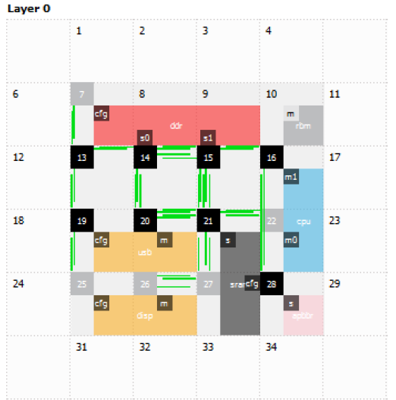
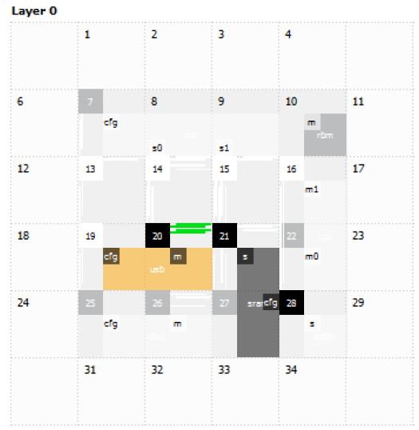
Tune Power
NocStudio creates routers while synthesizing the network
‘Tune power’ is a NocStudio optimization which auto assigns power domains to routers
Auto-assignment is based on adjacency, hardware cost, and on required traffic flows
Tune
power

Slide 10
Example: A Simple NoC with Power Management
PDsystem
NSPS
PD4
PD1
PD0
s0
H2
H1
m0
r
PD2
PD3
PPLN
PPLN
s1
H3
Simple 1 Master and 2 Slave Config

Slide 11
Low Power Flow: Power Intent Spec in Config
new_mesh 4 4 1 lp_example regbus_enabled
mesh_prop low_power_enabled yes
add_power_domain PD0
add_power_domain PD1
add_power_domain PD2
add_power_domain PD3
add_power_domain PD4
add_host m0 …….
add_traffic ………
add_range ………
bridge_prop m0/m power_domain PD0
bridge_prop m0/m power_domain_host PD4
bridge_prop s0/s power_domain PD1
bridge_prop s0/s power_domain_host PD1
bridge_prop s1/s power_domain PD2
bridge_prop s1/s power_domain_host PD3
add_power_profile m0_s0 PD0@ON PD1@ON PD4@ON
add_power_profile m0_s1 PD0@ON PD2@ON PD3@ON PD4@ON
add_power_profile s0_s1 PD0@ON PD1@ON PD2@ON PD3@ON
map
tune_power 1 1
gen_ip
Low power features enabled.
Creates new power domains for NoC elements.
Assign created power domains to NoC bridges. Host power domain can be set same as bridge.
Creates power mode conditions or power state tables. Only bridge power profiles are added.
Assigns power domains to routers and links based on the power profile info.

Slide 12
UPF/CPF Generation
Hierarchical CPF/UPFs generated with power intent specification for
Pre-Simulation for RTL simulations and
Pre-Synthesis including voltage nets, low power libs
Isolation rules with port level information, easier for post-synthesis integration
Testbench CPF/UPF for modeling host interface power domains (for Sanity bench)

