Slide 1
Automation Tool
Author: Kiet Huynh
Copyright © Terralogic., All rights reserved
Confidential Information, intended for approved distribution list of Terralogic

Slide 2
Agenda
GUI Project accomplishments for Q3 - 2022
QA/General/Roadmap discussion

Slide 3
Short Demo

Slide 4
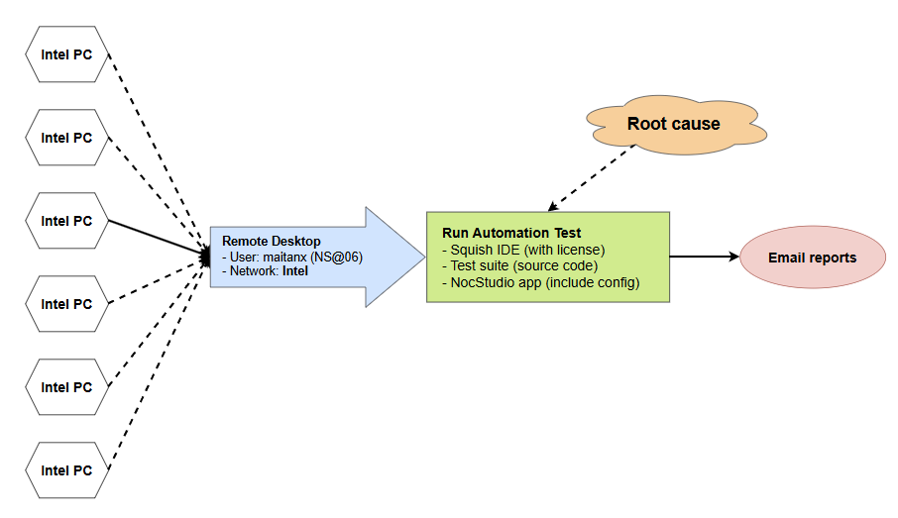
Run Automation Overview

Slide 5
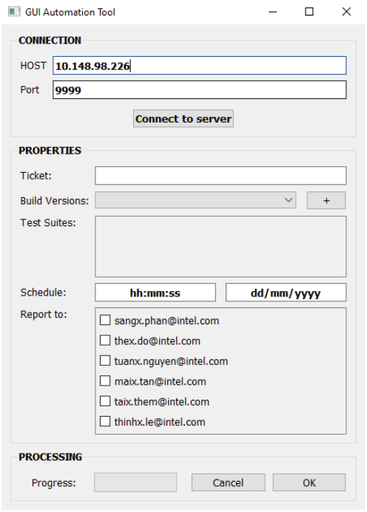
Tool Overview
Send build with extention .exe
Schedule an automation progress
Flexible reports

Slide 6
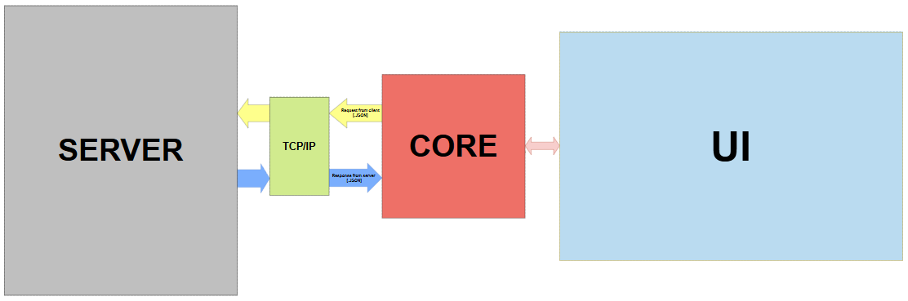
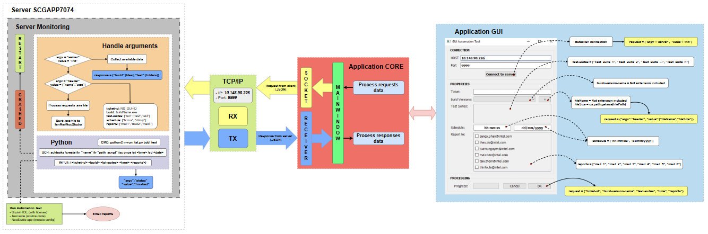
Automation Tool
Project Structure
Layer Architecture

Slide 7
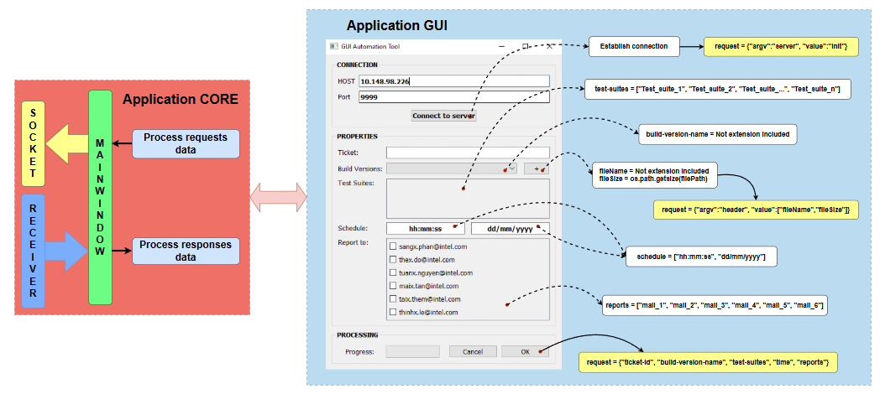
Application

Slide 8
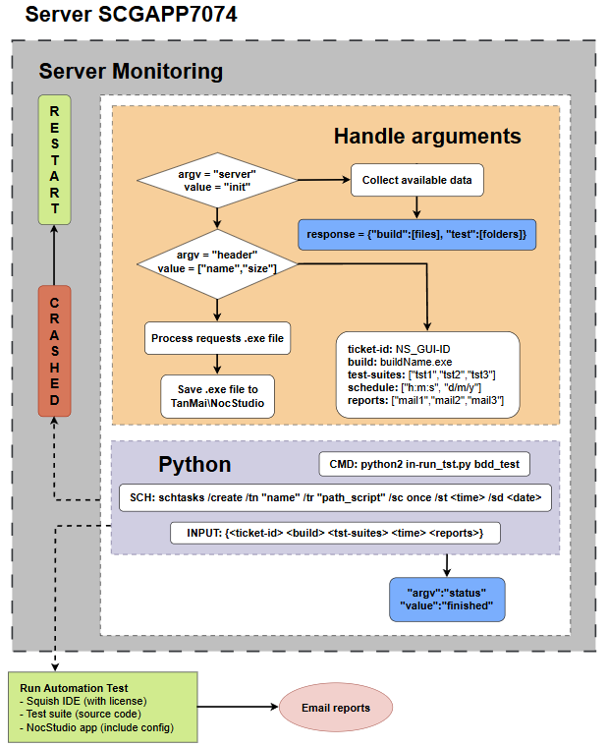
Server and Server Monitoring
Client request analysis
Create command and schedule
Send response to client

Slide 9
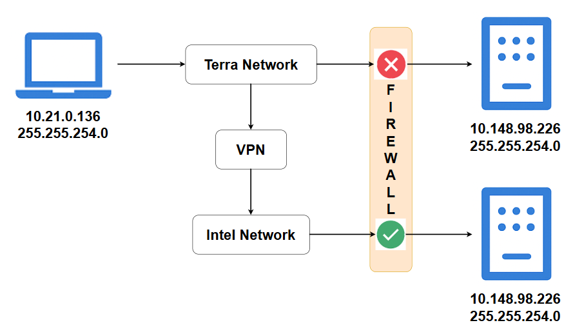
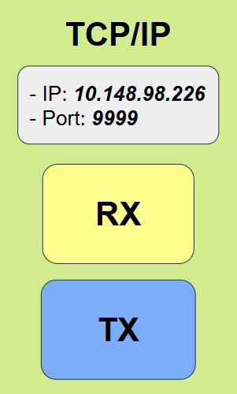
TCP/IP Protocol

Slide 10
Problems
Number of clients in a connection
Duplicate schedules of 2 processes
Remote time to desktop server
Update source code for server

Slide 11
Questions and Feedback

Slide 12
Let’s Create a Beautiful Story of Design & Tech
Thank you
terralogic.com
kiet.huynh@terralogic.com

