Slide 1
Plantwatch
An IoT Plant health monitoring system

Slide 2
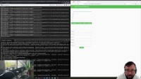
Demo

Slide 3
Objectives and Motivation
Develop an internet-connected plant health monitoring and care system
Expand knowledge of the IoT field
Learn new tools and technologies
Explore technological solutions to the climate and biodiversity crises – IoT has significant agritech applications

Slide 4
Key Technologies
Raspberry Pi and Seeed Studio electronics components for sensor device
Python 3 for sensor and service code
RabbitMQ and Protocol Buffers for messaging
MongoDB for data storage
Dart and Flutter for frontend application and REST API
GCP and Firebase for deployment

Slide 5
Functionality
Multi-user and multi-device system
Frontend displays sensor readings and visualisation of historical data
End-user can set parameters for plant conditions, allowing automated triggering of actuators

Slide 6
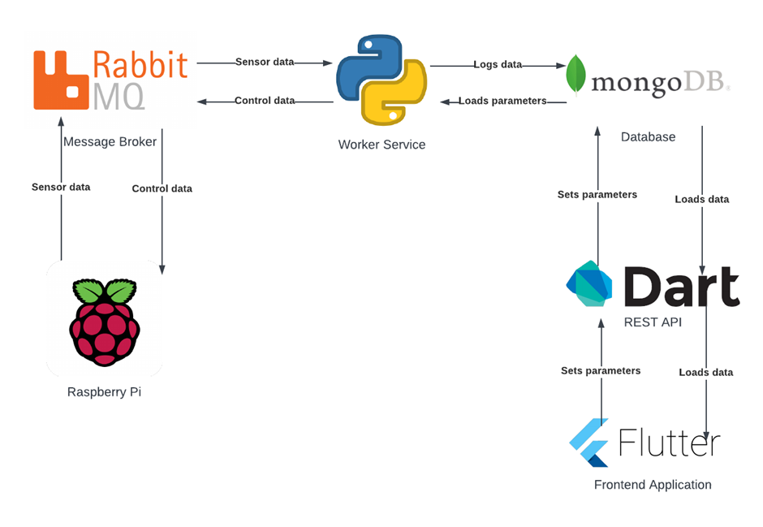
System Diagram

Slide 7
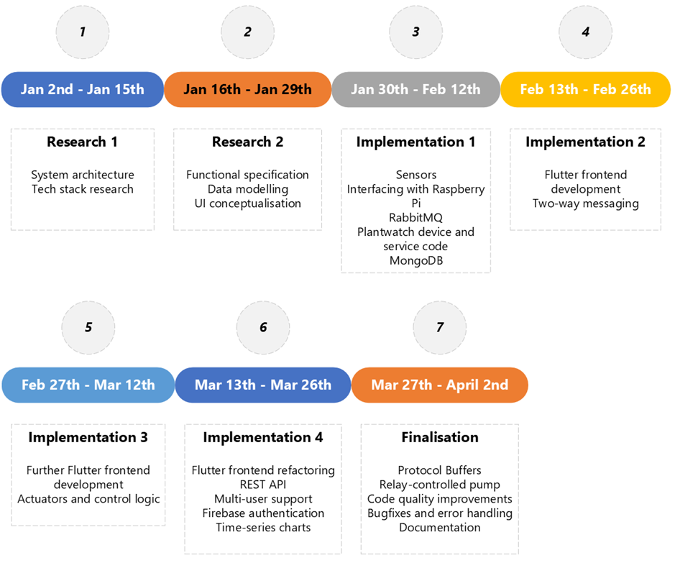
Project Phases

Slide 8
Design Changes During Development
Insecurities in the original design were resolved by introducing a REST API with JWT-based authentication to interface between the frontend and database
The potential inefficiency of JSON as a method for serialising IoT sensor and control data was addressed by using Protocol Buffers instead

Slide 9
Further Development
The project is composed of several independent components, each of which could be developed further
Notably the frontend application has a lot of potential for additional features and UI improvements
The REST API should use HTTPS

Slide 10
Project Achievements
Successful proof-of-concept of the system design and technology stack
Broadly fulfils the objectives set out in the proposal, with some adaptations made in the interest of best practices

Slide 11
Learning Outcomes
New technologies – including RabbitMQ, Protocol Buffers, Dart, Flutter, GCP
Learning these technologies was an opportunity to teach myself about alternatives to technologies that became familiar during the course modules – for example, Protocol Buffers as an alternative to JSON, GCP as an alternative to AWS
Implemented an IoT system which is more complex than any previous course assignment
Management of a longer-duration project compared to previous assignments

Slide 12
Q & A

