Slide 1
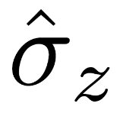

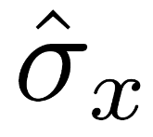
Bath z
Spin System
Bath y
Bath x

Slide 2
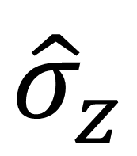
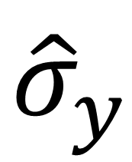
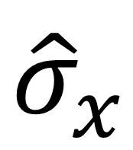
Bath z
$${\hat{σ}}_{z}$$
$${\hat{σ}}_{y}$$
Spin System
Bath y
$${\hat{σ}}_{x}$$
Bath x

