Slide 1
An alternative decomposition scheme for bath correlation functions based on Prony’s method
D2 Hideaki Takahashi
Notes:
このようなタイトルで発表～

Slide 2
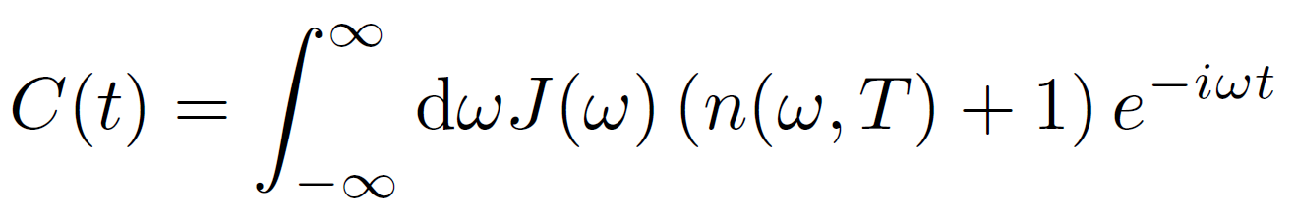
Decomposition schemes for bath correlation function
青：frequency domain, 赤：time domain, 緑：the other
basis set expansion
parameterization method
spectral decomposition
Chebyshev decomposition
⇒ complete or incomplete basis set
⇒ sum of exponential(or exponential polynomial)
⇒ sum of Bessel function

Slide 3
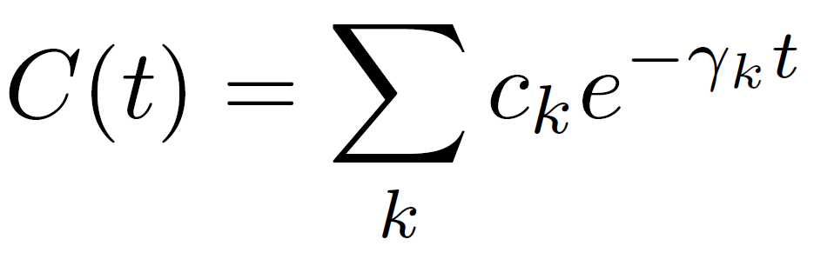
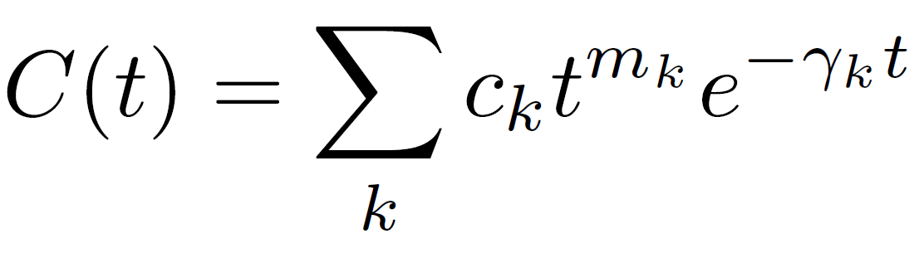
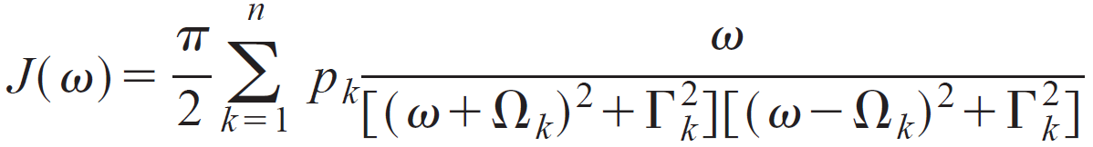
Decomposition schemes for bath correlation function (frequency domain)
i) Spectral decomposition of distribution function$n(ω, T)$ (applied to mainly Ohmic baths)
・Matsubara(Tanimura1990)
・Pade(Hu2010)
・Fano(Cui2019) (extremely low temperature case)
⇒ original HEOM(Ishizaki2005)
⇒ original HEOM + correlation term(Zhang2020)
or gHEOM(Ikeda2020)
ii) Parameterization of SDFs $J(ω)$ (Meier1999)
fit SDFs to the function
Disadvantage:・unsuitable for sub-Ohmic SDFs
⇒ original HEOM(Ishizaki2005)

Slide 4
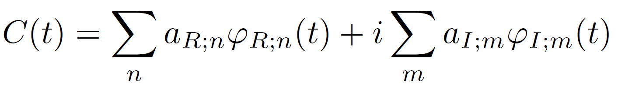

Decomposition schemes for bath correlation function (time domain)
Fit $C(t)$ to basis functions $φ(t)$ (complete or incomplete)
Complete basis set
・harmonic oscillator wave functions
・discrete Fourier series etc.
Incomplete basis set
・a set of oscillatory and non-oscillatory exponentially decaying functions etc.
⇒ eHEOM(Tang2015), gHEOM(Ikeda2020)
Advantage: ・arbitrary SDFs ・arbitrary temperature
$φ(t)$ satisfies
Disadvantage: ・bad convergence in strong coupling regime

Slide 5
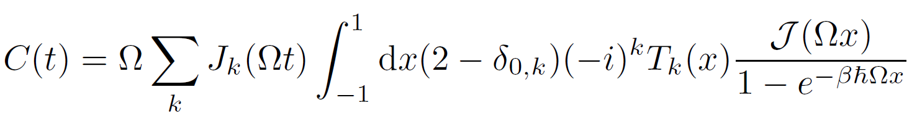
Decomposition schemes for bath correlation function (Chebyshev decomposition)
Chebyshev polynomials $T_{k}(x)$ + Bessel functions of the first kind $J_{k}(t)$(Tian2012)
⇒ C-HEOM(Rahman2019), gHEOM(Ikeda2020)
Advantage: ・arbitrary SDFs ・arbitrary temperature
Disadvantage: ・bad convergence in strong coupling regime ・unsuitable for overdamped cases

Slide 6
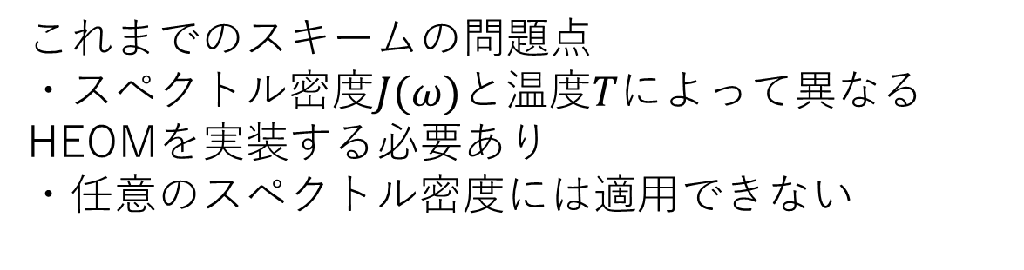
Alternative decomposition scheme
これまでのスキームの問題点
・スペクトル密度$J(ω)$と温度$T$によって異なるHEOMを実装する必要あり
・任意のスペクトル密度には適用できない
任意の相関関数を複素指数関数で近似
More easily
decomposition in the time domain
Complex exponential function

Slide 7
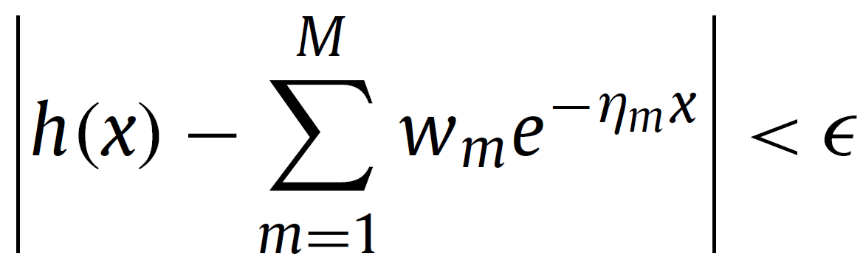
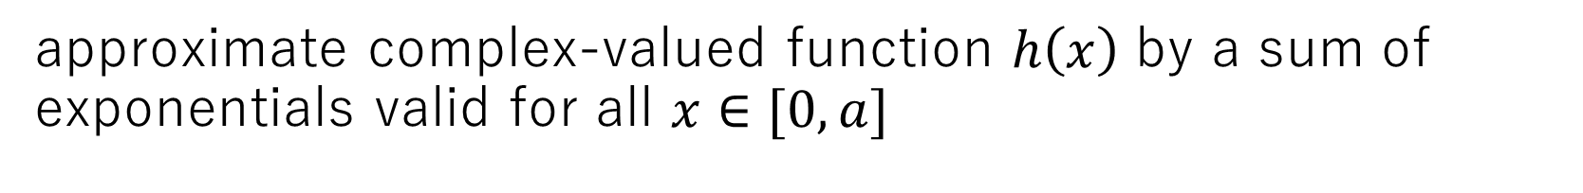
Prony’s method exponential sum
G. Beylkin and L. Monzón, Appl. Comput. Harmon. Anal. 19 (2005) 17–48
approximate complex-valued function $h\left(x\right)$ by a sum of exponentials valid for all $x∈[0, a]$

Slide 8
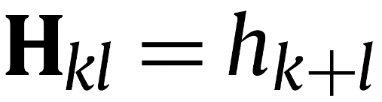
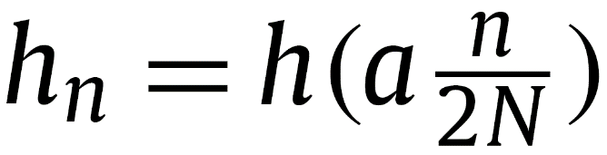
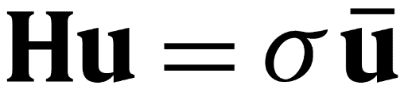
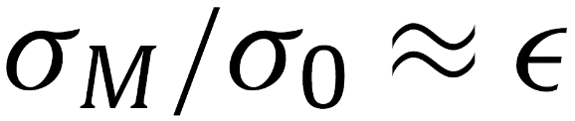
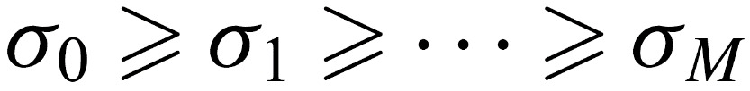
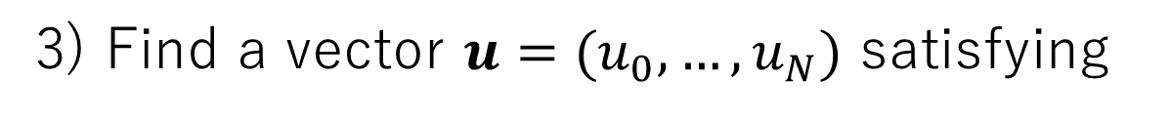

Brief review of
G. Beylkin and L. Monzón, Appl. Comput. Harmon. Anal. 19 (2005) 17–48
1) Give a number of samples $N$ and a range $a$ and accuracy $ε>0$
2) Build the Hankel matrix $H∈ℂ^{(N+1)×(N+1)}$
3) Find a vector $u=(u_{0}, …, u_{N})$ satisfying
where $σ∈ℝ^{+}$ is a singular value

Slide 9
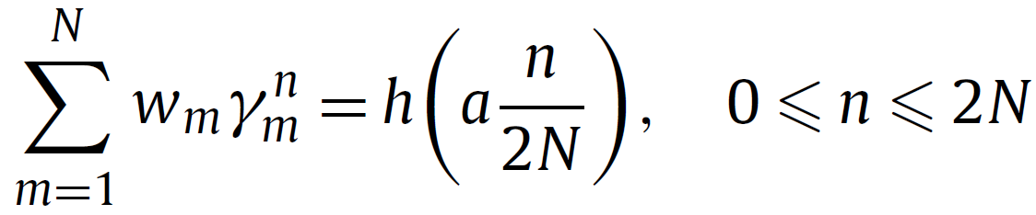
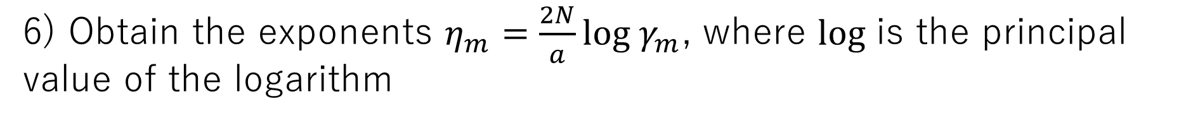
Brief review of
G. Beylkin and L. Monzón, Appl. Comput. Harmon. Anal. 19 (2005) 17–48
4) Compute roots $γ_{m}$ of polynomial $u(z)=\sum_{k=0}^{n}{u_{n}z^{n}}$
5) Solve the least-squares Vandermonde system and obtain the coefficients $w_{m}$
6) Obtain the exponents $η_{m}=\frac{2N}{a}log γ_{m}$, where $log$ is the principal value of the logarithm

Slide 10

Decomposition of bath correlation function
1) Give SDFs $J\left(ω\right)$ and temperature $T$
2) Calculate correlation function $C\left(t\right)$ analytically or numerically
3) Approximate $C(t)$by the Prony method

Slide 11
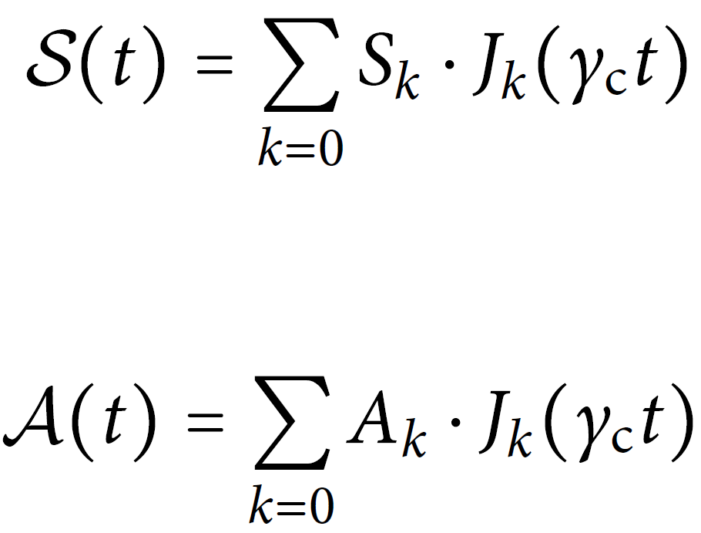
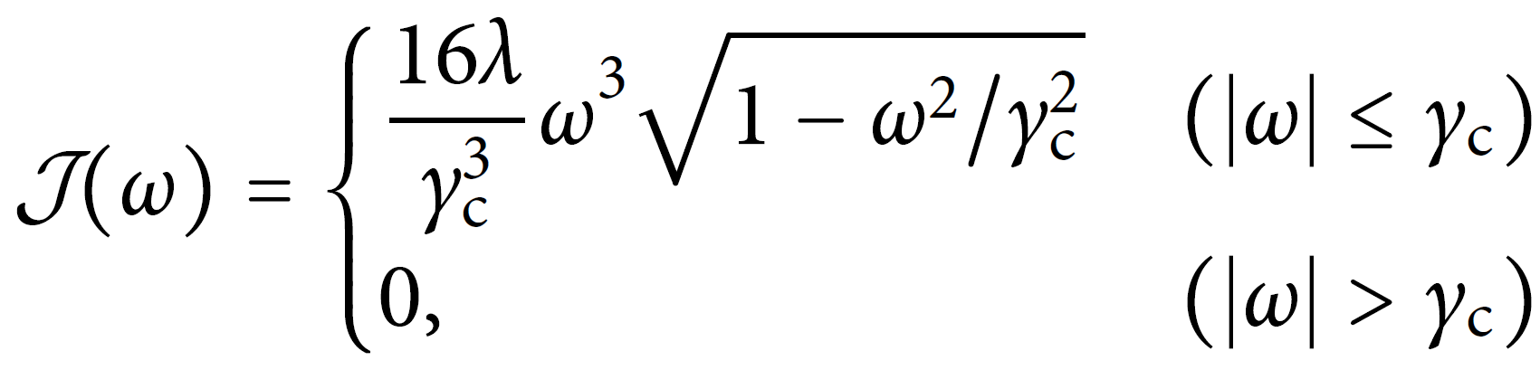
example1
T. Ikeda and G. D. Scholes, J. Chem. Phys. 152, 204101 (2020).
super-Ohmic(s=3) + circle cutoff

