Slide 1
An alternative decomposition scheme for bath correlation functions based on Prony’s method
D2 Hideaki Takahashi
Notes:
このようなタイトルで発表～

Slide 2
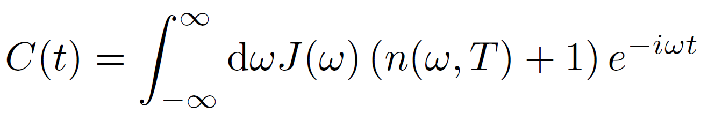
Decomposition schemes for bath correlation function
青：frequency domain, 赤：time domain, 緑：the other
basis set expansion
parameterization method
spectral decomposition
Chebyshev decomposition
⇒ complete or incomplete basis set
⇒ sum of exponential(or exponential polynomial)
⇒ sum of Bessel function

Slide 3
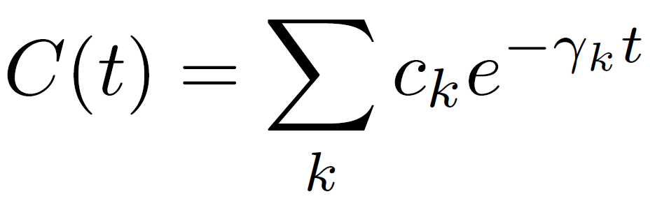
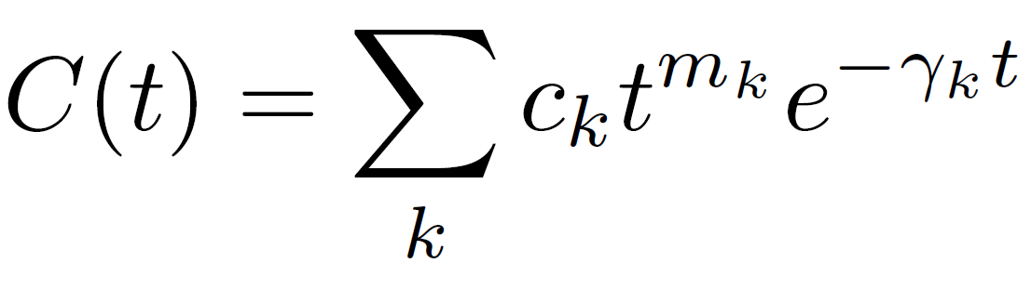
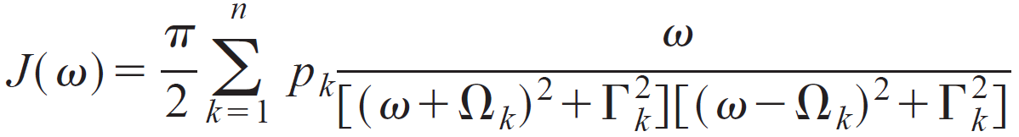
Decomposition schemes for bath correlation function (frequency domain)
i) Spectral decomposition of distribution function$n(ω, T)$ (mainly applied to Ohmic baths)
・Matsubara(Tanimura1990)
・Pade(Hu2010)
・Fano(Cui2019) (extremely low temperature case)
⇒ original HEOM(Ishizaki2005)
⇒ original HEOM + correlation term(Zhang2020)
or gHEOM(Ikeda2020)
ii) Parameterization of SDFs $J(ω)$ (Meier1999)
fit SDFs to the function
Disadvantage: ・unsuitable for sub-Ohmic SDFs
⇒ original HEOM(Ishizaki2005)

Slide 4
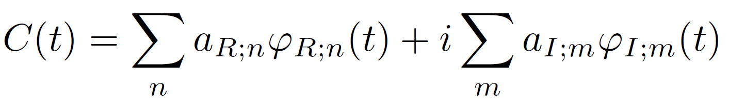

Decomposition schemes for bath correlation function (time domain)
Fit $C(t)$ to basis functions $φ(t)$ (complete or incomplete)
Complete basis set
・harmonic oscillator wave functions
・discrete Fourier series etc.
Incomplete basis set
・a set of oscillatory and non-oscillatory exponentially decaying functions etc.
⇒ eHEOM(Tang2015), gHEOM(Ikeda2020)
Advantage
Arbitrary SDFs
Arbitrary temperature
$φ(t)$ satisfies

Slide 5
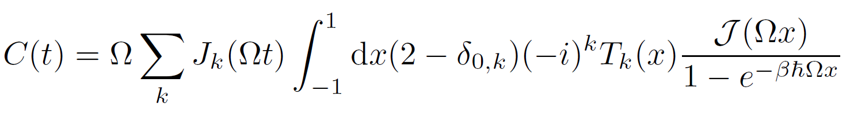
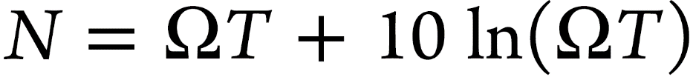
Decomposition schemes for bath correlation function (Chebyshev decomposition)
Chebyshev polynomials $T_{k}(x)$ + Bessel functions of the first kind $J_{k}(t)$(Tian2012)
⇒ C-HEOM(Rahman2019), gHEOM(Ikeda2020)
Advantage
Arbitrary SDFs
Arbitrary temperature
Disadvantage
Bad convergence in strong coupling regime
Unsuitable for overdamped cases
Depend linearly on the simulation time
An estimate of the number of terms

Slide 6
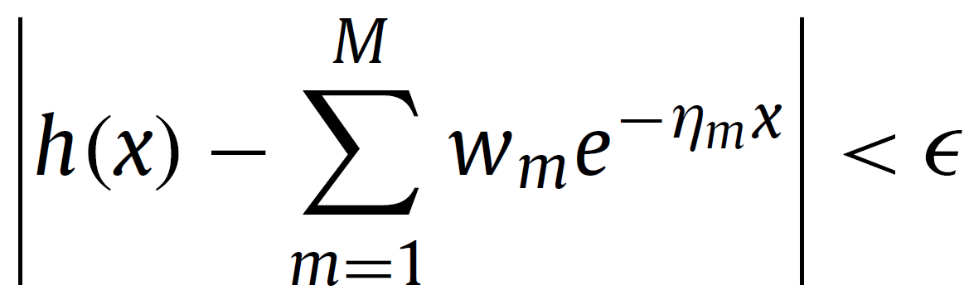
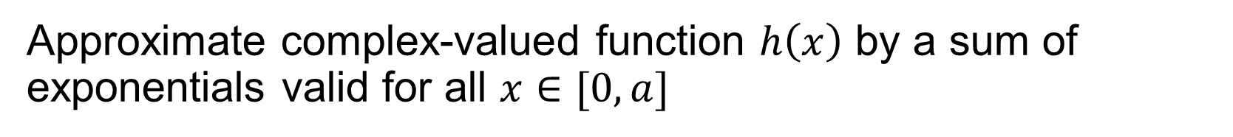

Alternative decomposition scheme: Prony’s method
Approximate complex-valued function $h\left(x\right)$ by a sum of exponentials valid for all $x∈[0, a]$
$$w_{m}, η_{m}∈ℂ$$
⇒ apply to a bath correlation function
Advantage
Arbitrary SDFs
Arbitrary temperature
Lead to an original form HEOM
Systematic approximation procedure
decomposition in the time domain

Slide 7
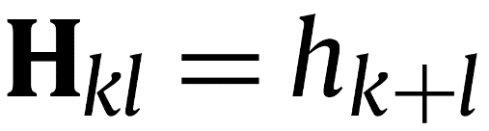
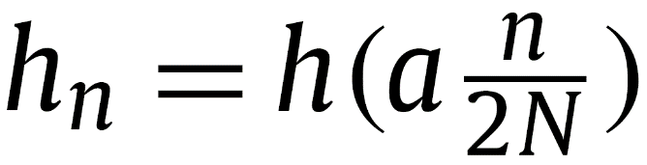

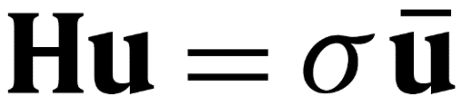
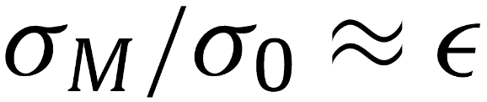
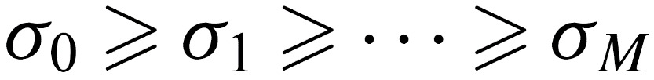
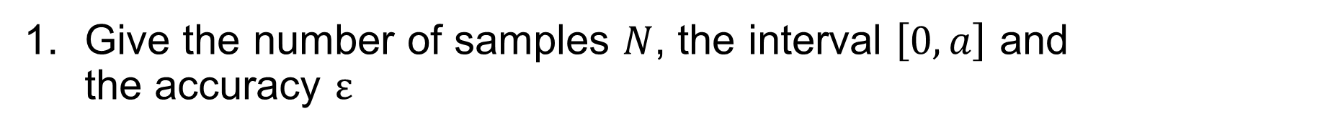
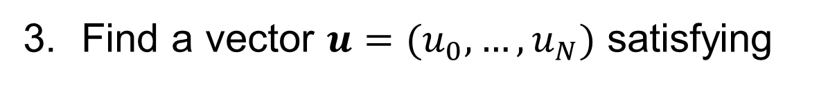

Brief description of the procedure
G. Beylkin and L. Monzón, Appl. Comput. Harmon. Anal. 19 (2005) 17–48
Give the number of samples $N$, the interval $\left[0, a\right]$ and the accuracy $ε$
Build the Hankel matrix $H∈{Sym}_{N+1}(ℂ)$
Find a vector $u=(u_{0}, …, u_{N})$ satisfying
where $σ∈ℝ^{+}$ is a singular value

Slide 8
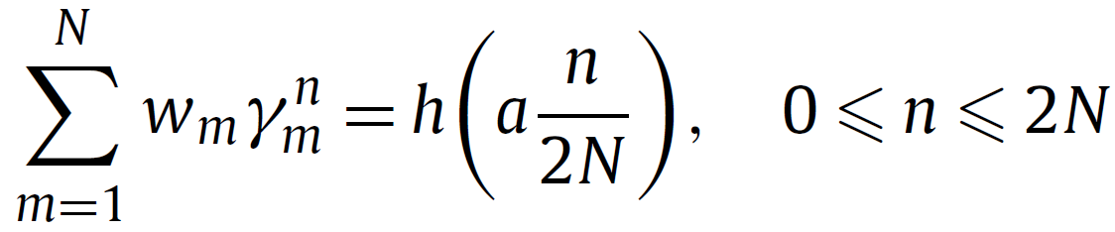
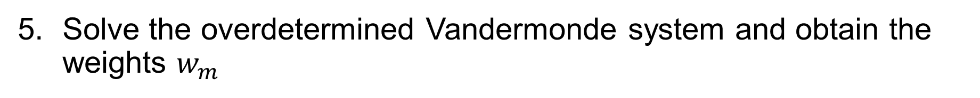
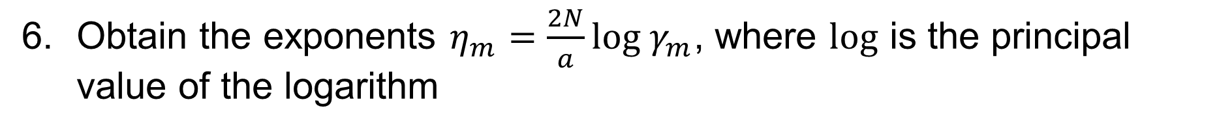
Brief description of the procedure
G. Beylkin and L. Monzón, Appl. Comput. Harmon. Anal. 19 (2005) 17–48
Compute roots $γ_{m}$ of polynomial $u(z)=\sum_{k=0}^{n}{u_{n}z^{n}}$
Solve the overdetermined Vandermonde system and obtain the weights $w_{m}$
Obtain the exponents $η_{m}=\frac{2N}{a}log γ_{m}$, where $log$ is the principal value of the logarithm
Obtain an approximation

Slide 9
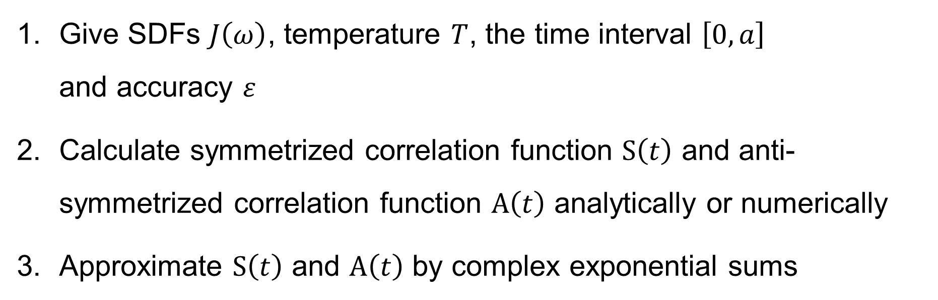
Decomposition of bath correlation function
Give SDFs $J\left(ω\right)$, temperature $T$, the time interval $\left[0, a\right]$ and accuracy $ε$
Calculate symmetrized correlation function $S\left(t\right)$ and anti-symmetrized correlation function $A\left(t\right)$ analytically or numerically
Approximate $S\left(t\right)$ and $A\left(t\right)$ by complex exponential sums
HEOM, QME etc.

Slide 10
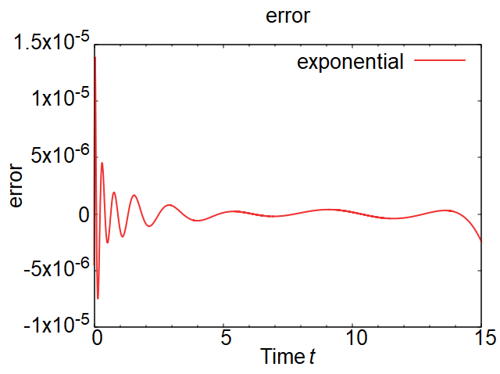
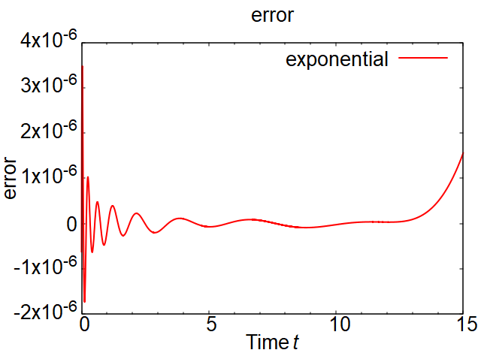
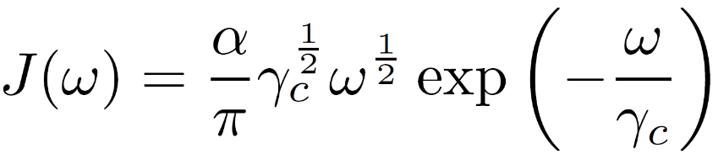
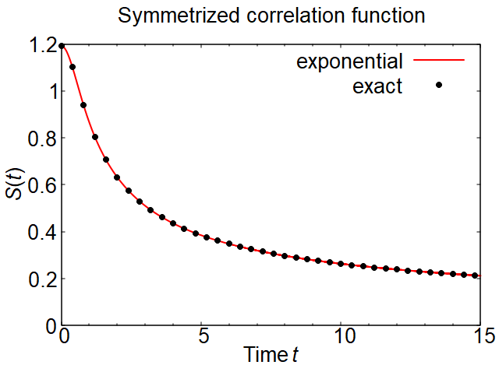
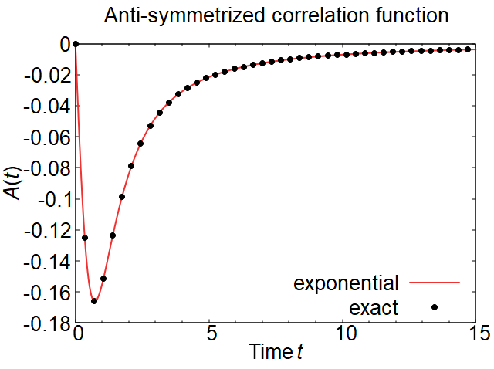

Example1: sub-Ohmic SDF
super-Ohmic(s=1/2) + exponential cutoff
Parameters: $βℏ=1,α=1, γ_{C}=1$

Slide 11
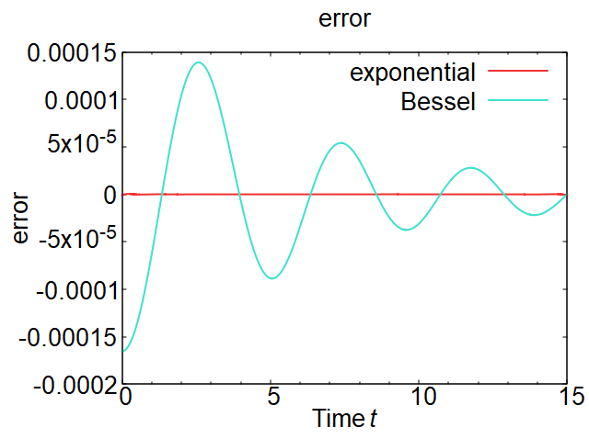
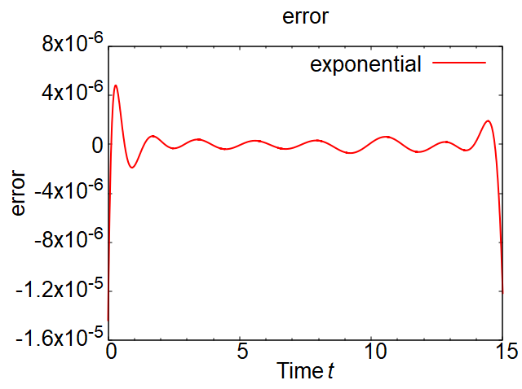
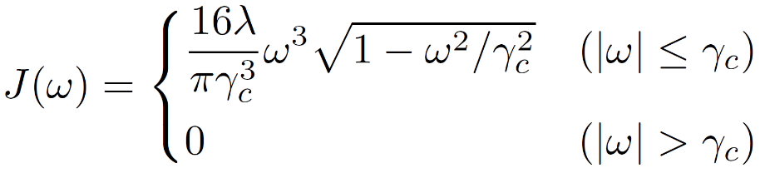
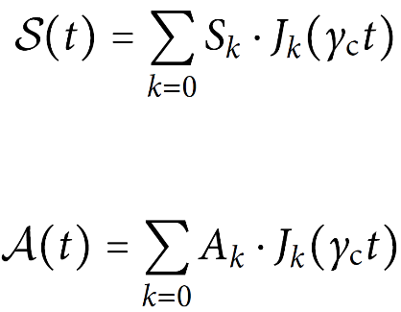
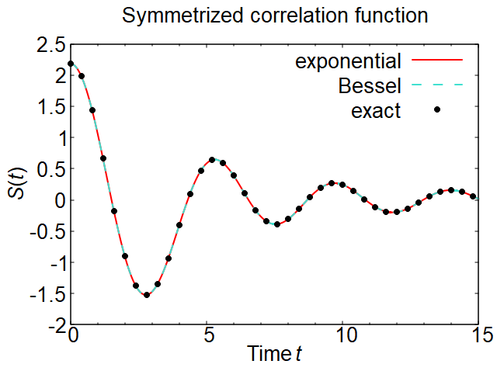
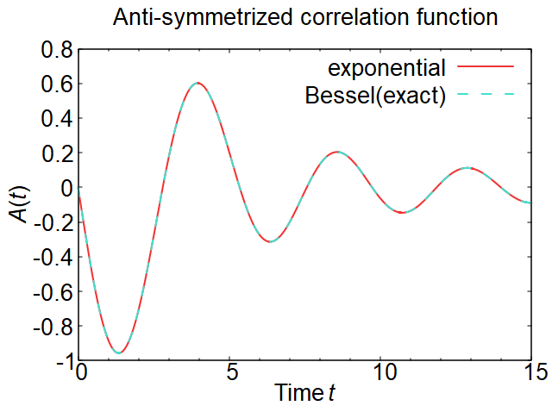

Example2: super-Ohmic SDF
T. Ikeda and G. D. Scholes, J. Chem. Phys. 152, 204101 (2020).
super-Ohmic(s=3) + semicircle cutoff
Analytical
calculation
Parameters: $βℏ=1,λ=1, γ_{C}=1.5$

Slide 12
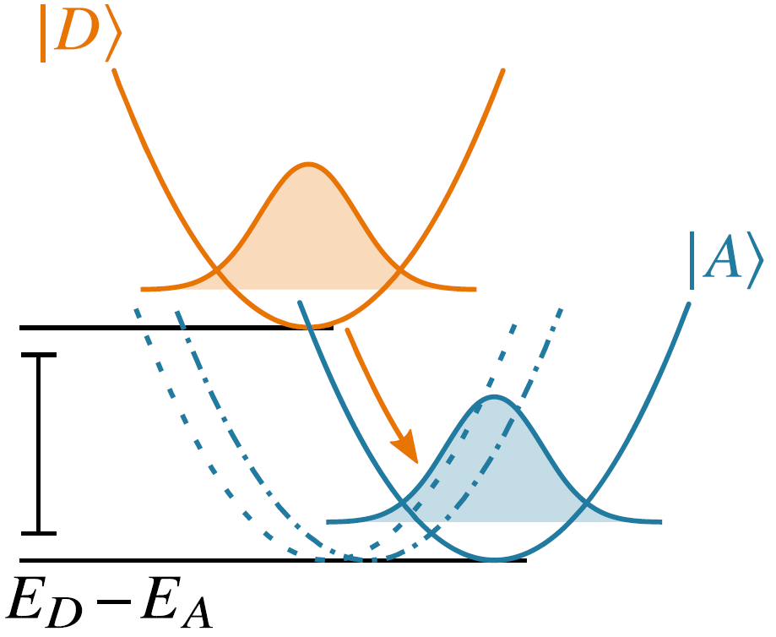
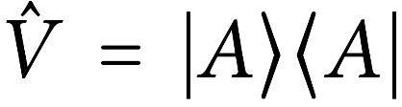
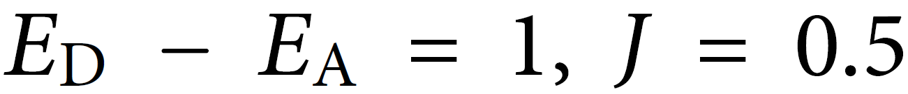
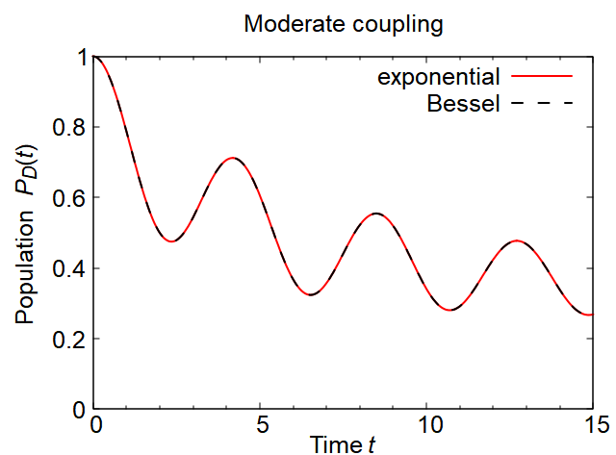
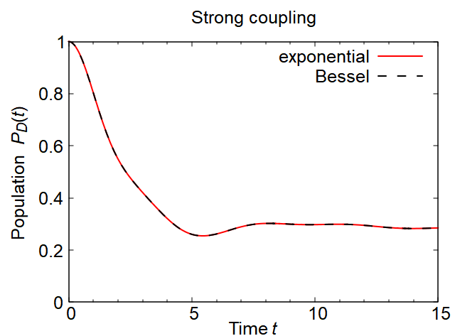


Example2: super-Ohmic SDF
T. Ikeda and G. D. Scholes, J. Chem. Phys. 152, 204101 (2020).
Numerical results (donor–acceptor system)
Hamiltonian:
Interaction:
(a) Moderate coupling ($λ=0.1$)
(b) Strong coupling ($λ=1$)

Slide 13
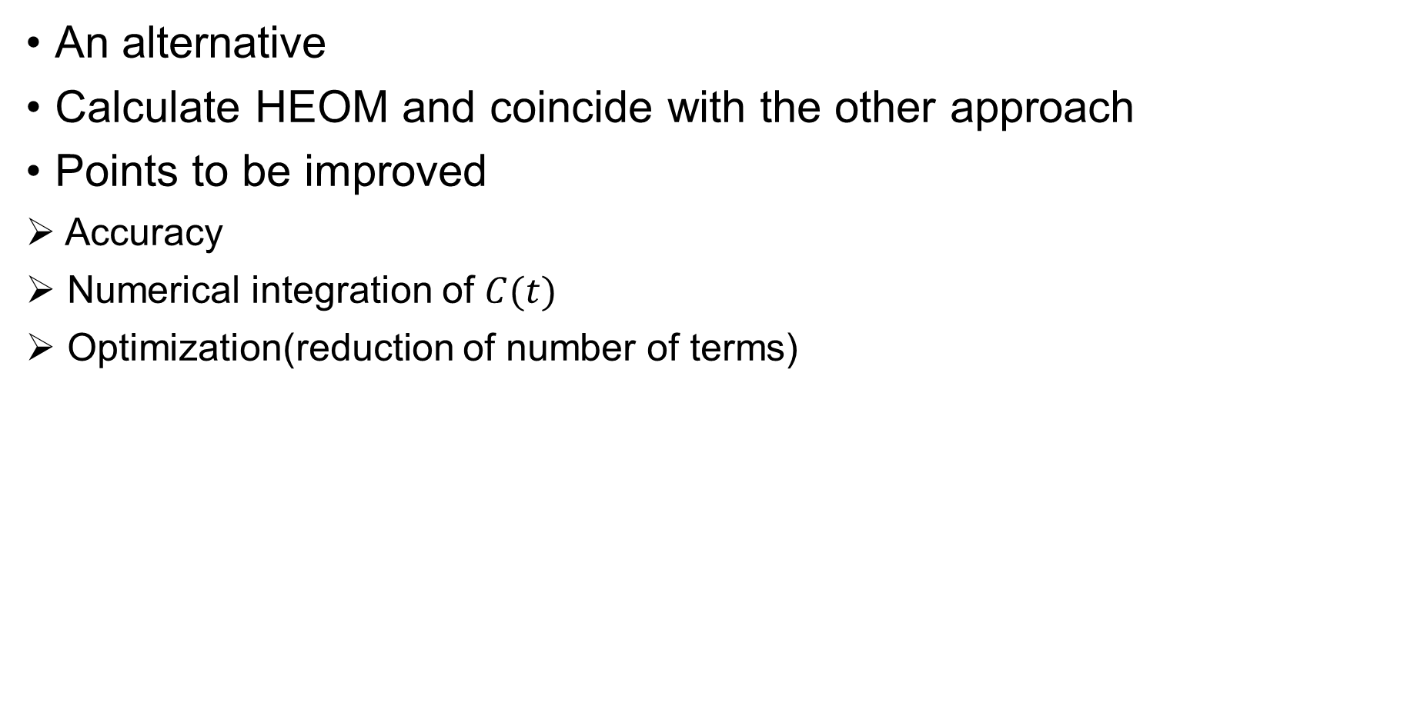
Conclusion
An alternative
Calculate HEOM and coincide with the other approach
Points to be improved
Accuracy
Numerical integration of $C(t)$
Optimization(reduction of number of terms)

