Slide 1
An alternative decomposition scheme for bath correlation functions based on Prony’s method
D2 Hideaki Takahashi
Notes:
このようなタイトルで発表～

Slide 2
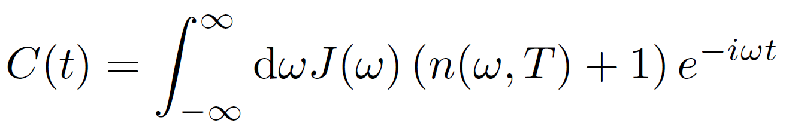
Decomposition schemes for bath correlation function
青：frequency domain, 赤：time domain, 緑：the other
basis set expansion
parameterization method
spectral decomposition
Chebyshev decomposition
⇒ sum of basis function
⇒ sum of exponential(or exponential polynomial)
⇒ sum of Bessel function

Slide 3
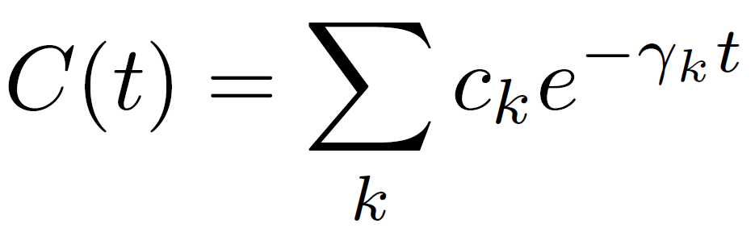
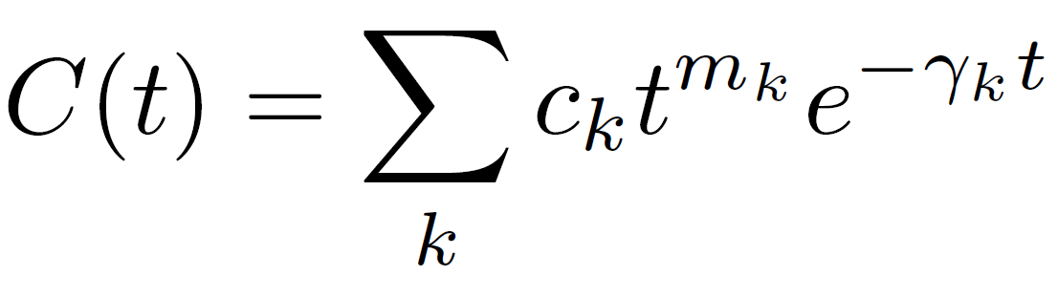
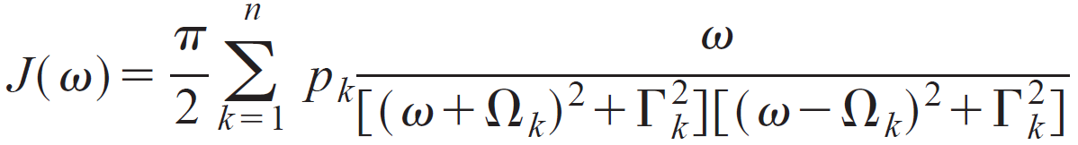
Decomposition schemes for bath correlation function (frequency domain)
i) Spectral decomposition of distribution function$n(ω, T)$ (mainly applied to Ohmic baths)
・Matsubara(Tanimura1990)
・Pade(Hu2010)
・Fano(Cui2019) (extremely low temperature case)
⇒ original form HEOM(Ishizaki2005)
⇒ original form + correction term(Zhang2020)
ii) Parameterization of SDFs $J(ω)$ (Meier1999)
fit SDFs to the function
Disadvantage: ・unsuitable for sub-Ohmic SDFs
⇒ original form HEOM(Ishizaki2005)

Slide 4
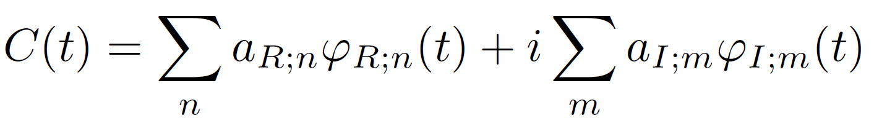

Decomposition schemes for bath correlation function (time domain)
Fit $C(t)$ to basis functions $φ(t)$ (complete or incomplete)
Complete basis set
・harmonic oscillator wave functions
・discrete Fourier series etc.
Incomplete basis set
・a set of oscillatory and non-oscillatory exponentially decaying functions etc.
⇒ eHEOM(Tang2015), gHEOM(Ikeda2020)
Advantages
Arbitrary SDFs
Arbitrary temperature
$φ(t)$ satisfies
Disadvantage(cautionary points)
Long-time behavior(static property)

Slide 5
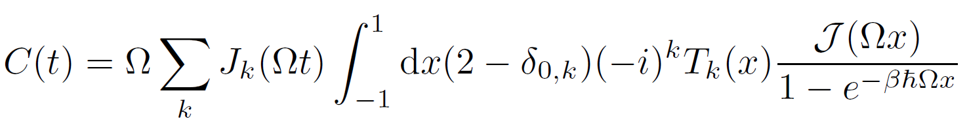
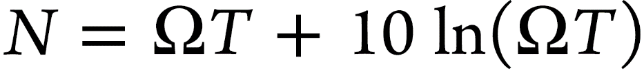
Decomposition schemes for bath correlation function (Chebyshev decomposition)
Chebyshev polynomials $T_{k}(x)$ + Bessel functions of the first kind $J_{k}(t)$(Tian2012)
⇒ C-HEOM(Rahman2019), gHEOM(Ikeda2020)
Advantages
Arbitrary SDFs
Arbitrary temperature
Disadvantages
Bad convergence in strong coupling regime
Unsuitable for overdamped cases
N depends linearly on the simulation time
An estimate of the number of terms

Slide 6
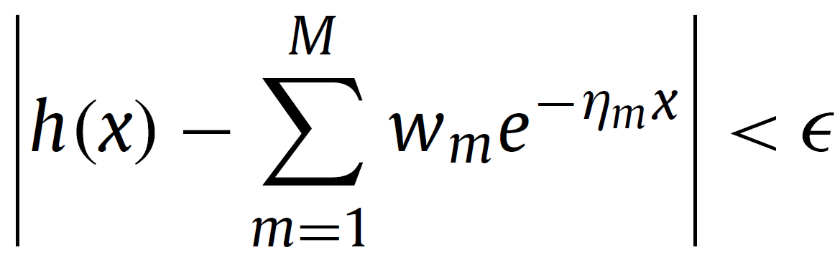
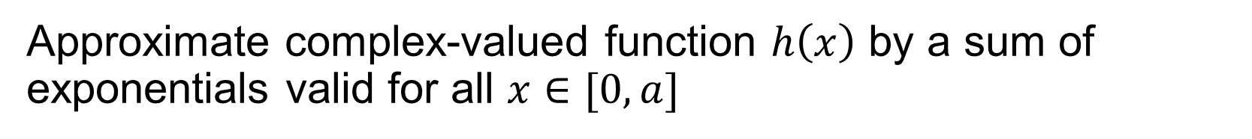

Alternative decomposition scheme: Prony’s method
Approximate complex-valued function $h\left(x\right)$ by a sum of exponentials valid for all $x∈[0, a]$
$$w_{m}, η_{m}∈ℂ$$
⇒ apply to bath correlation functions(decomposition in the time domain)
Advantage
Arbitrary SDFs
Arbitrary temperature
Lead to an original form HEOM
Systematic approximation procedure

Slide 7
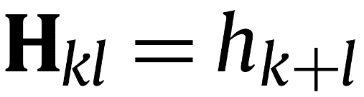
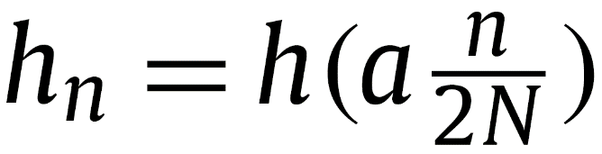

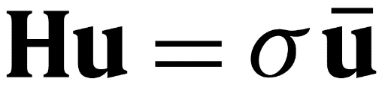
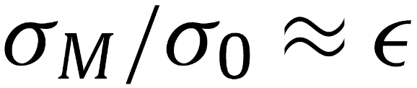
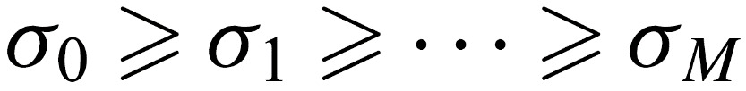
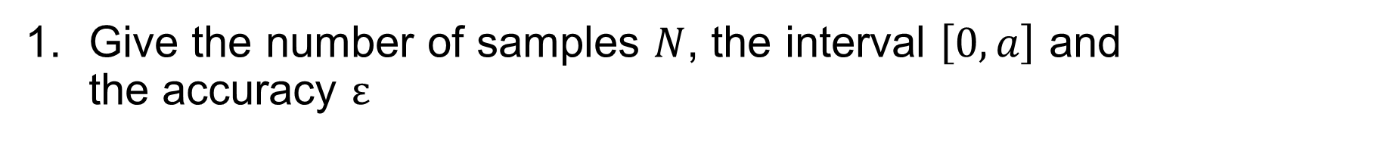
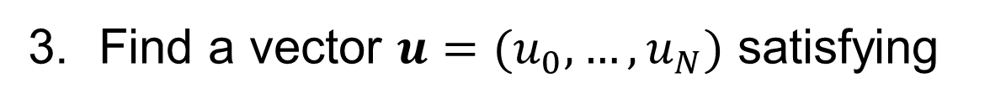

Brief description of the procedure
G. Beylkin and L. Monzón, Appl. Comput. Harmon. Anal. 19 (2005) 17–48
Give the number of samples $N$, the interval $\left[0, a\right]$ and the accuracy $ε$
Build the Hankel matrix $H∈{Sym}_{N+1}(ℂ)$
Find a vector $u=(u_{0}, …, u_{N})$ satisfying
where $σ∈ℝ^{+}$ is a singular value

Slide 8
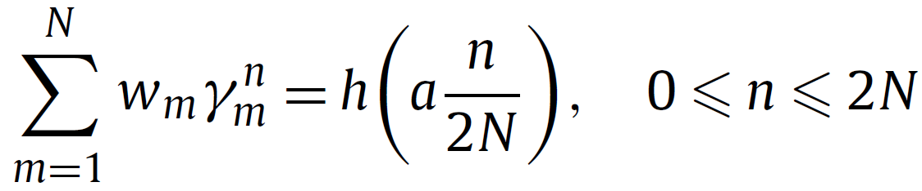
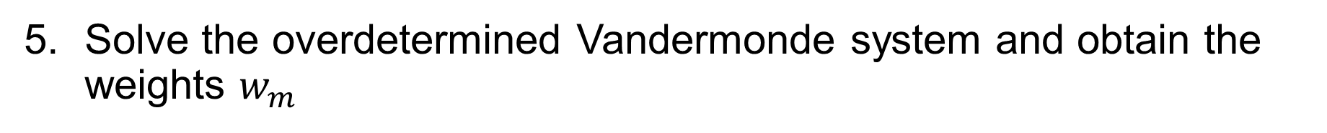
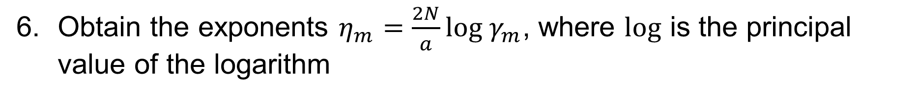
Brief description of the procedure
G. Beylkin and L. Monzón, Appl. Comput. Harmon. Anal. 19 (2005) 17–48
Compute roots $γ_{m}$ of polynomial $u(z)=\sum_{k=0}^{N}{u_{k}z^{k}}$
Solve the overdetermined Vandermonde system and obtain the weights $w_{m}$
Obtain the exponents $η_{m}=\frac{2N}{a}log γ_{m}$, where $log$ is the principal value of the logarithm
Obtain an approximation

Slide 9
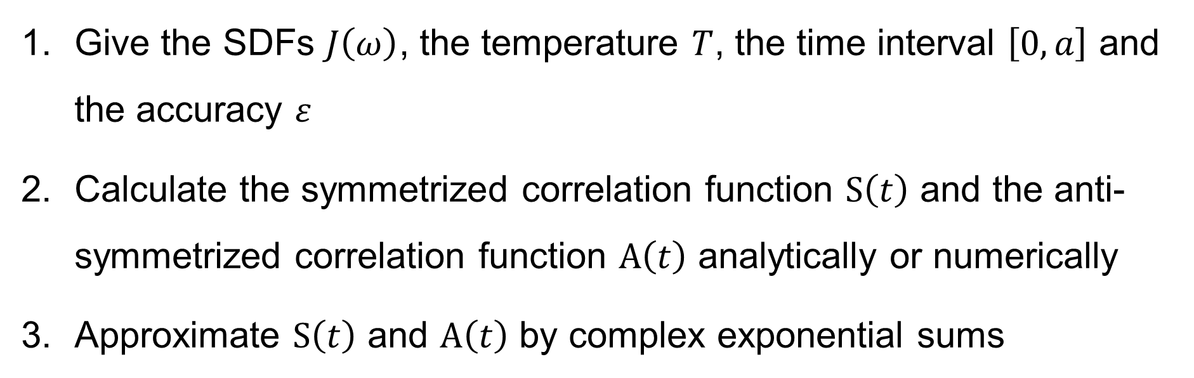
Decomposition of bath correlation function
Give the SDFs $J\left(ω\right)$, the temperature $T$, the time interval $\left[0, a\right]$ and the accuracy $ε$
Calculate the symmetrized correlation function $S\left(t\right)$ and the anti-symmetrized correlation function $A\left(t\right)$ analytically or numerically
Approximate $S\left(t\right)$ and $A\left(t\right)$ by complex exponential sums
HEOM, QME etc.

Slide 10
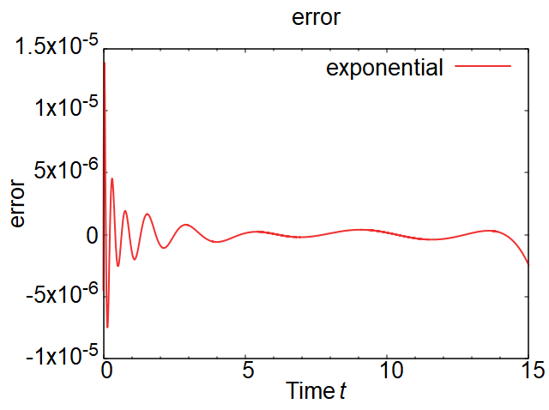
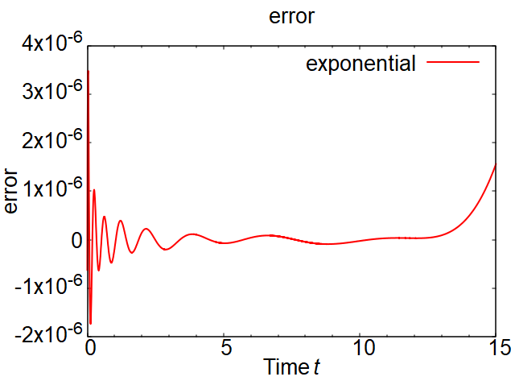
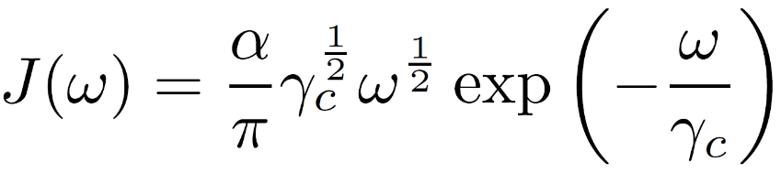
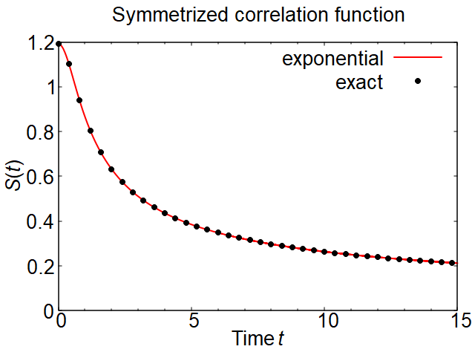
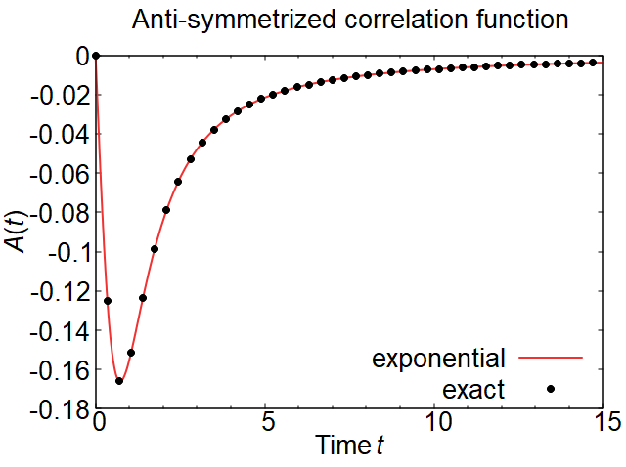

Example1: sub-Ohmic SDF
super-Ohmic(s=1/2) + exponential cutoff
Parameters: $βℏ=1,α=1, γ_{C}=1$

Slide 11
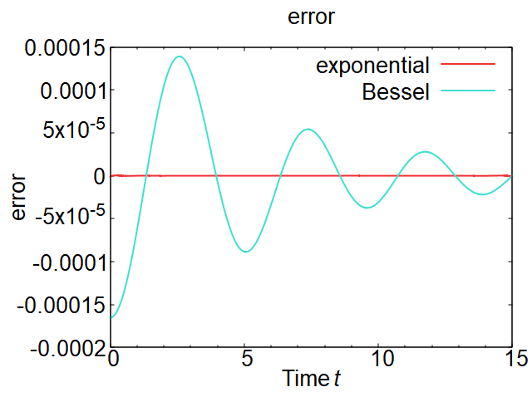
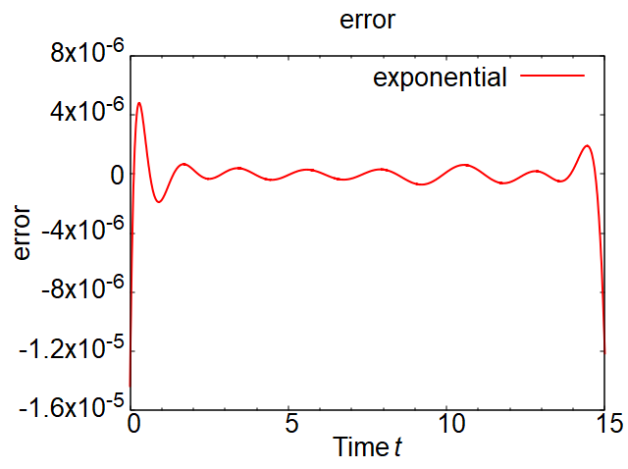
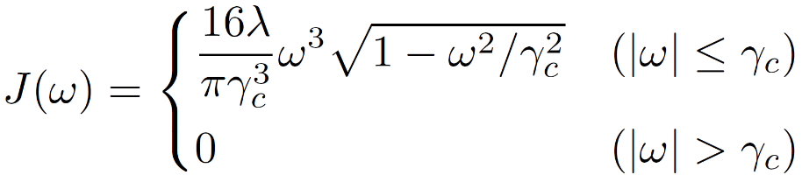
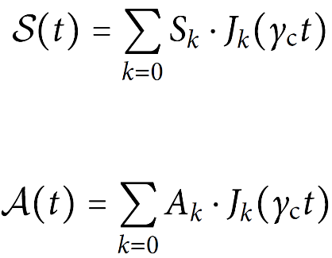
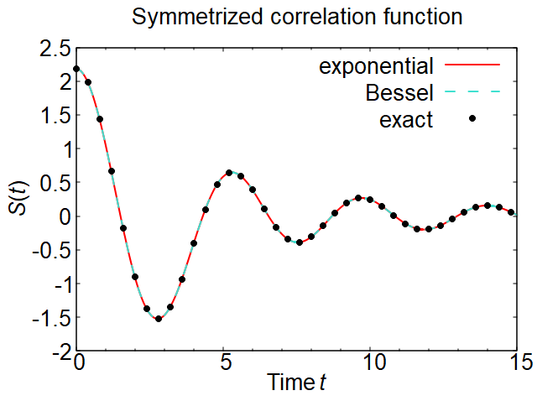
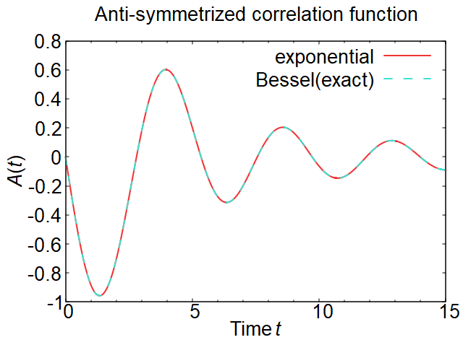

Example2: super-Ohmic SDF
T. Ikeda and G. D. Scholes, J. Chem. Phys. 152, 204101 (2020).
super-Ohmic(s=3) + semicircle cutoff
Analytical
calculation
Parameters: $βℏ=1,λ=1, γ_{C}=1.5$

Slide 12
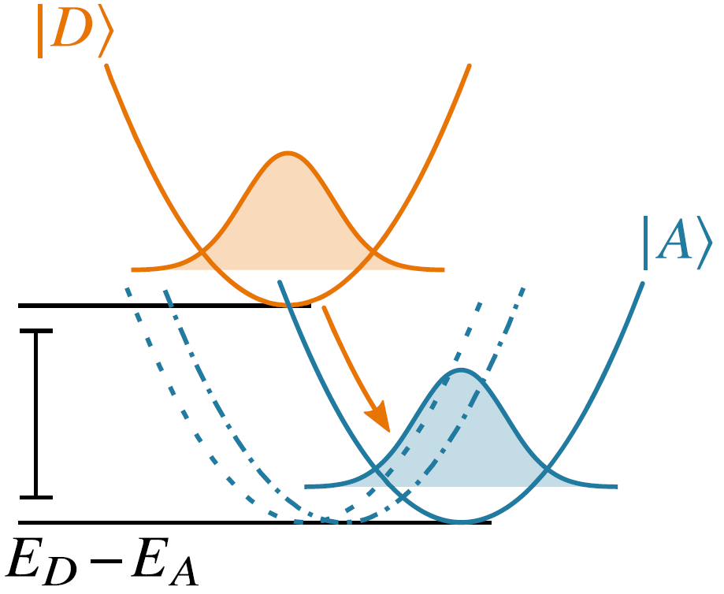
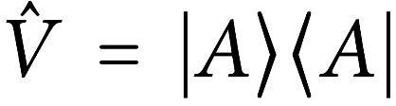
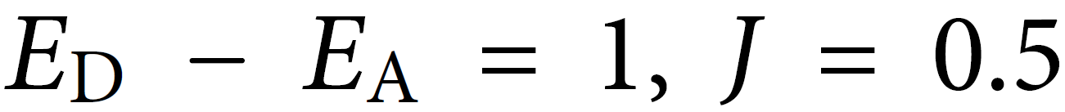
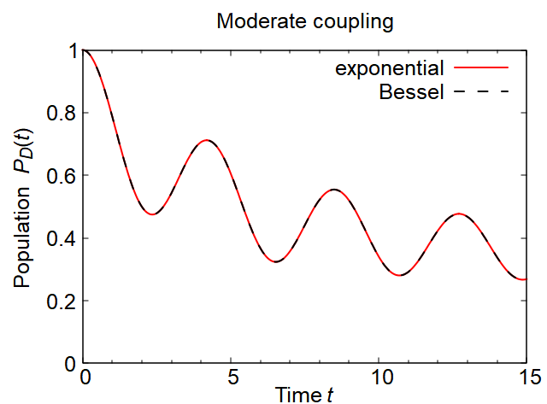
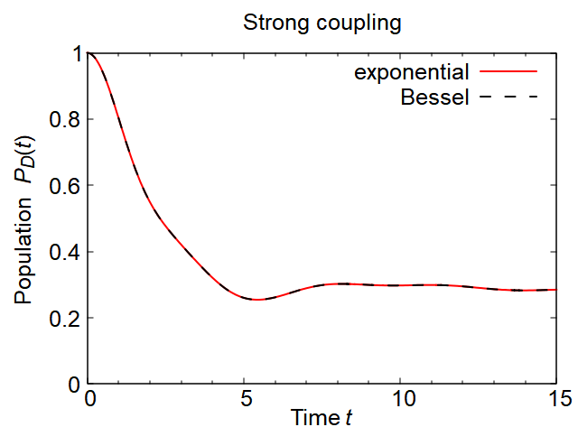


Example2: super-Ohmic SDF
T. Ikeda and G. D. Scholes, J. Chem. Phys. 152, 204101 (2020).
Numerical results (donor–acceptor system)
Hamiltonian:
Interaction:
(a) Moderate coupling ($λ=0.1$)
(b) Strong coupling ($λ=1$)

Slide 13
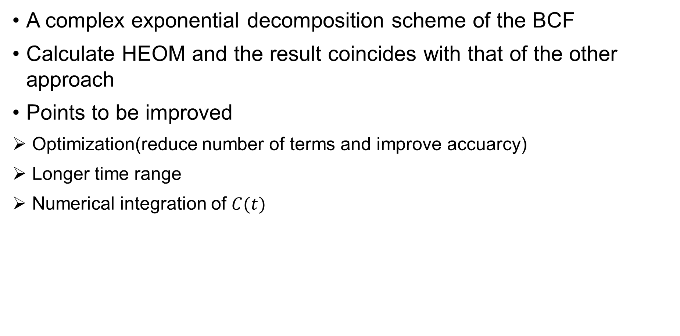
Conclusion
A complex exponential decomposition scheme of the BCF
Calculate HEOM and the result coincides with that of the other approach
Points to be improved
Optimization(reduce number of terms and improve accuarcy)
Longer time range
Numerical integration of $C(t)$

