Slide 1




$$t_{1}$$
$$t_{2}$$
Raman
THz
THz
$$t_{1}$$
$$t_{2}$$
THz
Raman
THz

Slide 2
$$t_{1}$$
$$t_{2}$$
THz
THz
Raman

Slide 3


$$t_{1}$$
$$t_{2}$$
THz
THz
Raman
$$t_{1}$$
$$t_{2}$$
THz
THz
Raman

Slide 4
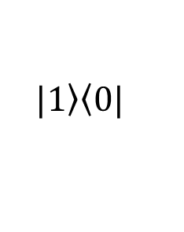

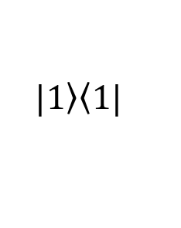

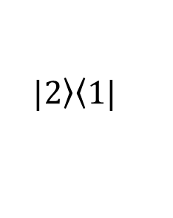
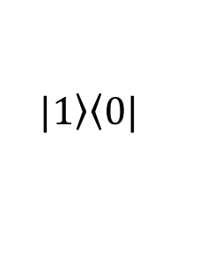
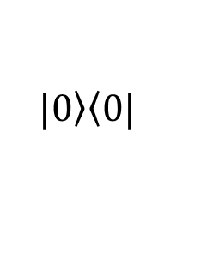
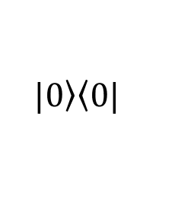
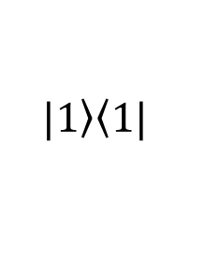
$$t_{1}$$
$$t_{2}$$
THz
THz
THz
$$|\left.1\right\rangle \left\langle 1\right.|$$
$$|\left.1\right\rangle \left\langle 1\right.|$$
$$|\left.2\right\rangle \left\langle 1\right.|$$
$$|\left.2\right\rangle \left\langle 1\right.|$$
$$|\left.1\right\rangle \left\langle 1\right.|$$
$$|\left.1\right\rangle \left\langle 0\right.|$$
$$|\left.1\right\rangle \left\langle 0\right.|$$
$$|\left.0\right\rangle \left\langle 0\right.|$$
$$|\left.0\right\rangle \left\langle 0\right.|$$

Slide 5


$$t_{1}$$
$$t_{2}$$
$$t_{3}$$
THz
THz
THz
$$t_{1}$$
$$t_{2}$$
$$t_{3}$$
IR
IR
IR

Slide 6
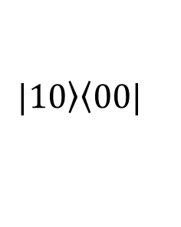
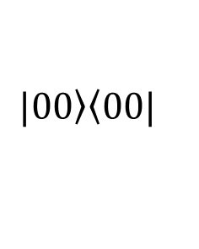
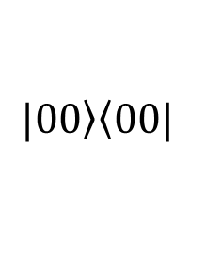
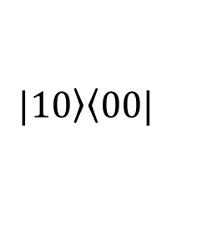
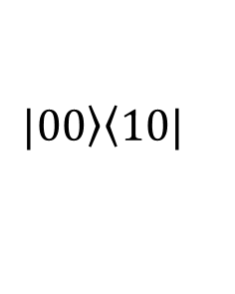
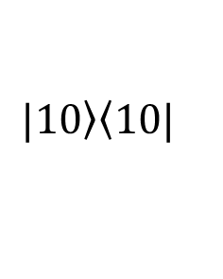
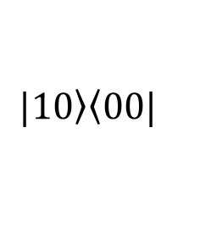
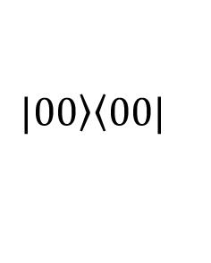
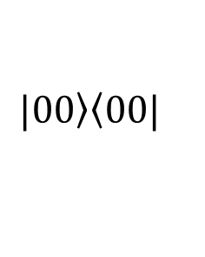
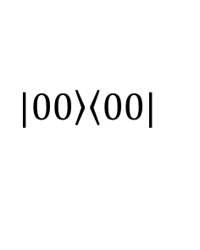
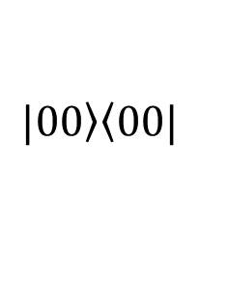
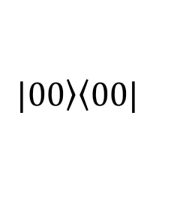
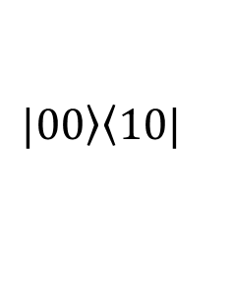
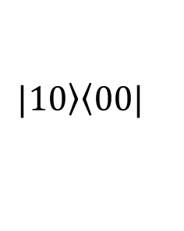
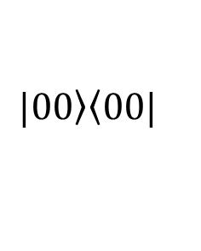
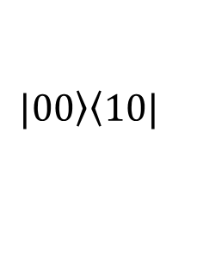
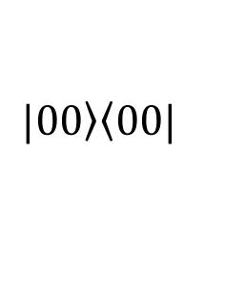
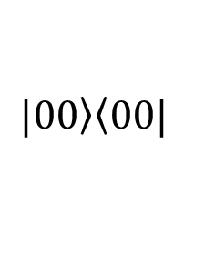
$$|\left.00\right\rangle \left\langle 00\right.|$$
$$|\left.00\right\rangle \left\langle 00\right.|$$
$$|\left.00\right\rangle \left\langle 1\right.0|$$
$$|\left.10\right\rangle \left\langle 0\right.0|$$
$$|\left.10\right\rangle \left\langle 00\right.|$$
$$|\left.00\right\rangle \left\langle 10\right.|$$
$$|\left.00\right\rangle \left\langle 0\right.0|$$
$$|\left.00\right\rangle \left\langle 0\right.0|$$
$$|\left.00\right\rangle \left\langle 00\right.|$$
$$|\left.00\right\rangle \left\langle 00\right.|$$
$$|\left.10\right\rangle \left\langle 1\right.0|$$
$$|\left.10\right\rangle \left\langle 0\right.0|$$
$$|\left.00\right\rangle \left\langle 00\right.|$$
$$|\left.00\right\rangle \left\langle 00\right.|$$
$$|\left.10\right\rangle \left\langle 0\right.0|$$
$$|\left.00\right\rangle \left\langle 1\right.0|$$
$$|\left.00\right\rangle \left\langle 0\right.0|$$
$$|\left.00\right\rangle \left\langle 0\right.0|$$

Slide 7
$$t_{1}$$
$$t_{2}$$
Raman
IR
IR
$$t_{1}$$
$$t_{2}$$
IR
Raman
IR

Slide 8
$$t_{1}$$
$$t_{2}$$
IR
IR
Raman

Slide 9

$$|\left.1\right\rangle \left\langle 1\right.|$$
$$t_{1}$$
$$t_{2}$$
$$|\left.2\right\rangle \left\langle 1\right.|$$
$$|\left.1\right\rangle \left\langle 0\right.|$$
$$|\left.0\right\rangle \left\langle 0\right.|$$
THz
THz
THz
$$t_{1}$$
$$t_{3}$$
IR
IR
IR

Slide 10
$$t_{1}$$
$$t_{2}$$
Raman
Raman
Raman

Slide 11
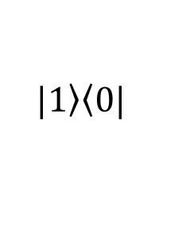
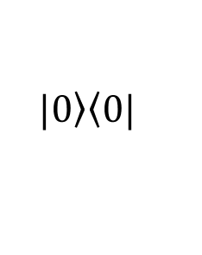
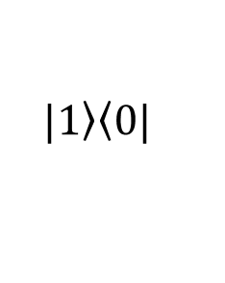
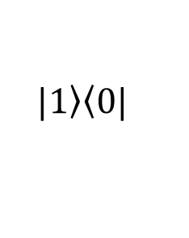
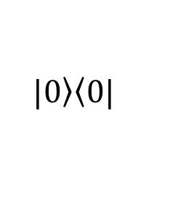
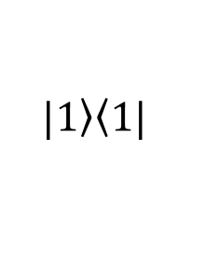
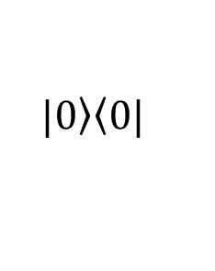
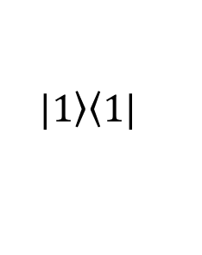
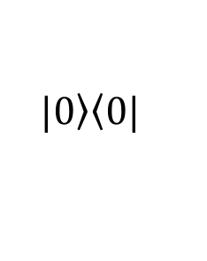
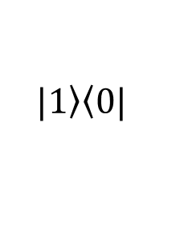
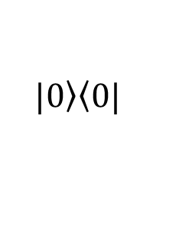
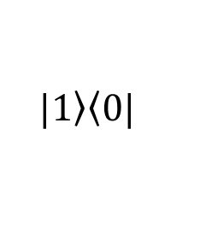
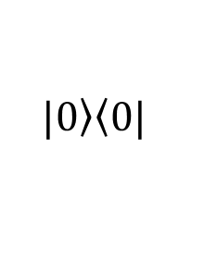
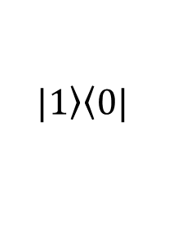
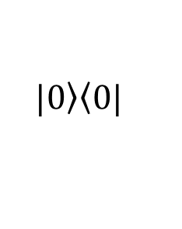
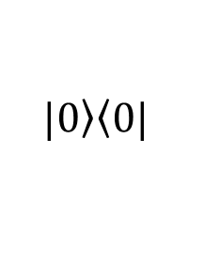
RTT
mode1
(a)
(b)
$$|\left.0\right\rangle \left\langle 0\right.|$$
$$|\left.0\right\rangle \left\langle 0\right.|$$
$$|\left.0\right\rangle \left\langle 0\right.|$$
$$|\left.1\right\rangle \left\langle 1\right.|$$
$$|\left.1\right\rangle \left\langle 0\right.|$$
$$|\left.1\right\rangle \left\langle 0\right.|$$
$$|\left.0\right\rangle \left\langle 0\right.|$$
$$|\left.1\right\rangle \left\langle 1\right.|$$
$$|\left.1\right\rangle \left\langle 0\right.|$$
$$|\left.1\right\rangle \left\langle 0\right.|$$
$$|\left.1\right\rangle \left\langle 0\right.|$$
$$|\left.1\right\rangle \left\langle 0\right.|$$
$$|\left.0\right\rangle \left\langle 0\right.|$$
$$|\left.0\right\rangle \left\langle 0\right.|$$
$$|\left.0\right\rangle \left\langle 0\right.|$$
$$|\left.0\right\rangle \left\langle 0\right.|$$

Slide 12
RTT
mode1
(A)
(B)
$$|\left.0\right\rangle \left\langle 0\right.|$$
$$|\left.0\right\rangle \left\langle 0\right.|$$
$$|\left.0\right\rangle \left\langle 0\right.|$$
$$|\left.1\right\rangle \left\langle 1\right.|$$
$$|\left.1\right\rangle \left\langle 0\right.|$$
$$|\left.1\right\rangle \left\langle 0\right.|$$
$$|\left.0\right\rangle \left\langle 0\right.|$$
$$|\left.1\right\rangle \left\langle 1\right.|$$
$$|\left.1\right\rangle \left\langle 0\right.|$$
$$|\left.1\right\rangle \left\langle 0\right.|$$
$$|\left.1\right\rangle \left\langle 0\right.|$$
$$|\left.1\right\rangle \left\langle 0\right.|$$
$$|\left.0\right\rangle \left\langle 0\right.|$$
$$|\left.0\right\rangle \left\langle 0\right.|$$
$$|\left.0\right\rangle \left\langle 0\right.|$$
$$|\left.0\right\rangle \left\langle 0\right.|$$

Slide 13
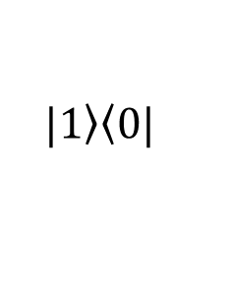
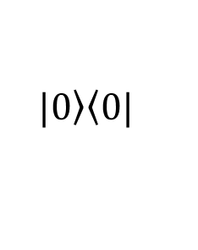
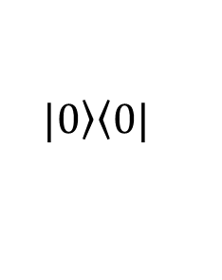
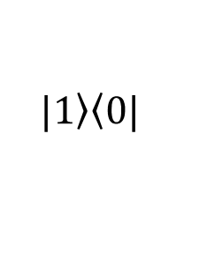
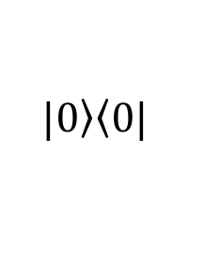
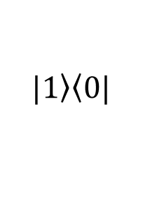
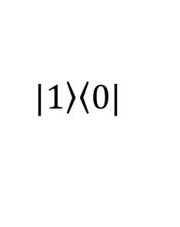
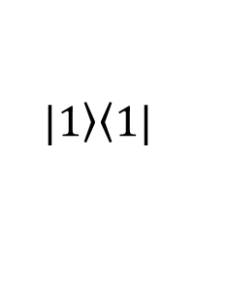
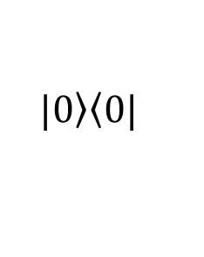











RTT
mode2
(c)
(d)
(e)
$$|\left.0\right\rangle \left\langle 0\right.|$$
$$|\left.0\right\rangle \left\langle 0\right.|$$
$$|\left.0\right\rangle \left\langle 0\right.|$$
$$|\left.1\right\rangle \left\langle 1\right.|$$
$$|\left.0\right\rangle \left\langle 0\right.|$$
$$|\left.1\right\rangle \left\langle 0\right.|$$
$$|\left.1\right\rangle \left\langle 0\right.|$$
$$|\left.1\right\rangle \left\langle 0\right.|$$
$$|\left.2\right\rangle \left\langle 1\right.|$$
$$|\left.2\right\rangle \left\langle 0\right.|$$
$$|\left.1\right\rangle \left\langle 0\right.|$$
$$|\left.1\right\rangle \left\langle 0\right.|$$
$$|\left.2\right\rangle \left\langle 0\right.|$$
$$|\left.2\right\rangle \left\langle 0\right.|$$
$$|\left.1\right\rangle \left\langle 0\right.|$$
$$|\left.0\right\rangle \left\langle 0\right.|$$
$$|\left.0\right\rangle \left\langle 0\right.|$$
$$|\left.0\right\rangle \left\langle 0\right.|$$
$$|\left.0\right\rangle \left\langle 0\right.|$$
$$|\left.0\right\rangle \left\langle 0\right.|$$

Slide 14




















TRT
mode2
(f)
(g)
$$|\left.0\right\rangle \left\langle 0\right.|$$
$$|\left.0\right\rangle \left\langle 0\right.|$$
$$|\left.0\right\rangle \left\langle 0\right.|$$
$$|\left.1\right\rangle \left\langle 0\right.|$$
$$|\left.1\right\rangle \left\langle 0\right.|$$
$$|\left.2\right\rangle \left\langle 0\right.|$$
$$|\left.1\right\rangle \left\langle 0\right.|$$
$$|\left.1\right\rangle \left\langle 0\right.|$$
$$|\left.1\right\rangle \left\langle 0\right.|$$
$$|\left.0\right\rangle \left\langle 0\right.|$$
$$|\left.0\right\rangle \left\langle 0\right.|$$
$$|\left.0\right\rangle \left\langle 0\right.|$$
TTR
(h)
$$|\left.0\right\rangle \left\langle 0\right.|$$
$$|\left.0\right\rangle \left\langle 0\right.|$$
$$|\left.2\right\rangle \left\langle 0\right.|$$
$$|\left.2\right\rangle \left\langle 0\right.|$$
$$|\left.1\right\rangle \left\langle 0\right.|$$
$$|\left.1\right\rangle \left\langle 0\right.|$$
$$|\left.0\right\rangle \left\langle 0\right.|$$
$$|\left.0\right\rangle \left\langle 0\right.|$$

Slide 15

TRT
mode2
$$|\left.0\right\rangle \left\langle 0\right.|$$
$$|\left.0\right\rangle \left\langle 0\right.|$$
$$|\left.1\right\rangle \left\langle 0\right.|$$
$$|\left.1\right\rangle \left\langle 0\right.|$$
$$|\left.1\right\rangle \left\langle 0\right.|$$
$$|\left.1\right\rangle \left\langle 0\right.|$$
$$|\left.0\right\rangle \left\langle 0\right.|$$
$$|\left.0\right\rangle \left\langle 0\right.|$$
TTR
$$|\left.0\right\rangle \left\langle 0\right.|$$
$$|\left.0\right\rangle \left\langle 0\right.|$$
$$|\left.2\right\rangle \left\langle 0\right.|$$
$$|\left.0\right\rangle \left\langle 0\right.|$$
$$|\left.1\right\rangle \left\langle 0\right.|$$
$$|\left.1\right\rangle \left\langle 0\right.|$$
$$|\left.0\right\rangle \left\langle 0\right.|$$
$$|\left.0\right\rangle \left\langle 0\right.|$$

