Slide 1

ExpertShop

Slide 2



Slide 3
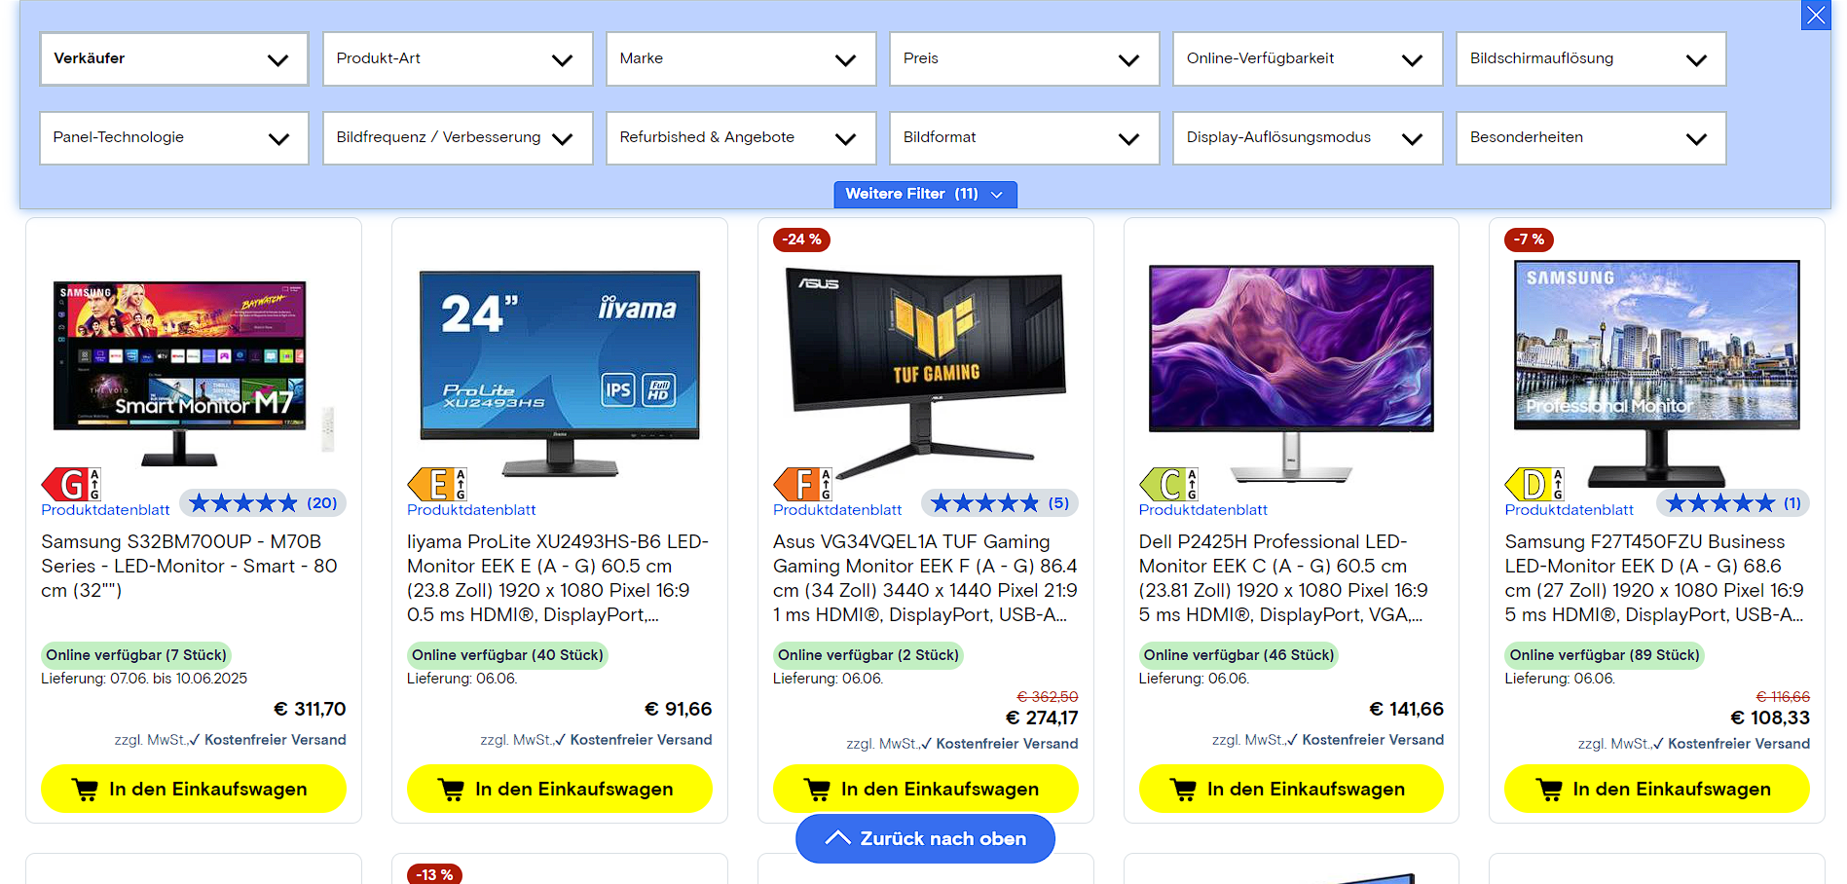
IDEE
Übersichtlicher Shop
Bessere UI

Slide 4
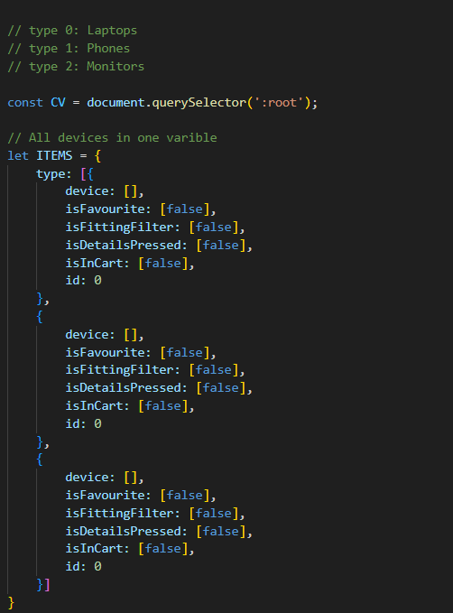
Details

Slide 5
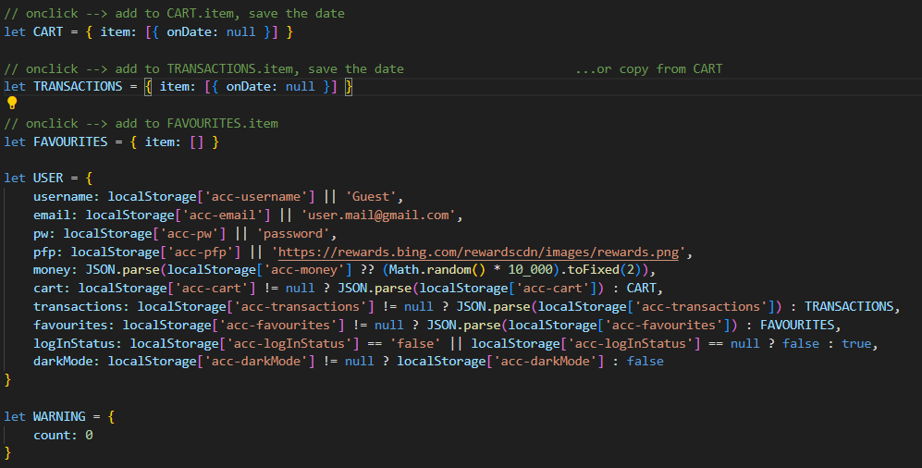
User/Shop base
User/Shop base

Slide 6
User/Shop base

Slide 7
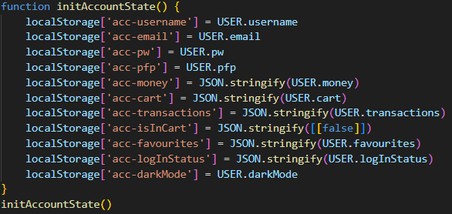
User/Shop base

Slide 8
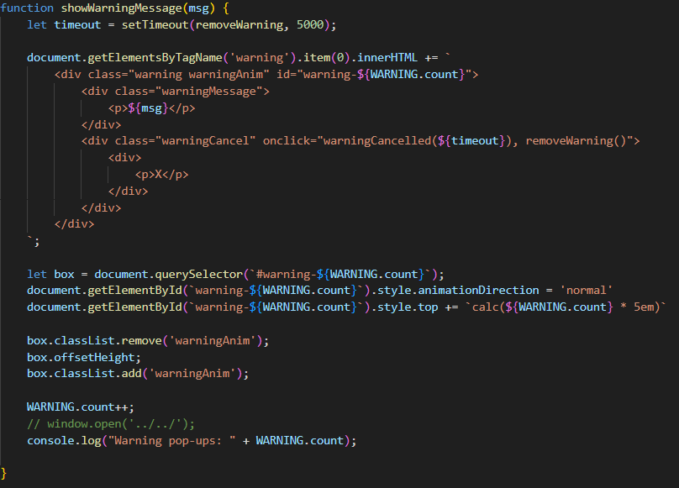
Warning pop-up

Slide 9
Warning pop-up

Slide 10
Warning pop-up

Slide 11
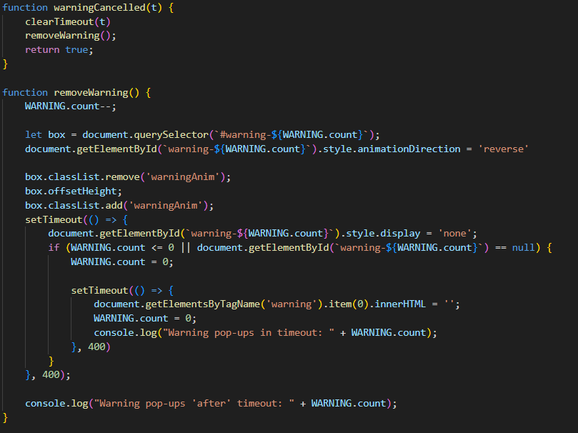
Warning pop-up

Slide 12
Warning pop-up

Slide 13
Warning pop-up

Slide 14
Warning pop-up

Slide 15
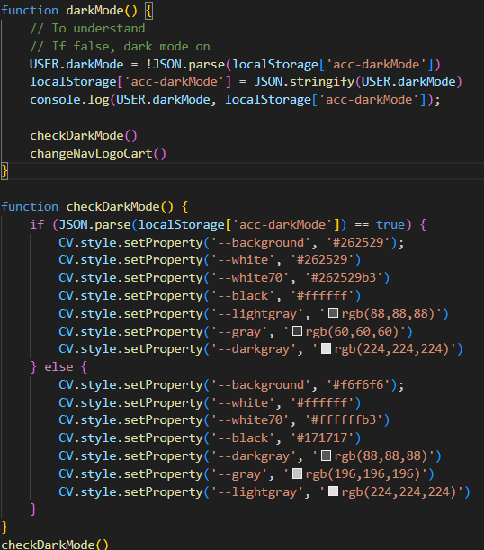
Dark mode

Slide 16
Dark mode

Slide 17
Dark mode

Slide 18
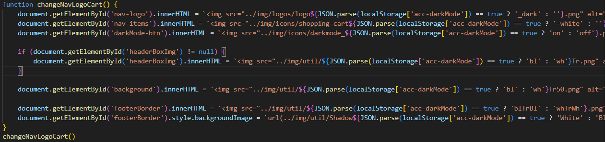
Dark mode

Slide 19
Dark mode

Slide 20
Dark mode

Slide 21
Vielen Dank fürs Zuhören

