Slide 1
NEON KANGAROO

Slide 2
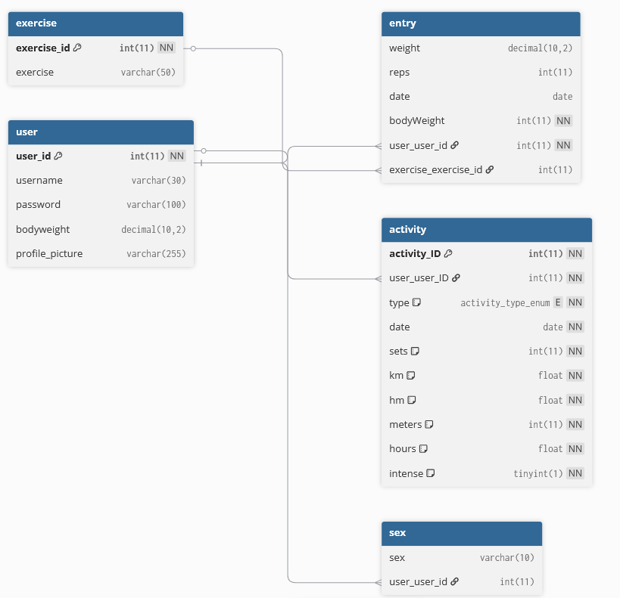
DATABASE

Slide 3
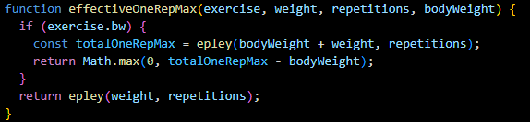
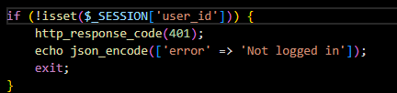
CODE-HIGHLIGHTS

Slide 4
LIVE-DEMO

