Slide 1
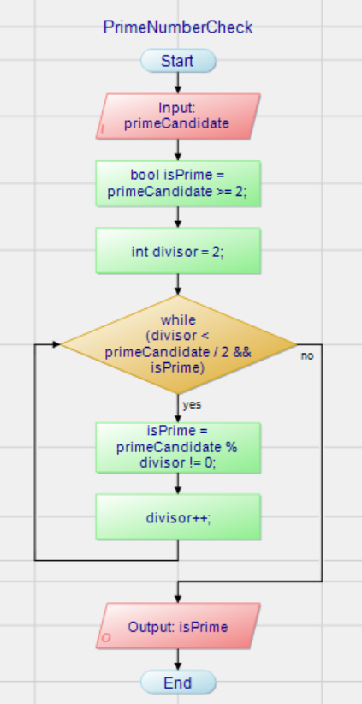
Flow Chart Terminology
Input / Output
Instruction
(Anweisung)
Selection
While-Loop

Slide 2
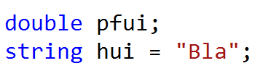
Terminology: Variable Declaration and Initialization
Declaration of a variable named „pfui“ of type double
Type
Name
Initialization of a variable
Assignment
operator
Value

Slide 3
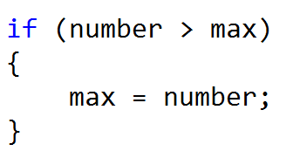
Terminology: Simple Selection
Keyword
Condition
Block start
If branch
Block end
Indent
one tab

Slide 4
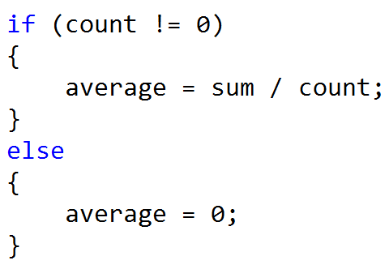
Terminology: Selection
Keyword
Condition
If branch
Indent
one tab
Keyword
Indent
one tab
Else branch

Slide 5
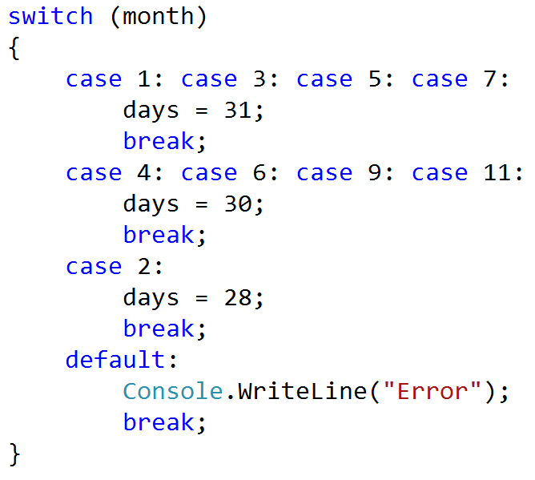
Terminology: Switch
Expression
Keyword
Keyword
Case labels
Case labels
Case labels
Case labels
Case branches
Case branches
Case branches
Block start / end
Block start / end
Default branch

Slide 6
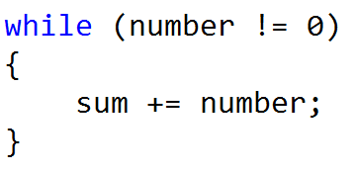
Terminology: While-Loop
Keyword
Condition
Head of loop
Indent
one tab
Body of loop
Block start / end
Block start / end

Slide 7
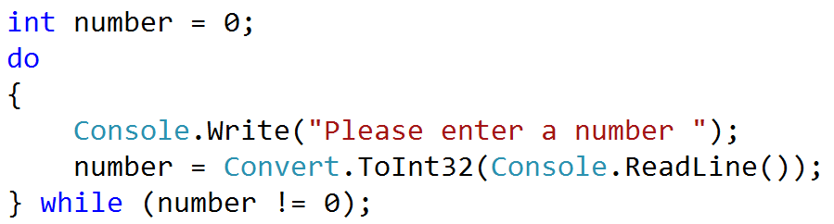
Terminology: Do-While-Loop
Keyword
Start of body of loop
Body of loop
Foot of loop
Condition
End of body of loop
Keyword

Slide 8
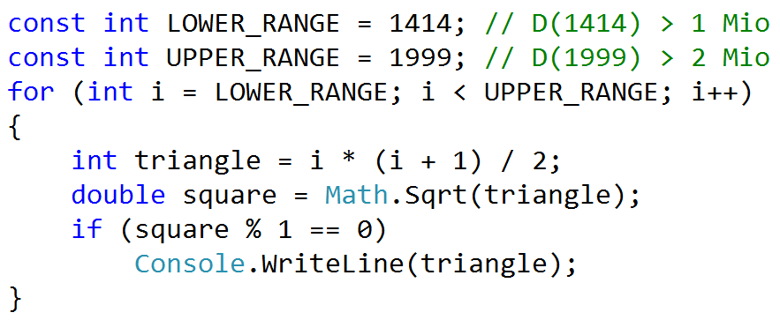
Terminology: For-Loop
Keyword
Declaration and
initialization
Condition
Loop variable increment
Body of
loop
Local variables
Local variables
Block start / end
Start / End of body

Slide 9
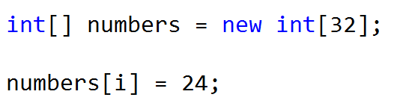
Terminology: Array
Type of array
Size of array
Index
Index operator
Index operator

Slide 10
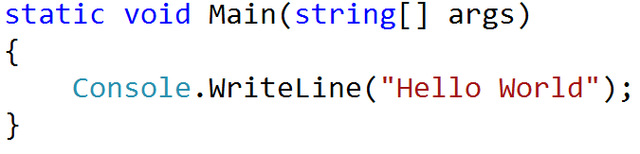
Terminology: Method
Declaration
type
Return type
of method
Name
of method
Parameters / Arguments
Head of
method
Indent
one tab
Body of
method
Definition of
method
End of
body
Start of
body

Slide 11
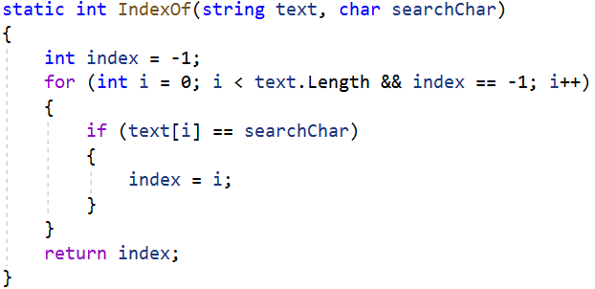
Terminology: Method with Return Value
Declaration
type
Return type
of method
Name
of method
List of formal arguments / parameters
Method signature
Local variable
Method body
Return value

Slide 12
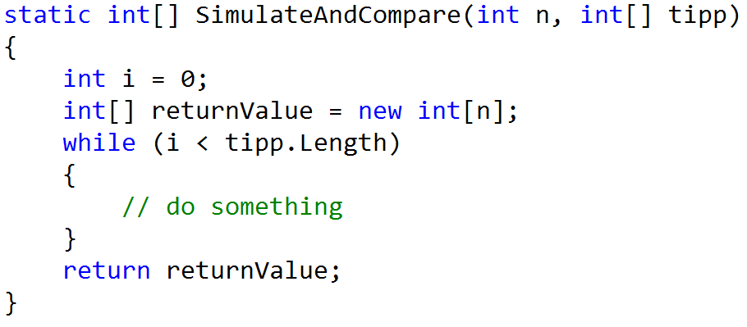
Terminology: Method with Return Value
Declaration
type
Return type
of method
Name
of method
List of formal arguments / parameters
Head of
method
Body of
method
Local variables
Return value

Slide 13
Terminology Exercise Sheets

Slide 14
Terminology: Variable Declaration and Initialization

Slide 15
Terminology: Simple Selection
Keyword
Condition
Block start
If branch
Block start

Slide 16
Terminology: Selection
Keyword
Condition
If branch
Keyword
Else branch

Slide 17
Terminology: Switch
Expression
Case labels
Case labels
Case labels
Case labels
Case branches
Case branches
Case branches
Block start / end
Block start / end
Default branch

Slide 18
Terminology: While-Loop
Keyword
Condition
Head of loop
Body of loop
Block start / end
Block start / end

Slide 19
Terminology: Do-While-Loop
Start of body of loop
Body of loop
Foot of loop
Condition
End of body of loop
Keyword

Slide 20
Terminology: For-Loop
Keyword
Declaration and
initialization
Condition
Loop variable increment
Body of
loop
bles
Block start / end
Start / End of body

Slide 21
Terminology: Array
Type of array
Size of array
Index
Index operator
Index operator

Slide 22
Terminology: Method
Return type
of method
Name
of method
Parameters / Arguments
Head of
method
Body of
method
Definition of
method
End of
body
Start of
body

Slide 23
Terminology: Method with Return Value
of method
Name
of method
List of formal arguments / parameters
Head of
method
Body of
method
Local variables
Return value

