Slide 1
I_POS
Prime Number Check – A Case Study
Unit 07

Slide 2
The Problem
The user can enter a number
This number should be checked whether its a prime number or not
If the number is a prime number the message “<n> is a prime number” should be printed
Otherwise the message “<n> is no prime number” should be printed
<n> should denote the number entered by the user

Slide 3
What are Prime Numbers?
Numbers > 1 which can be divided only by 1 and by themselves
E.g., 2, 3, 5, 7, 11, 13, 17, 19, …

Slide 4
How to Check?
Let’s call the number to be checked primeCandidate
If primeCandidate < 2 then this is no prime number
If primeCandidate == 2 then this is a prime number
Otherwise
  For all divisors 2, 3, 4, … primeCandidate/2
    Check whether divisor divides primeCandidate
    If so, primeCandidate is no prime number and exit loop
    Else, check next divisor

Slide 5
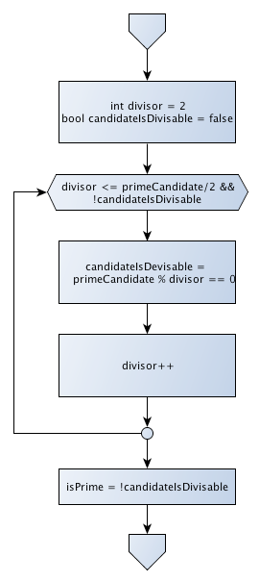
Kernel of Algorithm
Assumption: Input and first checks are already done
The following holds
  Given a number primeCandidate
  primeCandidate > 2

