Slide 1
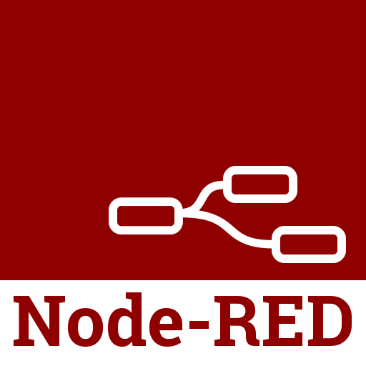
Node-RED

Slide 2
Mächtiges Tool für IoT
Visualisierung
Definition der Steuerungslogik
Läuft auf vielen Plattformen
Arbeitet u.a. eng mit Mqtt zusammen
Ist sehr gut in HA integrierbar
Komplexere Automatisierungen
Open-Source https://github.com/node-red/node-red
Guter Einstieg
https://www.youtube.com/watch?v=3AR432bguOY
https://nodered.org/

Slide 3
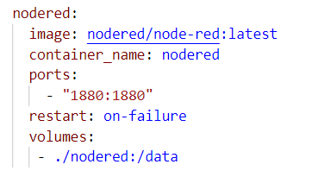
Installation über Docker
Läuft im selben Docker-Netzwerk wie HA
DNS ➔ homeassistant wird auf IP aufgelöst

Slide 4
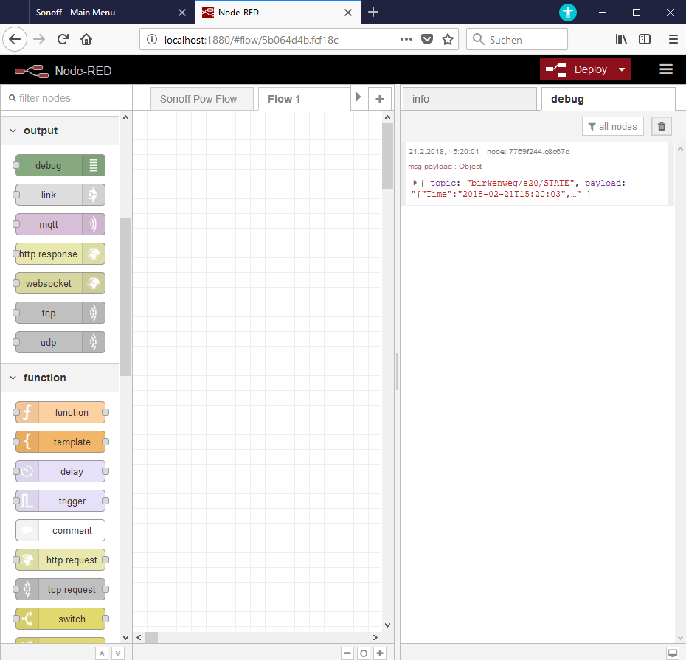
Übersicht

Slide 5
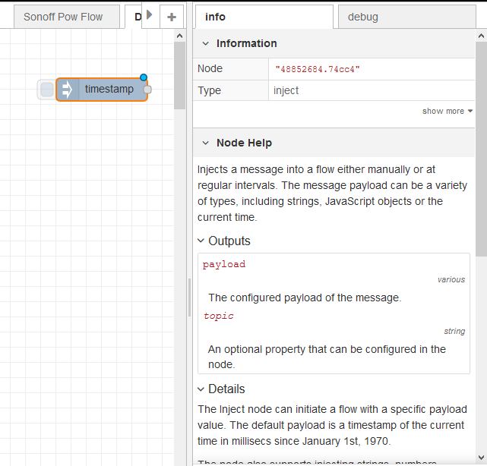
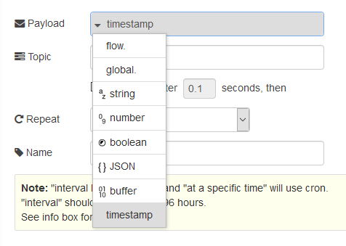
Erste Schritte – Inject-Node
Input-Node
Injiziert Daten in Flow
Enable/Disable
Repeatable
Beschreibung unter Info

Slide 6
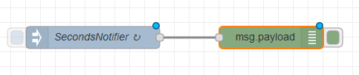
Zweiter Node Debug-Node
Beide Nodes verbinden
Output des Notifiers ➔ Input des DebugNodes
Übung

Slide 7
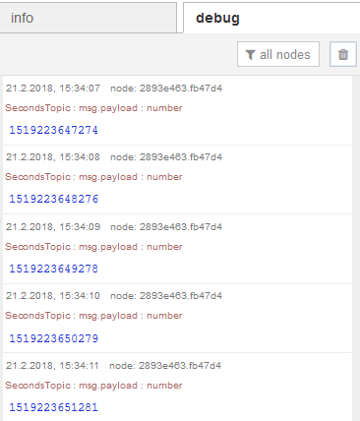

Deploy ➔ Debug-Window
Ausgabe der aktuellen Zeit im Unix-Format
Formatwechsel durch Klicken im Debugwindow
Hex, DateTime

Slide 8
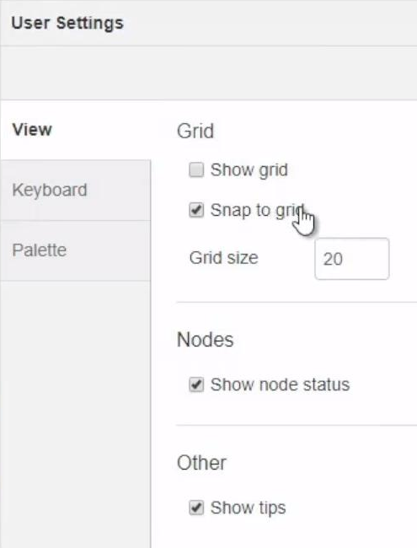
Usersettings

Slide 9
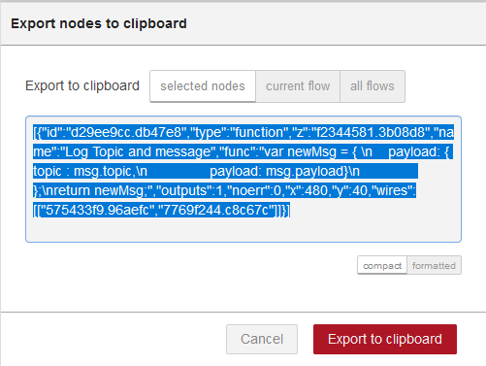
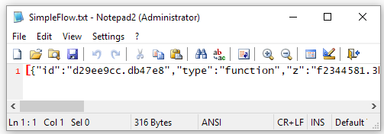
Sichern der Flows
Selektiv als Textdatei möglich
Einfacher Austausch

Slide 10
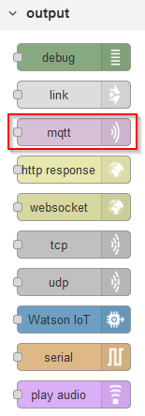
Erster einfacher Flow
Test des MQTT-Brokers
192.168.2.3
Publisher sendet Timestamp
Mqtt-Output
Subscriber beobachtet Topic auf Broker
Mqtt-Input
Ausgabe im Debugfenster
Übung

Slide 11
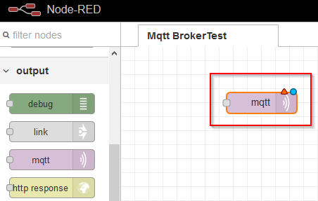
Neuer Flow MqttBrokerTest
Mqtt-Input-Node auf Sheet ziehen

Slide 12
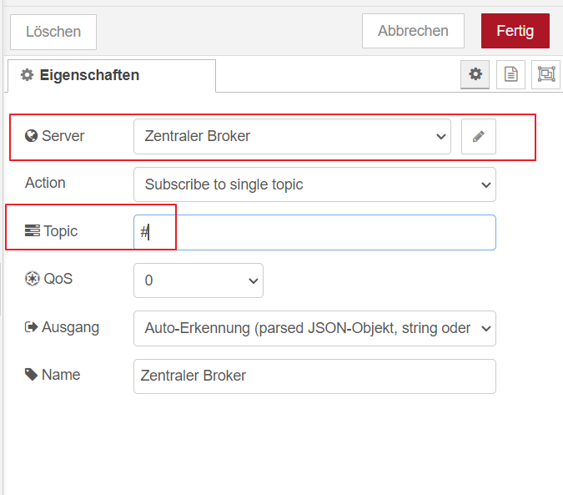
Broker - Grundkonfiguration
Alle Topics subscriben

Slide 13
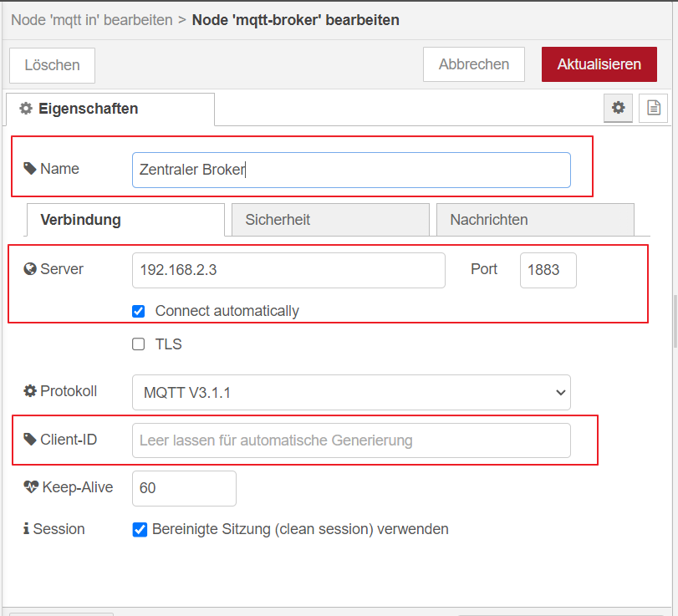
MQTT-Server konfigurieren

Slide 14
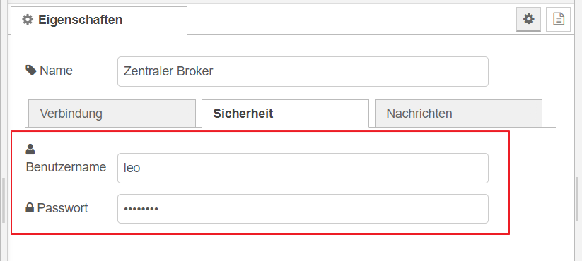
Security-Tab
Passwort: passme

Slide 15
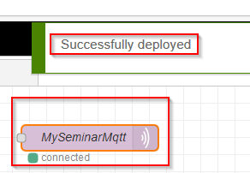
Nach dem Deploy
Verbindung zum Broker steht

Slide 16
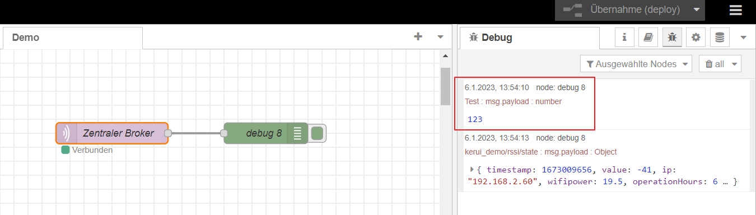
Ergebnis
Mit Mqtt-Explorer Message schicken

Slide 17
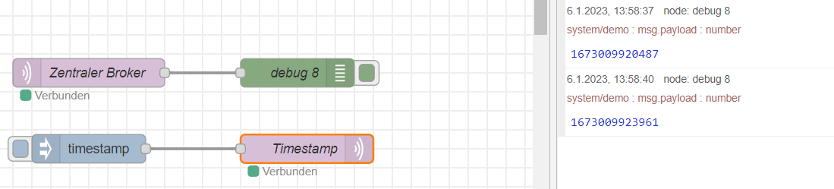
Mqtt-Messages schicken
Erweiterung: Über Mqtt wird per Inject-Node der aktuelle Timestamp geschickt

Slide 18
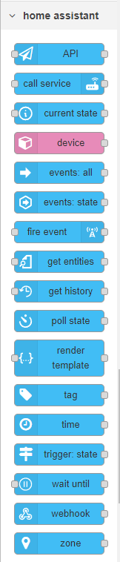
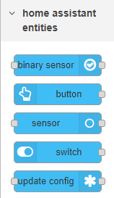
Integration Node-Red in HA
Viele neue Nodes
Zugriff auf Entities in HA aus Flows
Verwendung von HA-Services
Definition eigener Sensors/Actors in Node-Red
Alternative Möglichkeit Automatisierungen zu erstellen
Nutzen

Slide 19
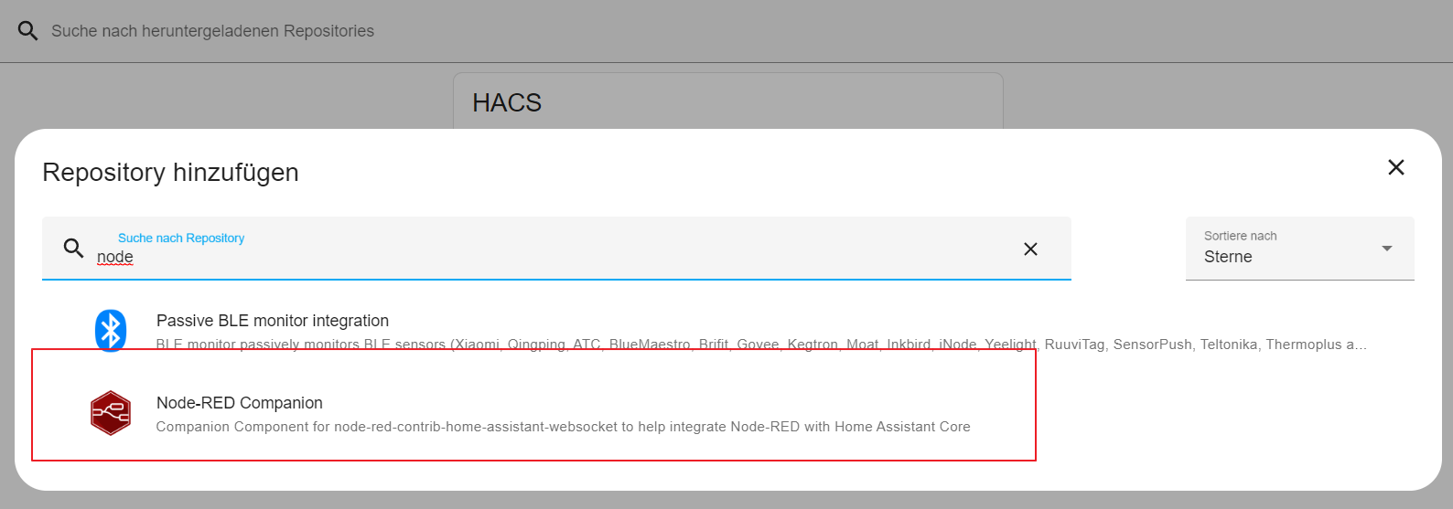
Node Red über HACS installieren

Slide 20
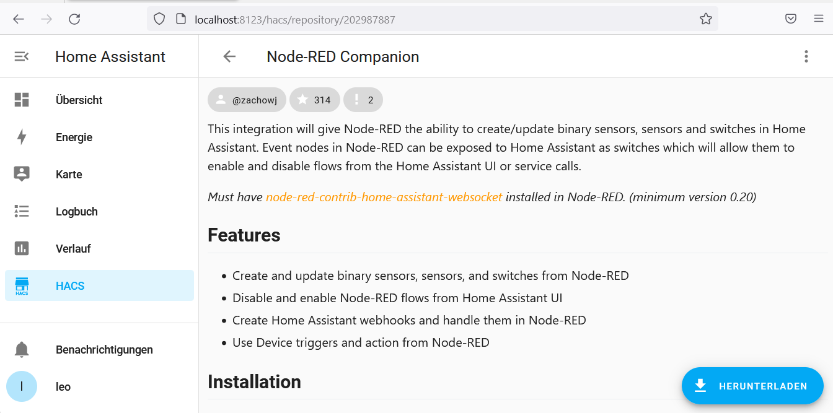
Node-RED Companion herunterladen …

Slide 21
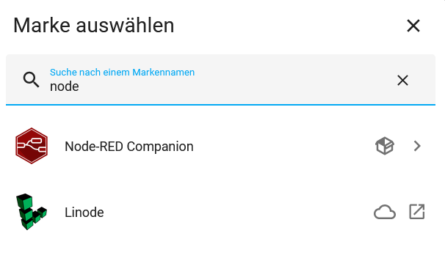
… und als neue Integration installieren

Slide 22
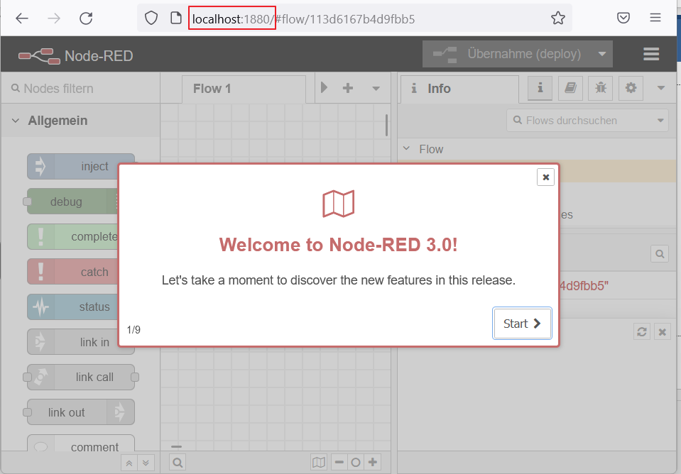
NodeRED starten
http://localhost:1880

Slide 23
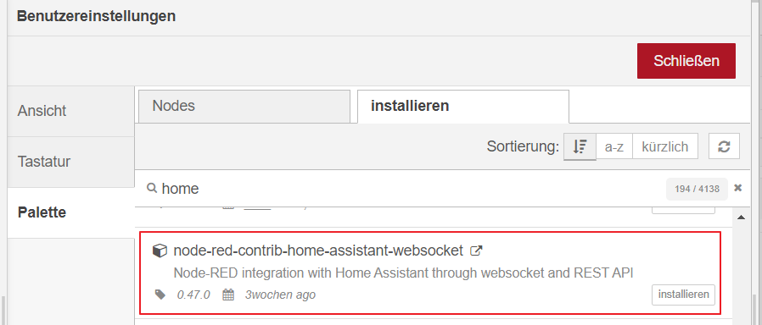
HA und NodeRed verbinden
In NodeRed (Port 1880) Komponente installieren
Palette

Slide 24
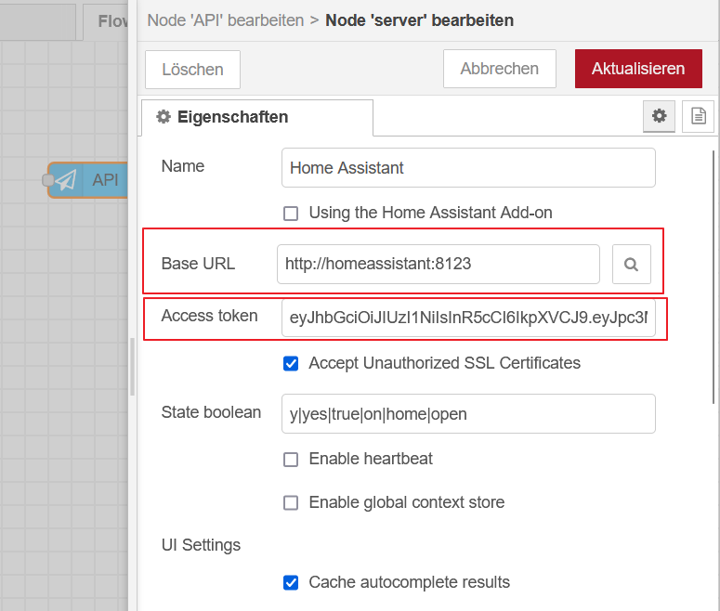
Server konfigurieren …

Slide 25
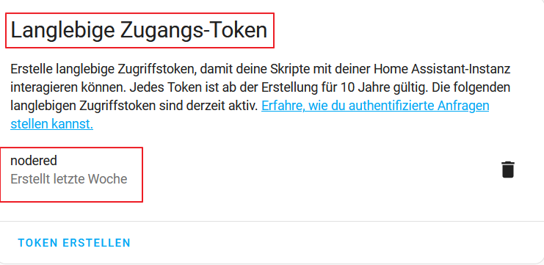
… vorher Accesstoken in HA anlegen

Slide 26
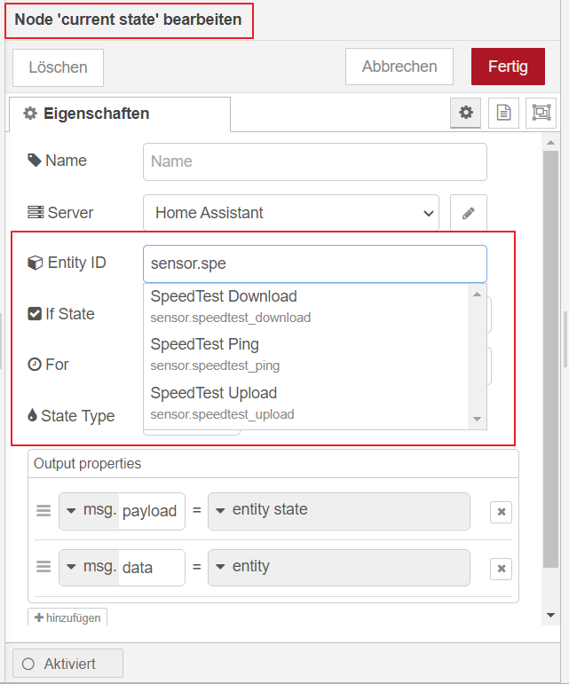
Zugriff mit Intellisense

Slide 27
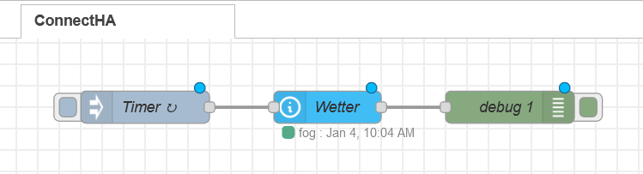
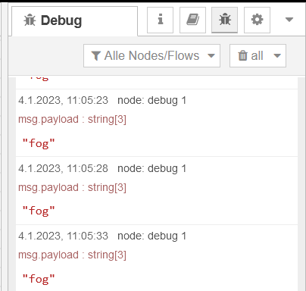
Kleiner Flow zum Testen der HA-Connection
Übung

Slide 28
Einbindung in Menü von HA
config.yaml editieren
panel_iframe:
nodered:
title: NodeRed
url: "http://192.168.0.2:1880/"
icon: si:nodered
require_admin: true
SimpleIcons über HACS herunterladen
Als Integration installieren
Ähnliche Vorgehensweise für andere Anwendungen
ZigBee2Mqtt, Portainer, …

Slide 29
Aufgabenstellung
Kerui-Mqtt-Sensor in HA einbinden
Wenn Humidity über 40% steigt
einmalig eine Nachricht zum Mqtt-Broker (1921.68.2.3) schicken
Notification an HA schicken
Eigener NodeRed-Binary-Sensor in HA, der anzeigt, ob es aktuell eine hohe Luftfeuchte hat
Übung

Slide 30
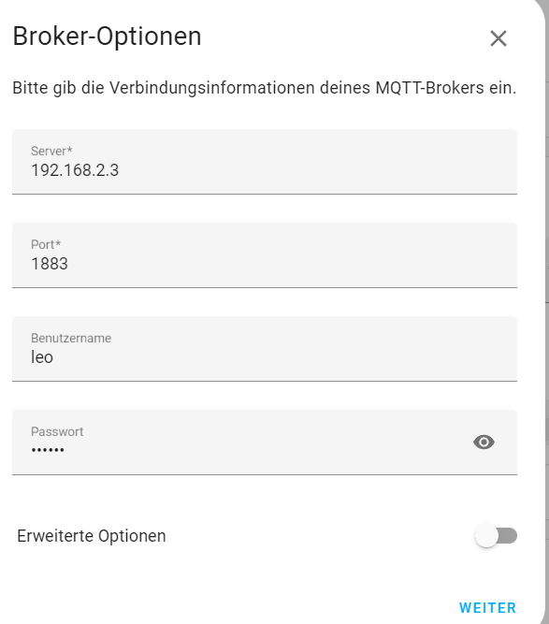
Mqtt in HA einbinden
Companion-Integration ist bereits installiert
Mqtt-Integration ist ebenfalls installiert

Slide 31
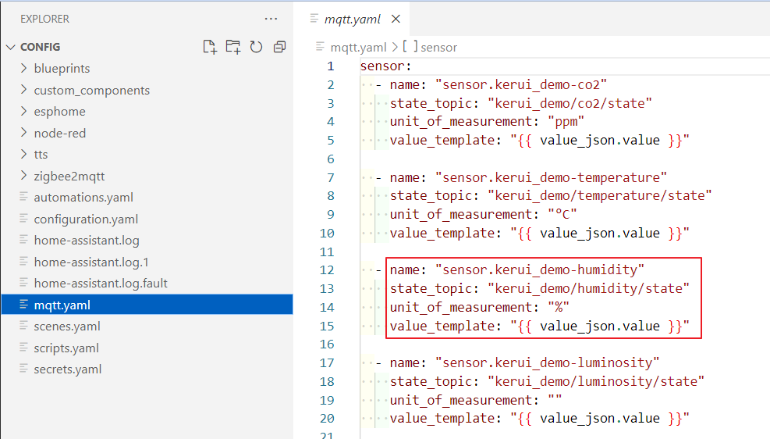
Mqtt-Sensoren in eigene Yaml-Datei auslagern …

Slide 32
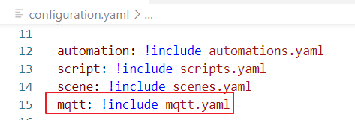
… und in configuration.yaml einbinden
Generelle Möglichkeit, die Konfigurationen zu strukturieren

Slide 33
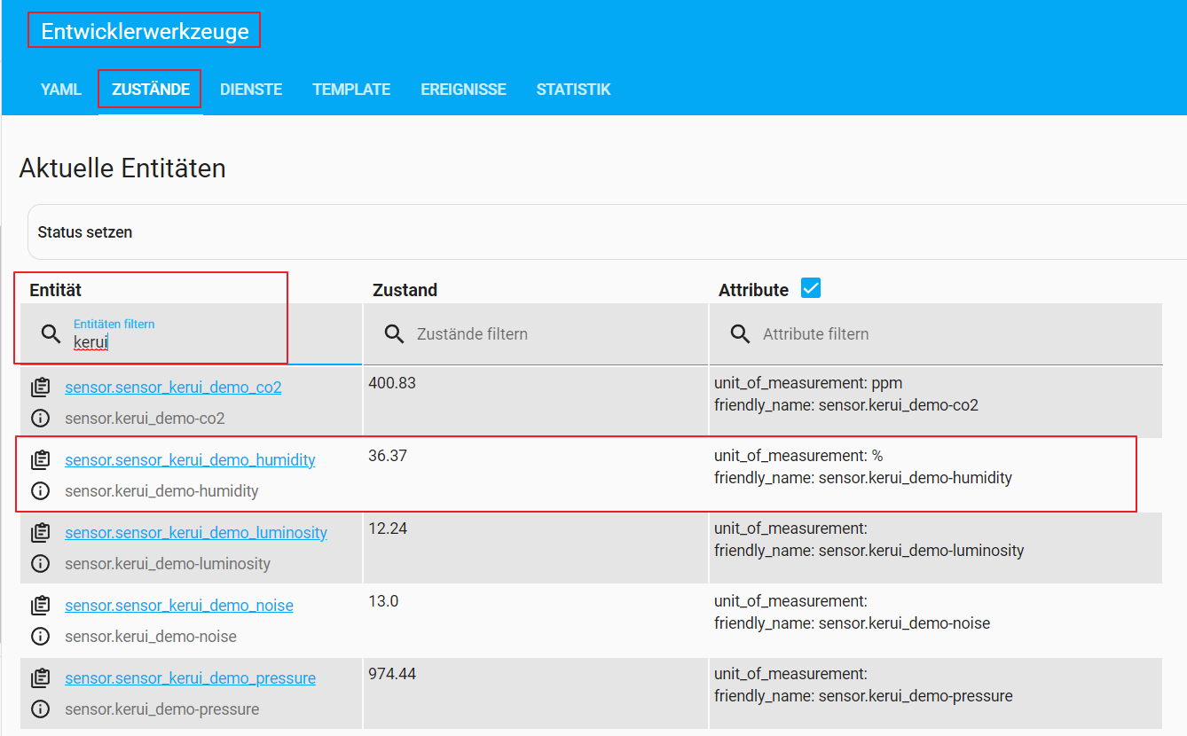
Kontrolle über Entwicklerwerkzeuge

Slide 34
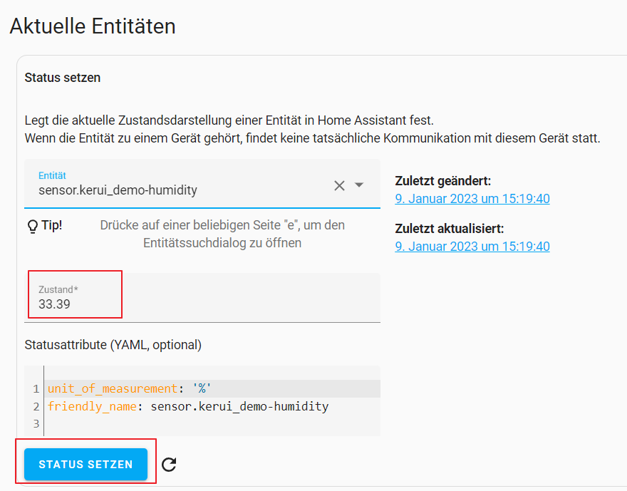
Detailansicht
Status der Entität ist änderbar

Slide 35
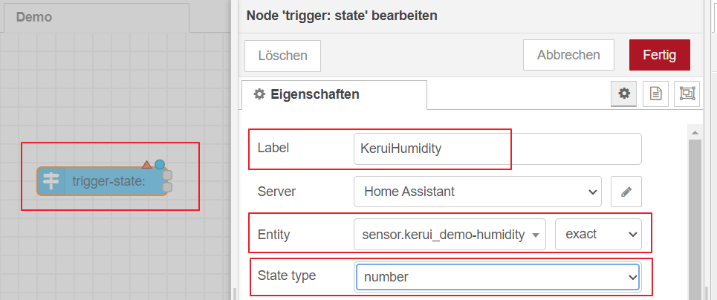
Kerui-Humidity in NodeRed anlegen …

Slide 36
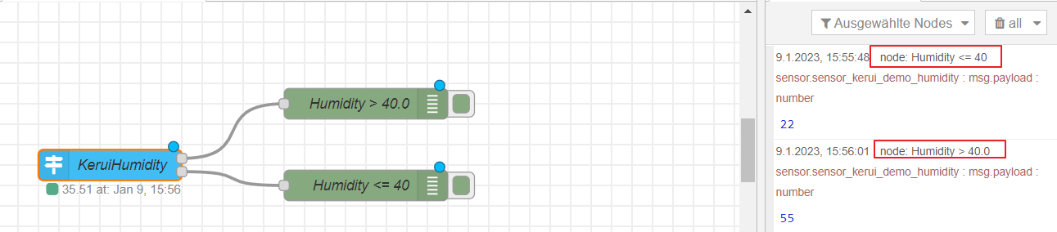
… und Änderungen protokollieren

Slide 37
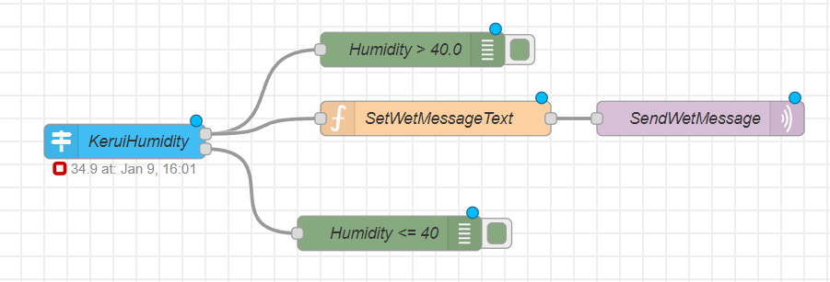
Notification per Mqtt

Slide 38
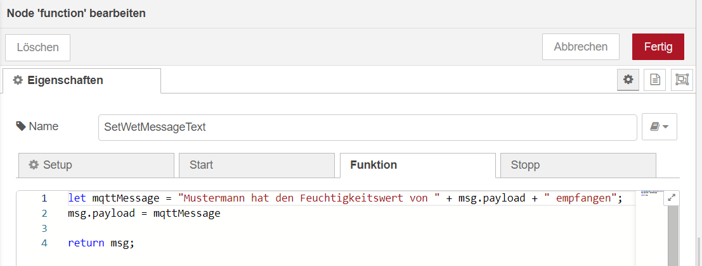
Messagetext aufbereiten

Slide 39
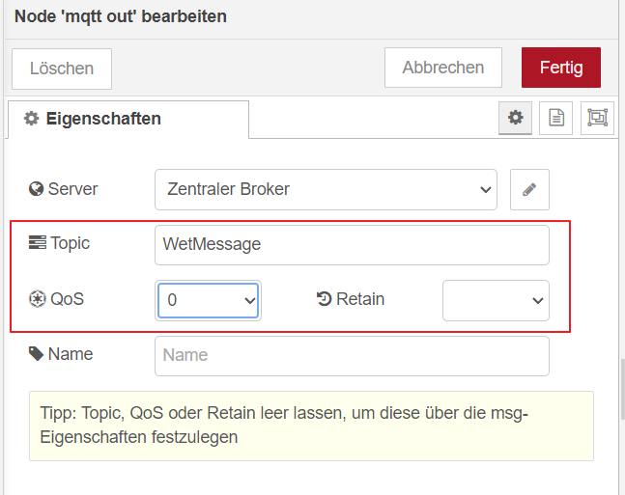
Messagetext an Mqtt-Broker senden

Slide 40
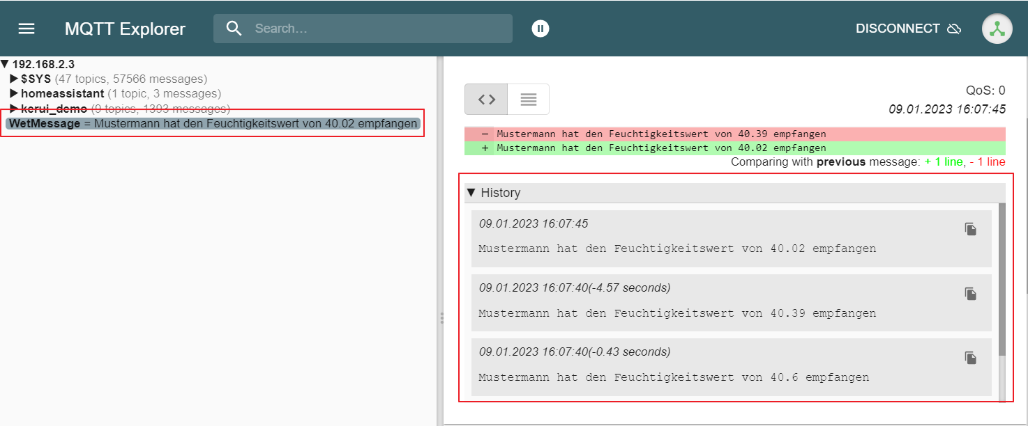
Mit Mqtt-Explorer testen
Nachricht kommt innerhalb weniger Sekunden mehrmals
Wie können wir das verhindern?

Slide 41
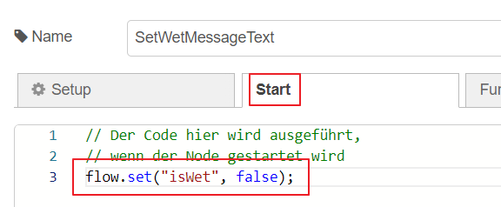
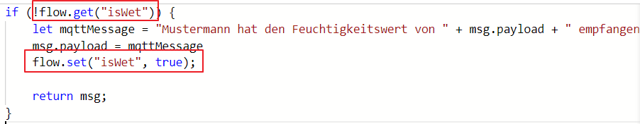
State verwalten
https://stevesnoderedguide.com/node-red-variables

Slide 42
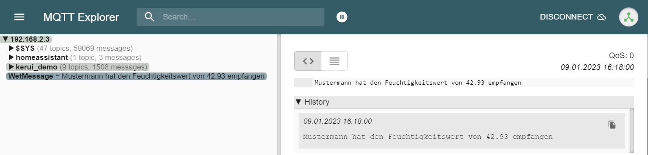
Nur mehr eine Nachricht, aber …

Slide 43
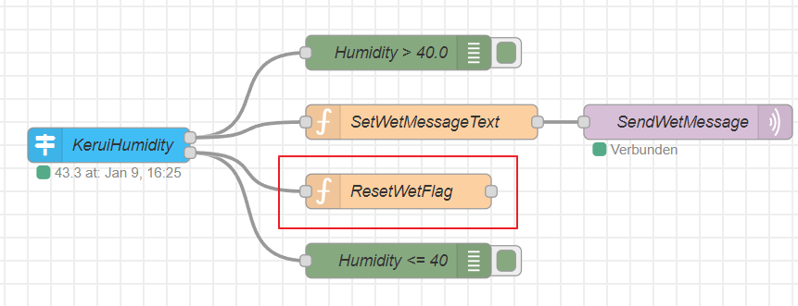
Flag zurücksetzen
Notes:
[{"id":"6674f2c47eabbb37","type":"tab","label":"Demo","disabled":false,"info":"","env":[]},{"id":"4bdec2c5c5413f22","type":"trigger-state","z":"6674f2c47eabbb37","d":true,"name":"Humidity","server":"dcab4375.28696","version":2,"exposeToHomeAssistant":false,"haConfig":[{"property":"name","value":""},{"property":"icon","value":""}],"entityid":"sensor.sensor_kerui_demo_humidity","entityidfiltertype":"exact","debugenabled":false,"constraints":[{"targetType":"this_entity","targetValue":"","propertyType":"current_state","propertyValue":"new_state.state","comparatorType":">","comparatorValueDatatype":"num","comparatorValue":"40"}],"inputs":0,"outputs":2,"customoutputs":[],"outputinitially":false,"state_type":"num","enableInput":false,"x":140,"y":580,"wires":[["a44e45370cd78f35","fcf56170d309c594","e63881cff9478241"],["dbd95576c88371de","e63881cff9478241"]]},{"id":"a44e45370cd78f35","type":"debug","z":"6674f2c47eabbb37","name":"debug 4","active":true,"tosidebar":true,"console":false,"tostatus":false,"complete":"false","statusVal":"","statusType":"auto","x":340,"y":480,"wires":[]},{"id":"fcf56170d309c594","type":"function","z":"6674f2c47eabbb37","name":"SetMessageText","func":"if(flow.get(\"waiting\")){\n let mqttMessage = \"Gerald hat den Feuchtigkeitswert von \" + msg.payload + \" empfangen\";\n msg.payload = mqttMessage\n flow.set(\"waiting\", false);\n return [msg]; \n}\n","outputs":1,"noerr":0,"initialize":"// Der Code hier wird ausgeführt,\n// wenn der Node gestartet wird\nflow.set(\"waiting\", true);","finalize":"","libs":[],"x":370,"y":580,"wires":[["765cb9b9a1b1bd64","4894aaeb8bf3ad2a","86471b85e61ca259"]]},{"id":"765cb9b9a1b1bd64","type":"debug","z":"6674f2c47eabbb37","name":"debug 5","active":true,"tosidebar":true,"console":false,"tostatus":false,"complete":"false","statusVal":"","statusType":"auto","x":560,"y":460,"wires":[]},{"id":"dbd95576c88371de","type":"function","z":"6674f2c47eabbb37","name":"Reset waiting","func":"if(!flow.get(\"waiting\")){\n flow.set(\"waiting\", true);\n return msg;\n}\n","outputs":1,"noerr":0,"initialize":"","finalize":"","libs":[],"x":360,"y":640,"wires":[["ca3f5f03fa882ac0"]]},{"id":"ca3f5f03fa882ac0","type":"debug","z":"6674f2c47eabbb37","name":"debug 6","active":true,"tosidebar":true,"console":false,"tostatus":false,"complete":"false","statusVal":"","statusType":"auto","x":560,"y":640,"wires":[]},{"id":"4894aaeb8bf3ad2a","type":"mqtt out","z":"6674f2c47eabbb37","name":"Send Message","topic":"DemoMessage","qos":"","retain":"","respTopic":"","contentType":"","userProps":"","correl":"","expiry":"","broker":"dbaa5b35c19cfbe5","x":620,"y":580,"wires":[]},{"id":"8a380c0c6d250f0b","type":"inject","z":"6674f2c47eabbb37","name":"","props":[{"p":"payload"},{"p":"topic","vt":"str"}],"repeat":"5","crontab":"","once":false,"onceDelay":0.1,"topic":"","payload":"","payloadType":"date","x":190,"y":60,"wires":[["469de53ba76f8b4b"]]},{"id":"469de53ba76f8b4b","type":"debug","z":"6674f2c47eabbb37","name":"debug 7","active":false,"tosidebar":true,"console":false,"tostatus":false,"complete":"false","statusVal":"","statusType":"auto","x":380,"y":60,"wires":[]},{"id":"83bb09e8170f88ad","type":"mqtt in","z":"6674f2c47eabbb37","name":"Zentraler Broker","topic":"#","qos":"0","datatype":"auto-detect","broker":"dbaa5b35c19cfbe5","nl":false,"rap":true,"rh":0,"inputs":0,"x":180,"y":220,"wires":[["33b1761946204a7e"]]},{"id":"33b1761946204a7e","type":"debug","z":"6674f2c47eabbb37","name":"debug 8","active":true,"tosidebar":true,"console":false,"tostatus":false,"complete":"false","statusVal":"","statusType":"auto","x":400,"y":220,"wires":[]},{"id":"9070662c7b9394a0","type":"mqtt out","z":"6674f2c47eabbb37","name":"Timestamp","topic":"system/demo","qos":"0","retain":"","respTopic":"","contentType":"","userProps":"","correl":"","expiry":"","broker":"dbaa5b35c19cfbe5","x":410,"y":300,"wires":[]},{"id":"823f6b9b83151a01","type":"inject","z":"6674f2c47eabbb37","name":"","props":[{"p":"payload"},{"p":"topic","vt":"str"}],"repeat":"","crontab":"","once":false,"onceDelay":0.1,"topic":"","payload":"","payloadType":"date","x":180,"y":300,"wires":[["9070662c7b9394a0"]]},{"id":"deadc9b848f18a2e","type":"ha-binary-sensor","z":"6674f2c47eabbb37","name":"IsHumidityHigh","entityConfig":"a91b61470ceb9a86","version":0,"state":"payload","stateType":"msg","attributes":[],"inputOverride":"allow","outputProperties":[],"x":600,"y":700,"wires":[[]]},{"id":"e63881cff9478241","type":"function","z":"6674f2c47eabbb37","name":"SetIsHumidityHigh","func":"msg.payload = msg.payload > 40.0;\nreturn [msg];\n","outputs":1,"noerr":0,"initialize":"// Der Code hier wird ausgeführt,\n// wenn der Node gestartet wird\nflow.set(\"waiting\", true);","finalize":"","libs":[],"x":370,"y":700,"wires":[["deadc9b848f18a2e"]]},{"id":"86471b85e61ca259","type":"api-call-service","z":"6674f2c47eabbb37","name":"HaNotification","server":"dcab4375.28696","version":5,"debugenabled":false,"domain":"notify","service":"persistent_notification","areaId":[],"deviceId":[],"entityId":[],"data":"{\"message\":msg.payload,\"title\":\"Wet\"}","dataType":"jsonata","mergeContext":"","mustacheAltTags":false,"outputProperties":[],"queue":"none","x":620,"y":520,"wires":[[]]},{"id":"b2ea2c057b29529b","type":"trigger-state","z":"6674f2c47eabbb37","name":"KeruiHumidity","server":"dcab4375.28696","version":2,"exposeToHomeAssistant":false,"haConfig":[{"property":"name","value":""},{"property":"icon","value":""}],"entityid":"sensor.sensor_kerui_demo_humidity","entityidfiltertype":"exact","debugenabled":false,"constraints":[{"targetType":"this_entity","targetValue":"","propertyType":"current_state","propertyValue":"new_state.state","comparatorType":">","comparatorValueDatatype":"num","comparatorValue":"40"}],"inputs":0,"outputs":2,"customoutputs":[],"outputinitially":false,"state_type":"num","enableInput":false,"x":130,"y":1060,"wires":[["53e76da4f6ad707c","e57fd19f046dd6eb"],["0b338f6dda8b481a","b88639fae84df749"]]},{"id":"53e76da4f6ad707c","type":"debug","z":"6674f2c47eabbb37","name":"Humidity > 40.0","active":true,"tosidebar":true,"console":false,"tostatus":false,"complete":"payload","targetType":"msg","statusVal":"","statusType":"auto","x":380,"y":980,"wires":[]},{"id":"0b338f6dda8b481a","type":"debug","z":"6674f2c47eabbb37","name":"Humidity <= 40","active":true,"tosidebar":true,"console":false,"tostatus":false,"complete":"payload","targetType":"msg","statusVal":"","statusType":"auto","x":380,"y":1160,"wires":[]},{"id":"d72ee5c0378bcd76","type":"mqtt out","z":"6674f2c47eabbb37","name":"SendWetMessage","topic":"WetMessage","qos":"0","retain":"","respTopic":"","contentType":"","userProps":"","correl":"","expiry":"","broker":"dbaa5b35c19cfbe5","x":630,"y":1040,"wires":[]},{"id":"e57fd19f046dd6eb","type":"function","z":"6674f2c47eabbb37","name":"SetWetMessageText","func":"if (!flow.get(\"isWet\")) {\n let mqttMessage = \"Mustermann hat den Feuchtigkeitswert von \" + msg.payload + \" empfangen\";\n msg.payload = mqttMessage\n flow.set(\"isWet\", true);\n\n return msg;\n}\n","outputs":1,"noerr":0,"initialize":"// Der Code hier wird ausgeführt,\n// wenn der Node gestartet wird\nflow.set(\"isWet\", false);","finalize":"","libs":[],"x":400,"y":1040,"wires":[["d72ee5c0378bcd76"]]},{"id":"b88639fae84df749","type":"function","z":"6674f2c47eabbb37","name":"ResetWetFlag","func":"flow.set(\"isWet\", false);\n","outputs":1,"noerr":0,"initialize":"","finalize":"","libs":[],"x":380,"y":1100,"wires":[[]]},{"id":"dcab4375.28696","type":"server","name":"Home Assistant","addon":true},{"id":"dbaa5b35c19cfbe5","type":"mqtt-broker","name":"Zentraler Broker","broker":"192.168.2.3","port":"1883","clientid":"","autoConnect":true,"usetls":false,"protocolVersion":"4","keepalive":"60","cleansession":true,"birthTopic":"GeraldKoeck","birthQos":"0","birthPayload":"","birthMsg":{},"closeTopic":"","closeQos":"0","closePayload":"","closeMsg":{},"willTopic":"","willQos":"0","willPayload":"","willMsg":{},"userProps":"","sessionExpiry":""},{"id":"a91b61470ceb9a86","type":"ha-entity-config","server":"dcab4375.28696","deviceConfig":"ea61b58f4bbbf96e","name":"binary_sensor.is_humidity_high","version":"6","entityType":"binary_sensor","haConfig":[{"property":"name","value":"binary_sensor.is_humidity_high"},{"property":"icon","value":""},{"property":"entity_category","value":""},{"property":"device_class","value":"moisture"}],"resend":false,"debugEnabled":false},{"id":"ea61b58f4bbbf96e","type":"ha-device-config","name":"NodeRedSensor","hwVersion":"","manufacturer":"Node-RED","model":"","swVersion":""}]

Slide 44
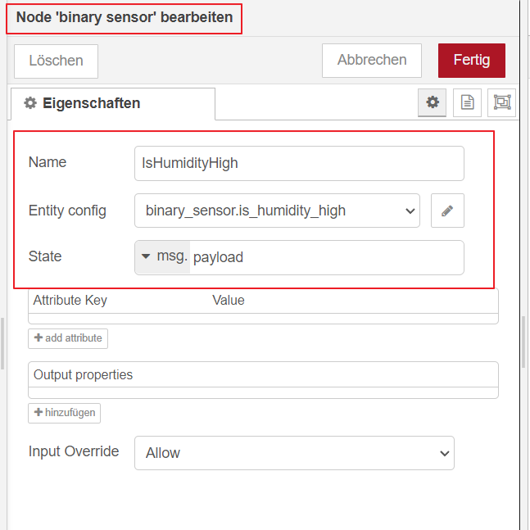
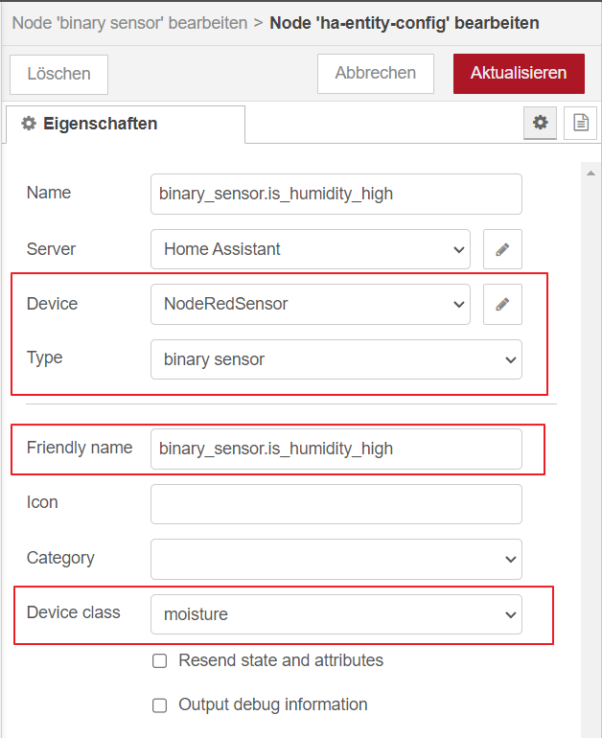
Entities per NodeRed anlegen

Slide 45
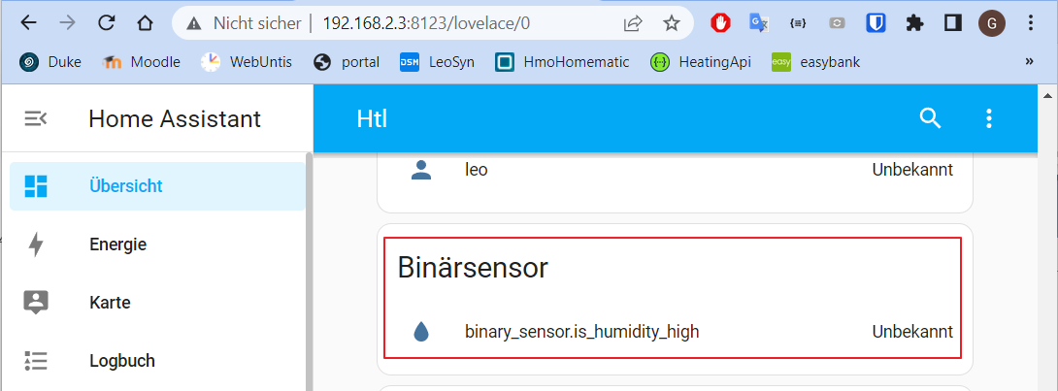
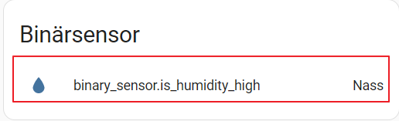
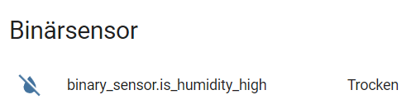
In HA verfügbar

Slide 46
Notifications
Benachrichtigungen sind wichtig für DevOp
Eingreifen, bevor es Ärger gibt
Actionable Notification
Viele Ziele
Handy über Companion-App
HA-Dashboard
Mail, Sms, …. Über Integrationen

Slide 47

HA-Notification
Wenn die Feuchtigkeit über 40% steigt, soll eine Benachrichtigung über HA ausgegeben werden
Bei App ➔ automatische Handy-Notification

Slide 48


call service - Node

Slide 49

Unterstützung nutzen

Slide 50


Test

Slide 51

Weitere Nodes
Comment
Events State als Trigger
Delay
Trigger
https://techexplorations.com/guides/esp32/node-red-esp32-project/node-red-trigger/

Slide 52


Debug-Output in Logs ausgeben
DebugNode konfigurieren
AddOns ➔ NodeRed Protokoll

Slide 53

Change Node ➔ Mapping …

Slide 54

… komplexe Pfade kopieren …

Slide 55

… und einfügen

