Slide 1


Android project 2021 MVVM NEWS APP
Group 8 – k17 Computer & embedded systems

Slide 2
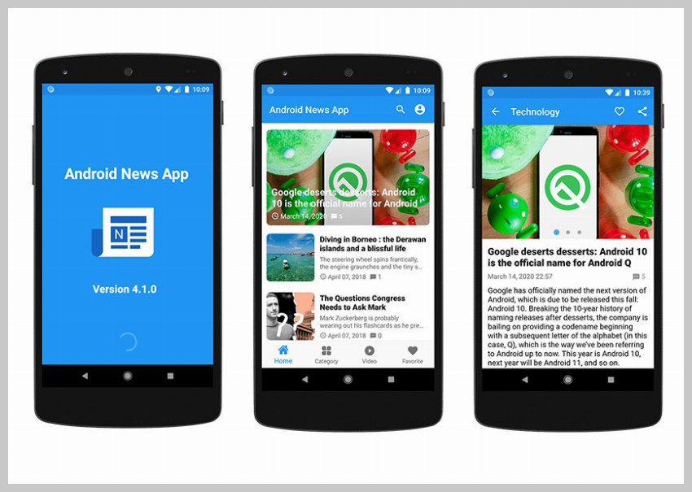
1. News APP – Examples template

Slide 3
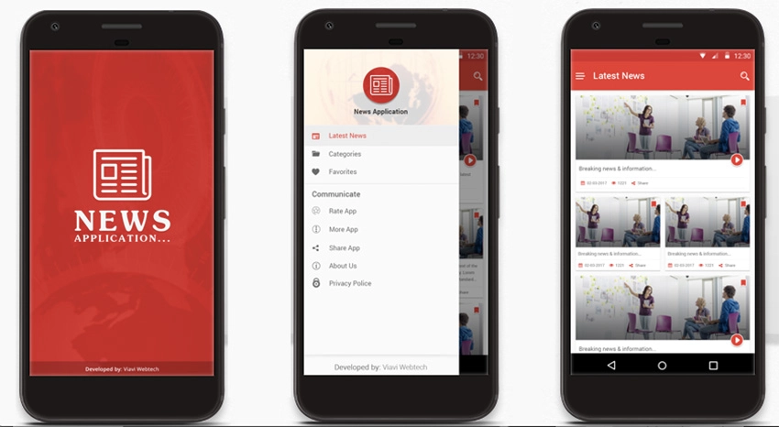

Slide 4
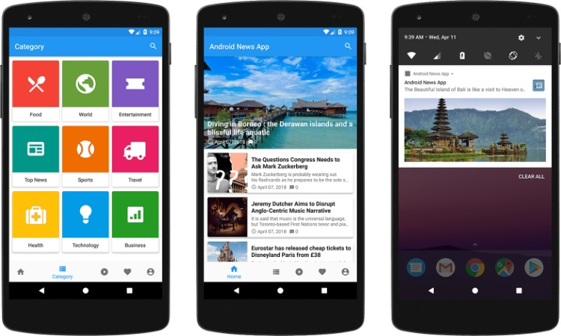

Slide 5
2. OUR PROJECT

Slide 6


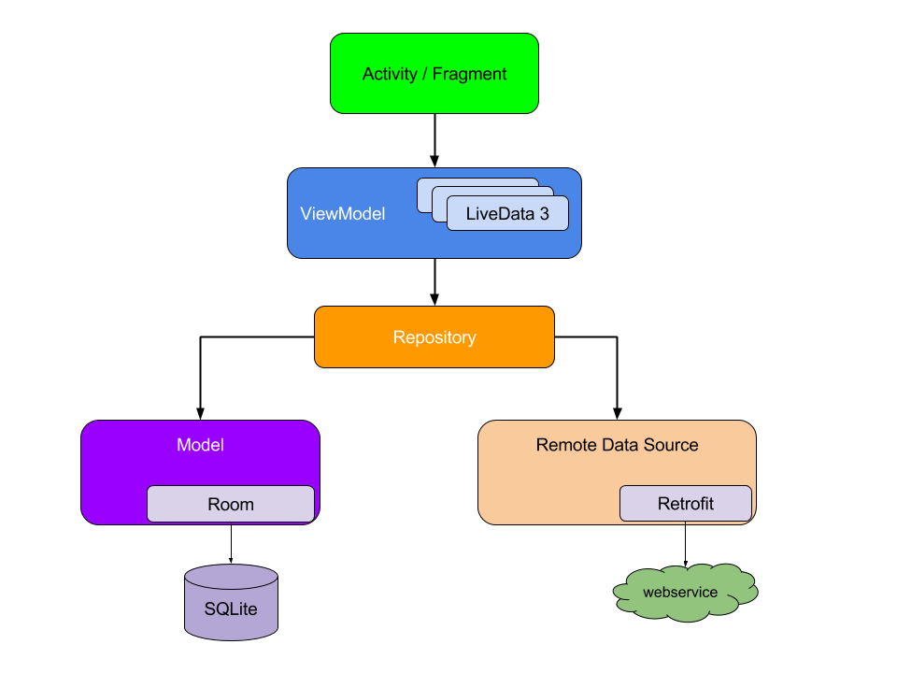
3. APP ARCHITECTURE

Slide 7
4. Navigation

Slide 8
5. Retrofit

Slide 9
6. Dao and article setup room

Slide 10
7. Database and room type converter

Slide 11
8. Recycleview with diffutil

Slide 12
9. Architectural skeleton

Slide 13
10. Handing breaking news response

Slide 14
11. Search news

Slide 15
12. Show articles in the webview

Slide 16
13. Adding and deleting articles to our room database

Slide 17
14. Handing pagination with retrofit

Slide 18
15. No internet checking

