Slide 1
CREDIT CARD FRAUD DETECTION
HENRY LAM & DANICE LONG

Slide 2
ABOUT THE DATASET
Original Dataset
From Kaggle
122 columns
307,511 rows
Cleaned Dataset
9 variables
Factorized discrete variables
Days of birth → Age in years
Notes:
Danice

Slide 3
SUMMARY STATISTICS
Target
282,686 no flag
24,825 flagged
Gender
202,448 females
105,059 males
4 not disclosed
Age
20 - 69 years old
Average: 43 years old
Income
$25,650 - $117,000,000
Average: $168,798
Credit Loan Amount
$45,000 - $4,050,000
Average: 599,026
Contract Type
278,232 cash loans
29,279 revolving loans
Car
202,924 clients own a car
104,587 clients do not own a car
Real Estate
94,199 clients own real estate
213,312 do not own real estate
Address Match: Contract/Permanent
302,842 do not match
4,657 match
Notes:
Danice
Target - indicates whether a client’s account was flagged for credit card fraud
Cash loan → Fixed , scheduled payments
Car loan, student loan, or mortgage
Revolving loan → clients take out varying amounts of money every month and manage their own personal cash flow
Credit loan
Address match - indicates whether the client’s address on the loan contract matched their permanent address

Slide 4
QUESTION
Can we predict whether a client will be flagged for credit card fraud based on the 9 variables we have selected?
Notes:
Danice

Slide 5
MOTIVATION
Build a risk analytics model that can be used in the banking sector to minimize the risk of losing money while lending to customers
Banks can gain customer trust and loyalty because customers will be confident their money is safe
Notes:
Henry

Slide 6
ANALYSIS
Logistic Regression
To predict the log odds of TARGET occurring, we used logistic regression on all our variables after cleaning and changing variable DAYS_AGE to AGE_YEARS. We set a threshold of 0.09 where anything greater receives a value of 1 for TARGET and 0 otherwise.
Decision Tree
With a decision tree model, we are able to pinpoint different ‘splits’ of decisions or outcomes based on our data set. We wanted to predict the outcome of being a ‘TARGET’ given the individual’s ‘AMT_CREDIT’, ‘AMT_INCOME_TOTAL’, and ‘CODE_GENDER’.
Clustering
We performed a K Means clustering algorithm using ‘euclidean’ as our distance metric. The idea here was for us to find distinct groups based on the variables “AGE_YEARS”, “AMT_CREDIT”, and “AMT_INCOME_TOTAL”.
We used a random sample of 1000 rows.
Notes:
Henry
With this regression model, after conducting cross-validation, we can get a sense of whether certain individuals demonstrate discrepancies in the system and could therefore ‘flagged’ as a target for fraud.

Slide 7
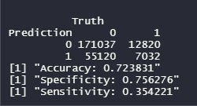
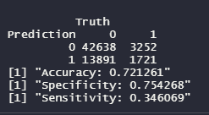
Logistic Regression
Training Confusion Matrix:
Testing Confusion Matrix:
Notes:
Henry

Slide 8
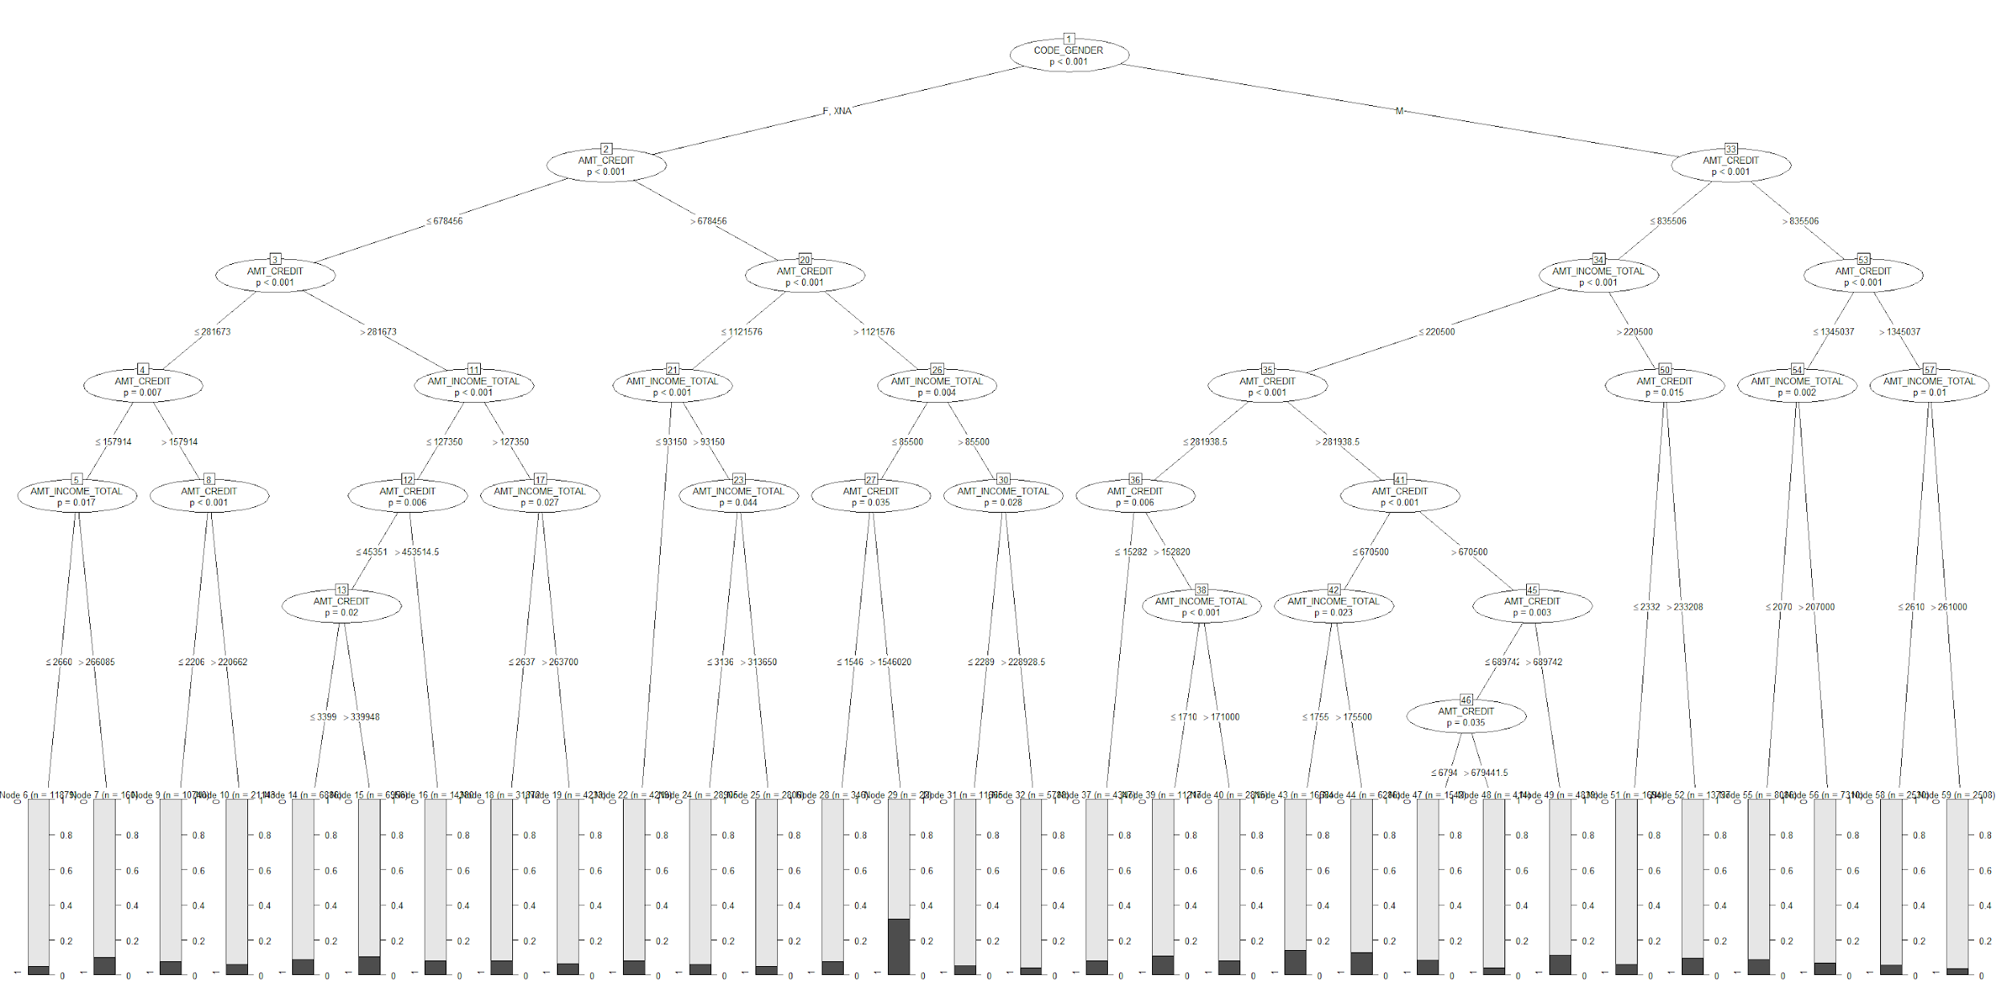
Decision Tree
Notes:
Danice
Decision Tree
Highest Probability
Female & NA
Loan Amount >$1,546,020
Income <=$85,500
Group with the lowest probability of getting flagged for credit card fraud
Male
Loan Amount >$1,345,037
Income >$261,000

Slide 9
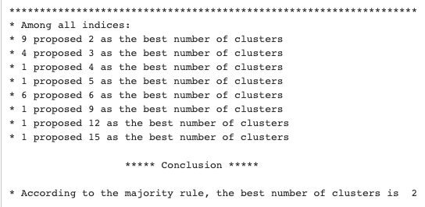
Clustering using Gap Statistics
Notes:
Danice
Used NbClust to compare all 24 statistical methods to find the optimal number of clusters
The results of this function indicated that 9 out of the 24 models, proposed 2 as the optimal number of clusters

Slide 10
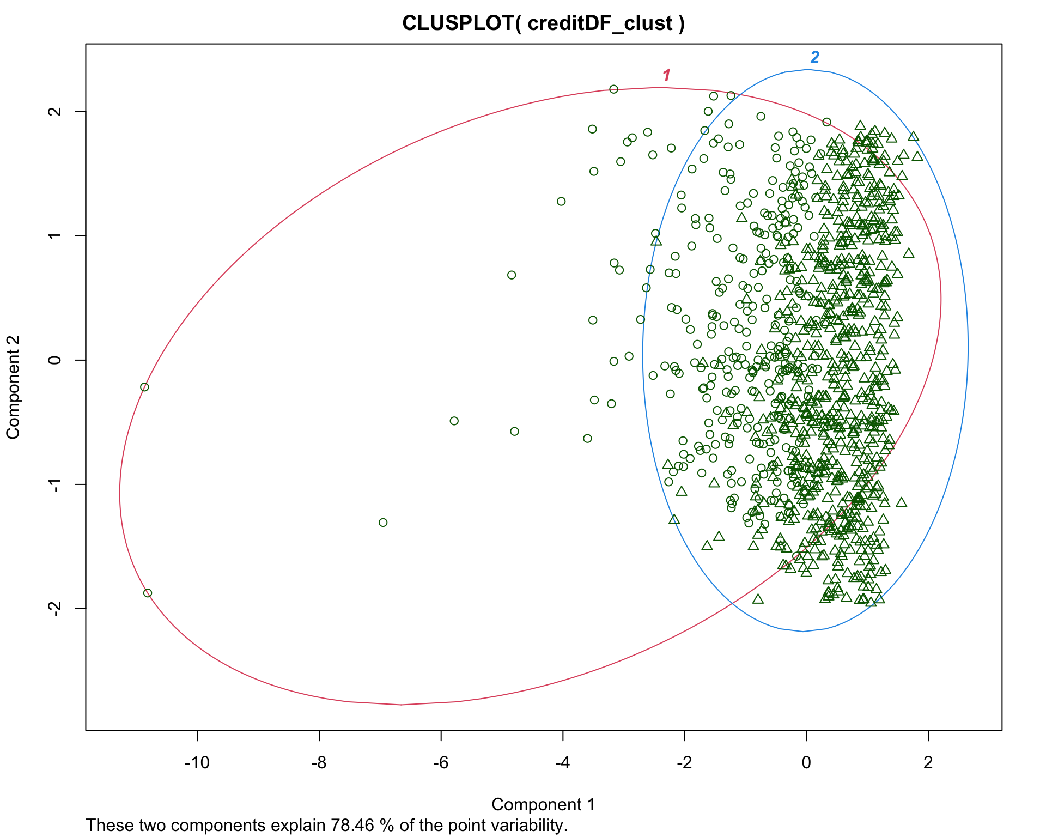
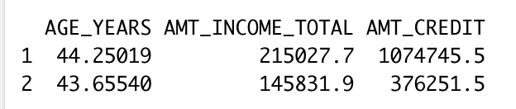
Notes:
Henry

Slide 11
COMPARISON OF PERFORMANCE
Logistic Regression
Accuracy: 72% for training & testing
Specificity high, sensitivity low
May be cause by threshold
Model requires for inputted threshold.
Trade Offs
Decision Tree
Highest Probability(30%)
Female & NA
Loan Amount >$1,546,020
Income <=$85,500
Lower Probability (~2%)
Male
Loan Amount >$1,345,037
Income >$261,000
K Means Cluster
Implications that there may not be distinct age groups that demonstrate likelihood of fraud.
Only a fraction of the whole data set
Notes:
Henry

Slide 12
CONCLUSION
Succeeded in building predictive models based on the 9 variables we have chosen
Best: decision tree → more specific/applicable
Failed to find distinctive clusters in our dataset
In the future…
Use more or different variables to run the same models → compare results
Notes:
Danice

Slide 13
THANKS FOR LISTENING!

