Slide 1
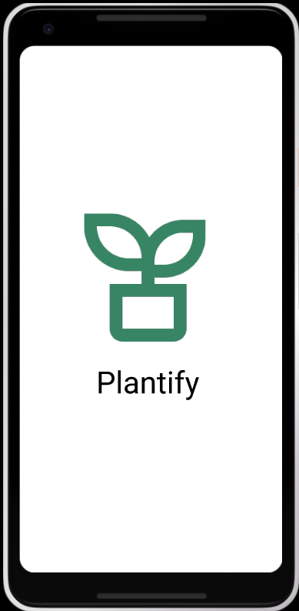
Plantify
Bringing nature closer

Slide 2

Problem
In this busy world people are so invested in their work, social media that the concept of having “me time” has vanished and it has been a root cause of anxiety and depression in most of our lives.
And eventually it is also the leading cause of shorter life span , drug and addictions and having short temper.
Notes:
In colleges when ever an event is announced we often see that our WhatsApp groups start getting spammed by the members of various clubs and after some point of time it really gets monotonous to see same kind of messages everyday. Most of the time these are the events in which many of the students are not interested, or we see messages by the dominating societies only.

Slide 3
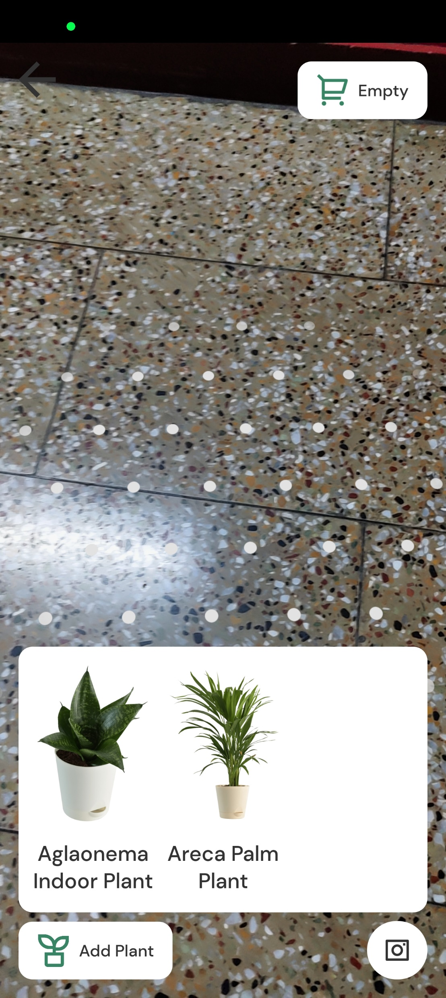
Solution
According to a study GARDENING has been helping people out fighting loneliness, decreasing dementia risk , providing good exposure to vitamin D and many more.
Then why people are not doing it?
Well , it is a time-consuming task and requires a lot of patience. Also people need to really take good care of the plant and also need to have knowledge about it.
So we came up with this app called Planitfy which manages all the tedious job, and you can just enjoy a peaceful mind.

Slide 4
What is Plantify
So it is an application which allows you to set up your garden and we at the other end handle all the tedious things. The app allows user to select plants and pots. Test it and place an order for it.

Slide 5
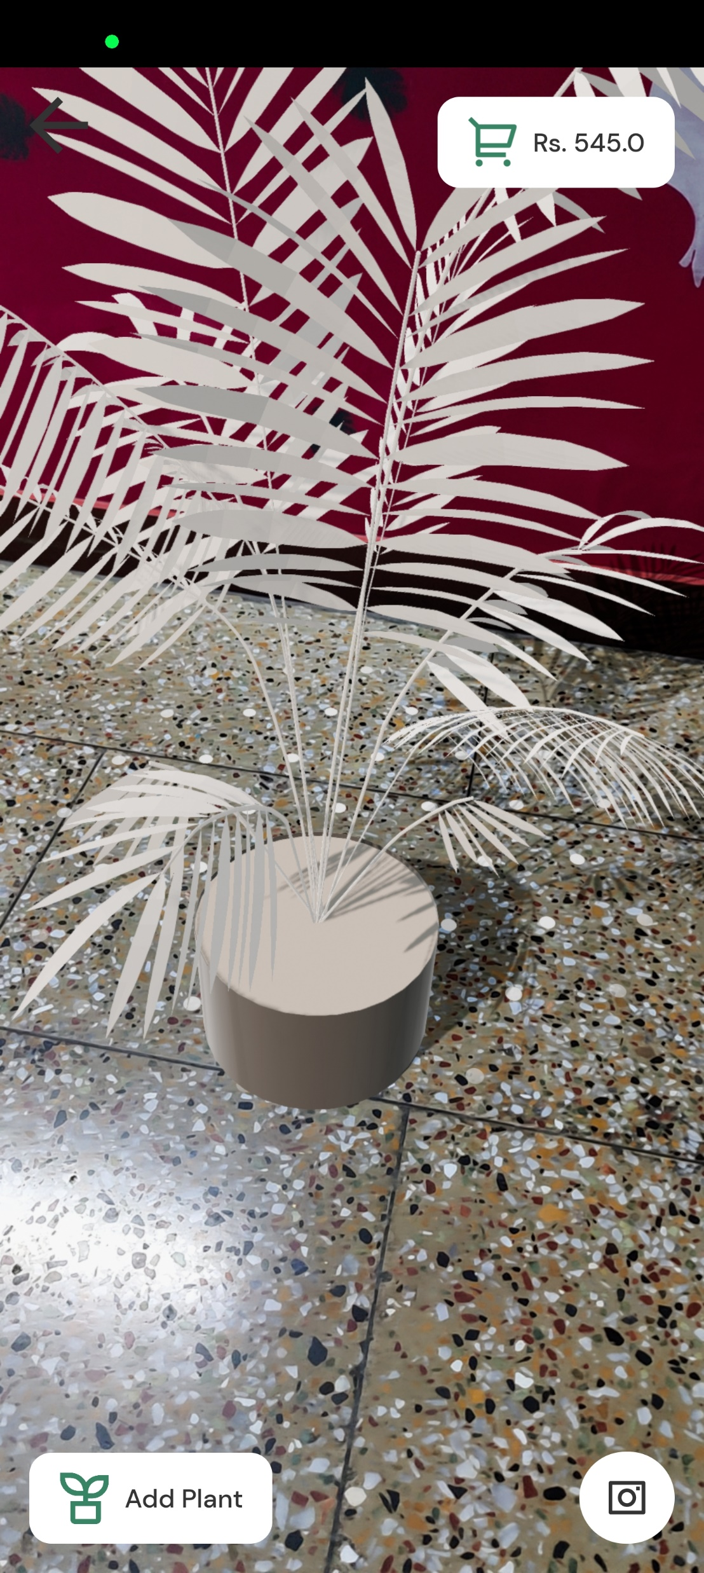
See before you buy
With the help of AR user can see how their garden will look before ordering a plant.

Slide 6
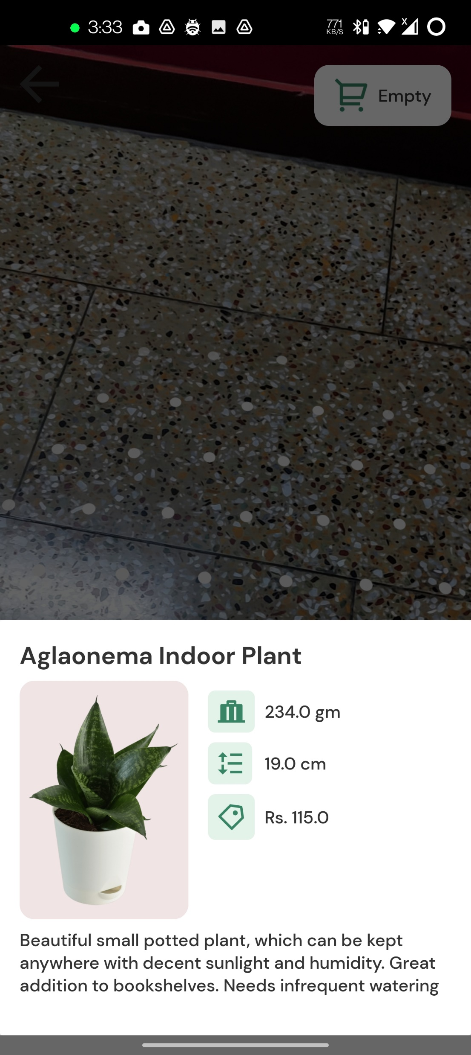
Get info about
So our system filters out the season plants and if anyone wants to find out more about the plants then they can simply click on the image and get entire information about it.

Slide 7
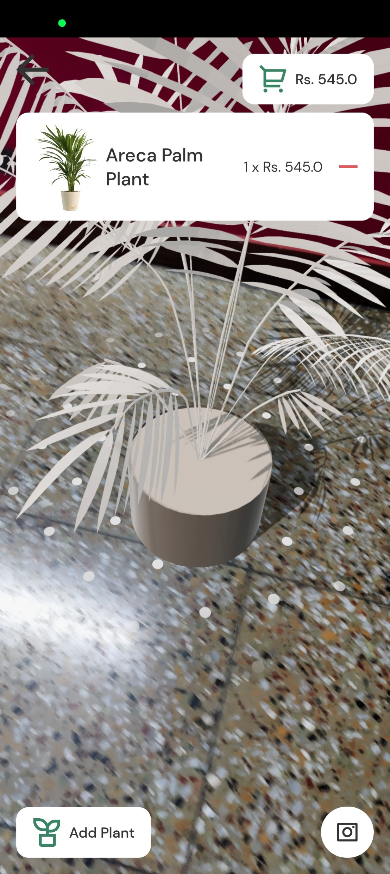
Easy Buy
Happy with your garden, then just click on buy button. And instead of sending you the seeds we send you the entire flower pot.

Slide 8
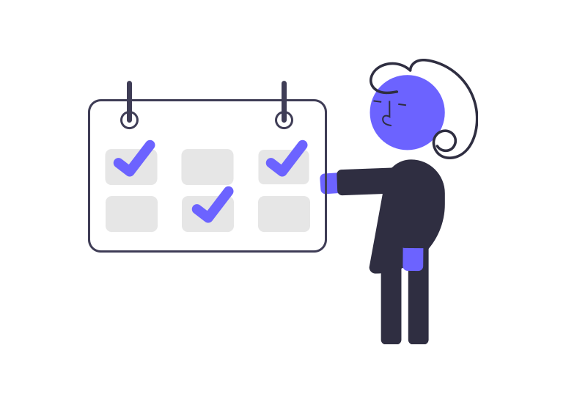
Future
We are planning to have a personnel schedule for each user in which on the basis of the plants that were purchased , we will keep a track of it and prepare schedule to water your plants and sending our professionals for monthly inspections.

Slide 9
STAY HAPPY KEEP Plantify

