Slide 1

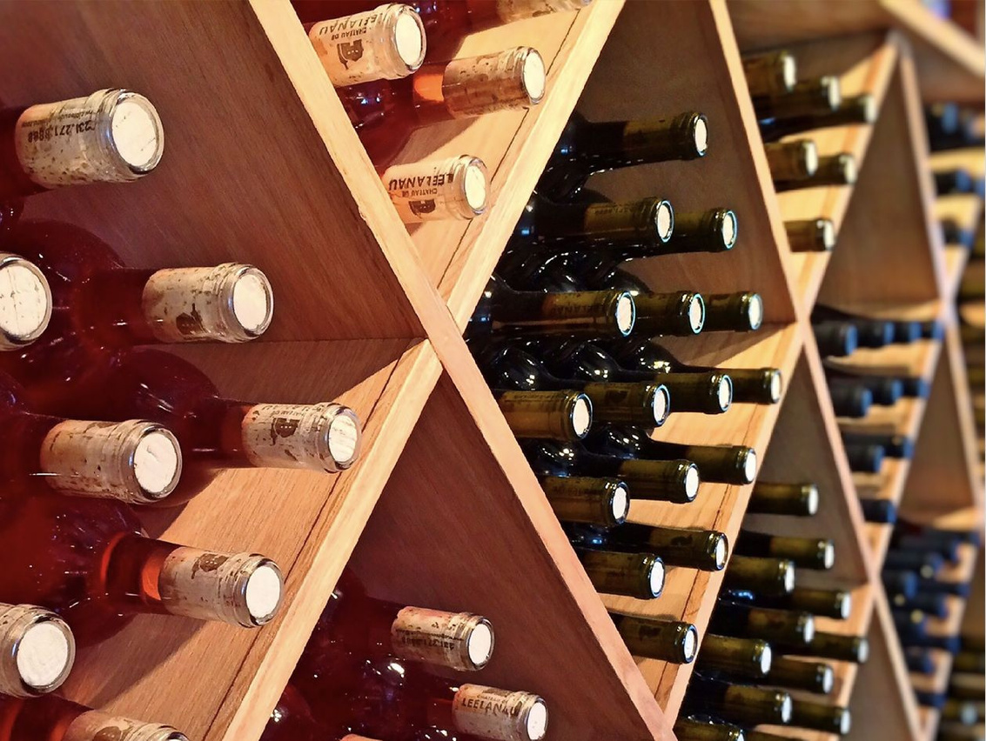

Slide 2

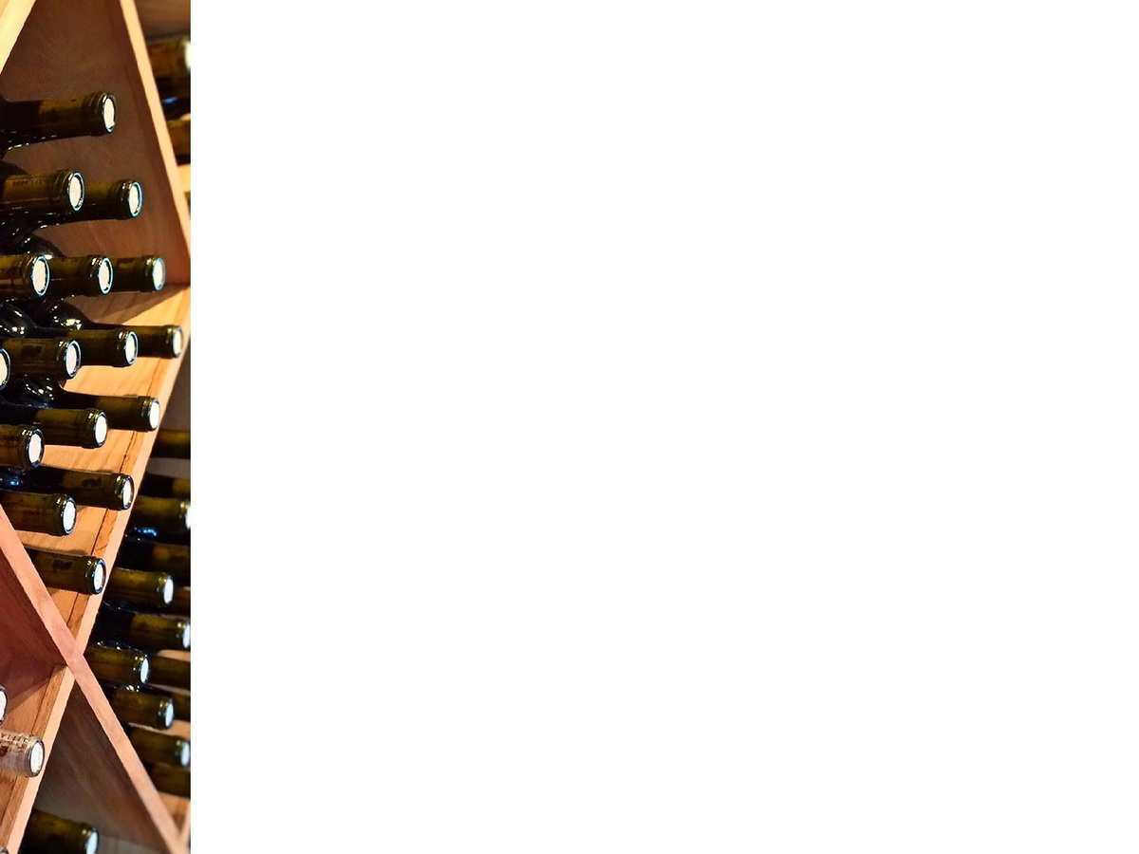

Red Wine Quality
Presented by
Faymin Chen

Slide 3


Introduction:
The wine industry is highly competitive and saturated with many different varieties and blends for
the consumer to choose from. As such, many wine rating websites have popped up such as Wine
Enthusiast and Vivino, which help customers separate the gems from the chaff. For a winery, it’s
important for them to invest in wines that are going to get high ratings so that they can recoup their
investments.

Slide 4
Objective:
This project will use Red Wine Quality Data Set, available on the UCI machine learning
repository https://archive.ics.uci.edu/ml/datasets/wine+quality/winequality-red.csv
to perform binary classification for wine quality using ML Algorithm.
The goal of this project is to determine wine quality based on its chemical properties.
It is important especially for small brewery to correctly identified high quality wine from the rest.
We want to minimize incorrectly classify low quality wine as high quality.
We wanted a model that perform better than average so the wine breweries can stay ahead of
competition. It will help the executive, directors, managers to understand their business and change strategy, make decision using a data driven approach.
We summarized our findings and insights gained from analyzing the red wine dataset, and evaluate model performance of both Logistic Regression and Random Forest Classifier. Finally, we choose the
best model for our wine quality prediction

Slide 5
Methodology:
Load the Dataset: The Red Wine Quality dataset is loaded using the pd.read_csv() function. The head() and info() methos are used to display the first few rows and get information about the dataset respectively.
Knowing the Dataset: Basic information about the dataset is generated; there are no categorical attributes, they are all numeric.
Data Cleaning: no duplicate values found, and no missing values
Data Visualization: Seaborn library is used to visualize the data
Data Preprocessing: The target variable ‘Quality' is further categorized and renamed to ’hi_quality’. Red wines with quality score higher than 6 will be classified as hi_quality = 1, score >=6 will be classified as hi_quality = 0 since we are performing binary classification. We scaled our features using Standard Scaler since the data has varying scales.
- Splitting the Dataset: The dataset is split into training and testing sets using the train_test_split() method from
scikit-learn.
Implementing Machine Learning Algorithms: Logistic Regression and Random Forest classifiers are
initialized and trained using the training data.
Model Evaluation: AUC ROC score and confusion matrix (precision, recall, F1 score) are computed to evaluate the
performance of each algorithm on the testing data. We also performed threshold adjustment which is preferred method over undersampling or oversampling when dealing with imbalanced data
Results: The results, including the AUC ROC score and confusion matrix, are printed for each algorithm.

Slide 6

Data Overview:
The dataset related to red wine samples, from the north of Portugal. The goal is to model wine quality based on physicochemical tests (see [Cortez et al., 2009], http://www3.dsi.uminho.pt/pcortez/wine/).
Additional Information
The dataset is related to red variants of the Portuguese "Vinho Verde"* wine. For more details, consult: http://www.vinhoverde.pt/en/ or the reference [Cortez et al., 2009]. Due to privacy and logistic issues, only physicochemical (inputs) and sensory (the output) variables are available (e.g. there is no data about grape types, wine brand, wine selling price, etc.). These datasets can be viewed as classification or regression tasks. The classes are ordered and not balanced (e.g. there are many more normal wines than excellent or poor ones). Outlier detection algorithms could be used to detect the few excellent or poor wines. Also, we are not sure if all input variables are relevant. So it could be interesting to test feature selection methods.
*Portuguese wine that originated in the historic Minho province in the far north of the country

Slide 7

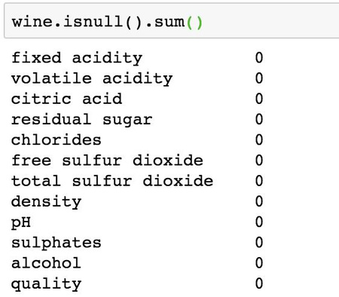
Features:
● ● ●
●
●
●
●
●
●
●
●
Fixed acidity Volatile acidity Citric acid
Residual sugar
Chlorides
Free sulfur dioxide
Total sulfur dioxide
Density
PH
Sulphates
Alcohol
We have clean dataset, no duplicates and no missing values

Slide 8

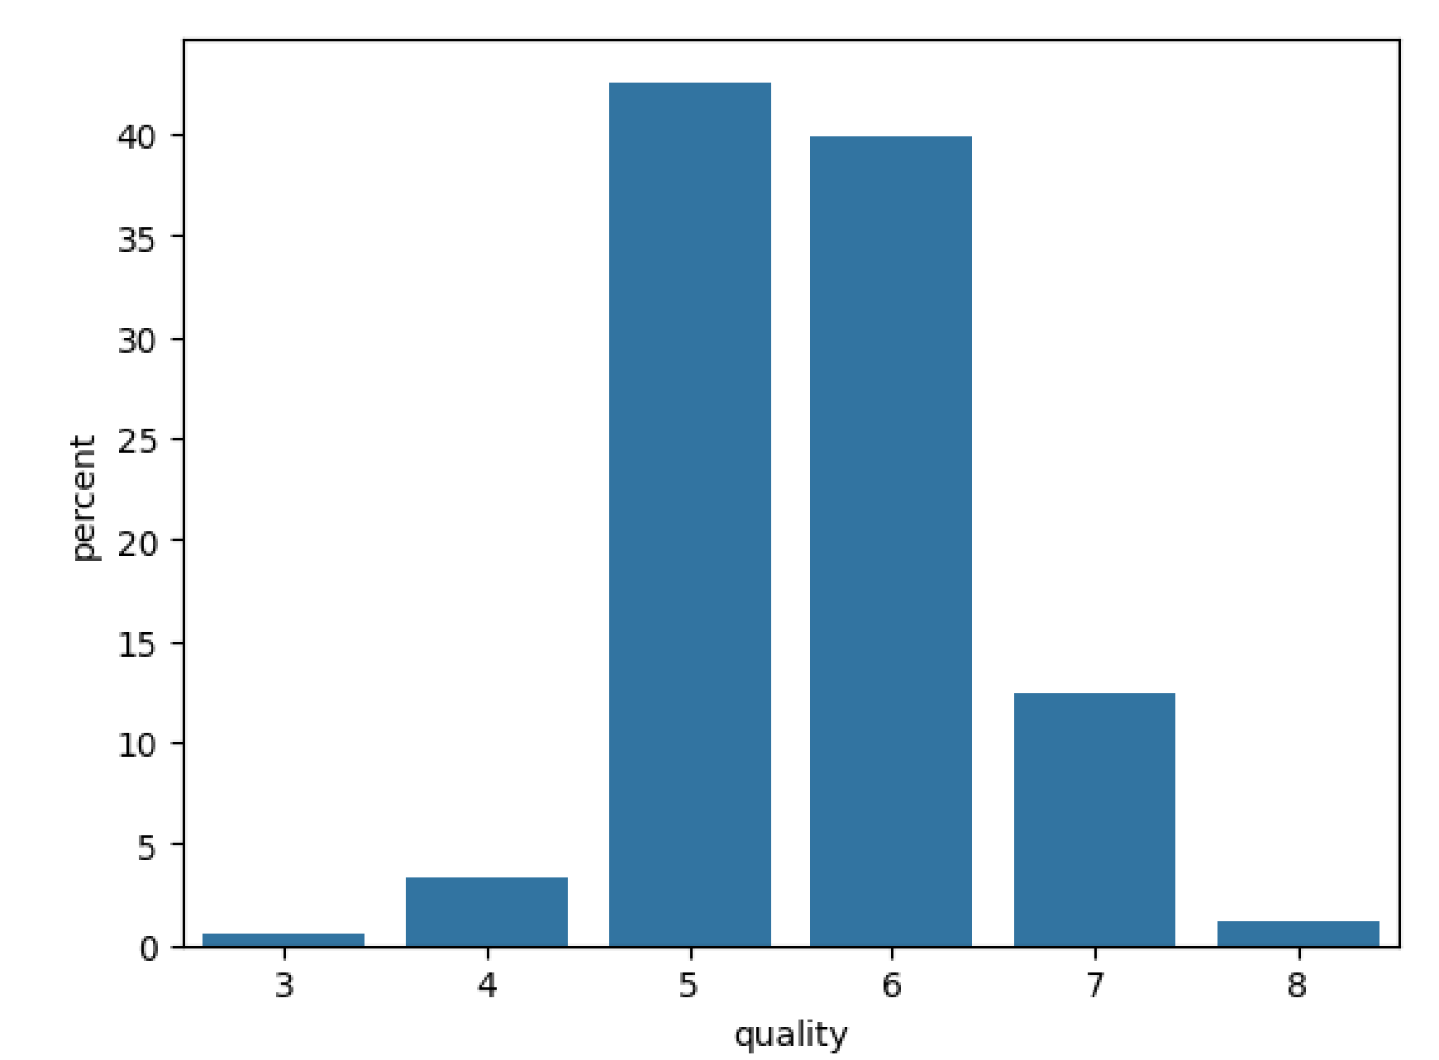
Label Distribution
● ●
Quality is represented by scores ranging from 0 to 10 0 is the worst and 10 is the best
The dataset consists of mostly mediocre wine quality

Slide 9

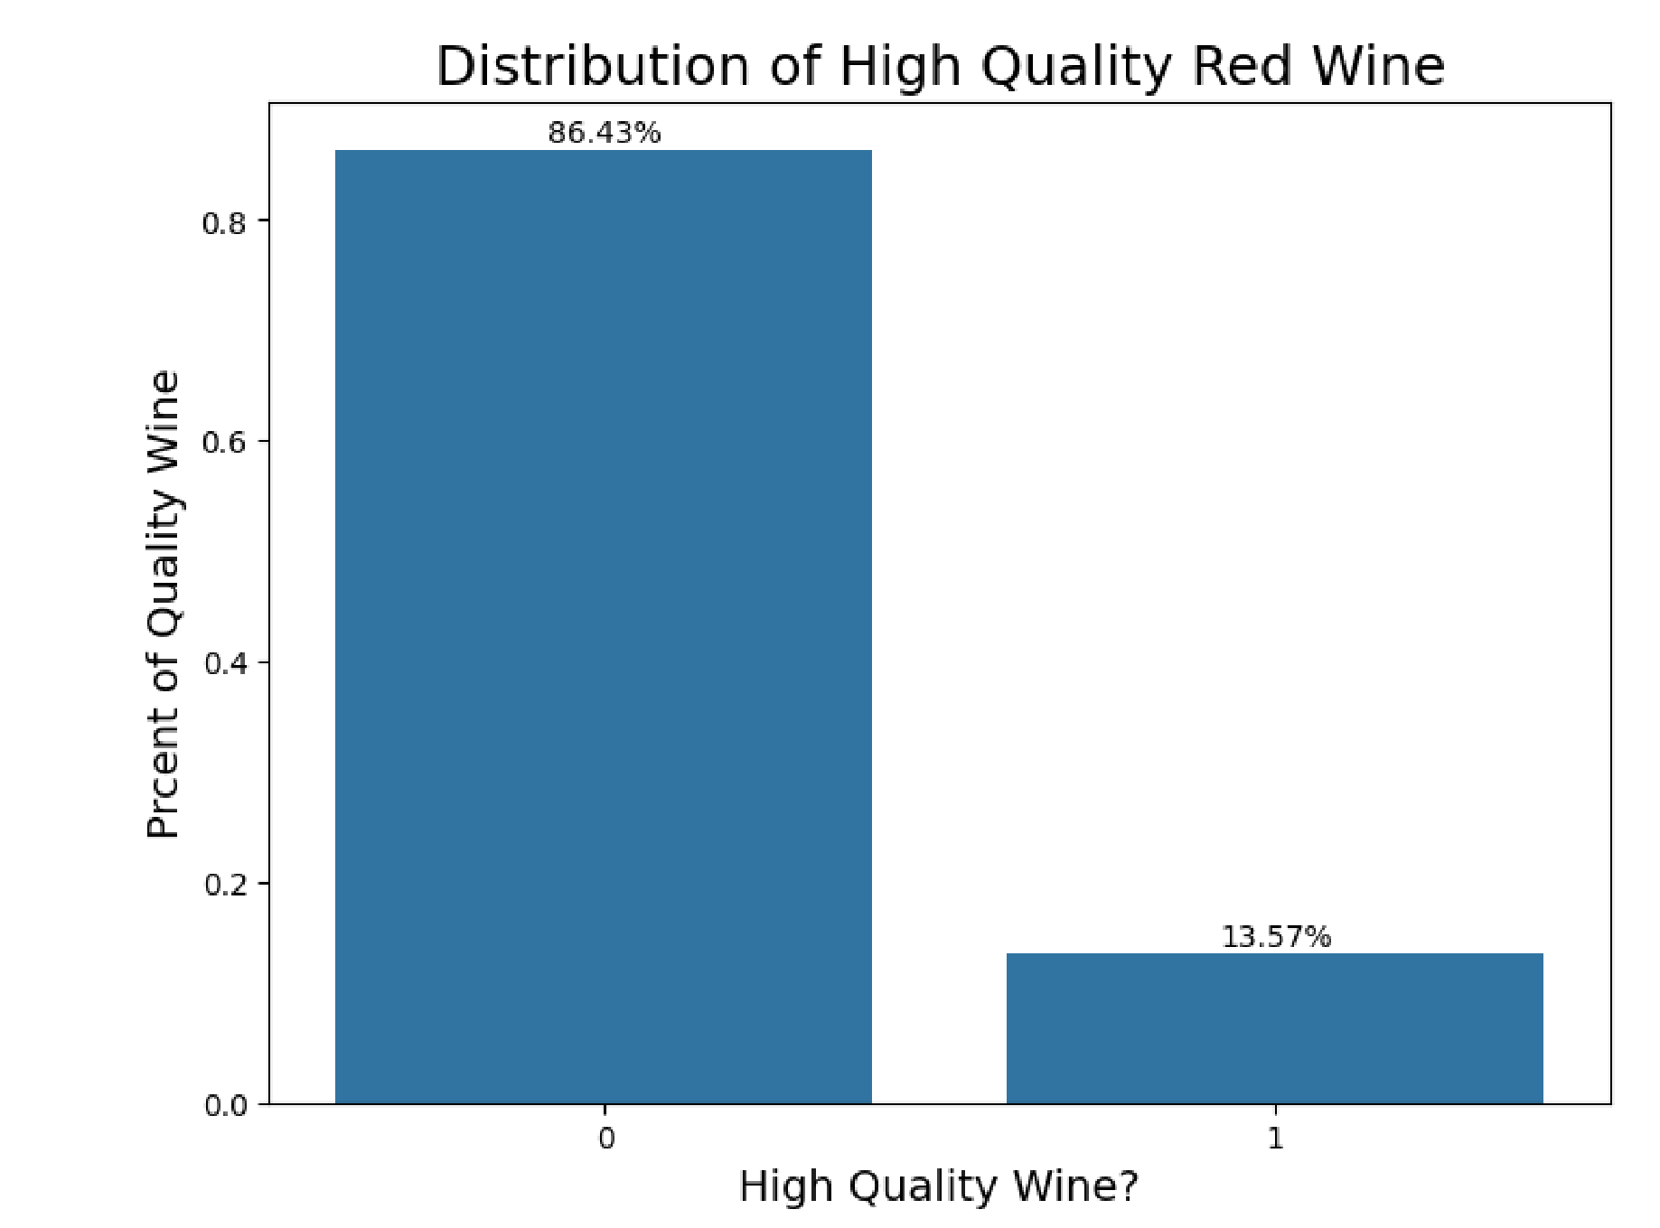

Labels and Encoding
●
Binning:
○ ○ ○
score under 6 → “Low quality
Score above 6 → High Quality

Slide 10

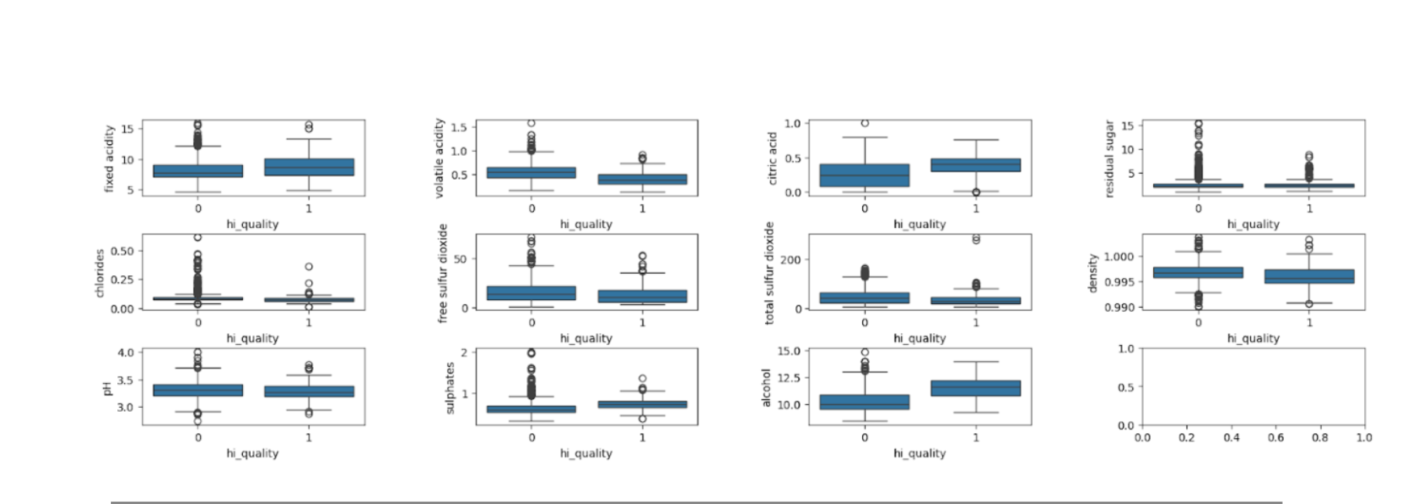













Slide 11
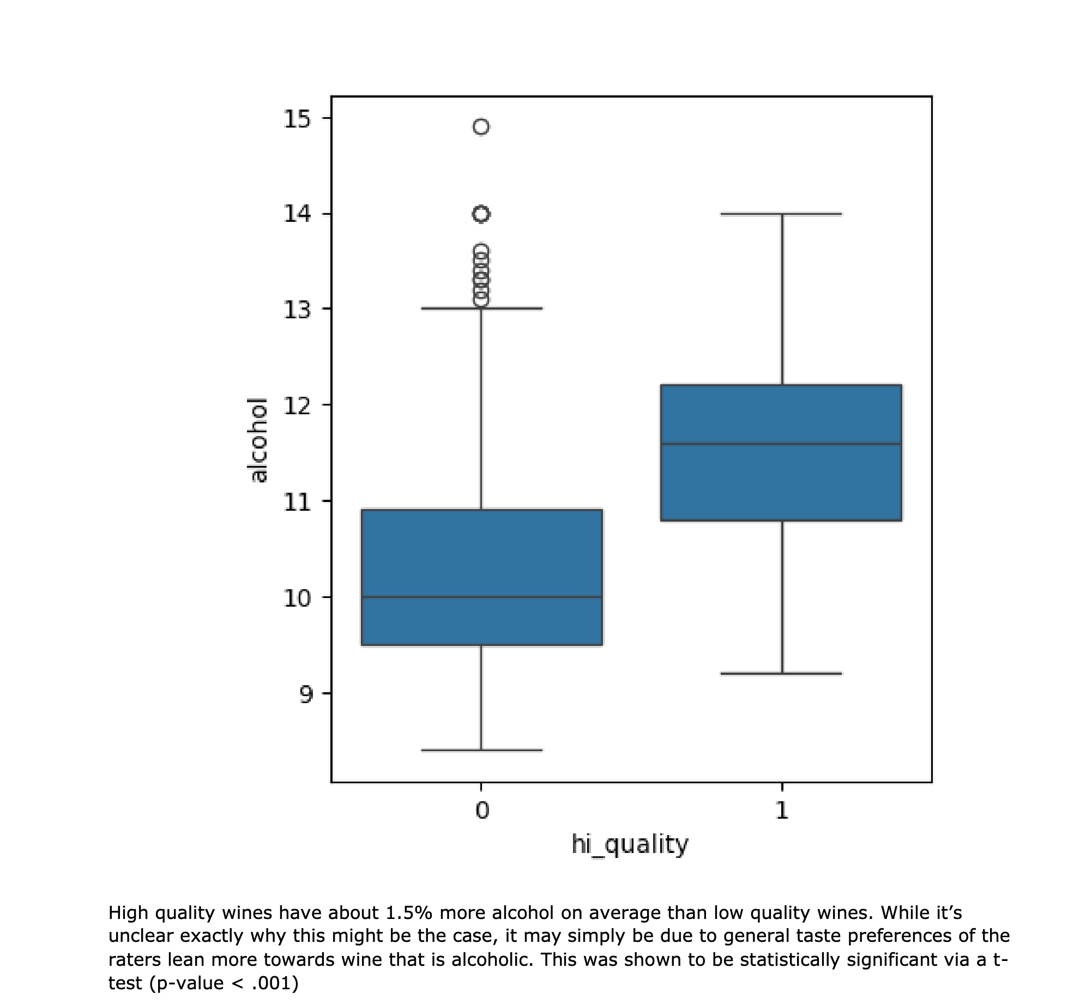
hi_quality vs alcohol

Slide 12
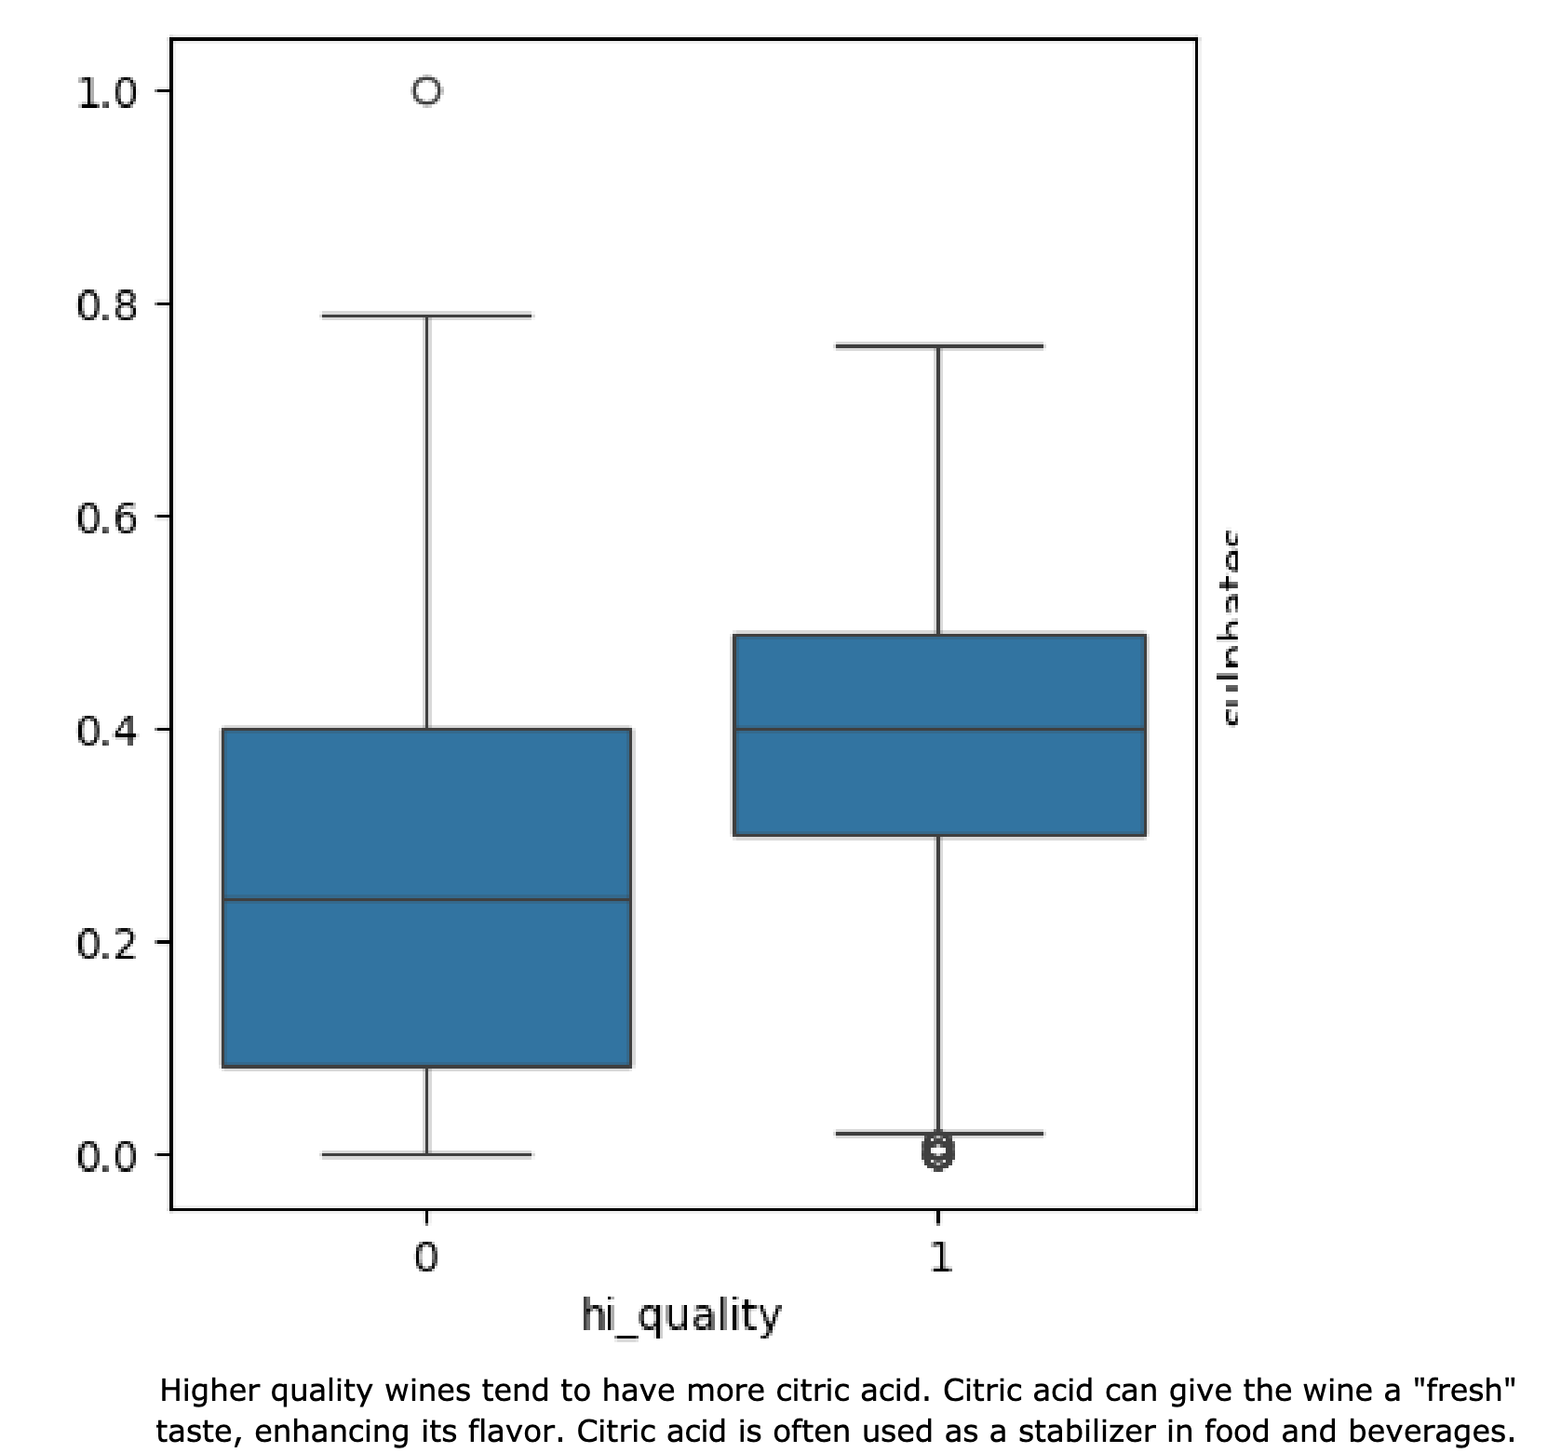
hi_quality vs citric acid

Slide 13
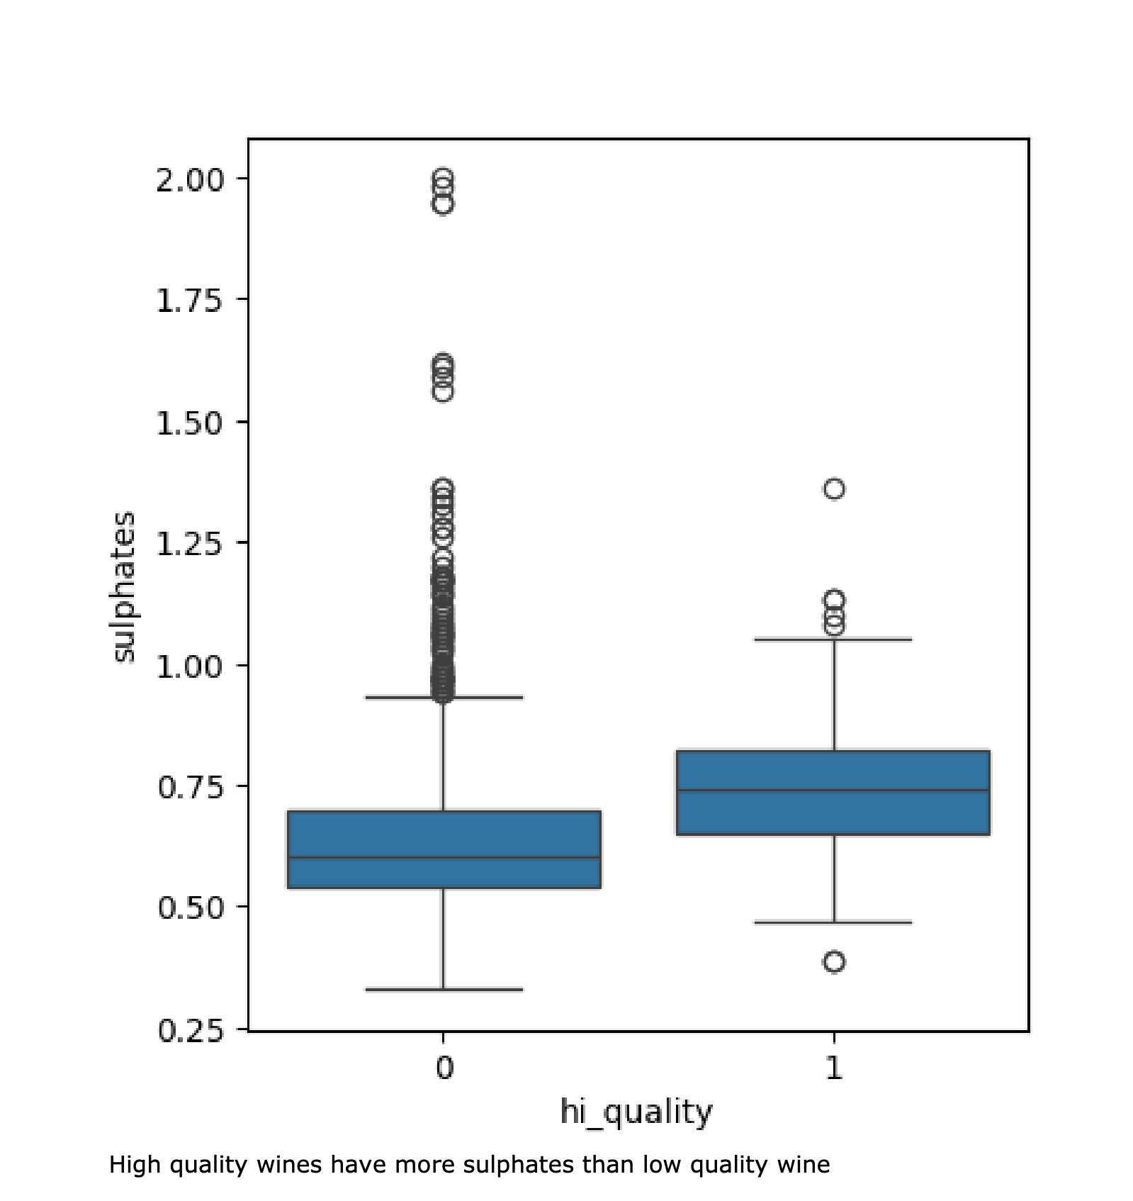
hi_quality vs sulphates

Slide 14
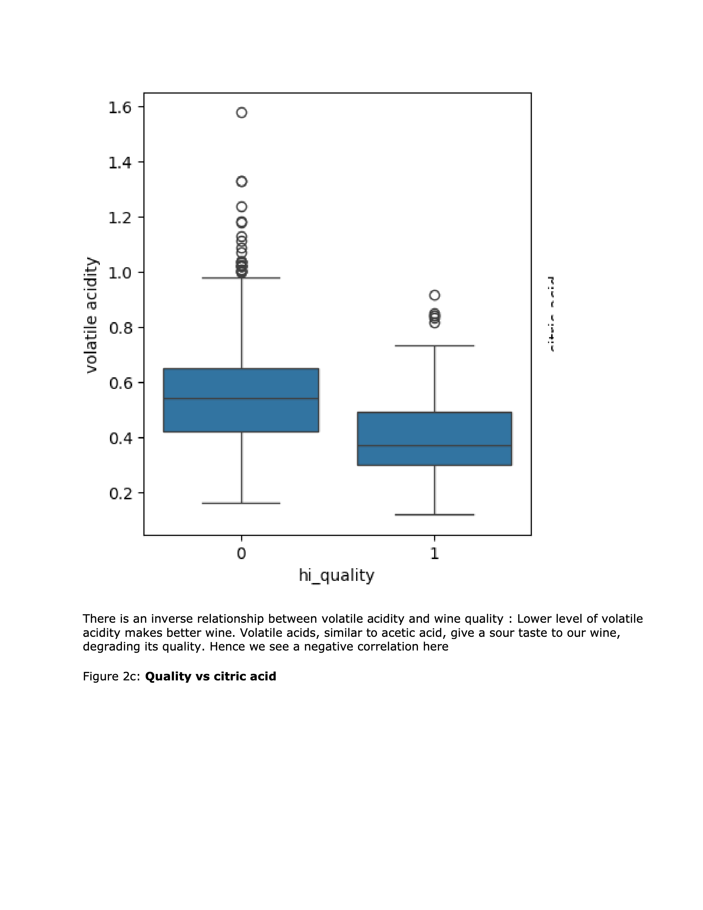
hi_quality vs volatile acidity

Slide 15
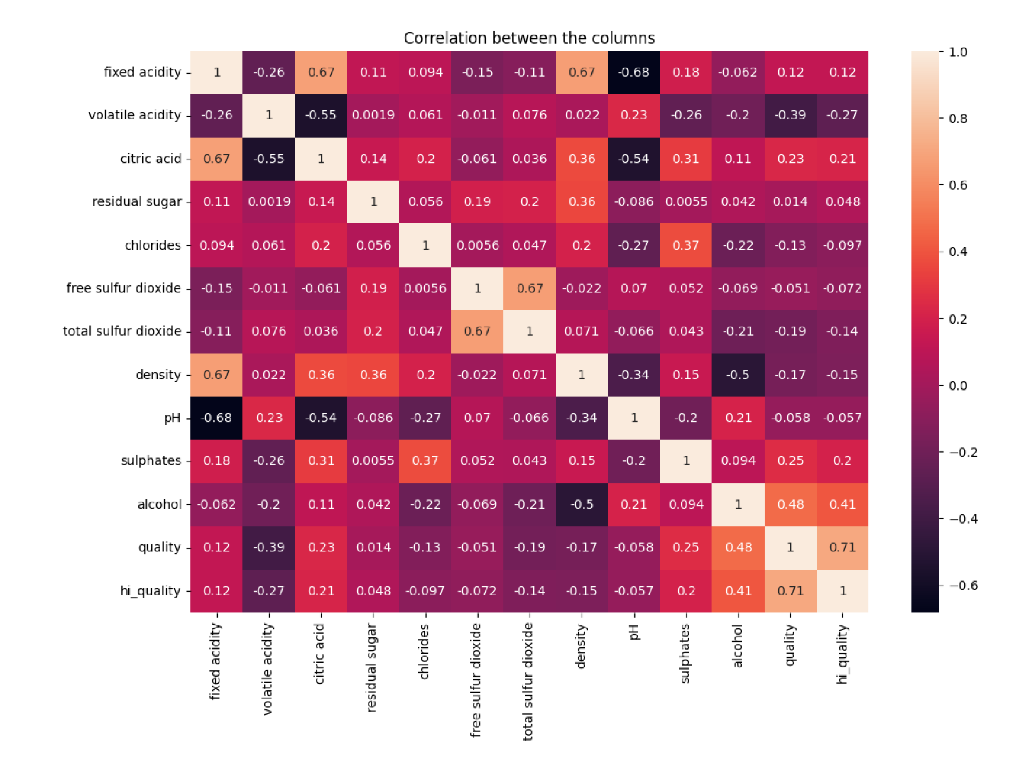

Variable Correlation Matrix

Slide 16
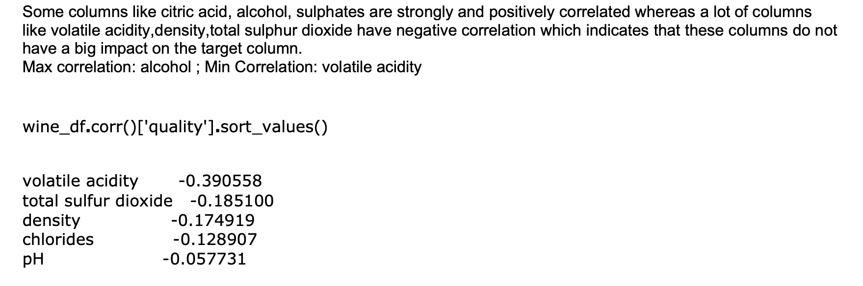
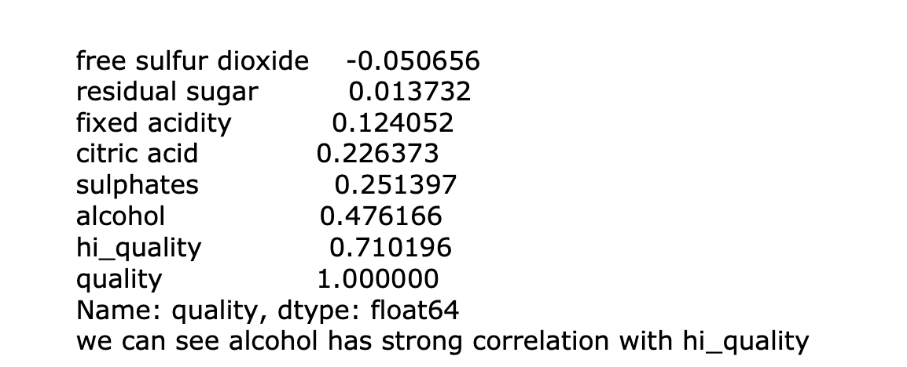
Variable Correlation Matrix

Slide 17
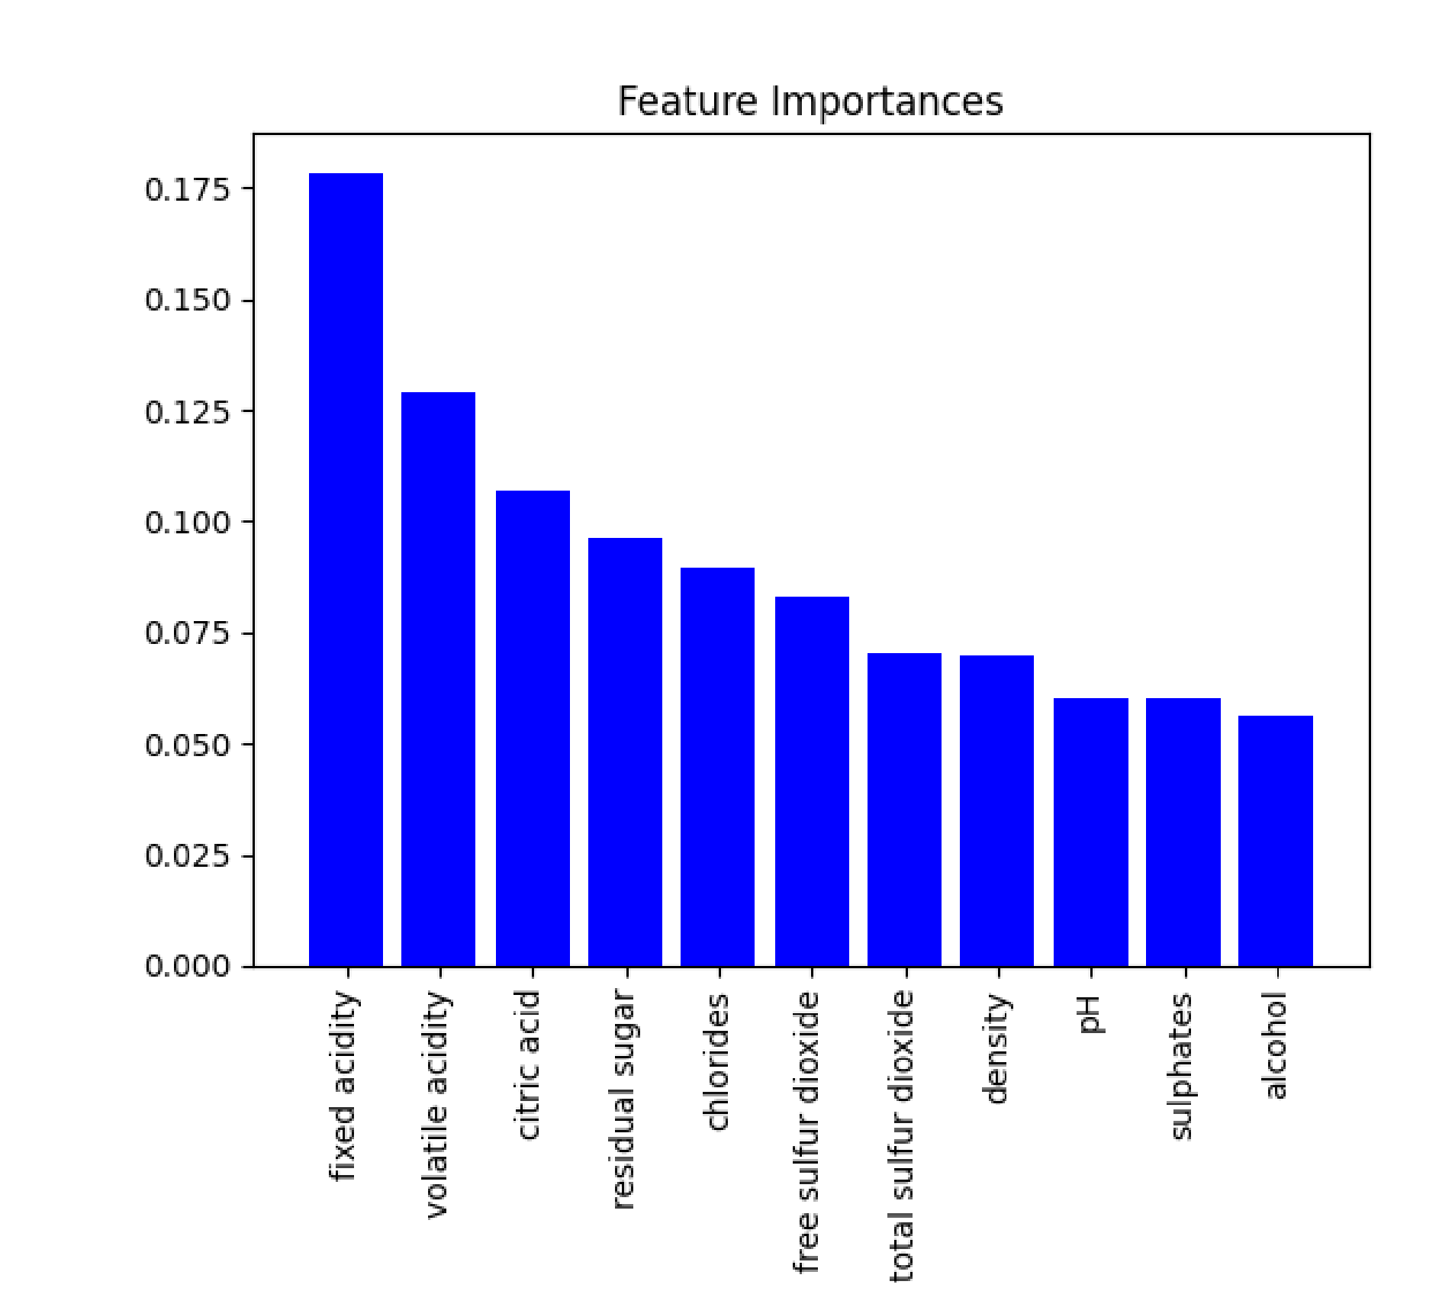
Features Importance from Random Forest

Slide 18

Modeling Process
Split data into train and test set and perform scaling
# Splitting the dataset into the Training set and Test set
from sklearn.model_selection import train_test_split
X_train, X_test, y_train, y_test = train_test_split(X, y, test_size = 0.2, random_state = 42) # Feature Scaling
from sklearn.preprocessing import StandardScaler
sc = StandardScaler()
X_train2 = sc.fit_transform(X_train)
X_test2 = sc.transform(X_test)

Slide 19
Logistic Regression Model
lr=LogisticRegression(solver='liblinear').fit(X_train2, y_train)
# Predicting Test Set
pred_test = lr.predict(X_test2) from sklearn.metrics import confusion_matrix, accuracy_score, f1_score, precision_score, recall_score
test_accuracy = accuracy_score(y_test, pred_test)
test_cf_matrix=confusion_matrix(y_test, pred_test) test_cl_report=classification_report(y_test,pred_test)

Slide 20
Logistic Regression Model
A logistic regression model is used for predicting classes using the probability of the target variable. Unlike linear regression, which uses expected values of the response model, logistic regression uses the probability or odds of the response variable to model based on the combination of values taken by the predictors. This model uses the sigmoid function that maps predicted values to probabilities.
It works well on linearly separable classes with easy implementation, making it a popular choice for classification problems.
There are two types of logistic regression models for classification: binary and multinomial.
Binary logistic regression requires a dependent variable with only two possible outcomes
whereas a multinomial requires three or more outcomes. In this case, the dataset is working with
binary logistic regression since the target variable is binary (1 or 0). Logistic regression is
applicable to this problem since we want to predict the probabilities and classify the red wine
quality into two categories based on the explanatory variables. For the solver in the logistic
regression model, liblinear is picked since it supports both L1 and L2 regularization.
We first tried to build a logistic regression model, which is specifically designed for binary
classification problems and is the most straightforward model in our case. And we also
performed hyperparameter tuning via GridSearchCV to improve the result of our model.

Slide 21
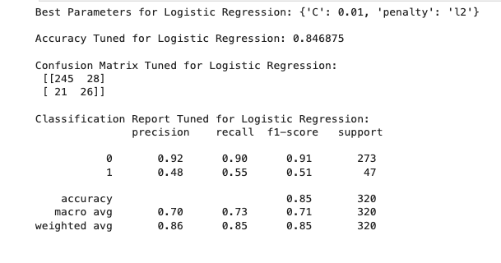
Logistic Regression Model

Slide 22
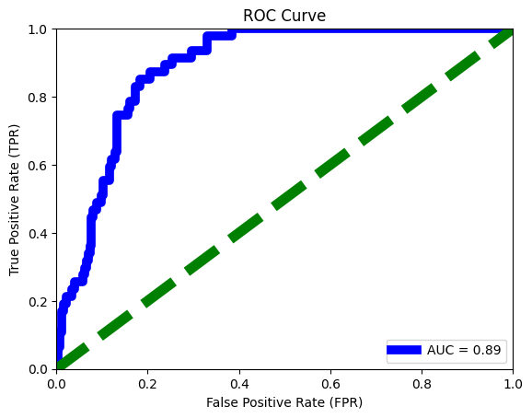
Logistic Regression Model

Slide 23
Random Forest Model
RF_model=RandomForestClassifier(n_estimators=100, bootstrap=False) RF_model.fit(X_train2,y_train) y_test_pred=RF_model.predict(X_test2) y_train_pred=RF_model.predict(X_train2)
train_accuracy=accuracy_score(y_train,y_train_pred) train_cf_matrix=confusion_matrix(y_train,y_train_pred) train_cl_report=classification_report(y_train,y_train_pred) test_accuracy=accuracy_score(y_test,y_test_pred) test_cf_matrix=confusion_matrix(y_test,y_test_pred) test_cl_report=classification_report(y_test,y_test_pred)

Slide 24
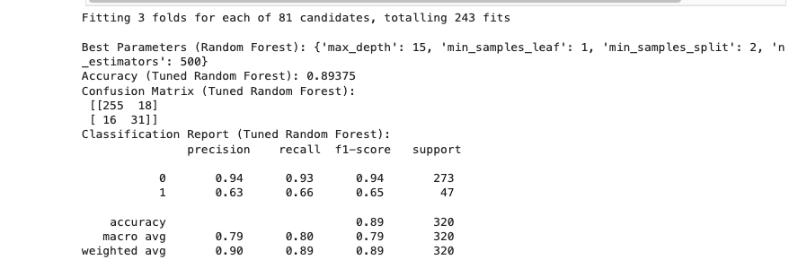
Random Forest Model

Slide 25
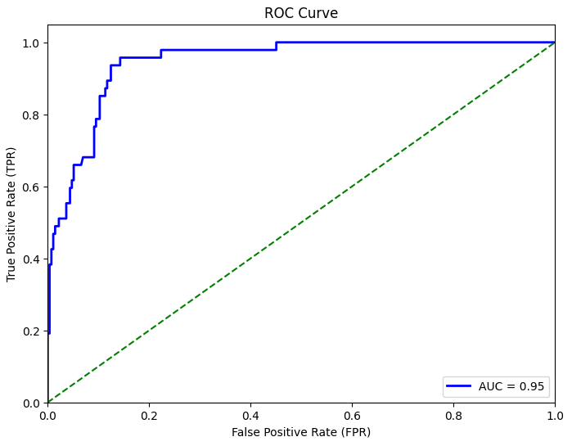
Random Forest Model

Slide 26

Conclusion
Our Random Forest model perform much better than the Logistic Regression model, suggesting there is a complex, non-linear relationship between the features and hi quality target variable.

