Slide 1


Slide 2
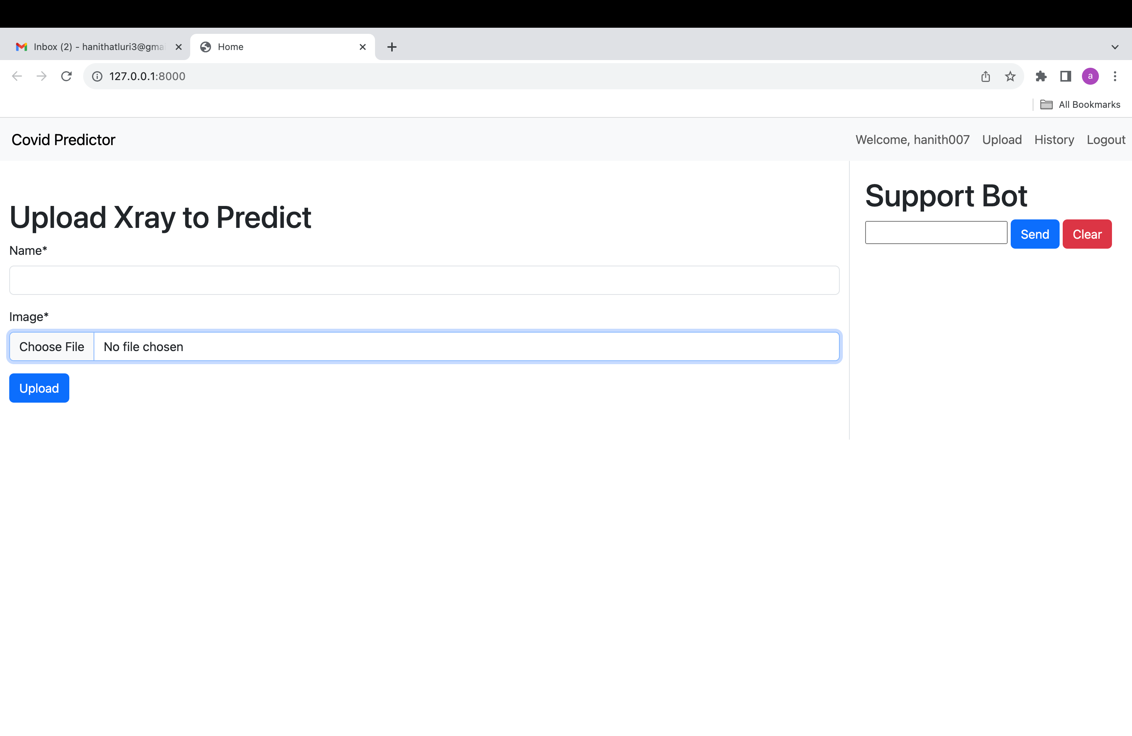
MVP-Minimum viable product
With this project's minimum viable product (MVP), we will be able to upload a CT-scan document from a patient with chronic obstructive pulmonary disease in order to verify the report's current status.

Slide 3
Convolutional Neural Networks (CNNs):
CNNs are able to identify COVID-19 and other medical disorders automatically by learning important features straight from the X-ray pictures. However, the quality and amount of the training data, as well as the network design, can have a significant impact on a CNN's performance. Therefore, it is crucial to conduct extensive validation and assessment prior to use CNNs for medical image processing, particularly in hospital settings.
Convolutional layer
Pooling layer
Convolutional layer
Pooling layer
Fully-connected layer
Output/prediction
Input

Slide 4
Team velocity(Sprint-05)

Slide 5
Team’s average velocity

Slide 6
Burndown chart

Slide 7
Retropective
WELL DONE THINGS- We've improved our deliverable by including additional amenities and ensuring that they all function properly. The success of our group effort may be attributed in large part to the open lines of communication we maintained throughout. When it comes to the construction process as a whole.
WHAT NEEDS TO BE CHANGED- We plan to use the professor's comments to refine our work. The group needs to work on its lack of teamwork. Meetings should focus more on brainstorming potential project directions.
WHAT MEASURABLE STEPS WE MADE TO DEVELOP- There must be more honesty and openness in our interactions. Additional conversations are required. We're going to have a more in-depth conversation about potential projects in order to refine our software.

Slide 8
Completed/Committed ratio
Changed the IDE to PyCharm from Android Studio.
Multiple results can be saved in a single profile.
User activity log
Conversational UI and user training
Database update
Put up a CT-scan and label it with your name
User dashboard development and implementation
Technical Report Revised

