Slide 1
Adaptive Arena
Sprint 3

Slide 2
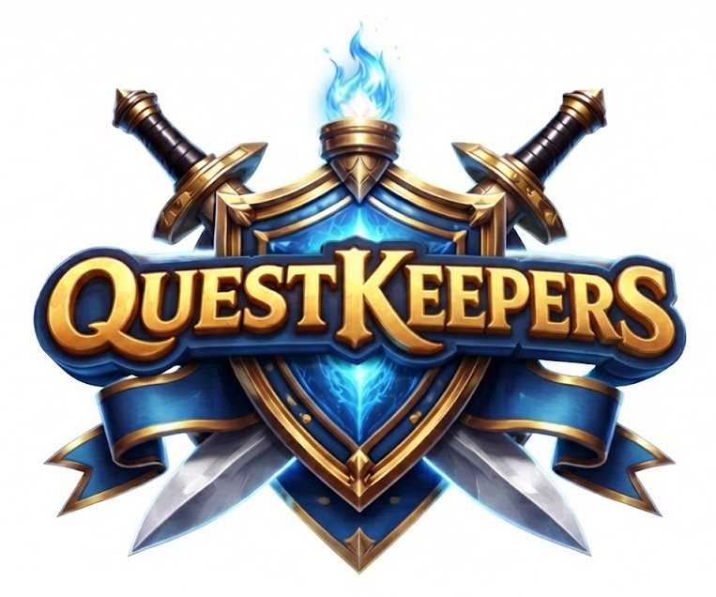

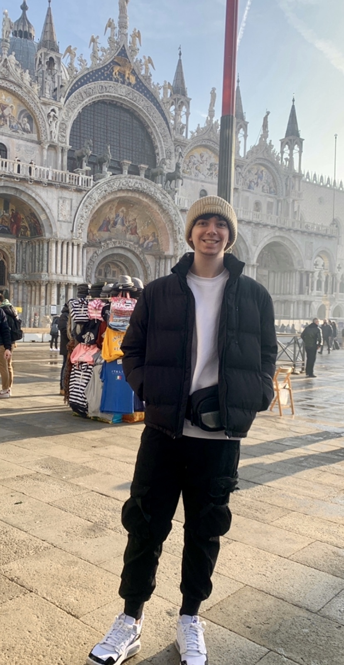

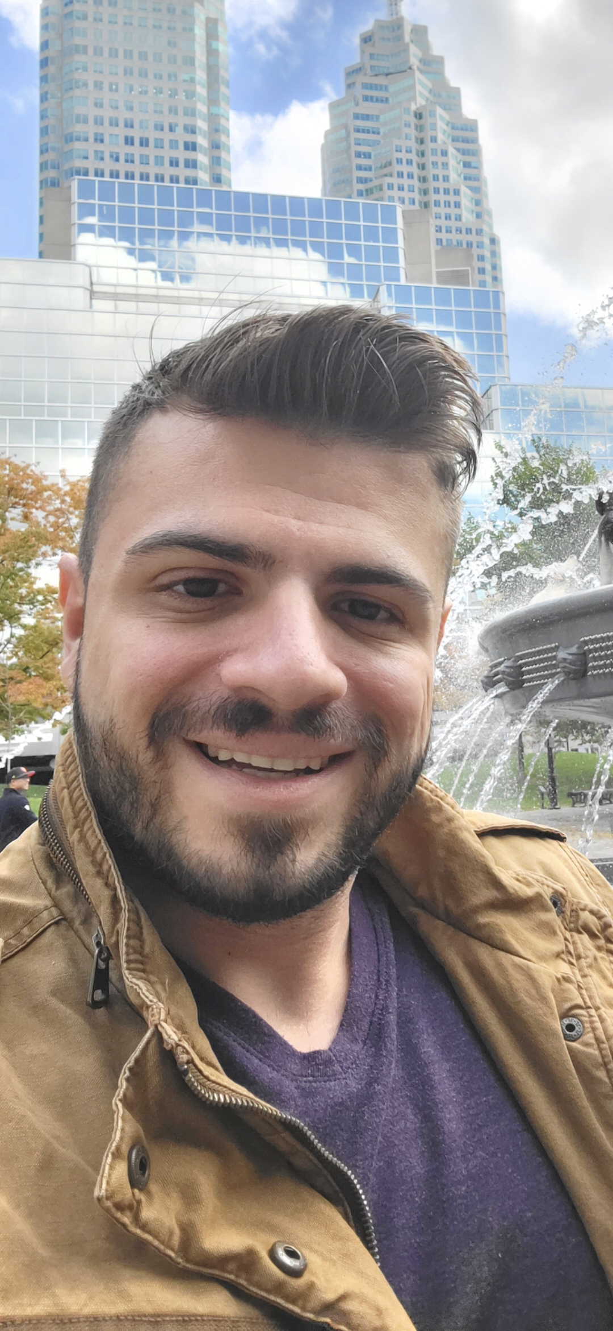
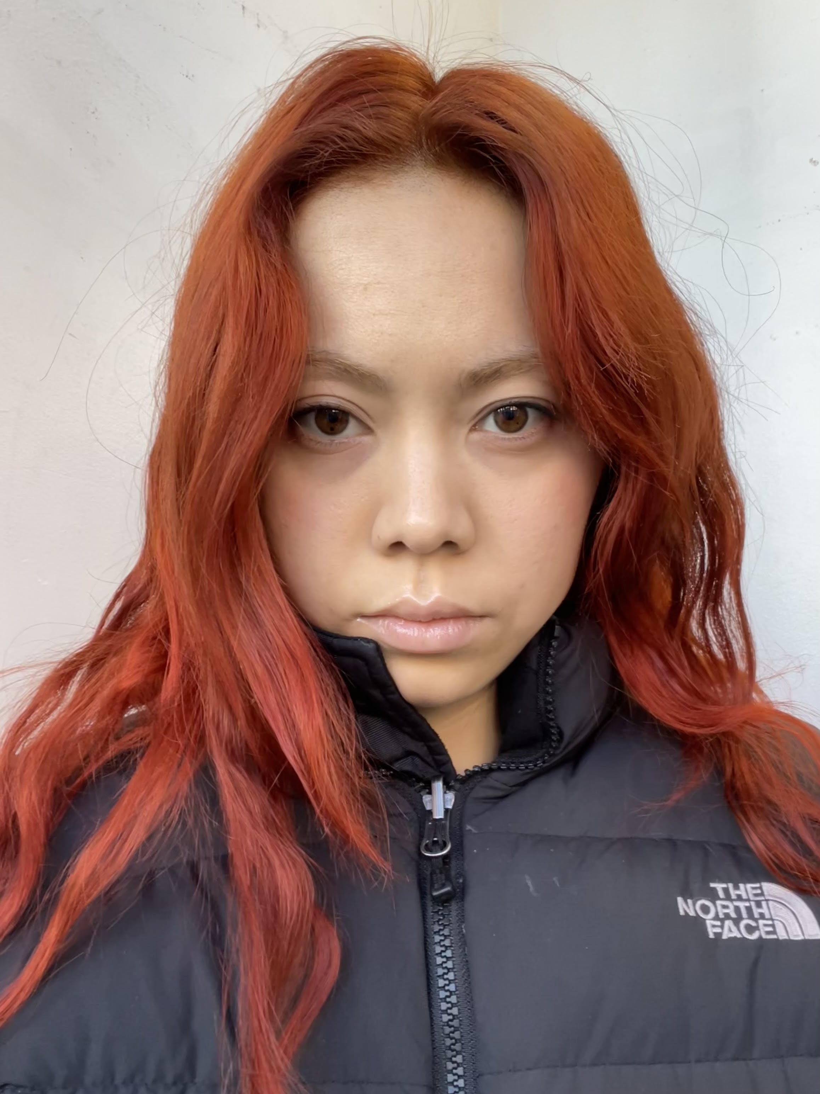

Meet The Team
Inna Ivashchenko
Johnhenry Brayman
Shariah Allen
Project Manager / Developer
Lead Game Developer
Game Developer / AI Engineer
Anthony Piombino
Gabrielle Schwan
Henry Wong
Project Manager / QA Engineer
UI/UX Developer
AL/ML Advisor / Consultant

Slide 3
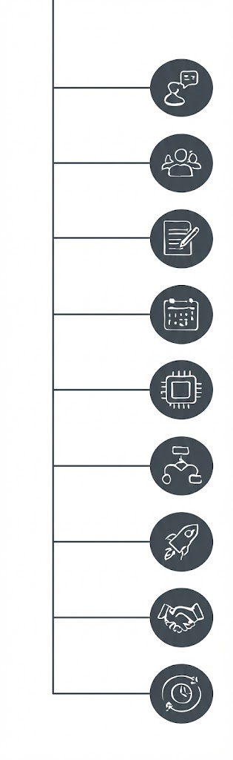
Recap sprint 2
Project Description
Team Working Agreement
User Personas
MVP / Tech / Algorithms
Diagrams
Product Backlog / User Stories
Team Velocity / Burndown
Demo
Agenda

Slide 4
Three AI difficulty levels introduced
Easy difficulty with slower reaction
Medium difficulty with average behavior
Hard difficulty with machine learning to implement reward and penalty system to guide AI learning
Bug testing and resolution
Sprint 2 Recap

Slide 5
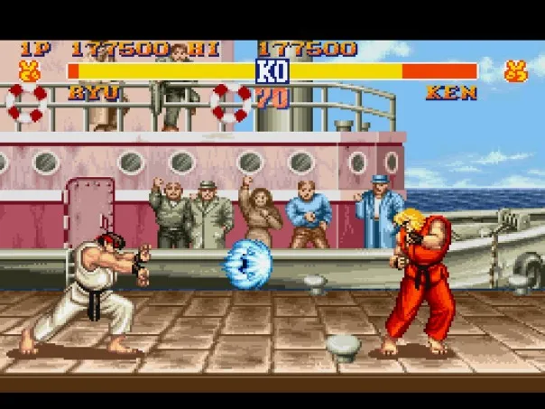
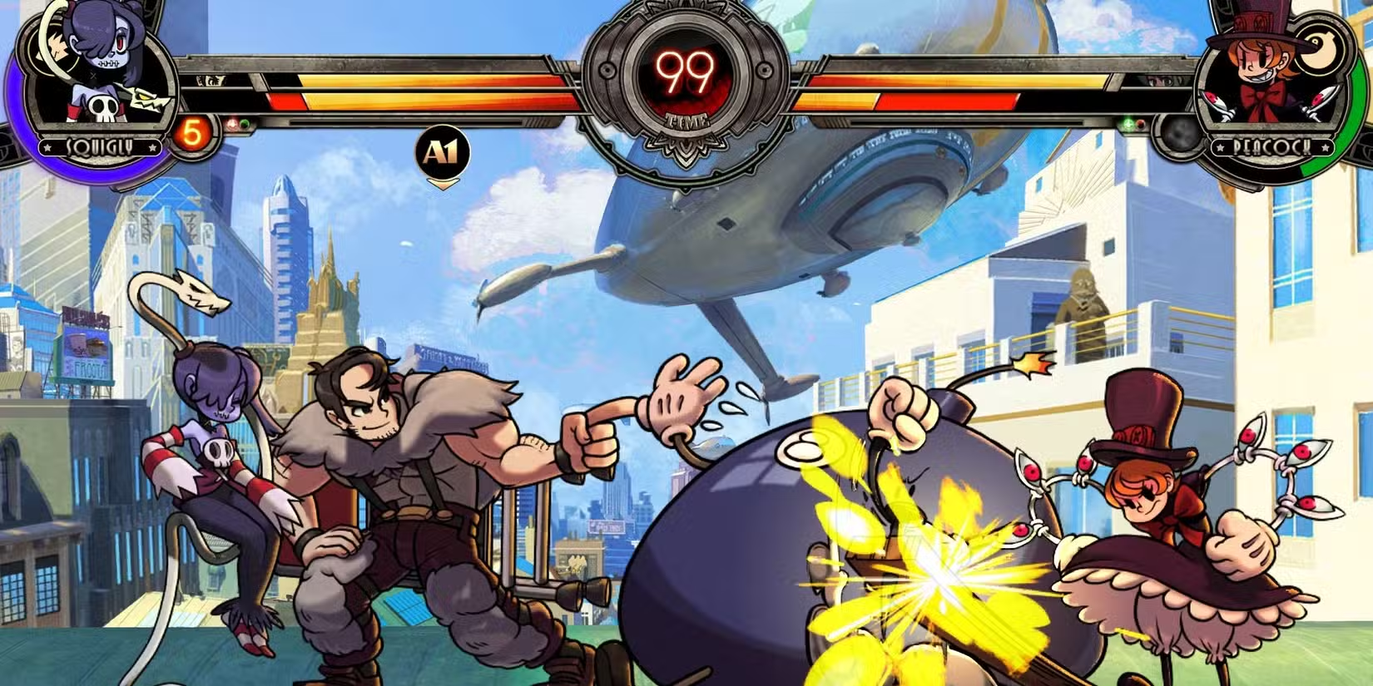
Project Description
2D-fighting game focusing primarily on AI opponents and improving your general fighting game skills.
AI will scale appropriately based on selected skill level
Easy : Mostly random or suboptimal moves
Medium : Basic strategy with a little randomness
Hard : Uses machine learning to adapt and respond
Provide user-friendly interface for user entry
Tally up and output results of game

Slide 6
Team Working Agreement
Communication And Responsibilities:
Communication through WhatsApp, Slack, Zoom.
All team members must respect each other and have the right to contribute their ideas to the project.
All ideas, vision and changes discussed together, and final decisions are up to most of the team, except urgent situations.
Each person works within the boundaries established before the start of work.
Everyone is responsible for their own part.
All conflicts should first be resolved between the people involved. If that is not possible the issue should be brought to the Team Lead.
Each member must inform the team about any changes or improvements they make.
Meetings:
Meeting happens through Zoom, Slack
The team must have Scrum meetings two times in a week and check WhatsApp, Slack daily to avoid missing any project information.
Schedule of a Scrum meeting : Tuesday at 8pm and Friday at 9.15pm
Each team member should participate in at least one meeting per week unless they have an important reason.

Slide 7

User Personas: The Competitive Gamer
Name: Anna Grace
Age: 28
Gender: Female
Occupation: Game Developer & Twitch Streamer
Anna is a season game developer with a solid fan base, that enjoys playing games in her free time, specifically fighting, first-person shooters (FPS), and racing games. She’s often searching for new and exciting games that have varying difficult levels and unique features that keeps players engaged.
Challenges:
Tired of playing the same popular titles, with reoccurring characters and stories
Wants to find new games developed by small teams to stream for her community
Goals:
She enjoys playing games and learning different mechanics
Wants to explore new games with AI elements
Seeks a game that can be replayed several times
Quote:
“ I just want to entertain my community and learn new skills; I love a good challenge!”

Slide 8
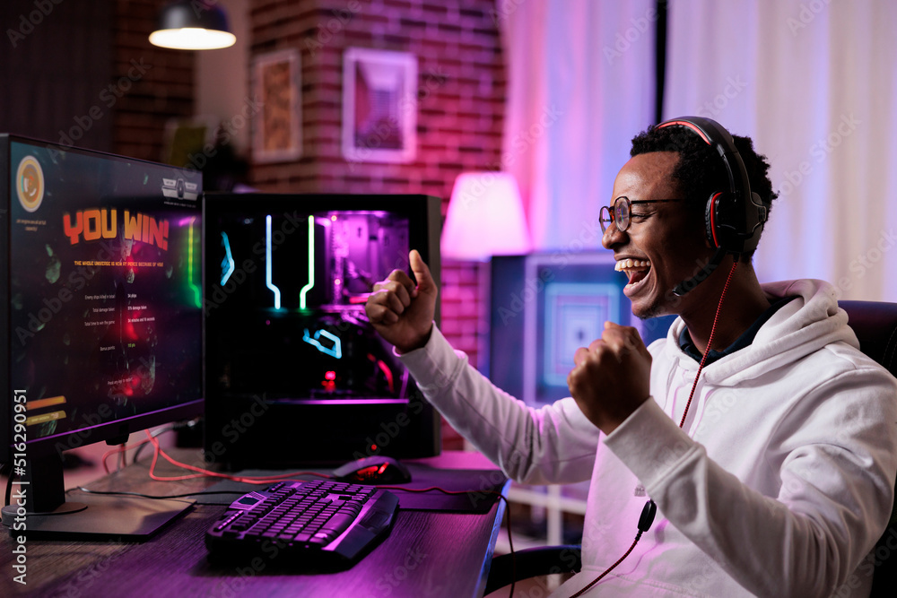
User Personas: The Button Smasher
Name: Jordan Carter
Age: 19
Gender: Male
Occupation: Undergraduate Student and Student Athlete
Jordan is a busy student athlete studying animation, that loves to play games on his free time on the weekends or while hanging out with friends. He loves playing games with lots of action, unique characters, and prefers to not memorize combos but just plays for fun, not to win.
Challenges:
Complex inputs and combinations makes gameplay frustrating
Long or vague tutorials
Goals:
Have fun solo or with friends
Win occasionally, or access to varying difficulties
Quote:
“ I skip tutorials, I just want to have mindless fun!”

Slide 9

User Personas: The Lore Explorer
Name: Dylan Taylor
Age: 12
Gender: Male
Occupation: Middle School Student
Dylan enjoys playing games after school with friends, family, or by himself, and specifically enjoys games that are action-packed. He seeks out games that provide a good challenge, has lots of enemies, and visual stimulation. He aspires to be a game developer and enjoys learning how to make 2D games during his video game club meetings.
Challenges:
Hard to find action games that are age appropriate
Wants games with unique enemies
Prefers 2D games
Goals:
Wants to explore new action games
Age-appropriate game with visual stimulation
Quote:
“ Games are fun when they have a lot of action!”

Slide 10
Inputs
Horizontal Movement:
Vertical Movement:
Move Forward: Player advances toward the opponent in the right direction using the "D" or "Right" arrow keys
More Backward: Player retreats from opponent towards the left direction using the "A" or "Left" arrow keys
Player can do a single or double jump mid-air to evade their opponent's attacks
Uses the spacebar to do single or double jumps
Double tap the spacebar to do a double jump
Blocking:
Defensive action intended to reduce or prevent incoming damage from attacks
Use the Right Mouse Button (RMB) to block attacks

Slide 11
Inputs
Attacks: Kick
Defensive: Duck
A defensive crouch that prevents movement while active
Cannot be performed while jumping or attacking
Hold C to duck, release to stand
A lower body attack that deals 10 damage when the player's hitbox collides with the opponent
Press "K" to kick
Attacks: Punch
Basic melee attack that deals damage when the player's hitbox collides with the opponent
Use the Left Mouse Button (LMB) to throw a punch

Slide 12
Attack Actions
Punching
Kicking
Triggered once an attack connects
Characters deals 10 damage to opponent
Opponent briefly enters a hit reaction state once hit
Triggered once an attack connects
Character deals 10 damage to opponent
Opponent briefly enters a hit reaction state once hit

Slide 13
Defensive Actions
Blocking
Ducking
Triggered when player holds duck input
Character enters ducking state
Prevents movement while active
Cannot be performed while jumping or attacking
Triggered when player holds block input
Negates incoming damage from attacks
Character enters blocking state

Slide 14
Reactive Actions
Being Hit
Dying
Triggered once an attack connects.
Character takes damage
May briefly enter a hit reaction state once hit
Each attack deals varying levels of damage
Ex. Punch & Kick deals 10 damage
Occurs once a fighter's health reaches 0
Ends Match
Game transitions to End-Game State

Slide 15




Technologies
Unity 6.3 LTS
Git LFS Extension
C# Programming
Python (for Machine Learning)

Slide 16
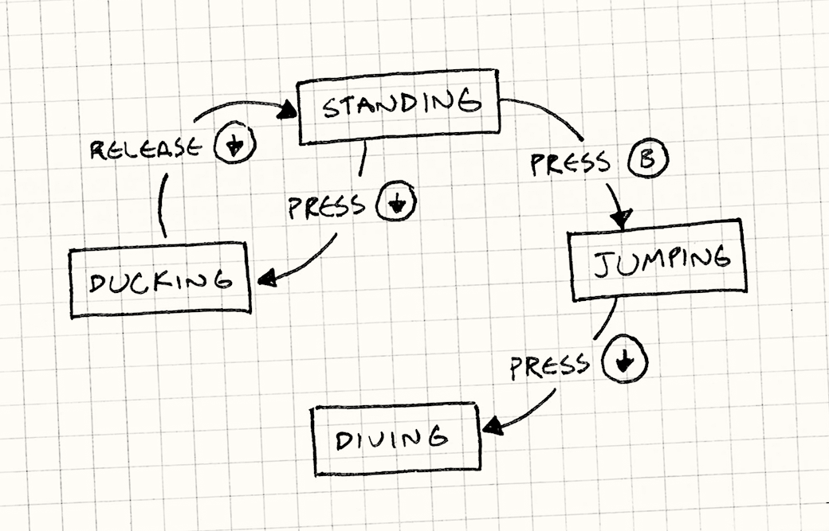
Algorithms
Easy Difficulty : Randomized Finite State Machine
The enemy AI is presented with multiple pre-defined states (Idle, Attack, Advance, Block, Duck).
Instead of using strategy, it picks which state to move to next randomly.
Attacks and movements still make sense but are suboptimal.

Slide 17
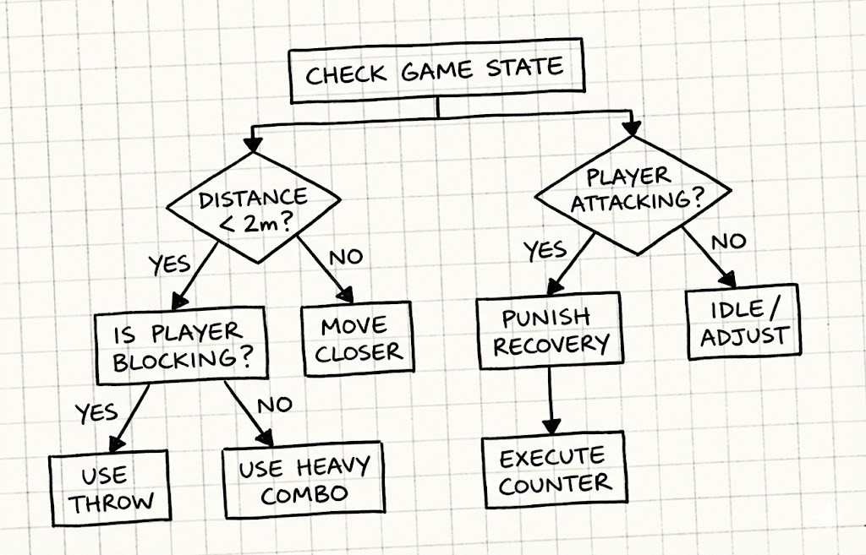
Algorithms
Medium Difficulty : Decision Trees
The enemy AI in this difficulty will start to react differently depending on certain criteria.
Before making an action, it will check a specific condition and act accordingly.
Can still make random decisions but in a more educated way.
Ex. Check to see if the player is attacking. If yes, randomly choose between block or counter.

Slide 18
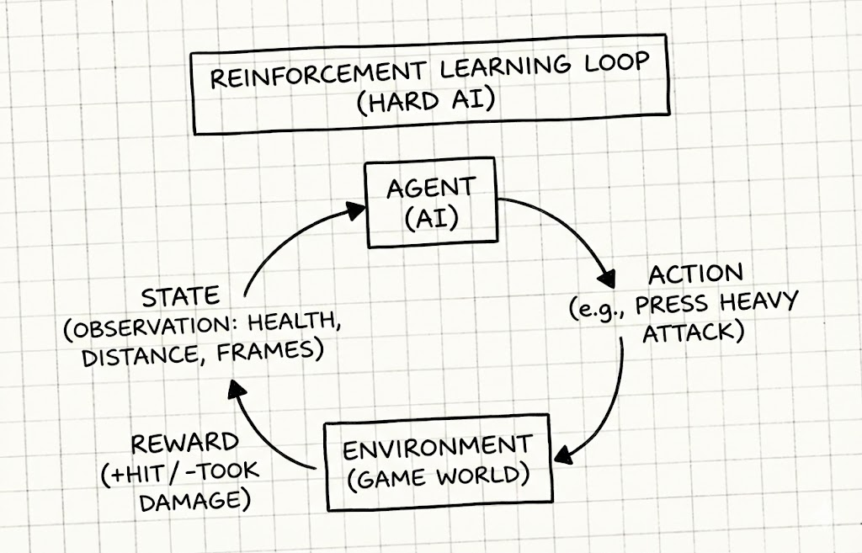
Algorithms
Hard Difficulty : Reinforcement Learning
The enemy AI will fight through many simulations either against itself, or one of the before mentioned difficulties.
It will receive a reward (+1) for landing a hit on the player, and a punishment (-1) for being struck by the player.
The AI will learn which actions lead to rewards and which actions lead to punishments.

Slide 19
Minimum Viable Product (MVP)
The Environment:
The Combat System:
A simple flat ground with invisible walls on each side to prevent falling off.
Simple environment design keeps focus on combat mechanics and player interaction
A basic camera with a script that keeps both players in-frame while zooming in as close as possible.
The bare minimum controls will be Locomotion, an Attack action, and a Block action.
Hit detection uses colliders to determine when attacks connect
Possibility to include combos, ducking, countering, and throwing later.
The AI Difficulties:
The Game Flow:
For the rules-based difficulties, the State Machine and Decision Tree logic must work, even if they are not complex.
For the hard difficulty, the Unity Agent must be able to read observations and output actions from the Neural Net.
The player must be able to enter the game from a main menu and select an AI difficulty.
Loads varying end-game scenes depending on match outcome
In-game must show health bars depleting, and a return to the main menu when one character reaches zero.

Slide 20
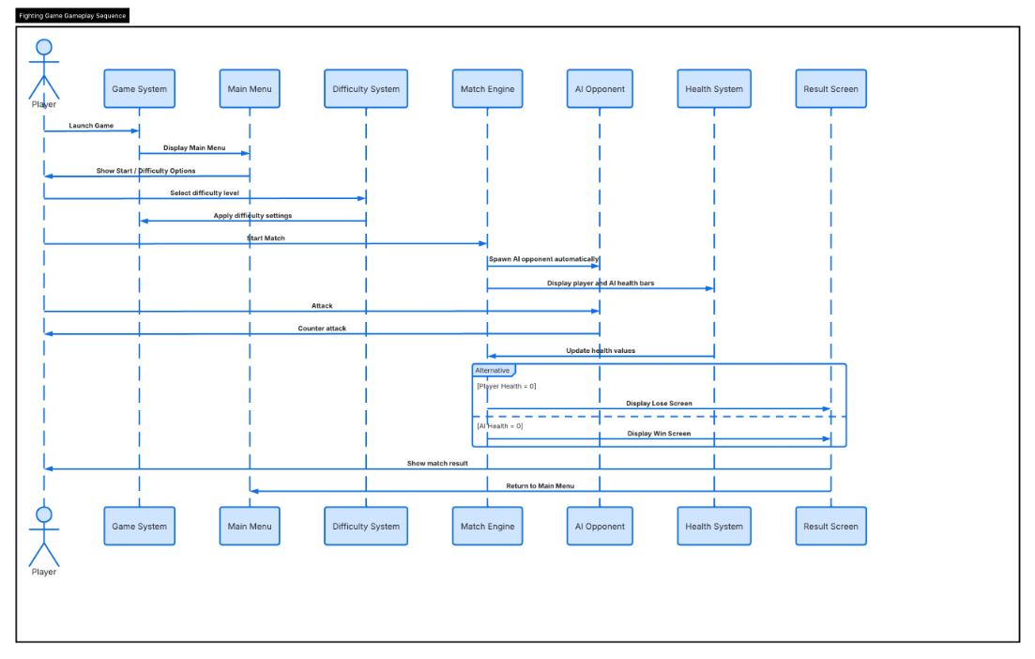
Sequence Diagram

Slide 21
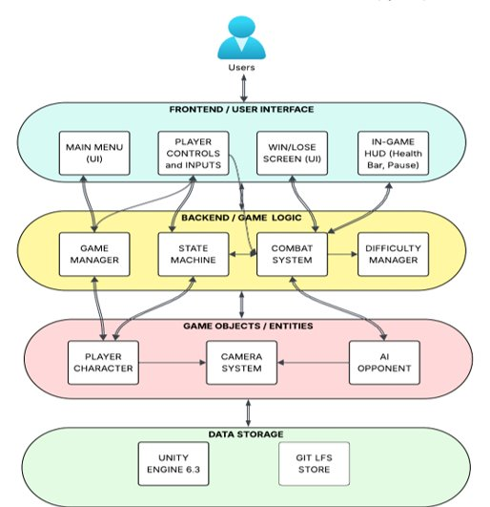
Conceptual Architecture Diagram​
Frontend: Accepts player input and displays health status (HUD), Win/Lose Screen.
Backend: The "brain" of the game, managing combat logic, character states, and difficulty.
Entities: Game characters and a "smart" camera, operating according to the backend's rules.
Data Storage: A stable foundation built on Unity 6.3 and Git LFS storage.

Slide 22
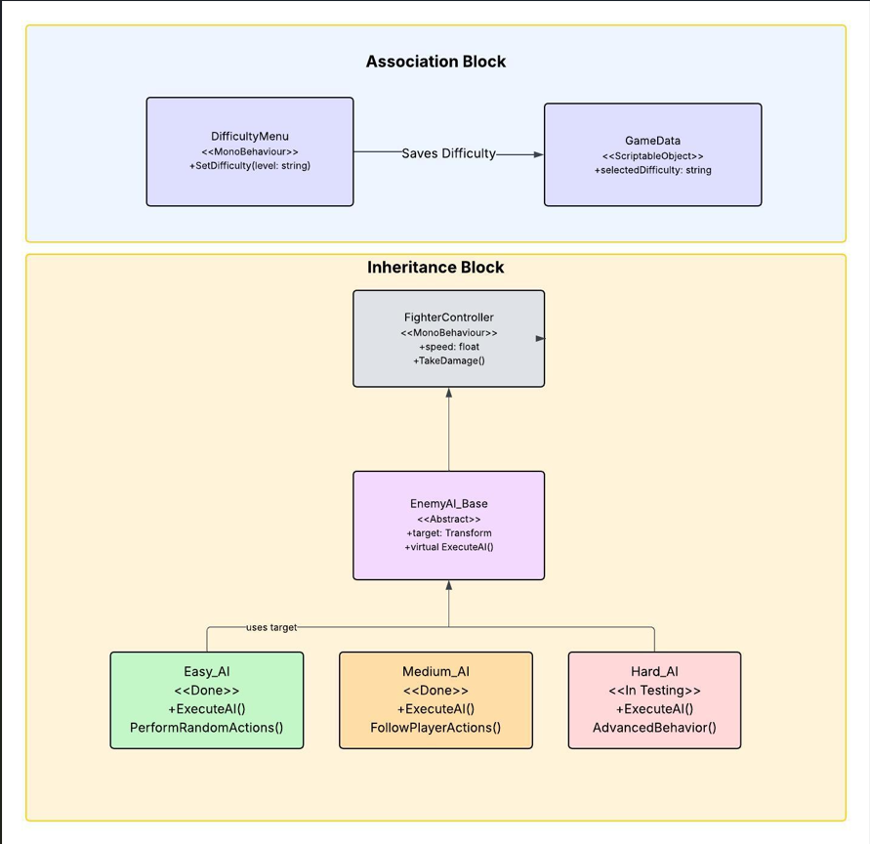
Class Diagram (UML Diagram)

Slide 23
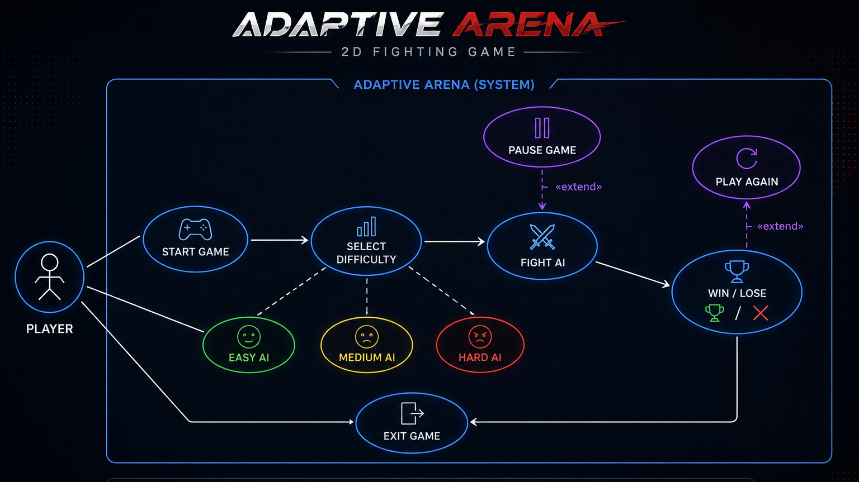
Use Case Diagram​

Slide 24
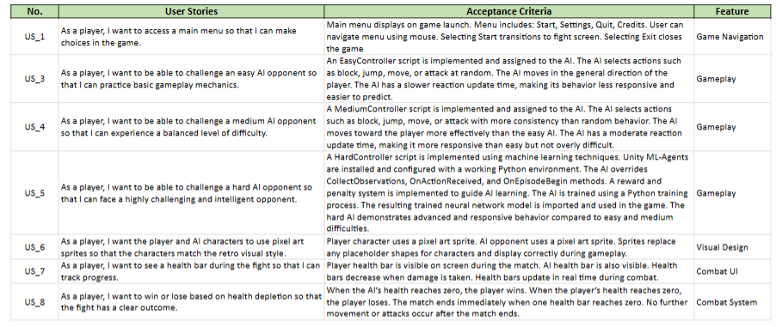
Product Backlog

Slide 25
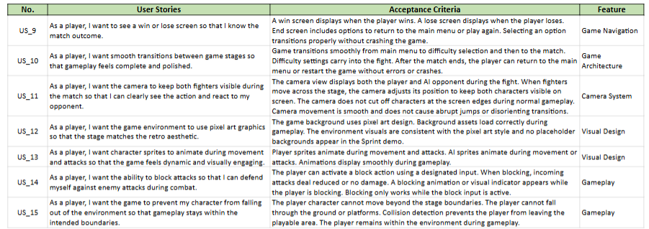
Product Backlog Continued

Slide 26
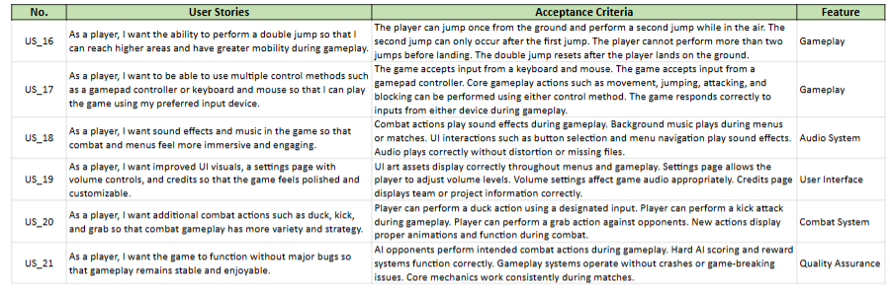
Product Backlog Continued

Slide 27
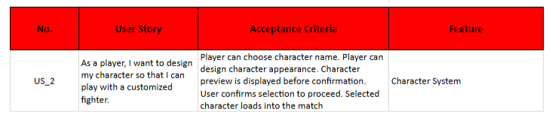
Product Backlog – Removed User Story

Slide 28
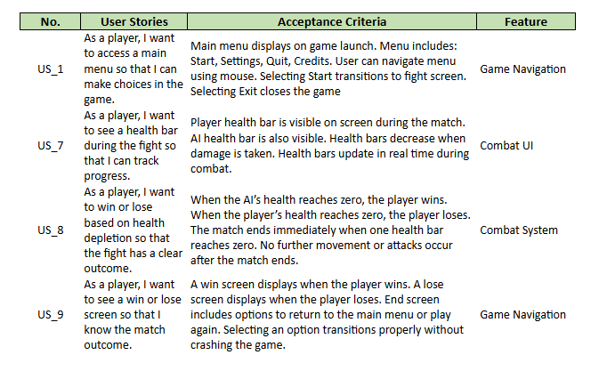
Sprint 1 User Stories

Slide 29
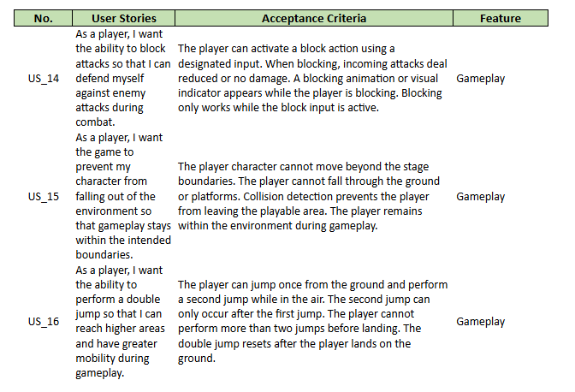
Sprint 1 User Stories Continued

Slide 30
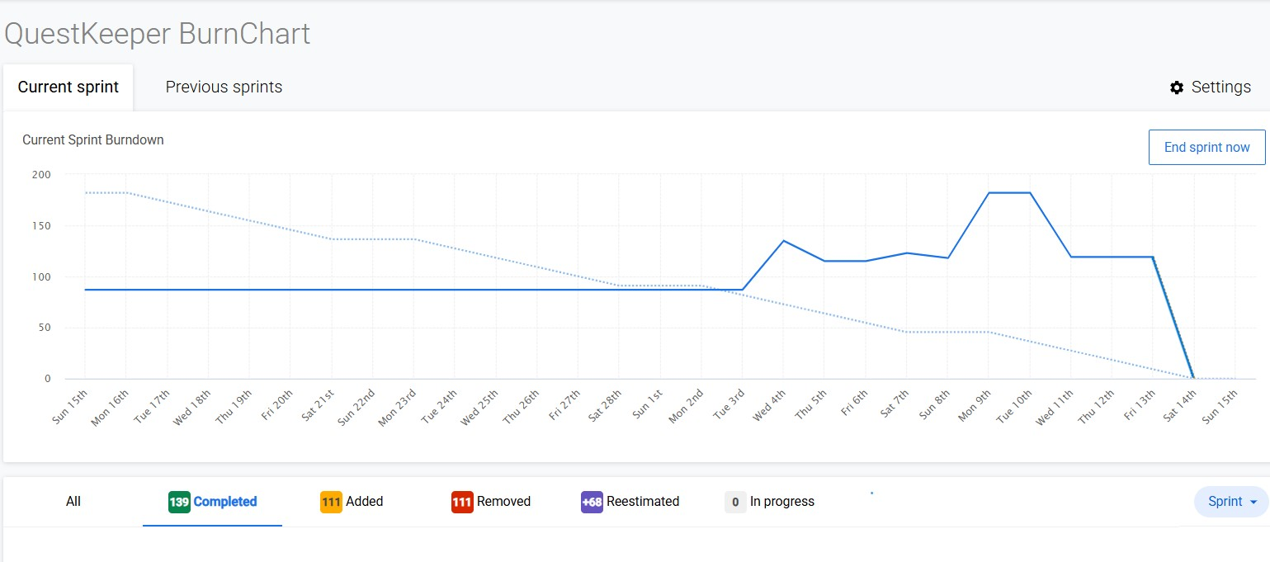
Sprint 1 Burndown Chart

Slide 31
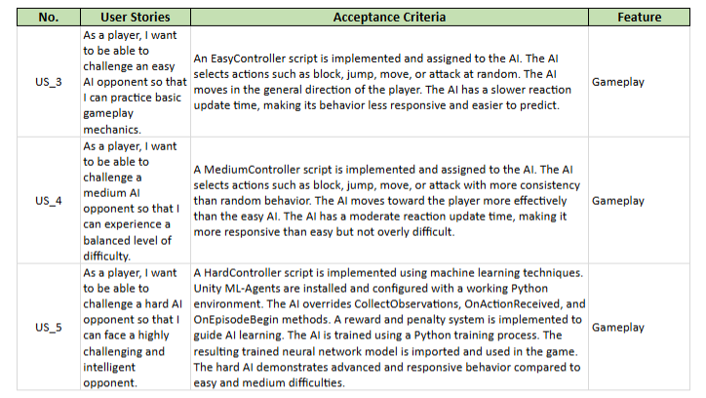
Sprint 2 User Stories

Slide 32
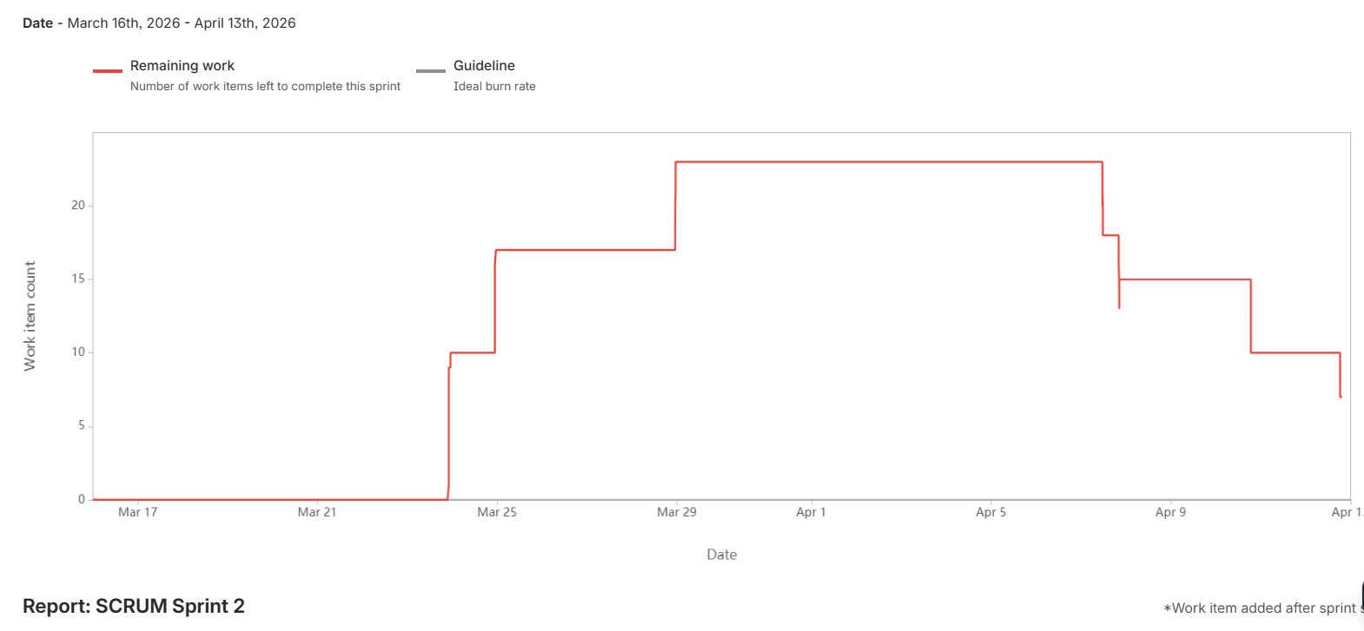
Sprint 2 Burndown Chart

Slide 33
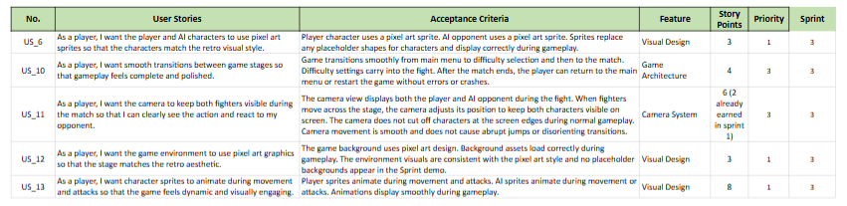
Sprint 3 Stories Backlog

Slide 34
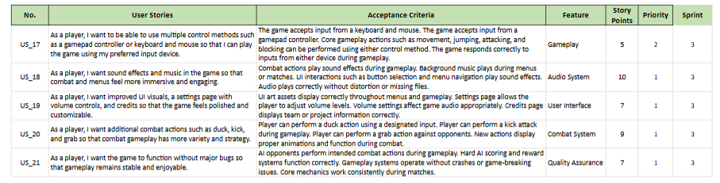
Sprint 3 Stories Backlog Continued

Slide 35
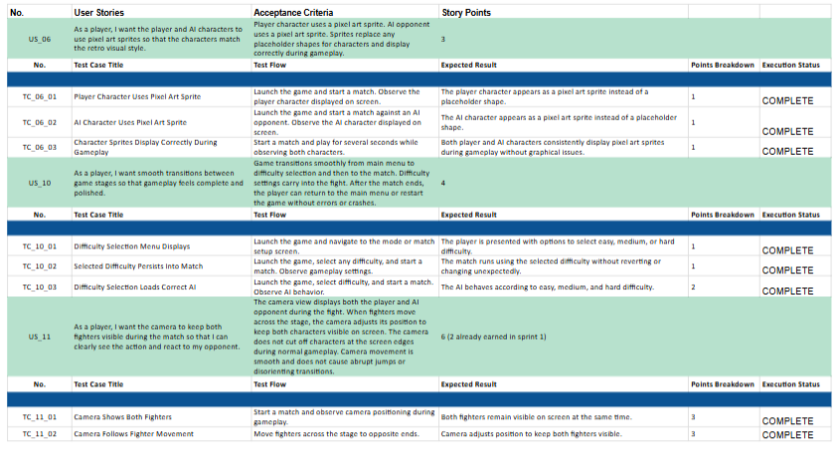
Sprint 3 Test Cases

Slide 36
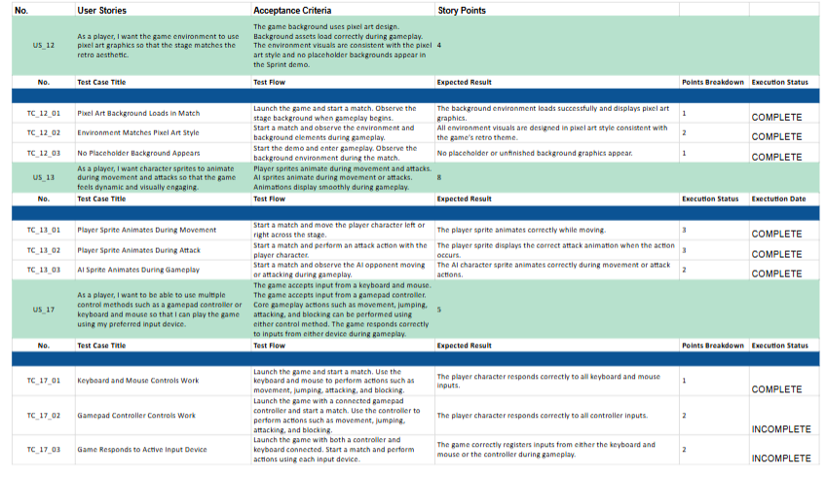
Sprint 3 Test Cases Continued

Slide 37
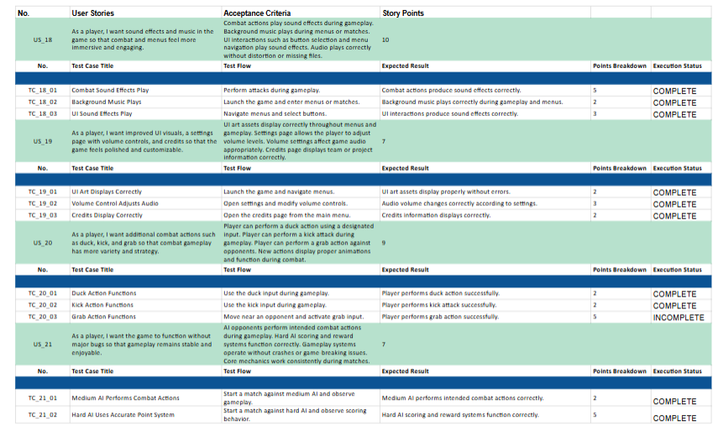
Sprint 3 Test Cases Continued

Slide 38
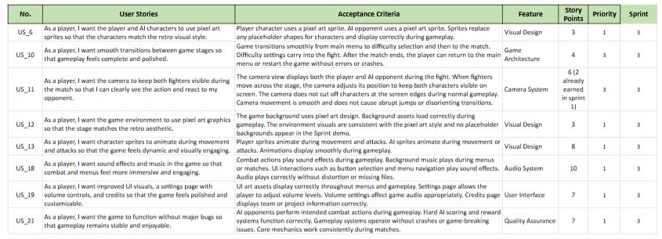
Sprint 3 Stories Completed

Slide 39
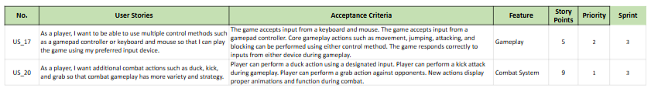
Sprint 3 Stories Not Completed

Slide 40
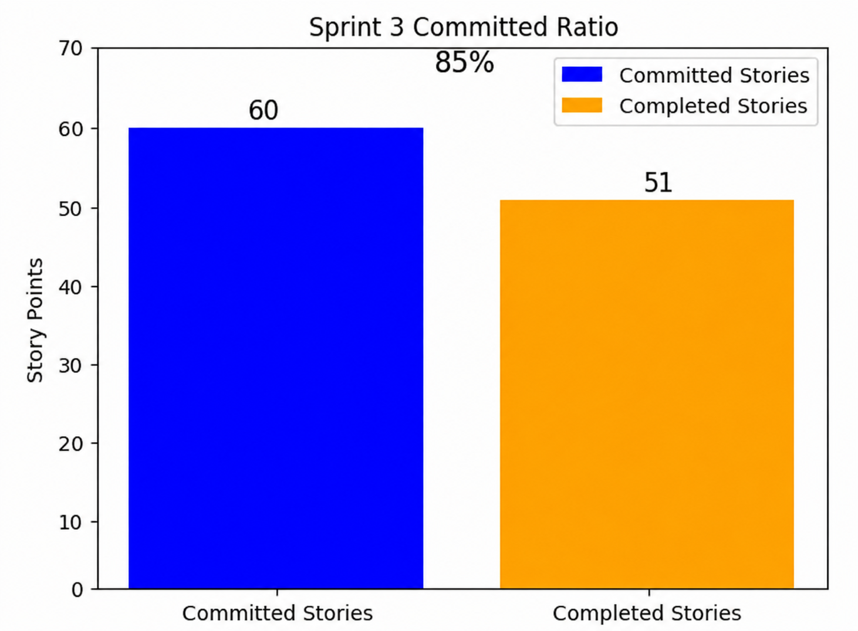
Team Velocity – Sprint 3
Story Points Committed: 60
Story Points Completed: 51

Slide 41

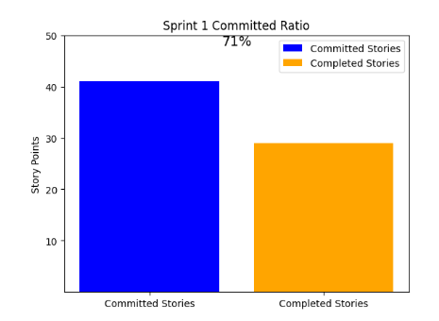
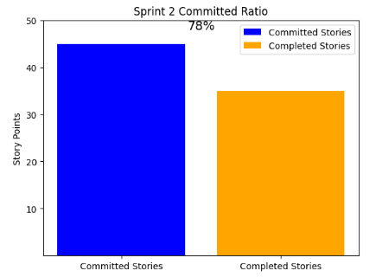
Team Velocity
Historical ratios:
Sprint 1: 70.73%
Sprint 2: 77.78%
Sprint 3: 85%
Improvement:
+7.05%, 7.22%
Average ratio:
77.84%

Slide 42
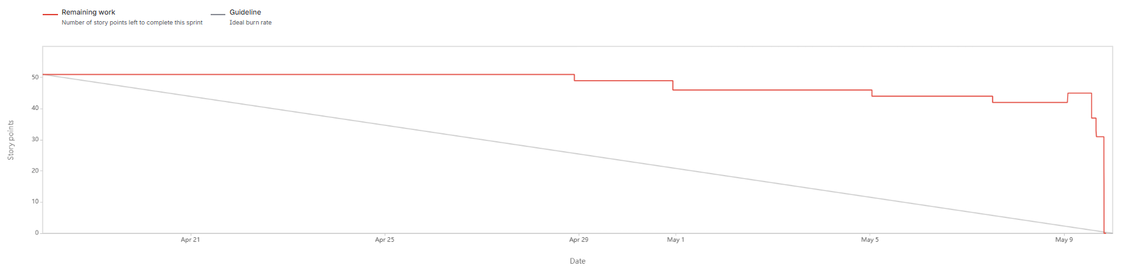
Sprint 3 Burndown Chart

Slide 43
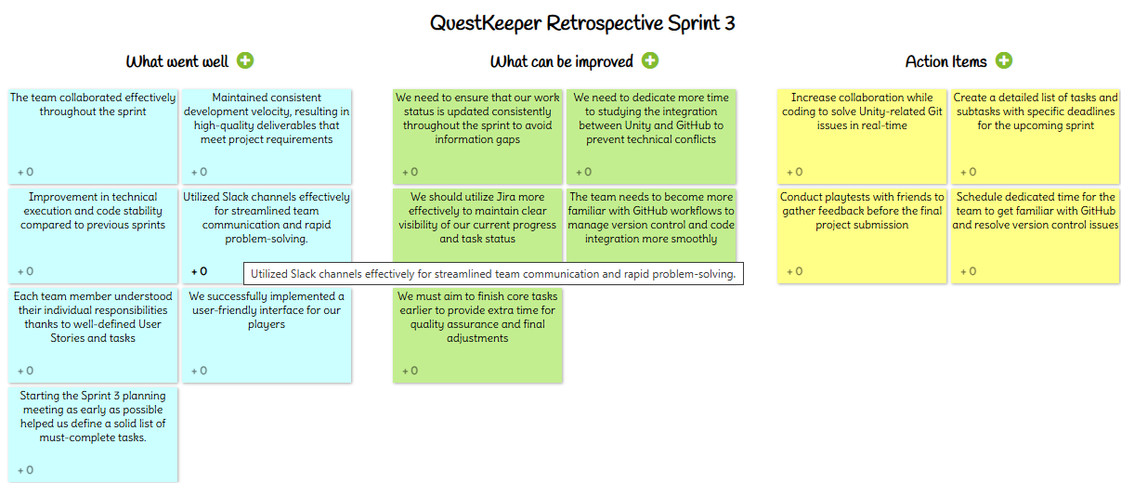
Retrospective

Slide 44
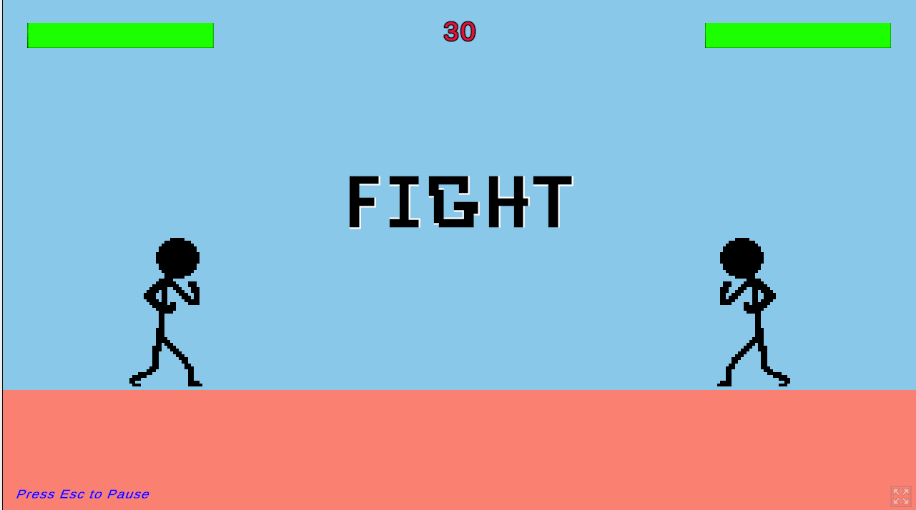
Project Demo
Adaptive Arena Demo

Slide 45
Wiki Page Link
https://github.com/htmw/2026SA-QuestKeeper/wiki

Slide 46
Thank You

