Slide 1





SPRINT 0
NutriAI
Presented By: TechDocs
CS691 Capstone Project
Professor Henry Wong

Slide 2



Team Members & Roles
Alan Tsui - Team Lead/Full Stack Developer
Angel Flores - AI/Backend Developer
Erin Sorbella - ML/Front End Developer
James Ambenge - Backend Developer
Qui Neubauer - Full Stack Developer
Saba Alam - Project Manager/Tester

Slide 3
AGENDA
Problem Statement
Project Description
MVP & Core Features
Personas
Technologies
Project Schedule
Retrospective
Working Agreement
Wiki Link Page

Slide 4
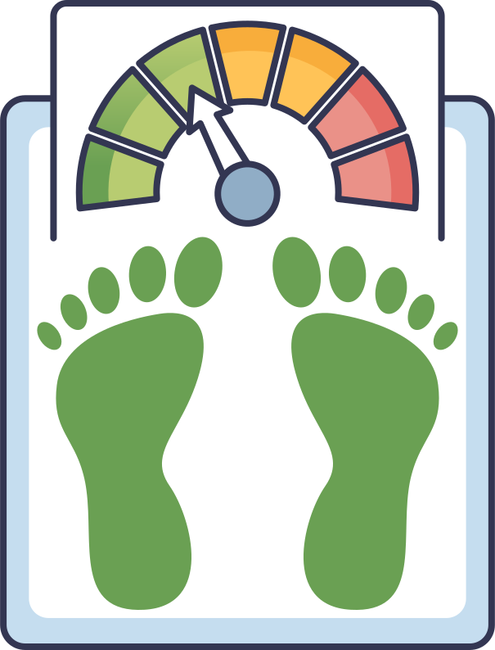

Problem Statement
Many people struggle with poor diets and nutrition control. Weight loss medications such as Ozempic have become more popular than ever to help manage hunger and reduce cravings.
Popular weight loss apps such as MyFitnessPal and Lose It! provide useful calorie and macronutrient trackers, but not personalized advice and behavioral coaching to build sustainable habits.

Slide 5
Project Description
NutriAI
This behavior-based app creates a nutrition plan based on your diet, energy, habits, and overall lifestyle. The main focus of this app is to make you healthier, feel more energetic, and reach or maintain a target weight. You can login daily and track your food, energy, and cravings.
The plan will adjust to your daily needs.

Slide 6

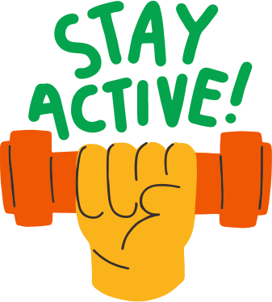
MVP/Core Features
  User Login & Profile Setup: Basic account creation with weight, height, goal weight, and lifestyle inputs.
  Smart Plan Generator: Generates a personalized daily calorie and macro target.
  “I’m Hungry” Button: Provides recommendations based on time since last meal and calorie intake.
  “I’m Craving” Button: Allows users to select craving type and receive a simple intervention.
  Daily Appetite Risk Score: Displays a basic prediction of hunger risk for the day.
  Basic Metrics Dashboard: Shows weight trend, calorie progress, and appetite score.

Slide 7
THE HEALTH OPTIMIZER
PERSONA
  Age: 26
  Occupation: Young Professional
  Fitness Level: Moderate
  Technology Comfort: High
  Goal: Improve nutrition, build better habits, and feel more energized
  Challenge: Struggles with sugar cravings and inconsistent eating habits

Slide 8
THE BUSY PROFESSIONAL
PERSONA
  Age: 42
  Occupation: Manager
  Fitness Level: Beginner
  Technology Comfort: Moderate
  Goal: Stay healthy and keep steady energy during busy work weeks
  Challenge: Has little time to plan meals and often eats whatever is quick and easy

Slide 9
THE OZEMPIC ALTERNATIVE
PERSONA
  Age: 34
  Occupation: Office Professional
  Fitness Level: Moderate
  Technology Comfort: High
  Goal: Lose weight and control hunger without using medication
  Challenge: Often feels hungry and eats more than planned, especially at night

Slide 10






Tech Stack
Frontend:
Backend:
Hosting:

Slide 11
Project Schedule
Sprint 0
Sprint 1
Sprint 2
Sprint 3
Jan 26 - Feb 15
Feb 15 - Mar 15
Mar 15 - Apr 12
Apr 12 - May 10
  Finalize app features
  Confirm tech stack
  Assign roles
  Set up GitHub, Wiki, and task tracker
  Design system architecture
  Build core feature structure
  Create basic UI
  Update documentation
  Develop and integrate features
  Implement ML components
  Deploy basic working version
  Conduct retrospective
  Final integration and testing
  Optimize and refine features
  Complete technical paper
  Final review and retrospective

Slide 12
Sprint Retrospective
What went well?
What can we improve?
  Everyone shared ideas and participated
  We agreed on our project idea
  We chose a tech stack
  We can define features earlier
  We can assign roles sooner
  We can schedule meetings earlier
Our commitments
  Lock in features before building
  Meet weekly and give updates
  Finish tasks on time

Slide 13
Team Working Agreement
Communication
  Weekly video meeting Saturday @ 4PM on Discord for updates and planning.
  Weekly WhatsApp check-in on Wednesdays for status updates.
  Members must give advance notice if missing meetings or becoming inactive.
Workflow
  Each member works on their assigned feature branch.
  A Task Tracker will manage assignments and deadlines.
  Code merges require coordination and pull request approval.
Team Values
  Treat all team members with respect.
  Disagree professionally without personal attacks.
  Raise concerns with the team before escalating.
  Share work fairly.
Marking Tasks Complete
  Features must meet agreed requirements.
  Open a pull request and receive at least two approvals.
  Update documentation and disclose any AI tool usage.

Slide 14
Project Wiki Link
https://github.com/htmw/2026SA-TechDocs/wiki

Slide 15
THANK YOU!

