Slide 1
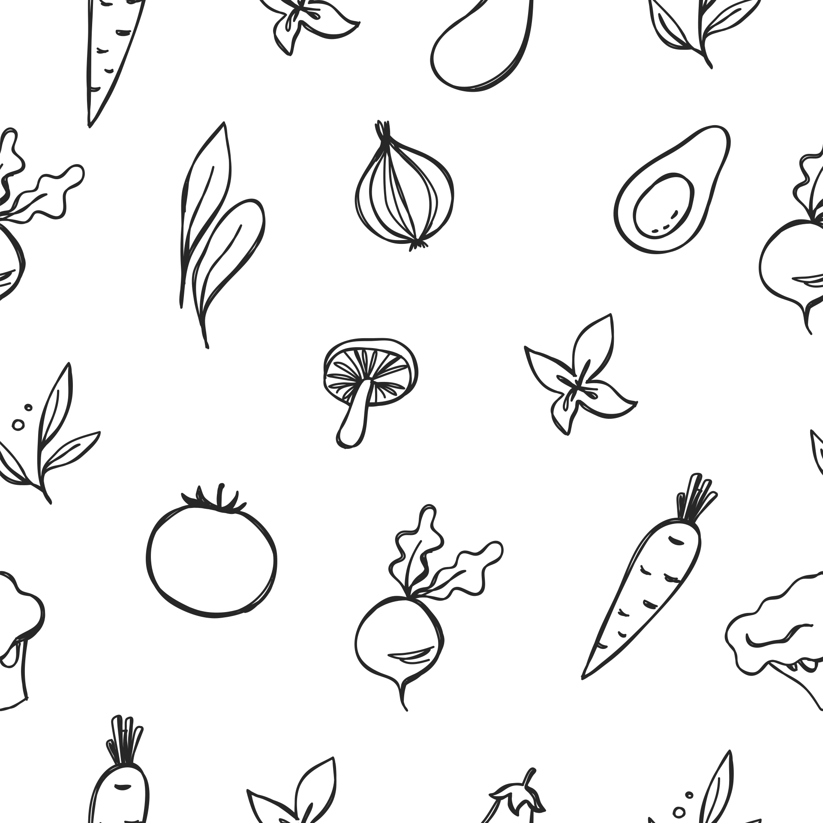




SPRINT 3
NutriAI
Presented By: TechDocs
CS691 Capstone Project

Slide 2

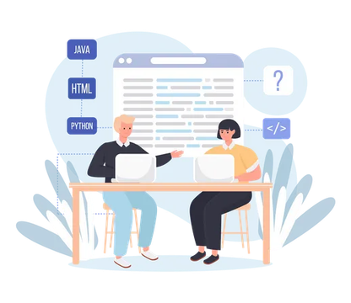



Team Members & Roles
Alan Tsui - Team Lead/Full Stack Developer
Angel Flores - AI/Backend Developer
Erin Sorbella - Front End Developer
James Ambenge - Full-Stack Developer
Qui Neubauer - Full-Stack Developer
Saba Alam - Project Manager/Tester

Slide 3
AGENDA
Feedback
Project Description
MVP & Core Features
Personas
Diagrams
Algorithms
Technologies
Sprint 2 Recap
Product Backlog
Sprint Summary
Sprint 3 Backlog
Metrics
Retrospective
Working Agreement
Github Link
Demo

Slide 4


Feedback
Added Feedback Slide
Added More Precise User Labels for User Stories
Diagrams have been remade to be more legible
Fixed Product Backlog Table
Historical Metrics + Completed/Committed Ratios

Slide 5
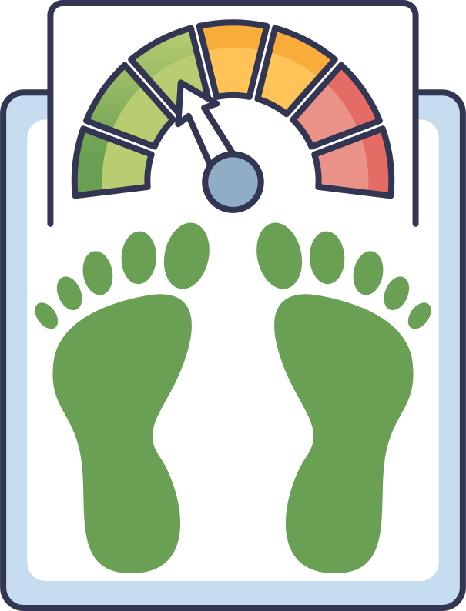
Project Description
NutriAI
This behavior-based app creates a nutrition plan based on your diet, energy, habits, and overall lifestyle. The main focus of this app is to make you healthier, feel more energetic, and reach or maintain a target weight. You can login daily and track your food, energy, and cravings.
The plan will adjust to your daily needs.

Slide 6


MVP/Core Features
Smart Plan Generator: Generates a personalized daily calorie and macro target.
“I’m Hungry” Button: Provides recommendations based on time since last meal and calorie intake.
“I’m Craving” Button: Allows users to select craving type and receive a simple intervention.
Basic Metrics Dashboard: Shows weight trend, calorie progress, and appetite score.
Recipe Recommender: Recommends a meal with ingredients and recipe instructions when hungry or craving.
User Login & Profile Setup: Basic account creation with weight, height, goal weight, and lifestyle inputs.

Slide 7

THE HEALTH OPTIMIZER
PERSONA
Age: 26
Occupation: IT Professional
Fitness Level: Moderate
Technology Comfort: High
Eric is a former athlete now adapting to a sedentary job. As someone in tech himself, he’s curious in seeing how far an app can be used to assist with nutritional and fitness needs.

Slide 8

THE BUSY PROFESSIONAL
PERSONA
Age: 42
Occupation: Office Manager
Fitness Level: Beginner
Technology Comfort: Moderate
Jessica is dedicated to her work, often eating what is convenient rather than what’s healthy. After receiving advice from her doctor to have a more balanced diet, she looks into NutriAI.

Slide 9

THE OZEMPIC ALTERNATIVE
PERSONA
Age: 34
Occupation: University Professor
Fitness Level: Moderate
Technology Comfort: High
Dylan has recently stopped taking weight loss medication and is looking for help managing his diet and appetite. He’s interested in NutriAI for its “I’m Feeling Hungry” button.

Slide 10





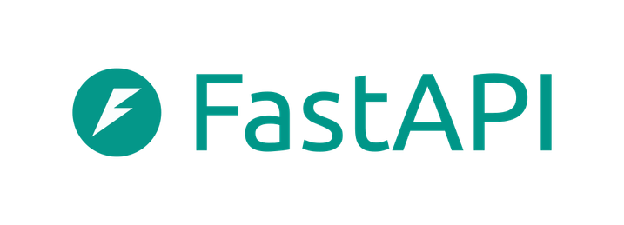
Tech Stack
Frontend:
Backend:
Hosting:

Slide 11
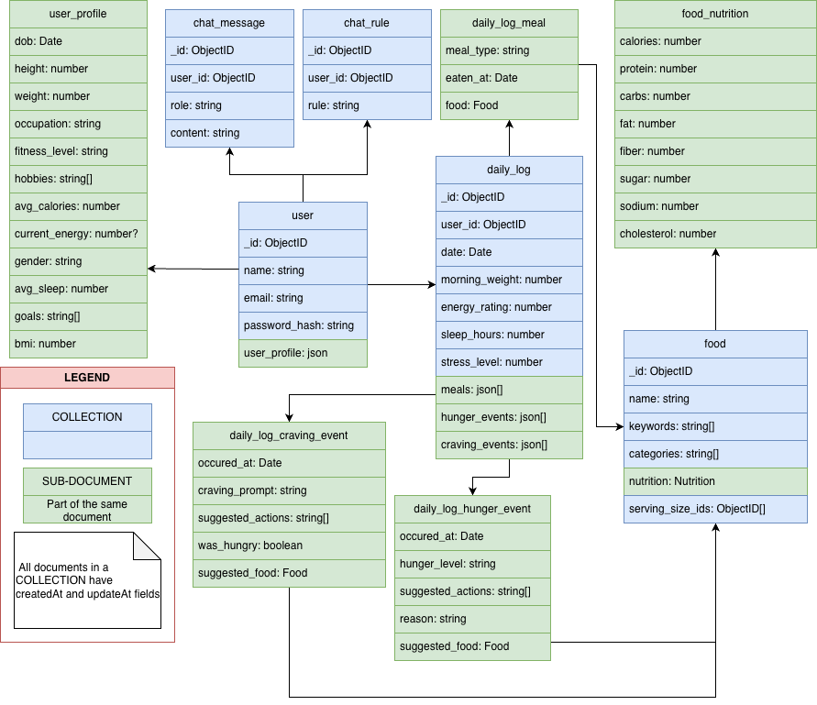
Diagrams - ER Diagram

Slide 12
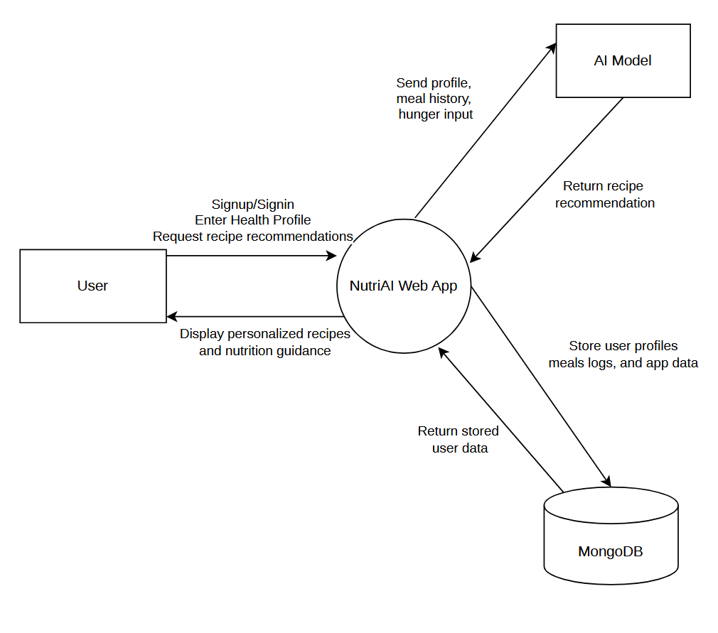
Diagrams - Context Diagram

Slide 13
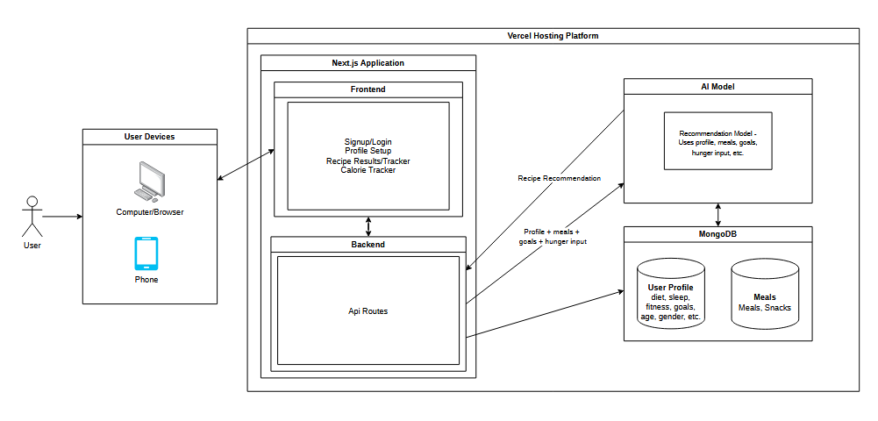
Diagrams - Architecture Diagram

Slide 14
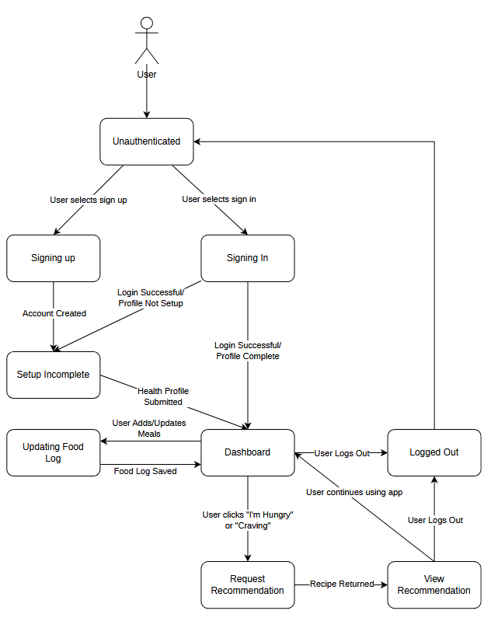
Diagrams - State Diagram

Slide 15
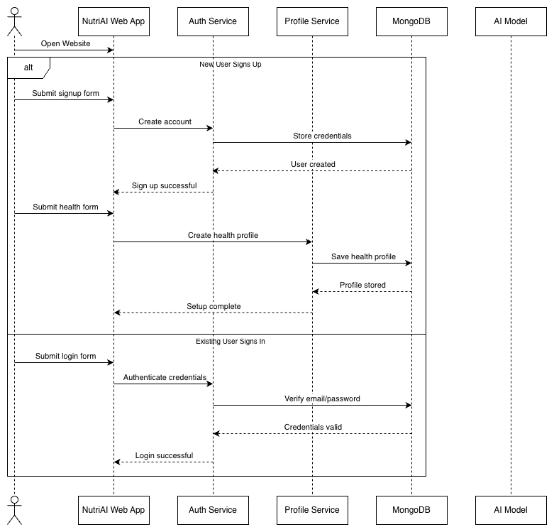
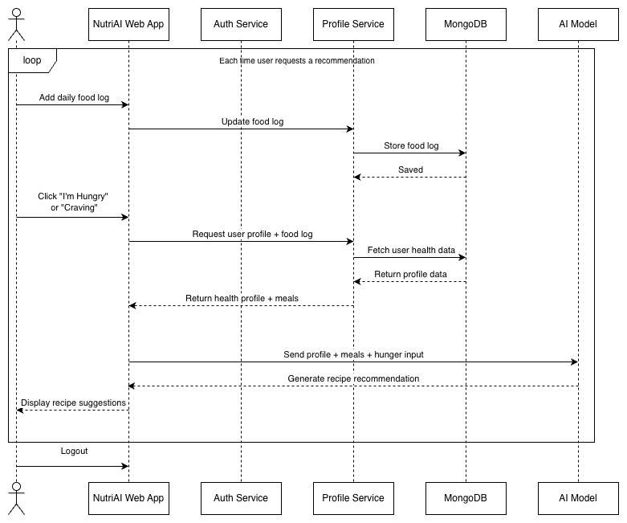
Diagrams - Sequence Diagram

Slide 16
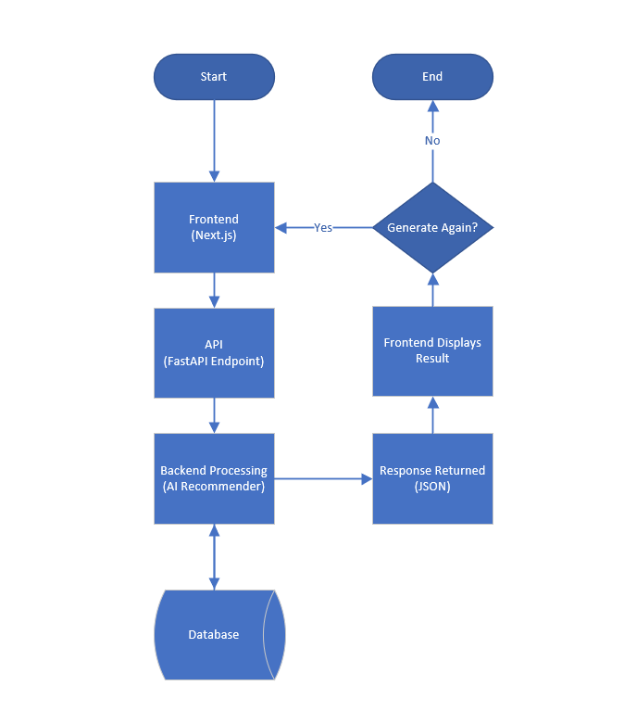
Diagrams - AI Recommendation Pipeline (FastAPI)

Slide 17
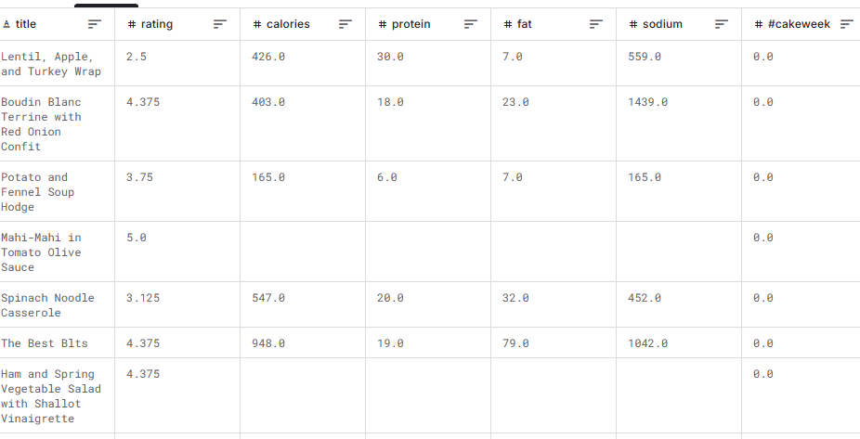
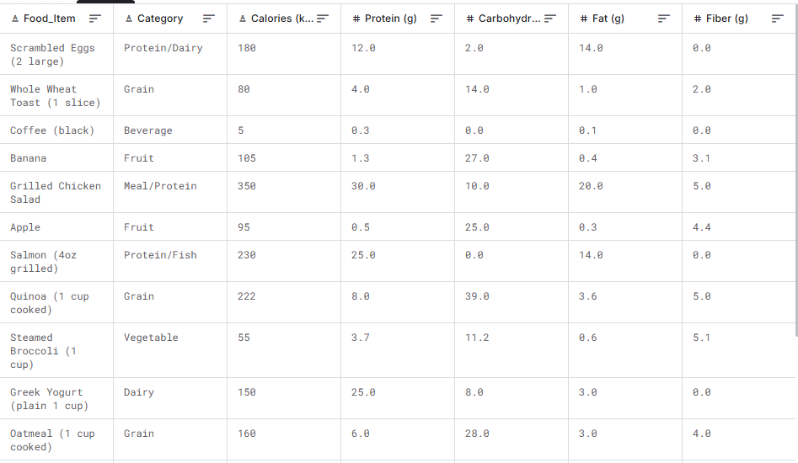
Dataset
Epicurious -
Recipes with Rating and Nutrition
https://www.kaggle.com/datasets/hugodarwood/epirecipes
Daily Food & Nutrition Dataset
https://www.kaggle.com/datasets/adilshamim8/daily-food-and-nutrition-dataset
20,000+ entries of data
600+ entries of data

Slide 18

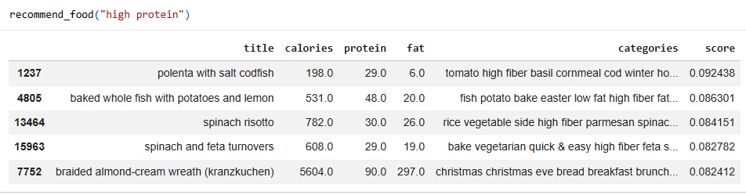
Algorithms
AI Recipe Recommender (Scikit-Learn)
Convert text data into numerical vectors using TF-IDF
Retrieve user information and user input for what they’re “craving”.
Clean user input by stripping symbols and spacing
Compare user input with recipe vectors
Cosine similarity measures matches with the user’s input and recipes in the dataset
Ranks recipe by similarity score
Returns top matching recipes as recommendations
Improvements:
Implemented into FastApi
Connected algorithm to NutriAI
Enhanced AI Recommender Logic

Slide 19
Sprint 1 Summary
Environment setup
Next.js frontend
MongoDB database
Core Application Pages Built
User profile & landing page
Authentication pages
AI Recommendation
Functionality for hungry and craving buttons
User functionality
Daily log
Daily check-in
BMI Calculator

Slide 20
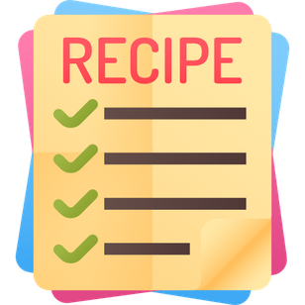
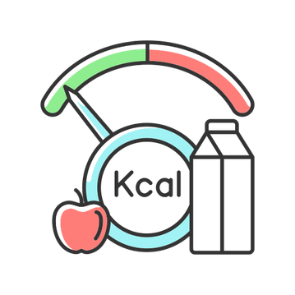
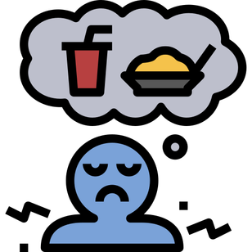
Sprint 2 Summary
Recipes Database Implemented
Calorie Tracker for Daily Logs
Calorie tracker underwent testing - updates followed in sprint 3
Craving and hunger events functionality is complete
Connected app to AI Python API

Slide 21
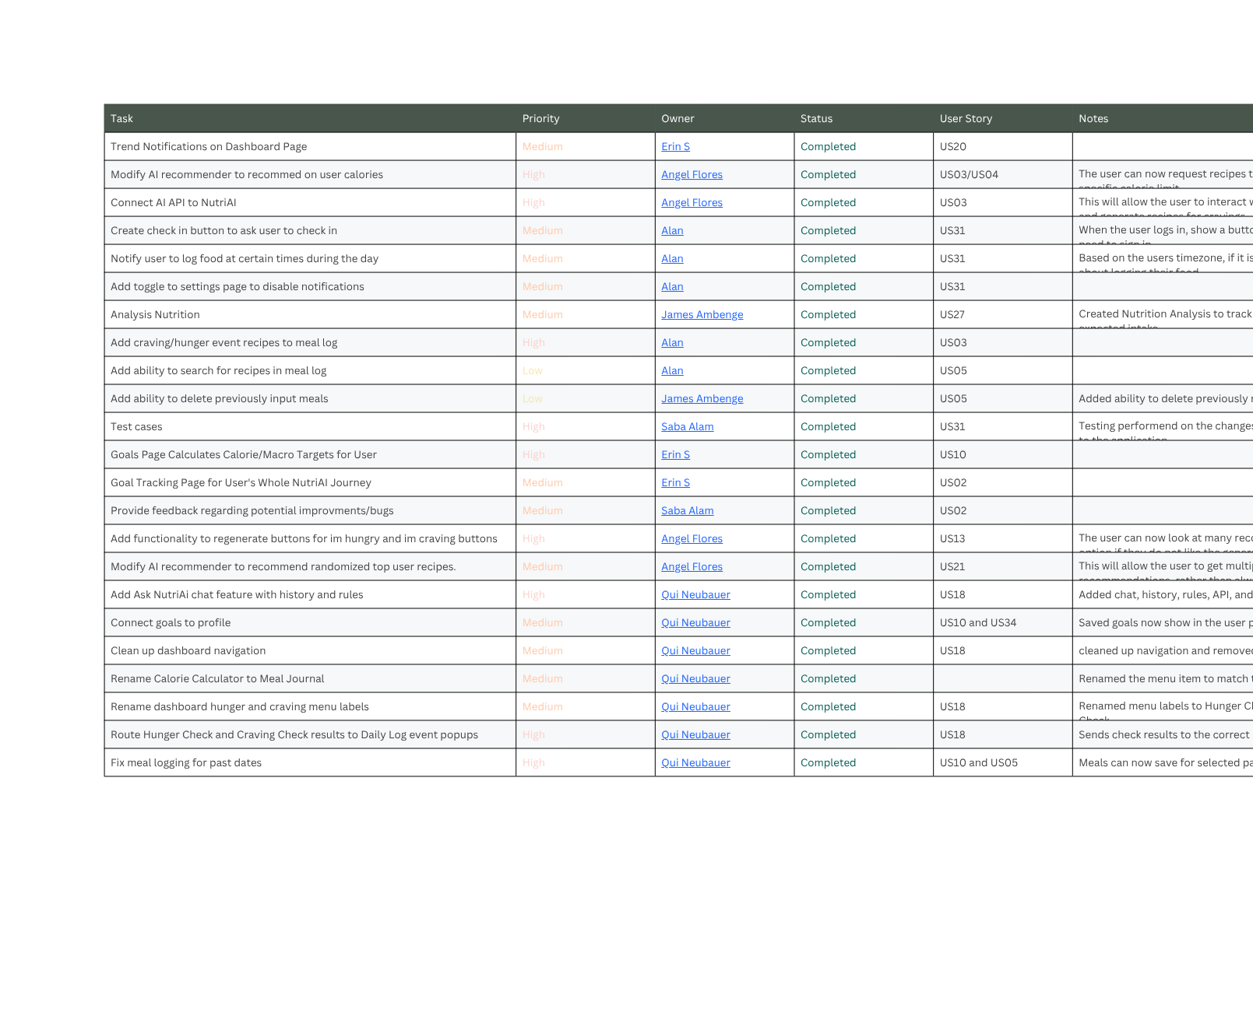
Sprint 3 Backlog

Slide 22
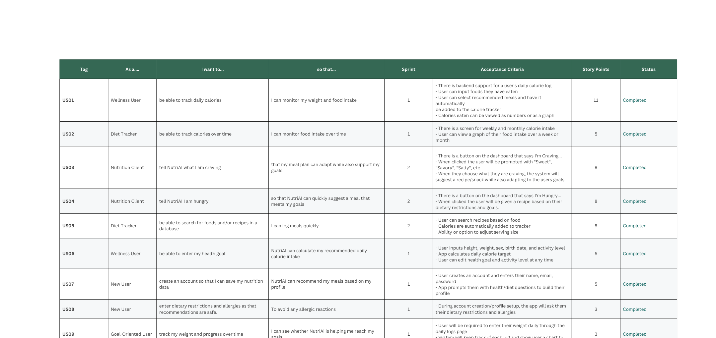
Product Backlog

Slide 23
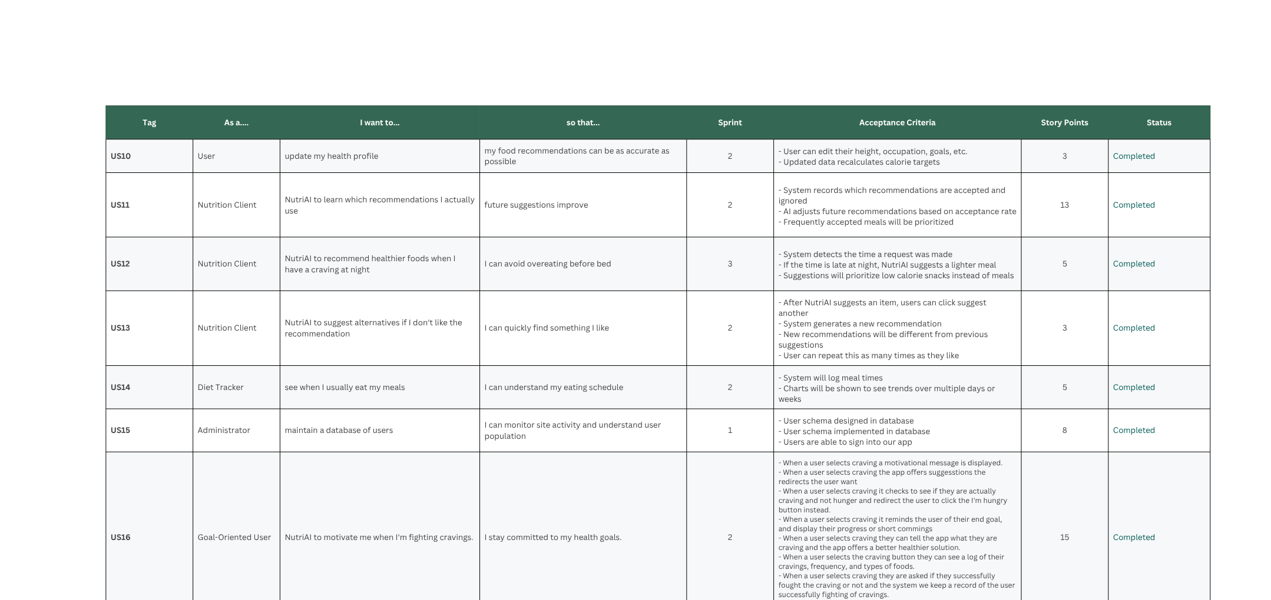
Product Backlog

Slide 24
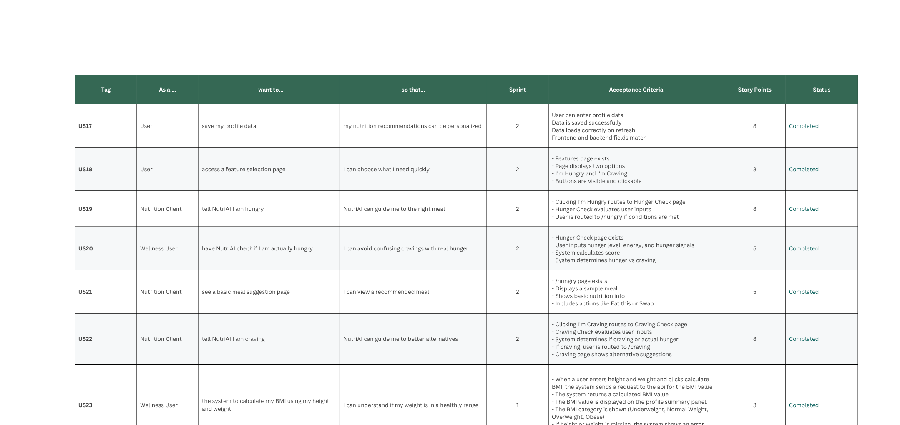
Product Backlog

Slide 25
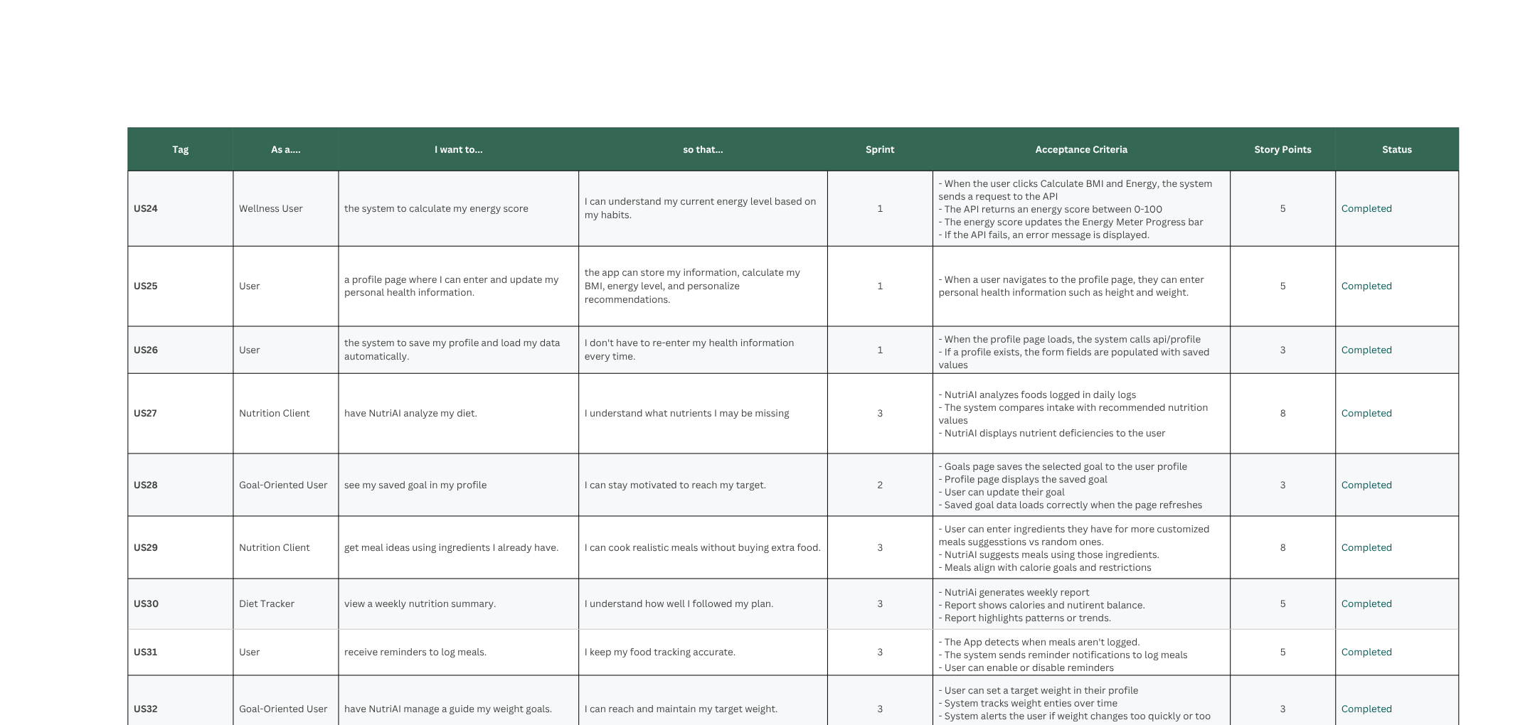
Product Backlog

Slide 26
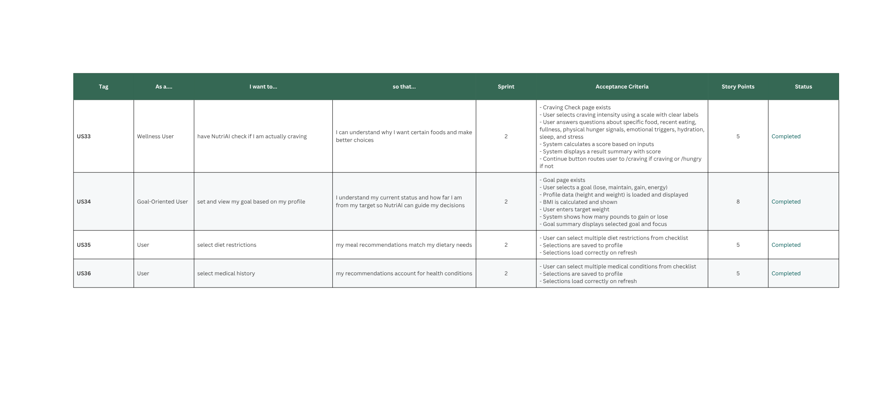
Product Backlog

Slide 27
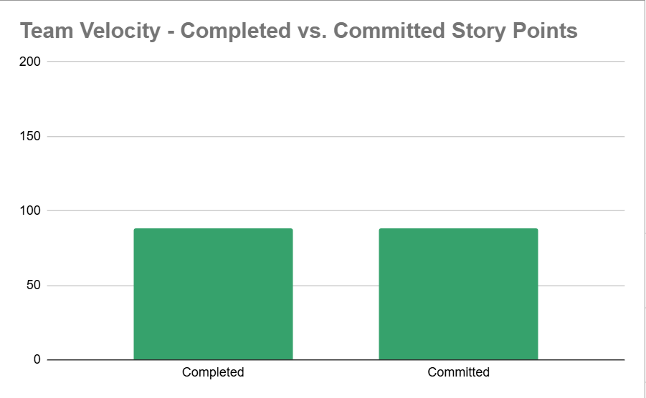
Sprint 3 - Completed/Committed
100%!
88/88

Slide 28
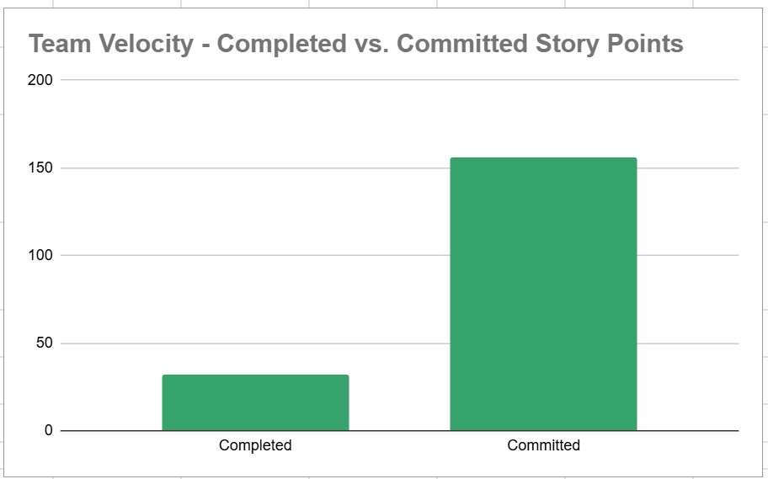
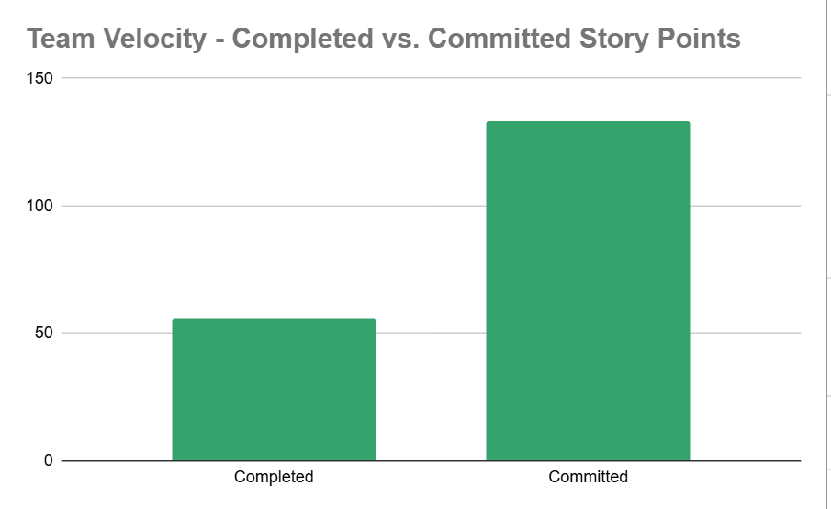
Historical Completed/Completed
Sprint 1
Sprint 2
20.5%
32/156
42.1%
56/133
Average: 54.2%

Slide 29
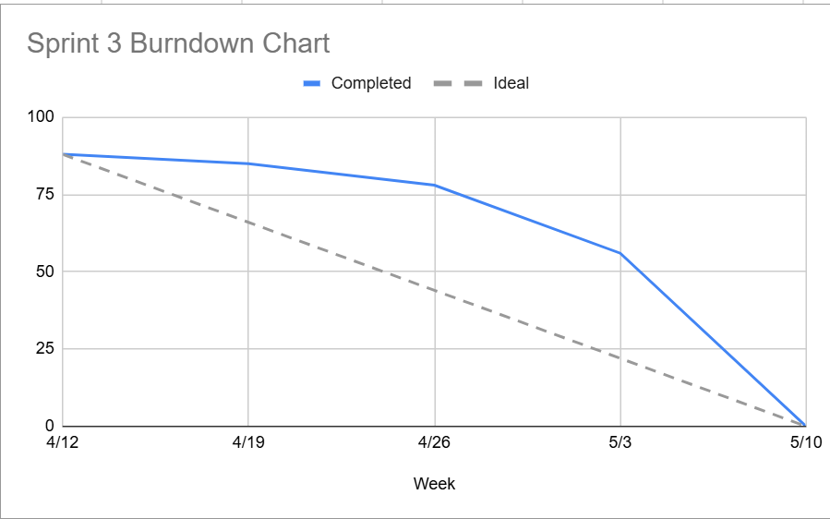
Sprint 3 Burndown Chart

Slide 30
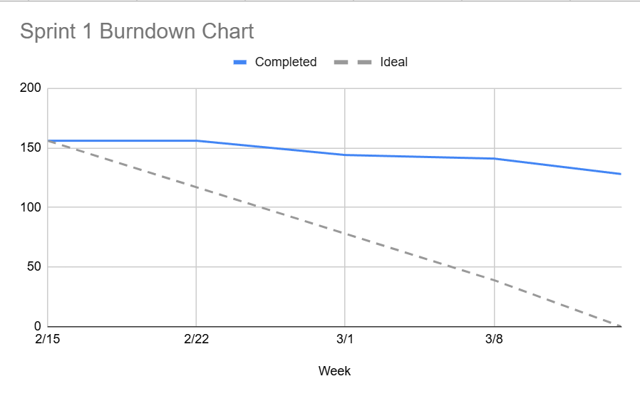
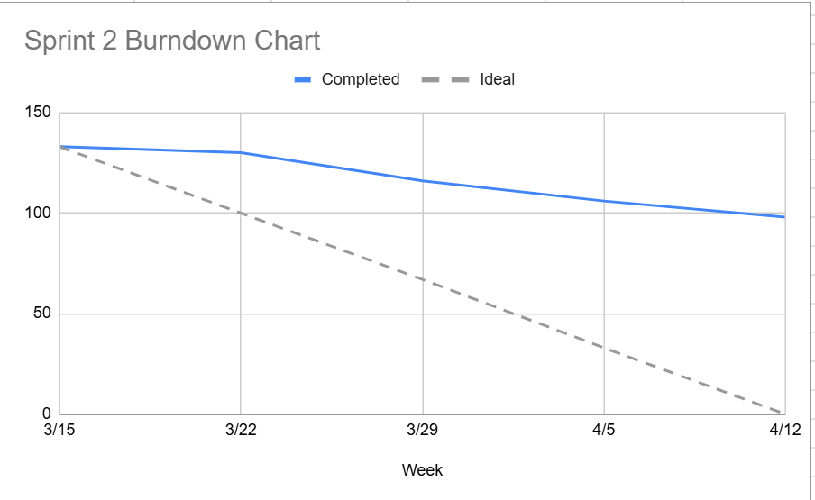
Historical Burndown Charts
Sprint 1
Sprint 2

Slide 31
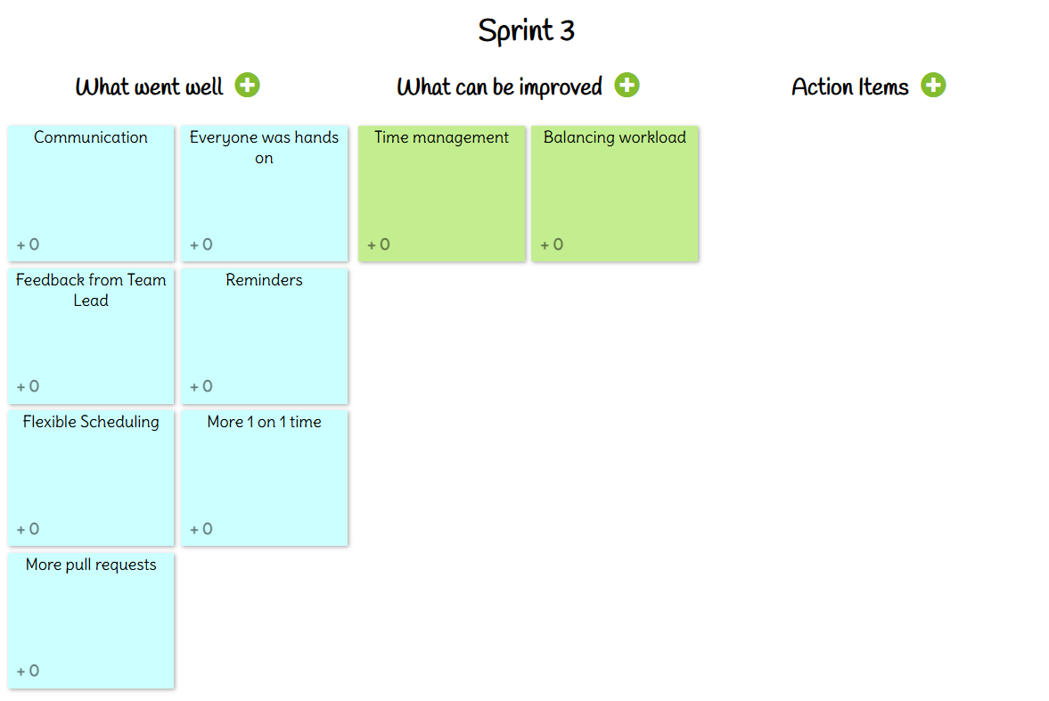
Sprint Retrospective

Slide 32

AI Disclosure
AI Was Used To:
Rapidly prototype screens
Provide answers on language’s syntax or usage
AI Was NOT Used To:
Generate ideas or features
Develop overall tech stack or flow between different components of the tech stack
Design key algorithms for NutriAI

Slide 33
Team Working Agreement
Communication
Weekly video meeting Saturday @ 4PM on Discord for updates and planning.
Weekly WhatsApp check-in on Wednesdays for status updates.
Members must give advance notice if missing meetings or becoming inactive.
Workflow
Each member works on their assigned feature branch.
A Task Tracker will manage assignments and deadlines.
Code merges require coordination and pull request approval.
Team Values
Treat all team members with respect.
Disagree professionally without personal attacks.
Raise concerns with the team before escalating.
Share work fairly.
Marking Tasks Complete
Features must meet agreed requirements.
Open a pull request and receive at least two approvals.
Update documentation and disclose any AI tool usage.

Slide 34
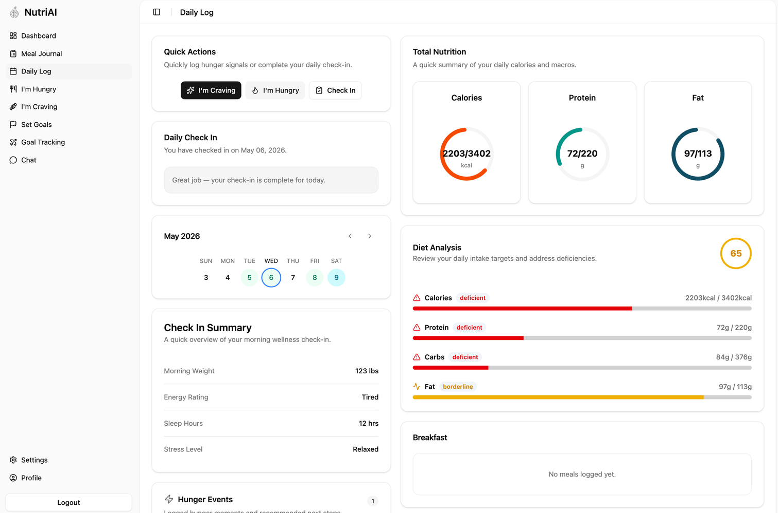
Demo
https://2026-sa-tech-docs.vercel.app/

Slide 35
Project Wiki Link
https://github.com/htmw/2026SA-TechDocs/wiki

Slide 36
THANK YOU!

