Slide 1
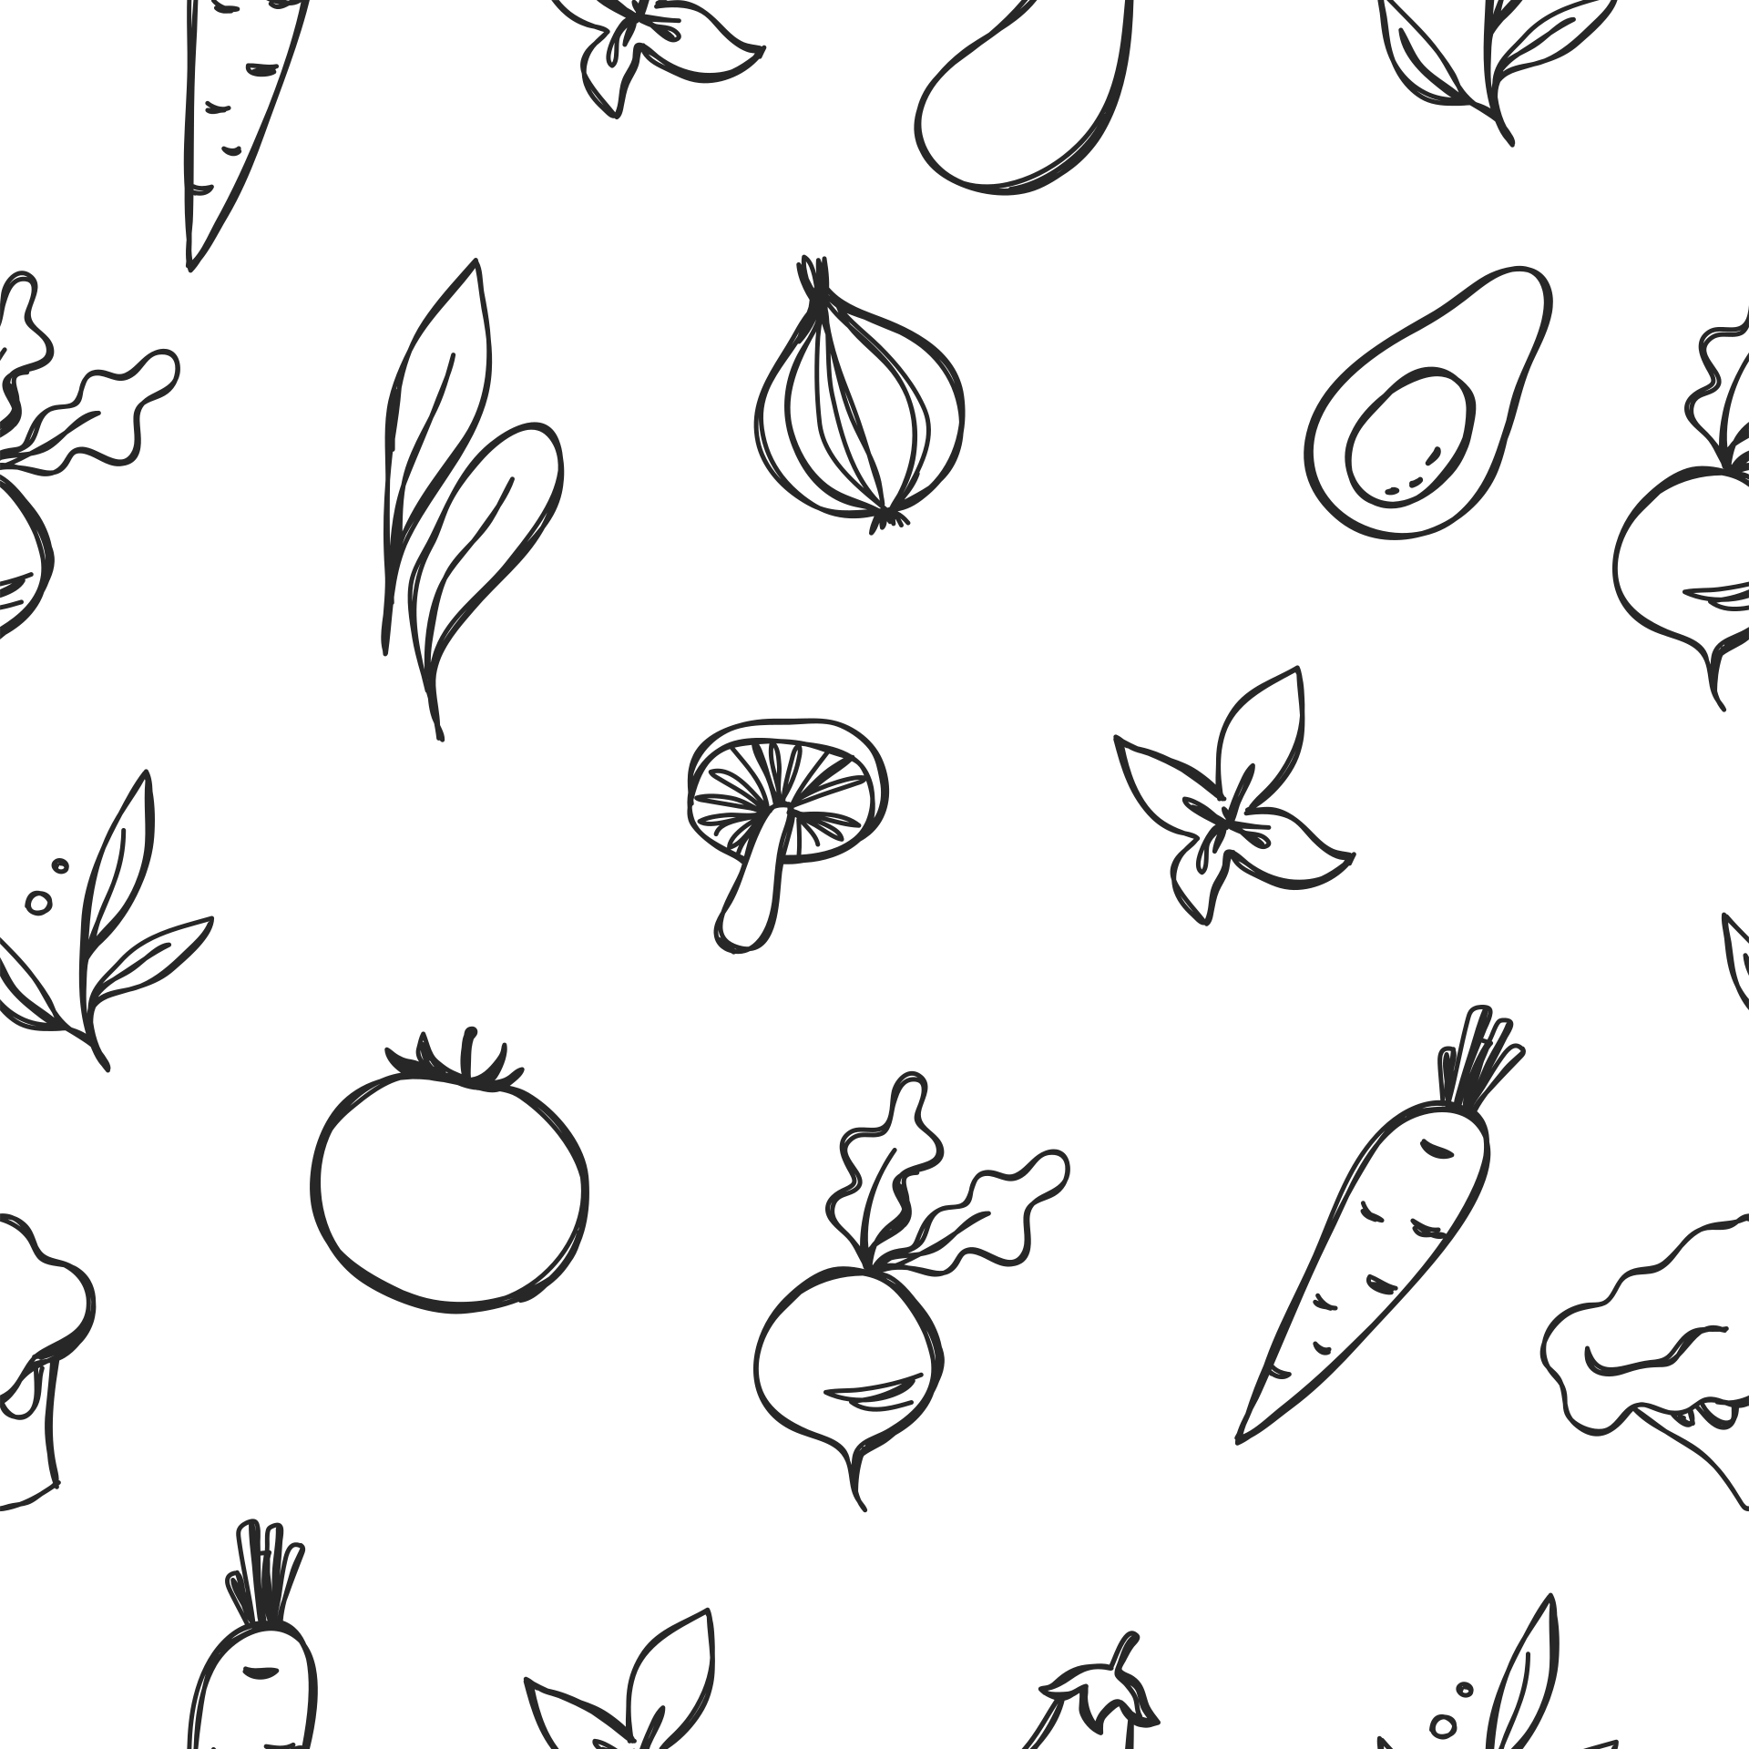




SPRINT 1
NutriAI
Presented By: TechDocs
CS691 Capstone Project
Professor Henry Wong

Slide 2


AGENDA
Project Description
MVP & Core Features
Diagrams
Algorithms
Product Backlog
Sprint 1 Backlog
Metrics
Personas
Technologies
Retrospective
Working Agreement
Github Link
Demo

Slide 3
Team Members & Roles
Alan Tsui - Team Lead/Full Stack Developer
Angel Flores - AI/Backend Developer
Erin Sorbella - ML/Front End Developer
James Ambenge - Full-Stack Developer
Qui Neubauer - Full-Stack Developer
Saba Alam - Project Manager/Tester

Slide 4
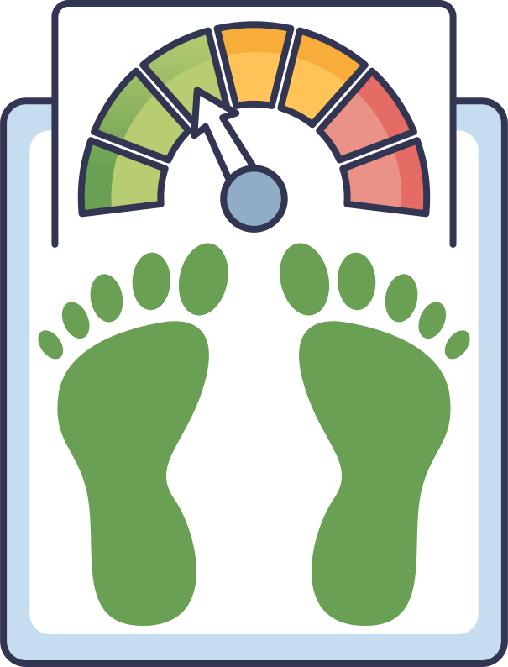

Project Description
NutriAI
This behavior-based app creates a nutrition plan based on your diet, energy, habits, and overall lifestyle. The main focus of this app is to make you healthier, feel more energetic, and reach or maintain a target weight. You can login daily and track your food, energy, and cravings.
The plan will adjust to your daily needs.

Slide 5


MVP/Core Features
Smart Plan Generator: Generates a personalized daily calorie and macro target.
“I’m Hungry” Button: Provides recommendations based on time since last meal and calorie intake.
“I’m Craving” Button: Allows users to select craving type and receive a simple intervention.
Basic Metrics Dashboard: Shows weight trend, calorie progress, and appetite score.
Recipe Recommender: Recommends a meal with ingredients and recipe instructions when hungry or craving.
User Login & Profile Setup: Basic account creation with weight, height, goal weight, and lifestyle inputs.

Slide 6
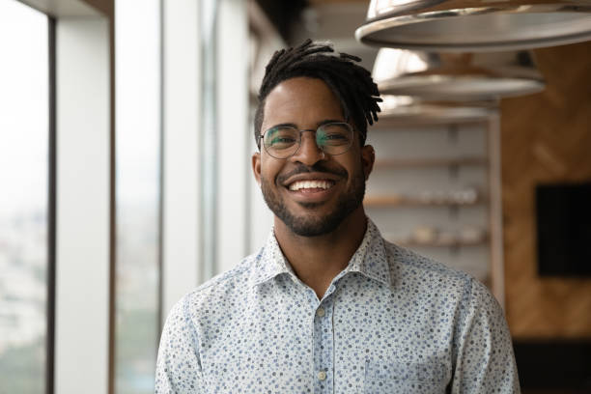
THE HEALTH OPTIMIZER
PERSONA
Age: 26
Occupation: IT Professional
Fitness Level: Moderate
Technology Comfort: High
Eric is a former athlete now adapting to a sedentary job. As someone in tech himself, he’s curious in seeing how far an app can be used to assist with nutritional and fitness needs.

Slide 7
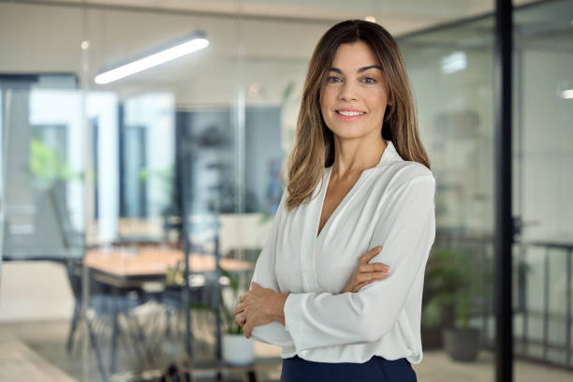
THE BUSY PROFESSIONAL
PERSONA
Age: 42
Occupation: Office Manager
Fitness Level: Beginner
Technology Comfort: Moderate
Jessica is dedicated to her work, often eating what is convenient rather than what’s healthy. After receiving advice from her doctor to have a more balanced diet, she looks into NutriAI.

Slide 8

THE OZEMPIC ALTERNATIVE
PERSONA
Age: 34
Occupation: University Professor
Fitness Level: Moderate
Technology Comfort: High
Dylan has recently stopped taking weight loss medication and is looking for help managing his diet and appetite. He’s interested in NutriAI for its “I’m Feeling Hungry” button.

Slide 9






Tech Stack
Frontend:
Backend:
Hosting:

Slide 10
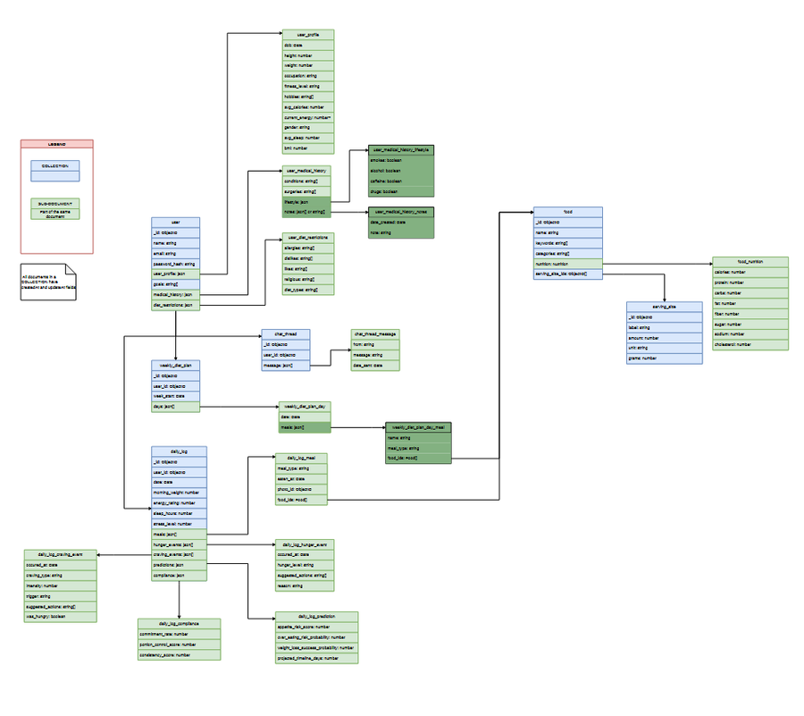
Diagrams - ER Diagram

Slide 11
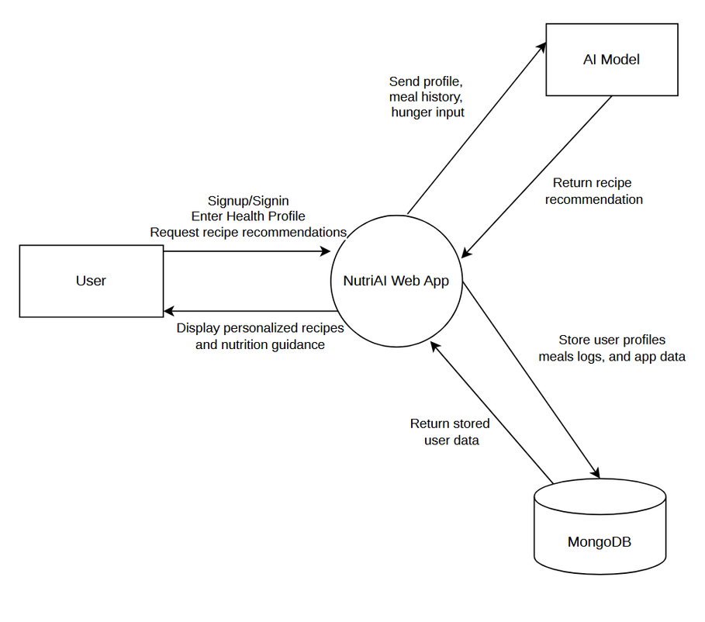
Diagrams - Context Diagram

Slide 12
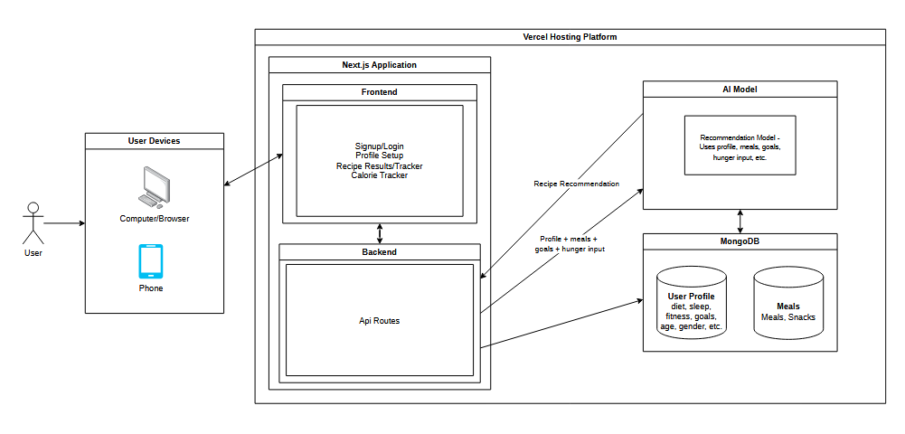
Diagrams - Architecture Diagram

Slide 13
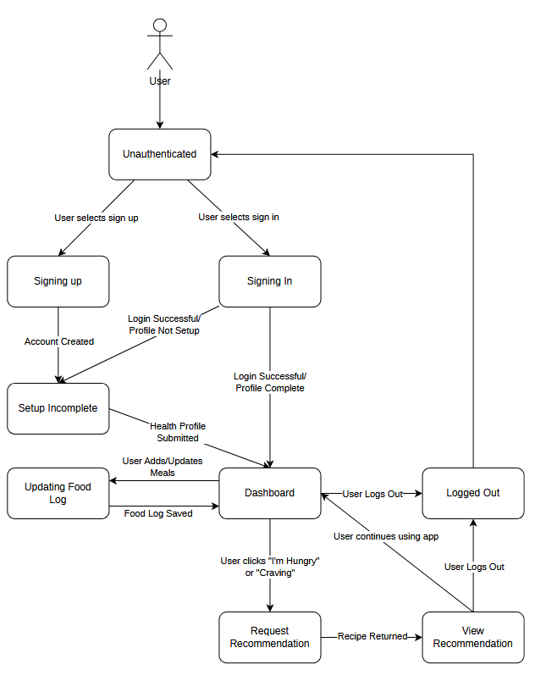
Diagrams - State Diagram

Slide 14
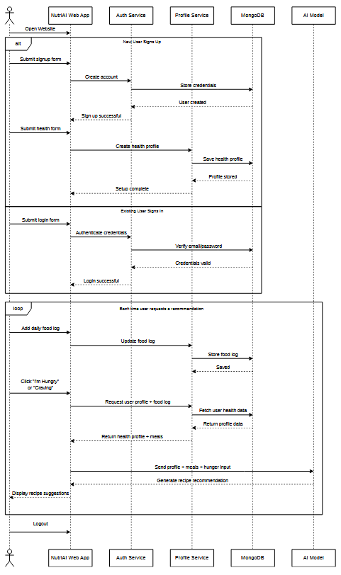
Diagrams - Sequence Diagram

Slide 15
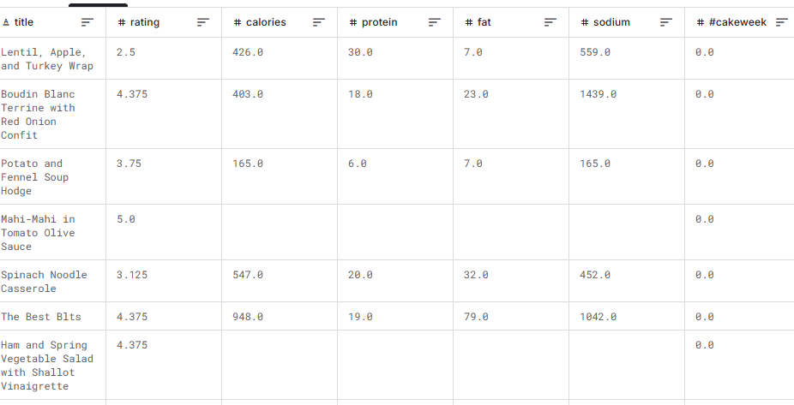
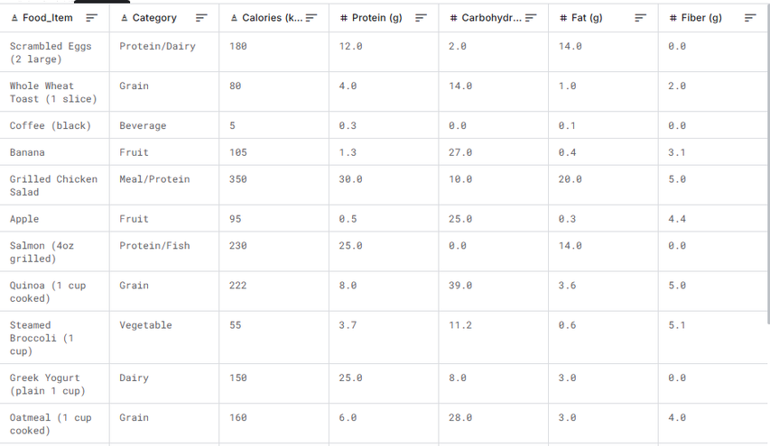
Dataset
Epicurious -
Recipes with Rating and Nutrition
https://www.kaggle.com/datasets/hugodarwood/epirecipes
Daily Food & Nutrition Dataset
https://www.kaggle.com/datasets/adilshamim8/daily-food-and-nutrition-dataset
20,000+ entries of data
600+ entries of data

Slide 16
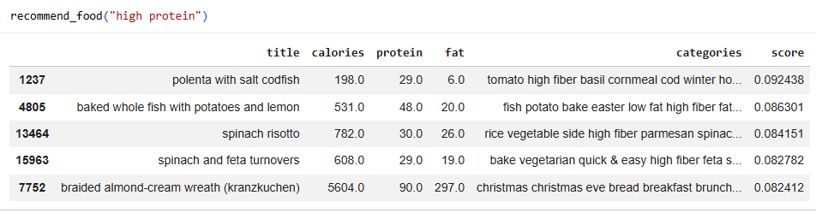
Algorithms
AI Recipe Recommender (Scikit-Learn)
Convert text data into numerical vectors using TF-IDF
Retrieve user information and user input for what they’re “craving”.
Clean user input by stripping symbols and spacing
Compare user input with recipe vectors
Cosine similarity measures matches with the user’s input and recipes in the dataset
Ranks recipe by similarity score
Returns top matching recipes as recommendations

Slide 17
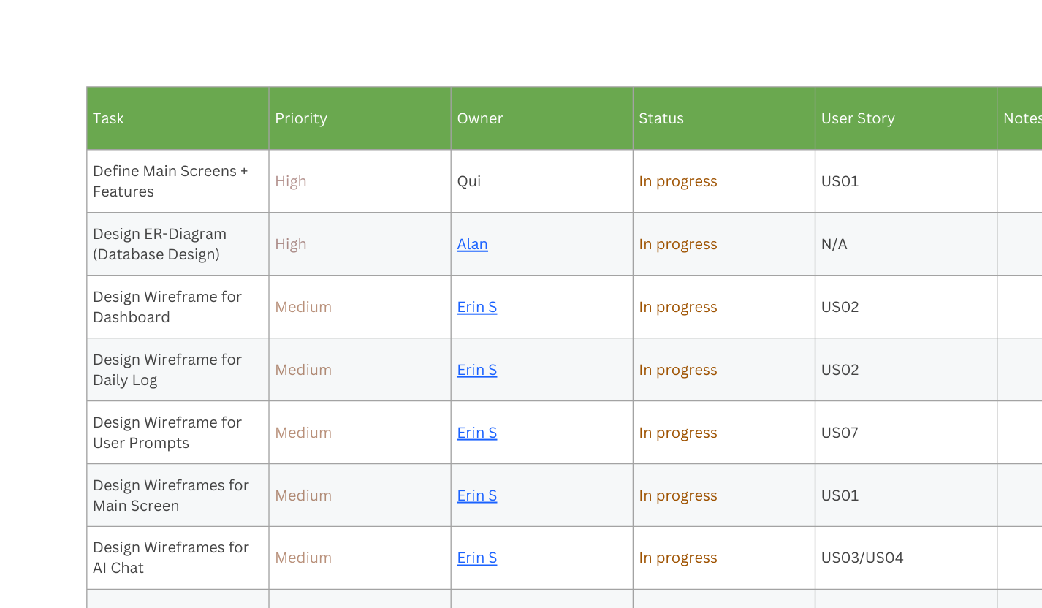
Sprint Backlog

Slide 18
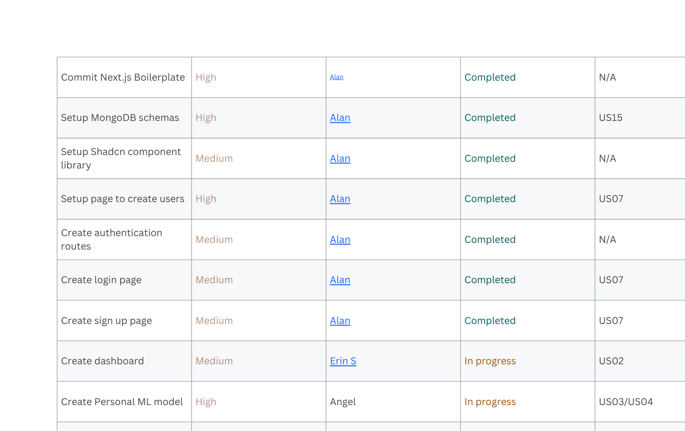
Sprint Backlog

Slide 19
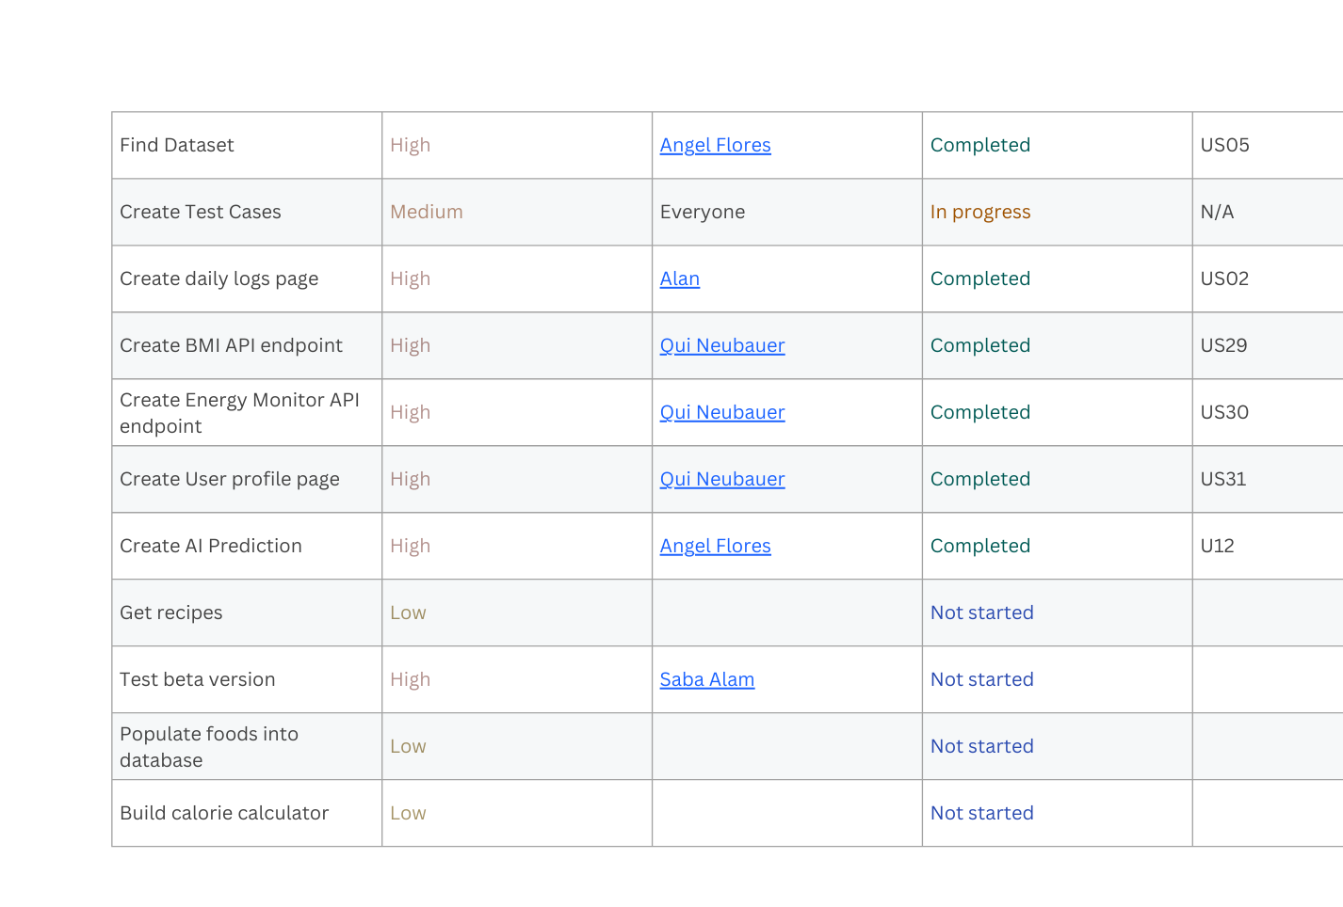
Sprint Backlog

Slide 20
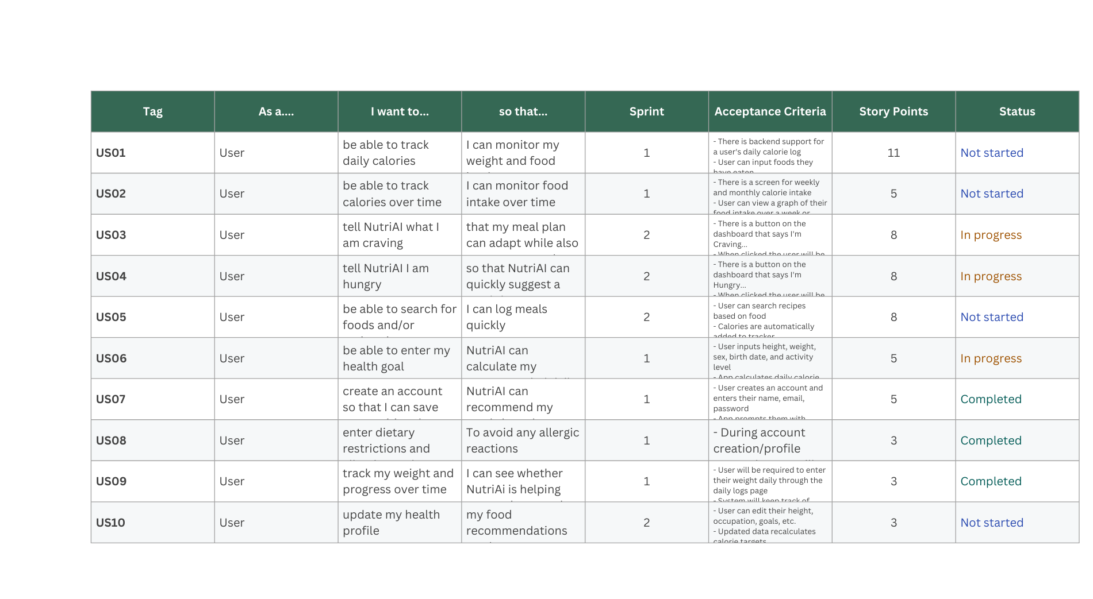
Product Backlog

Slide 21
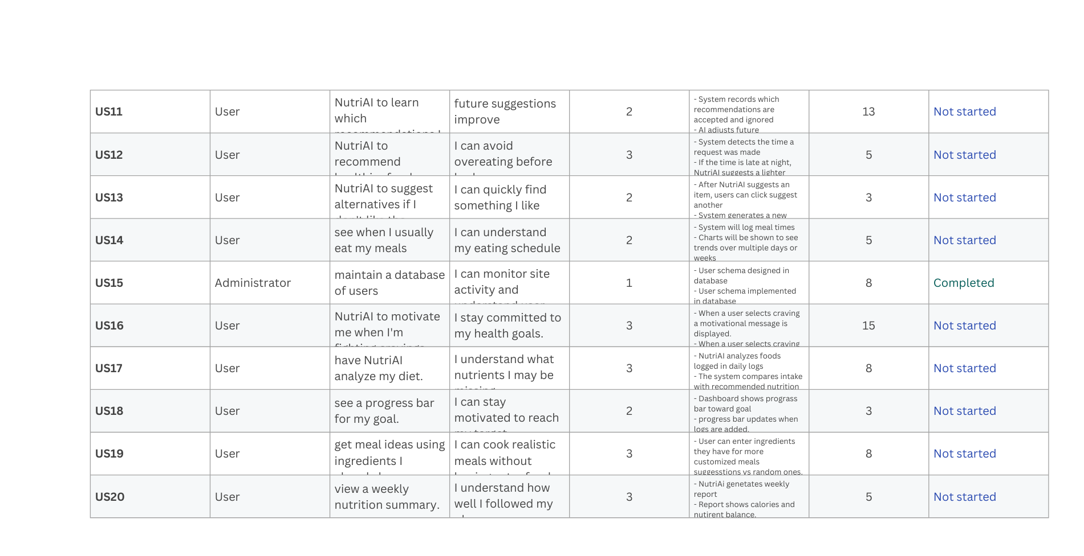
Product Backlog

Slide 22
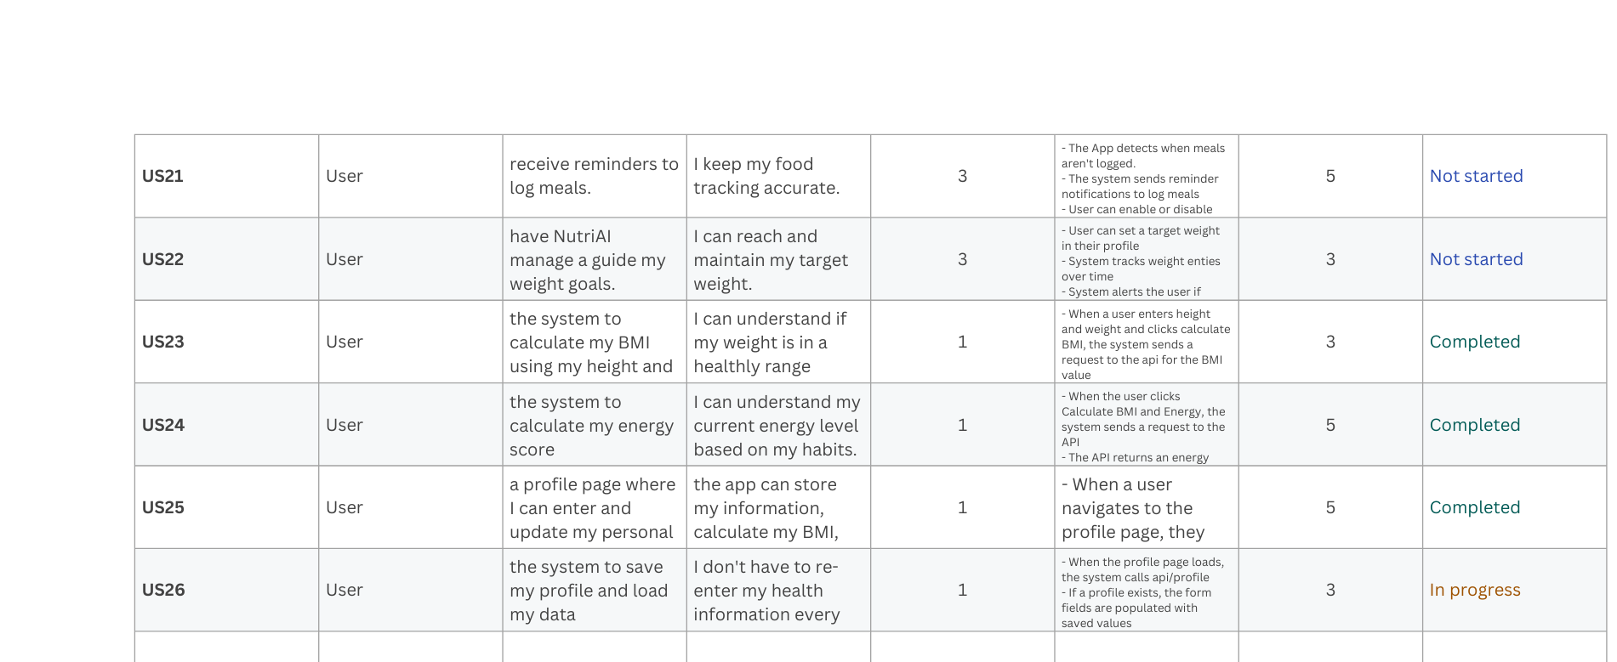
Product Backlog

Slide 23
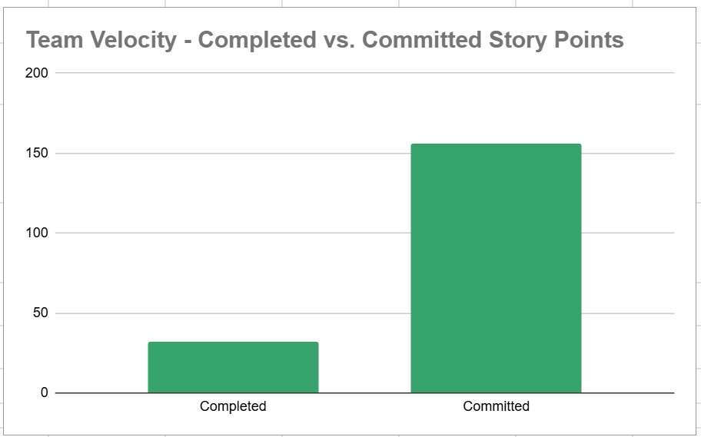
Metrics - Team Velocity

Slide 24
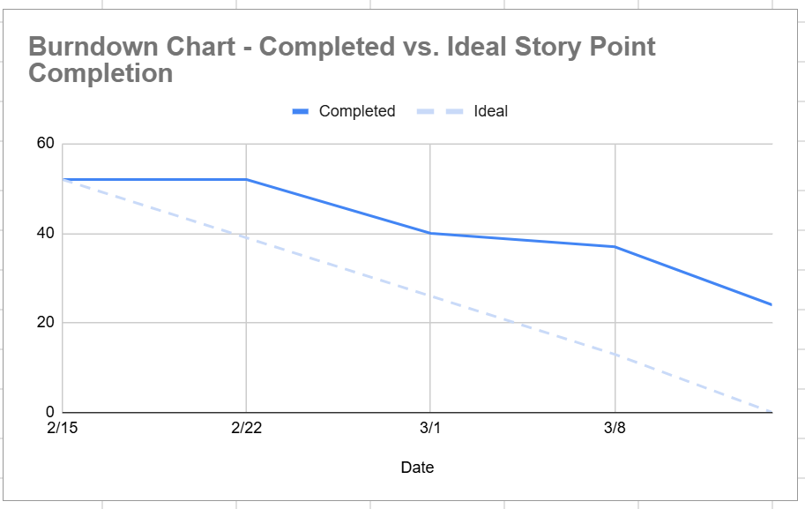
Metrics - Burndown Chart

Slide 25
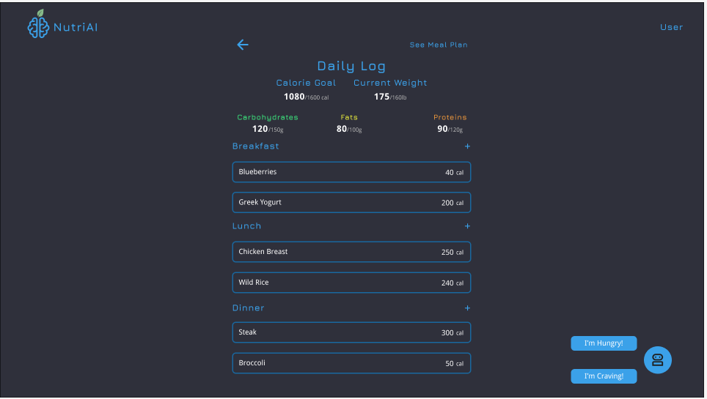
Mockups

Slide 26
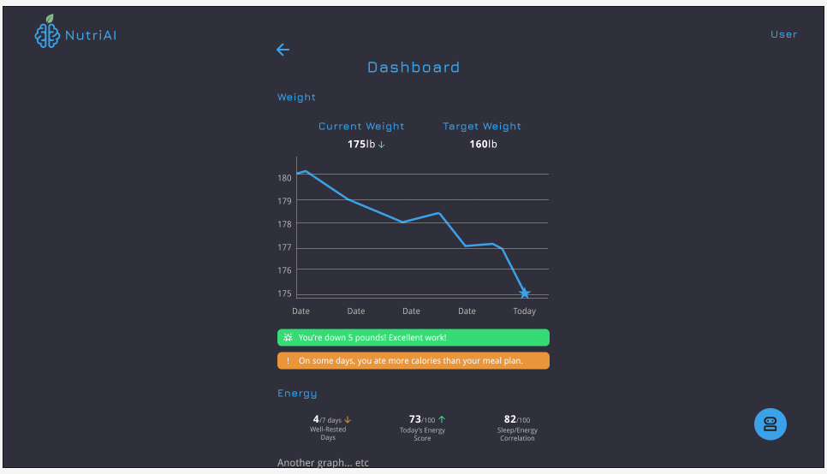
Mockups

Slide 27
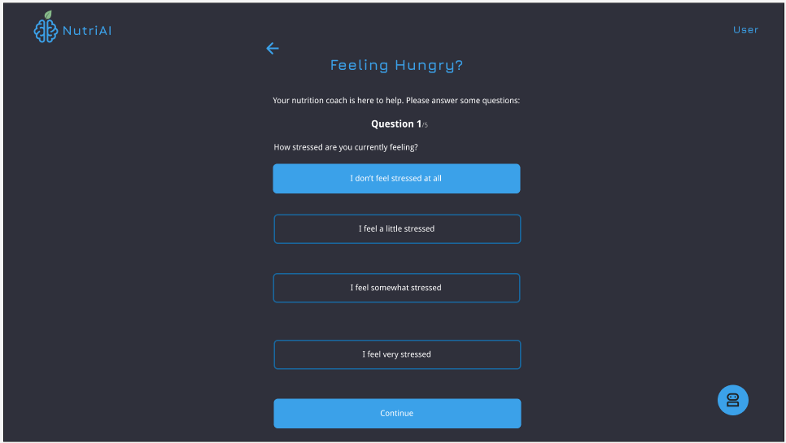
Mockups

Slide 28
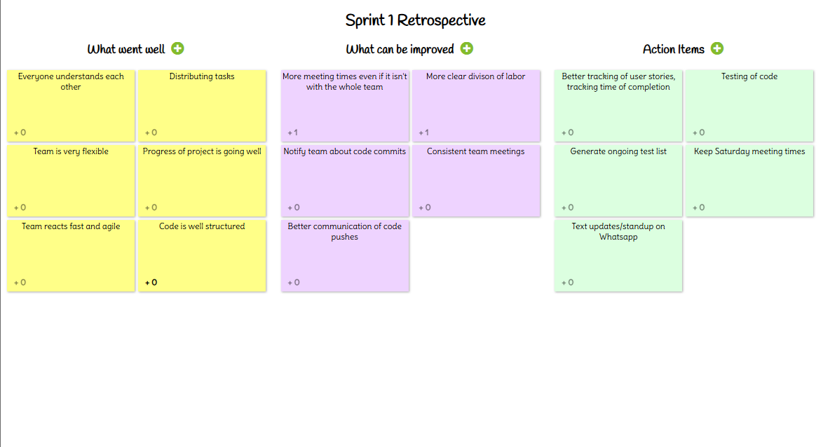
Sprint Retrospective

Slide 29
Team Working Agreement
Communication
Weekly video meeting Saturday @ 4PM on Discord for updates and planning.
Weekly WhatsApp check-in on Wednesdays for status updates.
Members must give advance notice if missing meetings or becoming inactive.
Workflow
Each member works on their assigned feature branch.
A Task Tracker will manage assignments and deadlines.
Code merges require coordination and pull request approval.
Team Values
Treat all team members with respect.
Disagree professionally without personal attacks.
Raise concerns with the team before escalating.
Share work fairly.
Marking Tasks Complete
Features must meet agreed requirements.
Open a pull request and receive at least two approvals.
Update documentation and disclose any AI tool usage.

Slide 30
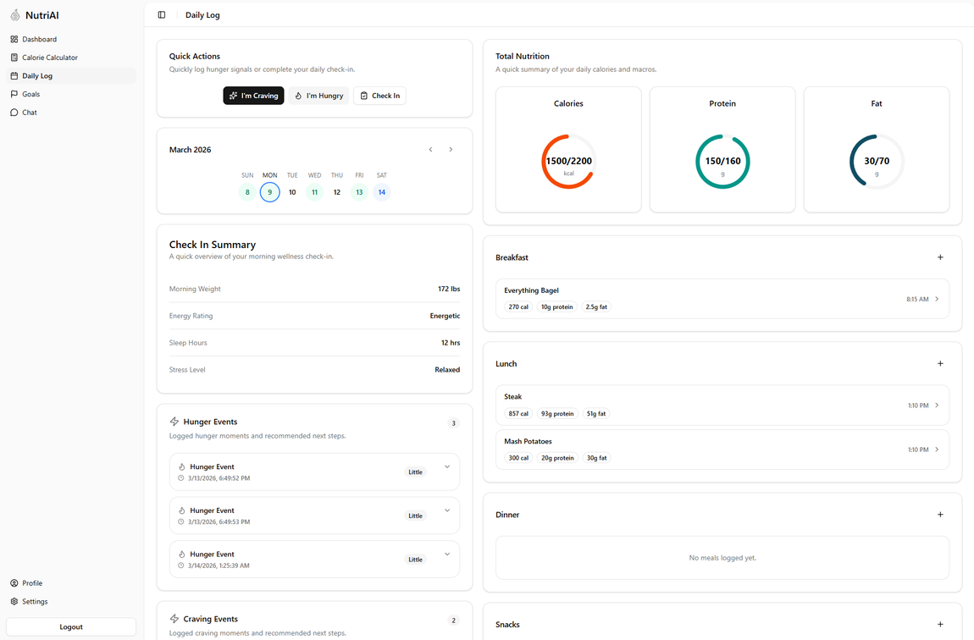
Demo
https://2026-sa-tech-docs.vercel.app/

Slide 31
Project Wiki Link
https://github.com/htmw/2026SA-TechDocs/wiki

Slide 32
THANK YOU!

