Slide 1
Sprint 2 Retrospective

Slide 2
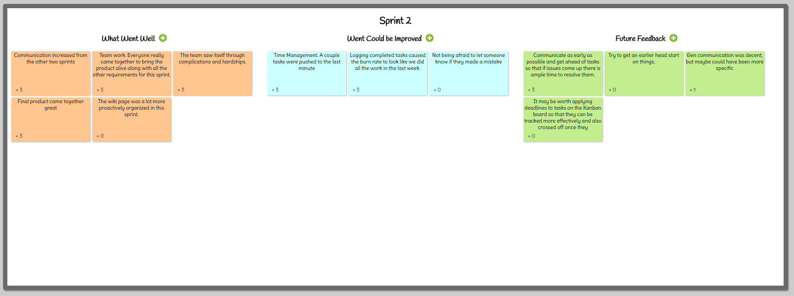
Screenshot of IdeaBoardz

