Slide 1



Crowdfunding
By
Team Nexus

Slide 2
Agenda
Team Member Roles | Improvements | Responsibilities
Problem Statement | Project Description | Team Working Agreement
User Personas | MVP | Project Design
Technologies | Algorithms | Diagrams
Product Backlog
Metrics
Sprint 2
User Stories
Test Cases
Stories Completed
Stories Not Completed
Metrics
Charts
Retrospective
Sprint 3
Project Demo

Slide 3


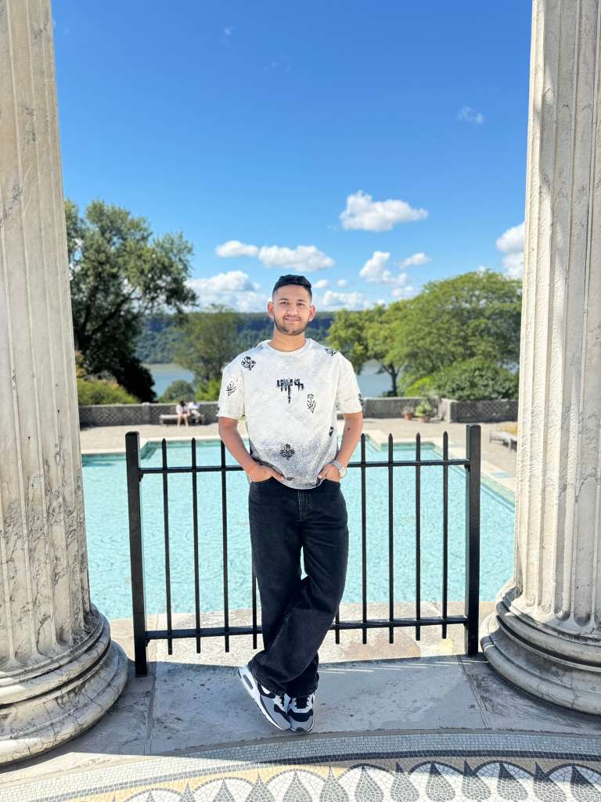
Getting to know the Team…
Ashwanth Maram Full Stack Developer
Ashwitha Maram
Developer/Tester
Raj Mandaliya
Block Chain Developer

Slide 4
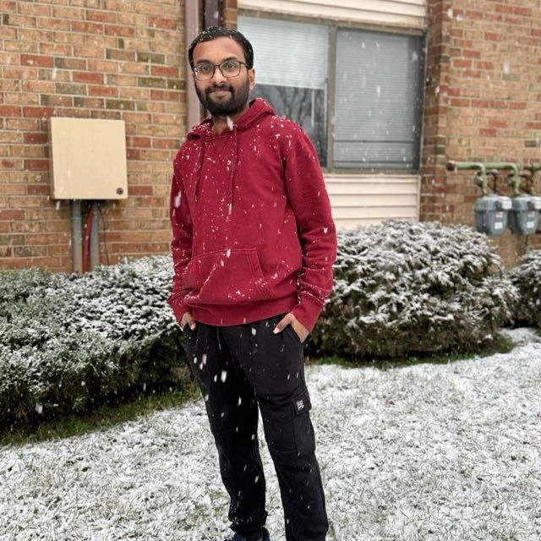
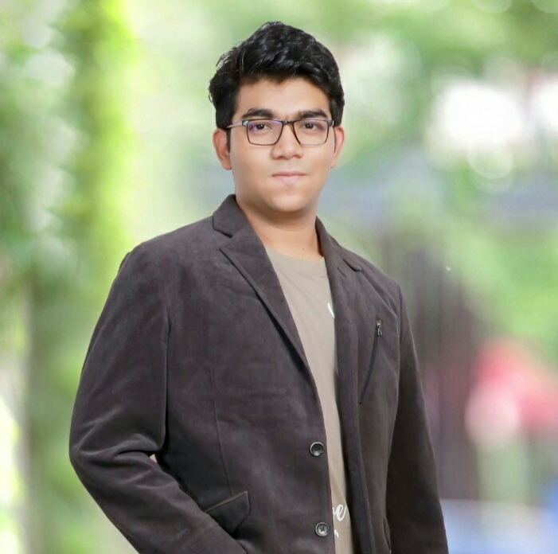

Getting to know the Team…
Vinukonda Yashwanth Reddy Backend and Database Engineer
Nyi Nyi Lwin Full Stack Developer
Naveen Pesalabanda
SCRUM Master

Slide 5
Improvements
Fixed the Diagrams (Architecture Diagram, Context Diagram, ER Diagram, Class Diagram, Sequence Diagram)
Improve the Metrics (Team Velocity, Sprint Burn down Chart, Completed Committed Ratio)
Improve user story points and product backlog

Slide 6
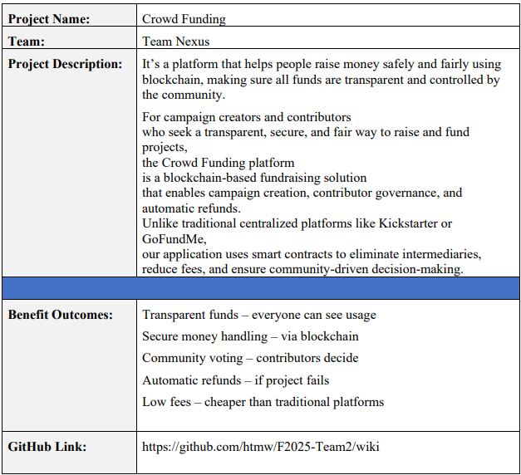
Project Description

Slide 7
Team Working Agreement
Communication Expectations
Use Zoom, GitHub for collaboration.
Respect everyone opinions; decisions are made collectively.
Notifying the team in advance if you cannot complete or attend.
In case of any conflicts, present research-backed solutions and resolve by majority vote.
Keeping everyone updated when pushing code or making changes.
No last-minute dumping of work on others.
Meeting Schedules
Meetings will be held twice weekly on Zoom or Google meet
Meeting time is set based on availability.
Agenda will be shared in advance for preparation.
Sprint Planning at the start, Retrospective at the end of each sprint.
Absence must be informed ahead of time; member must read meeting summary.
All members are expected to participate and contribute fairly.

Slide 8
Team Working Agreement
Checklist for Task Completion
Code should run without errors.
Work must meet all acceptance criteria.
Each task is reviewed and tested by everyone
Documentation should be updated with the task.
Final review by all team members before submission.
Team Dynamics & Principles
Each member must clearly understand and own their tasks.
Workload distributed fairly; large tasks broken into smaller ones.
Every task has a deadline and review on completion.
Encourage problem-solving before escalating blockers.
Trackers must be updated regularly.
Work progress should be committed and shared on GitHub.

Slide 9

The Startup Founder Persona
Name: Alice Johnson Age: 28 Gender: Female Occupation: Startup Founder
Alice is an ambitious entrepreneur developing a sustainable fashion brand. She wants to raise money to bring her eco-friendly products to market but struggles with high fees and limited visibility on traditional crowdfunding platforms.
Challenges:
Struggles to gain trust from contributors due to lack of transparency.
Centralized platforms charge high fees, cutting into her funding.
Limited control over how her campaign is presented.
Goals:
Raise funds fairly and transparently.
Build credibility with backers.
Ensure contributors see exactly how their money is being used.

Slide 10

The Investor Persona
Name: Bob Smith Age: 35 Gender: Male Occupation: Investor
Bob is a passionate investor who likes to fund innovative projects. He wants to support creators but often worries about whether his money is being used properly and feels disconnected after contributing.
Challenges:
Unsure if funds are spent transparently
No refunds if a project fails
Has no control once money is invested
Goals:
Invest with full transparency and security
Receive refunds if funding goals aren’t met
Have a say in how project funds are used through voting

Slide 11

The Community Member Persona
Name: Cathy Lee Age: 22 Gender: Female Occupation: College Student / Community Member
Cathy is an active member of online communities and DAOs. She enjoys contributing to causes but wants her voice to count, not just her money.
Challenges:
No say in how project funds are allocated
Hesitant to contribute without accountability
Finds most platforms profit-driven and restrictive
Goals:
Participate in voting and decision-making
Support transparent, community-driven projects
Learn about blockchain while backing meaningful causes

Slide 12
MVP
Campaign Creation: Allow users to launch funding campaigns with metadata (title, goal, deadline).
Contribution Logic: Accept ETH contributions and track them per user.
Refund Mechanism: Automatically refund contributors if the goal isn’t met.
Governance Voting: Let contributors vote on fund allocation or milestones.

Slide 13

TOOLS &Technologies
Blockchain: Ethereum + Solidity
Development: Remix IDE, Hardhat
Network: MetaMask, Sepolia Test Network, Sepolia ETH Faucets
Deployment & Testing: Hardhat
Collaboration Tools: GitHub, VS Code

Slide 14
Algorithms & Logic
Smart Contract–Based Voting Mechanism Implements a weighted voting system based on user stake or role. Ensures tamper-proof, transparent decision-making using smart contracts.
Refund Logic Automatically refunds users if the funding goal is not achieved. Executed via smart contract conditions to ensure user trust.
Fraud Detection Rules (Optional) Detects suspicious behavior like duplicate voting or fake contributions. Helps maintain fairness and integrity in decentralized processes.

Slide 15
Diagrams

Slide 16
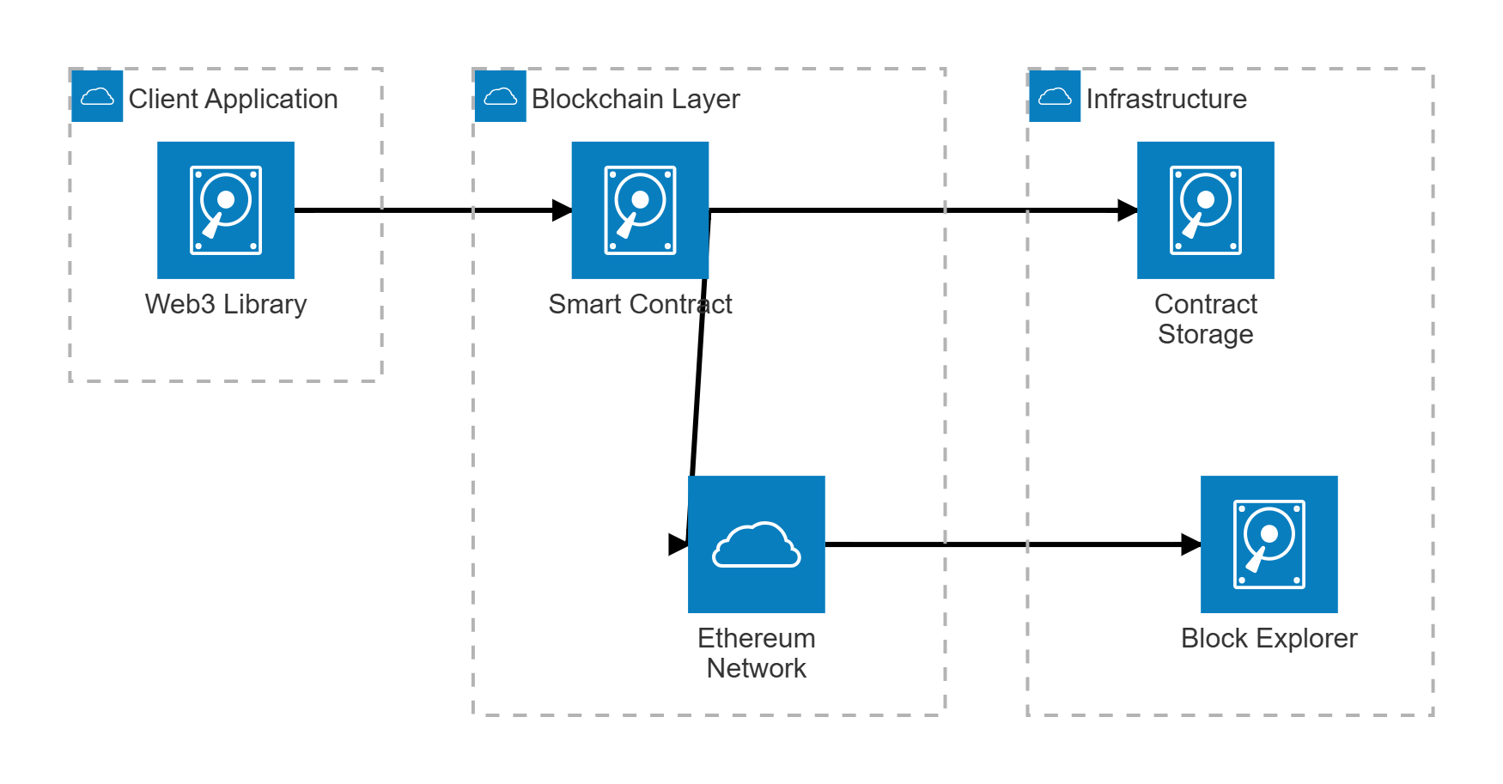
Architecture Diagram

Slide 17
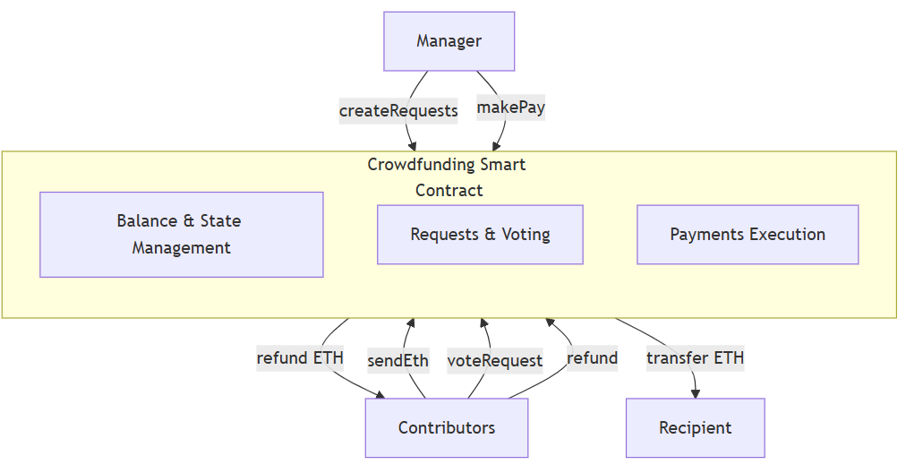
Context Diagram

Slide 18
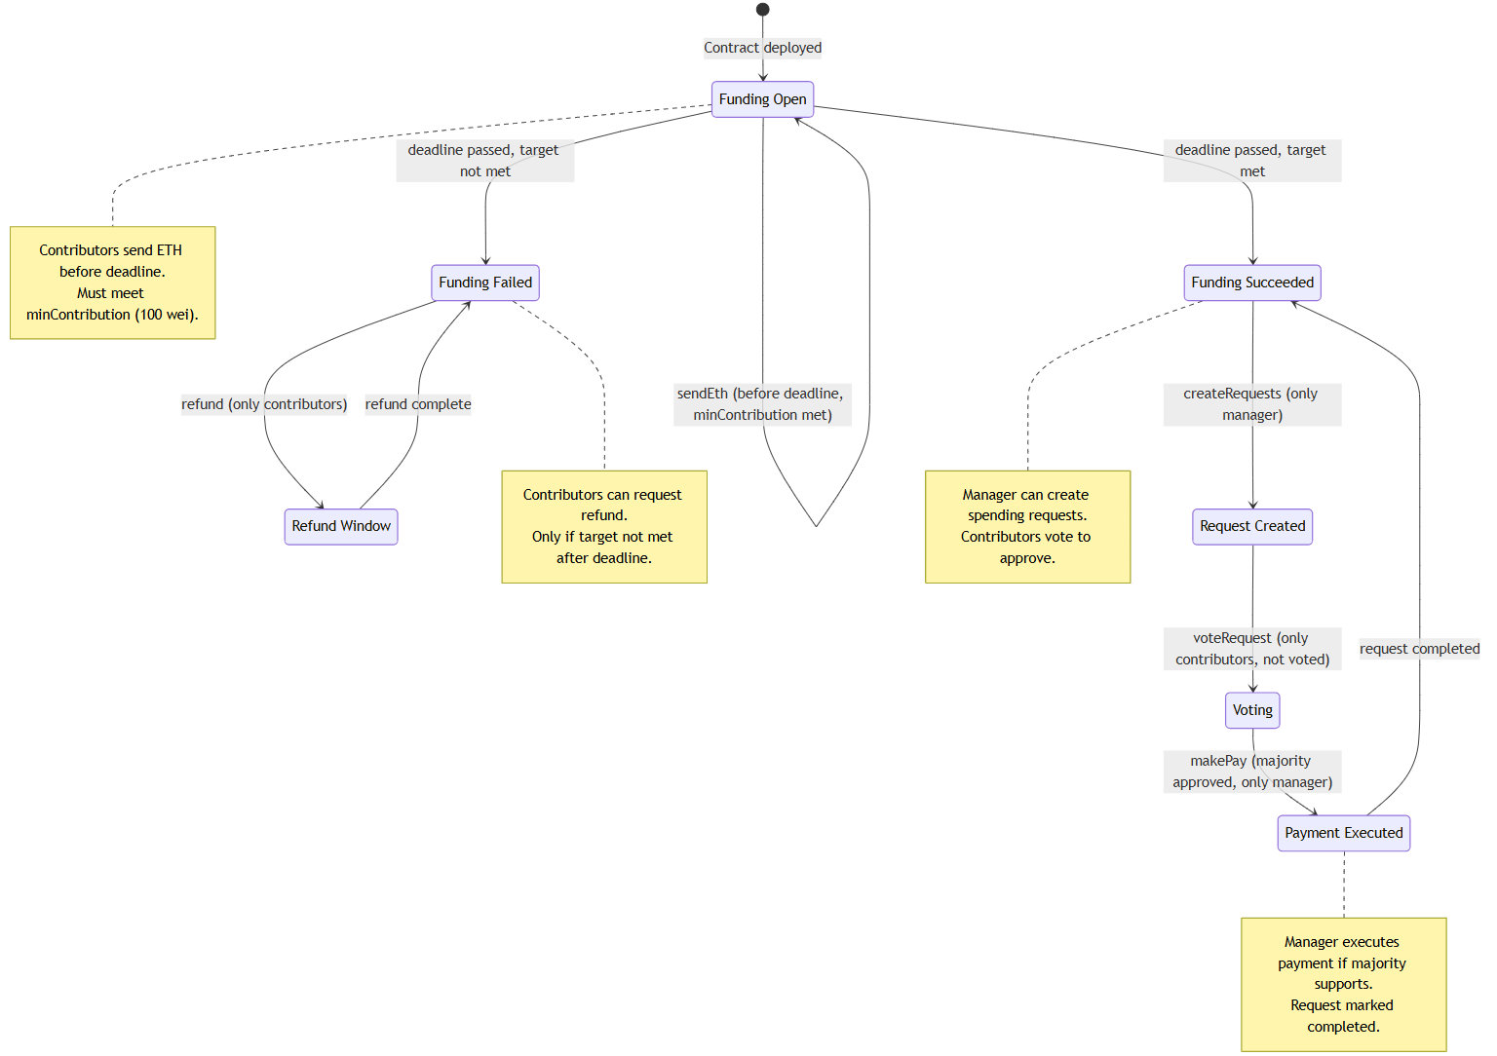
state Diagram

Slide 19
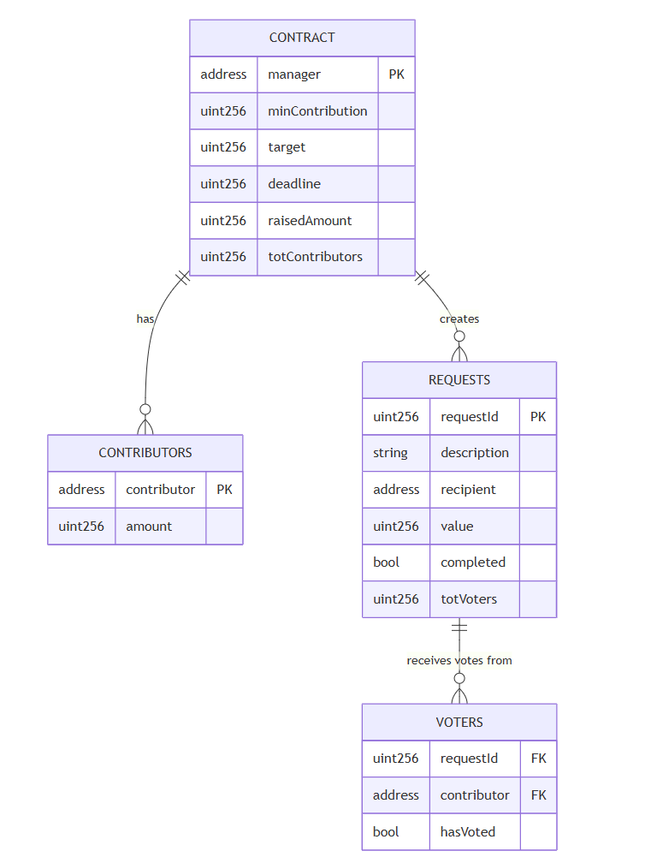
ER Diagram

Slide 20
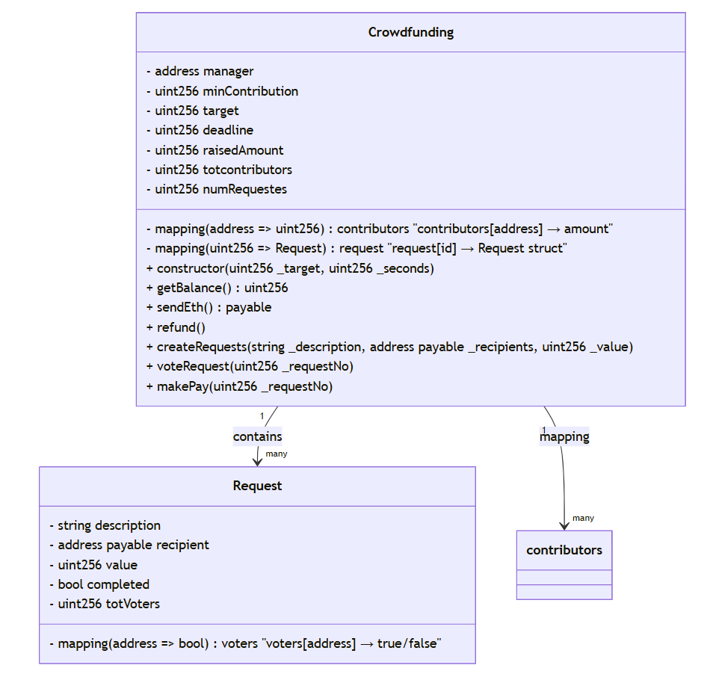
Class Diagram

Slide 21
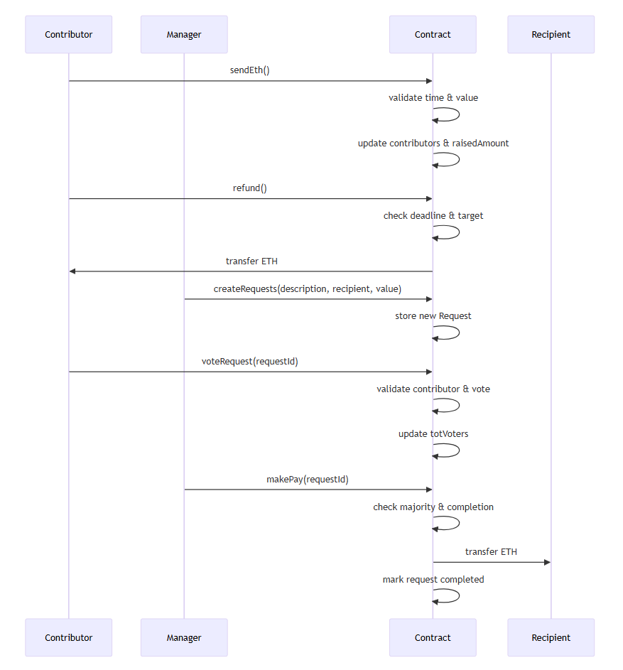
Sequence Diagram

Slide 22
Sprint 1 Recap

Slide 23
Product Backlog

Slide 24
No. | User Story | Acceptance Criteria | Feature Name | Component | Story Points
US_01 | As a campaign manager, I want to create a new campaign with a target and deadline so that I can raise funds. | Given I am the manager, When I deploy the contract with a target and deadline, Then the campaign is initialized and I am set as owner. | Campaign Creation | Smart Contract | 8
US_02 | As a contributor, I want to contribute funds to a campaign so that I can support causes I believe in. | Given the campaign is active, When I send ETH above the minimum, Then my contribution is recorded and the total raised updates. | Campaign Contribution | Smart Contract | 5
US_03 | As a contributor, I want to get a refund if the campaign fails so that I don’t lose my funds. | Given the deadline has passed and the target was not met, When I request a refund, Then I receive my ETH and my record is cleared. | Refund Processing | Smart Contract | 5
US_04 | As a manager, I want to create spending requests so that I can propose how to use the raised funds. | Given I am the manager, When I create a request with description, amount, and recipient, Then the request is stored with a unique ID. | Request Creation | Governance | 8
US_05 | As a contributor, I want to vote on spending requests so that I can influence how funds are used. | Given I am a contributor, When I vote on a request I haven’t voted on before, Then my vote is recorded and vote count increases. | Request Voting | Governance | 5

Slide 25
No. | User Story | Acceptance Criteria | Feature Name | Component | Story Points
US_06 | As a manager, I want to release funds after majority approval so that requests can be fulfilled responsibly. | Given the deadline has passed and the target is met, When a request has majority support and I execute it, Then ETH is transferred and request marked completed. | Fund Release | Governance | 8
US_07 | As a user, I want to view all campaigns with details so that I can choose which to support. | Given campaigns exist, When I open the campaign list, Then I see each campaign’s goal, raised amount, and current status. | Campaign Listing | Data Display | 5
US_08 | As a user, I want to see campaign status so that I know whether it’s active, successful, or failed. | Given a campaign has a deadline and target, When time passes or funds are raised, Then the status updates to Active, Successful, or Failed. | Campaign Status | Data Display | 3
US_09 | As a system, I want to validate minimum contributions so that campaigns remain fair and secure. | Given a contribution is below the minimum, When a user tries to send ETH, Then the transaction is rejected and an error message is shown. | Validation Logic | Contract Validation | 2

Slide 26
Product Backlog overview
Sprint 1 (15 pts) | Sprint 2 (21 pts) | Sprint 3 (13 pts)
US_01: As a campaign manager, I want to create a new campaign with a target and deadline so that I can raise funds. | US_04: As a manager, I want to create spending requests so that I can propose how to use the raised funds. | US_03: As a contributor, I want to get a refund if the campaign fails so that I don’t lose my funds
US_02: As a contributor, I want to contribute funds to a campaign so that I can support causes I believe in | US_05: As a contributor, I want to vote on spending requests so that I can influence how funds are used. | US_07: As a user, I want to view all campaigns with details so that I can choose which to support.
US_09: As a system, I want to validate minimum contributions so that campaigns remain fair and secure. | US_06: As a manager, I want to release funds after majority approval so that requests can be fulfilled responsibly. | US_08: As a user, I want to see campaign status so that I know whether it’s active, successful, or failed.

Slide 27
Sprint 2

Slide 28
Sprint 2 Backlog
No. | User Story | Acceptance Criteria | Feature Name | Component | Story Points | Assigned to
US_04 | As a manager, I want to create spending requests so that I can propose how to use the raised funds. | Given I am the manager, When I create a request with description, amount, and recipient, Then the request is stored with a unique ID. | Request Creation | Governance | 8 | Ashwanth| Yashwanth
US_05 | As a contributor, I want to vote on spending requests so that I can influence how funds are used. | Given I am a contributor, When I vote on a request I haven’t voted on before, Then my vote is recorded and vote count increases. | Request Voting | Governance | 5 | Nyi Nyi | Raj
US_06 | As a manager, I want to release funds after majority approval so that requests can be fulfilled responsibly. | Given the deadline has passed and the target is met, When a request has majority support and I execute it, Then ETH is transferred and request marked completed. | Fund Release | Governance | 8 | Ashwitha | Naveen

Slide 29
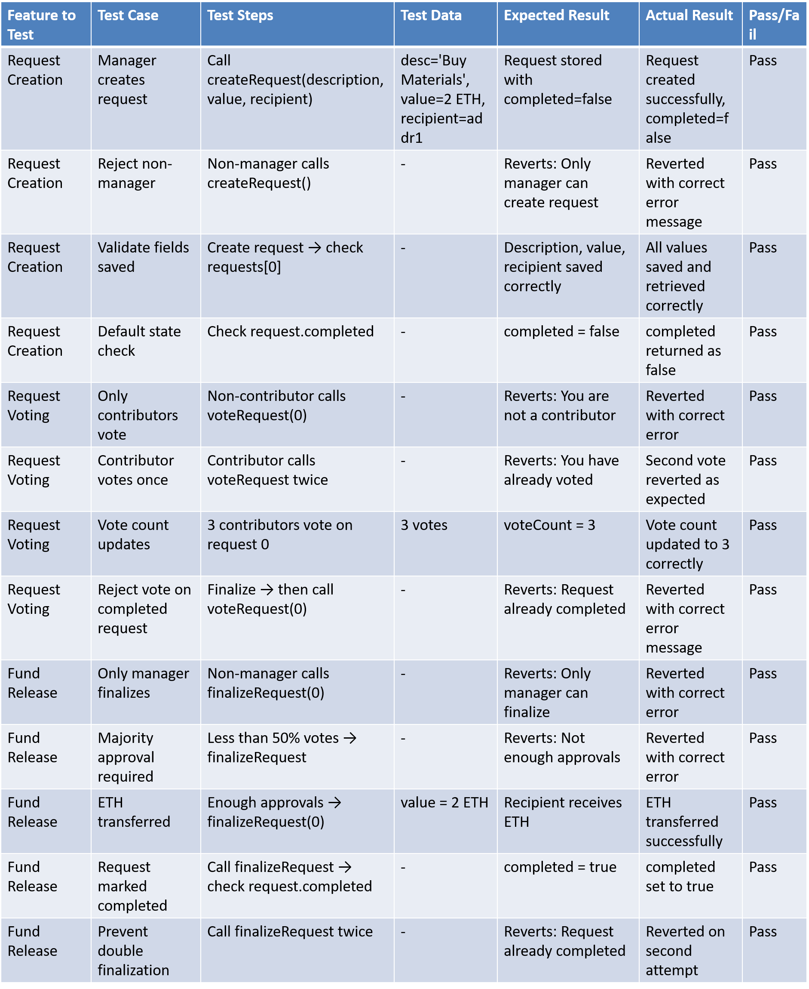
Sprint 2 Backlog testcases

Slide 30
Stories completed
No. | User Stories | Completed Date | Story Points | Completed Points
US_04 | As a Manager, I want to create spending requests for raised funds. | Oct 22 - Oct 28 | 8 | 8
 | Manager creates request. | Oct 22 - Oct 25 | 2 | 2
 | Reject non-manager. | Oct 25 - Oct 26 | 4 | 4
 | Validates fields saved & check the default state. | Oct 26 - Oct 28 | 2 | 2
US_05 | As a contributor, I want to vote on spending requests. | Oct 28 - Nov 6 | 5 | 5
 | Only contributors vote | Oct 28 - Oct 30 | 1 | 1
 | Contributor votes only once. | Oct 30 - Nov 3 | 2 | 2
 | Vote count updates & reject vote on completed requests. | Nov 3 - Nov 6 | 2 | 2
US_06 | As a manager, I want to release funds after majority approval. | Nov 6 - Nov 12 | 8 | 8
 | Only manager finalizes & executes payments, majority approval required | Nov 6 - Nov 8 | 4 | 4
 | ETH transferred & request marked completed & finalization | Nov 8 - Nov 12 | 4 | 4

Slide 31
Metrics: sprint 2
Completed Committed Ratio: Current CCR: 1.0, Previous CCR: 1.0, Historical CCR: 1.0
Story ID | Story description | Story points estimated | Story points delivered
US_04 | As a Manager, I want to create spending requests for raised funds | 8 | 8
US_05 | As a contributor, I want to vote on spending requests. | 5 | 5
US_06 | As a manager, I want to release funds after majority approval. | 8 | 8

Slide 32
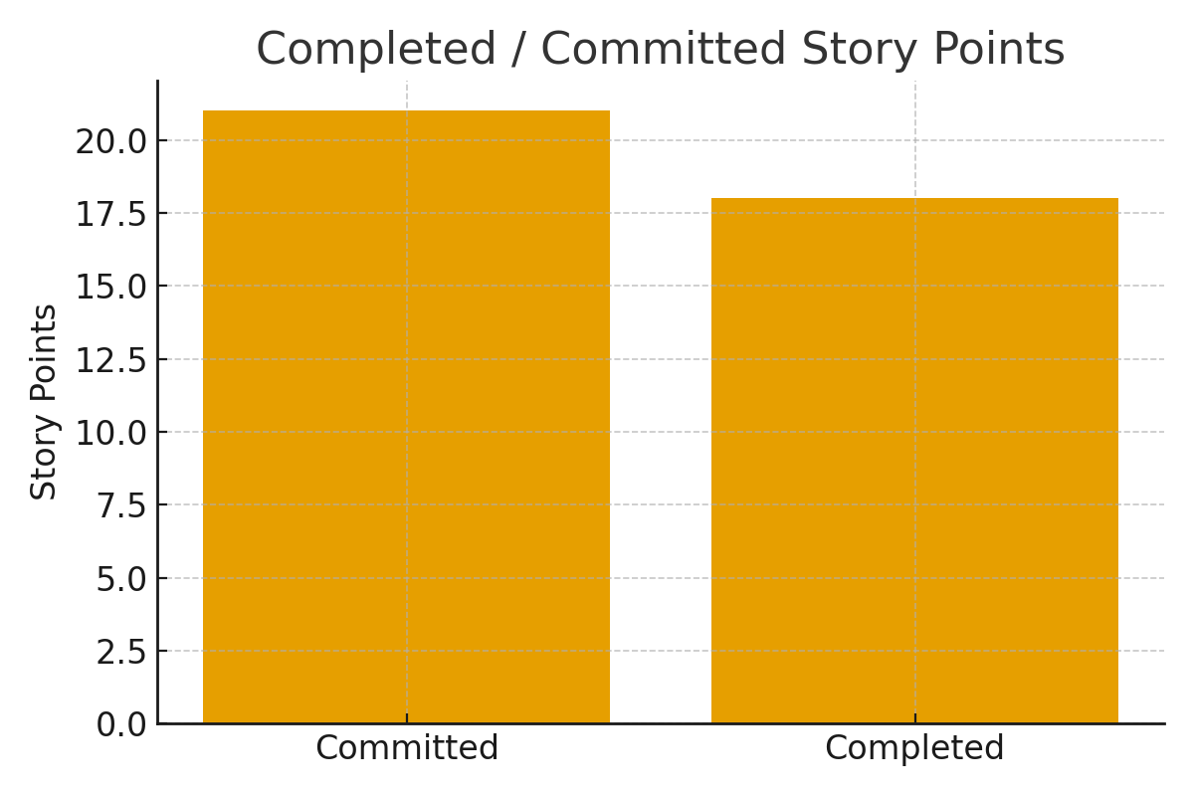
Completed/Committed Ratio

Slide 33
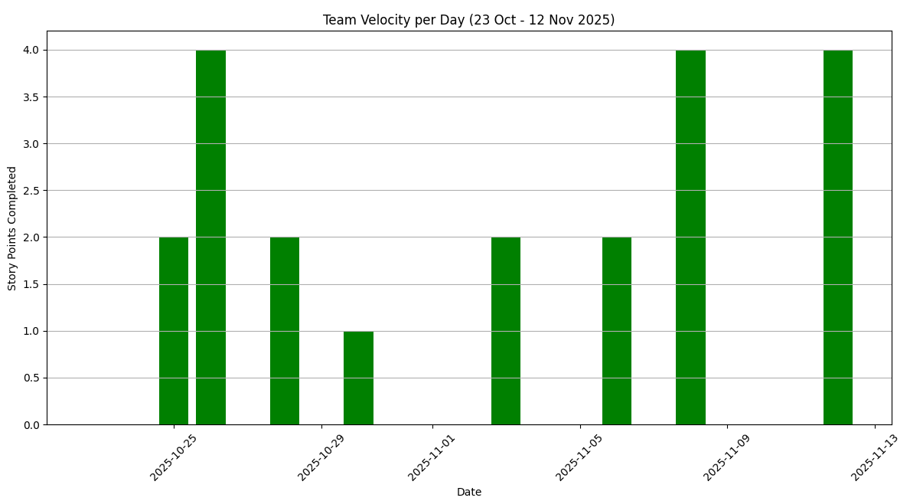
Metrics: Team Velocity
Metric | Value
Total estimated points: | 21
Total points delivered: | 21
Points carried over: | 0
Team Velocity: | 21
Current Sprint Velocity: 21
Historical Velocity (previous sprint): 15
Average Velocity (all sprints): 18

Slide 34
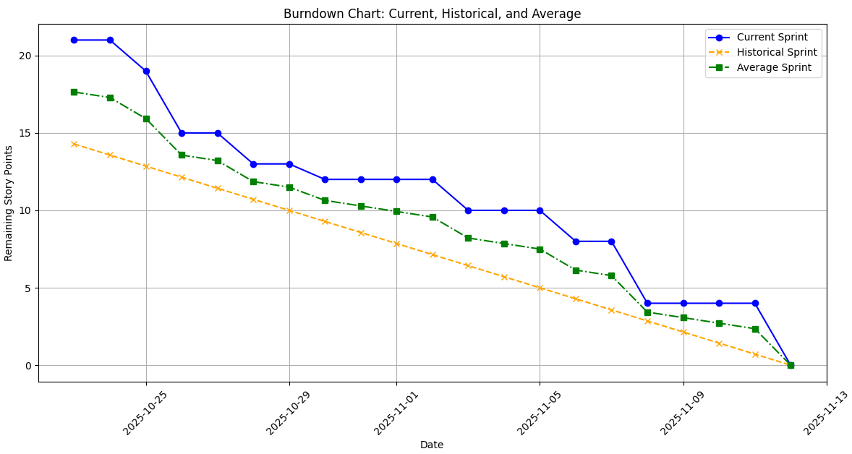
Metrics: Burndown Chart

Slide 35
Sprint 2 retrospective
What went well?
Better coordination among team members.
Faster task completion compared to Sprint 1
Clear understanding of the blockchain workflow
Improved GitHub collaboration and fewer merge conflicts
Stand-up meetings were more focused and time-efficient
Test cases were prepared and executed more consistently
What could be improved?
Need more clarity in dividing complex tasks
Some stories took longer due to dependency bottlenecks
Communication gaps during mid-sprint days
Limited time spent on reviewing pull requests
Need to improve test coverage and documentation updates
Our commitments
Break down big stories into smaller, achievable tasks
Increase communication on blockers in daily stand-ups
Maintain consistent Jira updates
Improve unit testing and peer-review process
Enhance coordination between blockchain and backend integration
Finish high-priority stories earlier in the sprint

Slide 36
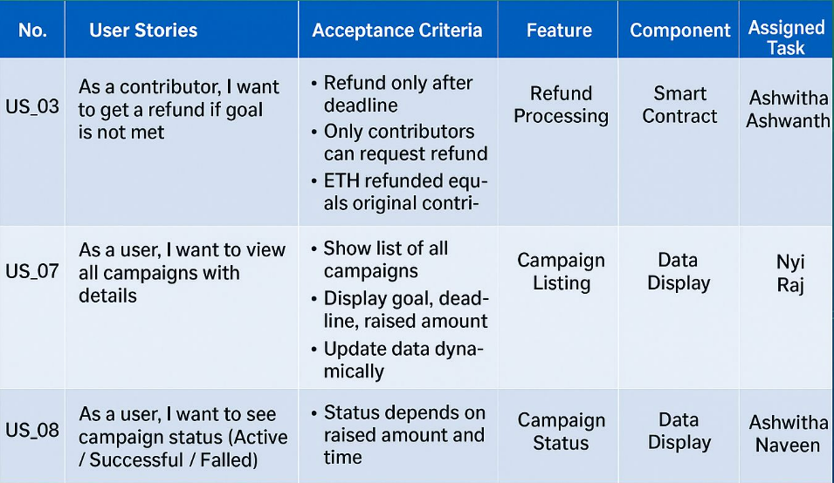
Sprint 3 Planning

Slide 37
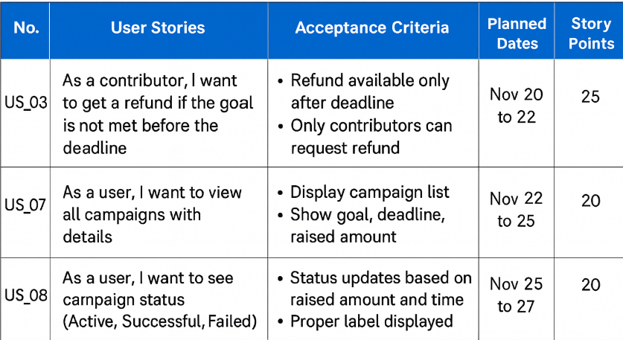
Sprint-3 Stories Planned

Slide 38
Project demo

Slide 39

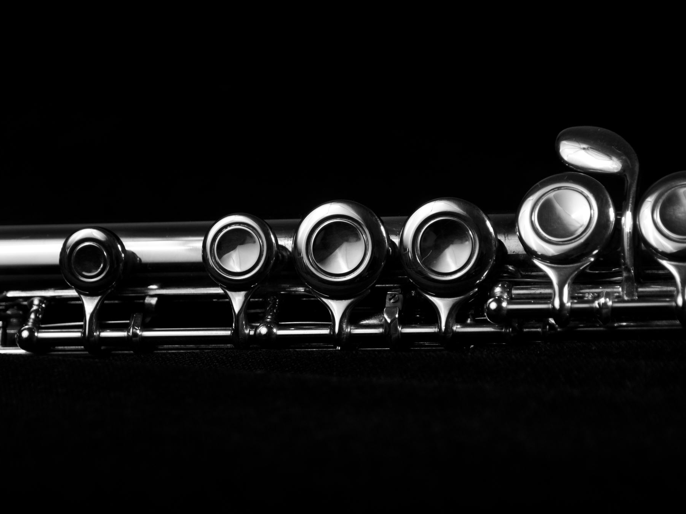
Wiki Page LINK
https://github.com/htmw/F2025-Team2/wiki

Slide 40
Thank You!

