Slide 1



Crowdfunding
By
Team Nexus

Slide 2
Agenda
Team Member Roles | Improvements | Responsibilities
Problem Statement | Project Description | Team Working Agreement
User Personas | MVP | Project Design
Technologies | Algorithms | Diagrams
Product Backlog
Metrics
Sprint 1
User Stories
Test Cases
Stories Completed
Stories Not Completed
Metrics
Charts
Retrospective
Sprint 2
Project Demo

Slide 3

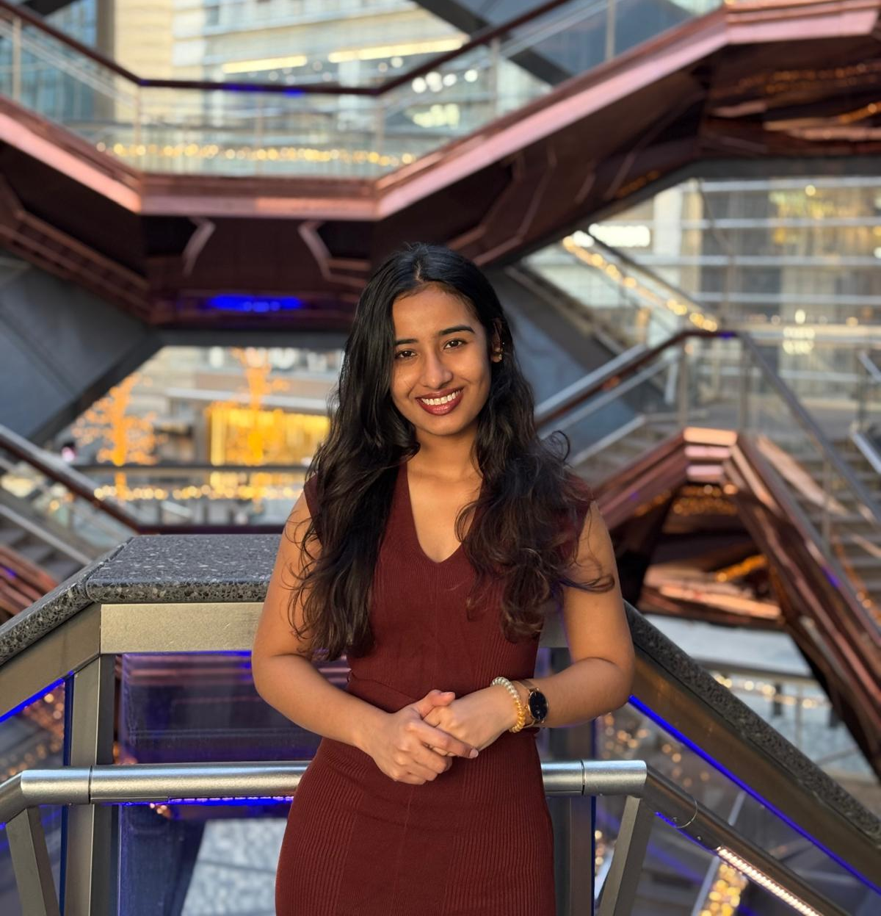
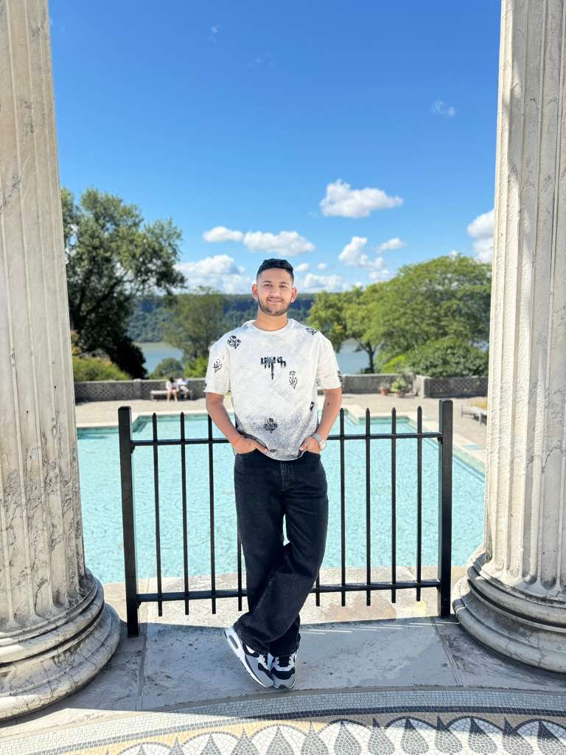
Getting to know the Team…
Ashwanth Maram Full Stack Developer
Ashwitha Maram
Developer/Tester
Raj Mandaliya
Block Chain Developer

Slide 4
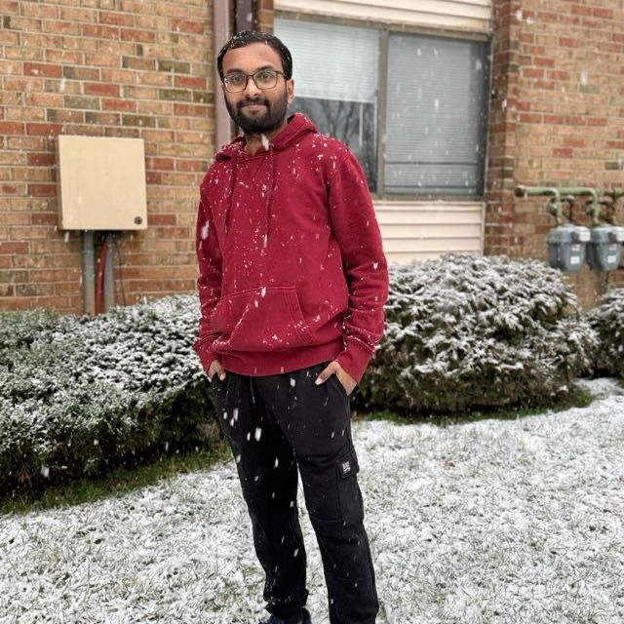
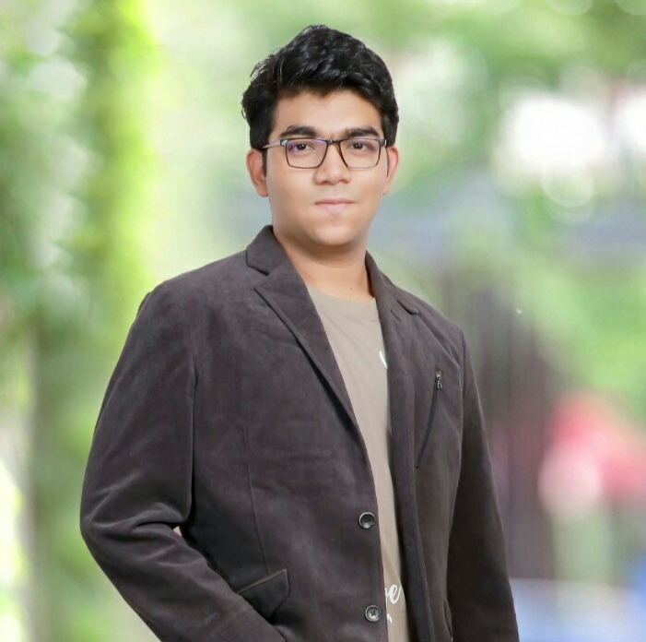

Getting to know the Team…
Vinukonda Yashwanth Reddy Backend and Database Engineer
Nyi Nyi Lwin Full Stack Developer
Naveen Pesalabanda
SCRUM Master

Slide 5
Improvements
Have Team Member introduction before starting the presentation and Retrospective.
Add group email to Wiki page link
Add Project description chart to Presentation slides.

Slide 6
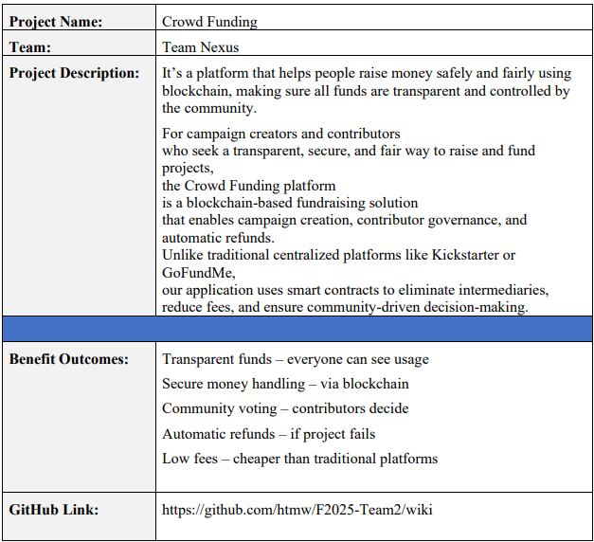
Project Description

Slide 7
Team Working Agreement
Communication Expectations
Use Zoom, GitHub for collaboration.
Respect everyone opinions; decisions are made collectively.
Notifying the team in advance if you cannot complete or attend.
In case of any conflicts, present research-backed solutions and resolve by majority vote.
Keeping everyone updated when pushing code or making changes.
No last-minute dumping of work on others.
Meeting Schedules
Meetings will be held twice weekly on Zoom or Google meet
Meeting time is set based on availability.
Agenda will be shared in advance for preparation.
Sprint Planning at the start, Retrospective at the end of each sprint.
Absence must be informed ahead of time; member must read meeting summary.
All members are expected to participate and contribute fairly.

Slide 8
Team Working Agreement
Checklist for Task Completion
Code should run without errors.
Work must meet all acceptance criteria.
Each task is reviewed and tested by everyone
Documentation should be updated with the task.
Final review by all team members before submission.
Team Dynamics & Principles
Each member must clearly understand and own their tasks.
Workload distributed fairly; large tasks broken into smaller ones.
Every task has a deadline and review on completion.
Encourage problem-solving before escalating blockers.
Trackers must be updated regularly.
Work progress should be committed and shared on GitHub.

Slide 9
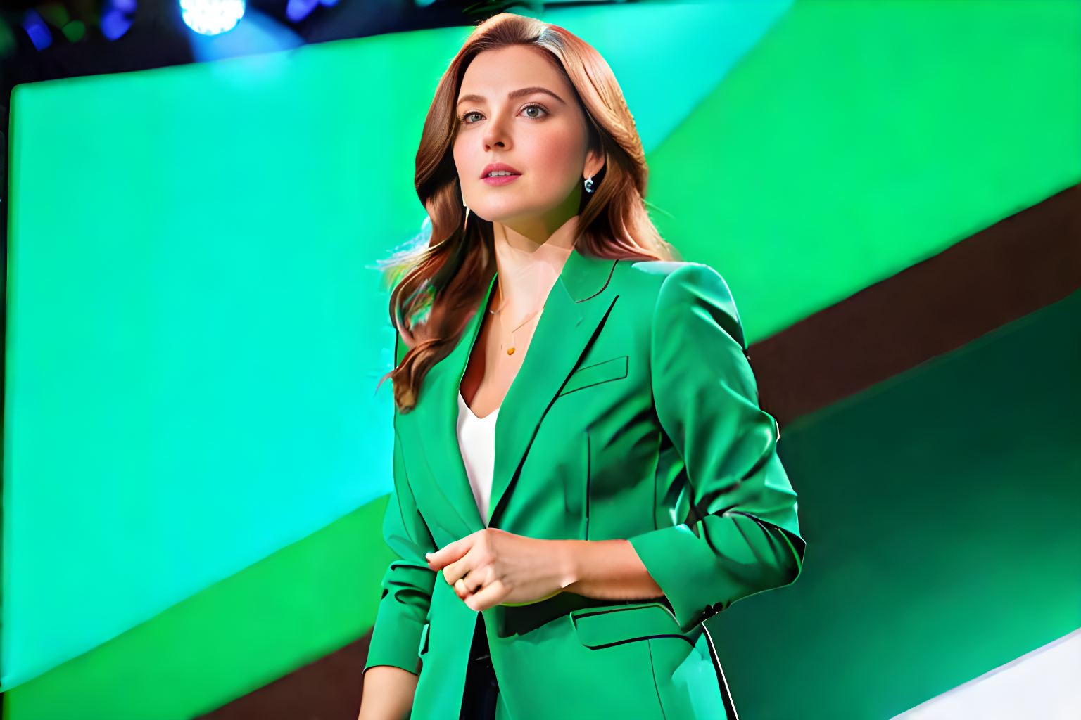
The Startup Founder Persona
Name: Alice Johnson Age: 28 Gender: Female Occupation: Startup Founder
Alice is an ambitious entrepreneur developing a sustainable fashion brand. She wants to raise money to bring her eco-friendly products to market but struggles with high fees and limited visibility on traditional crowdfunding platforms.
Challenges:
Struggles to gain trust from contributors due to lack of transparency.
Centralized platforms charge high fees, cutting into her funding.
Limited control over how her campaign is presented.
Goals:
Raise funds fairly and transparently.
Build credibility with backers.
Ensure contributors see exactly how their money is being used.

Slide 10

The Investor Persona
Name: Bob Smith Age: 35 Gender: Male Occupation: Investor
Bob is a passionate investor who likes to fund innovative projects. He wants to support creators but often worries about whether his money is being used properly and feels disconnected after contributing.
Challenges:
Unsure if funds are spent transparently
No refunds if a project fails
Has no control once money is invested
Goals:
Invest with full transparency and security
Receive refunds if funding goals aren’t met
Have a say in how project funds are used through voting

Slide 11

The Community Member Persona
Name: Cathy Lee Age: 22 Gender: Female Occupation: College Student / Community Member
Cathy is an active member of online communities and DAOs. She enjoys contributing to causes but wants her voice to count, not just her money.
Challenges:
No say in how project funds are allocated
Hesitant to contribute without accountability
Finds most platforms profit-driven and restrictive
Goals:
Participate in voting and decision-making
Support transparent, community-driven projects
Learn about blockchain while backing meaningful causes

Slide 12
MVP
Campaign Creation: Allow users to launch funding campaigns with metadata (title, goal, deadline).
Contribution Logic: Accept ETH contributions and track them per user.
Refund Mechanism: Automatically refund contributors if the goal isn’t met.
Governance Voting: Let contributors vote on fund allocation or milestones.

Slide 13

TOOLS &Technologies
Blockchain: Ethereum + Solidity
Development: Remix IDE, Hardhat
Network: MetaMask, Sepolia Test Network, Sepolia ETH Faucets
Deployment & Testing: Hardhat
Collaboration Tools: GitHub, VS Code

Slide 14
Algorithms & Logic
Smart Contract–Based Voting Mechanism Implements a weighted voting system based on user stake or role. Ensures tamper-proof, transparent decision-making using smart contracts.
Refund Logic Automatically refunds users if the funding goal is not achieved. Executed via smart contract conditions to ensure user trust.
Fraud Detection Rules (Optional) Detects suspicious behavior like duplicate voting or fake contributions. Helps maintain fairness and integrity in decentralized processes.

Slide 15
Diagrams

Slide 16
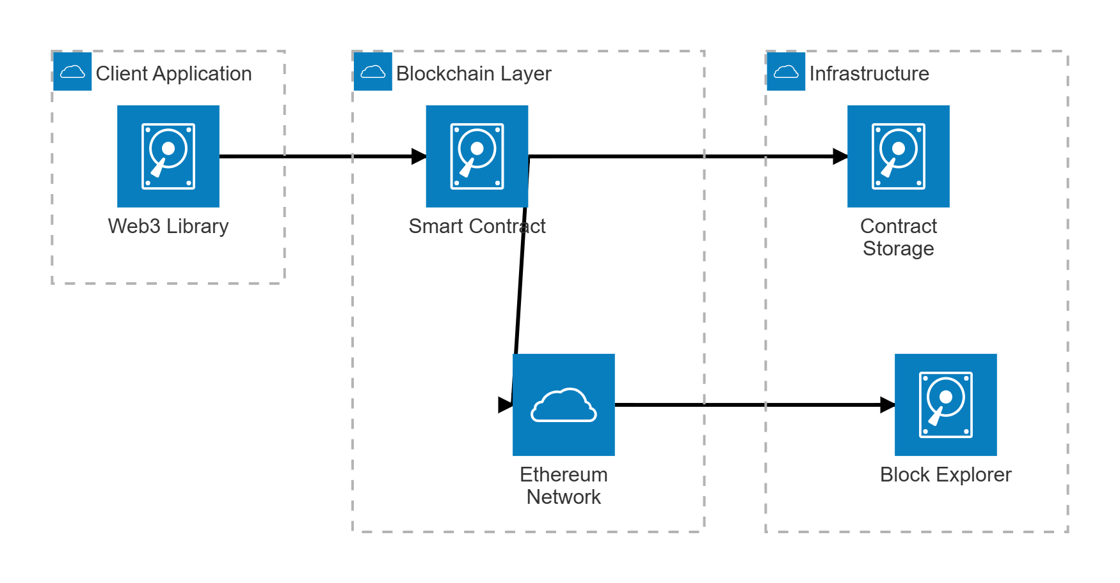
Architecture Diagram

Slide 17
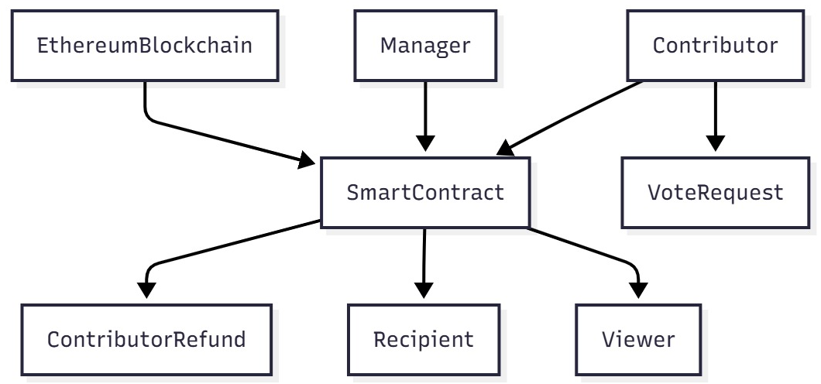
Context Diagram

Slide 18
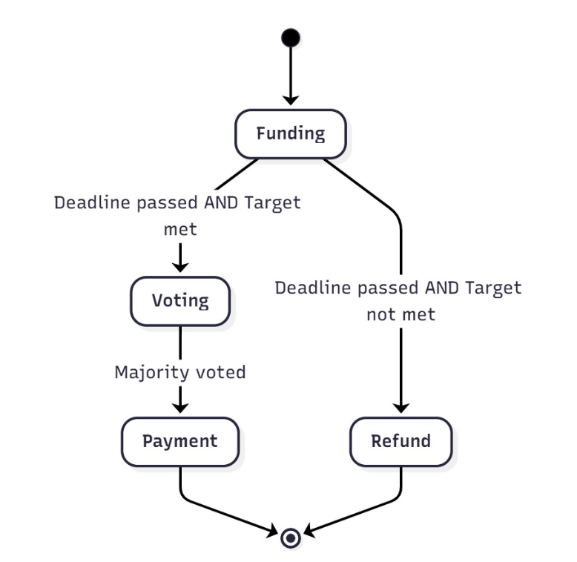
state Diagram

Slide 19
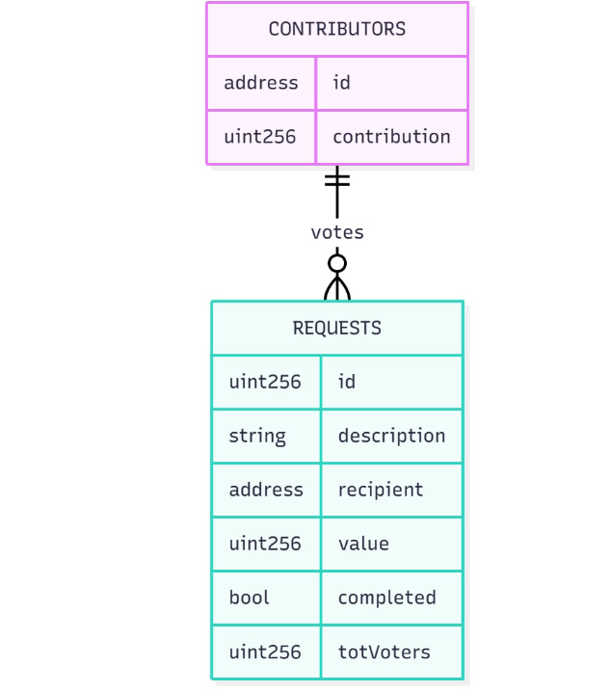
ER Diagram

Slide 20
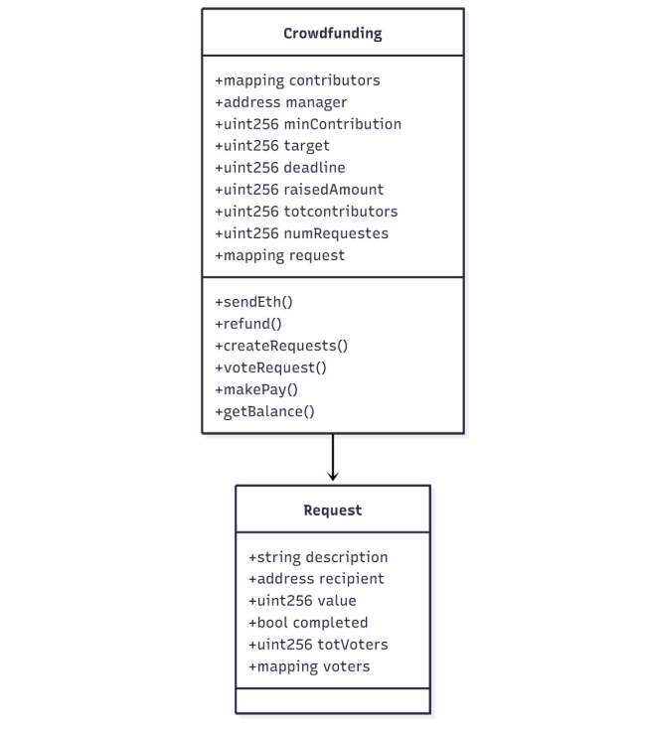
Class Diagram

Slide 21
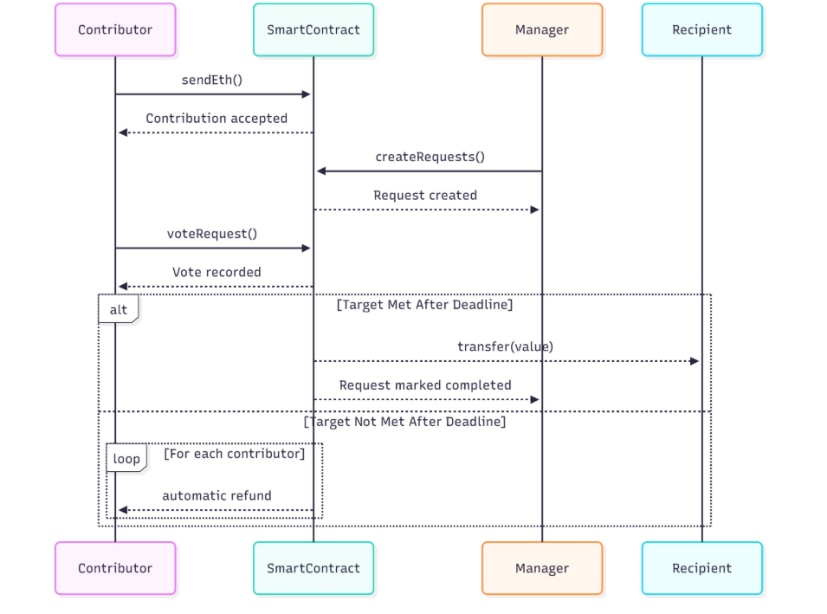
Sequence Diagram

Slide 22
Product Backlog

Slide 23
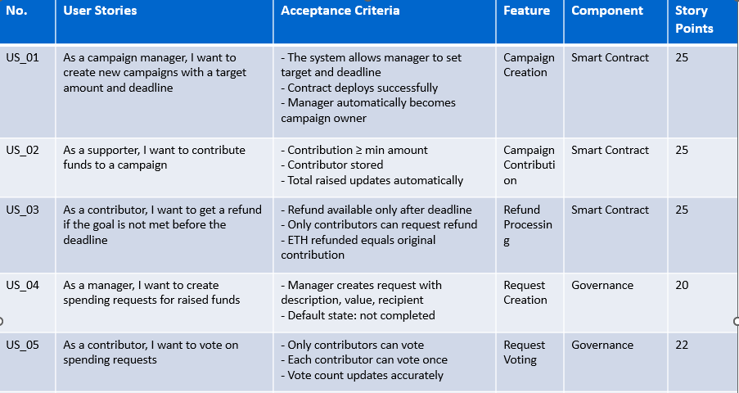

Slide 24
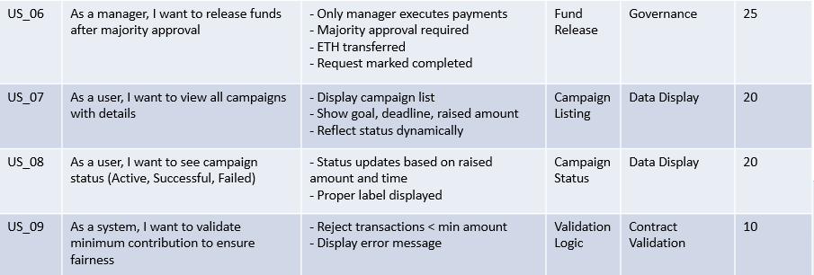

Slide 25
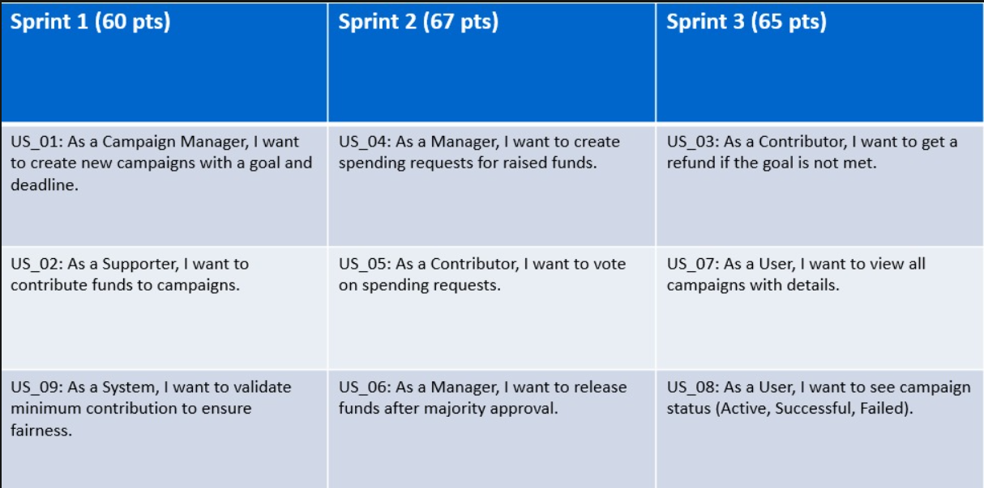
Product Backlog overview

Slide 26
Sprint 1

Slide 27
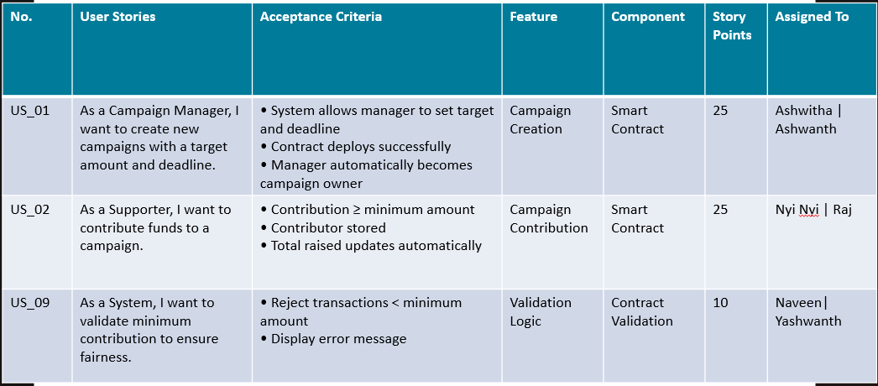
Sprint 1 Backlog

Slide 28
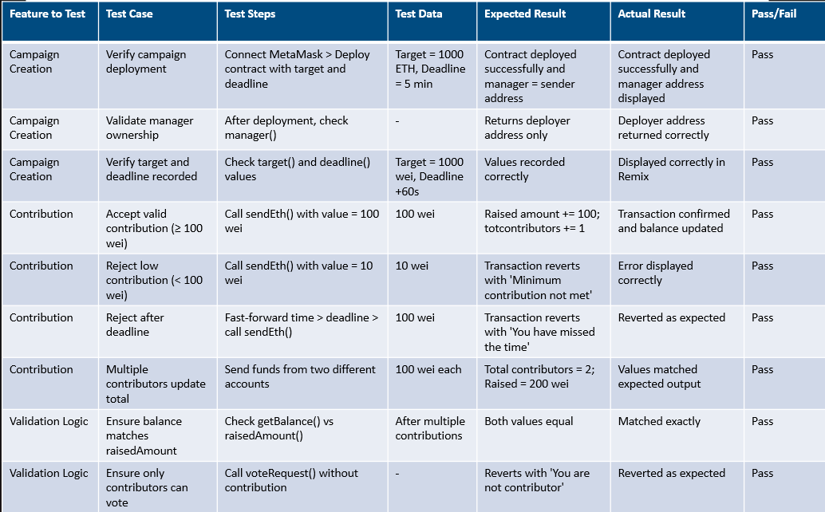
Sprint 1 Backlog testcases

Slide 29
Stories completed
No. | User Stories | Completed Date | Story Points | Completed Points
US_01 | As a campaign manager, I want to create new campaigns with a target amount and deadline. | Oct 14 | 25 | 25
 | Implement contract deployment with target and deadline. | Oct 14 | 10 | 10
 | Verify manager ownership after deployment. | Oct 15 | 5 | 5
 | Validate stored target and deadline values. | Oct 15 | 10 | 10
US_02 | As a supporter, I want to contribute funds to a campaign. | Oct 17 | 25 | 25
 | Test minimum contribution (≥ 100 wei). | Oct 17 | 10 | 10
 | Reject invalid contribution (< 100 wei). | Oct 18 | 5 | 5
 | Verify raised amount and contributors count update. | Oct 18 | 5 | 5
US_03 | As a contributor, I want to get a refund if the goal is not met before the deadline. | Oct 20 | 10 | 10
 | Ensure refund is available only after deadline and target unmet. | Oct 20 | 5 | 5
 | Confirm only contributors can initiate refunds. | Oct 21 | 5 | 5

Slide 30
Metrics: sprint 1
Story ID | Story description | Story points estimated | Story points delivered
US_01 | As a campaign manager, I want to create new campaigns with a target amount and deadline | 25 | 25
US_02 | As a supporter, I want to contribute funds to a campaign | 25 | 25
US_09 | As a contributor, I want to get a refund if the goal is not met before the deadline | 10 | 10

Slide 31
Metrics: Team Velocity
Metric | Value
Total estimated points: | 60
Total points delivered: | 60
Points carried over: | 0
Team Velocity: | 60

Slide 32
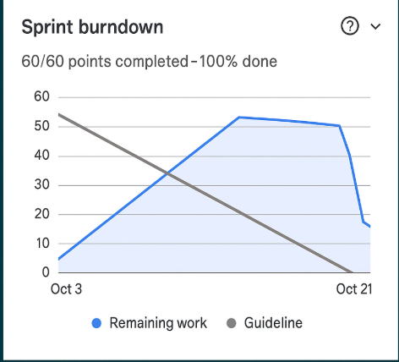
Metrics: Burndown Chart

Slide 33
Sprint 1 retrospective
What went well?
Improved Meeting Structure
Efficient Time Management
Better Communication
Seamless Code Integration
Open and Honest Communication
What could be improved?
Confidence in Decision-Making
Faster Response Times
Better Way of Scheduling
Clearer Dependency Tracking
Thorough Technical Analysis
Smaller, Manageable Tasks
Our commitments
Engage More in Technical Discussions
Improve Task & Dependency Tracking
Enhance Team Coordination
Frequent Jira Updates

Slide 34
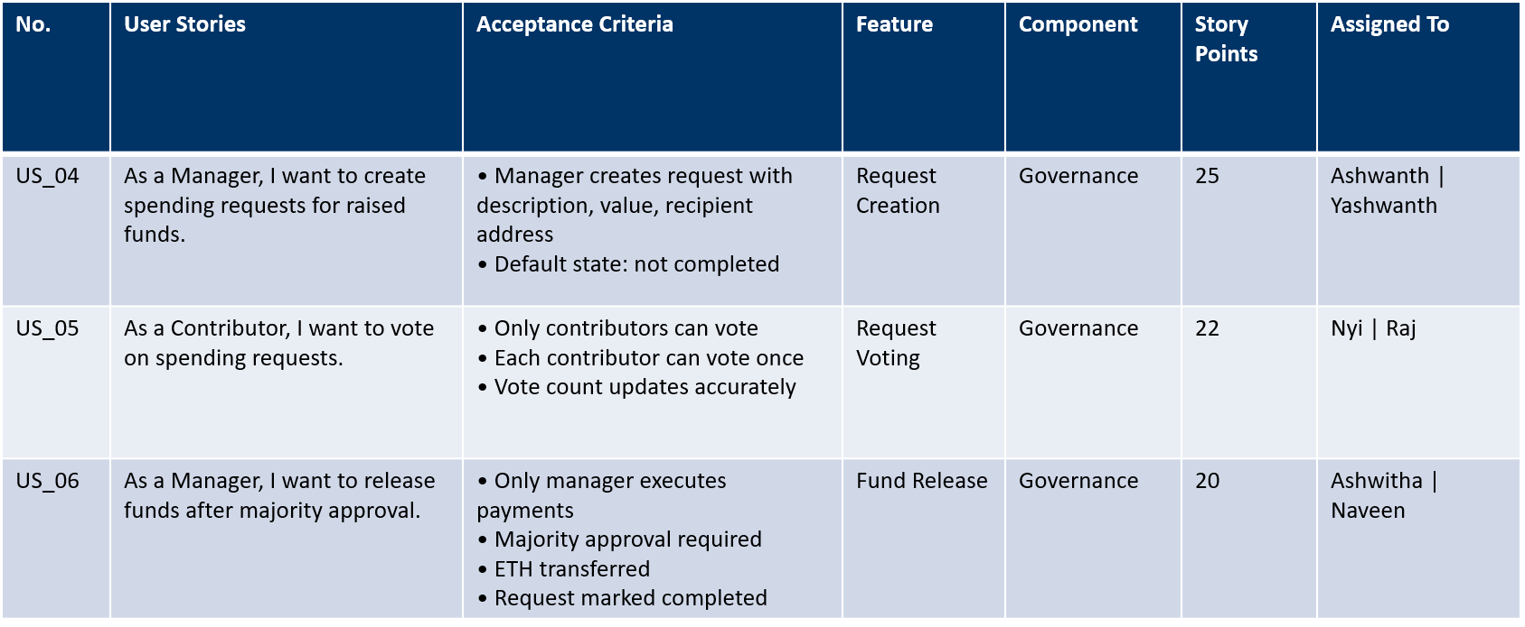
Sprint 2 Planning

Slide 35
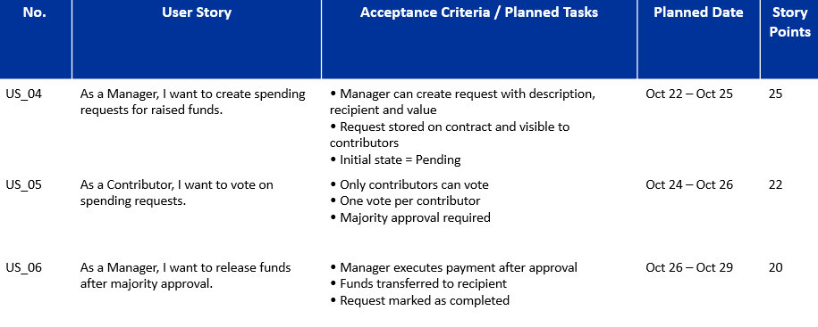
Sprint-2 Stories Planned

Slide 36
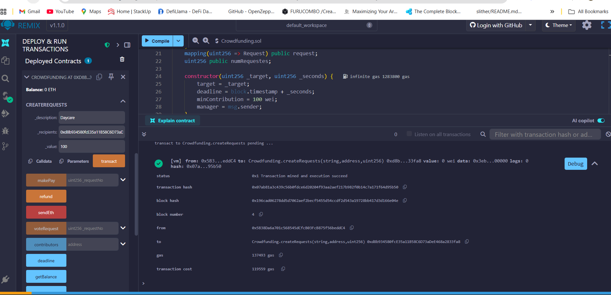
Project demo

Slide 37
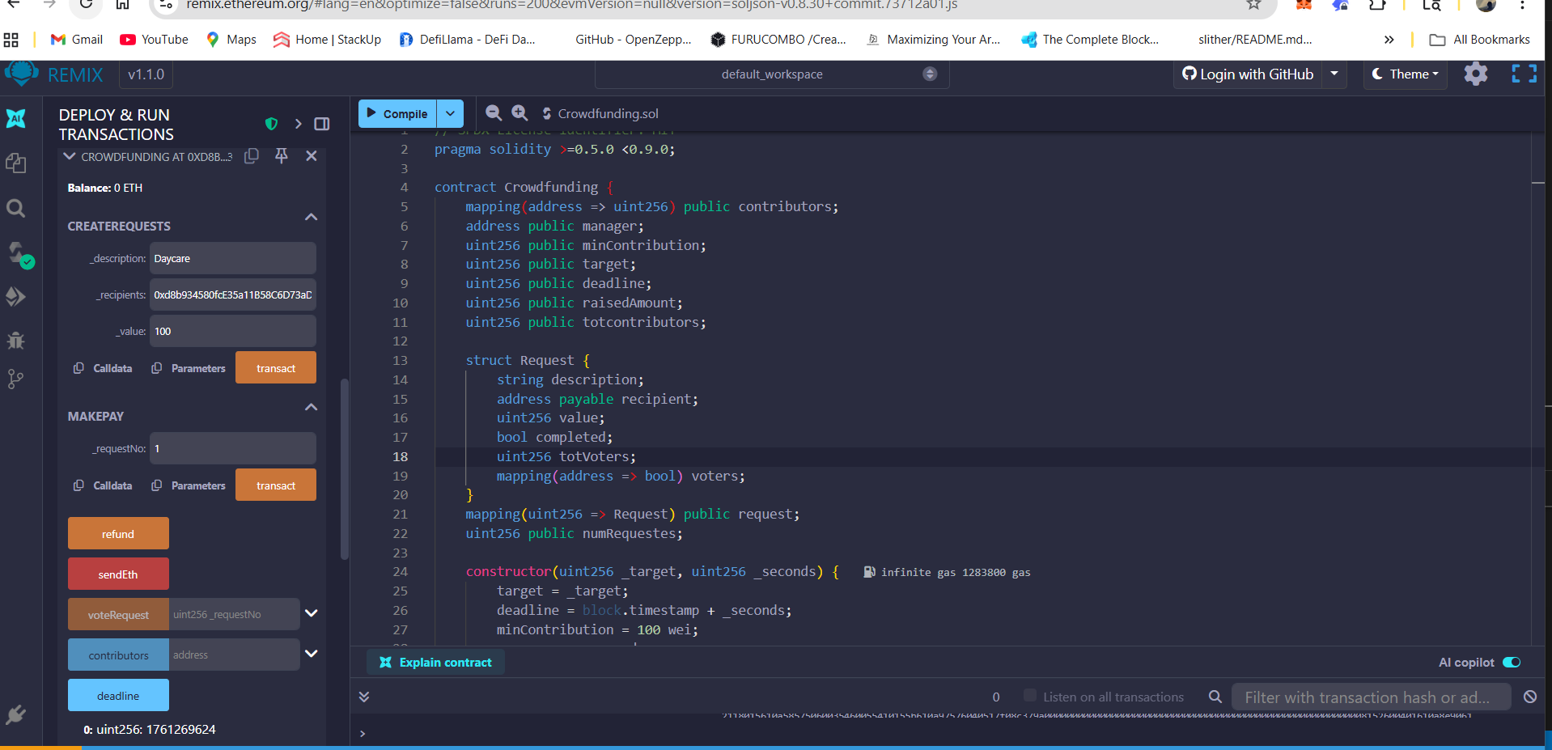
Project demo

Slide 38

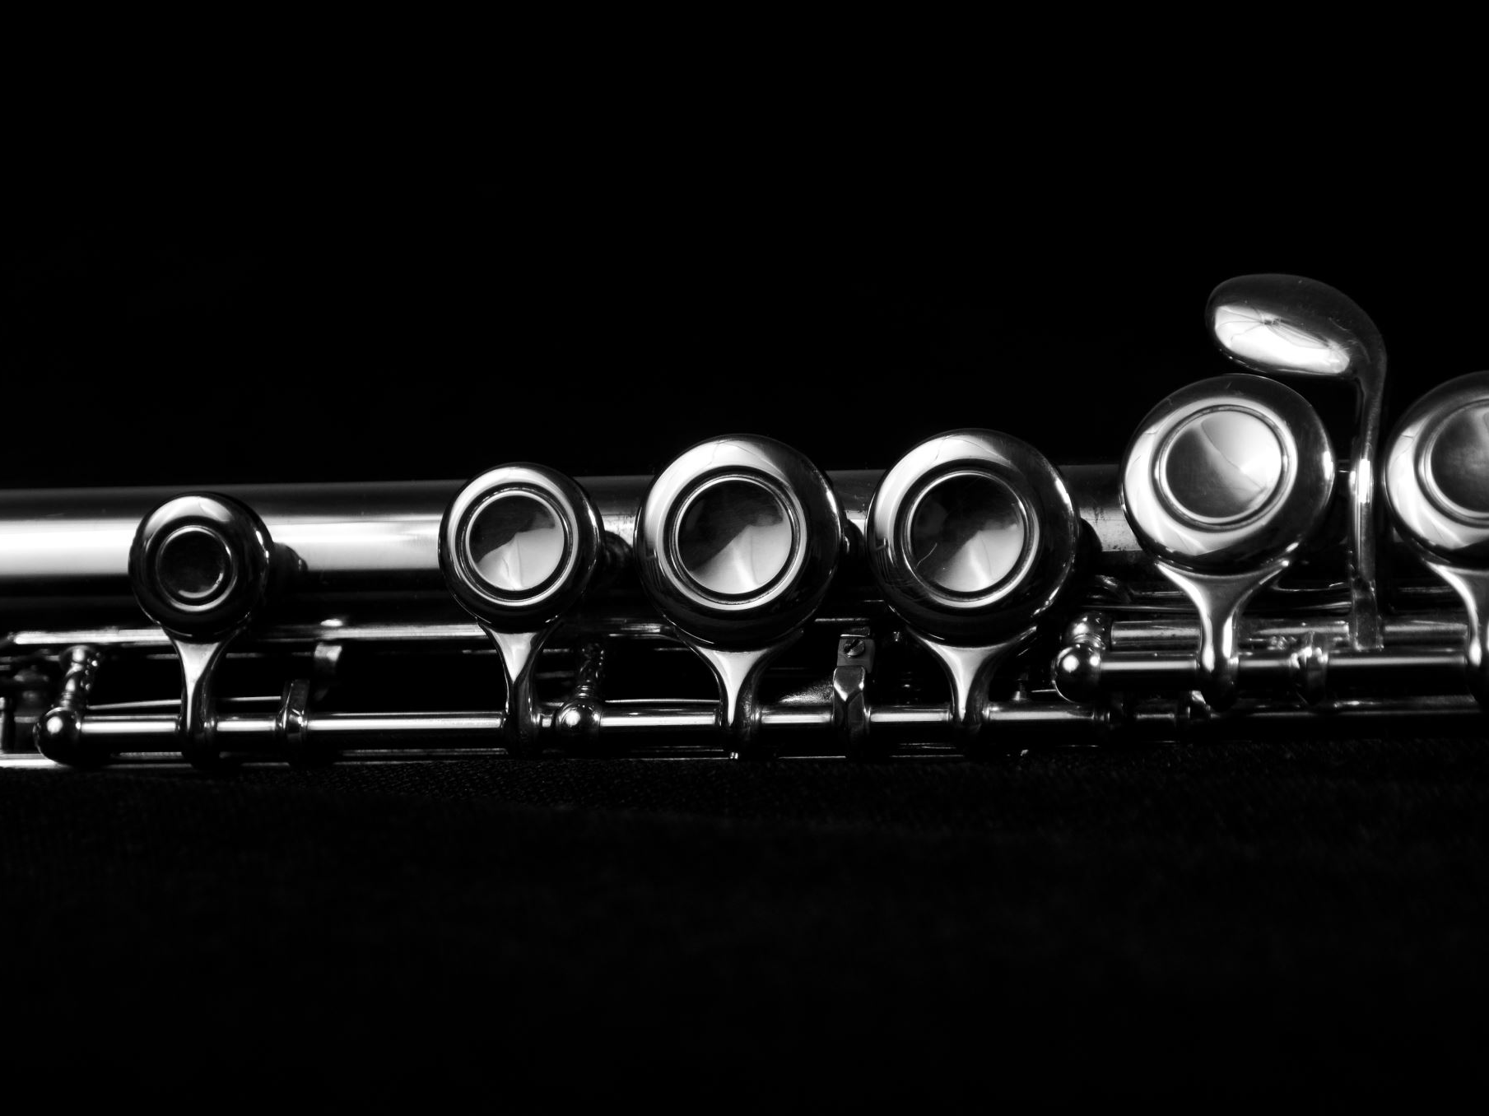
Wiki Page LINK
https://github.com/htmw/F2025-Team2/wiki

Slide 39
Thank You!

