Slide 1








From One Brief to the Right Team
CS691 CAPSTONE · SPRINT 1 REVIEW
Sprint 1 turns a registry of AI agents into a team that assembles itself from a single plain-language brief.
AgentMesh · Team 2 Phoenix
Fall 2026
Notes:
Hi everyone, we're Team 2, Phoenix, and this is our Sprint 1 review for AgentMesh. In Sprint 0 we showed you what we're building. In Sprint 1 we built the core loop: enroll an agent, read a brief, spawn only the agents it needs, and validate what they produce.

Slide 2
What we'll cover
AGENDA
1
Team roles and responsibilities
7
Diagrams
Who owns what
Architecture, context, ER, sequence, state, class
2
Improvements from feedback
8
Product and Sprint 1 backlog
What we changed since Sprint 0
Stories, criteria, points, tasks
3
Project description
9
Test cases
What AgentMesh is
23 cases across US_01 to US_05
4
Team working agreement
10
Metrics
How we work together
Velocity, burndown, completed / committed
5
Personas and MVP
11
Retrospective and Sprint 2
Who it is for, what they can use
What we learned, what is next
6
Technologies and algorithms
12
Project demo
The stack and the logic
Screenshots, API, GitHub, live demo
Notes:
Here's what we'll cover today. We start with the team and the changes we made from your feedback. Then the project, our working agreement, personas, MVP, technology and diagrams. After that, the backlog, test cases, metrics and our retrospective. We finish with a live demo.

Slide 3







Team roles and responsibilities
TEAM 2 · PHOENIX
REVISED · FEEDBACK
Dhwani Dobariya
Om Jadhav
Soumen Nageshkar
Aniruddha Rath
Team Leader / Frontend Engineer
Full Stack Engineer
Full-Stack / Platform Engineer
Frontend Engineer
Leads planning and reviews; builds the /office UI
Builds features end to end across UI and API
Owns the platform and the orchestration core
Builds frontend pages and components
Puneet Tulsiani
Sutej Kulkarni
Gurjot Singh
Backend Engineer
A.I. Engineer
QA / Scrum Master
Builds the API, enrollment and data layer
Capability analysis, LLM providers and routing
Runs Scrum events; owns test cases and QA
Notes:
This is our team of seven. Dhwani leads the team and builds the /office UI. Om and Soumen work full stack, with Soumen owning the platform and the orchestration core. Aniruddha builds the frontend and Puneet the backend and data layer. Sutej is our AI engineer, and Gurjot is our QA lead and Scrum Master.

Slide 4
What we changed from feedback
SPRINT 0 FEEDBACK
Feedback | What we improved | Slide
Minimal personas | Full personas: photo, age, role, scenario, three goals and three pain points | 7
Reading instead of presenting | Less text on each slide; talking points moved into speaker notes | All
Team photos | Professional headshots for every member, with role and responsibility | 3
Bad mic / speaker | Mic and speakers tested together as a group before every recording | Recording
Working agreement is vague | Exact meeting days, times and place, plus clear rules for missed work | 6
Retro was the aftermath | Sprint 1 retro held from scratch; each action item fixes one improvement item | 29
Lazy screenshots (wiki) | Screenshots cropped to the feature being shown, no extra noise | 22, 31
REVISED · FEEDBACK
marks every slide that changed because of this feedback
Notes:
After Sprint 0 you gave us seven points of feedback. Each row shows what we changed and the slide where you can see it. Every changed slide has an amber "Revised" tag in the corner. We also tested our mics and speakers together as a group before recording.

Slide 5




What AgentMesh is
PROJECT DESCRIPTION
AgentMesh is an AI agent orchestration platform. It coordinates multiple specialised AI agents and multiple LLM providers to solve complex tasks, acting as an intelligent workflow engine for AI rather than a single chatbot.
01
02
03
04
Receive
Decompose
Select and route
Synthesise
A user submits one natural-language brief describing a complex task.
The orchestrator analyses the brief and breaks it into the capabilities it needs.
Only the relevant agents are spawned, in the right order, each on a suitable model.
Validated agent outputs are combined into one explainable result.
Notes:
AgentMesh is an AI agent orchestration platform. Instead of one chatbot doing everything, it works like a workflow engine. A user sends one brief, we break it into the capabilities it needs, spawn only the right agents, and combine their validated outputs into one result.

Slide 6






How we work together
TEAM WORKING AGREEMENT
REVISED · FEEDBACK
When and where
Commitment
Deadlines
Stand-ups twice a week: Wednesday and Friday at 8 pm ET on google meet. Async updates daily in the team channel.
If you can't finish a task, flag it in the channel at least 24 hours before the deadline so it can be re-assigned.
Individual work is due 48 hours before a Sprint review. No same-day drops on one person.
Shared load
Reminders
Conflict
Reviews and integration are shared across the team, not owned by a single 'fixer'.
Teammates give one friendly reminder before a deadline; after that, it is on the individual.
Disagreements are raised in the team meeting, not worked around silently. Unresolved issues go to the Team Leader.
Notes:
You told us our agreement was vague, so we made it specific. We meet twice a week, on [DAY 1] and [DAY 2] at [TIME] on [PLATFORM]. If you can't finish a task, you flag it 24 hours before the deadline. Work is due 48 hours before a sprint review, so nobody gets a last-minute drop. Reviews are shared, we give one reminder, and disagreements are raised in the meeting.

Slide 7



Three people, three ways of working
PRODUCT PERSONAS
REVISED · FEEDBACK
Priya, 34
Daniel, 29
Aisha, 31
SOFTWARE ENGINEERING LEAD
DATA ANALYST
TECHNICAL PRODUCT MANAGER
Wants one orchestrated pipeline that runs security review, code fixes and tests before every merge.
Wants cleaning, analysis and reporting from a single plain-language request.
Wants to see which capability ran, why it was chosen and what it cost, for every workflow.
GOALS
GOALS
GOALS
One pipeline, end to end
Security review before merge
Automated fixes and tests
One plain-language request
Cleaning, analysis, reporting
Clean structured data handoff
See which capability ran, and why
Cost visibility per workflow
Audit latency, decision quality
PAIN POINTS
PAIN POINTS
PAIN POINTS
Manually chaining AI tools
Slow, error-prone handoffs
Fragmented tool results
Models lose track of steps
Messy stage-to-stage handoffs
Re-prompting at every stage
Black-box chatbot answers
No cost audit trail
Latency and quality unclear
Notes:
We build for three people. Priya is an engineering lead who wants security review, fixes and tests in one pipeline. Daniel is a data analyst who wants cleaning, analysis and reporting from one request. Aisha is a product manager who needs to see which agent ran, why, and what it cost.

Slide 8





What a user can actually do today
MINIMAL VIABLE PRODUCT
Sign in
Enroll
Brief
Spawn
Result
with Google
a new agent, no code
one request in /office
only the agents needed
validated, stored, shown
IN THE MVP
WHY IT IS AN MVP
Agent enrollment with a schema-validated results table per agent
Capability-based spawning with a reason for every pick and skip
Output validation before anything is stored or passed on
The /office workspace to brief, browse agents and watch progress
A user goes from one plain-language brief to a coordinated, validated result without calling the API or writing code. That is the smallest version of AgentMesh that is useful on its own.
Notes:
Our MVP is more than sign-in. A user signs in with Google, an engineer enrolls an agent without writing code, and anyone can submit a brief. AgentMesh spawns only the agents needed and returns a validated result, all from the /office workspace.

Slide 9





















The stack behind AgentMesh
TECHNOLOGIES
FRONTEND
BACKEND
DATA
Next.js
React
Python
FastAPI
PostgreSQL
Redis 8
TypeScript
SQLAlchemy
Pydantic
AI PROVIDERS
DEVOPS AND MONITORING
AUTH AND QUALITY
OpenAI
Anthropic
Docker
GitHub Actions
Google
JWT
Gemini
Hugging Face
Prometheus
Grafana
pytest
Playwright
Notes:
Our frontend is Next.js, React and TypeScript. The backend is Python with FastAPI, SQLAlchemy and Pydantic. PostgreSQL stores everything that matters, and Redis handles counters and locks. For AI we connect OpenAI, Anthropic, Gemini and Hugging Face behind one interface. Docker runs the stack, and GitHub Actions runs our tests on every push.

Slide 10






The logic behind the orchestrator
ALGORITHMS
Capability classification
Minimal covering set
Heuristic or LLM analysis maps a brief to the capabilities it needs, with a clarity check for vague briefs.
The selector spawns the fewest enabled agents that cover every capability and records why each other agent was skipped.
DAG planning
Conditional branching
Topological ordering builds sequential, parallel and conditional steps; plans with cycles are rejected.
Edge conditions read intermediate results, for example skipping the coding step when no vulnerability is found.
Cost-aware routing
Retry and schema validation
Models are ranked by cost and latency per step, with logged fallback to the next provider.
Each output is checked against JSON Schema; invalid output is retried with backoff up to three times.
Notes:
Six pieces of logic run the orchestrator. First, we classify the brief into capabilities. Then we pick the smallest set of agents that covers them and record why the others were skipped. We plan the steps as a graph, branch on intermediate results, route each step to a model by cost and speed, and validate every output with retries.

Slide 11
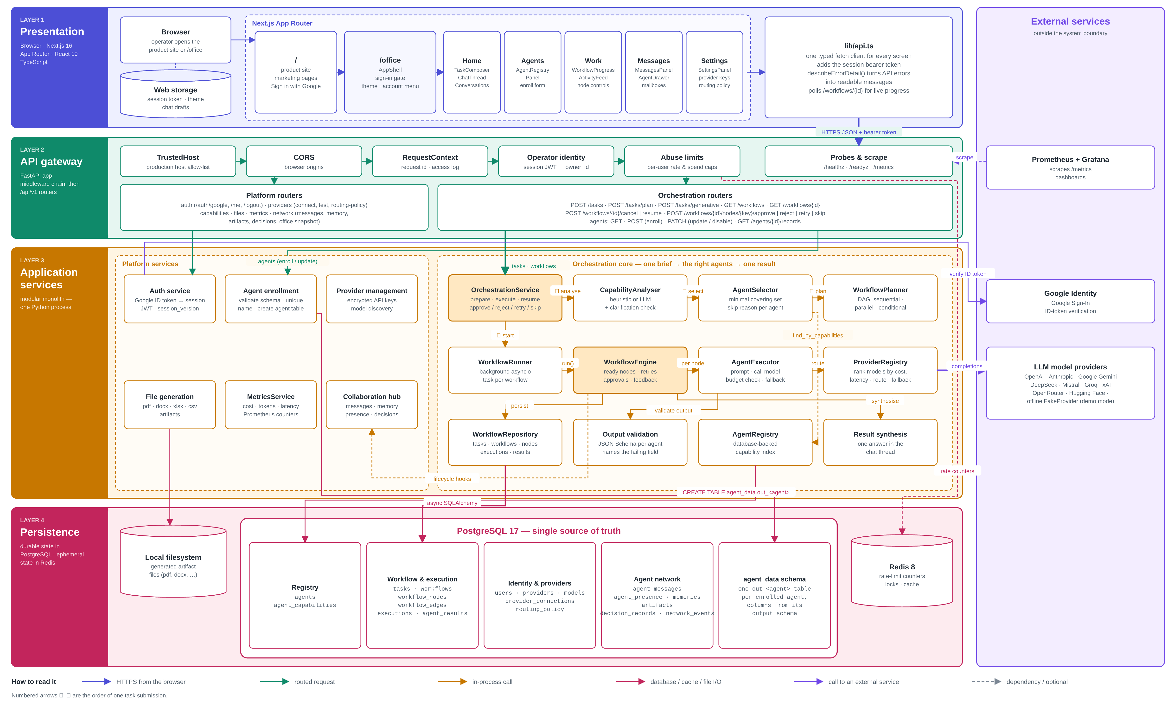
Four layers, one request path
ARCHITECTURE DIAGRAM
HOW TO READ IT
Presentation: Next.js /office pages and one typed API client
API gateway: FastAPI middleware chain, then platform and orchestration routers
Application services: the orchestration core picks, plans and runs agents
Persistence: PostgreSQL 17 as the source of truth, Redis 8 for counters and locks
External: LLM providers, Google Identity, Prometheus + Grafana
Notes:
The system has four layers. The browser talks to the Next.js pages. Requests pass through the FastAPI gateway, which checks identity and rate limits. The orchestration core analyses, selects, plans and runs the agents. Results land in PostgreSQL, and outside services like the LLM providers sit on the right.

Slide 12
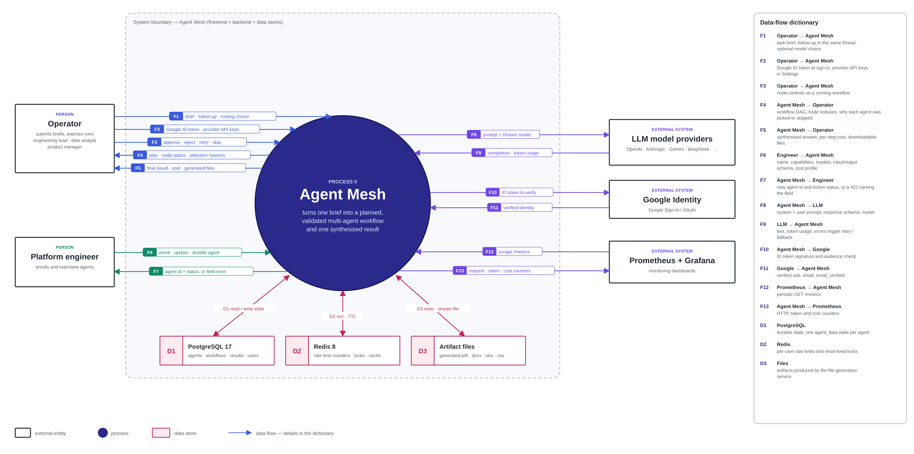
Agent Mesh and the world around it
CONTEXT DIAGRAM
Notes:
This is AgentMesh from the outside. Operators send briefs and get back plans, status and results. Platform engineers enroll and maintain agents. AgentMesh calls the LLM providers, verifies sign-in with Google, and sends metrics to Prometheus and Grafana.

Slide 13
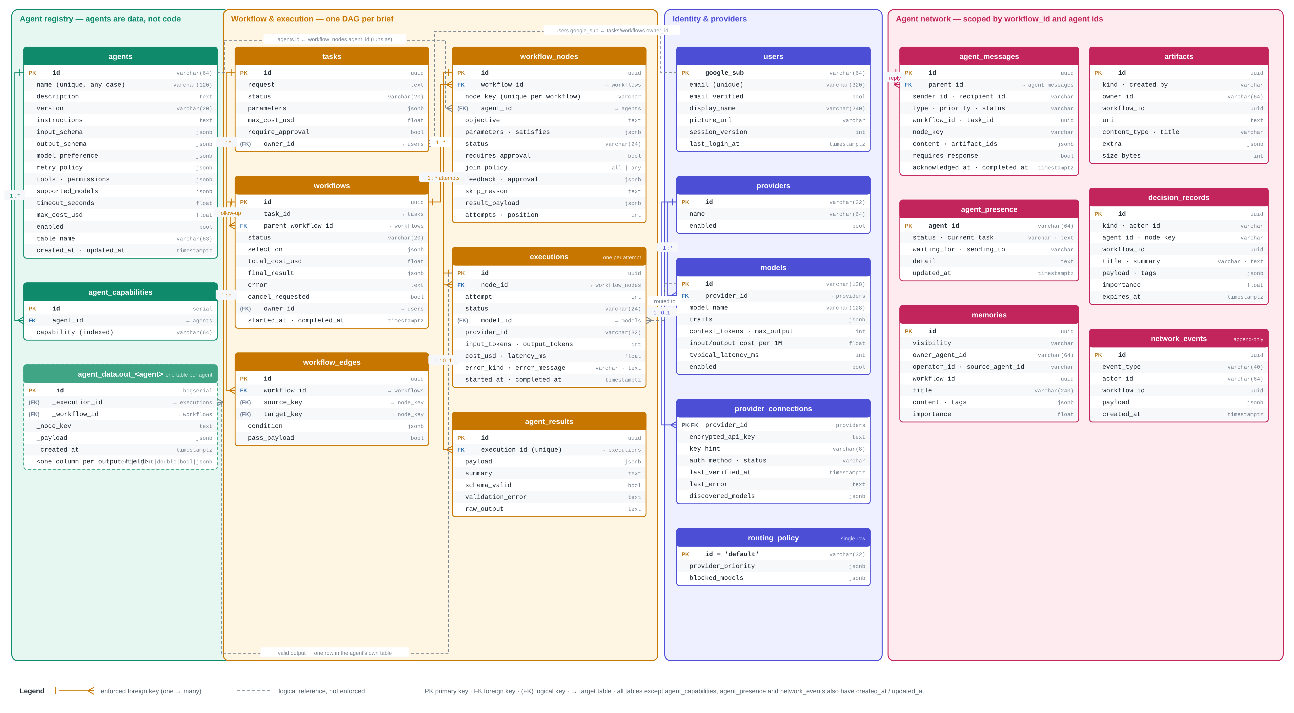
The database behind the agents
ER DIAGRAM · POSTGRESQL 17
Notes:
Our database has four groups of tables. The registry holds agents and their capabilities, plus one results table per agent. The workflow group stores each brief as tasks, nodes and edges, with executions and results. The other two groups cover users and providers, and how agents talk to each other.

Slide 14
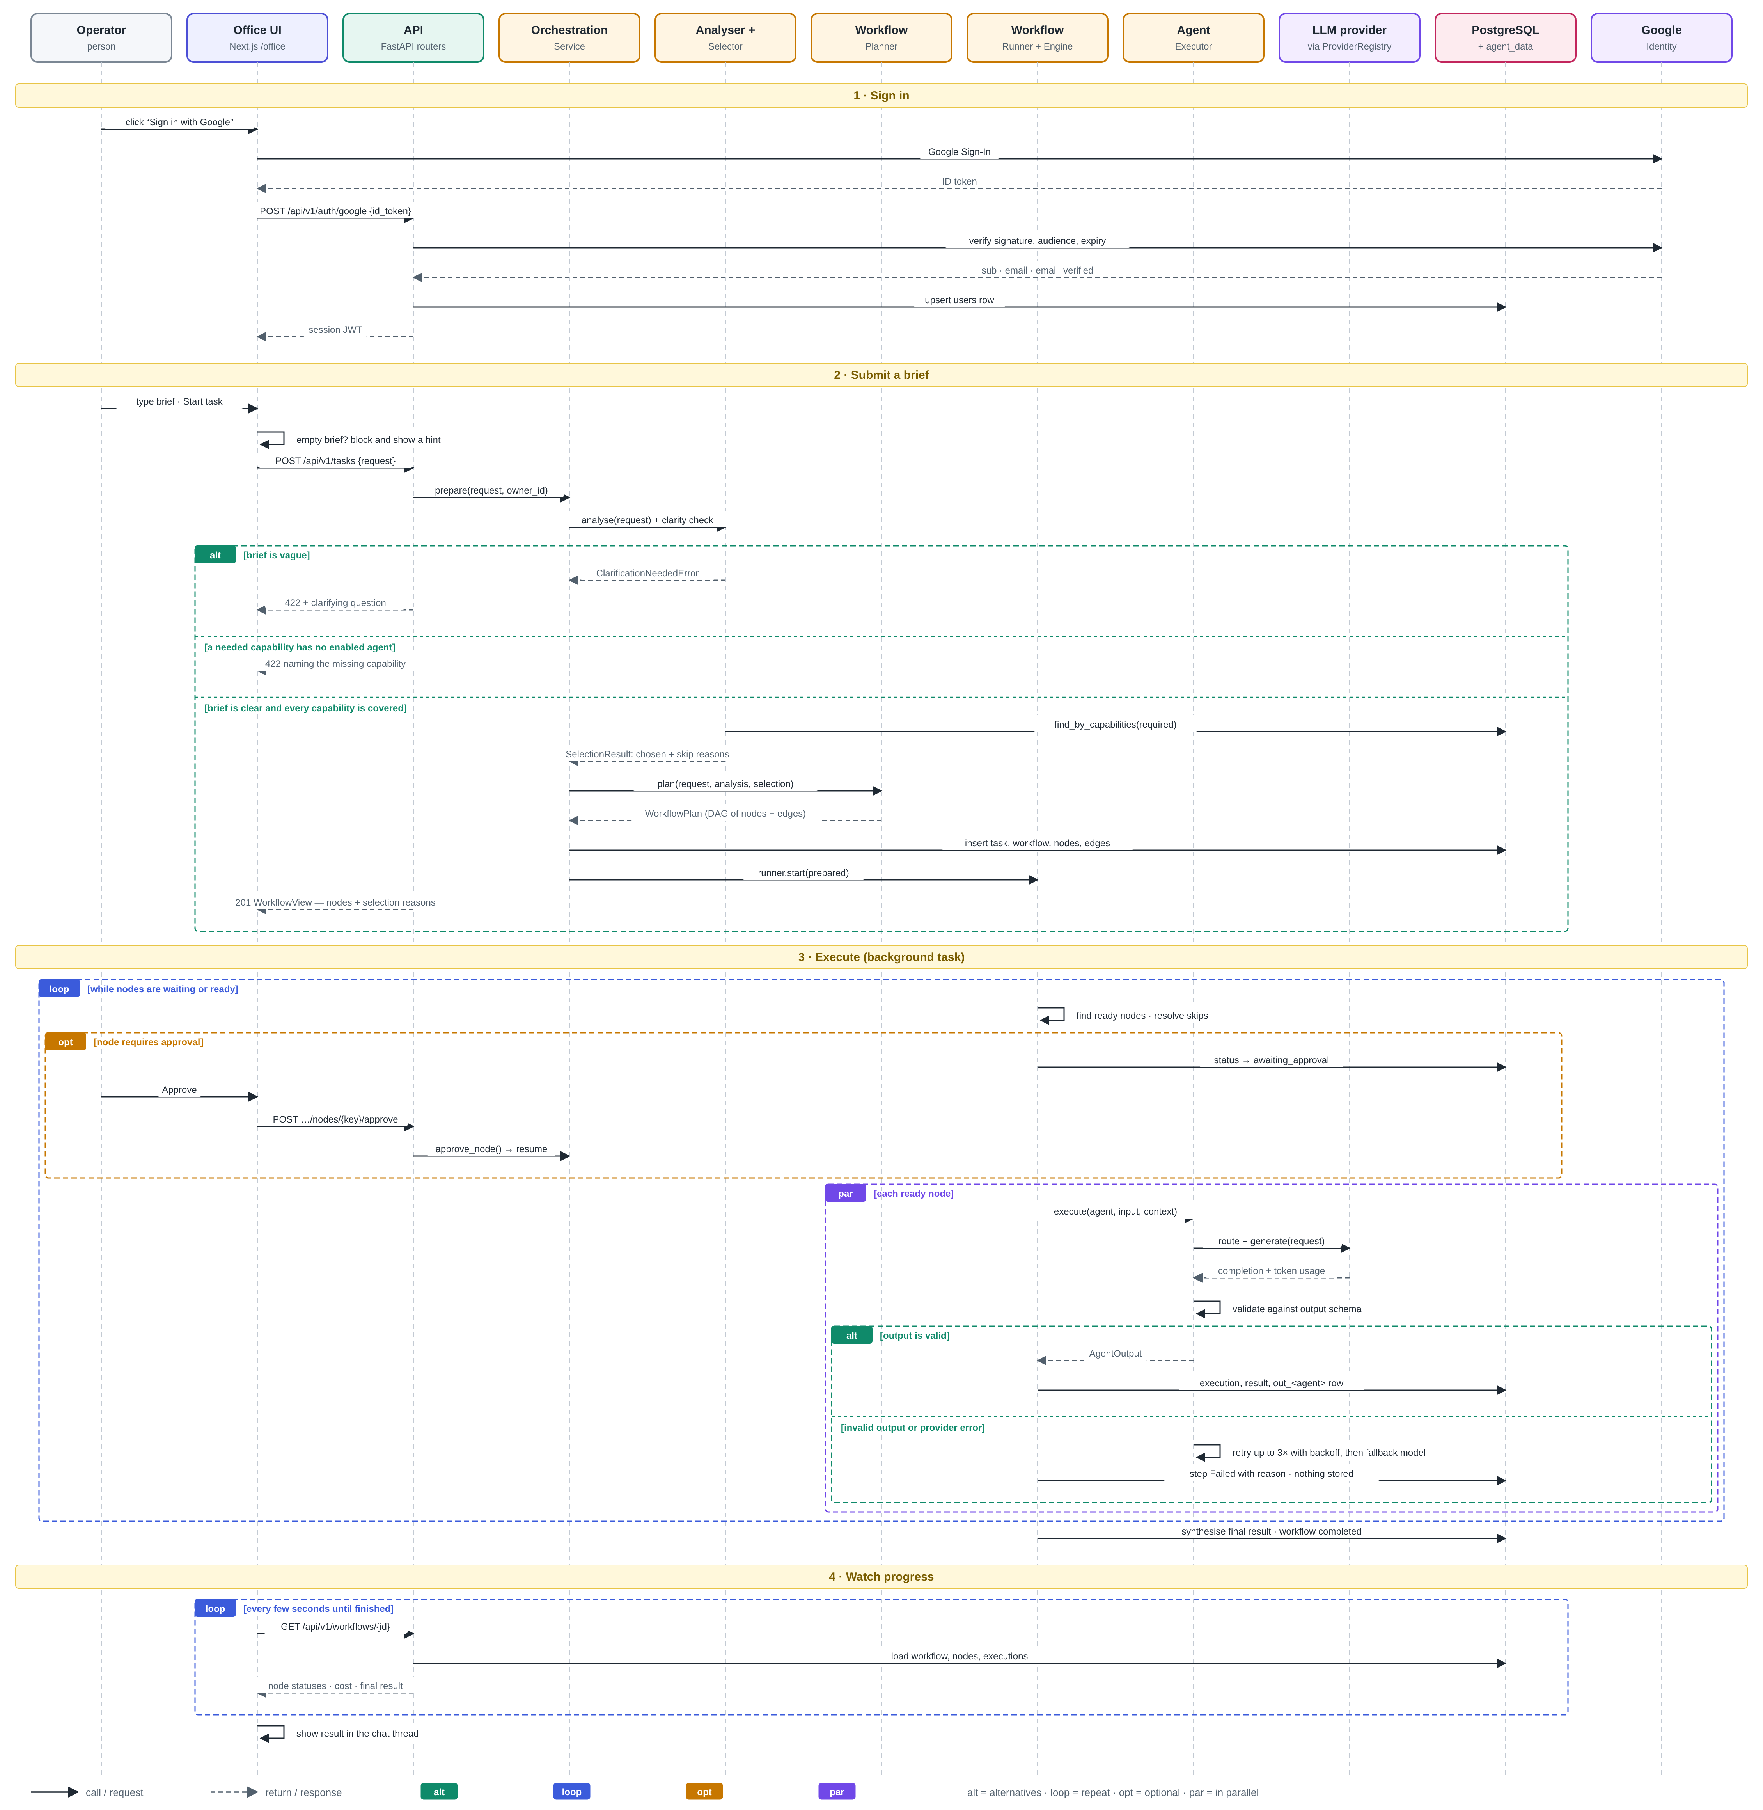
Sign in, submit a brief, run it
SEQUENCE DIAGRAM
HOW TO READ IT
1 Sign in: Google ID token is verified and a session JWT is issued
2 Submit a brief: vague briefs get a clarifying question, missing capabilities get a 422, otherwise the plan is saved
3 Execute: ready nodes run in parallel; output is validated, retried, or the step fails with a reason
4 Watch progress: the UI polls the workflow until it finishes
Notes:
This is one user's journey. They sign in with Google and get a session. When they submit a brief, one of three things happens: a vague brief gets a clarifying question, a missing capability gets a clear error, or a clear brief is planned and saved. Then the agents run, their outputs are validated, and the screen updates live.

Slide 15
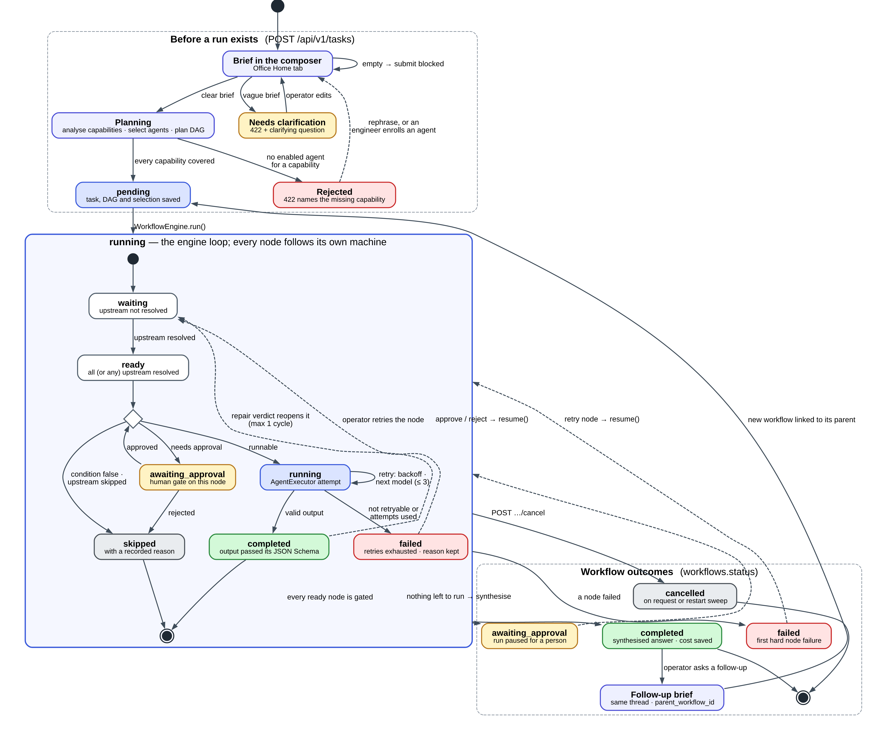
Every brief and node has a state
STATE DIAGRAM
HOW TO READ IT
Before a run: a brief is planned, sent back for clarification, or rejected with the missing capability
While running: each node moves waiting → ready → running, or pauses for approval or is skipped
A node ends completed (valid output) or failed (retries used up)
The workflow ends completed, failed, cancelled, or awaiting approval; a follow-up starts a new linked workflow
Notes:
Every brief and every step has a state. Before a run, a brief is planned, sent back for clarification, or rejected. During the run, each step moves from waiting to ready to running, and ends completed or failed. A step can also wait for approval or be skipped, always with a reason.

Slide 16
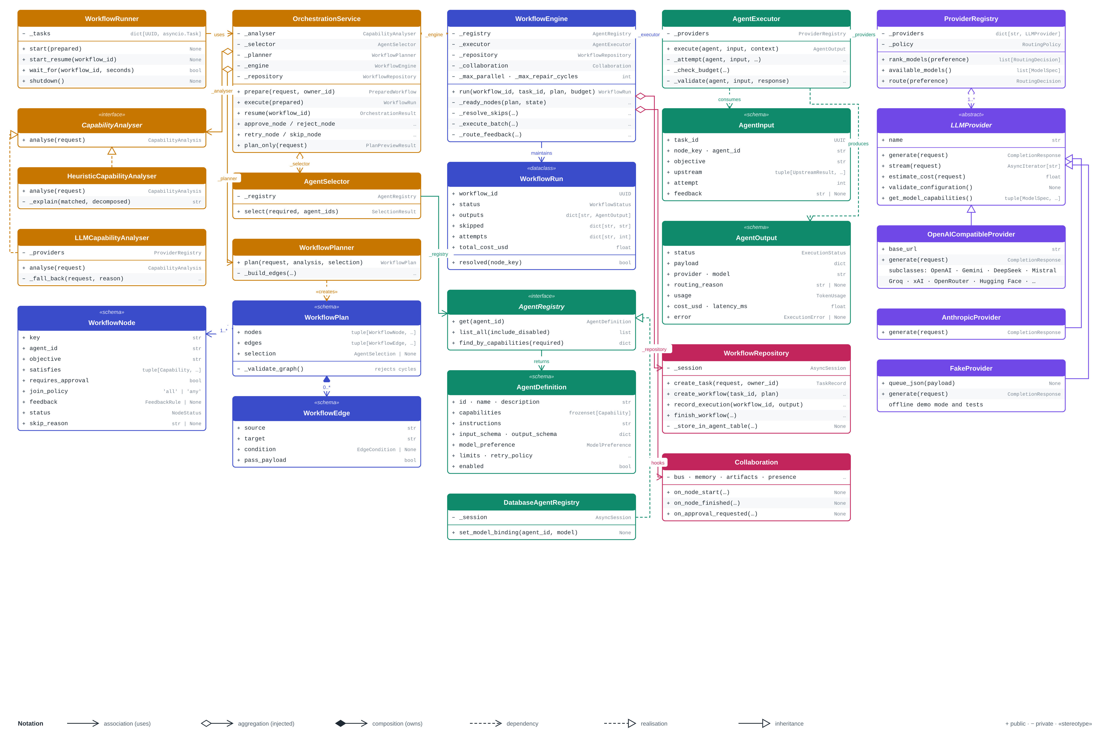
How the backend classes fit together
CLASS DIAGRAM · BACKEND/APP
HOW TO READ IT
OrchestrationService wires the analyser, selector, planner and engine
WorkflowEngine runs ready nodes through AgentExecutor
AgentRegistry is an interface; DatabaseAgentRegistry is the app implementation
LLMProvider is abstract: OpenAI-compatible, Anthropic and Fake providers plug in
Notes:
The orchestration service connects the analyser, selector, planner and engine. The engine runs each ready step through the agent executor. The registry and the LLM provider are interfaces, so in tests we swap in a fake provider and an in-memory registry. That's why none of our tests make a paid API call.

Slide 17
Five user stories committed, 42 points
SPRINT 1 BACKLOG
ID | Feature | User story | Pts | Criteria | Status
US_01 | Agent Enrollment | Platform engineer: enroll a new agent through one workflow so the orchestrator can use it without code changes | 8 | 5 / 5 | ACCEPTED
US_02 | Agent Spawning | User: the system reads my brief and spawns the right agents, more than one when needed | 13 | 5 / 5 | ACCEPTED
US_03 | Dynamic Table Creation | Data analyst: a table is created automatically from each agent's output schema | 8 | 4 / 4 | ACCEPTED
US_04 | Schema Validation | User: schemas and outputs are validated so bad data never reaches storage or the next step | 5 | 4 / 4 | ACCEPTED
US_05 | Frontend | User: one workspace to submit a brief, see enrolled agents and watch spawned agents | 8 | 4 / 4 | ACCEPTED
Total |  | 5 stories committed, 5 completed | 42 | 22 / 22
Notes:
In Sprint 1 we committed to five user stories worth 42 points: enrollment, spawning, dynamic tables, schema validation and the frontend. All five met every acceptance criterion, 22 out of 22. Let's go through them one by one.

Slide 18



Enroll agents, not code
US_01 · AGENT ENROLLMENT · 8 PTS
As a platform engineer, I want to enroll a new agent through one defined workflow so the orchestrator can discover and use it without code changes.
How we built it
Registry protocol with in-memory (tests) and database (app) implementations
Capabilities are their own indexed table, so lookup is a join, not a JSON scan
POST /agents enrolls; PATCH updates or disables, and disabled agents are never offered
Proof test: a brand-new agent is registered and selected with zero engine changes
ACCEPTANCE CRITERIA
ACCEPTED
Agent record holds name, description, capabilities, models, schemas, cost ceiling
Registered agent gets a unique ID and an Active (enabled) status
Duplicate IDs and missing required fields are rejected with a clear error
Enrollment completes in a single request (POST /agents) in under 3 seconds
Agents can be updated or disabled; disabled agents are never selected
SCRUM-10 · SCRUM-11 · SCRUM-12
Notes:
A platform engineer can add a new agent with one request, without changing any code. The agent gets a unique ID and an Active status in under three seconds. Duplicate names and missing fields are rejected with a clear error. An agent can be updated or disabled, and a disabled agent is never picked.

Slide 19


From brief to the right team
US_02 · AGENT SPAWNING · 13 PTS
Brief
Analyse
Select
Spawn
Plan
plain-language request
map to capabilities
only what is needed
instance ID + status
workflow DAG
NARROW BRIEF
BROAD BRIEF
CRITERIA
ACCEPTED
“Find security vulnerabilities in the payments service”
“Analyze this repo for vulnerabilities, fix the issues, write tests, and document the changes”
Brief mapped to capabilities; one or more agents spawned
Unneeded agents skipped with a reason
security-agent
planning
security
coding
Each spawned agent has its own node ID and status
1 agent spawned
6 skipped, each with a recorded reason
testing
documentation
No match: nothing spawned, 422 names the missing capability
5 agents spawned in order
research and review skipped
Empty briefs blocked; vague briefs get a clarifying question
Notes:
This is the heart of AgentMesh. A narrow brief like "find security vulnerabilities" spawns only the security agent, and the other six are skipped with a reason. A broad brief spawns five agents in order. If no agent covers a capability, nothing runs and the user is told what's missing. A vague brief gets a clarifying question.

Slide 20

A results table for every agent
US_03 · DYNAMIC TABLE CREATION · 8 PTS
As a data analyst, I want a table created automatically for each agent from its output schema so results are stored without manual database changes.
How we built it
Enrollment derives a safe table name and stores it on the agent record
agent_data.out_<agent>: one table per agent, one typed column per output field
CREATE TABLE runs inside the enrollment transaction, so a failure rolls both back
Each valid output is written as one row in that agent's own table
ACCEPTANCE CRITERIA
ACCEPTED
A table is created at enrollment, columns and types from the output schema
Table names generated safely and uniquely; unsafe names or SQL rejected
Running creation twice gives no error and no duplicate table
If table creation fails, enrollment rolls back with nothing half-created
SCRUM-10 · SCRUM-12
Notes:
When an agent is enrolled, we automatically create a table for its results, with one typed column for each output field. The table name is generated safely, so SQL in a name can't run. Creating it twice is harmless, and if it fails, the whole enrollment rolls back.

Slide 21

Bad data never reaches storage
US_04 · SCHEMA VALIDATION · 5 PTS
As a user, I want agent schemas and outputs validated so that bad data never reaches storage or the next step.
How it works
LLM output is treated as untrusted and parsed against JSON Schema (Draft 2020-12)
Errors name the field path, for example findings/0/severity
Invalid output is a retryable failure; raw text kept for debugging
Workflow plans are validated as DAGs: no cycles, valid edges
ACCEPTANCE CRITERIA
ACCEPTED
Malformed schema rejected at enrollment with an error naming the field
Output validated against the agent's JSON Schema before it is written
Missing field or wrong type: step marked failed, nothing stored
Validation errors logged with agent ID and field path
SCRUM-9 · SCRUM-11
Notes:
We treat AI output as untrusted. A broken schema is rejected at enrollment, and every output is checked against the agent's schema before it's stored. If a field is missing or has the wrong type, the step fails, nothing is stored, and the error is logged with the agent and field name.

Slide 22
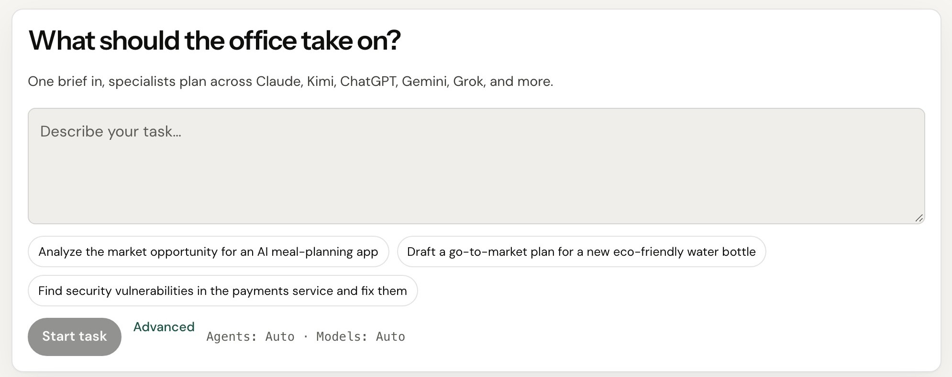
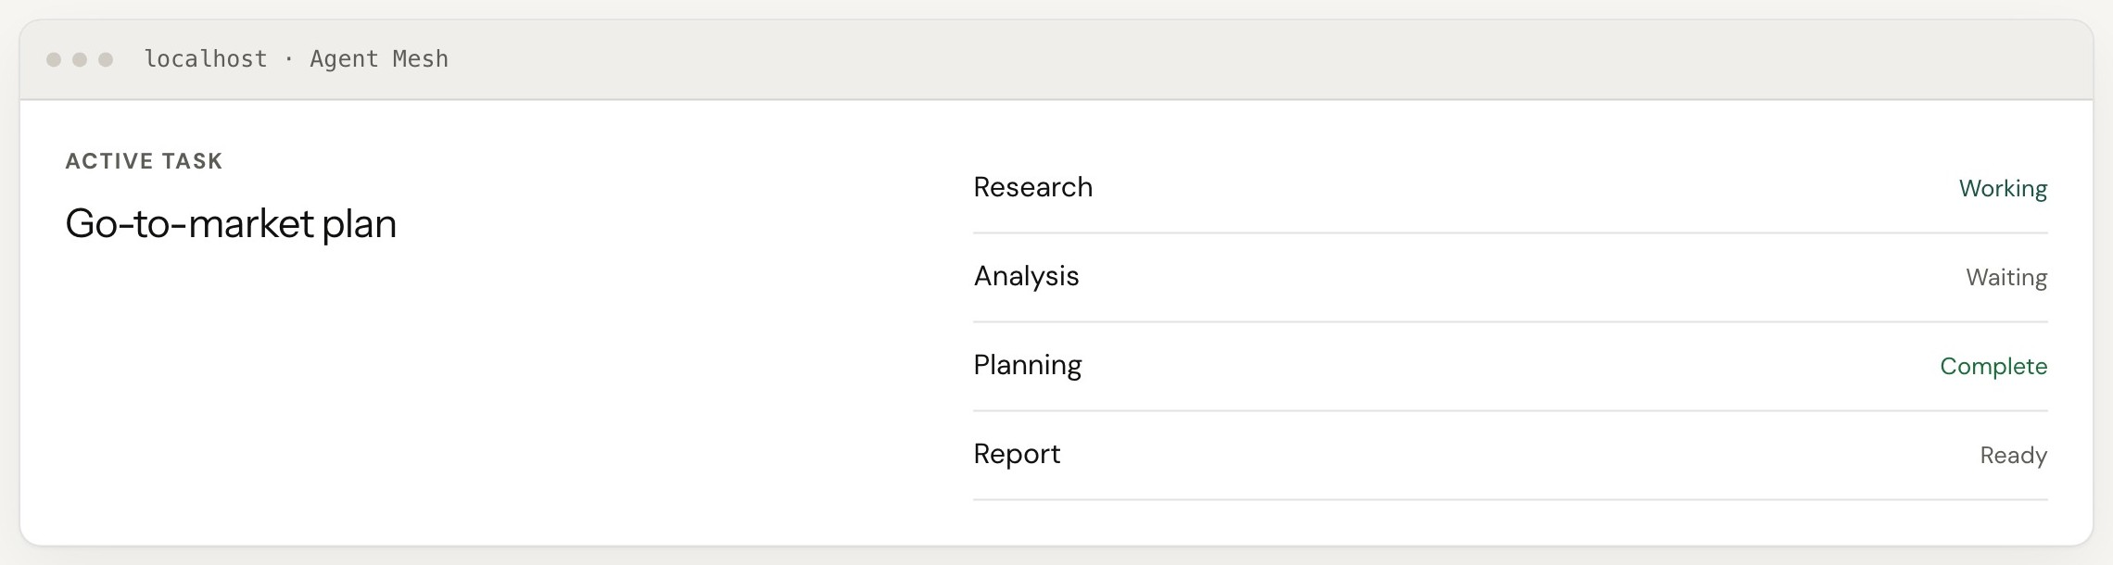
One workspace, no API calls needed
US_05 · FRONTEND · 8 PTS
REVISED · FEEDBACK
ACCEPTANCE CRITERIA
ACCEPTED
/office has a brief box and Start task; empty briefs keep the button disabled
Agents page lists enrolled agents with capabilities and status from the API
After submit, spawned agents appear with status and selection reason
Backend validation and error messages are shown clearly
Notes:
Users do everything from the /office workspace, with no API calls. They type a brief, and the Start button stays disabled until there's real text. They can see every enrolled agent and its status. After they submit, the spawned agents appear with their status and why each was picked. Errors from the backend show up as clear messages.

Slide 23



Nine tasks that delivered the stories
SPRINT 1 BACKLOG · TECHNICAL TASKS
Ship it
Backend core
Data and design
SCRUM-5
→ All
SCRUM-8
→ All
SCRUM-11
→ US_01 · US_04
Project root setup
Backend requirements, pyproject
SQLAlchemy models + schemas
.gitignore, .env.example, Makefile, README
pinned deps, ruff, mypy, pytest
10 tables, Pydantic contracts
SCRUM-6
→ US_05
SCRUM-9
→ US_02 · US_04
SCRUM-12
→ US_01 · US_03
Docker Compose environments
Config, logging, middleware
Alembic migrations
4 services, health-gated, hot reload
typed settings, structlog, request IDs
versioned, reversible schema
SCRUM-7
→ All
SCRUM-10
→ US_01 · US_03
SCRUM-13
→ US_02
GitHub Actions CI
Database session handling
Architecture documentation
5 automated jobs on every PR
async engine, sessions, base classes
architecture.md and ADRs
Notes:
Behind those stories were nine technical tasks in Jira, SCRUM-5 to SCRUM-13. They cover project setup, Docker, CI, the backend core, the database and our architecture docs. Each arrow shows which user story the task supported.

Slide 24
23 test cases, all passing
SPRINT 1 · APPLICATION TEST CASES
TC | Story | Scenario | Type | Result
TC_01 | US_01 | Enroll an agent with valid details | Positive | Pass
TC_02 | US_01 | Enroll with a missing required field | Negative | Pass
TC_03 | US_01 | Enroll a duplicate agent name | Negative | Pass
TC_04 | US_01 | Single fast enrollment request | Positive | Pass
TC_05 | US_01 | Disable an enrolled agent | Positive | Pass
TC_06 | US_02 | Brief needing several capabilities | Positive | Pass
TC_07 | US_02 | Brief needing one capability | Positive | Pass
TC_08 | US_02 | Brief with no matching agent | Negative | Pass
TC_09 | US_02 | Empty or vague brief | Negative | Pass
TC_10 | US_02 | Same brief submitted twice | Positive | Pass
TC_11 | US_02 | Selection reason is shown | Positive | Pass
TC_12 | US_03 | Table created on enrollment | Positive | Pass
TC | Story | Scenario | Type | Result
TC_13 | US_03 | Unsafe table name | Negative | Pass
TC_14 | US_03 | Repeat table creation | Positive | Pass
TC_15 | US_03 | Table creation failure rolls back | Negative | Pass
TC_16 | US_04 | Reject a malformed schema | Negative | Pass
TC_17 | US_04 | Store valid agent output | Positive | Pass
TC_18 | US_04 | Output missing a required field | Negative | Pass
TC_19 | US_04 | Output with the wrong data type | Negative | Pass
TC_20 | US_05 | Submit a brief from the UI | Positive | Pass
TC_21 | US_05 | Empty brief blocked in the UI | Negative | Pass
TC_22 | US_05 | Agents page matches the API | Positive | Pass
TC_23 | US_05 | Backend error shown to the user | Negative | Pass
23 / 23 passed 12 positive · 11 negative · automated in CI on Oct 18, 2026
Notes:
We wrote 23 test cases, all for Sprint 1 stories: 12 positive and 11 negative. Every one is automated. Backend tests run in CI, and the UI tests run in Playwright against our Docker stack. All 23 passed on October 18. The full sheet with steps and expected results is on our wiki.

Slide 25
Stories completed and not completed
SPRINT 1 OUTCOME
COMPLETED
5 stories · 42 pts
NOT COMPLETED
US_01
Agent Enrollment
8 pts
0
US_02
Agent Spawning
13 pts
stories carried over
US_03
Dynamic Table Creation
8 pts
Every committed story met all of its acceptance criteria, so nothing moves to Sprint 2.
US_04
Schema Validation
5 pts
US_05
Frontend
8 pts
Notes:
All five stories we committed to are completed, 42 points in total. Nothing was left unfinished, so nothing carries over into Sprint 2.

Slide 26
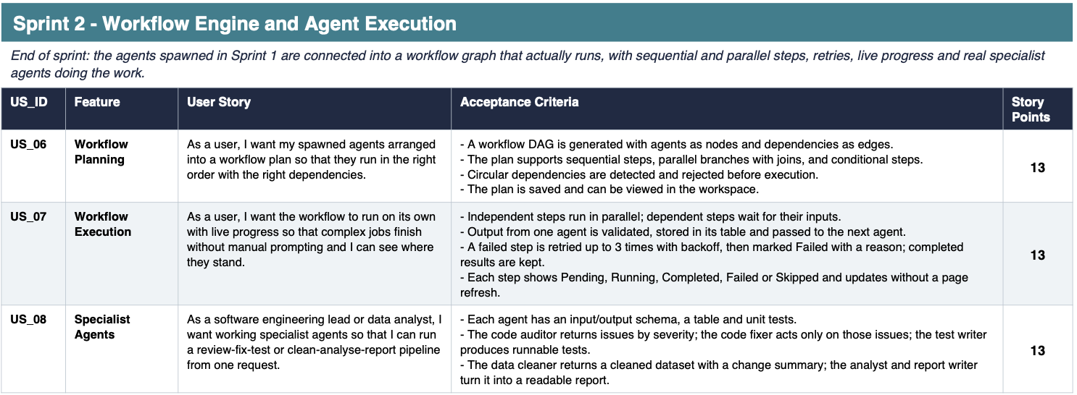
Product backlog
SPRINT 2 AND SPRINT 3
Notes:
This is what's left to build, starting with Sprint 2: the workflow engine and agent execution. US_06 arranges the spawned agents into a workflow graph and rejects circular dependencies. US_07 runs that workflow on its own, with parallel steps, up to three retries and live status. US_08 adds real specialist agents for review-fix-test and clean-analyse-report pipelines. That's 39 points.

Slide 27
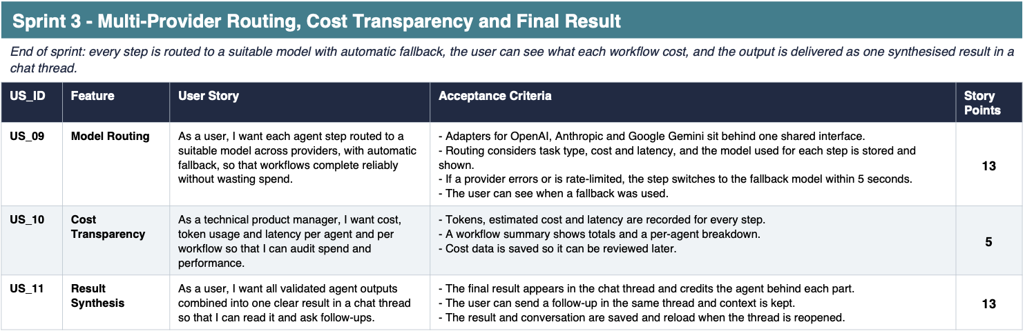
Product backlog
SPRINT 2 AND SPRINT 3
Notes:
Sprint 3 covers routing, cost and the final result. US_09 routes each step to a suitable model across OpenAI, Anthropic and Gemini, and switches to a fallback within five seconds. US_10 records tokens, cost and latency for every step, which is what Aisha needs. US_11 combines all outputs into one result in a chat thread that keeps context for follow-ups. That's 31 points.

Slide 28
Velocity and completion ratio
METRICS · TEAM VELOCITY
TEAM VELOCITY
42
story points completed
COMPLETED / COMMITTED
100%
42 of 42 points
Notes:
Our velocity this sprint is 42 story points. We committed 42 and completed 42, so our completed-to-committed ratio is 100 percent. The chart shows committed and completed points for each story side by side.

Slide 29
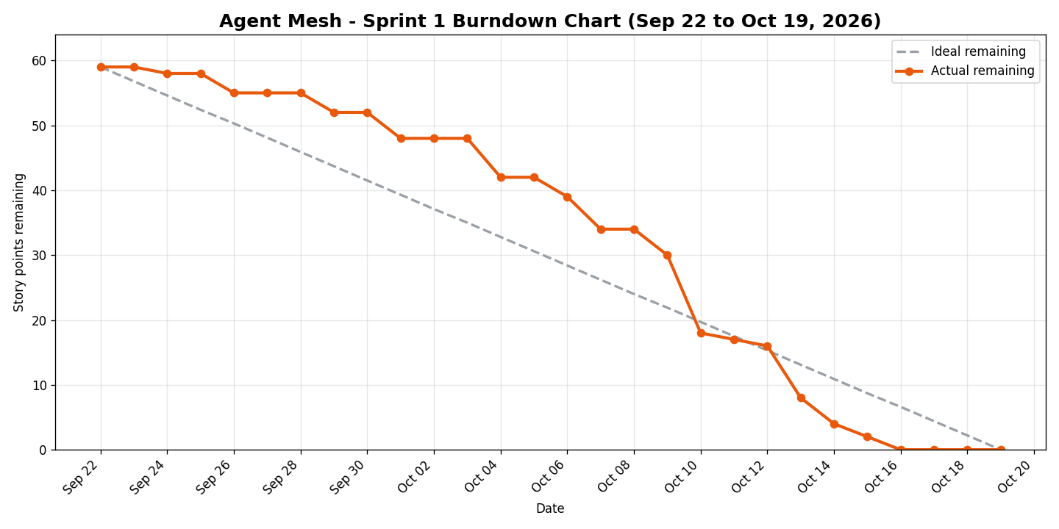

Sprint 1 burndown
METRICS · BURNDOWN CHART
COMPLETED TASKS
9 / 9
engineering tickets closed
SCRUM-5 Project root setup
SCRUM-6 Docker Compose
SCRUM-7 GitHub Actions CI
SCRUM-8 Backend requirements
SCRUM-9 Config and logging
SCRUM-10 DB session handling
SCRUM-11 Models and schemas
SCRUM-12 Alembic migrations
SCRUM-13 Architecture docs
Notes:
This is our Sprint 1 burndown from September 22 to October 19. For the first half we were behind the ideal line, because the 13-point spawning story was large. We caught up around October 10 and reached zero by October 16. On the right, all nine technical tasks are closed.

Slide 30



What Sprint 1 taught us
RETROSPECTIVE
REVISED · FEEDBACK
What went well
What can be improved
Action items
Completed Sprint 1 Planning effectively, establishing clear roles right from day one.
The 13-point ticket for multi-agent spawning was too massive, creating a delivery bottleneck.
Split any ticket larger than 5 story points into smaller, independent sub-tasks during planning.
Mapped out the initial foundation for the core Agent Mesh Enrollment Workflow.
Schema validation and dynamic table creation stalled because verifying structures required manual checks.
Implement automated schema assertion tests to validate database fields on every code commit.
Made significant theoretical headway on core optimization logic before code modification.
Technical documentation and Wiki page updates were neglected early on, resulting in a last-minute rush.
Enforce a strict 'Definition of Done' where a feature cannot be closed until its documentation is written.
Kicked off frontend design and development tasks early to provide visual mock-ups.
Technical dependencies between the frontend interface and backend workflows caused idle blocking time.
Create mock API schemas on Day 1 of the sprint so frontend and backend teams can develop in parallel.
Solidified user stories and technical acceptance criteria to establish product guardrails.
End-to-end testing of workflows lacked a dedicated setup, resulting in local environment confusion.
Build a lightweight Docker Compose script to launch the entire agent mesh locally with one command.
Structured the initial metrics tracking framework to gauge agent processing efficiency later.
Minor feature scope creep entered the sprint via loose parameters, delaying optimization code.
Require explicit Product Owner approval before any functional scope adjustments are made mid-sprint.
Notes:
This time we ran the retro from scratch as a team, and each action item fixes the improvement item in the same row. For example, the 13-point spawning ticket was too big, so from now on we split anything over 5 points. Docs were rushed at the end, so a story isn't done until its docs are written. And to stop frontend and backend blocking each other, we create mock API schemas on day one.

Slide 31

Stories committed for Sprint 2
SPRINT 2 · PLANNED AND COMMITTED
US_06
Workflow Planning
13 pts
COMMITTED
Agents arranged into a validated DAG, saved and viewable
39 pts
US_07
Workflow Execution
13 pts
Parallel steps, retries and live progress without refresh
US_08
Specialist Agents
13 pts
CARRY-OVER FROM SPRINT 1
Review-fix-test and clean-analyse-report pipelines
None
all five stories accepted
Sprint 2 goal the agents spawned in Sprint 1 run as a workflow graph with sequential and parallel steps, retries, live progress and real specialist agents.
Notes:
For Sprint 2 we're committing to US_06, US_07 and US_08, 39 points. Nothing carries over from Sprint 1. By the end of the sprint, the agents we spawn will run as a real workflow, with parallel steps, retries and live progress.

Slide 32
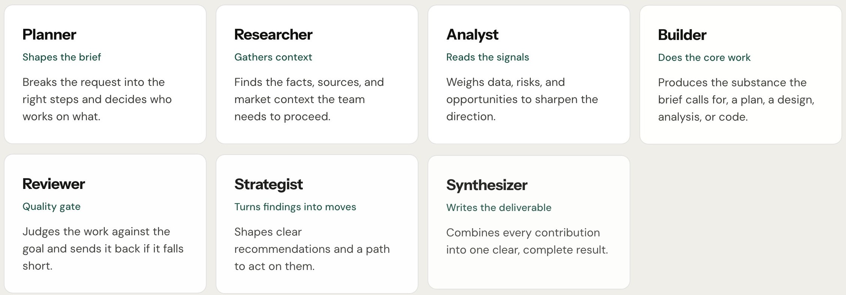

What a user sees, step by step
PROJECT DEMO · APP SCREENSHOTS
REVISED · FEEDBACK
2
Specialists only the desks a brief needs light up
1
Brief type one request or pick a suggestion
Built with
Next.js App Router + TypeScript
Light and dark themes with accessible contrast
Typed API client shared by every page
3
Live status working, waiting, complete, ready
Notes:
Here's what a user sees. First, they type one brief or pick a suggestion. Second, only the specialist agents the brief needs light up. Third, each agent's status updates live: working, waiting, complete or ready.

Slide 33
The API behind every screen
PROJECT DEMO · API
POST
/api/v1/auth/google
Sign in with a Google ID token
EXAMPLE
/api/v1/agents
GET /api/v1/agents
?capability=
security.vulnerability_analysis
200 OK
["security-agent"]
POST /api/v1/tasks
{"request": "help me"}
422 clarifying question
POST
Enroll an agent and create its table
PATCH
/api/v1/agents/{id}
Update or disable an agent
GET
/api/v1/agents?capability=…
List or filter enrolled agents
POST
/api/v1/tasks/plan
Preview which agents a brief spawns
POST
/api/v1/tasks
Submit a brief and run the workflow
GET
/api/v1/workflows/{id}
Node status, reasons, cost, result
Notes:
Every screen is backed by these endpoints. Enrollment is one POST, and PATCH updates or disables an agent. Filtering by a capability returns exactly the agent that should run. If you send a vague brief like "help me," you get a 422 with a clarifying question.

Slide 34

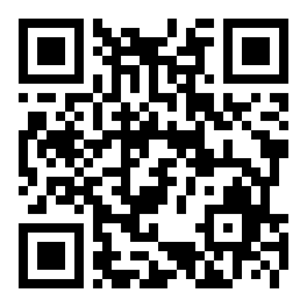
Source code and wiki
GITHUB
github.com/htmw/F2026-T2-Phoenix
frontend/ Next.js app and Playwright tests
backend/ FastAPI app, migrations and pytest suite
docs/ architecture, ADRs, agile artifacts, slides
Wiki deliverables, diagrams, personas, test cases
Scan to open the repository
$ docker compose up --build
Notes:
All our code, docs and deliverables are in our GitHub repository. You can scan the QR code to open it. The frontend, backend and docs each have their own folder, and the wiki links our slides, videos, diagrams and test cases. Anyone can run the whole stack with one Docker command.

Slide 35

Let's run it
LIVE APPLICATION DEMO
1
docker compose up --build
log: agents_seeded created=7 total=7
2
GET /api/v1/agents
all seven, with limits and retry policies
3
?capability=security.vulnerability_analysis
filter: exactly ["security-agent"]
4
GET /api/v1/capabilities
17 capabilities, none orphaned
5
POST /api/v1/tasks/plan
Recorded demo
agents selected and skipped, each with a reason
https://agent-mesh-web.onrender.com/
6
open localhost:3000/office
submit a brief, watch agents spawn
Notes:
Let's run it. (Demo steps, about 90 seconds.)
1. Start the stack and show the log line: agents_seeded created=7 total=7.
2. Call GET /api/v1/agents to show all seven agents.
3. Filter by security.vulnerability_analysis and show that only the security agent comes back.
4. Call GET /api/v1/capabilities to show 17 capabilities, none orphaned.
5. Call POST /api/v1/tasks/plan with a narrow brief and a broad brief, and show the selection and skip reasons.
6. Open localhost:3000/office, submit a brief, and watch the agents spawn.
That's AgentMesh Sprint 1.

Slide 36
Questions?
THANK YOU
github.com/htmw/F2026-T2-Phoenix
Notes:
Thank you for watching. Everything we showed today is in our repository and on our Sprint 1 wiki page. We're happy to take any questions.

