Slide 1
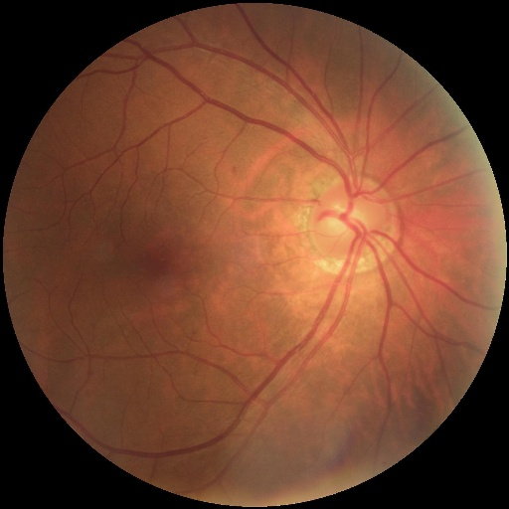
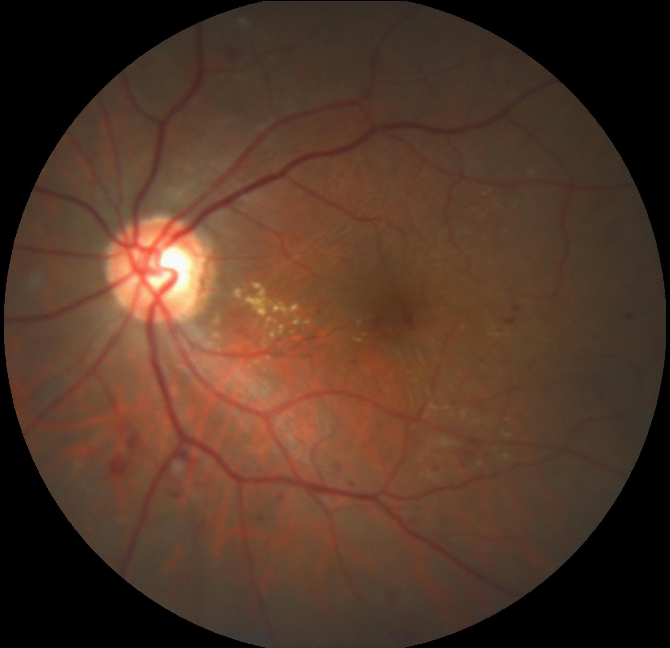
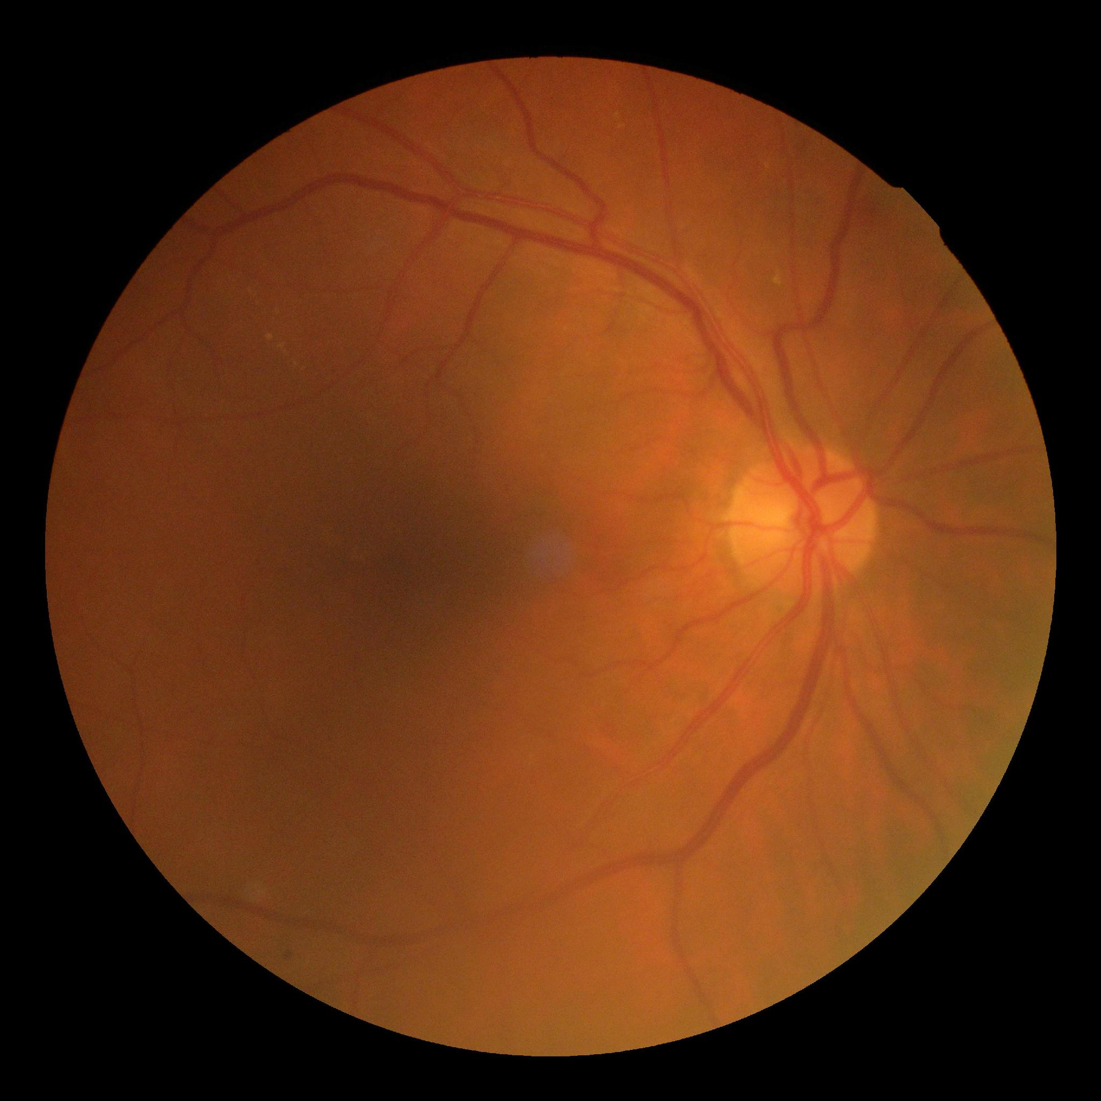

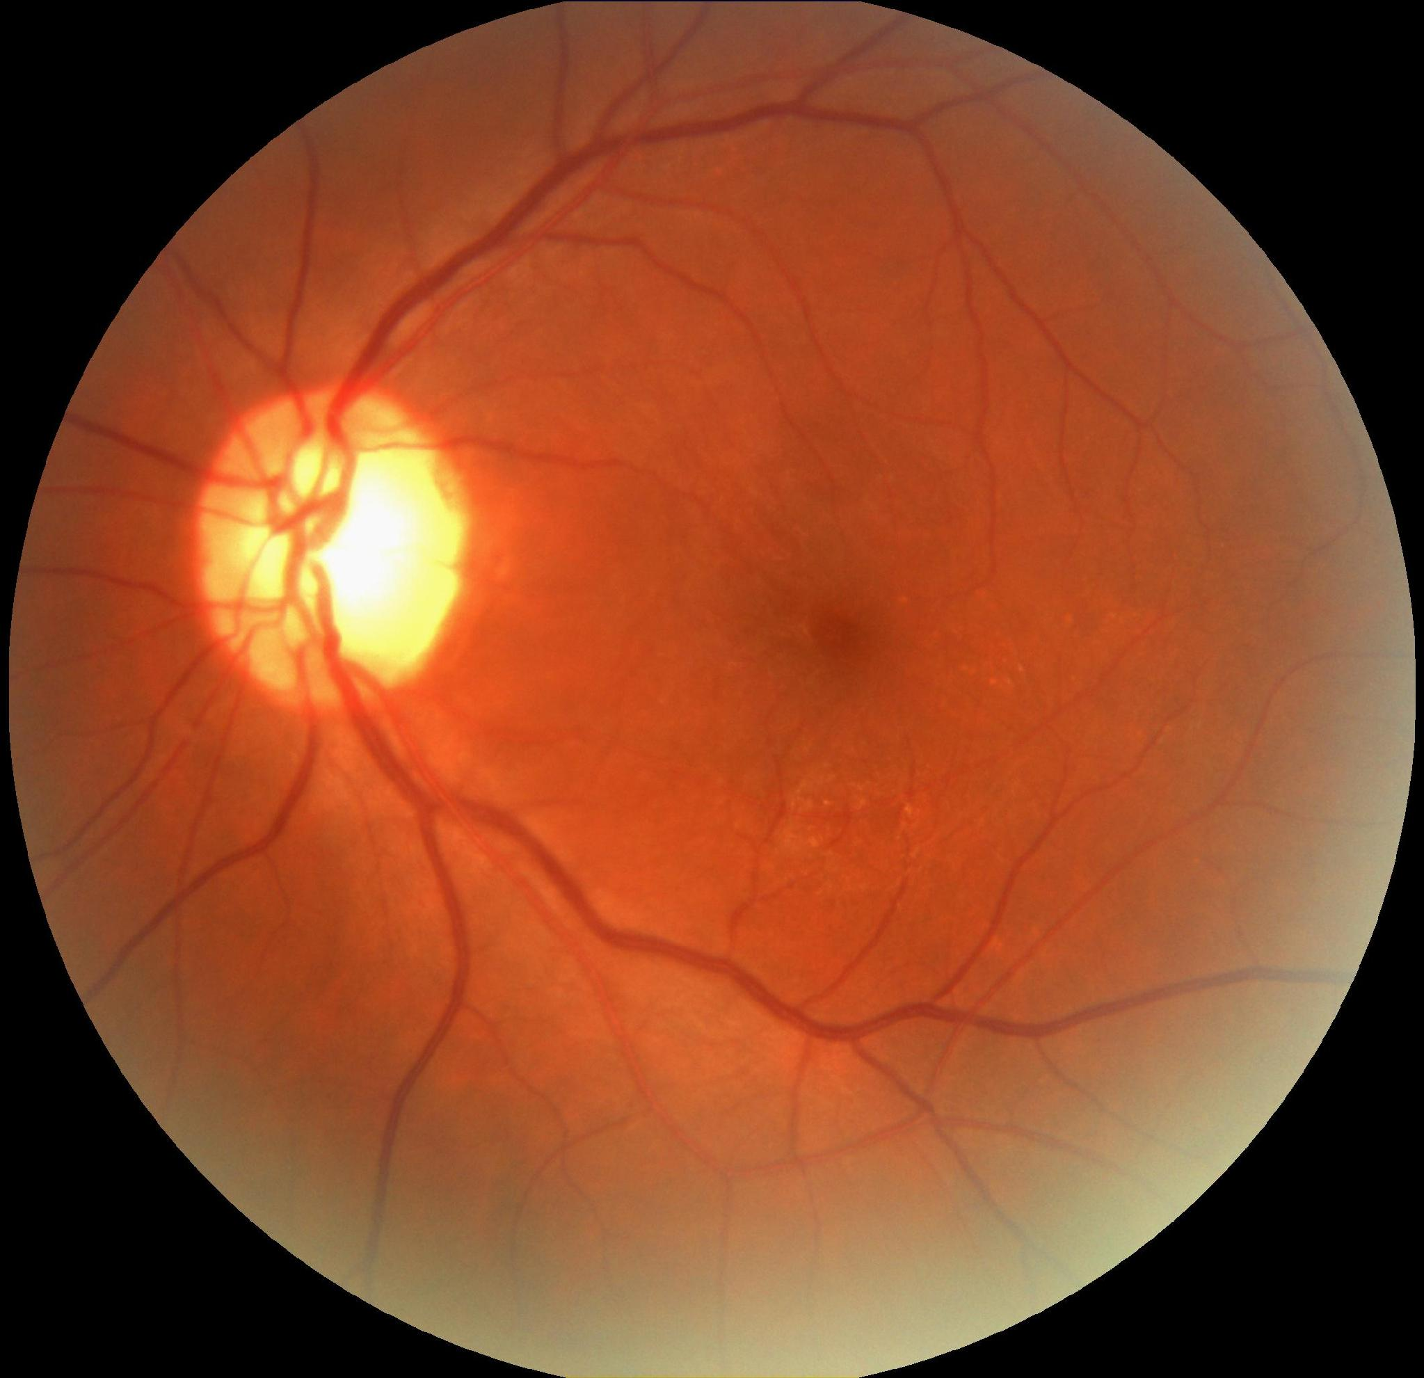
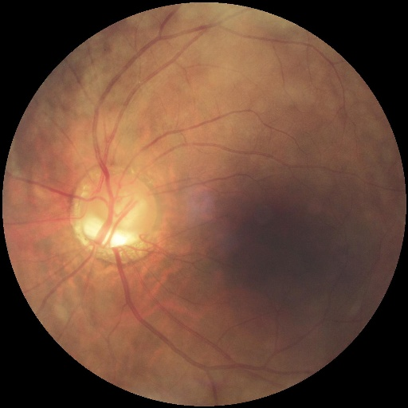
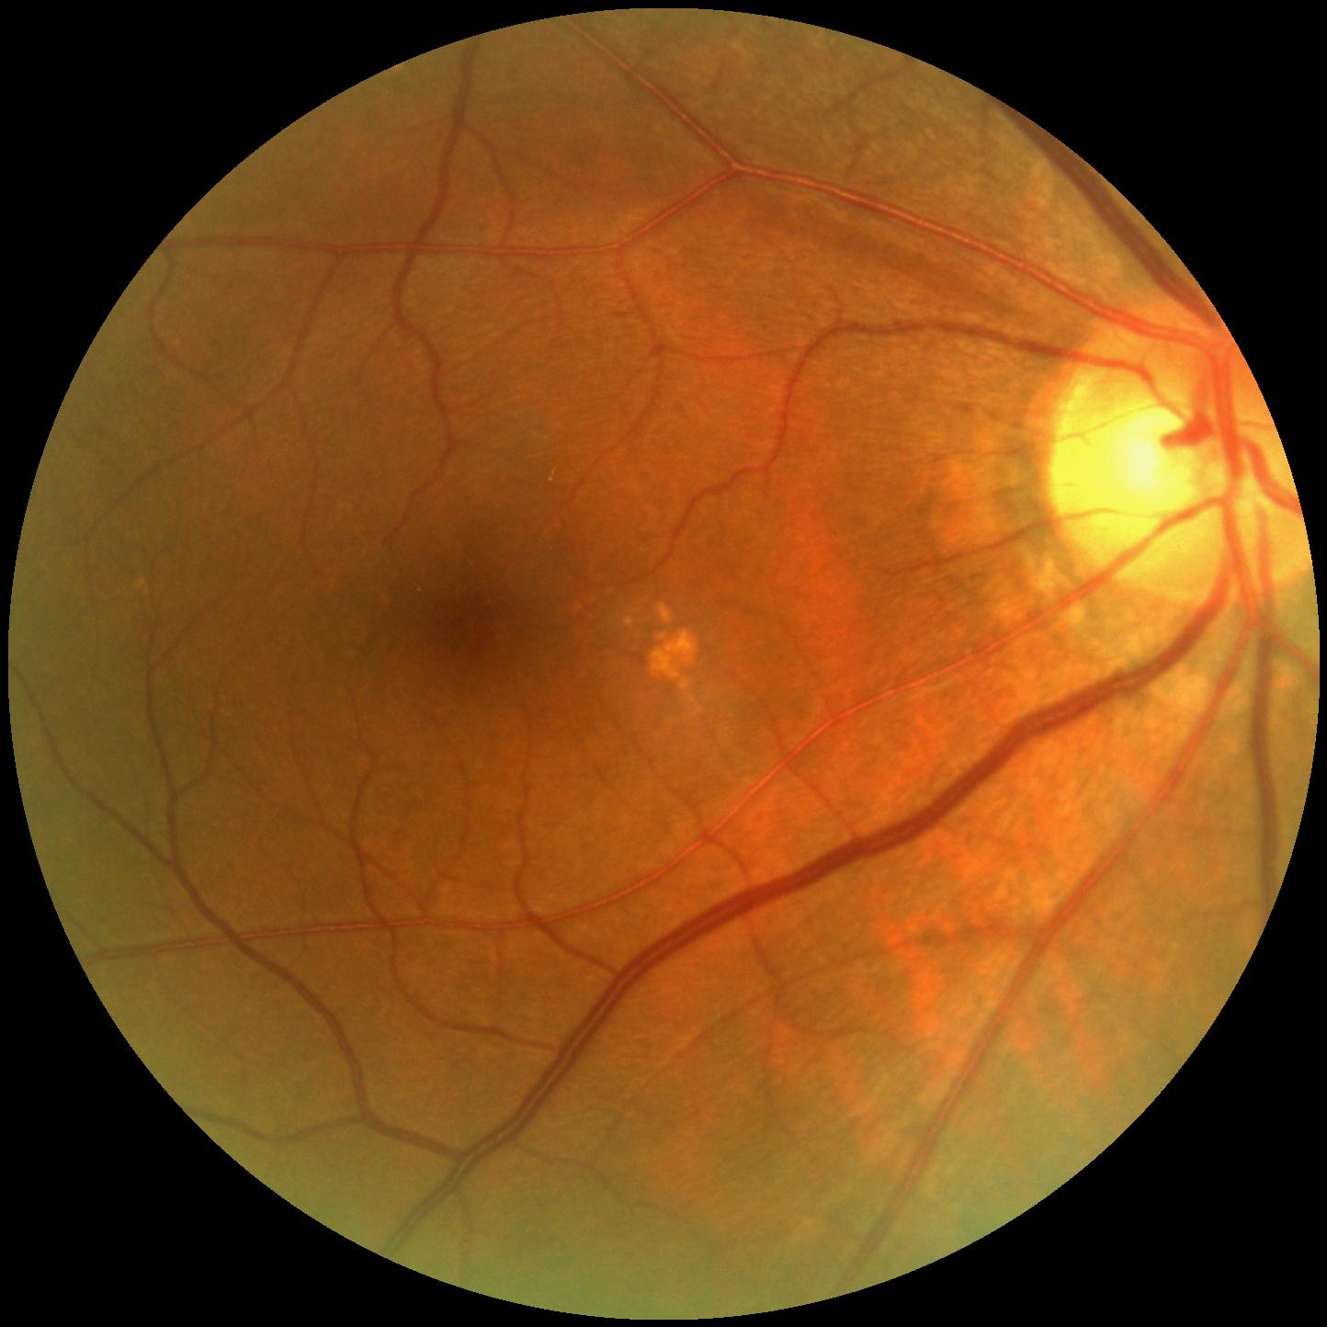
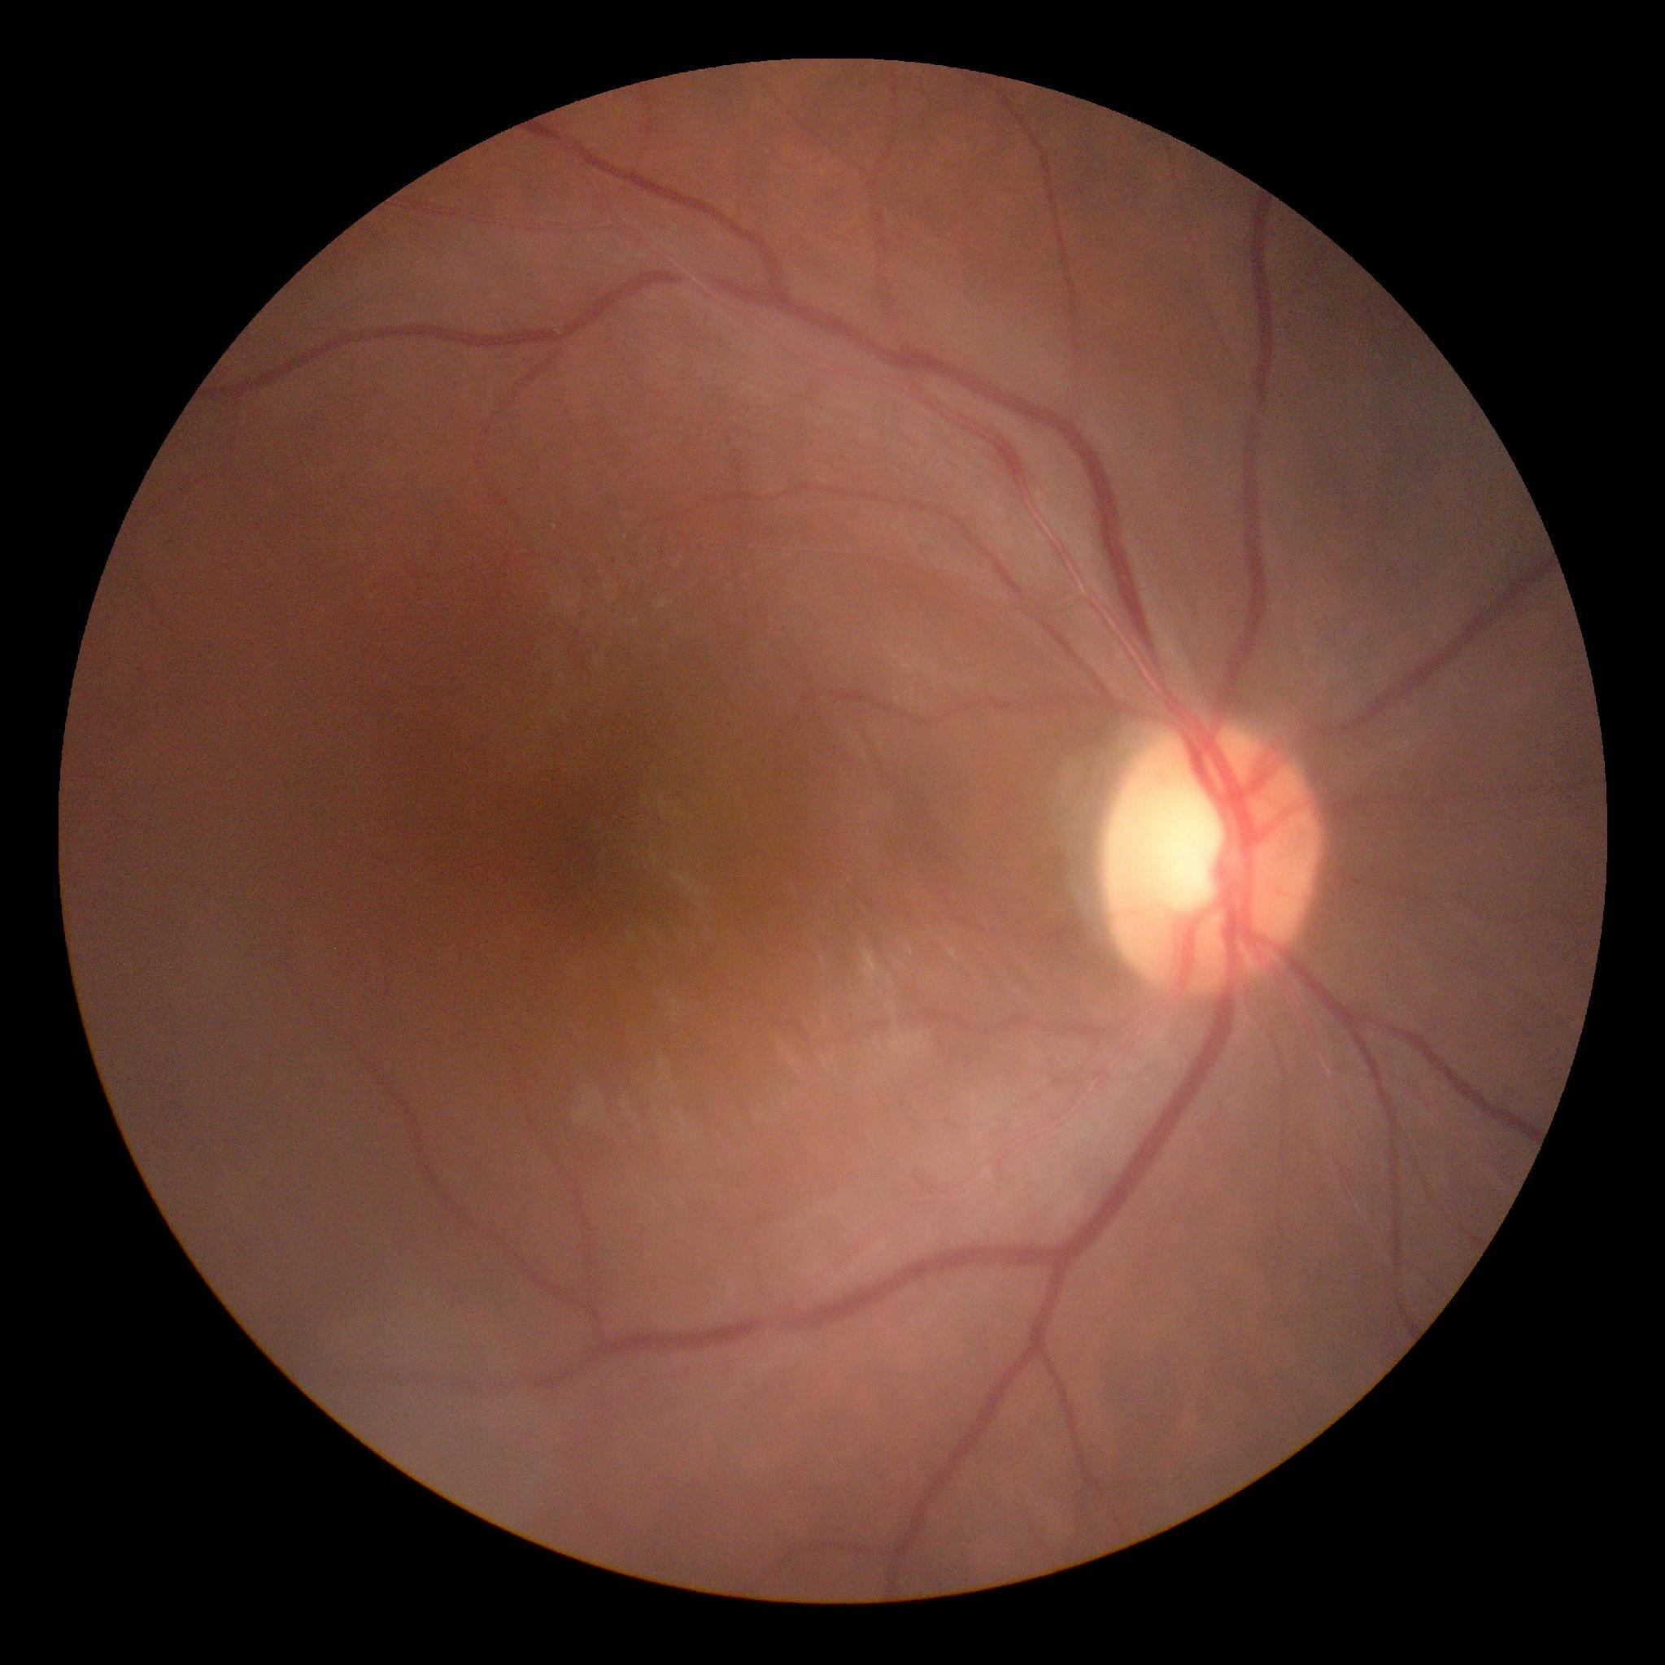
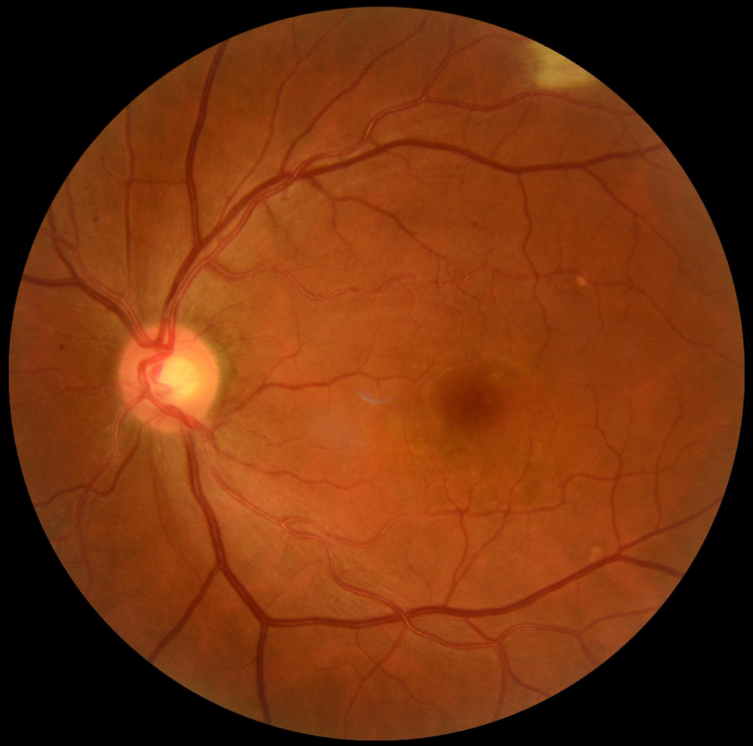
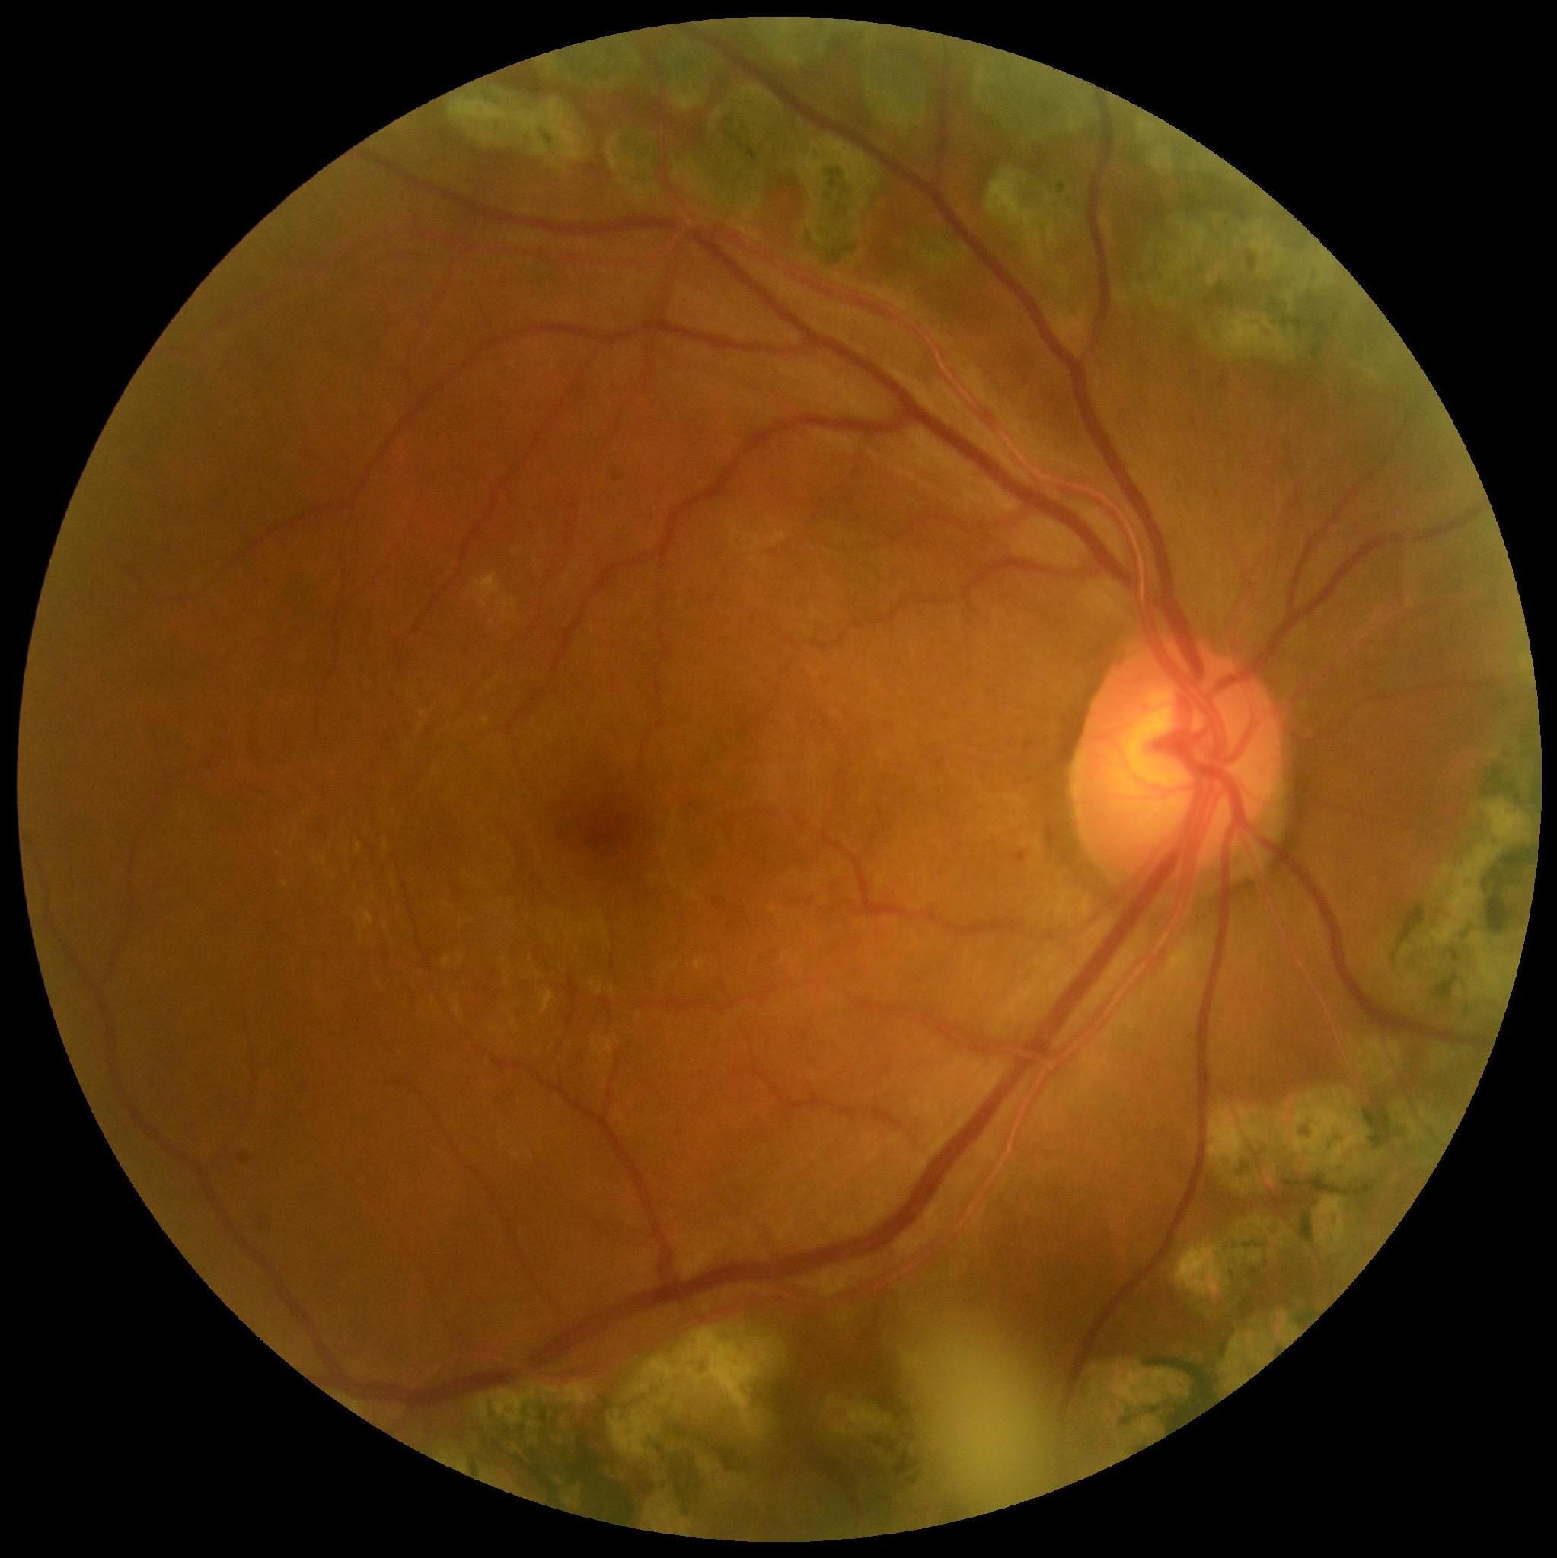
TEAM
EyeQ
SPRINT 0
DUAL
OCULAR DISEASE SCREENER
AI-assisted screening for cataract and glaucoma from a single retinal photograph per eye.
Notes:
Sprint 0 cover.

Slide 2
02 · AGENDA
What we'll cover
01
Team roles and responsibilities
06
Algorithms
02
Problem statement and hypothesis
07
Project schedule
03
Project description
08
Team working agreement
04
Personas
09
Retrospective and wiki
05
Technologies
Notes:
Agenda — matches the Sprint 0 checklist order.

Slide 3
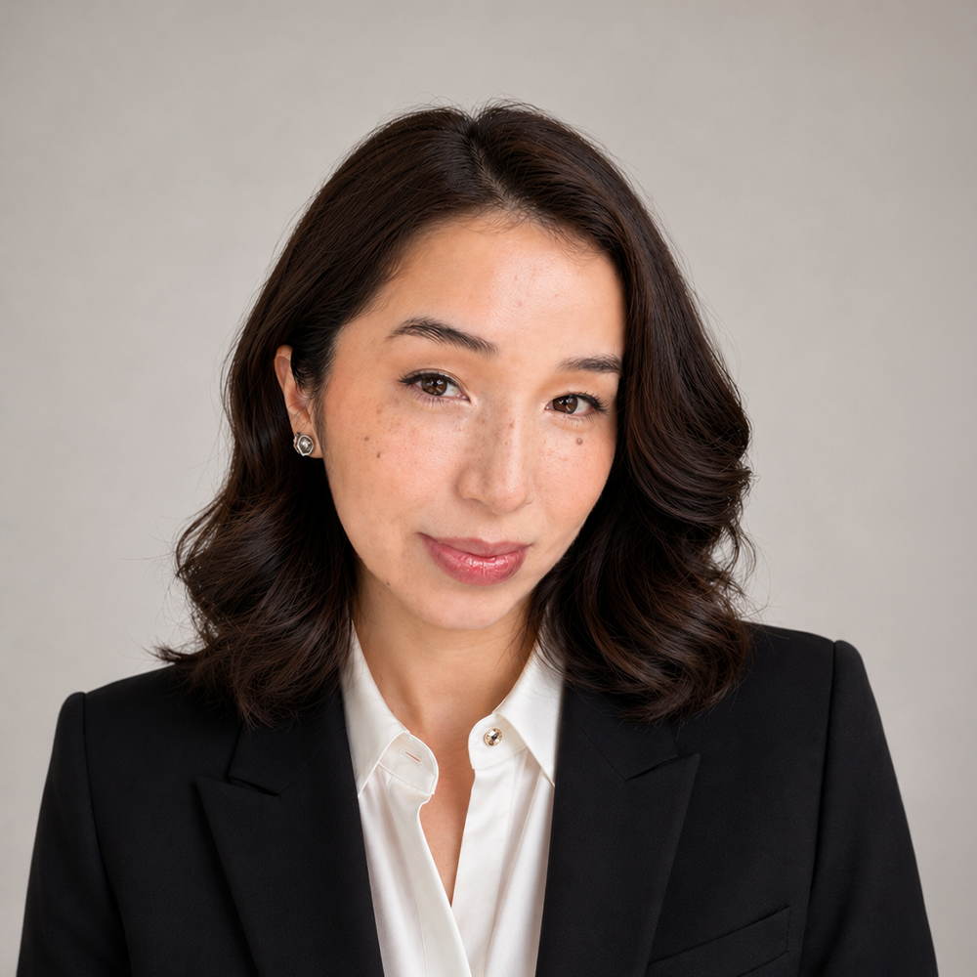
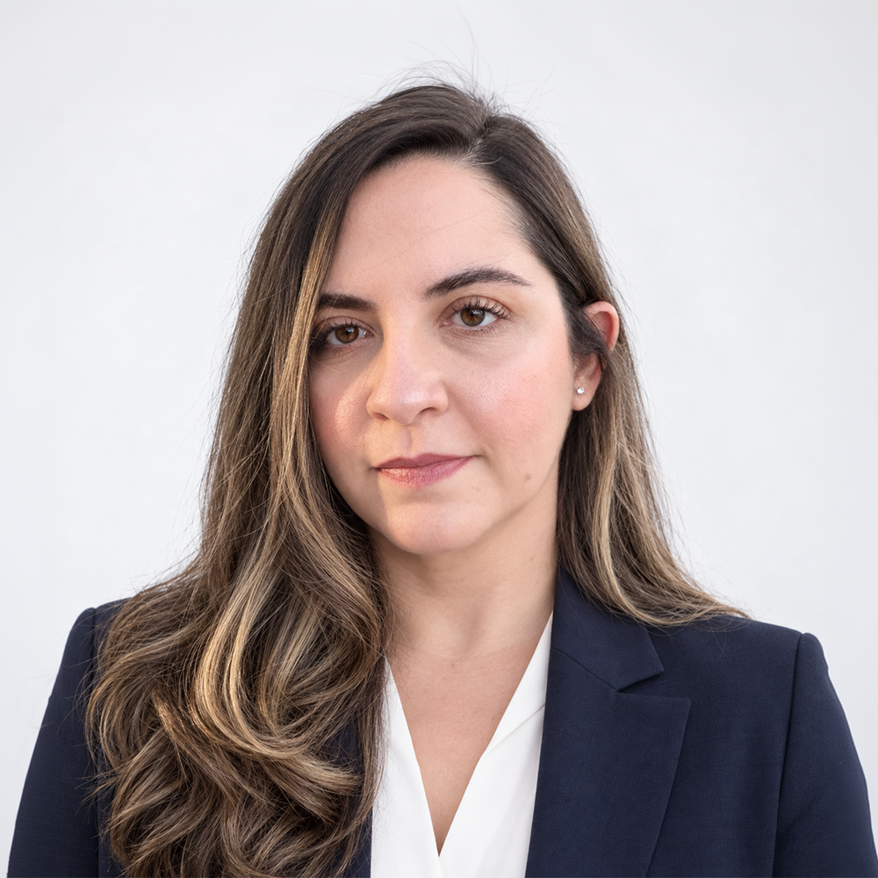

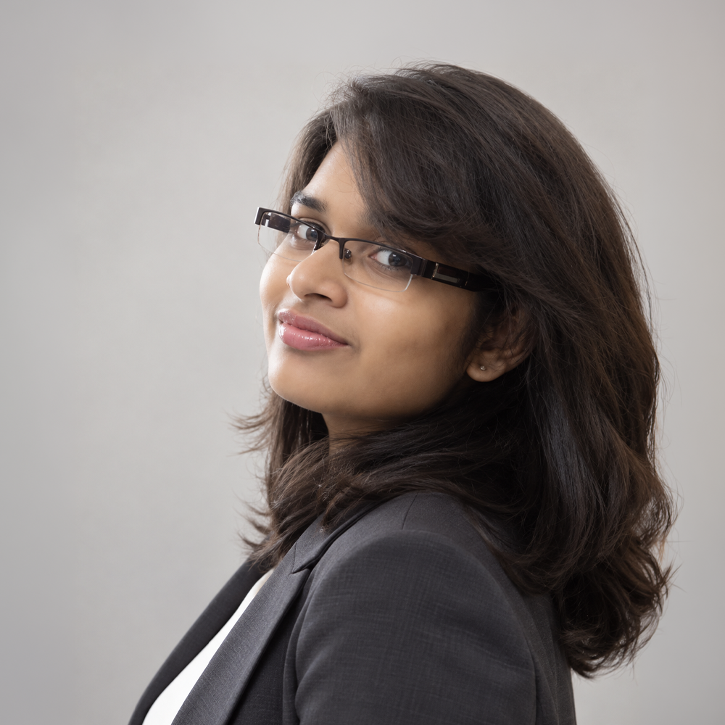
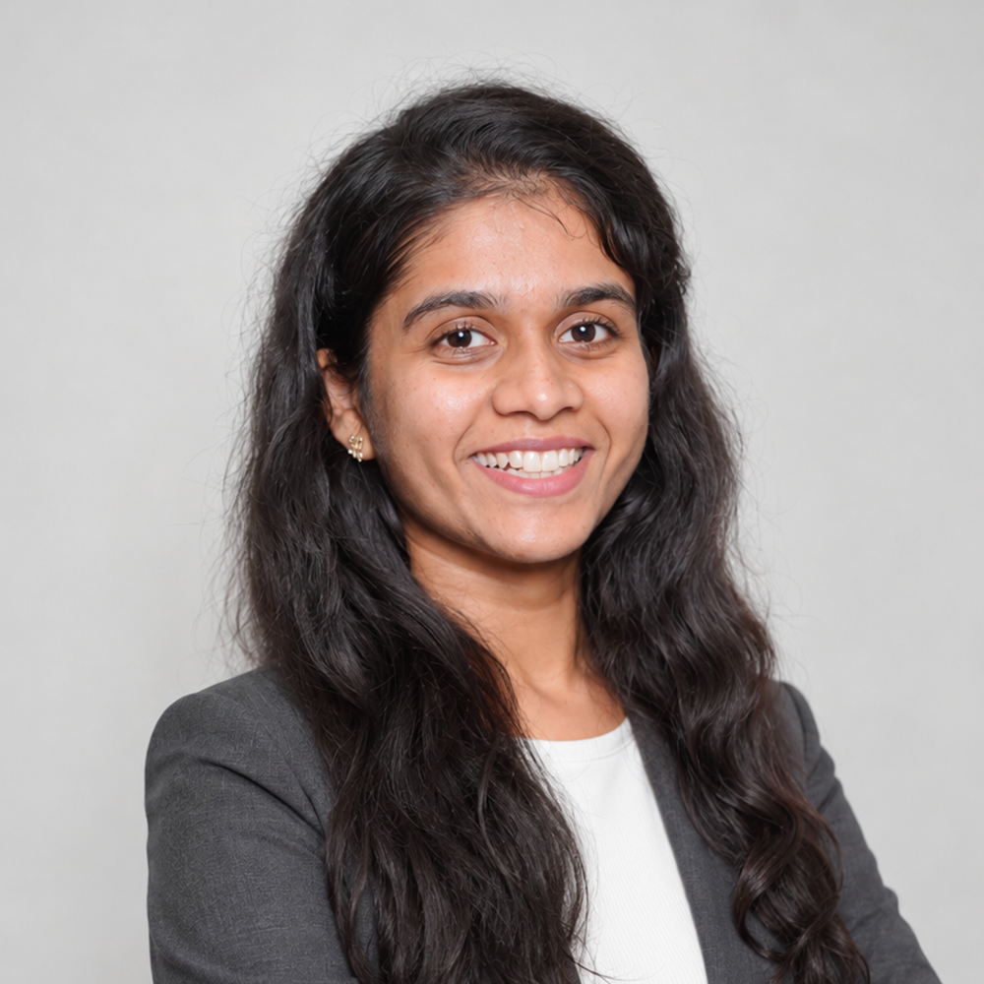
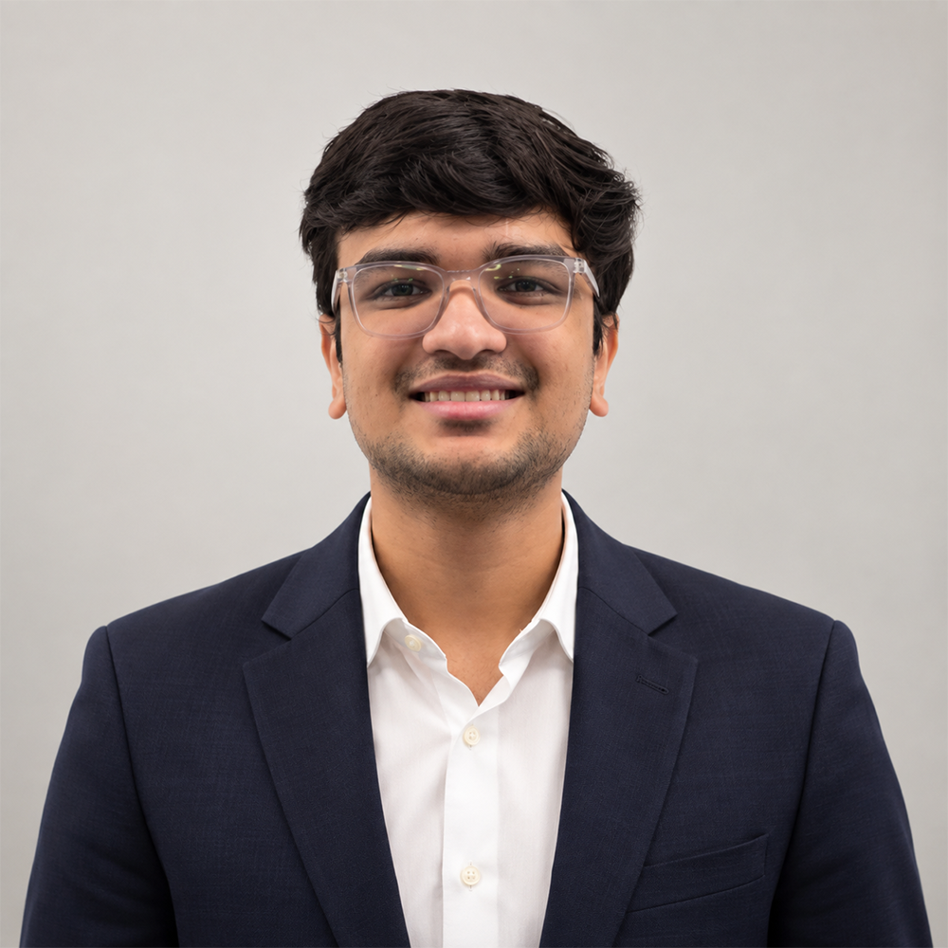
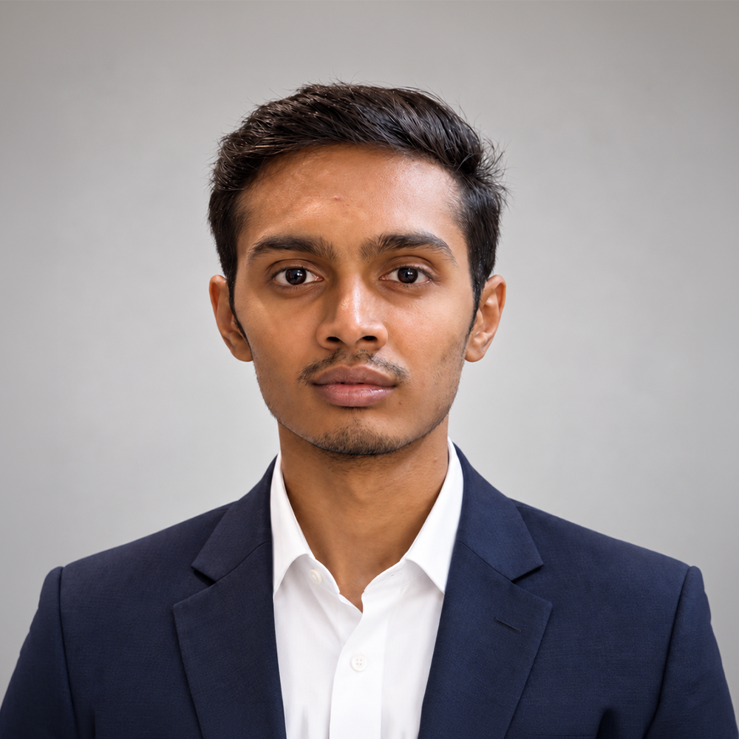
03 · TEAM
Roles & responsibilities
Anel Bazarbayeva
Negar Kamvij
Shridhi Patel
Bhoami Khona
Scrum Master, MLOps/ Integration Developer
ML Developer, External Validation & Calibration
Team Leader, ML Developer, Glaucoma Lead & Data Pipeline Developer
Frontend Developer
Krushiben Patel
Ansh Kevadiya
Smit Meghapara
Data Pipeline Developer
ML Developer,
Cataract Lead
ML Developer, Interpretability & Safety
Notes:
Seven team members. Fill in role and responsibilities for each.

Slide 4
04 · THE PROBLEM
Problem statement
PROBLEM STATEMENT
EVIDENCE TO CITE
Cataract and glaucoma cause a large share of the world's vision loss, but they fail patients in opposite ways: cataract is treatable if caught, glaucoma has no symptoms until the damage is already permanent. Both require routine screening that many at-risk patients never get.
45%
of global blindness caused by cataract (WHO / GBD 2020)
Half
of US glaucoma cases go undiagnosed (CDC)
0.90 → 0.58
AI screeners: AUC in-house drops across sites (J Clin Med, 2026)
Notes:
Problem statement plus hypothesis, with cited evidence.

Slide 5
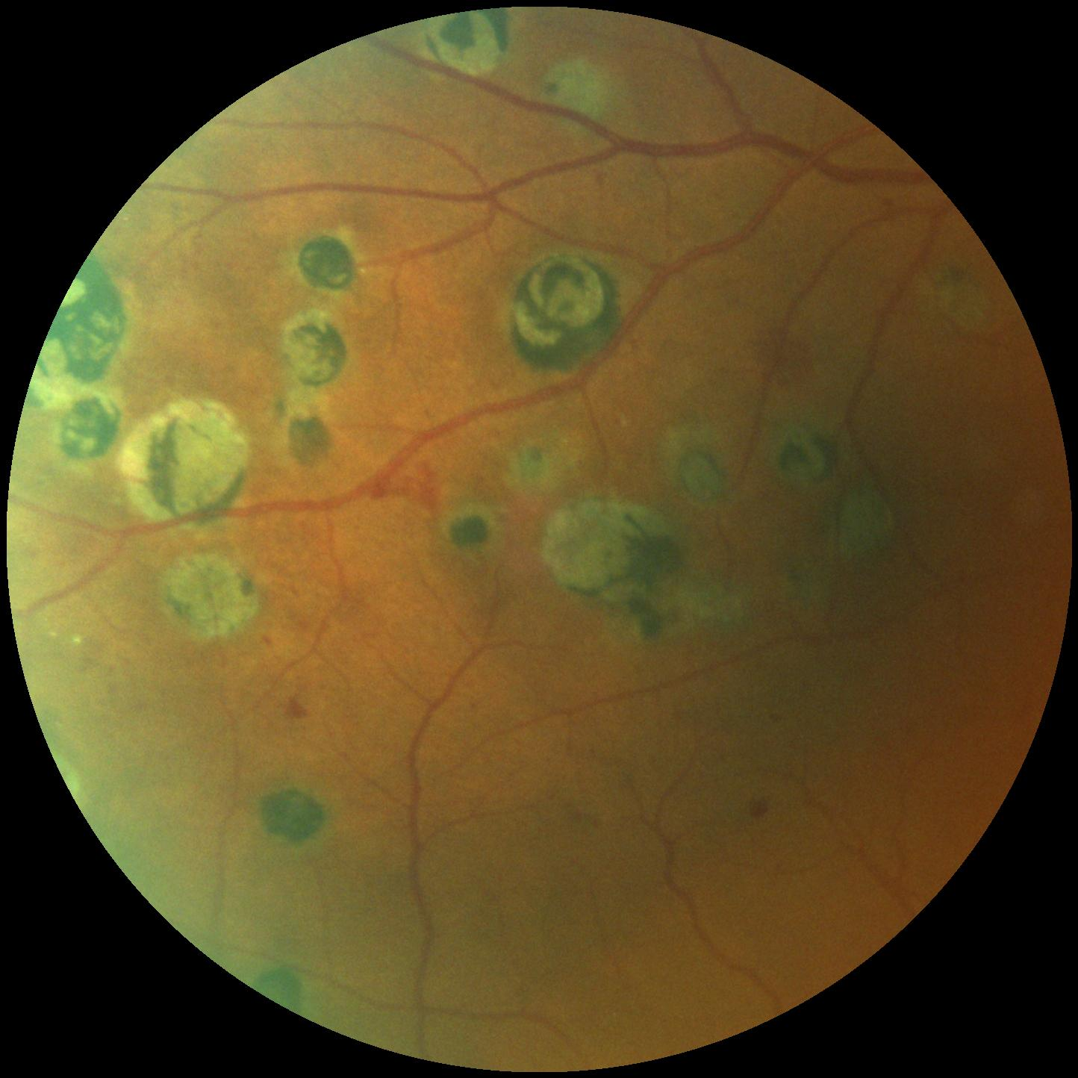
04 · THE PROBLEM
Hypothesis
We believe that giving primary care and community screening sites a single-photo AI tool that flags both cataract and glaucoma risk will result in more at-risk patients getting referred before damage is done.
We will know we are right when the model holds up not just on our own test data, but on photos from different fundus cameras and patient populations it never trained on.
Notes:
Hypothesis — what we believe and how we will know we are right.

Slide 6
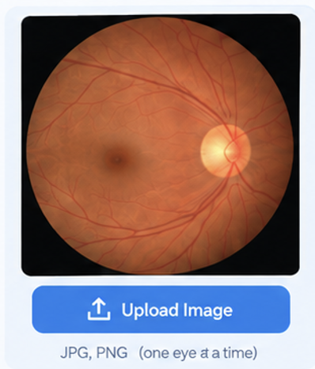
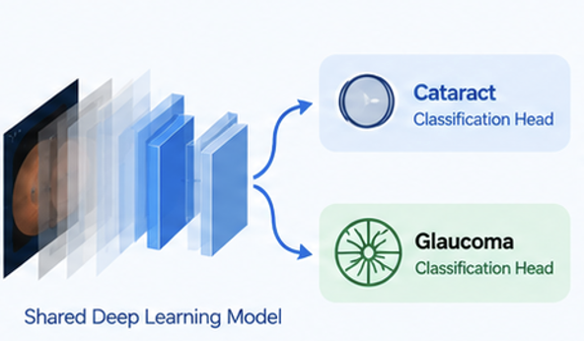
05 · PROJECT DESCRIPTION
What we are building
Dual is a web-based AI screening application that analyzes a fundus photograph of the eye and provides separate risk results for cataract and glaucoma , with confidence information and a referral recommendation when the image or prediction is uncertain.
01
Upload Fundus Image
02
AI Analysis
One shared deep learning model analyzes the image for both cataract and glaucoma.
One retinal photograph per eye is uploaded to Dual.
Notes:
Project description — what the project IS.

Slide 7
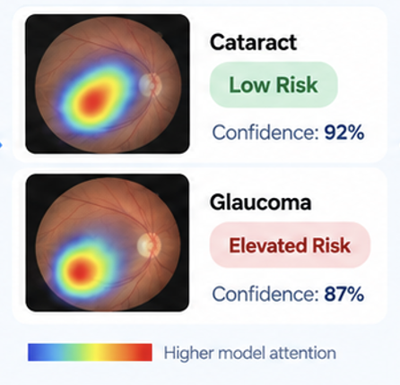
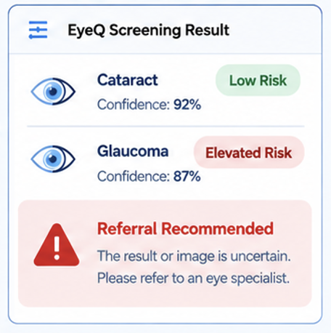
05 · PROJECT DESCRIPTION
Dual Screening Result
03
Risk Results
04
Referral Recommendation
Dual provides separate risk results with confidence levels and highlighted regions in the image.
Dual provides separate risk results with confidence levels and highlighted regions in the image.
Scope: Dual supports screening and referral decisions. It does not provide medical diagnosis, treatment advice, EHR integration, or other eye conditions.
CLEARER VISION HEALTHIER LIVES
Notes:
Steps 3 and 4 of the screening flow, plus scope boundary.

Slide 8

06 · PERSONAS
Helen Whitfield, 68
Retired · At-risk older adult
Last eye exam four years ago
Wants to stay proactive about eye health
GOALS
NEEDS
CONCERNS
Identify possible cataract or glaucoma concerns early
Plain-language results
Confusing medical terminology
Large, easy-to-read text
A clear next step
A frightening result without explanation
Understand her eye health clearly
Not knowing who to ask for help
Know what to do next
“I may not have symptoms now, but I want to understand my screening result and what I should do next.”
“I want to keep seeing the moments that matter.”
SCENARIO
Helen attends a screening visit. A technician captures her fundus image and runs DUAL. She receives a simple explanation of the screening result and the recommended next step. DUAL supports screening and referral; it does not provide a diagnosis.
01 | PATIENT PERSONA
Notes:
Persona 1 of 3 — Helen Whitfield, at-risk older adult.

Slide 9
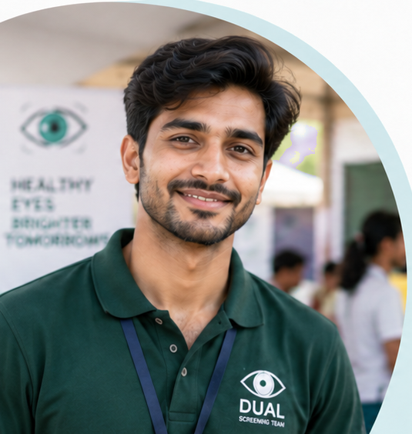
06 · PERSONAS
Arun Desai, 26
Screening Technician
Works at rural and community health camps
Uses a portable retinal/fundus camera
Focused on efficient, reliable screening
GOALS
NEEDS
CONCERNS
Capture high-quality images quickly
Immediate image-quality feedback
Poor-quality or ungradable images
Get easy-to-understand screening results
Simple, step-by-step workflow
Patients leaving before results are ready
Screen patients efficiently
Clear next-step guidance
Misinterpreting screening results
“I need clear feedback right away so I can move to the next patient without delays.”
“I want to help more people get screened, quickly and accurately.”
SCENARIO
Arun captures a patient’s fundus image at a screening camp and uploads it to the DUAL. The system checks image quality and screens for cataract and glaucoma. Arun receives a clear screening result and recommended next step and can generate a report for clinical review when needed.
02 | SCREENING TECHNICIAN PERSONA
Notes:
Persona 2 of 3 — Arun Desai, screening technician.

Slide 10

06 · PERSONAS
Dr. Maya Rao, 41
Primary Care Physician
Family physician in a busy primary care practice
No ophthalmology specialization
Uses screening information to support referral decisions
GOALS
NEEDS
CONCERNS
Identify patients who may need specialist evaluation
Clear cataract and glaucoma screening results
Missing a patient who may need referral
Support early detection and preventive care
Over-referring patients unnecessarily
Clear risk and uncertainty indicators.
Review screening information quickly
Misinterpreting an uncertain AI result
A clear recommended next step
“I need a clear screening result that helps me decide when further eye-care evaluation may be appropriate.”
“I want a quick, reliable way to know which patients may need specialist review.”
SCENARIO
Dr. Rao reviews a DUAL screening report after a technician captures and analyzes a patient’s fundus image. She checks the cataract and glaucoma screening results, uncertainty, and recommended next step, then decides whether further eye-care evaluation is appropriate. DUAL supports screening and referral; it does not diagnose.
03 | PRIMARY CARE PHYSICIAN PERSONA
Notes:
Persona 3 of 3 — Dr. Maya Rao, primary care physician.

Slide 11
DUAL in Action
Early Detection. A Brighter Tomorrow.
01
CAPTURE
02
SCREEN
03
REVIEW
04
NEXT STEP
“Time for my eye screening.”
DUAL
Helen — Patient
“Let me capture your eye image.”
Checking image…
Arun — Screening Technician
Screening Cataract + Glaucoma…
Screening complete!
✓ Cataract
No significant signs detected
⚠ Glaucoma
Possible elevated risk (Refer for further evaluation)
“I’ll review the result.”
Dr. Maya — Primary Care Physician
“Now I know my next step.”
Helen — Patient
Notes:
Walkthrough: capture, screen, review, next step.

Slide 12
07 · TECHNOLOGIES
Tech Stack
01
02
03
04
Model / ML
Backend
Frontend
Infra & Tooling
Computer vision and deep learning
for robust, clinically relevant
predictions.
High-performance APIs and
data services for secure, reliable
inference.
A responsive, clinician-friendly
interface for seamless screening
workflows.
Scalable infrastructure and modern
developer tooling for iteration
and deployment.
Python
PyTorch
FastAPI
PostgreSQL
HTML
CSS
Docker
GitHub
OpenCV
Weights & Biases
Object Storage
JavaScript
React
GitHub Actions
Vercel
Next.js
Render
Cloud GPU
TRAINING & VALIDATION DATA
REAL DATA
STRONGER MODELS
BETTER OUTCOMES
Train: ODIR-5K
External validation / test-only: ORIGA · DRISHTI-GS · ACRIMA · retina_dataset_2016
Fundus image
React/Next.js UI
FastAPI
PyTorch model
Screening result
FROM IMAGE
TO INSIGHT
FOR BRIGHTER LIVES
END-TO-END PIPELINE

Slide 13
08 · ALGORITHMS
Approach & evaluation
CANDIDATE APPROACHES
HOW WE WILL JUDGE IT
01
CNN transfer learning
Sensitivity
Use ResNet/EfficientNet to learn disease patterns from eye images.
How well the model detects actual cataract/glaucoma cases.
Specificity
02
Multi-task heads
How well it identifies healthy eyes.
One model detects both cataract and glaucoma using shared features.
AUC (Area Under the Curve)
Overall ability to distinguish between healthy and diseased eyes.
03
Baseline for comparison
Use Logistic Regression as a simple model for comparison.
Confusion Matrix
Shows correct and incorrect predictions for each condition.
Test Set
04
Image-quality classifier
Evaluate on unseen patient images to measure real-world performance.
Detects ungradable or poor-quality eye images before prediction
Key goal • Minimize missed disease cases while maintaining reliable predictions.
Notes:
Algorithms and evaluation plan.

Slide 14
09 · SCHEDULE
Cadence & deliverables
MEETING CADENCE
SPRINT DELIVERABLES
Sprint 0 — SEP-1 to SEP-21
Standup — Quick progress discussion after class.
Finalize the project scope, team responsibilities, personas, technology stack, datasets, and overall development plan.
Working session — Sunday 2-hour Zoom meeting + individual work throughout the week.
Sprint 1 — SEP-21 to OCT-19
Prepare and preprocess retinal images, create the basic user interface, and build initial cataract and glaucoma model functionality.
Sprint Duration — Approximately 4 weeks.
Sprint 2 — OCT-19 to NOV-16
Develop the shared dual-head model, evaluate both disease predictions, integrate the model with the application, and begin external validation.
Sprint 3 — NOV-16 to DEC-14
Complete the end-to-end application, perform final model testing and validation, improve the interface, and finalize project documentation and presentation
Notes:
Project schedule, cadence, and sprint deliverables.

Slide 15
10 · WORKING AGREEMENT
How we work together
Where & when we meet
Communication
Two-hour Zoom meeting every Sunday for project work and planning. Brief follow-up discussions after Tuesday's class.
For Primary channel, use the team group chat for regular updates and coordination. Respond within 24 hour.
If someone doesn't commit
Deadlines & reminders
Talk with the member first and work together to resolve the issue. Repeated problems will be discussed as a team and, if necessary, brought to the instructor.
Set internal deadlines ahead of official due dates. The team leader sends reminders before deadlines. Work is considered complete when it is finished, tested, reviewed, and submitted to the team repository.
Notes:
Team working agreement.

Slide 16
11 · RETROSPECTIVE
Sprint 0 retro
What went well
What can improve
ACTION 1 → SPRINT 1 BACKLOG
We successfully defined the Dual Ocular Disease Screener and its scope.
We could communicate more consistently when tasks or plans change.
We could assign responsibilities earlier so everyone knows their focus from the start.
We could review the dataset and technical approach sooner to make the transition into Sprint 1 smoother.
Finalize Sprint 1 task ownership and deadlines.
We identified our target users/personas and initial technology/algorithm approach.
Owner: Team Lead + all team members
By when: Before Sprint 1 development begins.
Team members divided Sprint 0 responsibilities across the presentation deliverables.
ACTION 2 → SPRINT 1 BACKLOG
Review the dataset and establish the initial data pipeline/model baseline.
Owner: Assigned ML/Data team members
By when: During Sprint 1.
Notes:
Sprint 0 retrospective. Two actions feed the Sprint 1 backlog.

Slide 17
GROUP WIKI
https://github.com/htmw/F2026-Team1/wiki
Earlier Detection. Brighter Tomorrows.
Notes:
Group wiki link on its own slide, per the checklist.

Slide 18
Thank you
TEAM EYEQ
Notes:
Closing slide.

