Slide 1

SPRINT 1 | CORE ADVISEMENT PLATFORM

Slide 2
AGENDA
Sprint 1 review
A focused review of the product, sprint evidence and next increment.
01 Product & team
02 Solution design
Scope, personas, ownership
Architecture, data model, technology
03 Sprint execution
04 Outcomes & next steps
Backlogs, data, tests and status
Metrics, demo, retrospective, Sprint 2
ACADMATE • TEAM 3 • CS 691 • FALL 2026
02

Slide 3

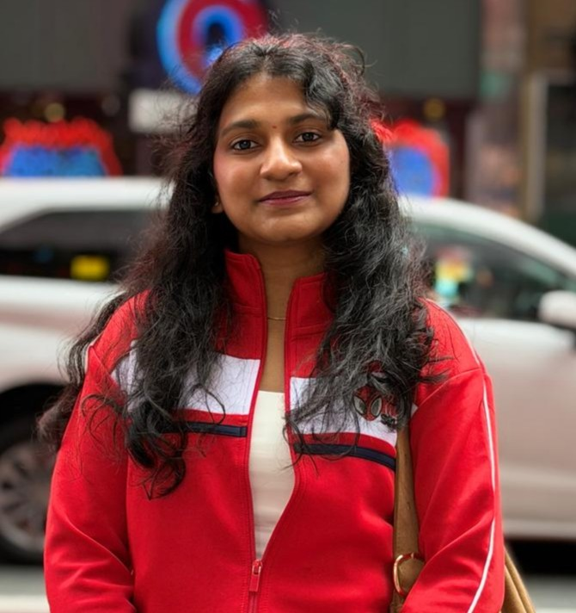
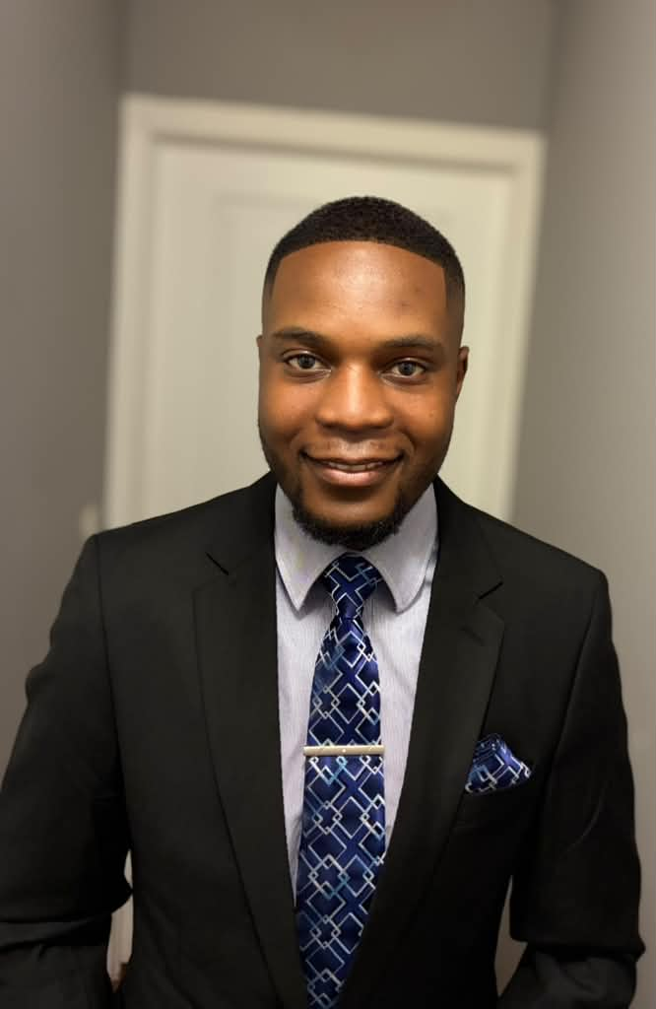
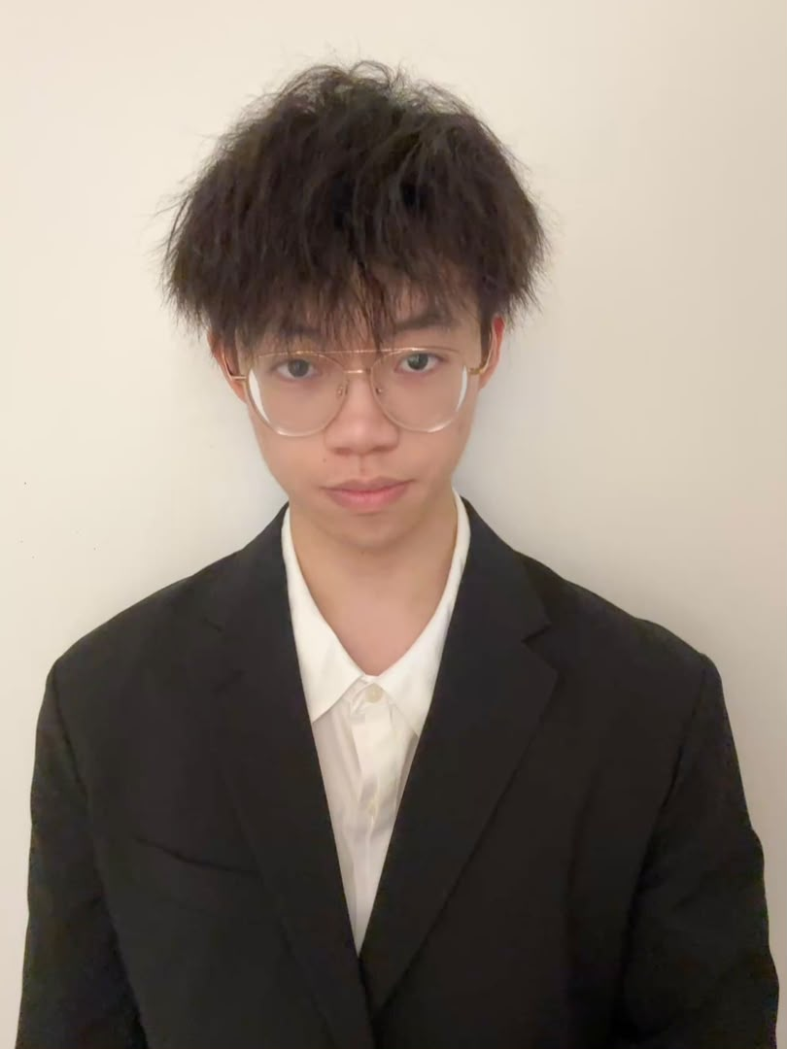

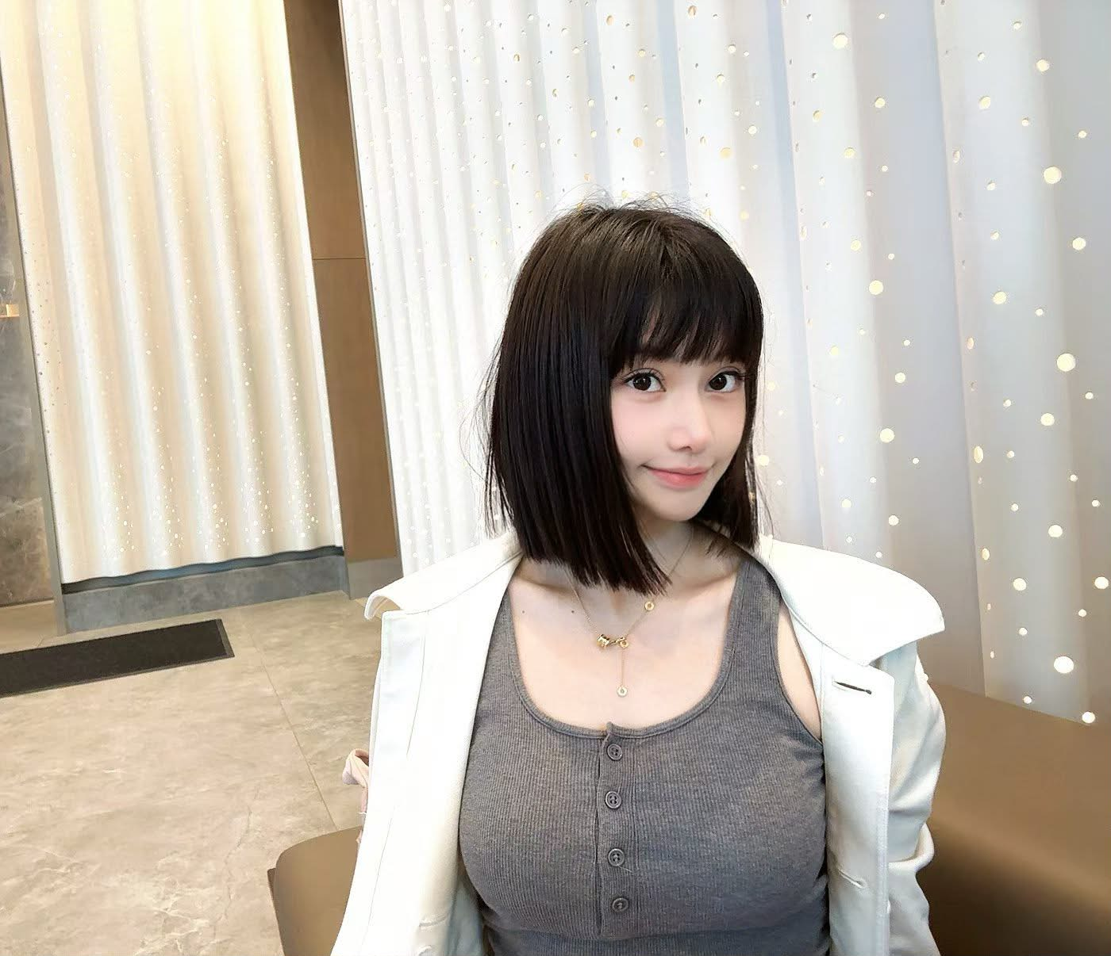
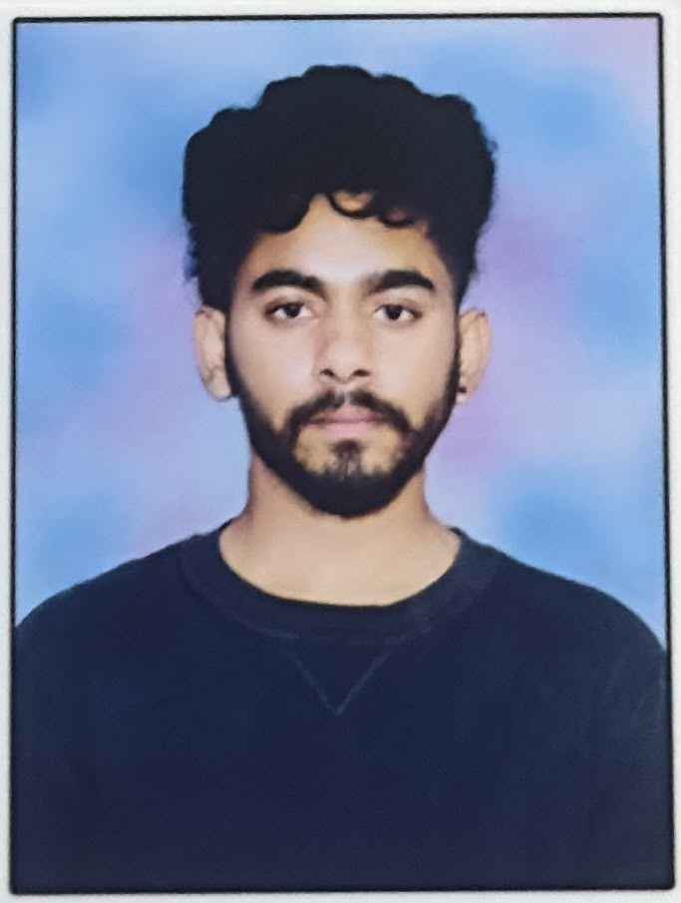
PEOPLE + COLLABORATION
Team ownership
Tafadzwa
Pranali
Lyno
Liangxian Li
Product Owner • AI/ML
Scrum Master • Backend
Frontend • LLM
Backend
Datta
Saisai
Chintu
Database • Backend
UI/UX • Documentation
Frontend • QA
ACADMATE • TEAM 3 • CS 691 • FALL 2026
03

Slide 4
AGENDA
Improvements from Professor Feedback
The professor advised our team to give individual introductions while presenting so that each member is properly introduced in the presentation keep the presentation seem like a one team.
Writing actionable retrospective points clearly and presenting how we conducted the retrospective.
ACADMATE • TEAM 3 • CS 691 • FALL 2026
02

Slide 5
Project Description
A full-stack advising platform that turns academic data into actionable support
1
2
3
4
5
6
Student Data
Risk Prediction
Explainability
Recommendations
Advisor + AI Support
Progress
Grades • attendance • assignments • LMS
Estimate academic-support risk
Show the factors behind the result
Suggest tutoring, planning or resources
Human intervention + conversational guidance
Track follow-up and outcomes

Slide 6



PRODUCT DEFINITION
Product, personas & MVP
Academic records become a usable foundation for student and advisor decisions.
STUDENT (Lucas Vance, 20y)
ADVISOR (Elena Sterling Academic Advisor, 38y)
ADMINISTRATOR
(Leo Mercer Administrator, 45)
"I want to stay on track and reach my goals."
"I want to support my students before they fall behind."
"I want a safe, reliable system that improves student outcomes."
• Fragmented academic information
• Late awareness of declining performance
• Generic rather than personalized support
• Large advising caseloads
• Manual review of multiple data sources
• Limited time for proactive outreach
• Data privacy and access control
• Consistency of advising information
• Responsible use of AI
Sprint 1 usable slice
Sign in / roles
→
Academic records
→
Admin profile
→
Student Profile
Later increments: Advisor Profile , predictive risk, SHAP explanations and RAG-supported advising.
ACADMATE • TEAM 3 • CS 691 • FALL 2026
04

Slide 7
SYSTEM DESIGN
Architecture & technology
Core Sprint 1 services are separated from future intelligence capabilities.
Experience
React / Next.js • Student, advisor, admin UI
↓
Application
Python / FastAPI • REST endpoints • authorization
↓
Academic data
PostgreSQL / Neon • users, courses, enrollments
↓
Future intelligence
scikit-learn • SHAP • LLM / RAG (not Sprint 1 delivery)
ACADMATE • TEAM 3 • CS 691 • FALL 2026
05

Slide 8
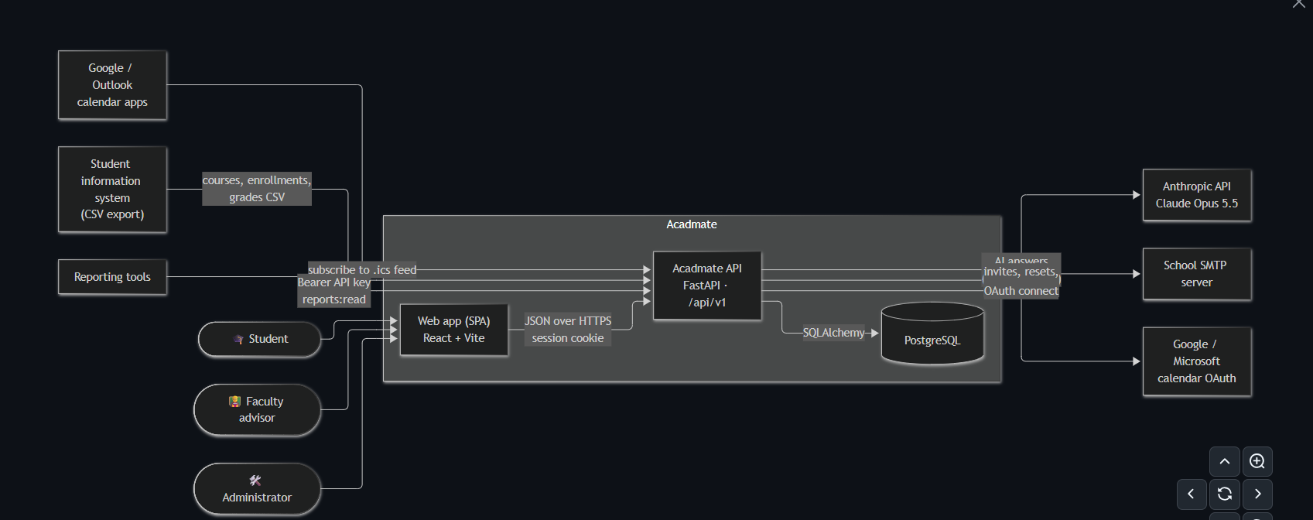
SYSTEM DESIGN
Architecture & technology
↓
ACADMATE • TEAM 3 • CS 691 • FALL 2026
06

Slide 9
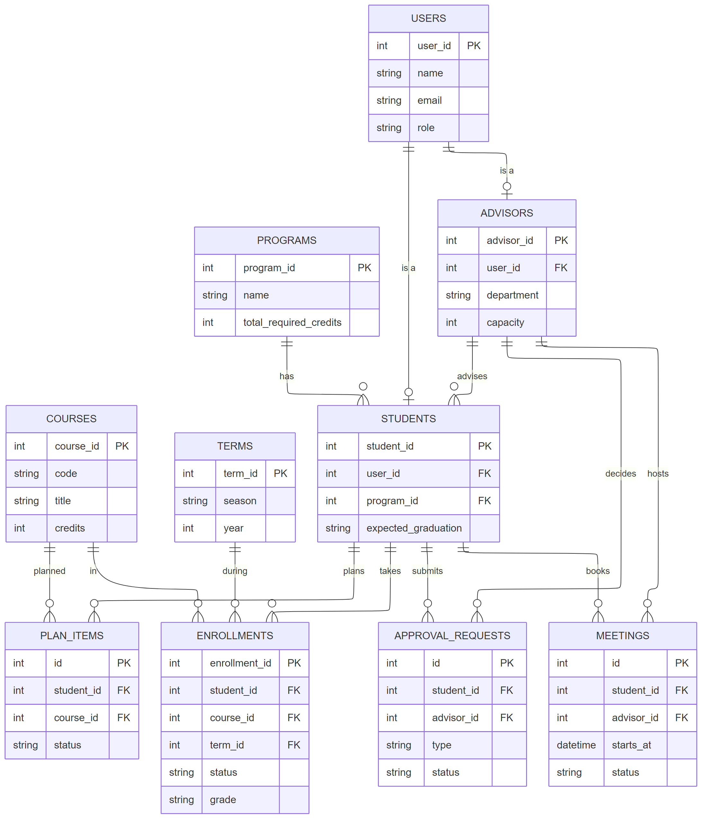
SYSTEM DESIGN
ER Diagram
↓
ACADMATE • TEAM 3 • CS 691 • FALL 2026
07

Slide 10
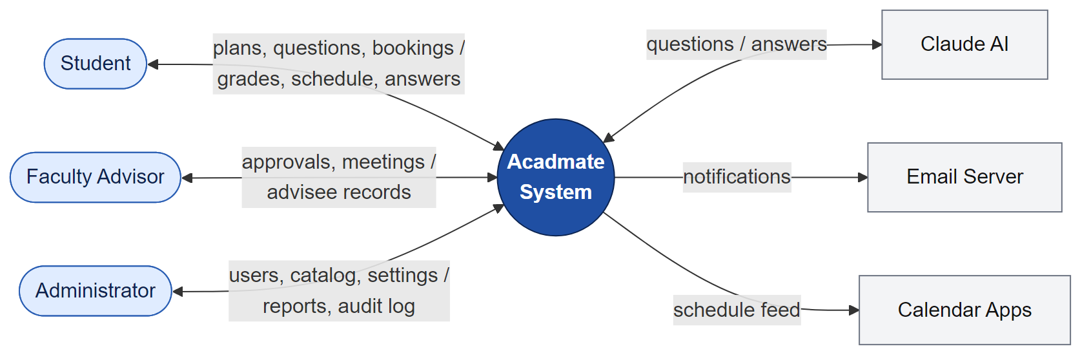
SYSTEM DESIGN
Context Diagram
↓
ACADMATE • TEAM 3 • CS 691 • FALL 2026
08

Slide 11
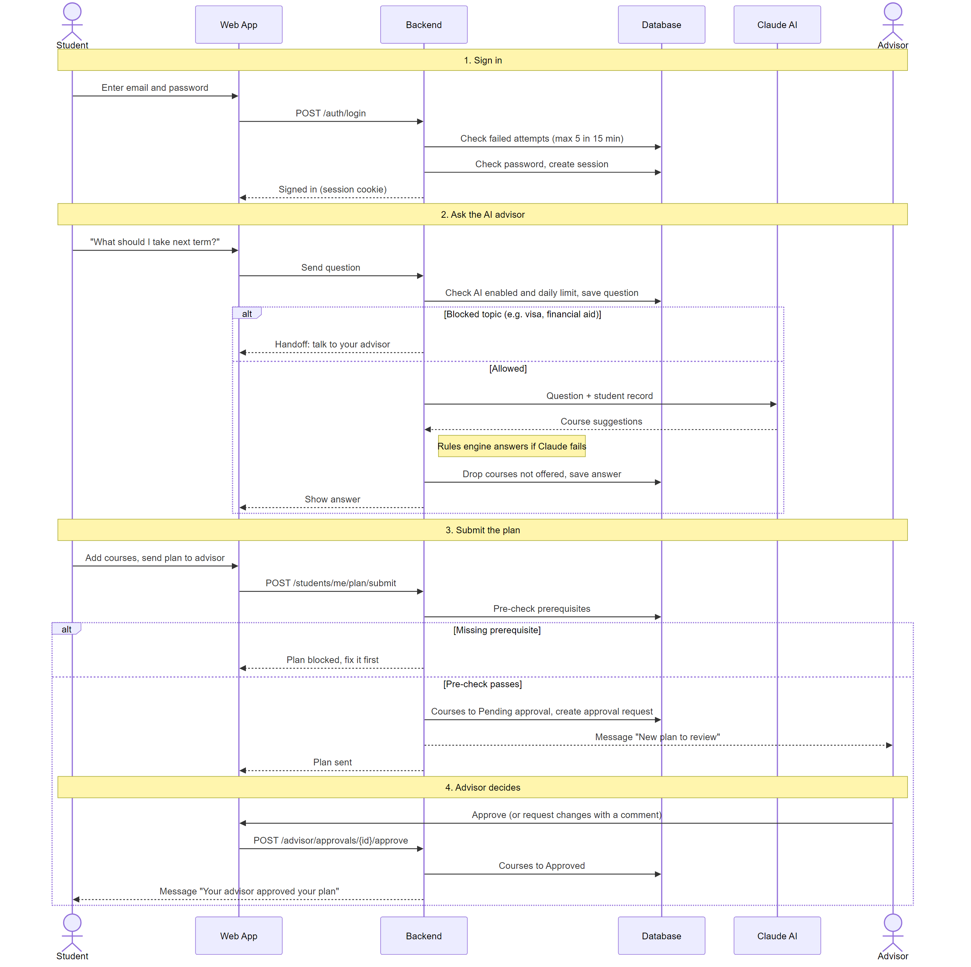
SYSTEM DESIGN
Sequence Diagram
↓
ACADMATE • TEAM 3 • CS 691 • FALL 2026
09

Slide 12
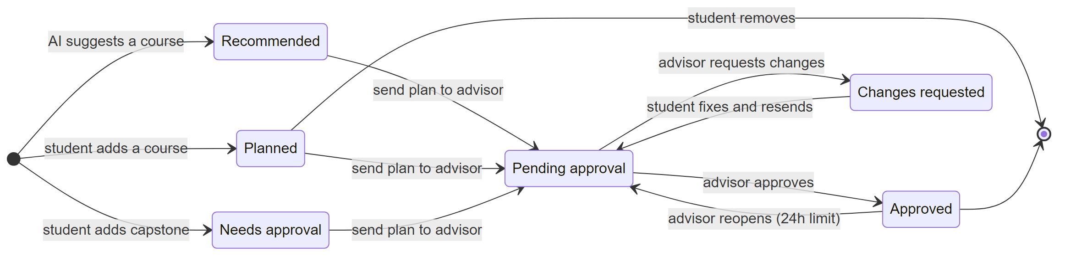
SYSTEM DESIGN
State Diagrams
↓
ACADMATE • TEAM 3 • CS 691 • FALL 2026
10

Slide 13
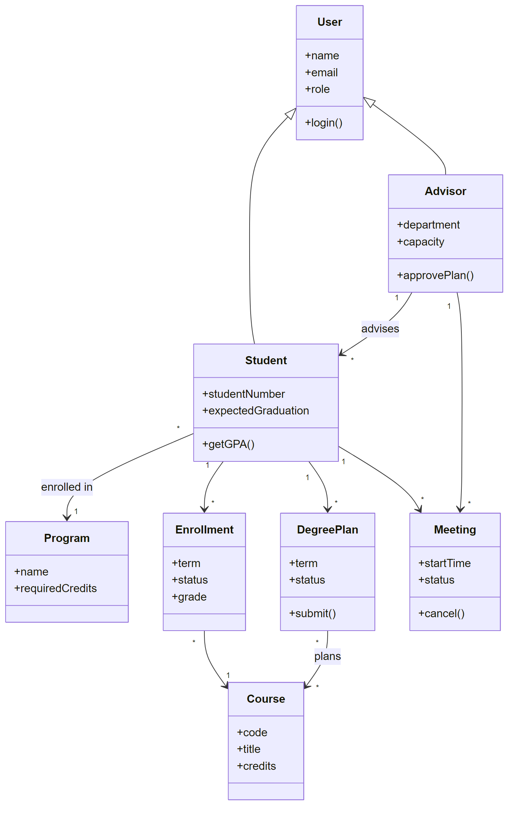
SYSTEM DESIGN
Class Diagrams
↓
ACADMATE • TEAM 3 • CS 691 • FALL 2026
11

Slide 14
ENTITY RELATIONSHIPS
Academic data model
The synthetic CSVs mirror the backend’s core entities and relationships.
USERS
→
STUDENTS
←
PROGRAMS
Advisor–student assignments link advisors to students. Program requirements specify eligible course IDs.
ADVISORS
→
ENROLLMENTS
→
COURSES
Contract fields: enrollment.status = in_progress • program_requirements.eligible_course_ids
ACADMATE • TEAM 3 • CS 691 • FALL 2026
12

Slide 15
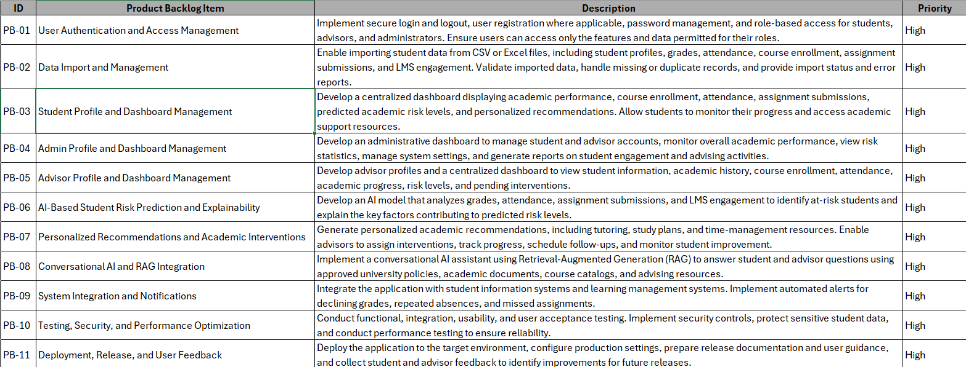
AGILE DELIVERY
Product backlog
The complete product backlog spans the full MVP; Sprint 1 selects the foundational work.
ACADMATE • TEAM 3 • CS 691 • FALL 2026
13

Slide 16
COMMITTED WORK
Sprint 1 backlog
Data & import
Schema-aligned CSVs; valid keys, statuses and repeat scenarios
Identity & access
Authenticated roles; student/advisor records protected
Student academic profile
Course history and GPA/credits exposed correctly
Admin workflow
Assigned-student roster and dashboard API accessible
AI readiness & review
Risk target/doc sources defined; end-to-end review prepared
ACADMATE • TEAM 3 • CS 691 • FALL 2026
14

Slide 17
SPRINT 1 DELIVERABLE
Synthetic academic dataset
Fixed CSV artifacts prepared for repeatable integration testing.
100
800
30
4
students
enrollments
courses
advisors
Coverage
Integration handoff
105 users • 100 assignments • 1 program • 3 requirement groups
PR #6 reviewed
Canonical fields: in_progress • eligible_course_ids | Existing seed records preserved.
ACADMATE • TEAM 3 • CS 691 • FALL 2026
15

Slide 18
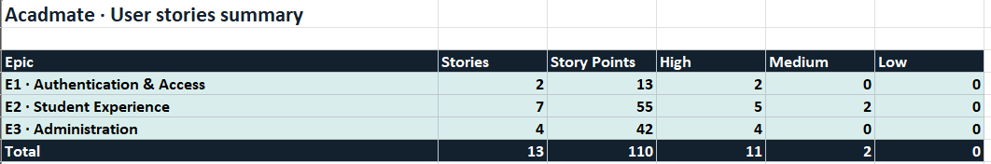
REVIEW + QUALITY
Sprint 1 User Story and Acceptance Criterial
ACADMATE • TEAM 3 • CS 691 • FALL 2026
16

Slide 19
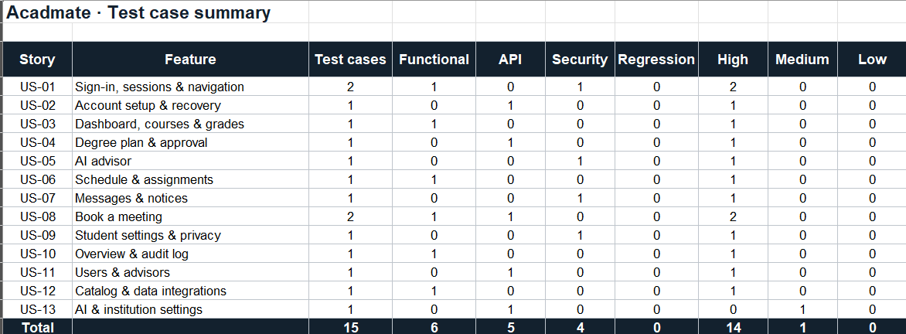
REVIEW + QUALITY
Sprint 1 Test Cases
Separate verified dataset work from integration work requiring final team confirmation.
ACADMATE • TEAM 3 • CS 691 • FALL 2026
17

Slide 20
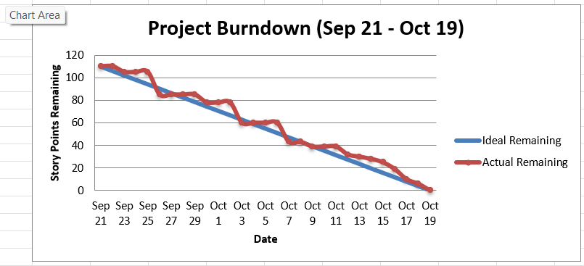
VELOCITY + BURNDOWN
Sprint 1 metrics
Use the team’s recorded story points; do not substitute issue counts or estimates.
Velocity / completion
Sprint 1 burndown
Estimated Points : 110
Total Points Delivered : 110
Total Point Carried Over : 0
Team Velocity: 110
ACADMATE • TEAM 3 • CS 691 • FALL 2026
18
Notes:
Presenter: Saisai Hu (Zoey). Introduce yourself as requested in the team feedback.
Thank you, Li. Hi everyone, I’m Saisai, and my role is UI/UX and documentation. I’ll present our Sprint 1 metrics and introduce the product demonstration.
According to the team’s Sprint 1 summary, we planned 110 story points and delivered 110 story points. This gives us a completion rate of 100 percent and a team velocity of 110 points. The summary reports zero points carried over from the committed Sprint 1 backlog.
These figures describe the scope of this sprint. Additional features, such as the advisor profile and degree progress, remain planned for Sprint 2.
The burndown chart shows how the remaining work changed during the sprint.
Presenter preparation, not spoken: 110 planned, 110 delivered, zero carryover and the supplied burndown come from the team deck. Confirm with the Jira owner before recording. The chart includes October 19, so confirm whether its final point is actual or projected. Do not present the chart as independently verified. Sprint 2 advisor work must be distinguished from unfinished Sprint 1 commitments.

Slide 21
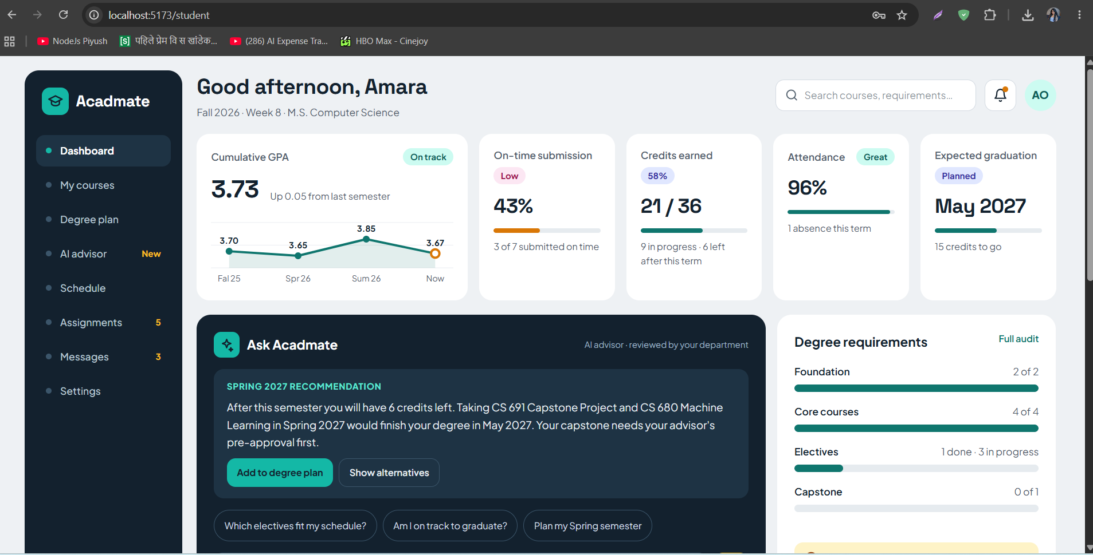
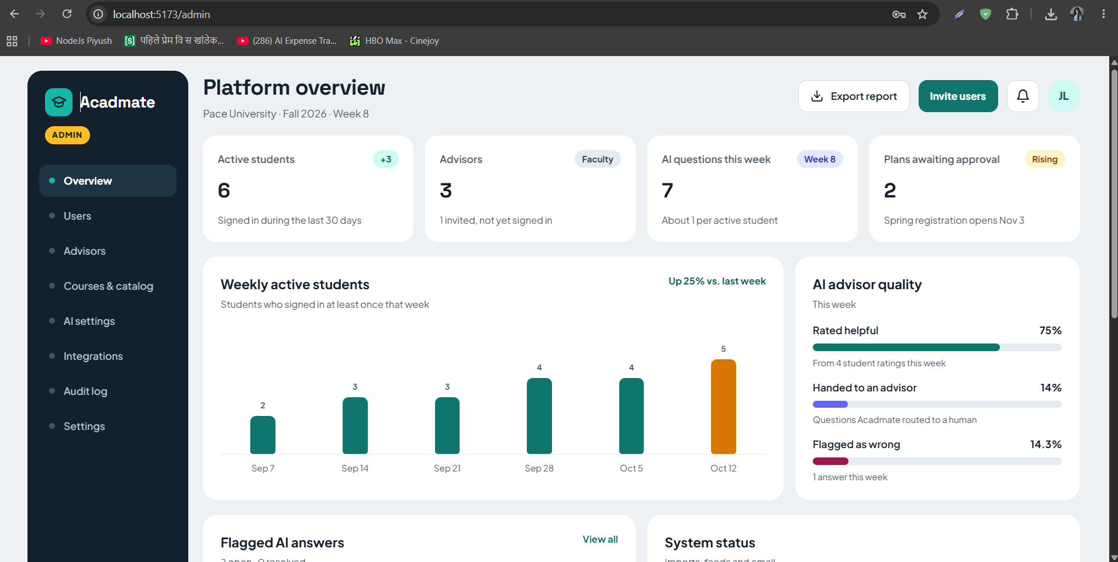
APP + API EVIDENCE
Sprint 1 product demonstration
Capture only real screens from the integrated application, not mockups.
STUDENT UI
ADMIN UI
Academic profile / course history
Overview of Advisor-student performance
Repository: github.com/htmw/F2026-Team3
ACADMATE • TEAM 3 • CS 691 • FALL 2026
19

Slide 22
PROCESS
Team working agreement & retrospective
Shared responsibilities, clear acceptance criteria and earlier integration.
Working agreement
What worked
Collaborated effectively on synthetic dataset ownership and schema alignment.
Conducted peer reviews across backend and data development.
Completed assigned tasks successfully and kept the GitHub repository organized and clutter-free.
Ensured smooth integration of work and completed all sprint tasks within the desired timeline.
Each team member completed their assigned tasks successfully and on time.
We maintained clear ownership of the synthetic dataset and aligned the schemas across backend and data development.
We kept the GitHub repository organized and clutter-free, with peer reviews to ensure code quality and smooth integration.
Through effective teamwork and communication, we completed all sprint tasks within the desired timeline.
Improve
Next actions
The team collaborated on implementation and completed the assigned tasks, but some work continued until the last day of the sprint.
We had limited time for the final demo preparation and rechecking APIs and routes.
A few meetings were missed, which affected coordination and progress tracking.
1. Complete tasks earlier: Set clear deadlines for each team member and aim to finish implementation before the last day, leaving enough time for API and route testing, bug fixing, and demo preparation.
2. Improve coordination and demo readiness: Attend scheduled meetings consistently, communicate blockers early, and conduct a final team review to ensure all features are integrated, tested, and ready for demonstration.
ACADMATE • TEAM 3 • CS 691 • FALL 2026
20
Notes:
Presenter: Saisai Hu (Zoey).
Next, let’s look at the product demonstration.
The screenshots on this slide introduce the student interface and the administrator interface. The student view focuses on the academic profile and course history, including GPA and credits. The administrator view provides an overview of student and advisor information.
For the live demonstration, we will show the current integrated application and check how academic information appears in these views. This will help us connect the sprint results to what a user can actually see and do.
That concludes my section. I’ll now hand over to Pranali for the retrospective and our Sprint 2 plans.
If another teammate controls the live demo, say: I will now hand over to our teammate for the live demonstration. Resume the final handoff to Pranali after the demo.
Presenter preparation, not spoken: preserve the supplied screenshots. They show the student and admin interfaces but do not independently establish that every visible function is connected or operational. Do not describe the unmerged personal dashboard patch as deployed. Confirm who will share the application before recording. Source: supplied AcadMate Sprint 1 deck and team messages dated October 18, 2026.

Slide 23
NEXT SPRINT
Sprint 2 | Planned increment
Carry over uncompleted Sprint 1 work before expanding intelligence features.
01 Advisor Profile Work
02 Degree progress
Close outstanding auth, advisor UI and integration work
Compute requirement-group and credit completion
03 Academic risk
04 AI foundations
Prepare training dataset, baseline model and thresholds
SHAP explanations and approved knowledge ingestion
ACADMATE • TEAM 3 • CS 691 • FALL 2026
21

Slide 24
TEAM 3
Thank you
AcadMate: AI-Powered Personalized Academic Advisement System
Questions & discussion
Student data → meaningful academic support
ACADMATE • TEAM 3 • CS 691 • FALL 2026
22

