Slide 1
Detecting Selection
BIO 594-
University of Rhode Island

Slide 2

Outline
How do we detect selection with population genomic data?
Brief history
Overview of current methods
Live Coding
Exercise
BIO 594

Slide 3
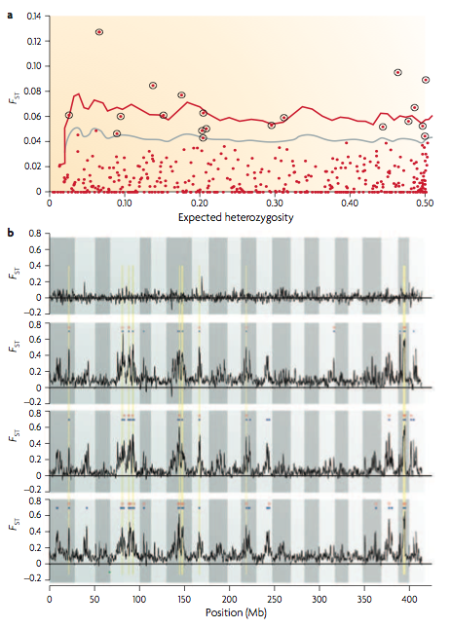
A Little History
Lewontin & Krakaurer (1972)
Posited that forces such as migration and drift should act on all loci equally
Significant heterogeneity in F_{ST} values must be do to selection.
Original test for significance based on Χ² distribution
BIO 594

Slide 4
F_{ST} across all loci

Slide 5
F_{ST} across all loci

Slide 6
F_{ST} across all loci

Slide 7
Current Methods (Not exhaustive)
Correlation based methods
Logistic regression between binary response variable and environment (Joost et al. 2007)
Generalized Estimating equations (Poncet et al. 2010)
Differentiation based methods
Coalescent based simulations (Beaumont & Nichols 1996; Excofier et al. 2009)
Bayesian estimates of drift and selection (Foll & Gaggioti 2008, extending (Beaumont and Balding (2004)
Unbiased FST distribution tests (Whitlock and Lotterhos 2015)
Bayescan
OutFLANK
Bayesian Estimates of Demography and Environmental Differentiation
an extension of the Lewontin–Krakauer test for structured populations, using a phylogenetic tree to estimate coancestry test statistic (Bonhomm et al 2010; Günther and Coop 2013)
BayEnv2
PCA based methods
Uses PCA analysis and Mahalanobis distance to detect outliers. (Luu et al. 2017)
PCAdapt
BIO 594

Slide 8
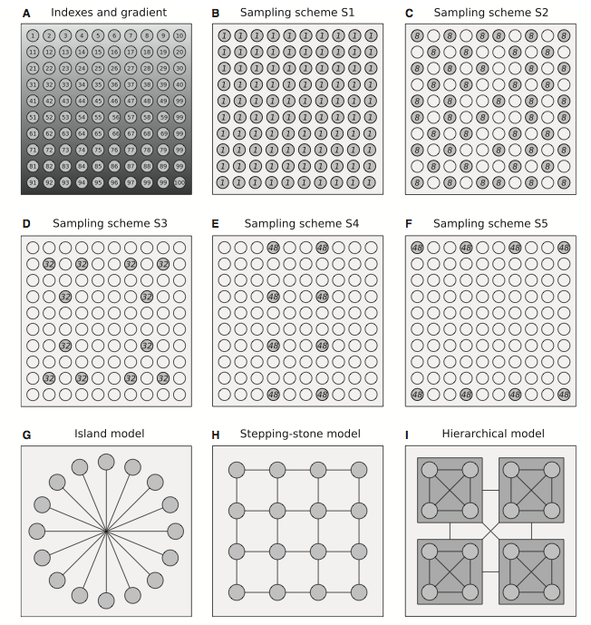
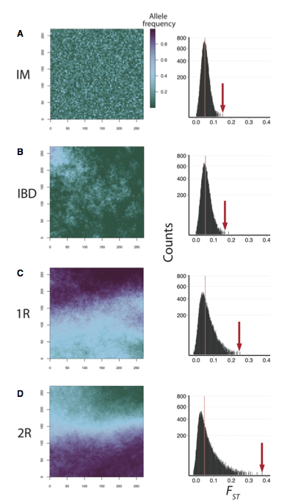
Which one to use??
De Mita et al. 2013
Lotterhos & Whitlock 2014
BIO 594

Slide 9
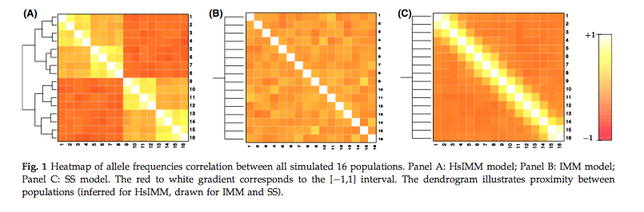
Which one to use??
If selection is polygenic, power decreases substantially across all methods (Villemereuil et al. 2013).
However, using multiple methods helps to reduce error rates.
BIO 594

Slide 10
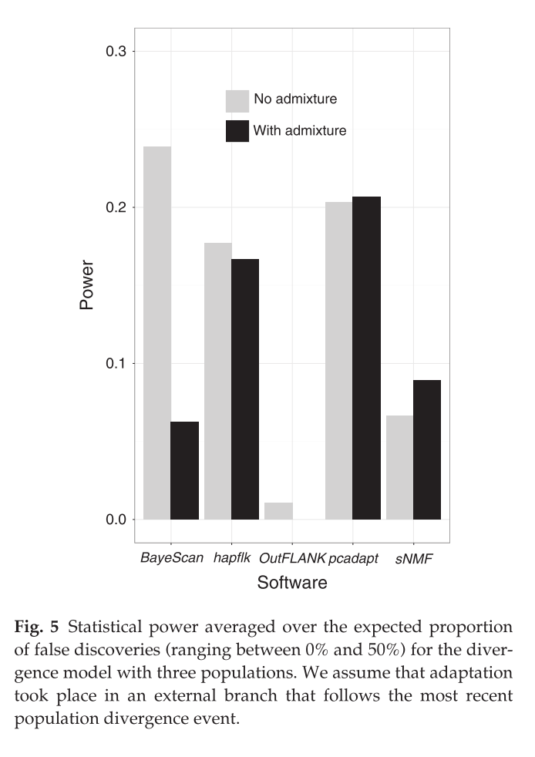
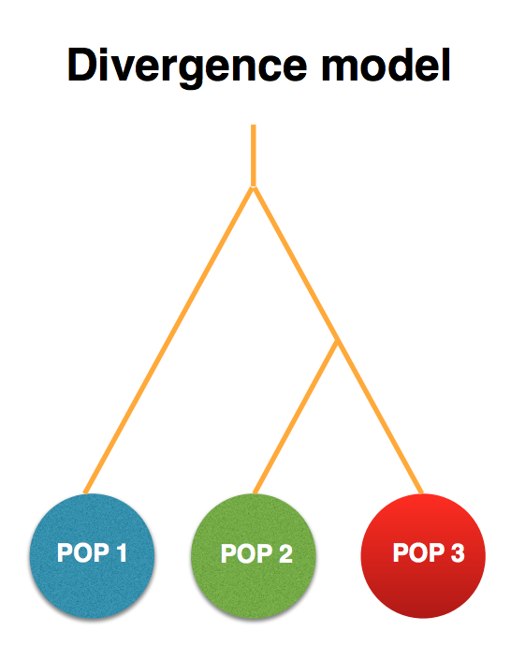
Which one to use???
Luu et al. 2017
BIO 594

Slide 11
Which one to use????
Program | What kind of sampling | What it measures
OutFLANK | Individuals grouped into populations | Outliers for genetic differentiation
SelEstim | Individuals grouped into populations (?) | Outliers for genetic differentiation
PCAdapt | Individuals (don’t have to be in populations) | Outliers for genetic differentiation
FLK/hapFLK | Individuals grouped into populations | Outliers for genetic differentiation
REHH | Individuals from one population or pair | Linkage disequilibrium around a locus
SWEED | Individuals from one population | Genetic variation around a locus - allele frequency spectrum
BayPass | Individuals grouped into populations, may associate with environmental variables | Outliers for genetic differentiation (XtX) and associations between allele frequencies and environments
LEA | Individuals (don’t have to be grouped into populations) and environmental variables | Associations between allele frequencies and environments
Table Courtesy of Katie Lotterhos
BIO 594

Slide 12
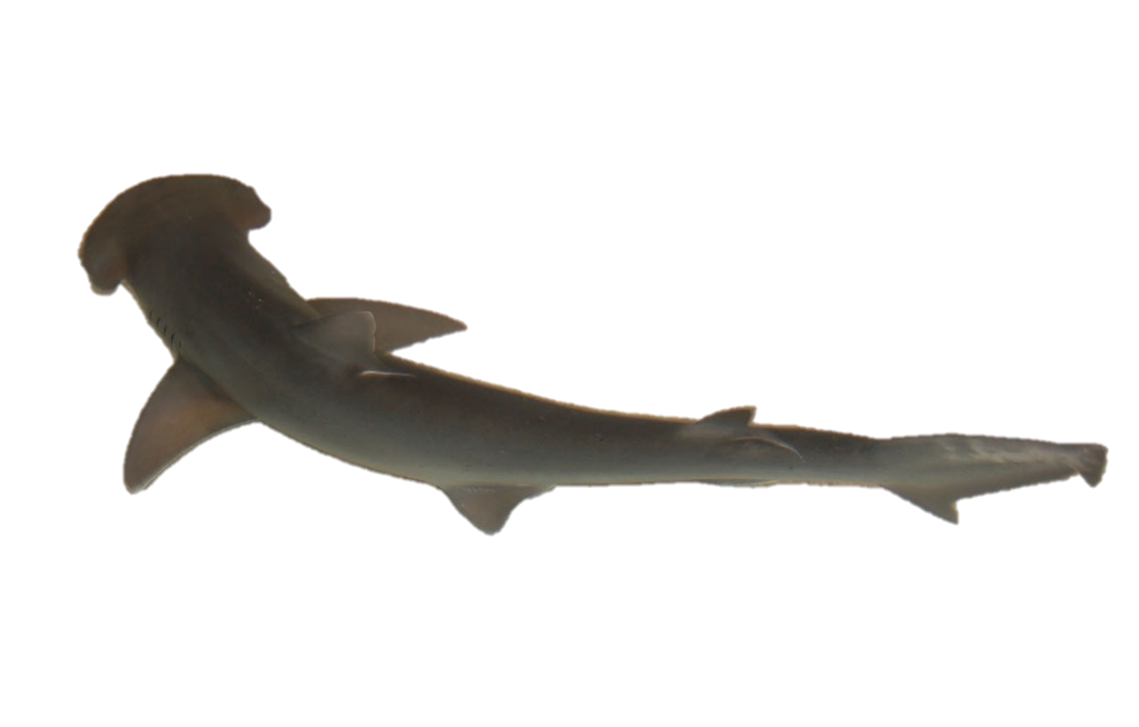
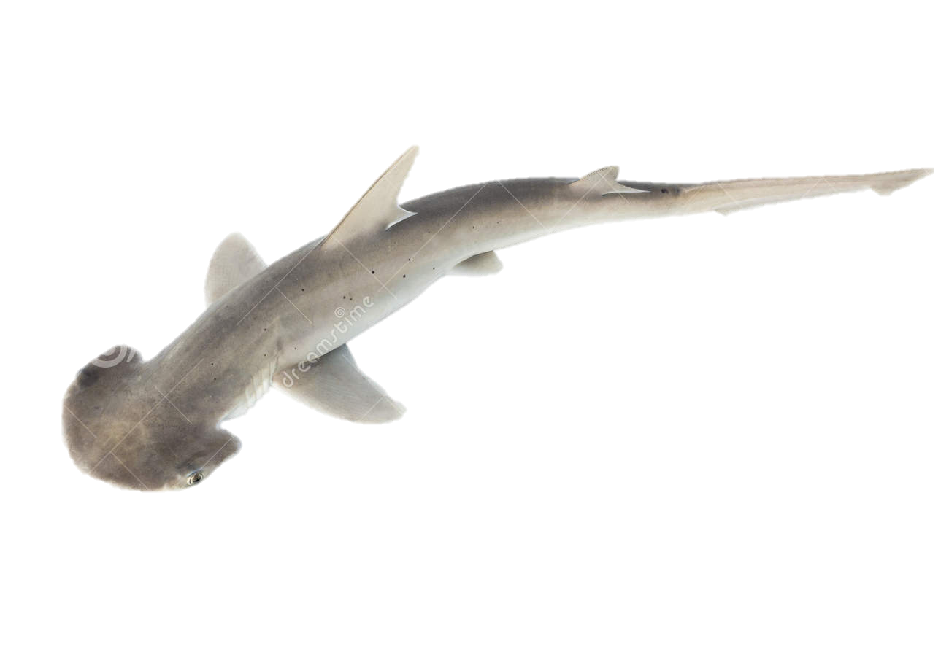
Bonnethead Sharks (Sphyrna tiburo)
Found in coastal waters of western Atlantic and Gulf of Mexico
Known to use nearshore habitat for gestation and parturition
Thought to exhibit female philopatry
extensive maternal investment
natal habitats differ substantially
Significant differences in life history among across geographic regions
Size at age
Growth rate
Size and age at maturity

Slide 13
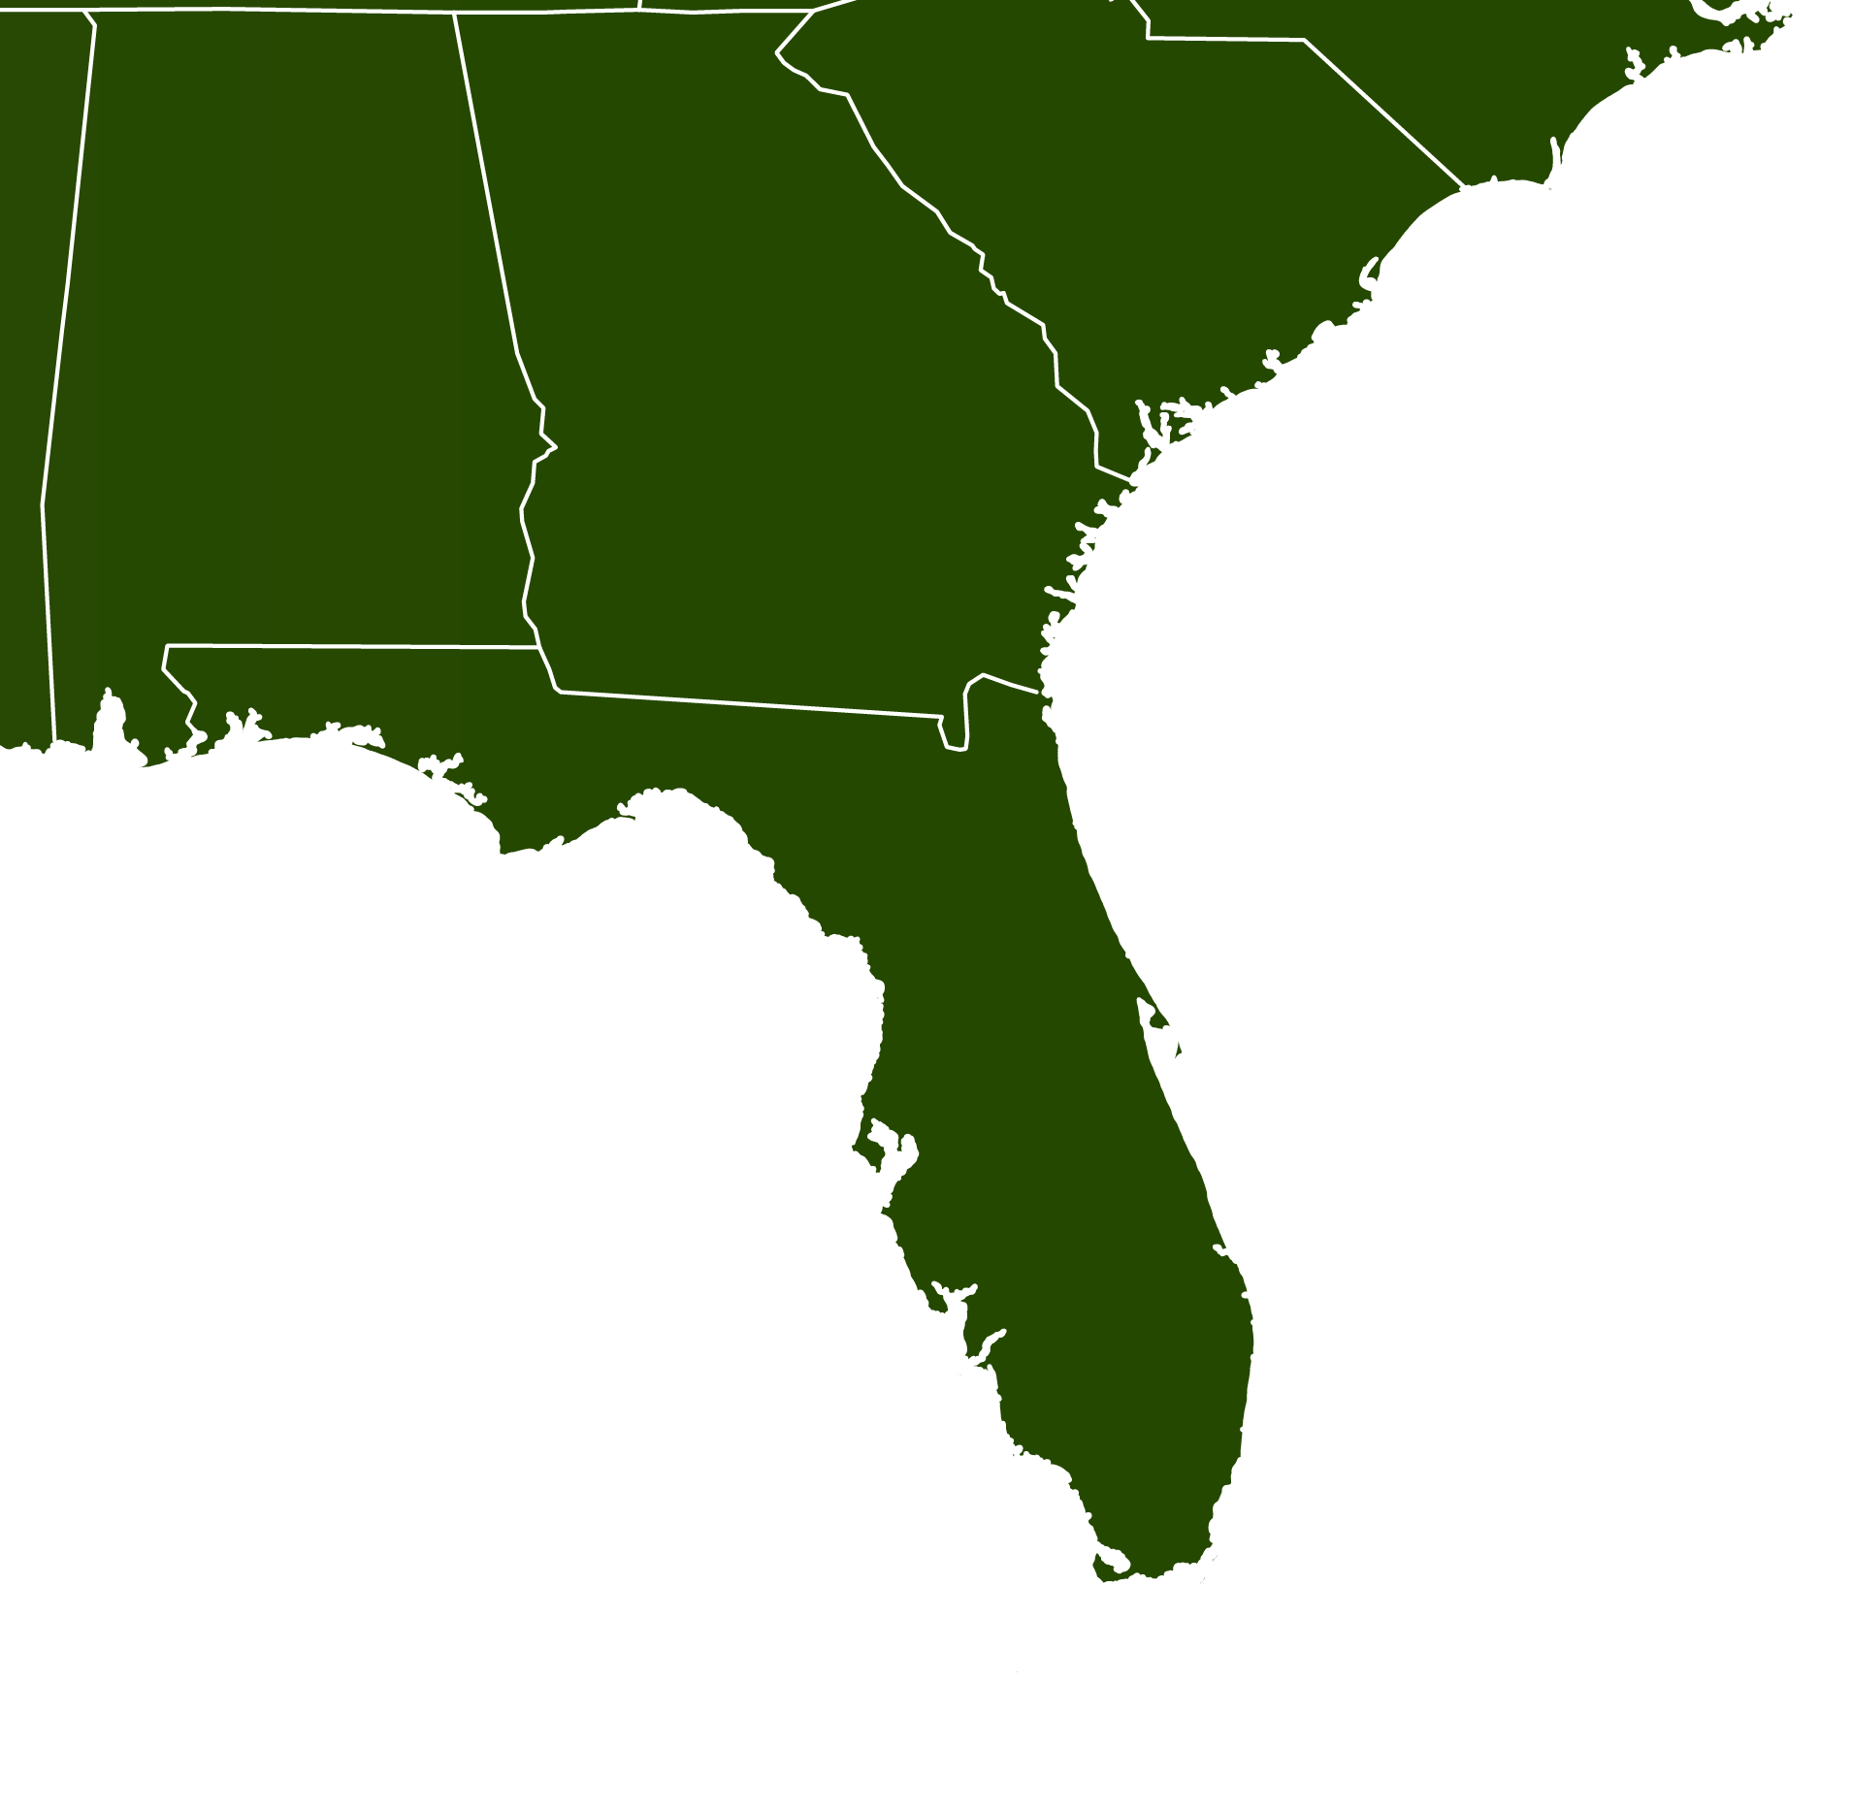
Bonnethead Population Genomics
Surveyed 134 individuals from 4 different localities
ddRAD sequencing
Sanger sequencing
NC
22
PC
36
TB
31
FB
31

Slide 14
RAD data
Quality Filtering
De Novo Assembly
Read Mapping
SNP Calling
SNP Filtering
SNPs were filtered by genotype depth, allelic balance, HWE, average locus depth, and a variety of other bioinformatics
5,914 SNPs haplotyped into 3,967 RAD loci across 121 individuals
BayeScan found 30 outlier loci that were putatively under selection

Slide 15
Bonnethead DAPC
Neutral
NC
22
PC
36
Outlier
TB
31
FB
31

Slide 16
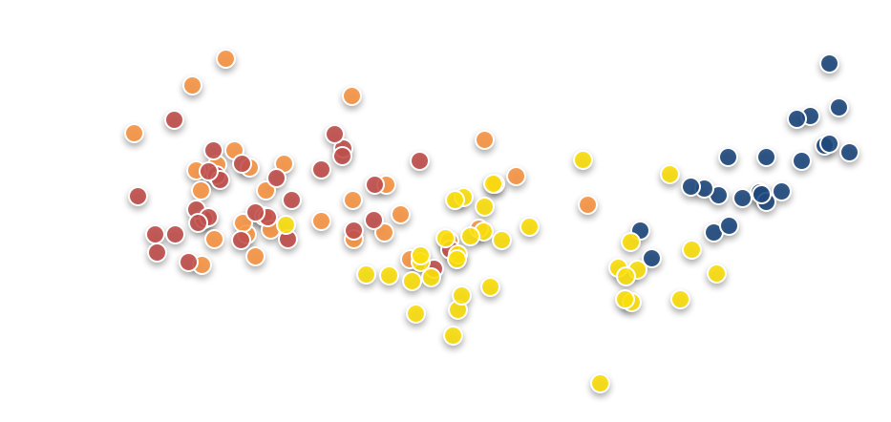
Drivers of outlier allele frequencies
NC
22
PC
36
TB
31
FB
31

Slide 17
Drivers of outlier allele frequencies
NC
22
PC
36
TB
31
FB
31
18 O-SNP loci had r² values ≥ 0.90
Explained 75.6% of X axis variation

Slide 18
Live Coding

Slide 19
Exercise
In the folder: /home/BIO594/DATA/Week7/exercise
You will find a vcf file, a popmap, an file with library information, and an environmental file
Perform and document all analyses that were demoed during class
Push to /BIO_594_2018/Exercises/Week7 of the class github repository

