Slide 1





Group 17
Hoàng Trần Nhật Minh 20204883
Nguyễn Hoàng Phúc 20204923
Lý Nhật Nam 20204886
Lê Thảo Anh
20200054
Đỗ Xuân Phong
20219701

Slide 2
THE PENNILESS PILGRIM RIDDLE
Contributors: Hoàng Trần Nhật Minh Nguyễn Hoàng Phúc Lý Nhật Nam
Lê Thảo Anh
Đỗ Xuân Phong
Group 17 presents
An Introduction to AI group project

Slide 3
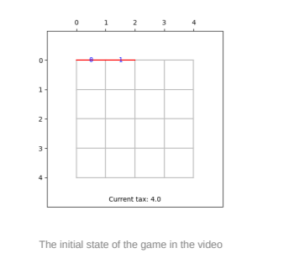
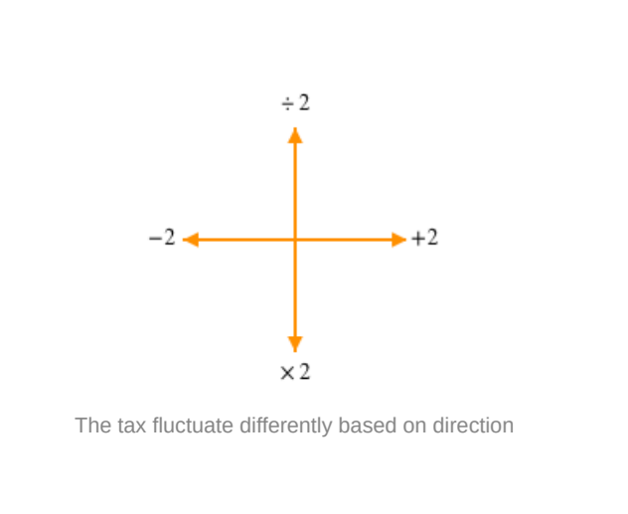
Problem description
Inspired by this TED-ED video
There’s a strange tax in this city
Can you find your way to goal without having to pay?

Slide 4
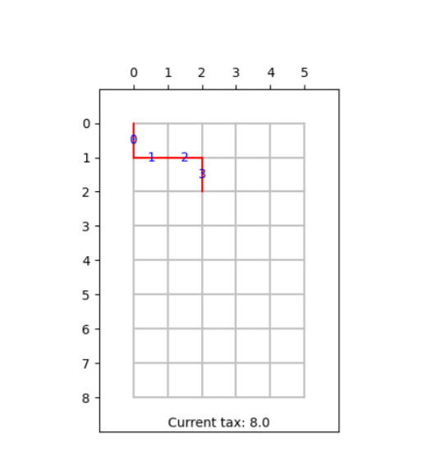
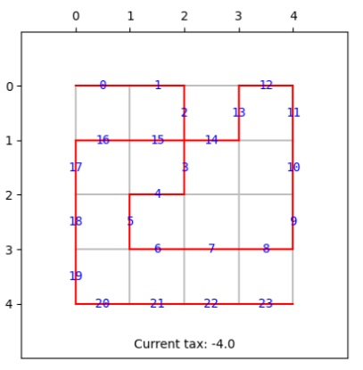
Problem Formulation
Single-state problem, solving by searching
Randomized initial board sizes: 4 to 8 each side
4 available actions: U, D, L, R
Output: time complexity, space complexity
One of the randomized initial states
Example solution

Slide 5
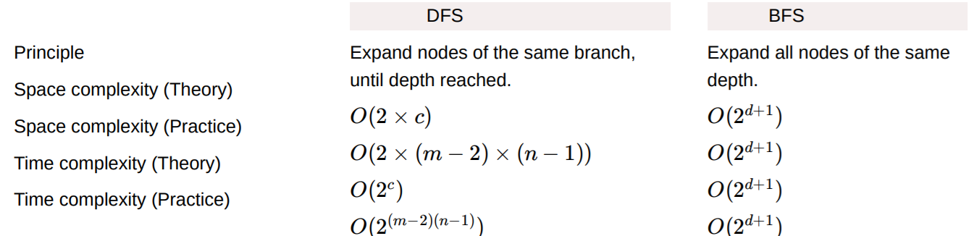
Depth-first Search (DFS)
Depth-first Search vs. Breadth-first Search:
Averaging/assuming two branches per node, c = m*n nodes with depth d = c/2
However, DFS never reaches worst-case for space and time complexity, no guarantee for BFS
DFS more suitable

Slide 6
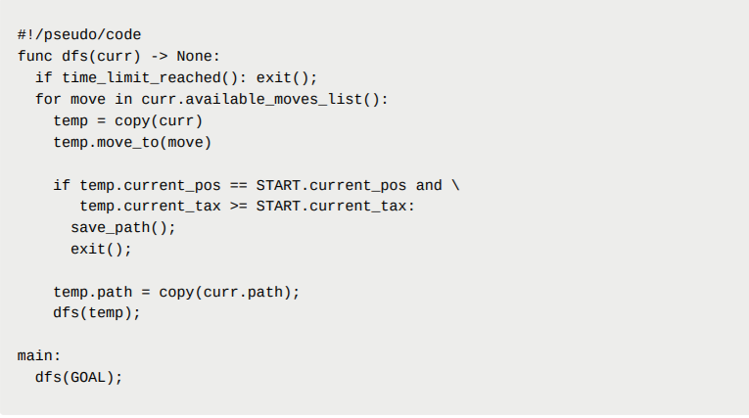
DFS Implementation
t_limit: 10 seconds
Simple recursive DFS implementation
Difficulties: No setbacks aside from needing decent CPU and plenty of RAM.

Slide 7
A-star Search (A*)
Heuristic problem: none actually worked for majority of boards => “bending” definition
Implementing code
Difficulties in implementing:
Finding a solution to the heuristic problem:
For the sake of simple heuristic, understandable in a peek, without over-arching presentation time limit, we settled on a simple heuristic instead, accepting that solution is imperfect.
Dropping optimal path searching:
Cannot design true heuristic within the time available
Simple formula, space-friendly, not optimal, can be pessimistic, guides A* to solution

Slide 8
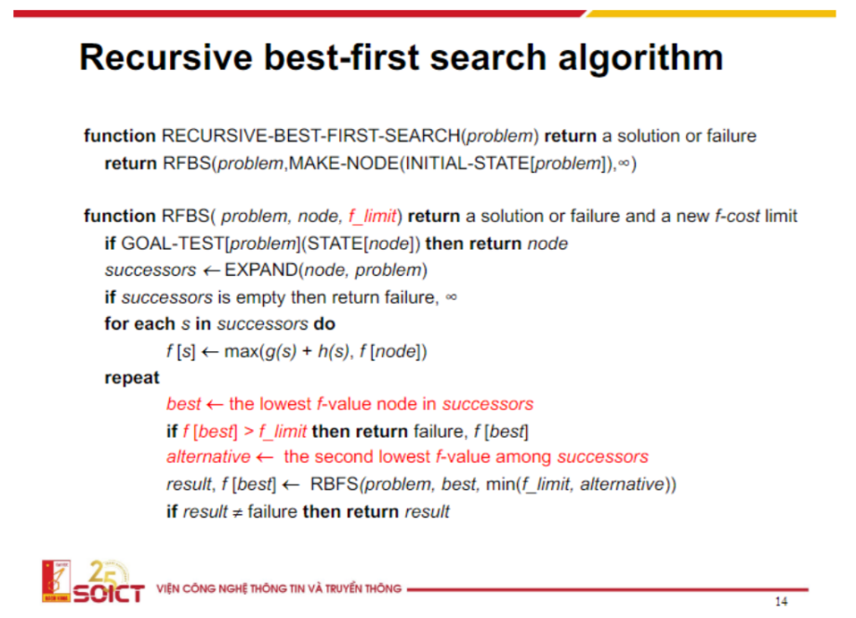
Recursive Best-first Search (RBFS)
Applying RBFS algorithm
Some difficulties:
Estimating heuristic unlikely to be
correct because non-uniformly
changing path cost
Can be stuck in infinite loop
Not good enough heuristic leads to
skipping some branches, not finding the ideal solution
Difficult balancing time and space complexity
Data samples may be unsolvable, not easy to prove

Slide 9
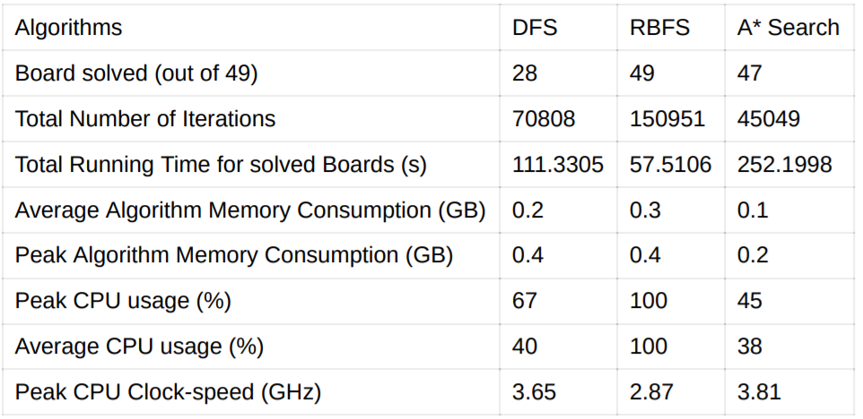
Comparing Algorithms’ Results
Recap:
Did it find a solution? : RBFS > A* > DFS
How fast?: RBFS > DFS > A*
Space-efficient?: A* > DFS > RBFS

Slide 10
Conclusion
Search algorithms:
RBFS most suitable
A* not suitable due to having to take into account unpredictable cost up to the expanding node
DFS finds solution quickly if expanded from goal; however, it fails on all boards that start only has one way to reach goal, and adjacent node has less than 3 possible moves
Possible extensions:
Road removal, path length limit, random modifiers, time constraint, etc.

Slide 11

References and additional links
TED-ED’s video: https://youtu.be/6sBB-gRhfjE
Demo program: https://github.com/PySimpleGUI/PySimpleGUI/blob/master/DemoPrograms/Demo_Matplotlib_Embedded_Toolbar.py
GitHub repository: : https://github.com/htnminh/AI-intro-project
Project website: https://htnminh.github.io/AI-intro-project/
Report Notion page: https://htnminh.notion.site/The-Penniless-Pilgrim-Riddle-e3bbfaf5d7b949fdadf5a898df1f8883

