Slide 1

An AlphaZero Implementation of Ultimate Tic-Tac-Toe
Hoang Tran Nhat Minh
Data Science & Artificial Intelligence
Instructed by Dr. Tran Nguyen Ngoc

Slide 2
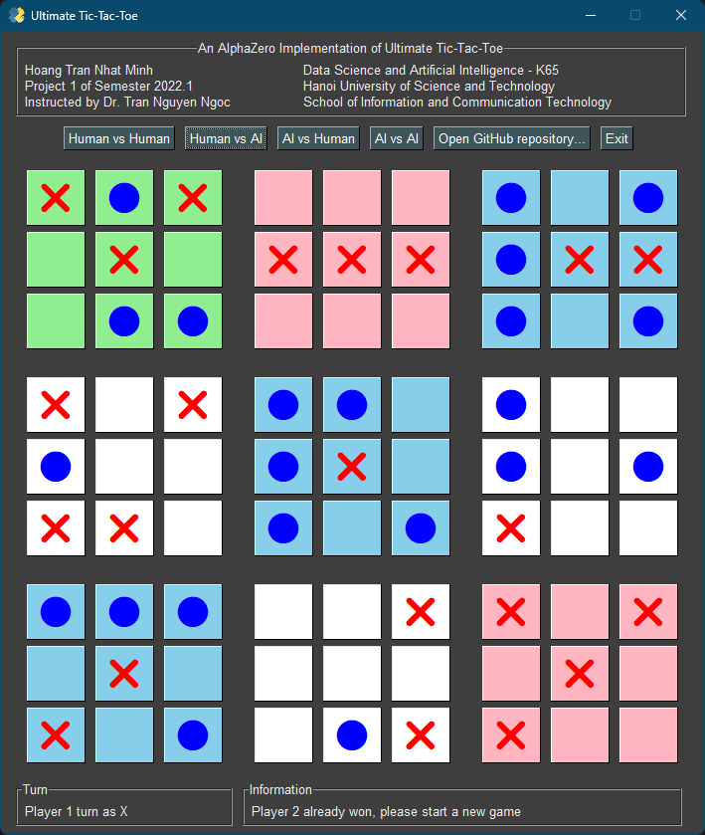
Abstract
A modified version of the AlphaZero algorithm is used to train a new artificial intelligence program that plays ultimate tic-tac-toe, one of the most difficult variations of tic-tac-toe, while making use of human-extracted features using a convolutional neural network.

Slide 3
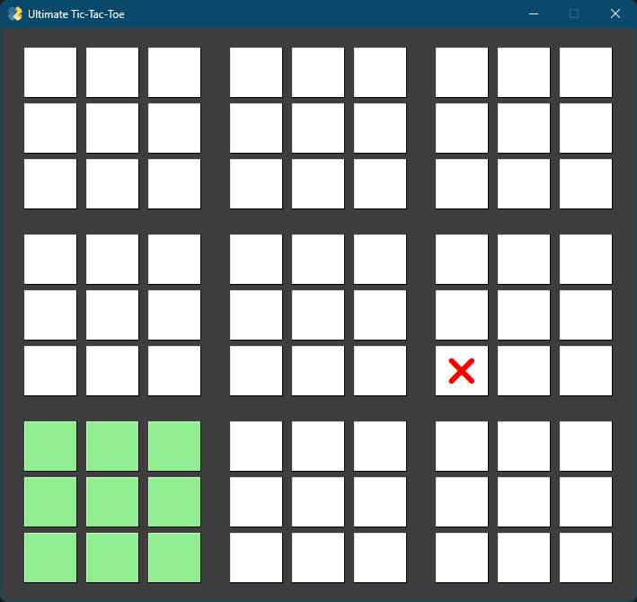
Introduction to ultimate tic-tac-toe
“Send” opponent to the relative local board in the next move

Slide 4
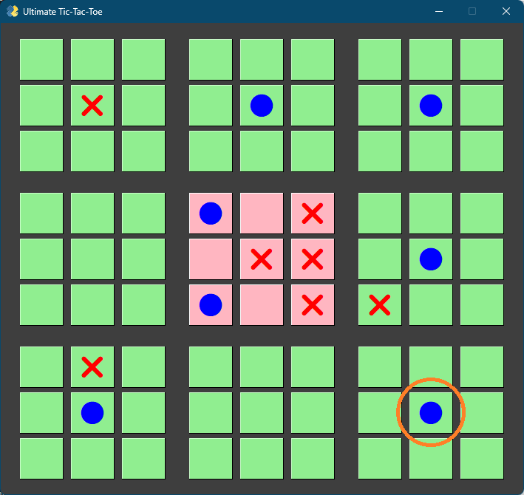
Introduction to ultimate tic-tac-toe
If a local board is determined, it is not playable anymore
If sent to it, play anywhere else (but determined boards)

Slide 5
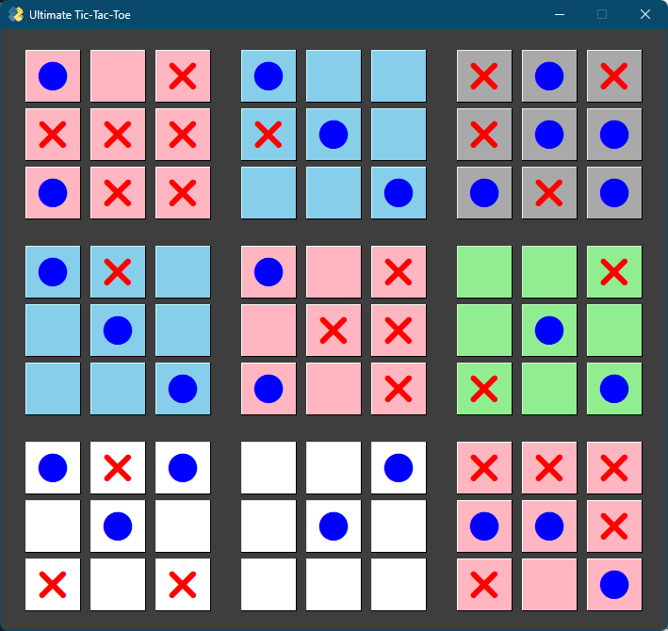
Introduction to ultimate tic-tac-toe
Player 1 won this game

Slide 6
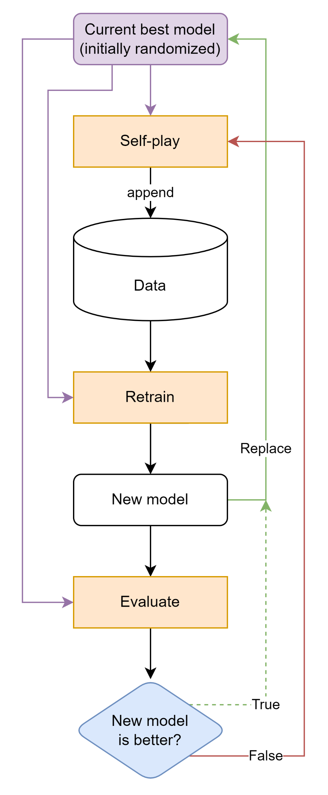
Alphazero: training loop
Self-play: to generate new data
Retrain: to get new model
Evaluate: to decide replacing the best model or not
In self-play and evaluate: Monte Carlo tree search decision guided by a convolutional neural network (model)

Slide 7
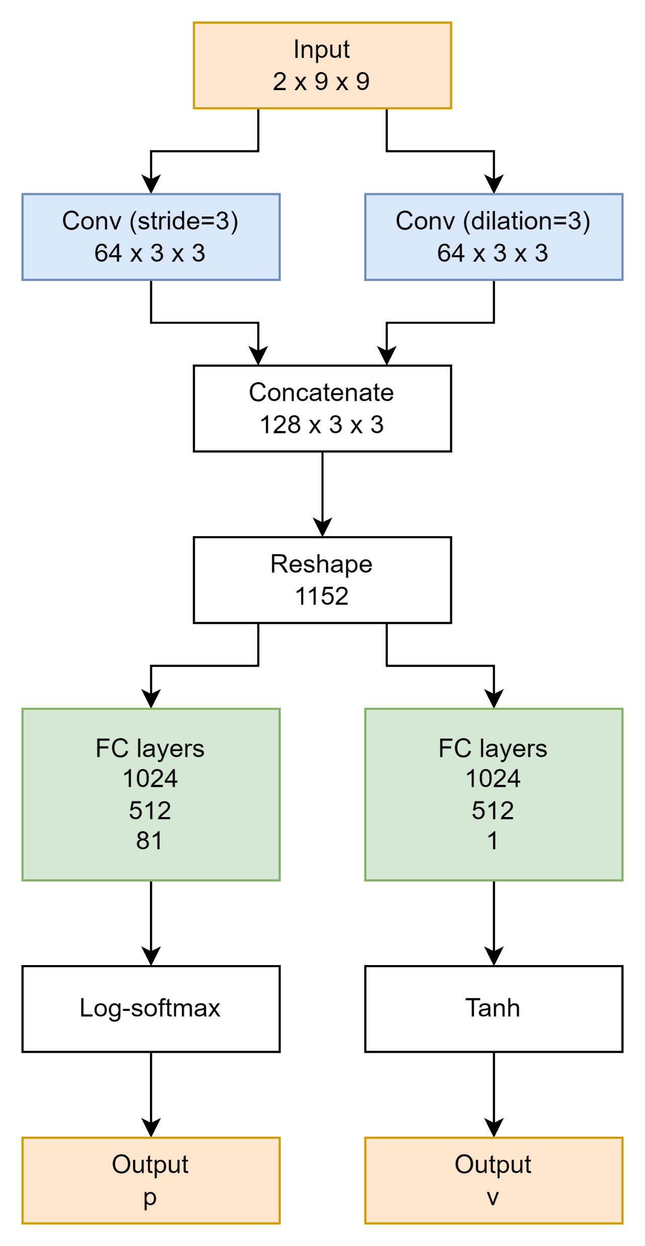
network architecture
Convolutional layers
Fully connected layers

Slide 8
input
Channel #1: state (values: 1, -1, 0)
Channel #2: valid-move mask (values: 1, 0)

Slide 9
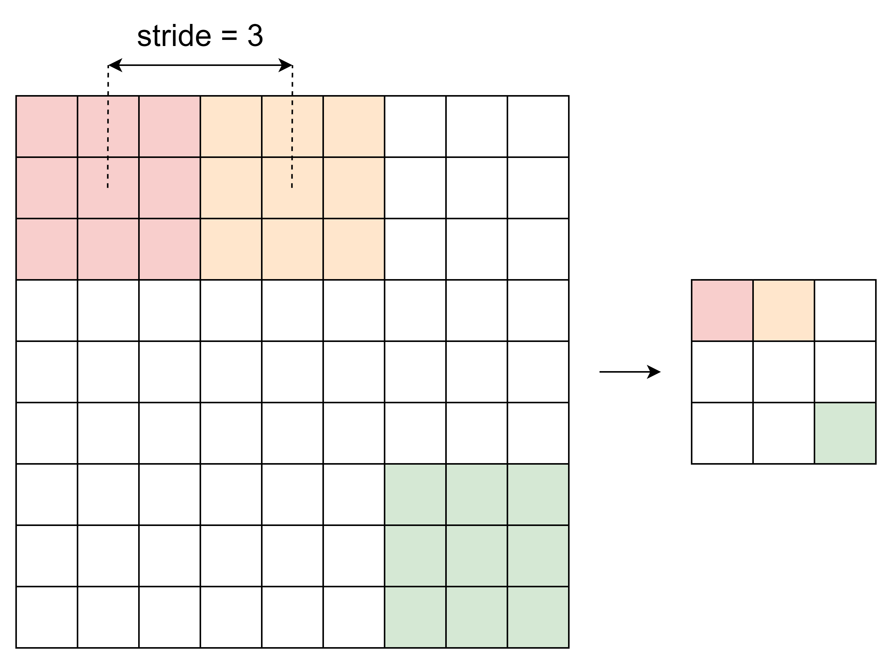
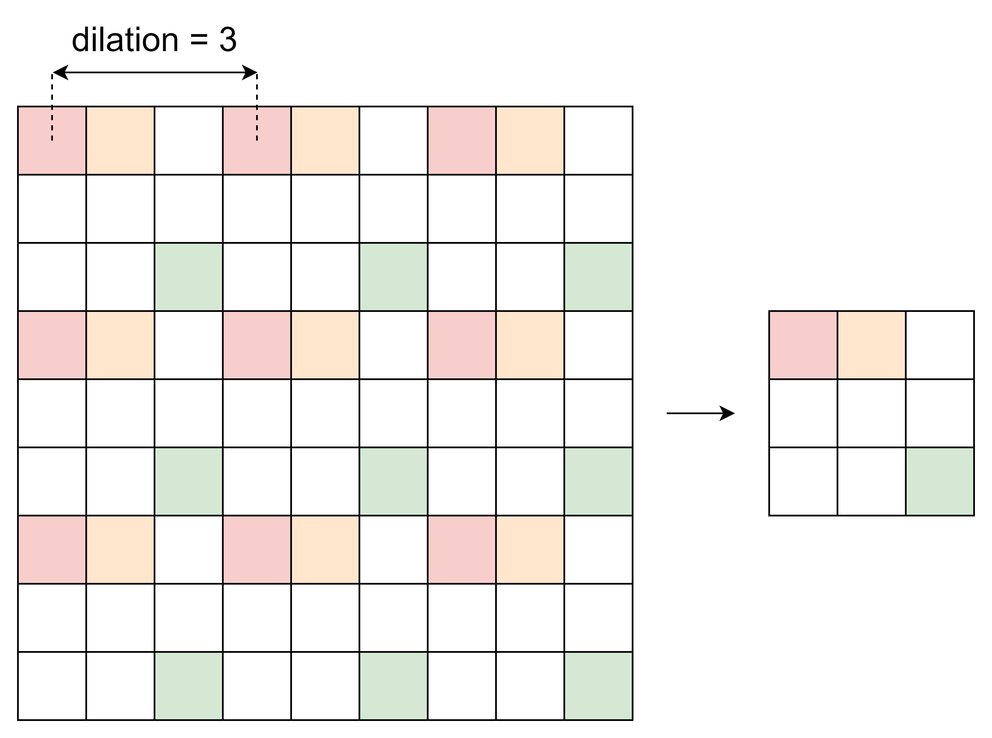
convolutional layers
Similarities
Kernel size: 3x3
Output image size: 3x3
Differences
Layer #1: stride = 3
Layer #2: dilation = 3

Slide 10
Output
p: Policy, the probabilities of moves
v: Value, the evaluation of the input board

Slide 11
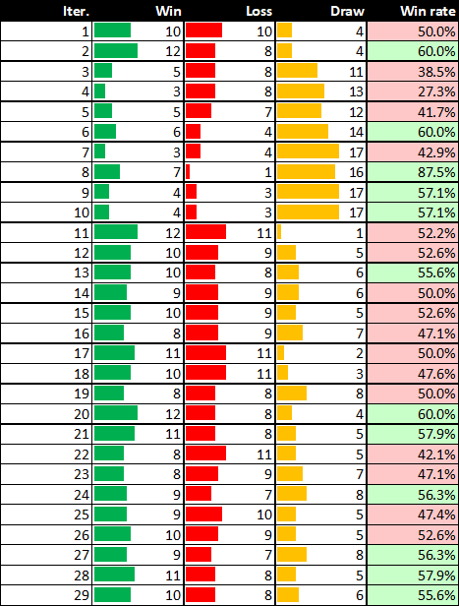
Results
Tested itself in the training loop
Discarding previous models: improvement
Beginner level

Slide 12
An AlphaZero Implementation of Ultimate Tic-Tac-Toe
Oversimplified, isn’t it? Please see the report for more details.
Everything is in https://github.com/htnminh/AlphaZero-Ultimate-TicTacToe

