Slide 1

APPLIED reinforcement learning methods for the capacitated vehicle routing problem
Hoang Tran Nhat Minh
Instructed by Dr. Pham Quang Dung
Data Science & Artificial Intelligence 2020
January 2024

Slide 2
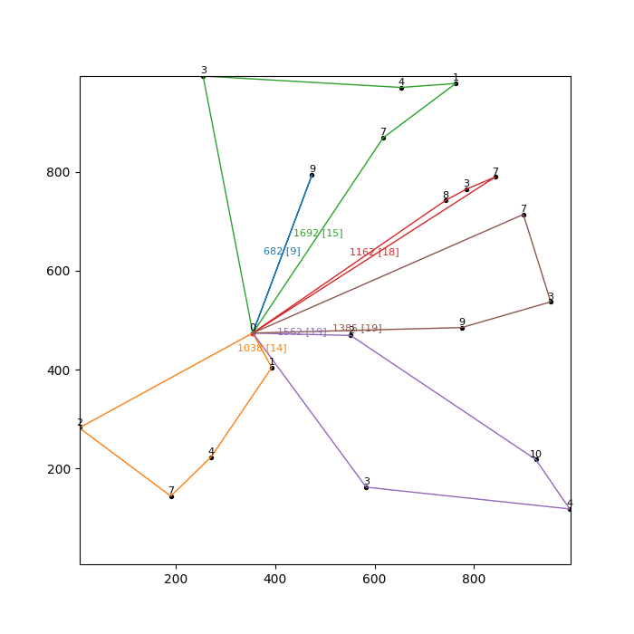
OVERVIEW
This project reviews reinforcement learning (RL) approaches to optimization problems in general, then dive deeper for the Capacitated Vehicle Routing Problem (CVRP). The problem is formulated as a RL problem, then several RL methods are implemented as an endeavor to solve it, in comparison with the solutions provided by OR-Tools, namely:
Deep Q-Network (DQN)
Advantage Actor-Critic (A2C)
Proximal Policy Optimization (PPO)

Slide 3
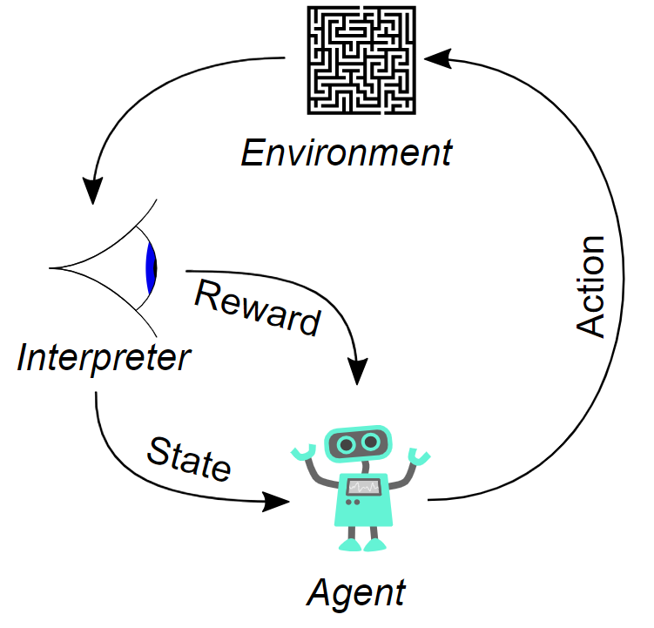
What is Reinforcement learning (rl)?
Reinforcement Learning (RL) is an area of machine learning, alongside supervised and unsupervised learning.
RL aims to maximize the cumulative reward when an intelligent agent takes actions in a dynamic environment.

Slide 4
WHY rl for optimization problems?
First, it must be appliable:
Environment = Problem
(Long-term) Reward = Objective
State = Configuration
Agent = Algorithm
Action = Decision

Slide 5
WHY rl for optimization problems?
RL is well-fit for optimization problems…
Sequential decision making: RL can learn a series of sequential decisions to maximize a long-term objective.
Exploration and Exploitation: RL can balance exploration and exploitation.
Complex problems: RL can handle very complex problems provided enough resources.
Delayed rewards: RL algorithms can use its experience to optimize the cumulative reward based on immediate rewards and their past experience.
Transferability: Trained agent can be directly used on the same problem with different configurations.

Slide 6
Rl Approaches for optimization problems
There are many ways to approach optimization problems using RL, the following three are used in this project:
Deep Q-Network (DQN)
Advantage Actor-Critic (A2C)
Proximal Policy Optimization (PPO)

Slide 7

TWO General TYPES OF RL algorithms
Value-based: Approximate the optimal value function…
Which is one of the two mappings:
$state →cumulative_reward$
$(state, action)→cumulative_reward$
for all $action ε action_space$ in all $state ε state_space$
If optimized: Higher cumulative reward = Better
Example: Q-learning (learn the latter mapping)
The $cumulative_reward \text{in} \text{this} \text{case} \text{is} \text{often} \text{denoted} \text{as} \text{Q}\text{−}\text{value}\text{:}$ $Q$
Advantages: Sample efficient, steady.
Policy-based: Approximate the optimal policy function…
Which is the mapping:
$state→P\left(action \right| state)$
$P\left(action \right| state)$ $\text{is} \text{often} \text{denoted} \text{as} π$
for all $action ε action_space$ in current $state$
If optimized: Higher action probability = (Probably) better action
Example: REINFORCE
Advantages: Better for continuous spaces, converges faster.

Slide 8

Q-learning
Value-based: $(state, action)→Q$
for all $action ε action_space$ in all $state ε state_space$
Pseudocode:
Q_table = random_values(Q_table.shape); // Initialize random values
state = initial_state; // Initialize state
while true {
action = choose(Q_table, state, action_space);
// Choose an action based on a kind of policy
next_state, reward = execute(state, action);
Q_table[state, action] = Q_table[state, action] + alpha * (
reward + gamma * max(Q[next_state, action_space]) – Q_table[state, action]
); // Update Q-table
if final(state) {state = initial_state}
else {state = next_state}; // Continue to the next state
if stop_training {break}; // Break based on a stopping condition
}

Slide 9
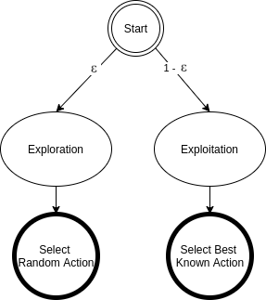

Epsilon-Greedy “POLICY”
This “policy” is simple enough for Q-learning to still be considered a policy-free algorithm.
action = choose(Q_table, state, action_space);
At state $s$, for a constant $ε ε \left[0, 1\right]$
$ε$ chance: Select a completely random action
$1−ε$ chance: Select the best known action
Or, the action $a=\underset{a}{argmax}{Q(s, a) }$

Slide 10

Update Q-table using Bellman equation
Update Q-table:
Q_table[state, action] = Q_table[state, action] + alpha * (
reward + gamma * max(Q[next_state, action_space]) – Q_table[state, action]
);
Bellman equation:
$$Q\left(s,a\right)←Q\left(s,a\right)+α(r+γ\max\left(Q\left(s^{′}, a^{′}\right)\right)−Q\left(s,a\right))$$
$Q\left(s,a\right)$ : Q-table value at state $s$ and action $a$
$α$ : learning rate
$r$ : immediate reward (after executing action $a$ on state $s$)
$γ ε [0, 1]$ : discount factor
$\max\left(Q\left(s^{′}, a^{′}\right)\right)$: maximum Q-value of the next state $s′$ (after executing all actions available in $a^{′}=action_space$)

Slide 11

discount factor
$$Q\left(s,a\right)←Q\left(s,a\right)+α(r+γ\max\left(Q\left(s^{′}, a^{′}\right)\right)−Q\left(s,a\right))$$
$Q\left(s,a\right)$ converges to $r+γ\max\left(Q\left(s^{′}, a^{′}\right)\right)$
The discount factor $γ ε [0, 1]$ is the importance of future reward:
$γ=0$ means
$Q\left(s,a\right)$ converges to $r$
Future reward is not considered
$γ=1$ means
$Q\left(s,a\right)$ converges to $r+\max\left(Q\left(s^{′}, a^{′}\right)\right)$
The future reward is as important as the immediate reward
Why typically $0<γ<1$: This help many algorithms, including Q-learning, to converge properly and faster.

Slide 12
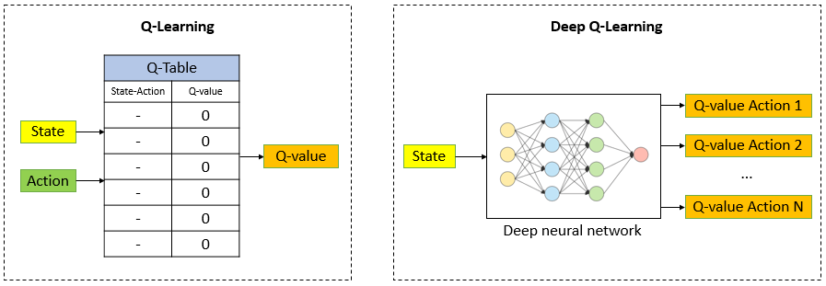

deep Q-network
What if state space and/or the action space grow larger?
The size of Q-table grows exponentially with them
Storing the Q-values $Q\left(s,a\right)$ as a table has a main drawback: It is infeasible for almost any non-trivial problems.
Deep Q-Network: the table instead will be “stored” as a deep neural network:

Slide 13
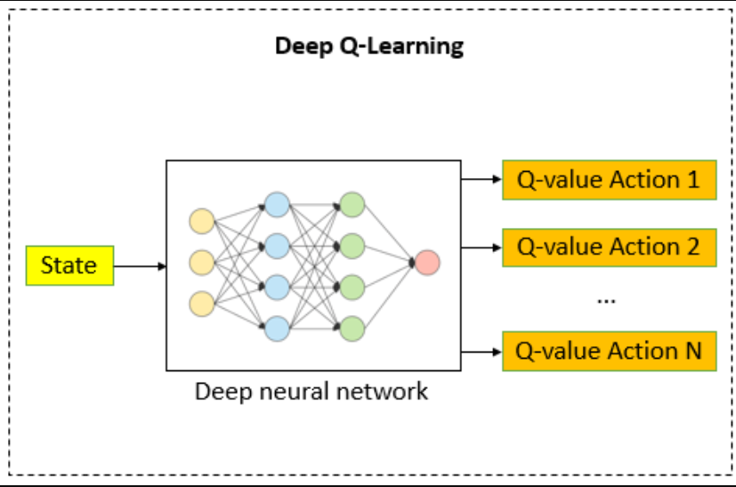

deep Q-LEARNING
Deep Q-Learning refers to a Q-Learning implementation using a Deep Q-Network.
Replay memory: Each “experience” will be stored as a tuple
(state, action, reward, next state)
This dataset of many tuples will be sampled during the training process of networks
Deep Q-Network: Learn the mapping $state →Q\left(action \right| state)$ for each action in the action space (using the dataset)
Target Network: Another network to estimate the target Q-values
A copy of the main network
But updated periodically to…
prevent overfitting
mitigate the effect of delayed reward
Everything else is the same

Slide 14
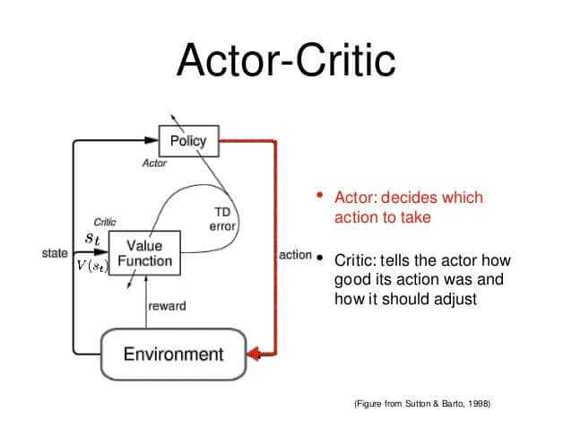

Actor-critic
Combines the two types:
Actor: The policy-based part
$state→π$
While running deterministically, it output the action with highest probability: Probably the best action
Critic: The value-based part
$state→cumulative_reward$
Same idea as Q-value, but it does not consider any action
The $cumulative_reward \text{in} \text{this} \text{case} \text{is} \text{often} \text{denoted} \text{as} \text{just} \text{value}\text{:}$ $V$
Update the actor accordingly using policy gradient: Same idea as gradient descent

Slide 15

Advantage Actor-Critic (A2C)
Critic in Actor-Critic learns the mapping
$$state→V$$
Advantage Actor-Critic (A2C) splits the Q-value into two parts, based on action $a$:
State value $V(s)$
Advantage value $A\left(s, a\right)$
$$Q\left(s,a\right)=V\left(s\right)+A\left(s, a\right) \\ ⇒A\left(s, a\right)=Q\left(s,a\right)−V\left(s\right)$$

Slide 16
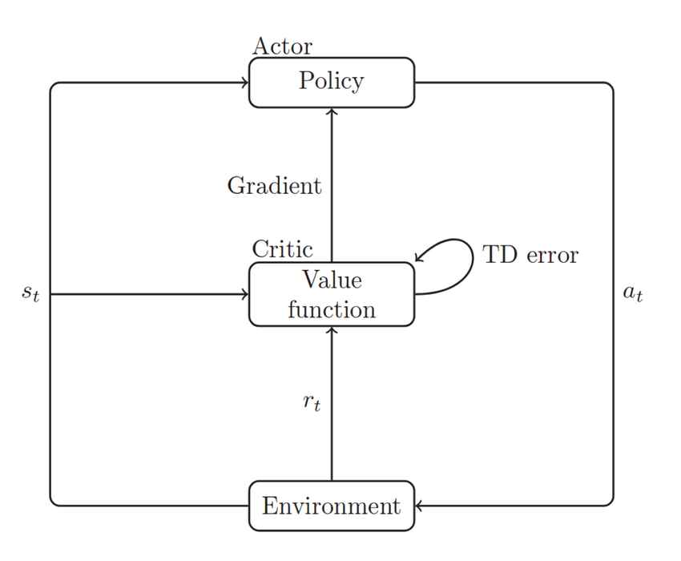

Advantage Actor-Critic (A2C)
Actor-Critic:
Actor: $state→P\left(action \right| state)$
Critic: $state→V$
Advantage Actor-Critic:
Actor: $state→P\left(action \right| state)$
Critic: $\left(state, action\right) →A$
Why Advantage value?
Instead of learning how “good” is a $state$, the critic instead learn how much advantage it will gain if the $action$ is executed on that $state$.
Generalize better, especially on complex problems
But obviously also cost more memory

Slide 17
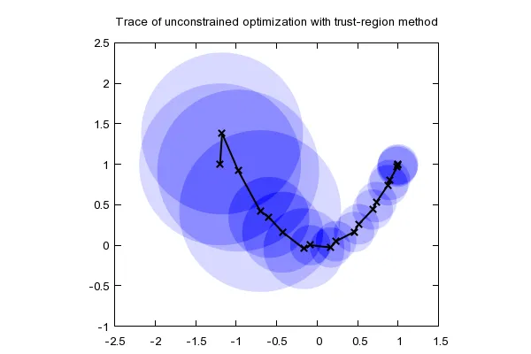

Proximal Policy Optimization (PPO)
Proximal Policy Optimization improves the learning progress of the actor in A2C using Trust Region Policy Optimization (TRPO)
TRPO is a technique to limit how large can the actor update its policy $π$
Or clipping
Avoid too large updates

Slide 18

Proximal Policy Optimization (PPO)
Since many of the mathematical details of TRPO are out of the scope of this project, here are some quick explanations:
The constraint is expressed in terms of Kullback–Leibler divergence
Kullback–Leibler divergence: the “distance” between two probability distributions
In this case, the old policy and the new policy
The theoretical TRPO update is impractical, so an approximation is used using the Taylor expansion of the objective function around the parameters of current $π$
The problem is then solved by Lagrangian duality to give the Natural Policy Gradient
Since the approximation will naturally have an error, sometimes really large...
The Natural Policy Gradient is then tweaked by using a backtracking coefficient to mitigate the impact of the approximation error
Backtracking coefficient: how much the approximation should “relies” on some of its previous ones

Slide 19
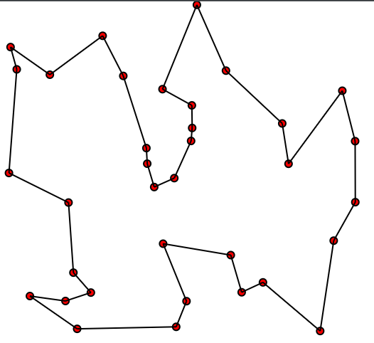
Travelling salesman problem (TSP)
“What is the shortest possible route that visits each city exactly once and return to the origin city?”
Travelling Salesman Problem (TSP) is an optimization problem, and is classified as
A combinatorial optimization problem
An integer programming problem

Slide 20
CODE Review of a reinforcement learning implementation for tsp
import pandas as pd
import numpy as np
import matplotlib.pyplot as plt
import os
import time
from tqdm import tqdm_notebook
from scipy.spatial.distance import cdist
import imageio
from matplotlib.patches import Rectangle
from matplotlib.collections import PatchCollection
plt.style.use("seaborn-dark")
import sys
sys.path.append("../")
from rl.agents.q_agent import QAgent
Some regular imports.

Slide 21
Code review
class DeliveryEnvironment(object):
def __init__(self,n_stops = 10,max_box = 10,method = "distance",**kwargs):
print(f"Initialized Delivery Environment with {n_stops} random stops")
print(f"Target metric for optimization is {method}")
# Initialization
self.n_stops = n_stops
self.action_space = self.n_stops
self.observation_space = self.n_stops
self.max_box = max_box
self.stops = []
self.method = method
# Generate stops
self._generate_constraints(**kwargs)
self._generate_stops()
self._generate_q_values()
self.render()
# Initialize first point
self.reset()
Initialize the environment with
n_stops: number of cities (or stops)
max_box: maximum coordinate value of a city
method: accepts three values
“distance”: regular 2D problem
“traffic_box”: add a random box of high traffic inside the environment, in which the salesman is slowed down
“time”: regular 2D problem but the reward is added by a random number

Slide 22
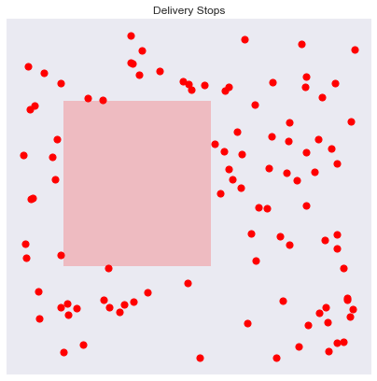
Code review
box_size: how large the box is (approximately)
traffic_intensity: how much slower the salesman is when moving through it (approximately)
def _generate_constraints(self,box_size = 0.2,traffic_intensity = 5):
if self.method == "traffic_box":
x_left = np.random.rand() * (self.max_box) * (1-box_size)
y_bottom = np.random.rand() * (self.max_box) * (1-box_size)
x_right = x_left + np.random.rand() * box_size * self.max_box
y_top = y_bottom + np.random.rand() * box_size * self.max_box
self.box = (x_left,x_right,y_bottom,y_top)
self.traffic_intensity = traffic_intensity
Add a random box of high traffic inside the environment, in which the salesman is slowed down, with

Slide 23
Code review
Randomly generate placement of cities.
If a traffic box is used, all cities are strictly outside of it.
def _is_in_box(self,x,y,box):
# Get box coordinates
x_left,x_right,y_bottom,y_top = box
return x >= x_left and x <= x_right and y >= y_bottom and y <= y_top
def _generate_stops(self):
if self.method == "traffic_box":
points = []
while len(points) < self.n_stops:
x,y = np.random.rand(2)*self.max_box
if not self._is_in_box(x,y,self.box):
points.append((x,y))
xy = np.array(points)
else:
# Generate geographical coordinates
xy = np.random.rand(self.n_stops,2)*self.max_box
self.x = xy[:,0]
self.y = xy[:,1]

Slide 24
Code review
Initialize Q-table
box_size is improperly placed and not used
If the method is time, initialize Q-table by a random array where values are in [0, max_box), except for Q[i, i] = 0 for any i
This is not a good starting point, the author should have used the same Q-table as below
Else, initialize Q[m, n] = distance(m, n)
def _generate_q_values(self,box_size = 0.2):
# Generate actual Q Values corresponding to time elapsed between two points
if self.method in ["distance","traffic_box"]:
xy = np.column_stack([self.x,self.y])
self.q_stops = cdist(xy,xy)
elif self.method=="time":
self.q_stops = np.random.rand(self.n_stops,self.n_stops)*self.max_box
np.fill_diagonal(self.q_stops,0)
else:
raise Exception("Method not recognized")

Slide 25
Code review
def render(self,return_img = False):
# THE AUTHOR RENDER THE ENVIRONMENT IMAGE
def reset(self):
# Stops placeholder
self.stops = []
# Random first stop
first_stop = np.random.randint(self.n_stops)
self.stops.append(first_stop)
return first_stop
Reset the environment
stops: all the stops that the salesman have visited, in respective order. The original stop is randomized.

Slide 26
Code review
Makes a step towards destination and returns
new_state: the new state
reward: the reward given for going to destination
done: if the episode is finished
The state is simply an integer which is the current stop.
_get_xy() returns the coordinate of the current stop.
def step(self,destination):
# Get current state
state = self._get_state()
new_state = destination
# Get reward for such a move
reward = self._get_reward(state,new_state)
# Append new_state to stops
self.stops.append(destination)
done = len(self.stops) == self.n_stops
return new_state,reward,done
def _get_state(self):
return self.stops[-1]
def _get_xy(self,initial = False):
state = self.stops[0] if initial else self._get_state()
x = self.x[state]
y = self.y[state]
return x,y

Slide 27

Code review
def _get_reward(self,state,new_state):
base_reward = self.q_stops[state,new_state]
if self.method == "distance":
return base_reward
elif self.method == "time":
return base_reward + np.random.randn()
elif self.method == "traffic_box":
# Additional reward correspond to slowing down in traffic
xs,ys = self.x[state],self.y[state]
xe,ye = self.x[new_state],self.y[new_state]
intersections = self._calculate_box_intersection(xs,xe,ys,ye,self.box)
if len(intersections) > 0:
i1,i2 = intersections
distance_traffic = np.sqrt((i2[1]-i1[1])**2 + (i2[0]-i1[0])**2)
additional_reward = distance_traffic * self.traffic_intensity * np.random.rand()
else:
additional_reward = np.random.rand()
return base_reward + additional_reward
The base reward is the Q-value of (state, new_state), which also is the reward of “distance”
Else, the reward function is defined as
If “time”: Add a random number in [0, 1)
If “traffic_box”: Add
distance through box $×$ traffic_intensity $×$ a random number in [0, 1)

Slide 28
Code review
def _calculate_box_intersection(self,x1,x2,y1,y2,box):
# Get box coordinates
x_left,x_right,y_bottom,y_top = box
# Intersections
intersections = []
# Top intersection
i_top = self._calculate_point(x1,x2,y1,y2,y=y_top)
if i_top > x_left and i_top < x_right:
intersections.append((i_top,y_top))
# Bottom intersection
i_bottom = self._calculate_point(x1,x2,y1,y2,y=y_bottom)
if i_bottom > x_left and i_bottom < x_right:
intersections.append((i_bottom,y_bottom))
# Left intersection
i_left = self._calculate_point(x1,x2,y1,y2,x=x_left)
if i_left > y_bottom and i_left < y_top:
intersections.append((x_left,i_left))
# Right intersection
i_right = self._calculate_point(x1,x2,y1,y2,x=x_right)
if i_right > y_bottom and i_right < y_top:
intersections.append((x_right,i_right))
return intersections
2 functions to calculate the coordinates of two intersections between a segment and a rectangle
@staticmethod
def _calculate_point(x1,x2,y1,y2,x = None,y = None): if y1 == y2:
return y1
elif x1 == x2:
return x1
else:
a = (y2-y1)/(x2-x1)
b = y2 - a * x2
if x is None:
x = (y-b)/a
return x
elif y is None:
y = a*x+b
return y
else:
raise Exception("Provide x or y")

Slide 29
Code review
class DeliveryQAgent(QAgent):
def __init__(self,*args,**kwargs):
super().__init__(*args,**kwargs)
self.reset_memory()
def act(self,s):
# Get Q Vector
q = np.copy(self.Q[s,:])
# Avoid already visited states
q[self.states_memory] = -np.inf
if np.random.rand() > self.epsilon:
a = np.argmax(q)
else:
a = np.random.choice([x for x in range(self.actions_size) if x not in self.states_memory])
return a
def remember_state(self,s):
self.states_memory.append(s)
def reset_memory(self):
self.states_memory = []
Initialize the Q-Agent
act(s) uses Epsilon-Greedy to choose an action on state s
remember_state(s) saves the current state to the memory, in this case simply the visited city s
reset_memory() clears the memory

Slide 30
Code review
# Update the caches
episode_reward += r
s = s_next
# If the episode is terminated
i += 1
if done:
break
return env,agent,episode_reward
def run_n_episodes(env, agent, name="training.gif", n_episodes=1000, render_each=10, fps=10):
# Store the rewards
rewards = []
imgs = []
# Experience replay
for i in tqdm_notebook(range(n_episodes)):
# Run the episode
env,agent,episode_reward = run_episode(env,agent,verbose = 0)
rewards.append(episode_reward)
if i % render_each == 0:
img = env.render(return_img = True)
imgs.append(img)
# THE AUTHOR SAVE SOME IMAGES HERE
return env,agent
The Q-Learning implementation
def run_episode(env,agent,verbose = 1): s = env.reset()
agent.reset_memory()
max_step = env.n_stops
episode_reward = 0
i = 0
while i < max_step: # Remember the states
agent.remember_state(s)
# Choose an action
a = agent.act(s)
# Take the action, and get the reward from environment
s_next,r,done = env.step(a)
# Tweak the reward
r = -1 * r
if verbose: print(s_next,r,done)
# Update our knowledge in the Q-table
agent.train(s,a,r,s_next)

Slide 31
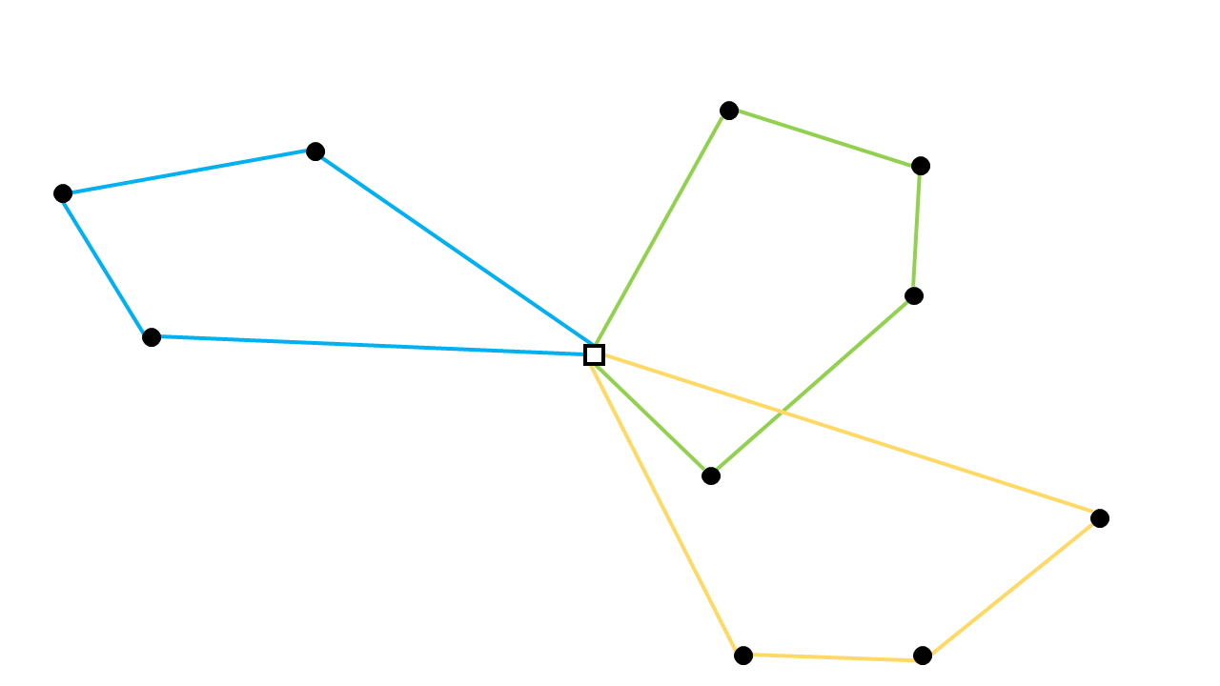
Capacitated Vehicle Routing Problem (CVRP)
"What is the optimal set of routes for a fleet of vehicles to traverse in order to deliver to a given set of customers?"
Also known as the Vehicle Routing Problem (VRP), Capacitated Vehicle Routing Problem (CVRP) is a generalization of TSP, which also is
A combinatorial optimization problem
An integer programming problem

Slide 32
PARAMETERS
class Delivery(gymnasium.Env):
def __init__(self, n_stops=10, max_demand=10, max_vehicle_cap=30, max_env_size=1_000_000,
gen_seed=None, gym_seed=None, print_input=True, print_terminated=True)
The data are generated using the following parameters
n_stops : number of stops
max_demand : the maximum demand of all cities
max_vehicle_cap : the maximum capacity of the vehicle
max_env_size : the maximum coordinate of all cities

Slide 33

ASSUMPTIONS
To ensure the feasibility of the problem, assume that
max_demand $≤$ max_vehicle_cap
The number of vehicles = n_stops
So that the problem always has a naïve solution: all vehicles move to all stops then comeback to depot immediately after
To somewhat simplify the problem, assume that
All vehicles have the same capacity
The objective is the total distance only, disregard the time, number of vehicles used, profit, or other factors

Slide 34
Data generation
demands: demands of stops
A list with n_stops elements
demand of depot is always 0
n_stops - 1 random integers in [1, max_demand]
stop_coords: coordinates of stops
A matrix of shape (n_stops, 2)
Values are random integers in [0, max_env_size]
The depot is the first stop in those lists (index 0)
vehicle_cap: the vehicle capacity
A random integer in [max_demand, max_vehicle_cap]

Slide 35
Cvrp formulation as a rl problem
The problem can be translated into: One vehicle problem, and it cannot visit a stop if the load left is not enough for it.
The implementation of this formulation is in pure Python with Stable Baselines3 (SB3).
Environment: remain constants
demands
stop_coords
vehicle_cap
State
current_stop
visited: list of stops are visited or not
Some other derived information, including
current_length: total length moved
Objective: current_length

Slide 36

Cvrp formulation as a rl problem
Immediate reward
Valid action
reward = - segment_length
segment_length: The length between the two stops
Invalid action: Move to a visited stop (except depot), or move to a stop with not enough load
reward = - 2 * n_stops * max_env_size
Idea behind
The maximum segment_length is $\sqrt{2}$ * max_env_size $≈$ $1.41$ * max_env_size
Punish the agent even more, proportional to a constant large number n_stops
Normalized reward
Valid action: reward = - segment_length / max_env_size
Invalid action: reward = - 2 * n_stops

Slide 37
Results
Deep Q-Learning (DQN)
250, 500, 1000, 5000, 10000, and 50000 are the (minimum) numbers of environment total timesteps during training
Each result is the minimum objective found out of 10 episodes
n_stops | 250 | 500 | 1000 | 5000 | 10000 | 50000
5 | 3958 | 3602 | 5902 | 2855 | 4164 | 3730
6 | 4356 | 4417 | 4639 | 5071 | 4356 | 4417
7 | 3126 | 3306 | 2934 | 3037 | 3822 | 3228
8 | 4916 | 4930 | 4699 | 4916 | 4643 | 5011
9 | 6051 | 5492 | 5153 | 5167 | 4976 | 5557
10 | 6897 | 5827 | 5910 | 5218 | 6386 | 5864
12 | 6097 | 6856 | 6915 | 5345 | 5973 | 6550
15 | 10511 | 10852 | 11351 | 10335 | 10393 | 10079
20 | 14061 | 12699 | 12436 | 14362 | 12399 | 11828

Slide 38
Results
Advantage Actor-Critic (A2C)
n_stops | 250 | 500 | 1000 | 5000 | 10000 | 50000
5 | 3602 | 2988 | 3730 | 3602 | 2988 | 3602
6 | 4356 | 4516 | 4639 | 4902 | 4417 | 4516
7 | 3855 | 3990 | 2794 | 2772 | 3093 | 3870
8 | 4817 | 4817 | 5187 | 4904 | 5259 | 5212
9 | 5040 | 5085 | 5348 | 5462 | 5612 | 5040
10 | 5749 | 7196 | 6946 | 5309 | 6661 | 6150
12 | 7902 | 9392 | 7345 | 8812 | 7951 | 8097
15 | 10143 | 10458 | 10038 | 10164 | 10165 | 9970
20 | 13239 | 11280 | 11118 | 12582 | 10982 | 14469

Slide 39
Results
Proximal Policy Optimization (PPO)
n_stops | 250 | 500 | 1000 | 5000 | 10000 | 50000
5 | 2855 | 2855 | 3958 | 3602 | 3225 | 3581
6 | 4356 | 4356 | 4356 | 4516 | 4803 | 4417
7 | 3309 | 3315 | 3057 | 3037 | 3660 | 3550
8 | 4699 | 4930 | 5295 | 5475 | 5104 | 5011
9 | 5229 | 5240 | 5076 | 5282 | 5282 | 5368
10 | 6372 | 5258 | 5460 | 6127 | 5364 | 6003
12 | 7321 | 6444 | 6817 | 7171 | 7462 | 7415
15 | 8354 | 10118 | 9039 | 9035 | 9325 | 11043
20 | 11741 | 11079 | 11259 | 11454 | 11649 | 13128

Slide 40
Results
n_stops | a2c | dqn | ppo | ortools
5 | 2988 | 2855 | 2855 | 2855
6 | 4356 | 4356 | 4356 | 4356
7 | 2772 | 2934 | 3037 | 2772
8 | 4817 | 4643 | 4699 | 4643
9 | 5040 | 4976 | 5076 | 4648
10 | 5309 | 5218 | 5258 | 3554
12 | 7345 | 5345 | 6444 | 4196
15 | 9970 | 10079 | 8354 | 7325
20 | 10982 | 11828 | 11079 | 7521
Best results, comparing with the solution provided by OR-Tools
Deep Q-Learning (DQN) is the best RL model
As expected, the RL models get worse when there are more stops
However, they will still give a reasonable solution on a live environment without prior knowledge

Slide 41
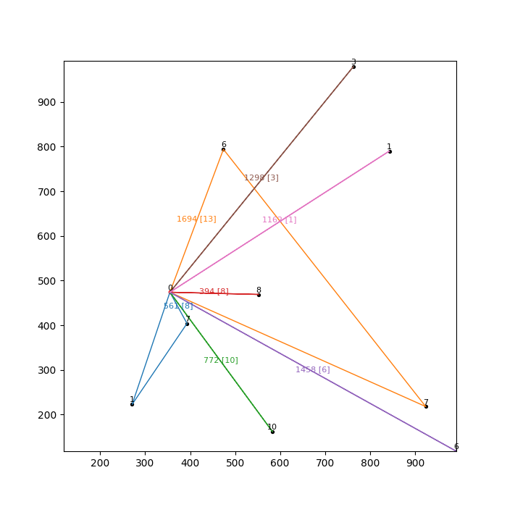
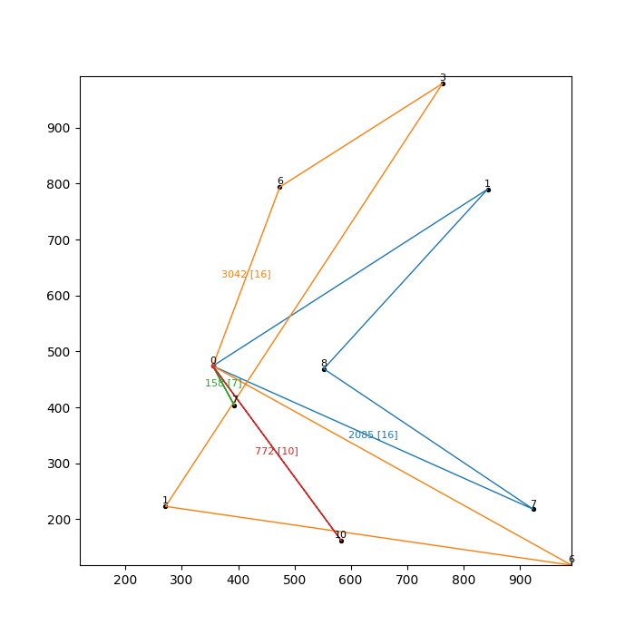
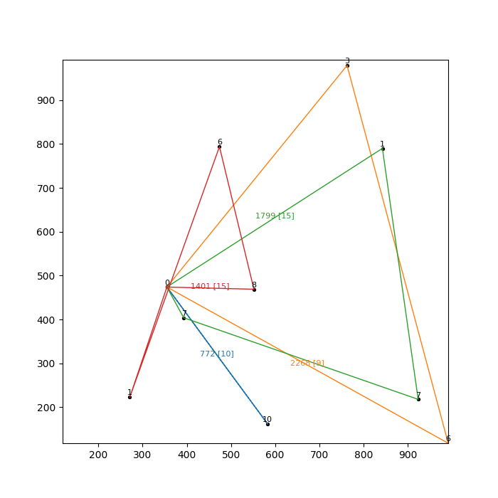
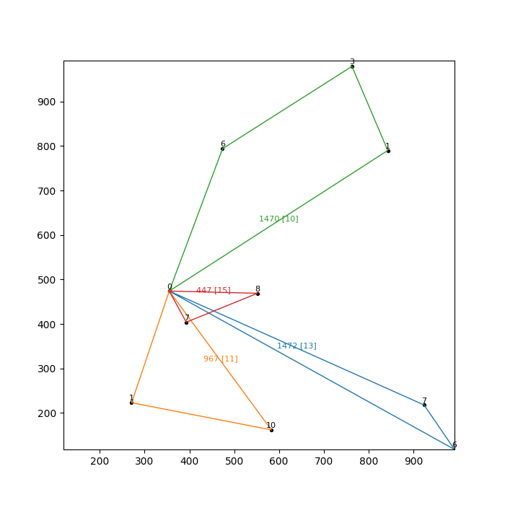
Examples
A2C (7339) DQN (6057) PPO (6240) OR-Tools (4356)

Slide 42
Conclusion & future works
This project has
Investigated RL approaches to optimization problems in general
Reviewed a Q-learning implementation for TSP
Formulated CVRP as a RL problem
Implemented A2C, DQN, and PPO algorithms for CVRP
Achieved remarkable results with DQN is the best model
Future works
Continue to adjust the implemented algorithms
Implement more algorithms
Explore more RL applications for traditional optimization problems

Slide 43
APPLIED reinforcement learning methods for the capacitated vehicle routing problem
Hoang Tran Nhat Minh
Instructed by Dr. Pham Quang Dung
Data Science & Artificial Intelligence 2020
January 2024

Slide 44
References
Solving the Traveling Salesman Problem with Reinforcement Learning. (2021, November 3). Eki.Lab. https://ekimetrics.github.io/blog/2021/11/03/tsp/#references
L. Wang, Z. Pan and J. Wang, "A Review of Reinforcement Learning Based Intelligent Optimization for Manufacturing Scheduling," in Complex System Modeling and Simulation, vol. 1, no. 4, pp. 257-270, December 2021, doi: 10.23919/CSMS.2021.0027.
Wikipedia contributors. (2024, January 5). Reinforcement learning. In Wikipedia, The Free Encyclopedia. Retrieved 04:02, January 16, 2024, from https://en.wikipedia.org/w/index.php?title=Reinforcement_learning&oldid=1193685081
Gilman, R. (2018, January 9). Intuitive RL: Intro to Advantage-Actor-Critic (A2C). HackerNoon. https://hackernoon.com/intuitive-rl-intro-to-advantage-actor-critic-a2c-4ff545978752
Karagiannakos, S. (2018, November 17). The idea behind Actor-Critics and how A2C and A3C improve them | AI Summer. AI Summer. https://theaisummer.com/Actor_critics/
Understanding the role of the discount factor in reinforcement learning. (n.d.). Cross Validated. https://stats.stackexchange.com/questions/221402/understanding-the-role-of-the-discount-factor-in-reinforcement-learning

Slide 45
References
Mnih, V., Badia, A. P., Mirza, M., Graves, A., Lillicrap, T., Harley, T., ... & Kavukcuoglu, K. (2016, June). Asynchronous methods for deep reinforcement learning. In International conference on machine learning (pp. 1928-1937). PMLR.
Wikipedia contributors. (2024, January 4). Q-learning. In Wikipedia, The Free Encyclopedia. Retrieved 04:08, January 16, 2024, from https://en.wikipedia.org/w/index.php?title=Q-learning&oldid=1193548086
A2C — Stable Baselines3 2.3.0a1 documentation. (n.d.). https://stable-baselines3.readthedocs.io/en/master/modules/a2c.html
Luu, Q. T., & Luu, Q. T. (2023, May 2). Q-Learning vs. Deep Q-Learning vs. Deep Q-Network | Baeldung on Computer Science. Baeldung on Computer Science. https://www.baeldung.com/cs/q-learning-vs-deep-q-learning-vs-deep-q-network
Science, B. O. C., & Science, B. O. C. (2023, March 24). Epsilon-Greedy Q-Learning | Baeldung on Computer Science. Baeldung on Computer Science. https://www.baeldung.com/cs/epsilon-greedy-q-learning

Slide 46
References
GeeksforGeeks. (2021, September 27). Bellman equation. https://www.geeksforgeeks.org/bellman-equation/
Wikipedia contributors. (2023, December 29). Bellman equation. In Wikipedia, The Free Encyclopedia. Retrieved 04:12, January 16, 2024, from https://en.wikipedia.org/w/index.php?title=Bellman_equation&oldid=1192511038
DQN — Stable Baselines3 2.3.0a1 documentation. (n.d.). https://stable-baselines3.readthedocs.io/en/master/modules/dqn.html
Fig. 7. Advantage actor critic. (n.d.). ResearchGate. https://www.researchgate.net/figure/Advantage-Actor-Critic_fig3_334521853
Schulman, J., Levine, S., Abbeel, P., Jordan, M., & Moritz, P. (2015, June). Trust region policy optimization. In International conference on machine learning (pp. 1889-1897). PMLR.
Proximal Policy Optimization — Spinning Up documentation. (n.d.). https://spinningup.openai.com/en/latest/algorithms/ppo.html

Slide 47
References
Trust Region Policy Optimization — Spinning Up documentation. (n.d.). https://spinningup.openai.com/en/latest/algorithms/trpo.html
Karunakaran, D. (2021, December 16). Trust Region Policy Optimisation(TRPO) — a policy-based Reinforcement Learning. Medium. https://medium.com/intro-to-artificial-intelligence/trust-region-policy-optimisation-trpo-a-policy-based-reinforcement-learning-fd38ff9e996e
Wikipedia contributors. (2023, December 27). Travelling salesman problem. In Wikipedia, The Free Encyclopedia. Retrieved 04:19, January 16, 2024, from https://en.wikipedia.org/w/index.php?title=Travelling_salesman_problem&oldid=1191996141
Wikipedia contributors. (2023, December 1). Vehicle routing problem. In Wikipedia, The Free Encyclopedia. Retrieved 04:18, January 16, 2024, from https://en.wikipedia.org/w/index.php?title=Vehicle_routing_problem&oldid=1187812878
Capacitated Vehicle Routing Problem formulation — AIMMS How-To. (2020, August 31). https://how-to.aimms.com/Articles/332/332-Formulation-CVRP.html

