Slide 1
Relationship between pH and chlorophyll in western Lake erie basin
Helen Toledo
BIO 670

Slide 2
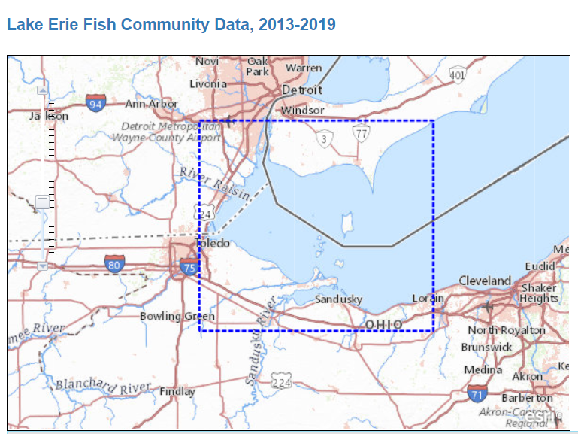
Question/Description
H₀: pH of water in Lake Erie has no influence on chlorophyll levels
H_{A}: pH of water in Lake Erie has influence on chlorophyll levels

Slide 3
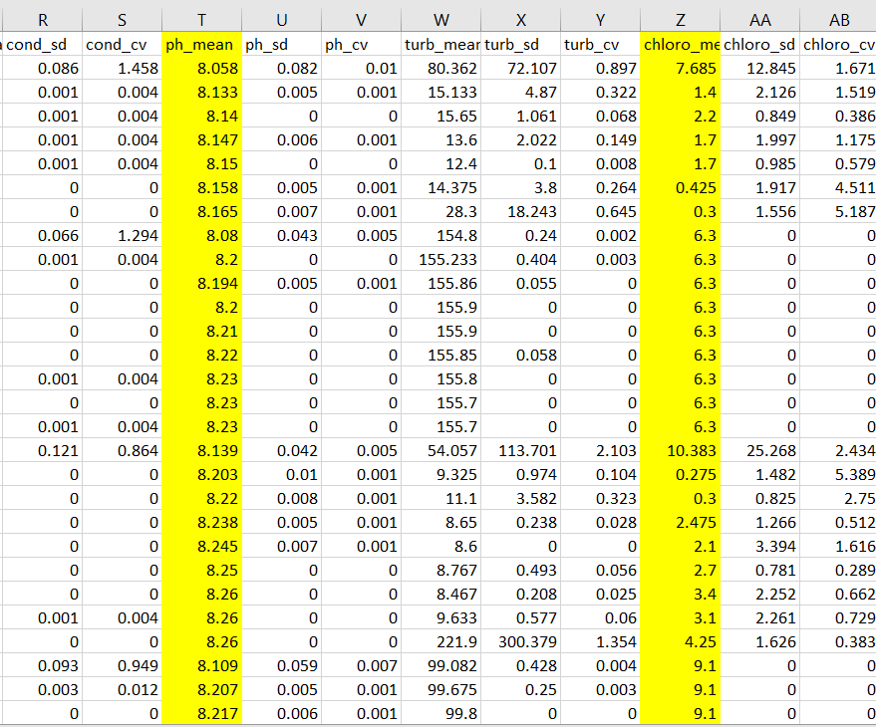
Datasets used
Derived from USGS survey 6/2013-9/2019
WB_WaterQuality CSV
temperature, conductivity, pH, turbidity, chlorophyll, and dissolved oxygen
pH_mean and chloro_mean columns

Slide 4
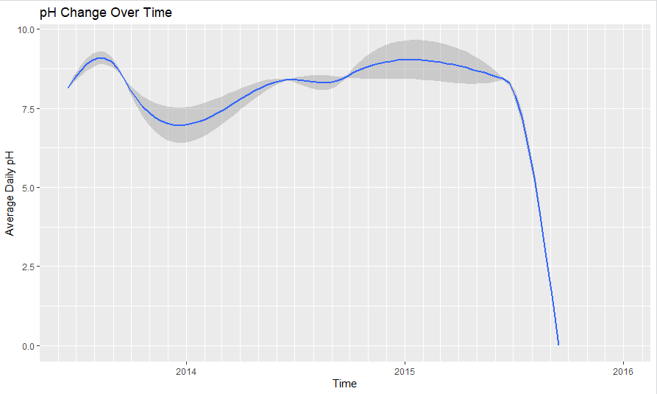
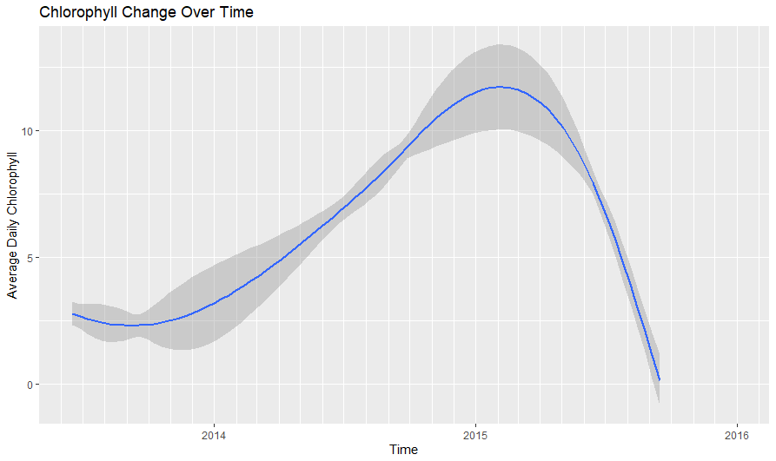
Summary analysis of the data
ggplot(Ph_vs_chloro_df, aes(x=Time, y=numeric_pH)) +
geom_smooth() +
ggtitle('pH Change Over Time') +
labs(x= "Time", y= "Average Daily pH") +
scale_x_date(limit=c(as.Date("2013-06-17"),as.Date("2015-12-31")), date_minor_breaks = "1 month")
ggplot(Ph_vs_chloro_df, aes(x=Time, y=numeric_chloro)) +
geom_smooth() +
ggtitle('Chlorophyll Change Over Time') +
labs(x= "Time", y= "Average Daily Chlorophyll") +
scale_x_date(limit=c(as.Date("2013-06-17"),as.Date("2015-12-31")), date_minor_breaks = "1 month")

Slide 5
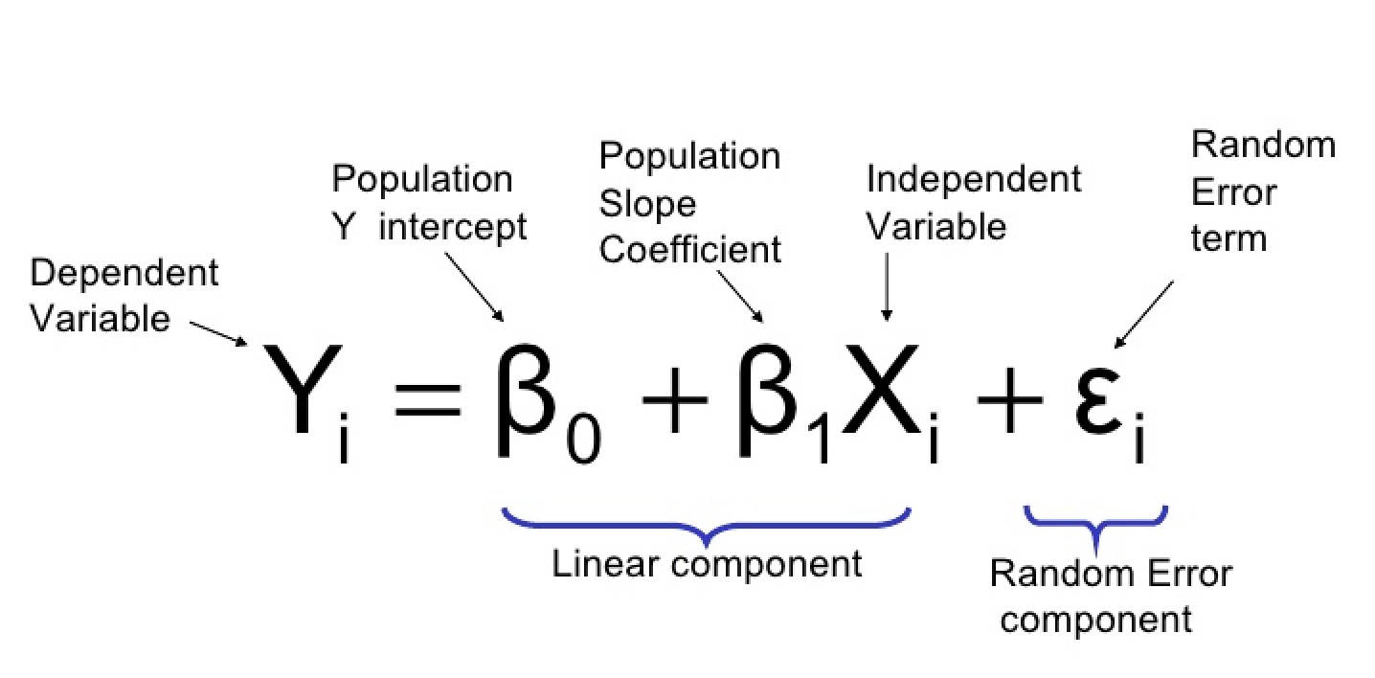
Statistical Analysis preformed
Loaded in data (CSV file)
Library(xts) & Library(ggplot2)
Create xts object of fixed dates
Create dataframe with dates, pH, and chlorophyll (daily values)
Make sure they are read numerically
Generate linear model:
ph_vs_chloro_lm<- lm(numeric_chloro ~ numeric_pH, data= Ph_vs_chloro_df)
summary(ph_vs_chloro_lm)
Linear Regression- a model in which one variable or outcome is predicted by another

Slide 6
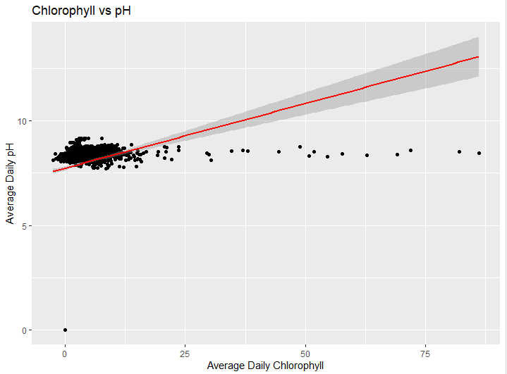
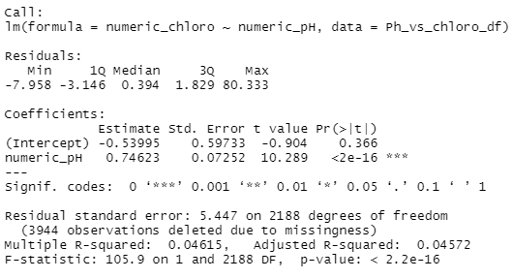
Results (numerical and graphic)
What does this mean?
P value: <2e-16
R squared: 0.04572
Scatterplot with trend line
Notes:
R^{2:} The proportion of variance accounted for by the regression model.

Slide 7
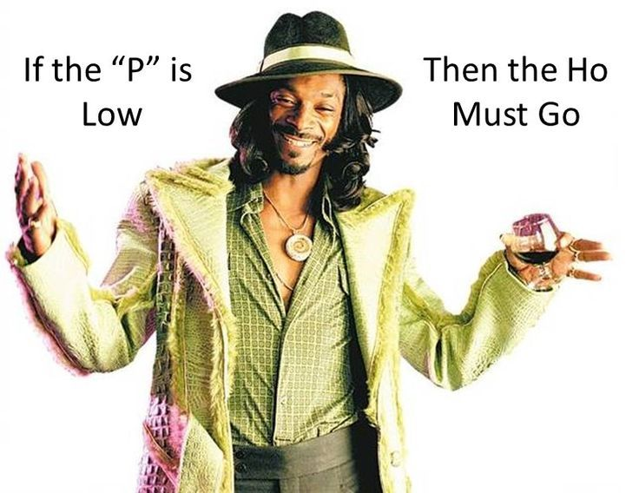
Accept or reject the null?
H0: Rejected
Why?
HA: Accepted
pH of water in Lake Erie has influence on chlorophyll levels
Notes:
7.5 min mark

Slide 8
New R Package used: xts
XTS (eXtensible Time Series): provides for uniform handling of R's different time-based data classes by extending zoo, maximizing native format information preservation and allowing for user level customization and extension, while simplifying cross-class interoperability
WB_WaterQuality <- read.csv(file.choose(), header = TRUE)
WB_WaterQuality$fixed_date <- as.Date(WB_WaterQuality$Date,"%m/%d/%Y")
WB_WaterQuality_xts<- xts(WB_WaterQuality, order.by= WB_WaterQuality$fixed_date)
WaterQuality_df<- data.frame(WB_WaterQuality_xts['/'][,"turb_mean"], Time = index(WB_WaterQuality_xts))

Slide 9
New R Package used: xts
XTS object: a matrix of observations combined with an index of corresponding dates and times
WB_WaterQuality_xts<- xts(WB_WaterQuality, order.by= WB_WaterQuality$fixed_date)
Other XTS uses:
Extract data based on recurring times
Alter time zones
Subset data based off dates

Slide 10
References
Data derived from:
Keretz, K.R., Kraus, R.T., and Schmitt, J.D., 2020, Lake Erie Fish Community Data, 2013-2019: U.S. Geological Survey data release, https://doi.org/10.5066/P9LL6YOR.

