Slide 1

Prog2590 Group-5
Income Classification Using Machine Learning
Group Members
Harkamal Singh Toor
Harsimranpreet kaur
SaInabou samba camara
Lewis Moura

Slide 2

Introduction
“Hello everyone, we are Group 5, and our project is Income Classification Using Machine Learning for PROG2590. Our team members are Harkamal Toor, Harsimranpreet Kaur ,Lewis Moura and Sainabou Samba Camara. Today we’ll walk you through our full ML workflow: from EDA and preprocessing to four different models and final evaluation.”

Slide 3
Problem Overview
“The main problem we’re solving is predicting whether a person earns more than 50 thousand dollars per year, based on their demographic and work-related attributes from the Adult Census dataset. This is a binary classification task: the target label is either <=50K or >50K. This kind of model can be used in financial services, marketing, or policy-making to understand income patterns in a population.”

Slide 4
Dataset Description
“We use a subset of the Adult Census Income dataset with 29,385 records and 15 columns. There are 14 input features and one target. Features include age, education, workclass, marital status, occupation, hours per week, capital gain and loss, and native country. The target is the income bracket. The dataset is imbalanced: about 76% of people earn <=50K and 24% earn >50K, which we show in this class distribution chart. We also looked at correlations between numeric features and saw that most correlations are fairly weak, except for some relationship between education level and capital gain.”

Slide 5
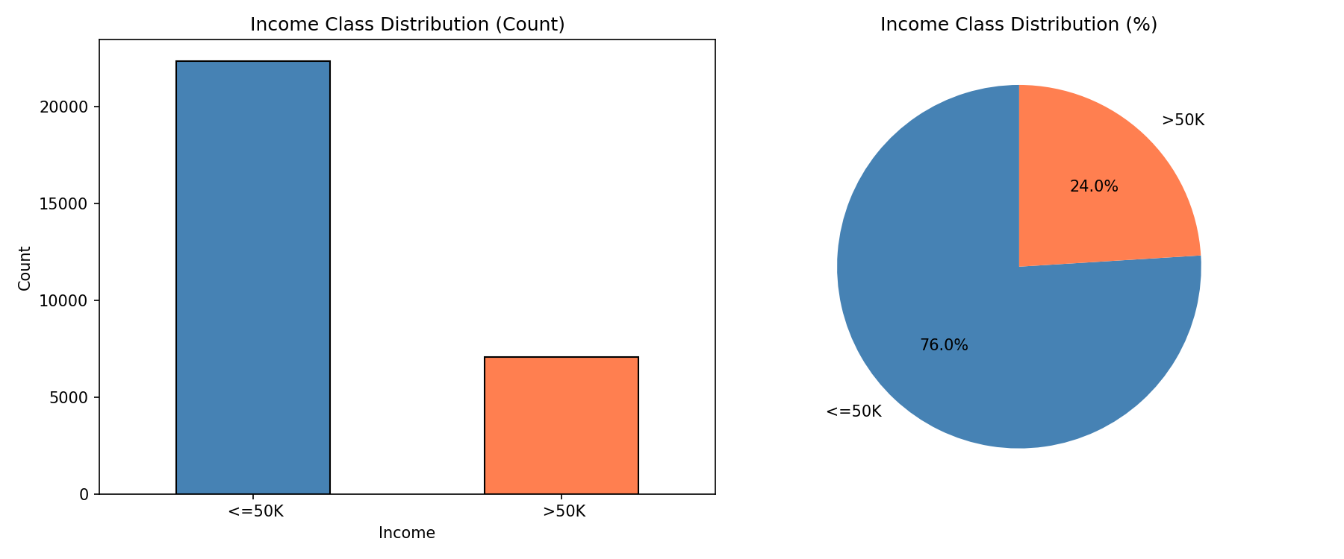
Income Class Distribution

Slide 6
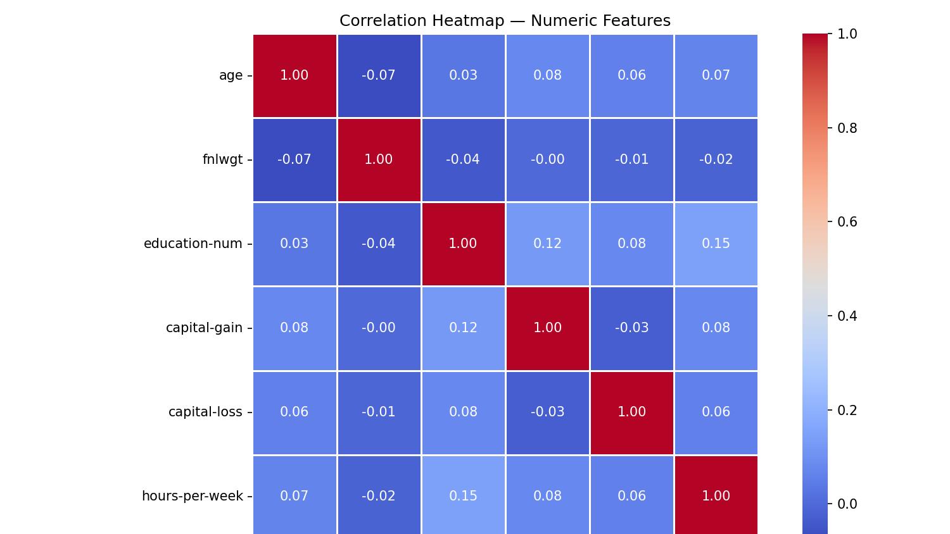

Slide 7
Data Preprocessing
“Before modeling, we cleaned and standardized the data. Missing values were originally encoded as '?', particularly in workclass, occupation, and native-country. We replaced those with proper NaNs and handled them in a preprocessing pipeline. For numerical features we used median imputation followed by StandardScaler. For categorical features, we used most‑frequent imputation and OneHotEncoder with handle_unknown='ignore'. All of this is wrapped in a ColumnTransformer so the same pipeline is shared across all models. Finally, we did a stratified 80/20 train‑test split to preserve the income class balance.”

Slide 8
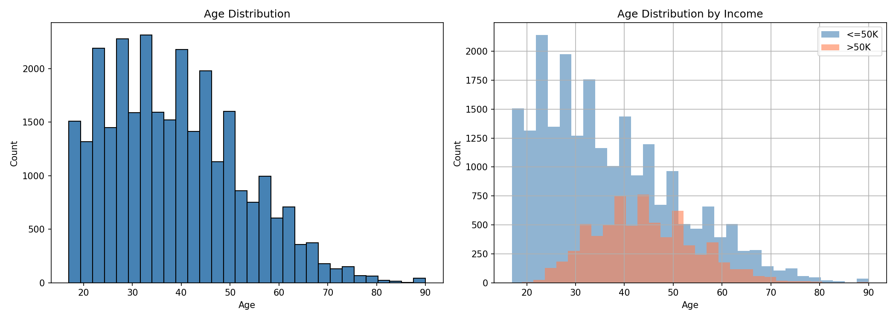
Age Distribution

Slide 9
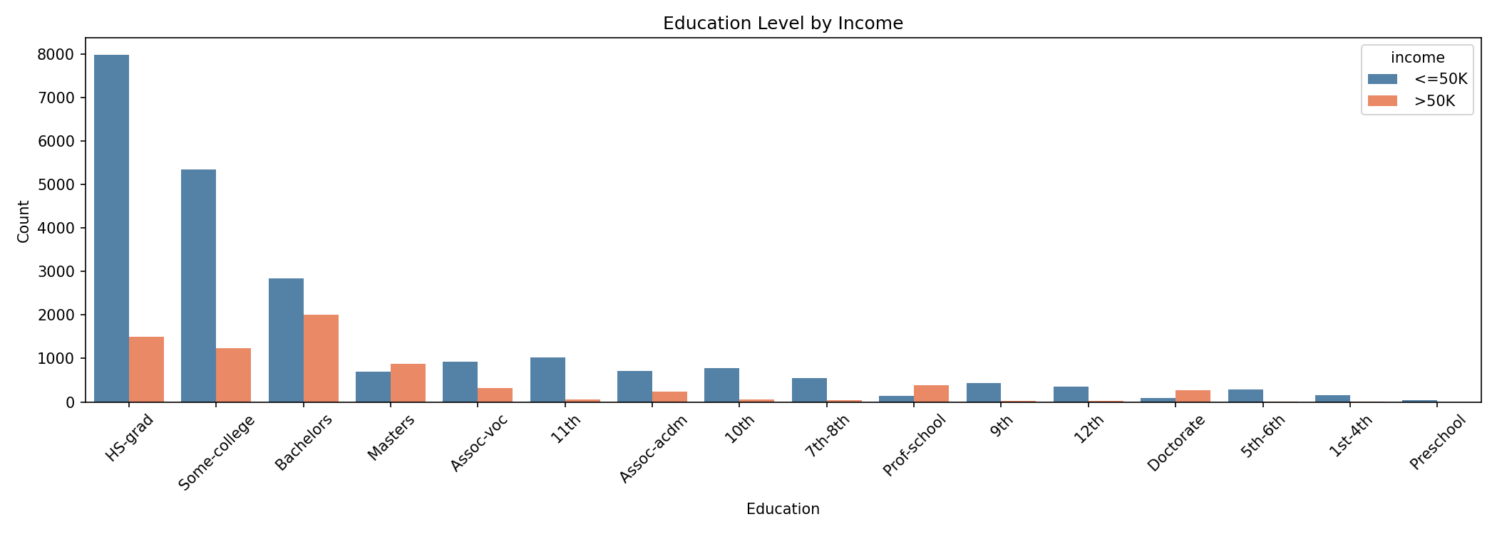

Slide 10
Our Approach
4 Models, 1 Dataset, Best Wins
Logistic Regression — baseline linear model, interpretable, fast
Random Forest — ensemble method, handles mixed data, reduces overfitting
KNN — distance-based, non-parametric comparison
Decision Tree — interpretable rule-based model, fast prediction, rule-based
Each model uses the exact same preprocessing pipeline to ensure a fair comparison.”

Slide 11
Logistic Regression
“Logistic Regression is our baseline model. We trained it with class balancing so it handles the 76/24 income imbalance properly.
On the test set, it achieved:
Accuracy: 80.96%
ROC‑AUC: 0.9062
Recall for >50K: 0.8476 (this is the highest recall among all models)
So Logistic Regression is very good at catching most of the people who actually earn more than 50K, even though its precision is lower. That makes it a strong model when missing high‑income cases would be costly.”

Slide 12
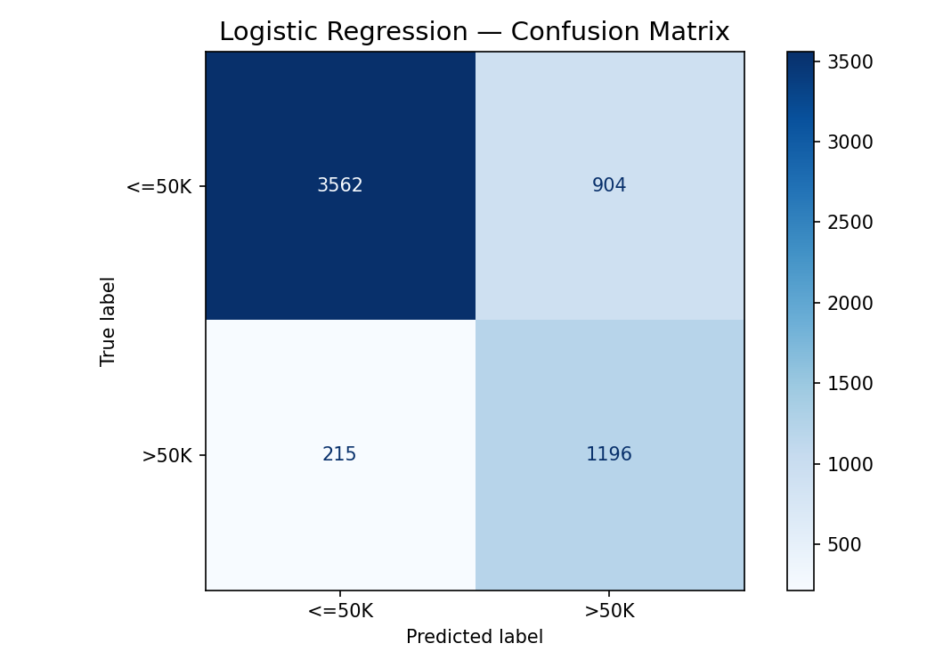
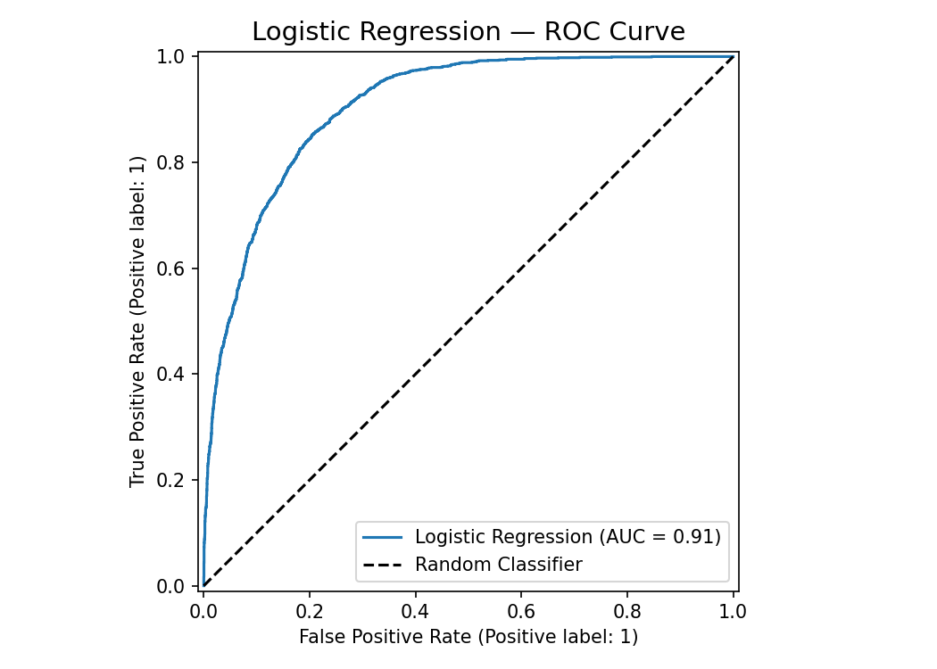

Slide 13
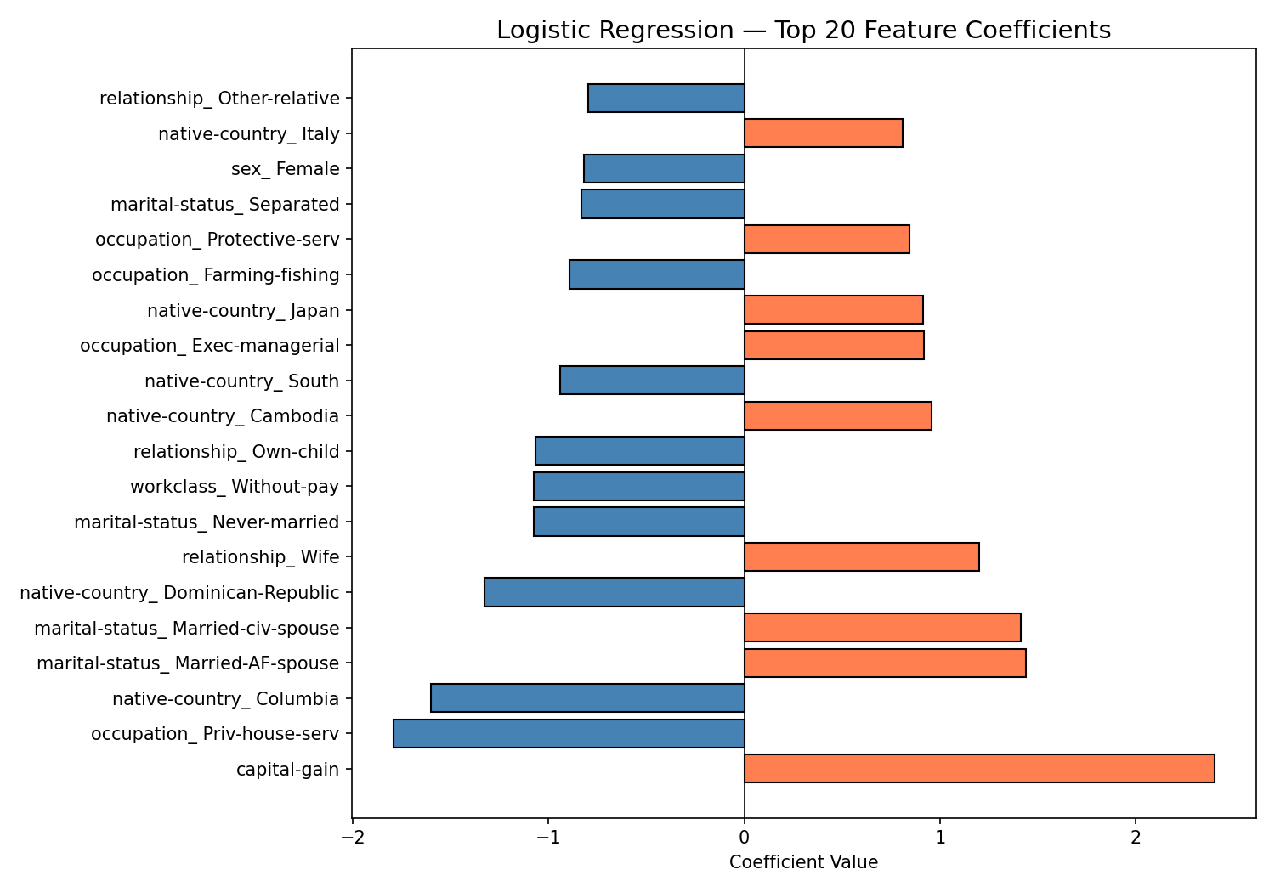

Slide 14

Random Forest
“For Random Forest, we used RandomForestClassifier inside the same pipeline and tuned hyperparameters using GridSearchCV. The best configuration used 100 trees, max_depth=None, and min_samples_split=5. With this configuration, Random Forest achieved the highest accuracy at 85.89% and the highest ROC‑AUC at 0.9093. Precision for the >50K class is 0.7474 and recall is 0.6230, giving an F1‑score of 0.6796. So compared to Logistic Regression, Random Forest improves overall accuracy and AUC and gives a better balance between precision and recall. The feature importance plot shows that capital gain, age, hours per week, and education level are among the top contributors to the predictions.”

Slide 15
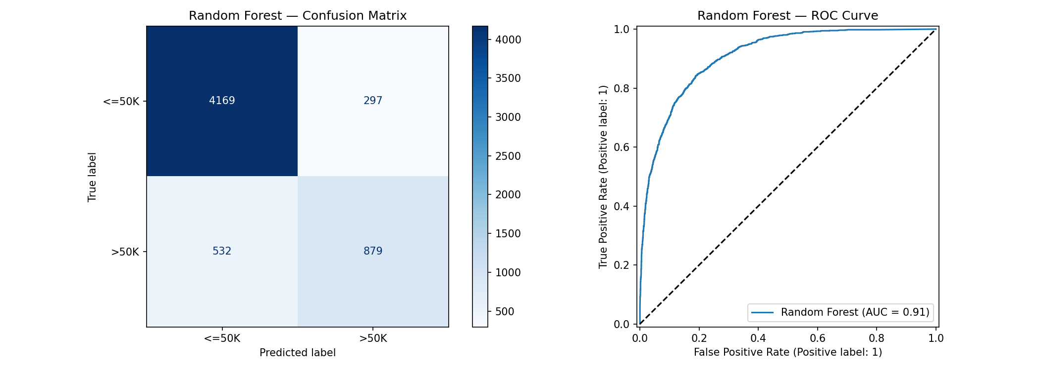

Slide 16
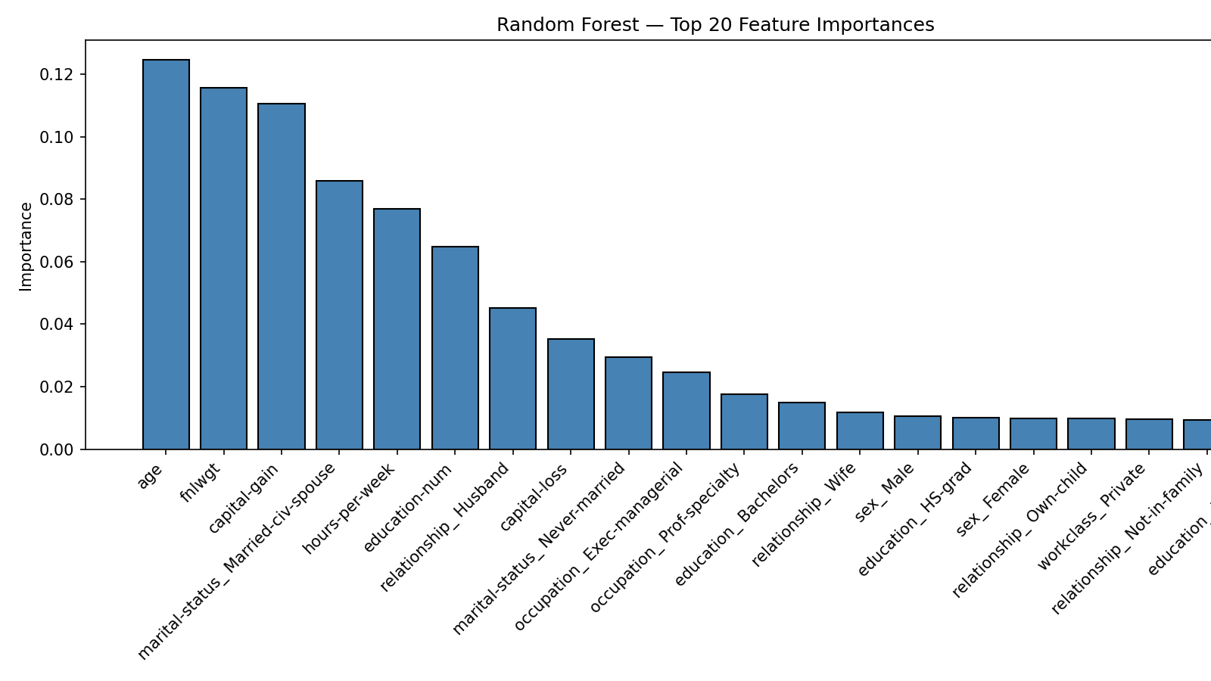

Slide 17

KNN
“For K‑Nearest Neighbors, we first selected the best value of K using an elbow method, testing K from 1 to 20 and plotting accuracy. The optimal choice was K=16. With K=16, KNN reached an accuracy of 84.38% and ROC‑AUC of 0.8870. Precision for >50K is 0.7203 and recall is 0.5712, with an F1‑score of 0.6372. So KNN performs reasonably well, but it is weaker than Random Forest and Logistic Regression on ROC‑AUC. Another important point is runtime: KNN has relatively fast training (about 0.12 seconds), but slow prediction (around 0.20 seconds) because it has to compute distances to many training samples at inference time. That makes it less suitable for real‑time large‑scale deployment.”

Slide 18


Slide 19
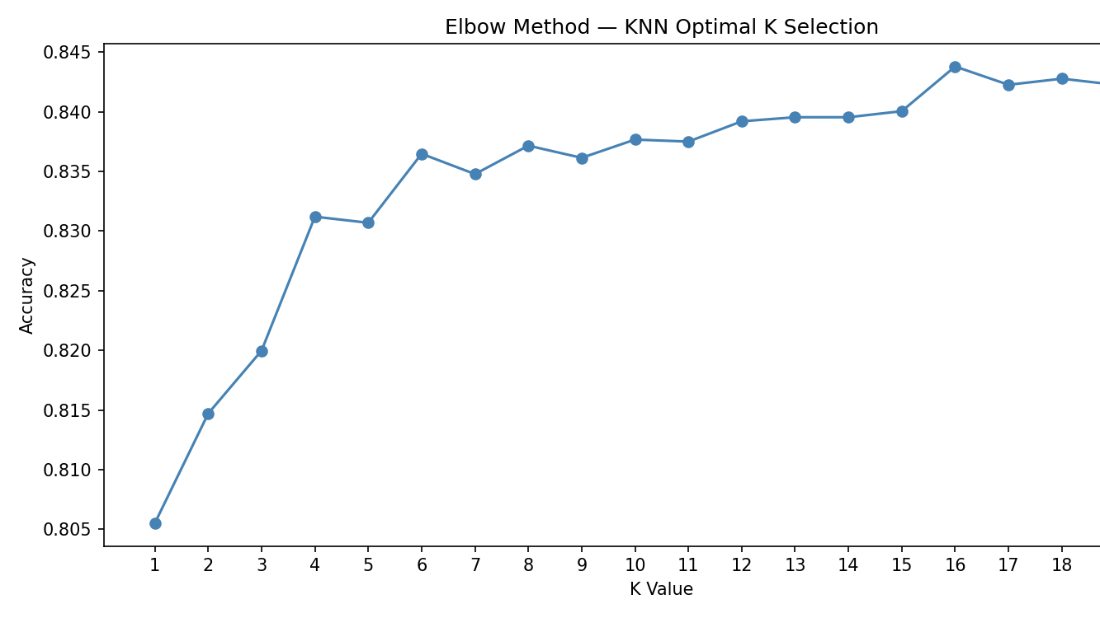

Slide 20
Decision Tree
“For the Decision Tree model, we used DecisionTreeClassifier and tuned the hyperparameters max_depth, min_samples_leaf, and criterion with GridSearchCV. The best tree used entropy as the criterion, max_depth=10, and min_samples_leaf=10, which helps prevent overfitting. The tuned Decision Tree achieved 85.13% accuracy, ROC‑AUC of 0.8985, and precision 0.7579 with recall 0.5592 for the >50K class. This is the highest precision among all models, meaning when it predicts >50K, it is often correct, but it misses more of the actual positives. We also visualized the top three levels of the tree, which makes the model interpretable. And in terms of speed, Decision Tree has the fastest prediction time at about 0.006 seconds, making it very attractive for real‑time applications.”

Slide 21


Slide 22
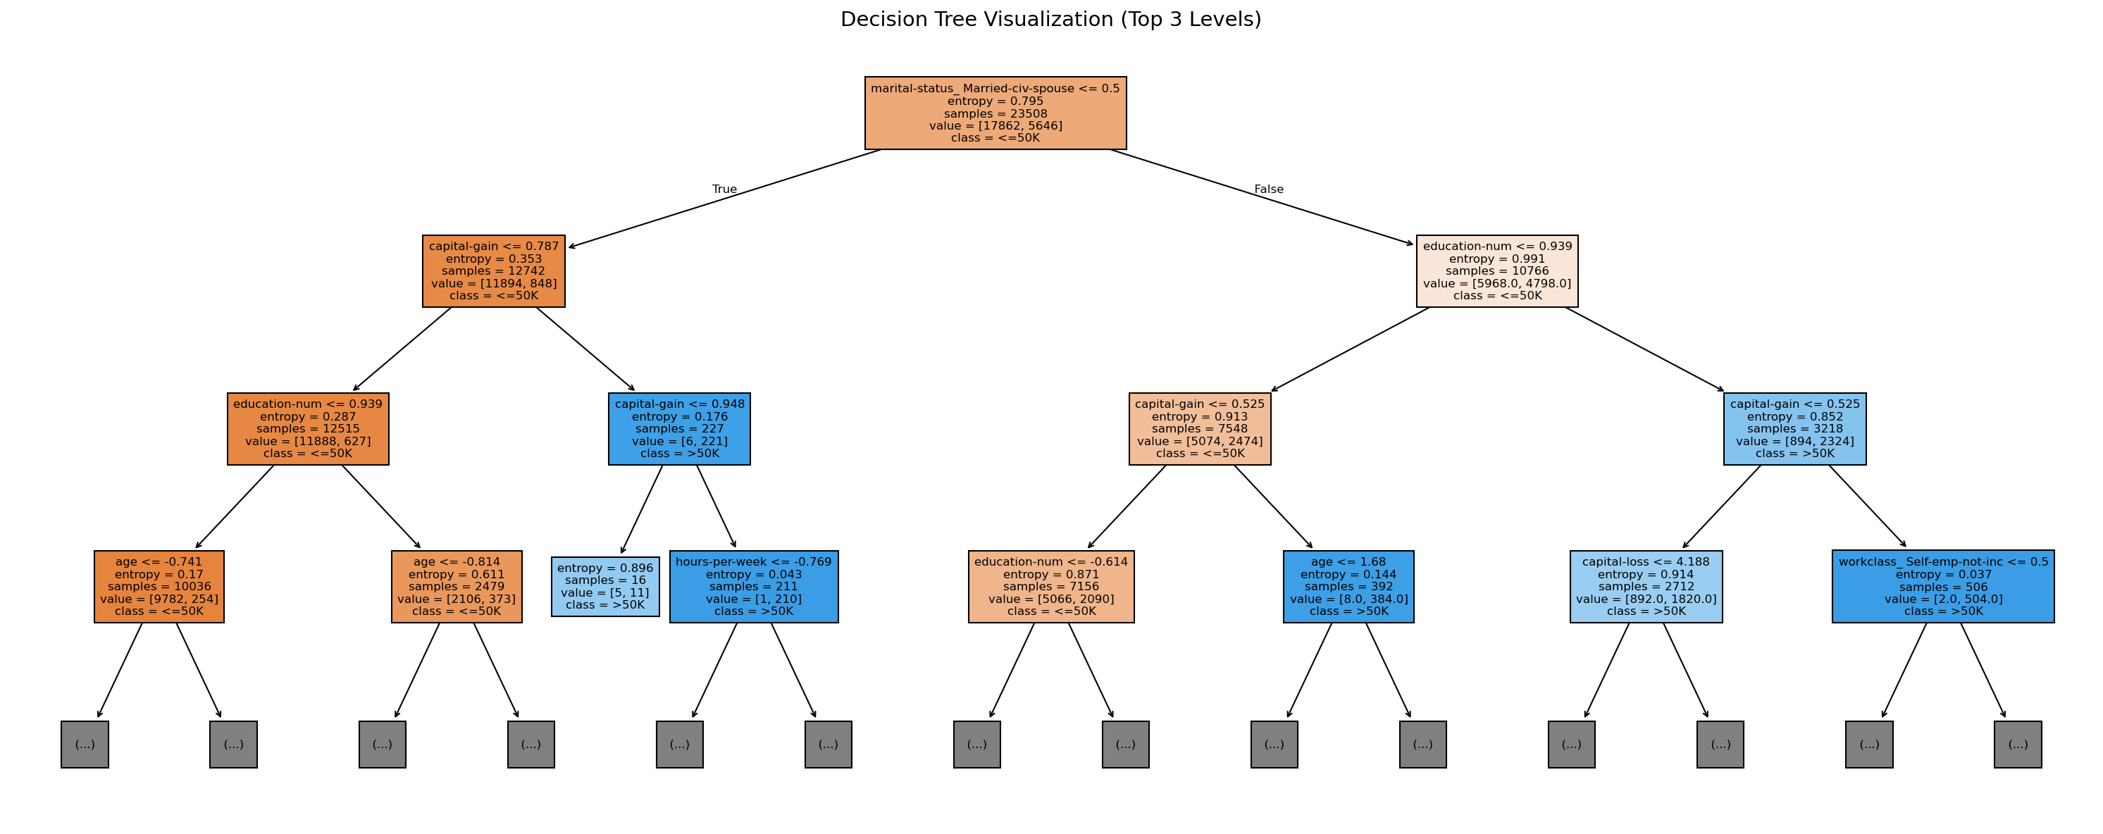

Slide 23
Performance Result
Logistic 80.96% 0.9062 0.6813
Regression
Decision 85.13% 0.8985 0.6436
Tree
KNN 84.38% 0.8870 0.6372
Random 85.89% 0.9093 0.6796 ← BEST
Forest
Model Accuracy ROC-AUC F1-Score

Slide 24
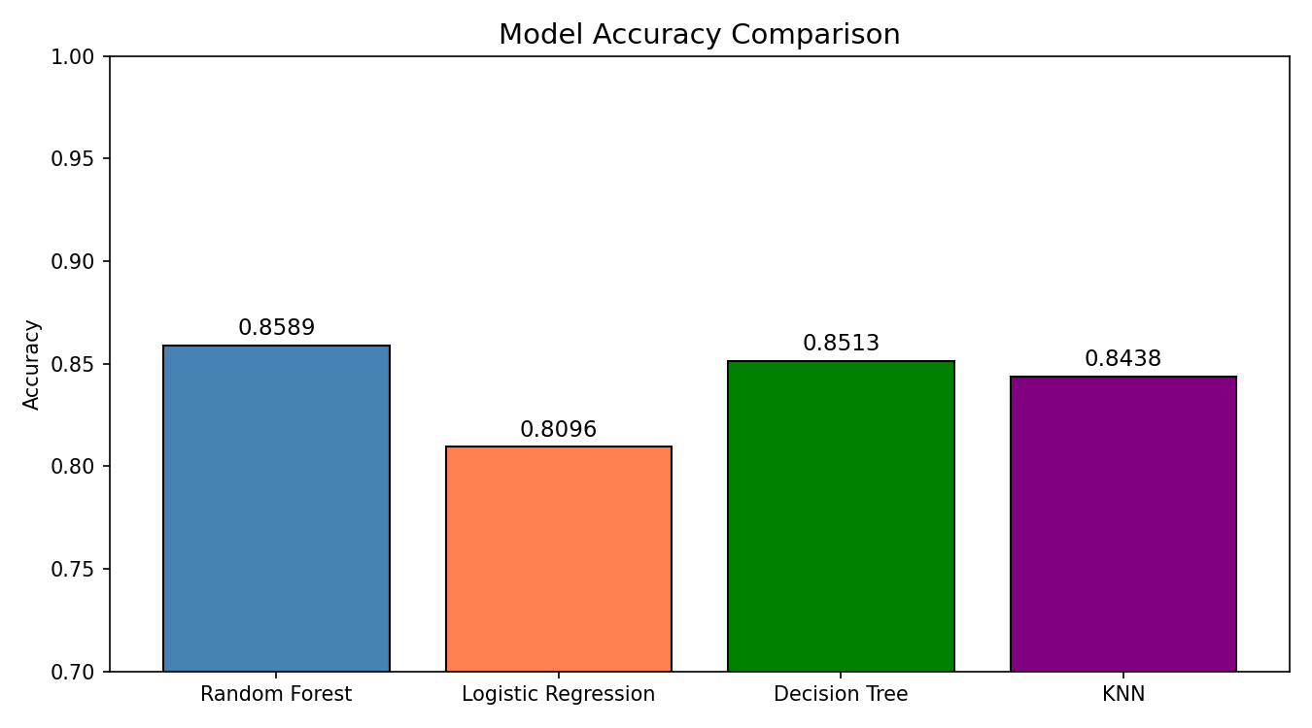

Slide 25
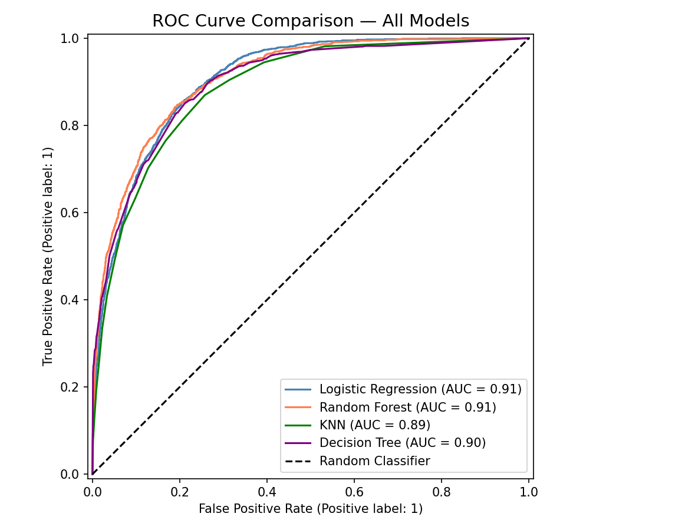
ROC Curve

Slide 26
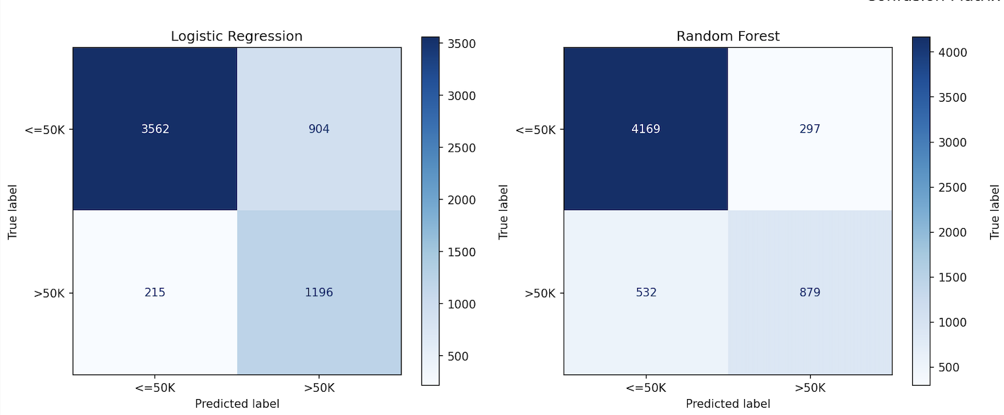
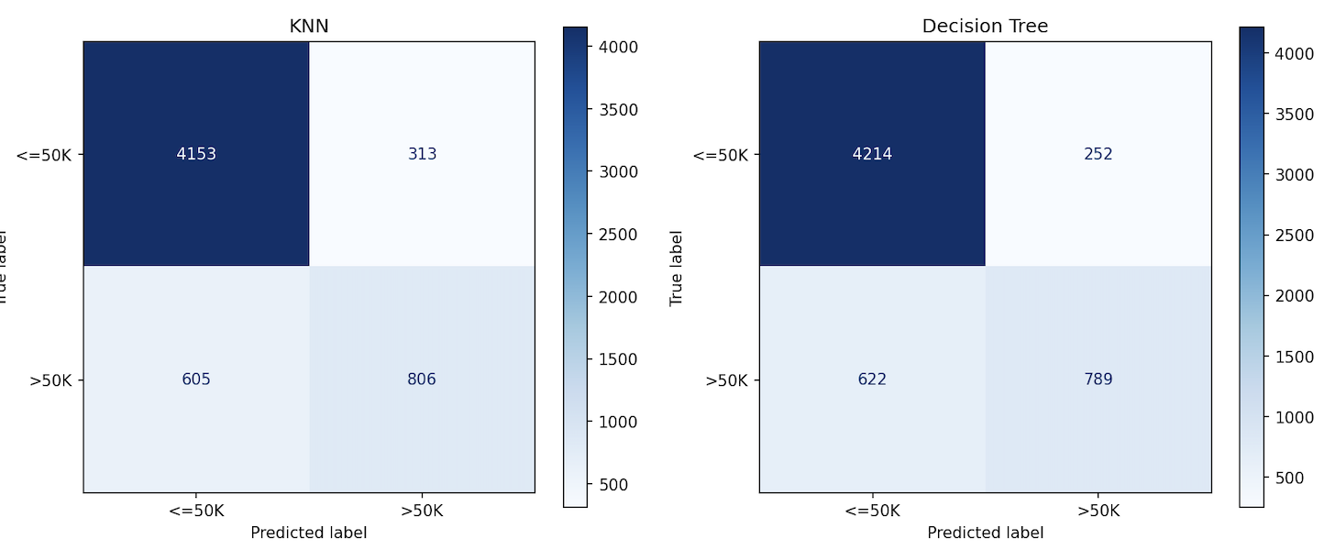
Confusion Matrices

Slide 27
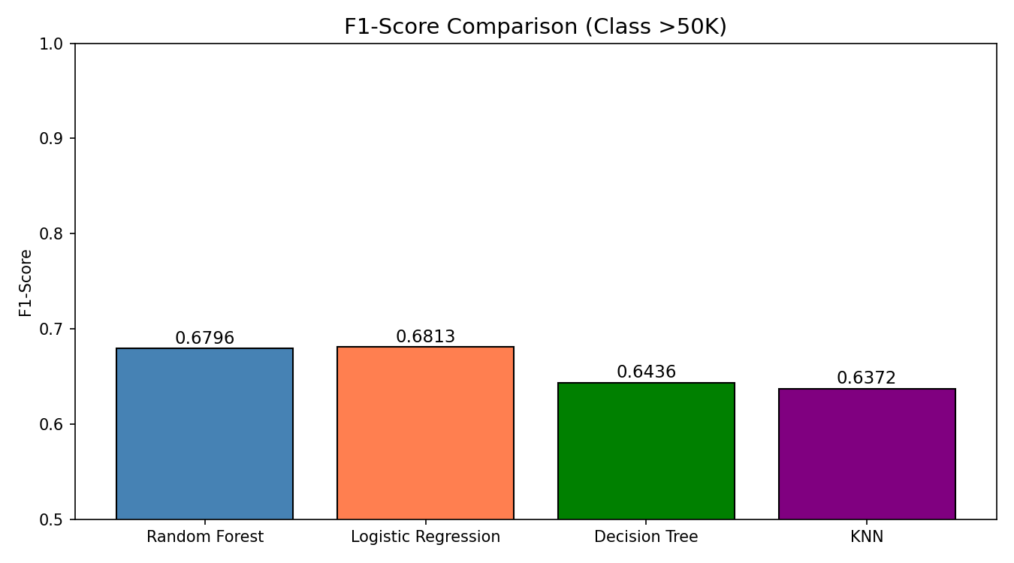

Slide 28

Precision vs Recall
“These plots illustrate the trade‑off between precision and recall and the confusion matrices for each model.
Logistic Regression focuses on recall, catching more >50K cases but with more false positives.
Decision Tree focuses on precision, being stricter in predicting >50K.
Random Forest achieves a good middle ground, reducing both false positives and false negatives. Looking at the confusion matrices side-by-side makes it clear how each model behaves differently on misclassifications.”

Slide 29
Runtime & Memory
“In terms of runtime and memory, all models used roughly 39 MB of peak memory, since the main cost is the shared preprocessing pipeline. For training time, Random Forest is the slowest at about 1.5 seconds, which is expected because it builds 100 trees. Logistic Regression and Decision Tree are much faster to train. For prediction time, Decision Tree is by far the fastest at around 0.006 seconds, followed by Logistic Regression and Random Forest. KNN is the slowest at prediction because it has to compute distances at inference time.”

Slide 30
Why Random Forest Has the Best Accuracy
1. Ensemble Learning (Wisdom of the Crowd)
Instead of relying on one decision tree, Random Forest builds 100+ trees and takes a majority vote — individual errors cancel out, overall accuracy improves.
2. Handles Mixed Data Well
The dataset has both numerical (age, hours-per-week) and categorical (occupation, education) features. Random Forest handles this natively without being sensitive to scale.
3. Reduces Overfitting (Bagging)
Each tree is trained on a random subset of data and features — this prevents any single tree from memorizing noise, unlike a plain Decision Tree (which hit only 85.13%).
4. Captures Non-Linear Relationships
Income isn't linearly related to features — e.g., capital-gain spikes matter more than a steady increase. Random Forest captures these complex splits that Logistic Regression misses (80.96%).
5. Class Imbalance Resilience
Our dataset is 75% <=50K, 25% >50K (imbalanced). Random Forest's voting mechanism naturally handles this better than KNN, which gets biased toward the majority class.

Slide 31
Conclusion & & Future Work
“To conclude, we successfully built an end‑to‑end ML pipeline on the Adult Income dataset, from EDA and preprocessing to four different models and a final comparative evaluation. Our experiments show that Random Forest offers the best balance between predictive performance and robustness, while Logistic Regression is a strong alternative when high recall is needed, and Decision Tree is ideal when extremely fast predictions and interpretability are required. For future work, we could explore techniques like SMOTE or class‑weighted ensembles to handle the class imbalance even better, try Gradient Boosting models such as XGBoost, and perform more advanced feature engineering. Thank you for listening — we’re happy to answer any questions.”

