Slide 1
Laser Beam Analysis, Propagation, and Shaping Techniques
J. R. Leger
Department of Electrical and Computer Engineering
University of Minnesota
Minneapolis, Minnesota

Slide 2
Outline
Basic laser beam propagation
  Hermite-Gaussian beam propagation
  Talbot effects and non-diffracting beams
  Optical vortices and orbital angular momentum
Characterization and measurement
  Strehl ratio
  M²
  Power in the bucket
Beam concentration and fiber coupling
  Coherent
  Incoherent
External cavity beam shaping techniques
  Phase modulation techniques
  Polarization modulation techniques
Intracavity beam shaping techniques

Slide 3
Characteristics of Laser Radiation
Temporal coherence (spectral width)
Spatial coherence
  HeNe laser (high coherence)
  Lithographic excimer laser (low coherence)
Wavefront shape
Beam intensity profile
Polarization
  Space-invariant (e.g. linear, circular)
  Space-variant (e.g. cylindrical)
y
y
E(x₁,y₁,z₁,t₁)
x
E(x₁,y₁,z₁, t₂)
x
t
Temporal coherence <E(x₁,y₁,z₁, t₁) E*(x₁,y₁,z₁,t₂)>
y
E(x₂,y₂,z₂,t₁)
x
E(x₁,y₁,z₁,t₁)
Spatial coherence <E(x₁,y₁,z₁,t₁) E*(x₂,y₂,z₂,t₁)>

Slide 4
Laser Beams from Stable Spherical Resonators
- Fundamental Mode -
φ(x)
I(x)
1
Laser resonator modes
Intensity
x
Phase
x
E Field:
Beam width:
Beam curvature:
Rayleigh range:

Slide 5
Physical Interpretation of Rayleigh Range
ROC
I(r)
I(r)
-z_{R}
2z_{R}
r
r
z_{R}
z
- 2z_{R}
z_{R}
Distance from waist where beam width increases by √2
Distance from waist where ROC is minimum
Half the value of minimum ROC (ROC_{min} = 2z_{R})
Boundary between “plane-wave-like” behavior (near-field) and “spherical-wave-like” behavior (far-field)

Slide 6
Propagation Limits of Gaussian Beams
Line of constant
θ_{beam}
z = z_{R} z = 0 z = z_{R}
Far Field
Near Field
Far Field
Near-field limit (z << z_{R})
Far-field limit (z >> z_{R})
In far-field limit,
Plane-wave like
Spherical-wave like
Fixed divergence angle

Slide 7
Imaging Effects of Lenses on Gaussian Beams
“Image” formed at s" = f
Gaussian beam at
∞
s = ∞
Spherical wave with ROC = ∞
f
(point source limit)
Approx. planar wavefront
Gaussian beam at
“Image” formed at s" = f
s = f
(plane wave limit)
f
f
“Object” and “image” are beam waists
Image is formed at back focal plane in both of the above cases!

Slide 8
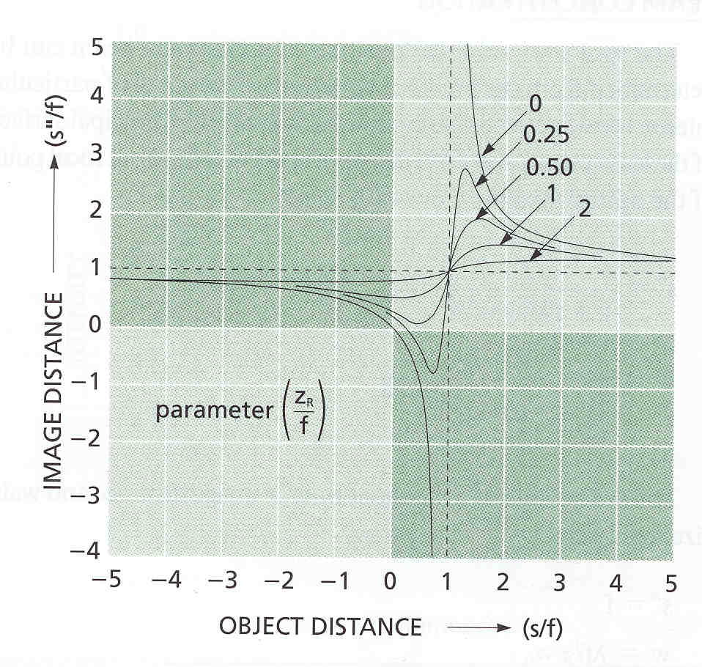
Propagation of Gaussian Beams Through Lenses
S. A. Self, Appl. Opt.
22, 658 (1983)
s
s"
Point source imaging:
Gaussian beam imaging:
For z_{R}/f << 1, Gaussian behaves like a spherical wave ⇒ point source imaging
For z_{R}/f >> 1, Gaussian behaves like a plane wave ⇒ waist at focal point
  There is a minimum and maximum image distance
  The maximum image distance occurs when object is at f + z_{R} (not f)

Slide 9
Magnification Equation for Beam Waist
Lens focal
length = f
Waist Magnification Equation
Example: Waist at a focal point
Let s = f
ω
"
f
or
=
0
=
m
ω
0
z
R

Slide 10
“Unusual” Effects of Gaussian Beam Imaging
- Waist in front focal plane -
Gaussian beam imaging equation
f
f
If object waist is in front focal plane, s/f = 1
Beam waist is in back focal plane regardless of Rayleigh range or beam waist size

Slide 11
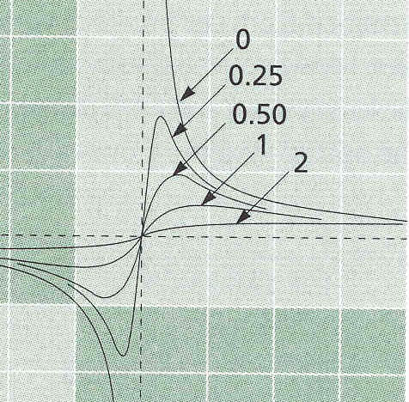
“Unusual” Effects of Imaging Gaussian Beams
- Focal Length Shortening -
S"/f
3
Image distance
is a function
of Z_{R}
Z_{R}/f
Image distance (s"/f) is reduced as z_{R}/f increases ⇒ Lens focal length appears shorter
2
•
•
•
•
1
•
Fixed object
distance
0
S/f
0 1 2 3 4
S. A. Self, Appl. Opt., 22, 658 (1983)
ω₀’’
ω₀
Physical interpretation: The curvature of the Gaussian beam is less than for a spherical wave and so the lens can focus the image closer
2f
f
f
2f
Point source
ROC
Gaussian
Beam ROC
Image Shift

Slide 12
“Unusual” Effects of Imaging Gaussian Beams
- Power Concentration at Fixed Distance -
Waist 2
Waist 1
ω₀
Target
Z = 0
Z = L
Problem: Choose a lens focal length to maximize intensity on a target at a fixed
distance L
If lens is chosen to place waist at z = L (waist 1), intensity is not maximized
at target
If lens focal length is chosen as L, waist forms before target (waist 2), but
intensity at target is maximized

Slide 13
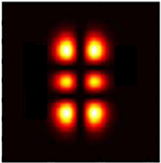
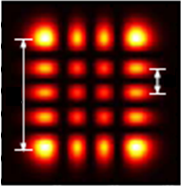
Higher-order Gaussian Modes
- Spherical Stable Resonator: Rectangular Coordinates -
a
a
A
a
A
A
TEM_{1,2} mode TEM_{3,4} mode
H_{l} = Hermite polynomial or order l, Φ_{g} = Gouy phase shift
Hermite Gaussians preserve their shape upon propagation
“Width” of higher-order TEM_{m} mode ≈ A ~
“Divergence” of higher-order TEM_{m} mode ≈ (λ/a) ~

Slide 14
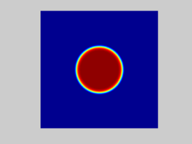
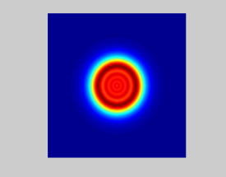
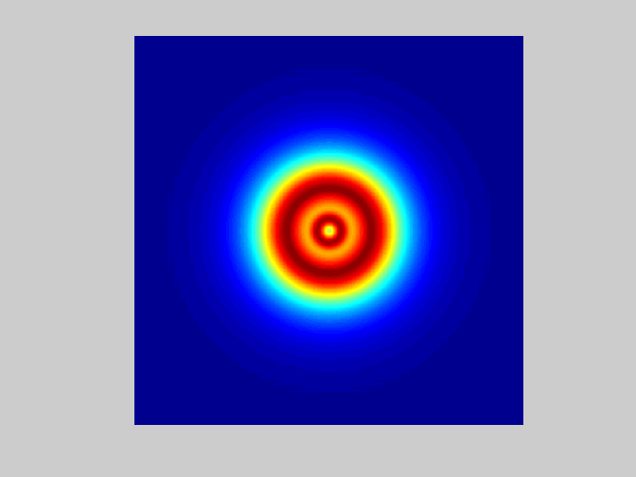
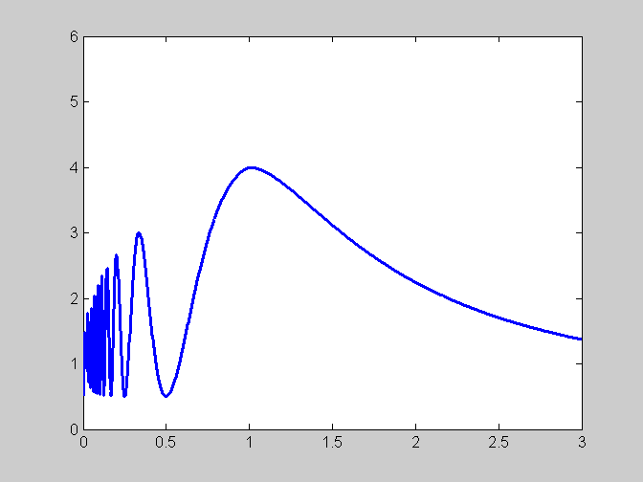
Propagation of “Top Hat” Distribution
Top hat distribution
A(x,y)
Free space propagation
y
x
Top-hat Intermediate plane Poisson spot
On-axis intensity from circular aperture of radius R
Top hat has complex diffraction pattern
Poisson spots are generated at z = R²/Nλ,
N = odd integer
Beam relay optics are required to preserve
top-hat shape
On-axis Intensity (a.u)
Z / (R² / λ)

Slide 15
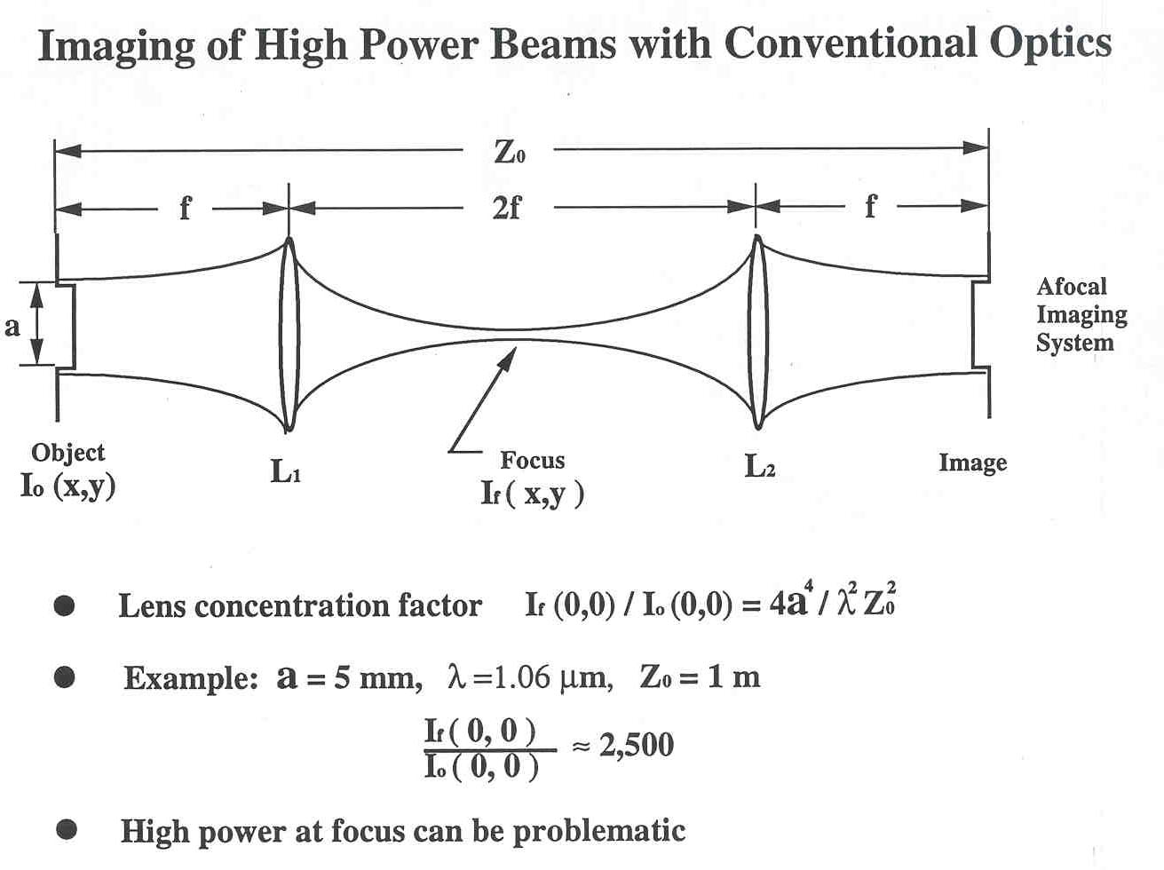
Relaying Non-Gaussian Beams with Afocal Optics
Z_{l}
Afocal optics preserve beam intensity and phase
Lens concentration factor I_{f}(0,0) / I₀(0,0) = 4a⁴ / (λ² Z_{l}²)
High power at focus can require vacuum to prevent air breakdown

Slide 16
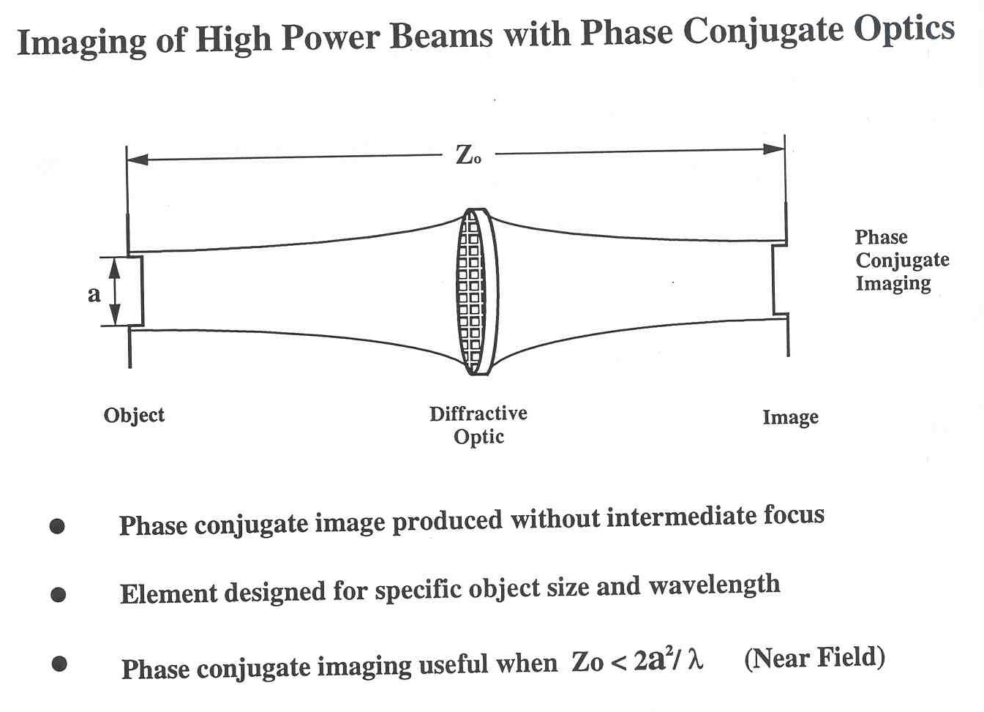
Z_{l}
S. Makki, Z. Wang, and J. Leger, App. Opt. 36, 4749 (1997).
Phase conjugate image produced without intermediate focus
Element designed for specific object size and wavelength
Phase conjugate image useful when Z_{l} < 2a²/ λ

Slide 17
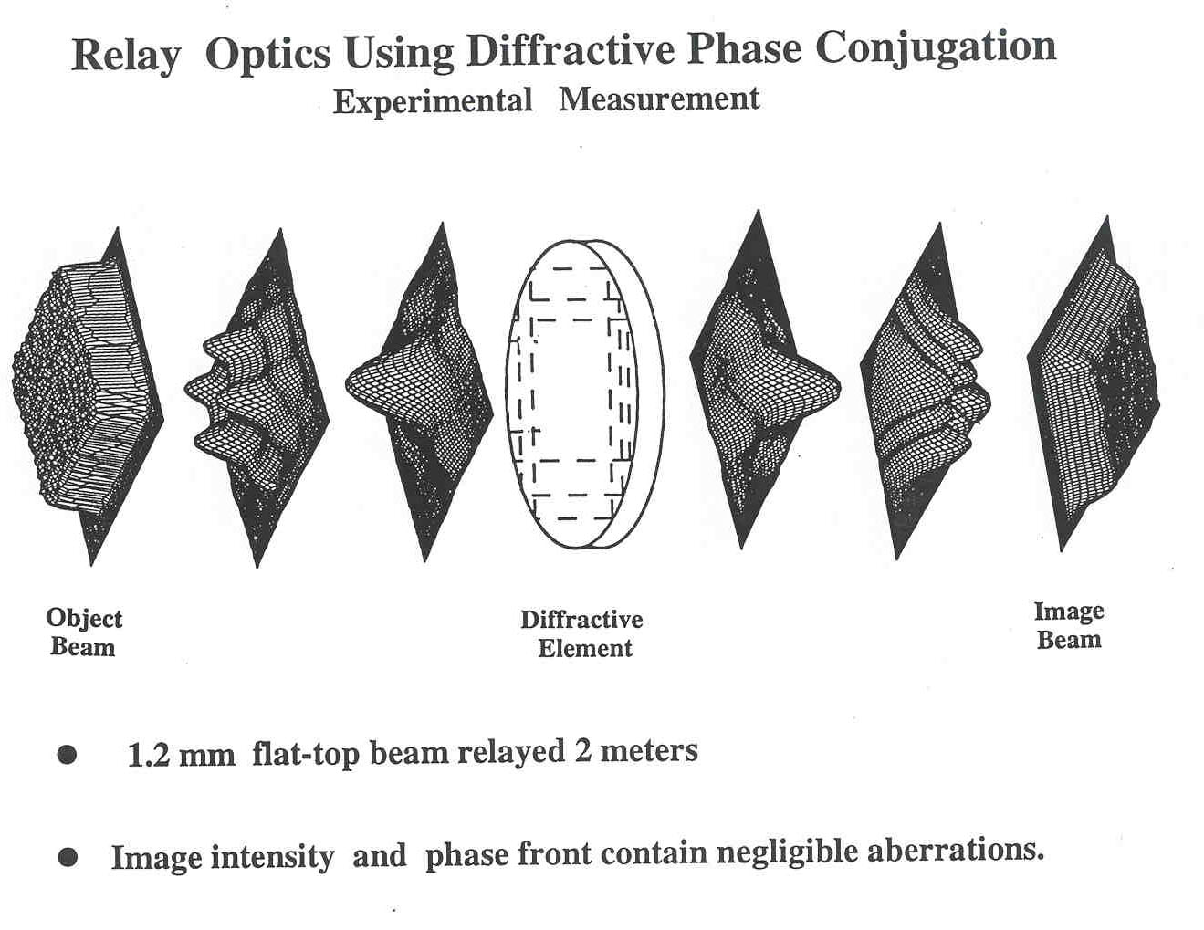
S. Makki, Z. Wang, and J. Leger, App. Opt. 36, 4749 (1997).

Slide 18
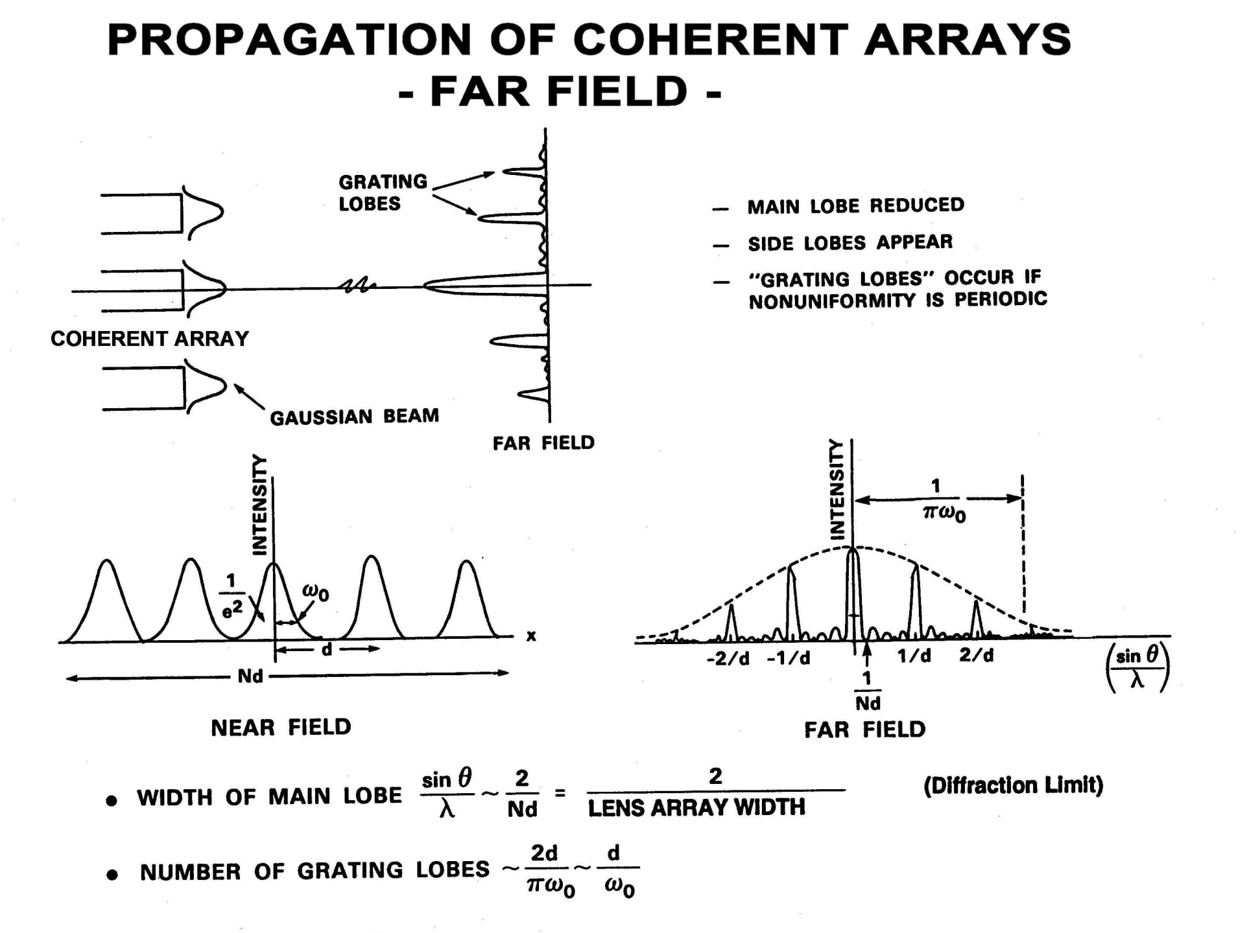
Propagation of Coherent Arrays
- Far Field -

Slide 19
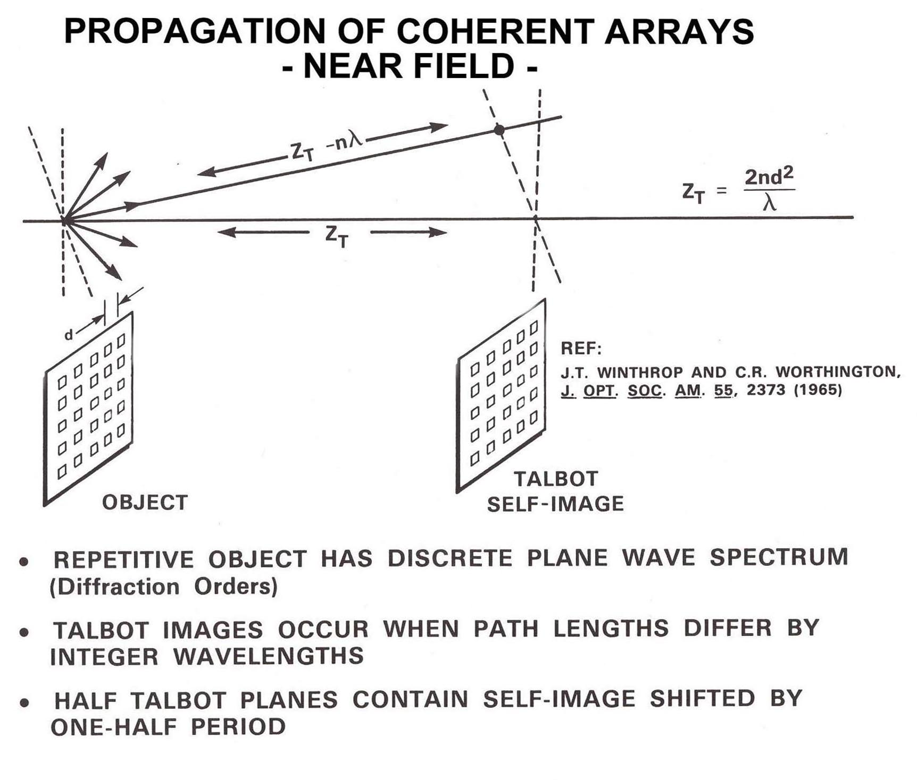
Propagation of Coherent Arrays
- Near Field -
Repetitive object has discrete plane wave spectrum (diffraction orders)
Talbot images occur when path lengths differ by integer wavelengths
Half Talbot planes contain self-image shifted by one-half period
Fractional Talbot planes contain multiple copies of original object

Slide 20
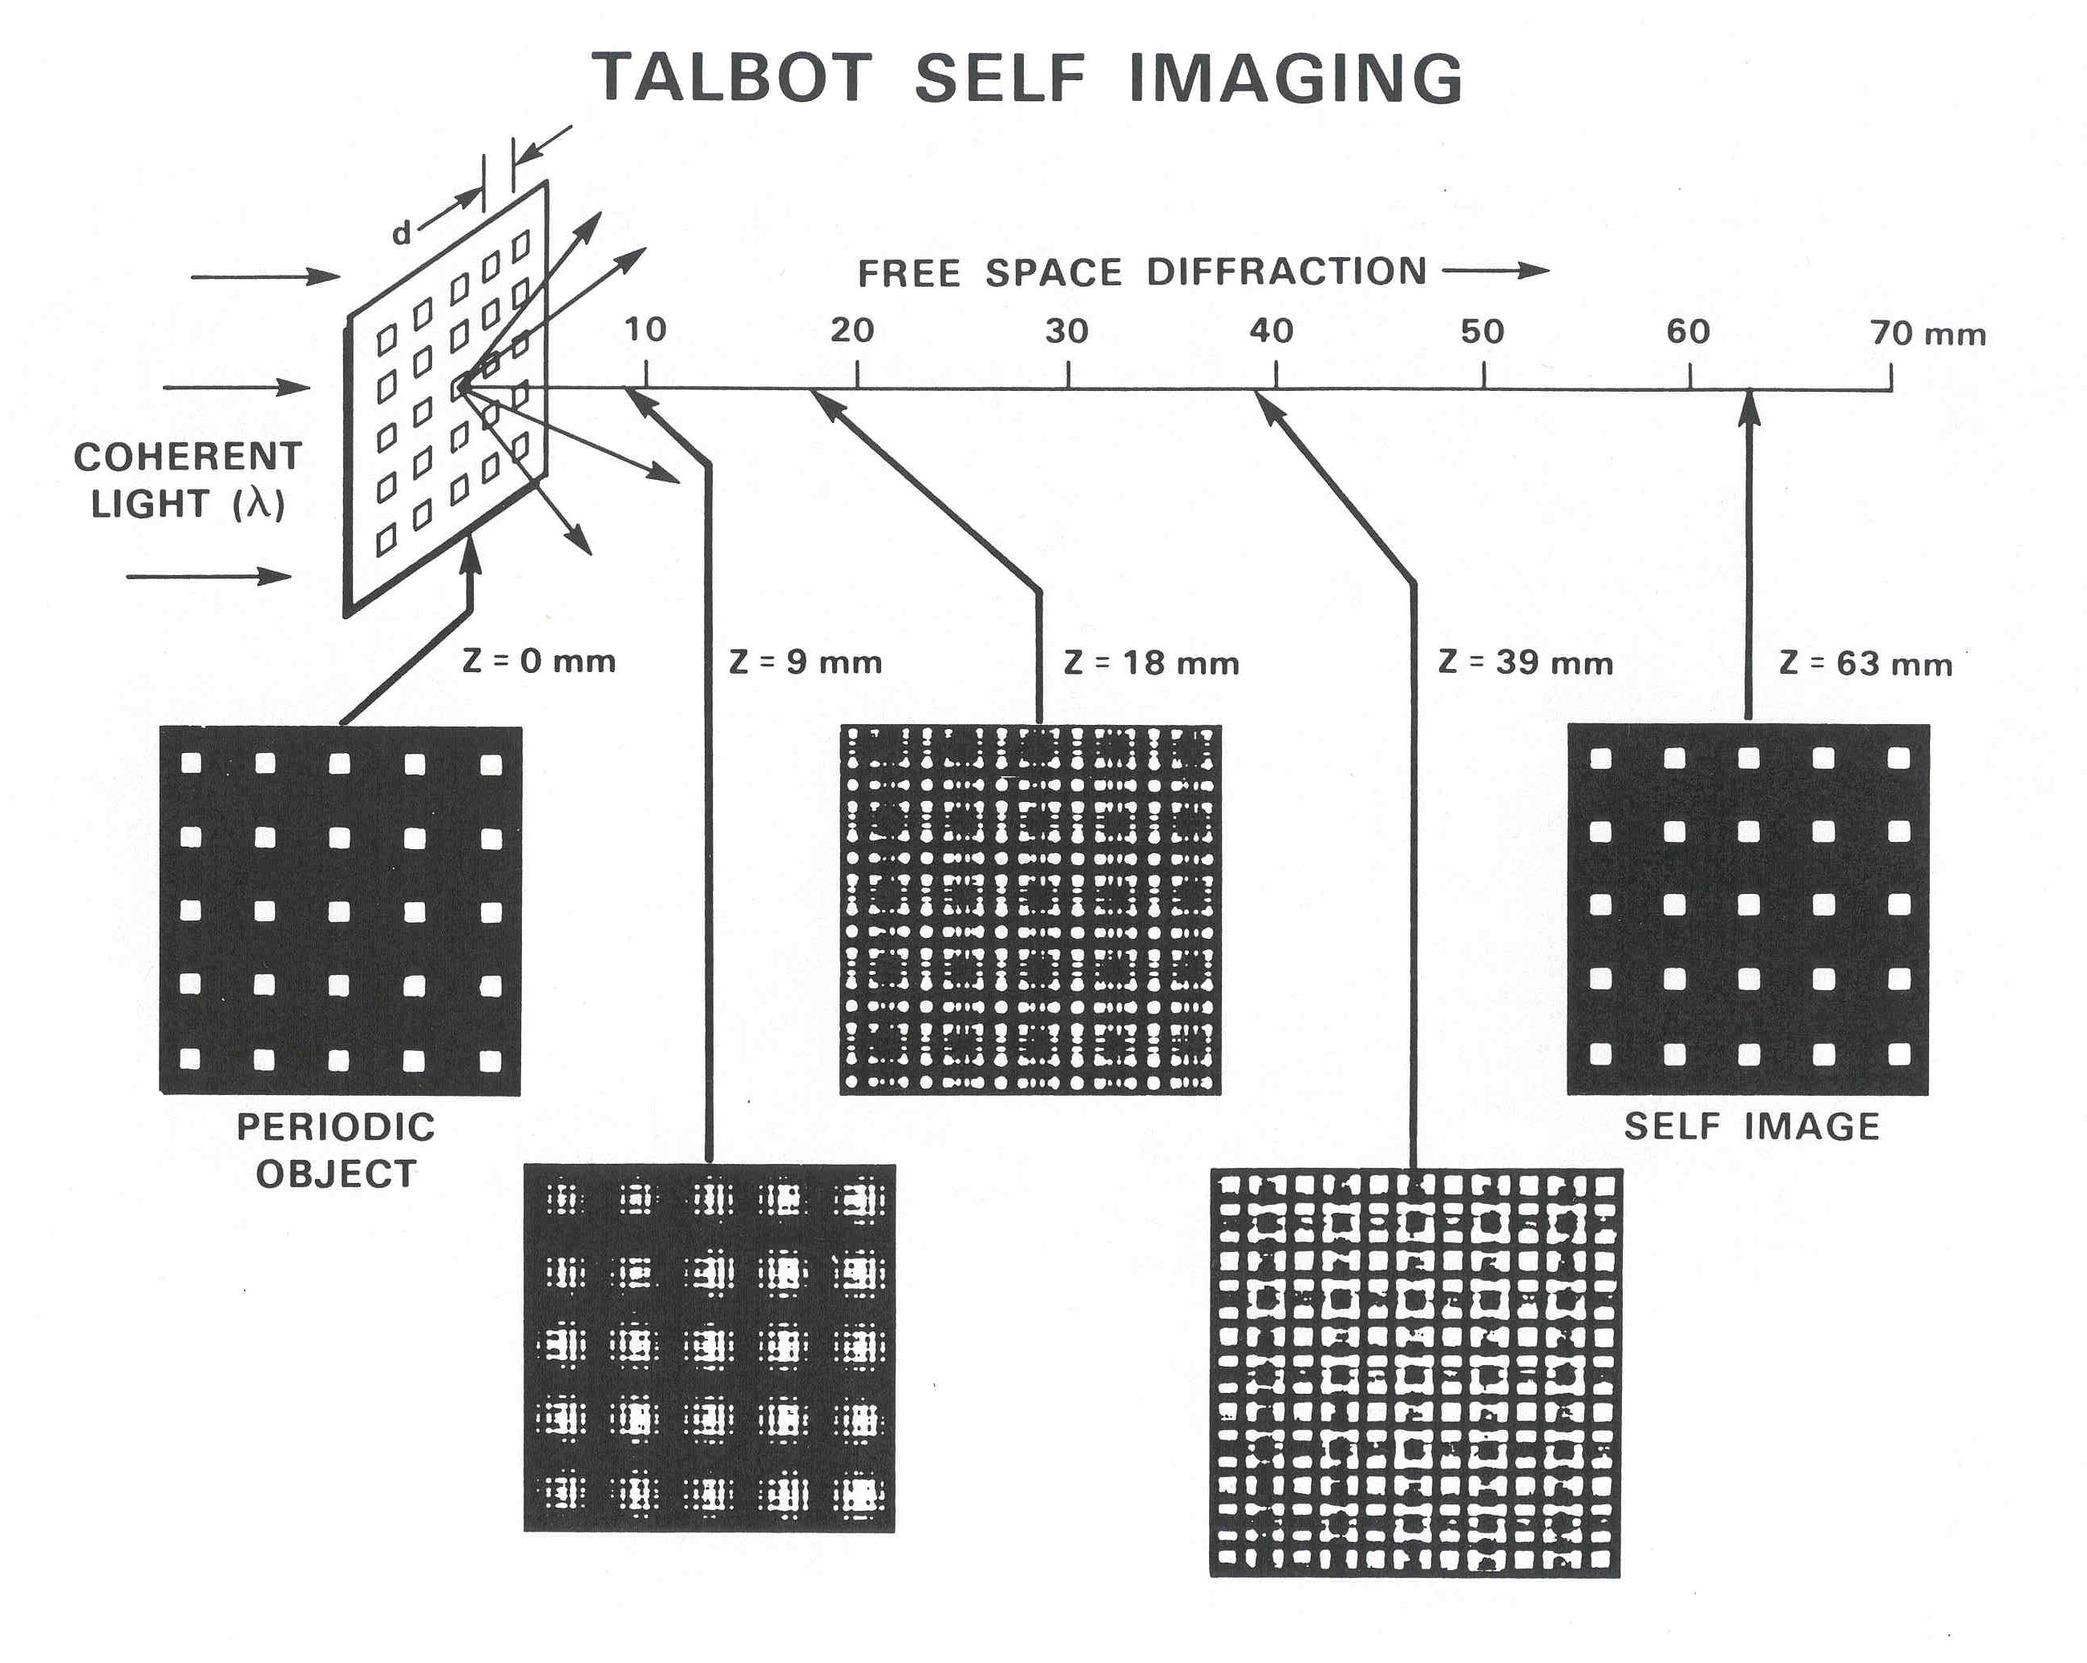

Slide 21
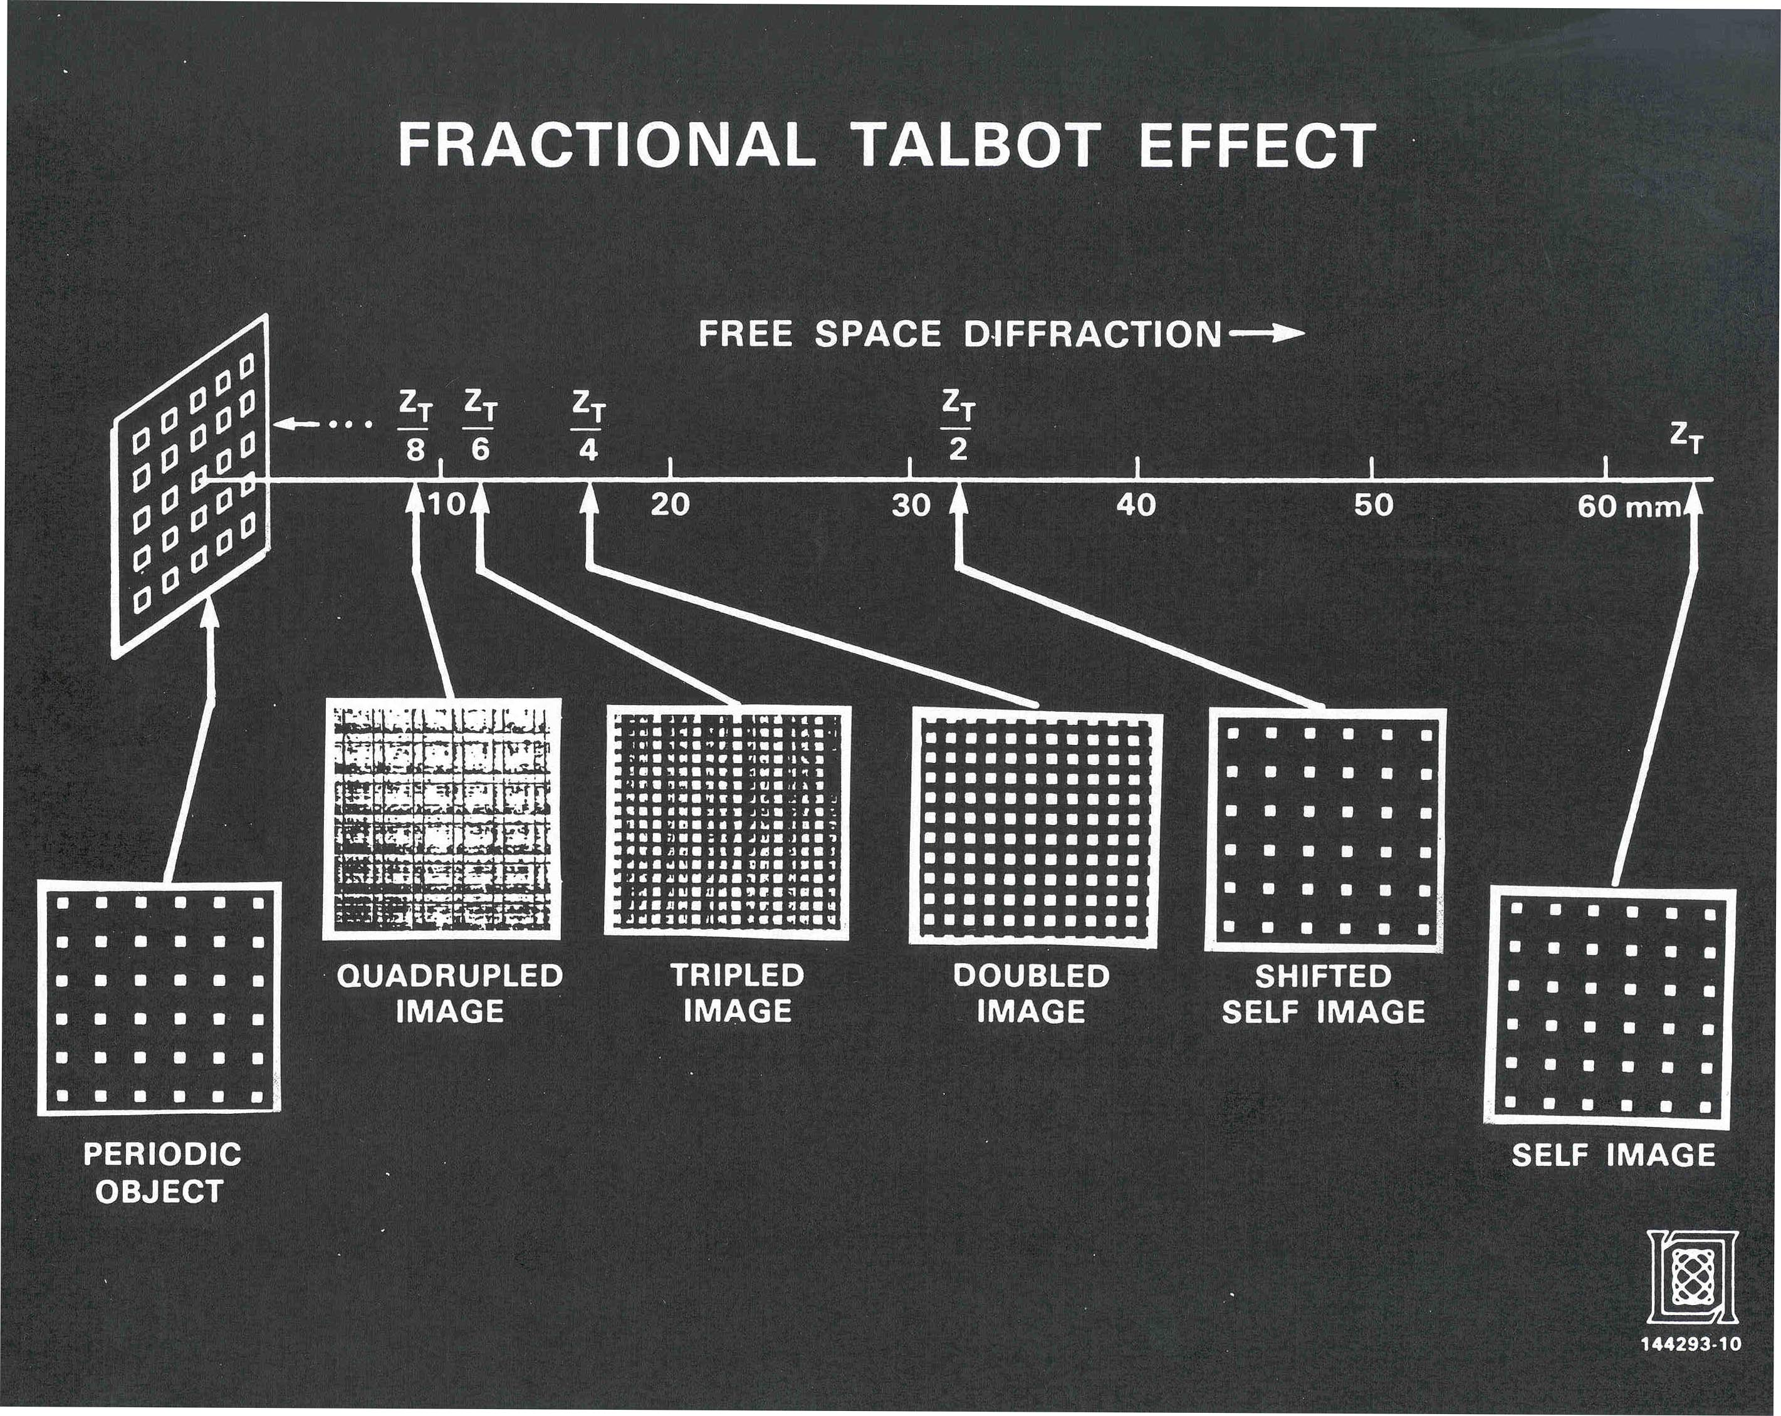

Slide 22
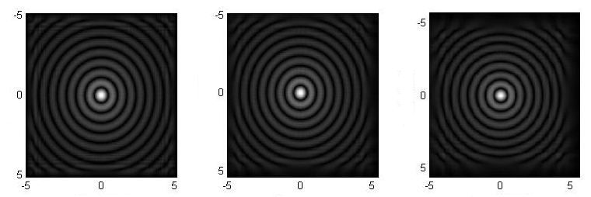
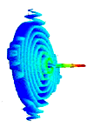
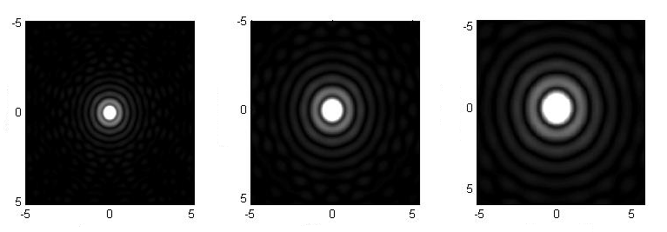
Non-Diffracting Beams
- Bessel Beams-
Bessel Beam
y (mm)
z
Z = 200 mm
Z = 300 mm
Z = 500 mm
x (mm)
x (mm)
x (mm)
Near field
Angular plane wave spectrum
y (mm)
Circular Aperture
Bessel Beam Properties
Z = 200 mm
Z = 300 mm
Z = 500 mm
x (mm)
x (mm)
x (mm)
Diffraction pattern at several propagation distances
J₀ Bessel function consists of a hollow cone of plane waves traveling at a constant angle from the z-axis. Thus, all plane waves suffer the same phase delay independent of propagation length and reproduce the same Bessel function everywhere (non diffracting)
Bessel beams can repair central core after it is blocked (self-healing)
An axicon is a convenient method of producing an approximate J₀ distribution

Slide 23
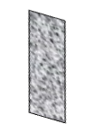
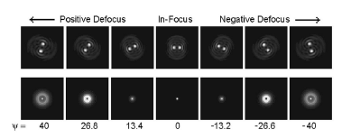
Designing Fields that Evolve with Propagation
Custom Diffractive Element
Circular Aperture
Intensity in focal region as a function of propagation distance
Adam Greengard, Yoav Y. Schechner, and Rafael Piestun, Opt. Lett. 31, 181-183 (2006).
Free-space diffraction through a focal point changes the shape of a light field.
By proper choice of the initial distribution, the propagating field can be designed to change in a specified manner.
Rotating beam can be formed from a linear superposition of five Gauss-Laguerre beams.

Slide 24
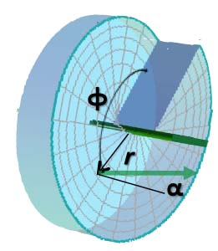
Beams with Circularly Varying Phase and Polarization
Circularly polarized plane wave (Space invariant)
Optical Vortex Beam (Space-variant phase)
Cylindrical vector beam (Space-variant polarization)
Circularly polarized light is space-invariant and contains spin angular momentum of ± ħ (where ħ = Planck’s constant)
An optical vortex beam contains a space-variant phase and an orbital angular momentum of ± mħ, where m is the topological charge
A cylindrical vector beam contains a space-variant polarization

Slide 25
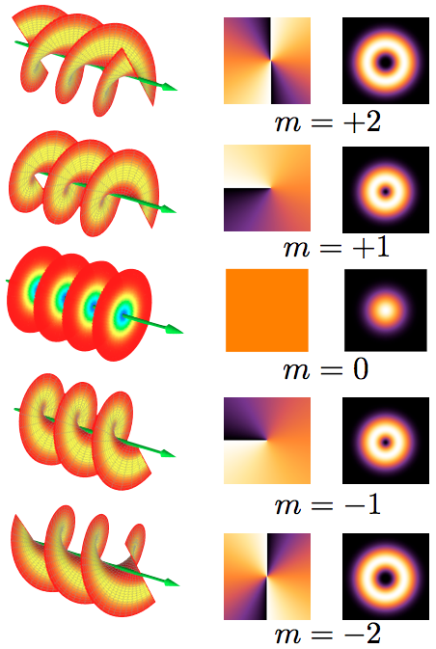
Optical Vortex Beams
Beam contains spiral phase component
Number of 2π rotations in phase is called the topological charge “m”
Beams with charge m ≠ 0 must have a null in the center
Applications
  Optical tweezers
  Imaging
  Telecom
  Applying angular torque to microsystems
Wavefront Phase Intensity
Shape
Optical Vortex Beams
Art by E-karimi

Slide 26
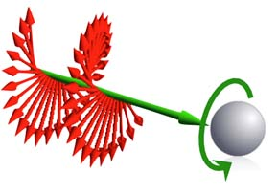
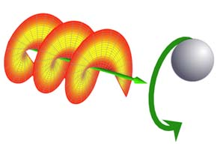
Optical Angular Momentum Producing Torque on a Particle
Circularly polarized light
Optical vortex beam
Spin angular momentum
Orbital angular momentum
If light is absorbed by matter, the angular momentum is transferred to the matter resulting in a torque
Spin angular momentum is transferred around the axis of the particle. For transparent particles, birefringence is required.
Orbital angular momentum is transferred around the optical axis of the light
Art from Wikipedia “Angular momentum of light”

Slide 27
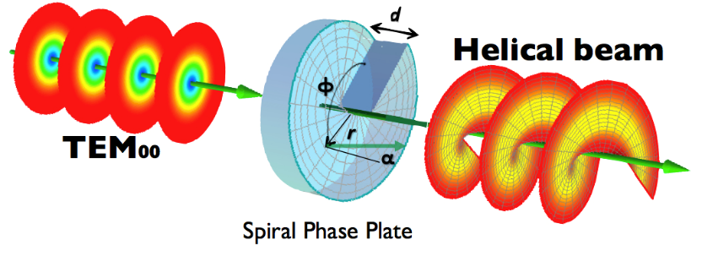
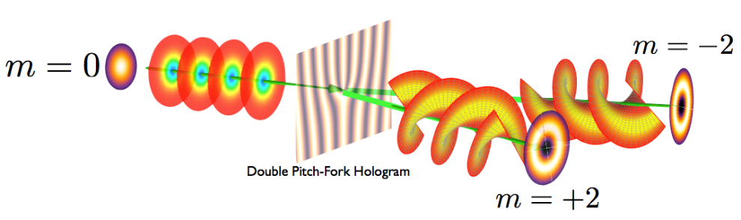
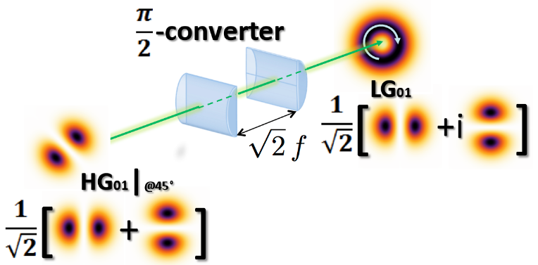
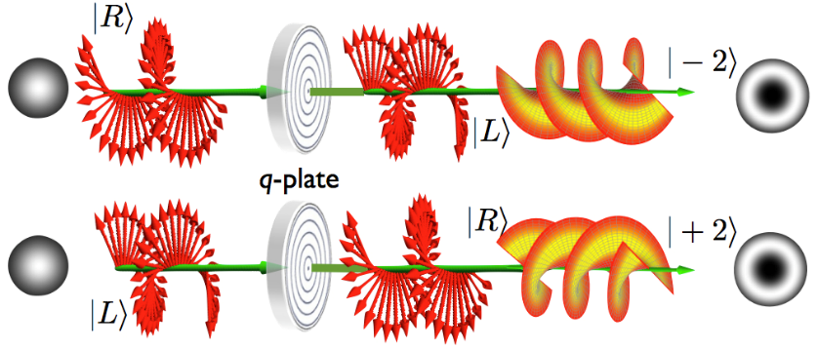
Generation of Optical Vortex Beams
Spiral phase plate Computer-generated hologram
Cylindrical mode converter Q-plate
Art from Wikipedia “Angular momentum of light”

Slide 28
Cylindrical Vector Beams
φ₀
Radial
Azimuthal
Generalized cylindrical
K.S. Youngworth and T.G. Brown, Opt. Exp. 7, 77 (2000).
Solutions of Maxwell’s equations which obey cylindrical symmetry both in amplitude and polarization
Polarization can affect light distribution at focal point of high-NA lens

Slide 29
Diffraction from Space-Variant Polarized Light
- Richards and Wolf Vector Diffraction Theory -
Vertical polarization state Horizontal polarization state
Angular plane wave spectrum computed for each polarization state
Final field consists of adding polarizations vectorially
Large angular tilts can give rise to polarization modification

Slide 30
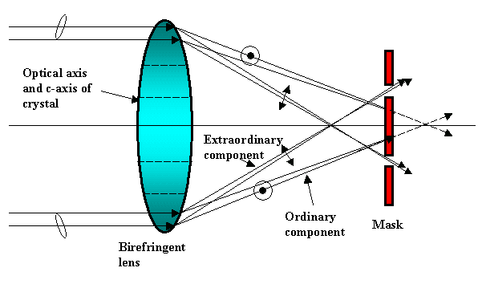
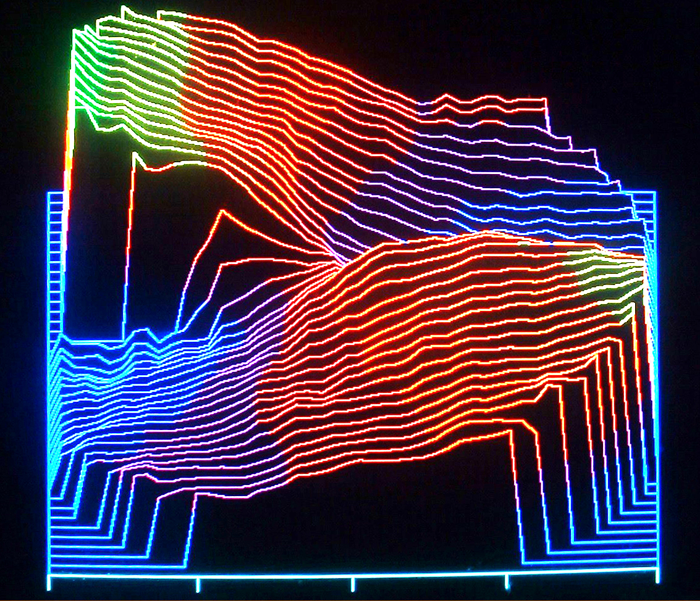
Generation of Cylindrical Vector Beams
Circularly polarized light
λ/2 plate
λ/2 plate
φ₀
C-axis of crystal
Final polarization state
Δφ
Birefringent lens Mask Pure polarization rotation
Q. Zhan and J. Leger, Optics Comm.
213, 241-245 (2002).
Q. Zhan and J. Leger, Applied Optics 41, 4630-4637 (2002).
Measured spiral phase
Birefringent lens with stop acts as a radially symmetric analyzer
Double half-wave plates rotate linear polarization independent of incident polarization angle
Resulting light is radially polarized but contains unwanted spiral phase
Spiral phase can be removed with a spiral phase element

Slide 31
Measurement of Beam Characteristics

Slide 32
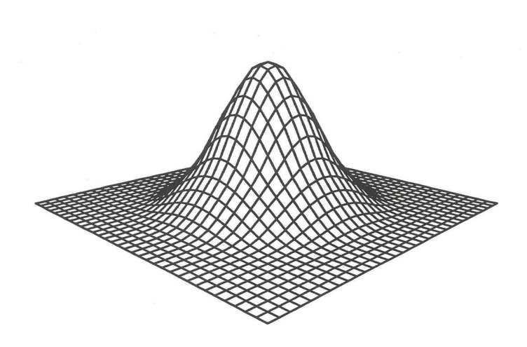
Problems with Simple Intensity Measurement
“Non-Gaussian” Beam
A. Siegman, OSA Annual Meeting, Long Beach, CA (1997)
In single plane, mode looks like fundamental Gaussian (actual )
Above distribution will propagate very differently than Gaussian
“Divergence” will be greater than Gaussian

Slide 33
Direct Measurement of Intensity and Phase
- Fully coherent beam -
Intensity measurement I(x,y)
  CCD camera
  Photodetector array
  Scanning slit
  Scanning knife edge
  Scanning point detector
Phase measurement Φ(x,y)
  Self-referencing Mach-Zehnner
  interferometer
  Shearing interferometers
  (lateral or radial)
  Shack-Hartman wavefront sensor
Measured field:
Propagated field:

Slide 34
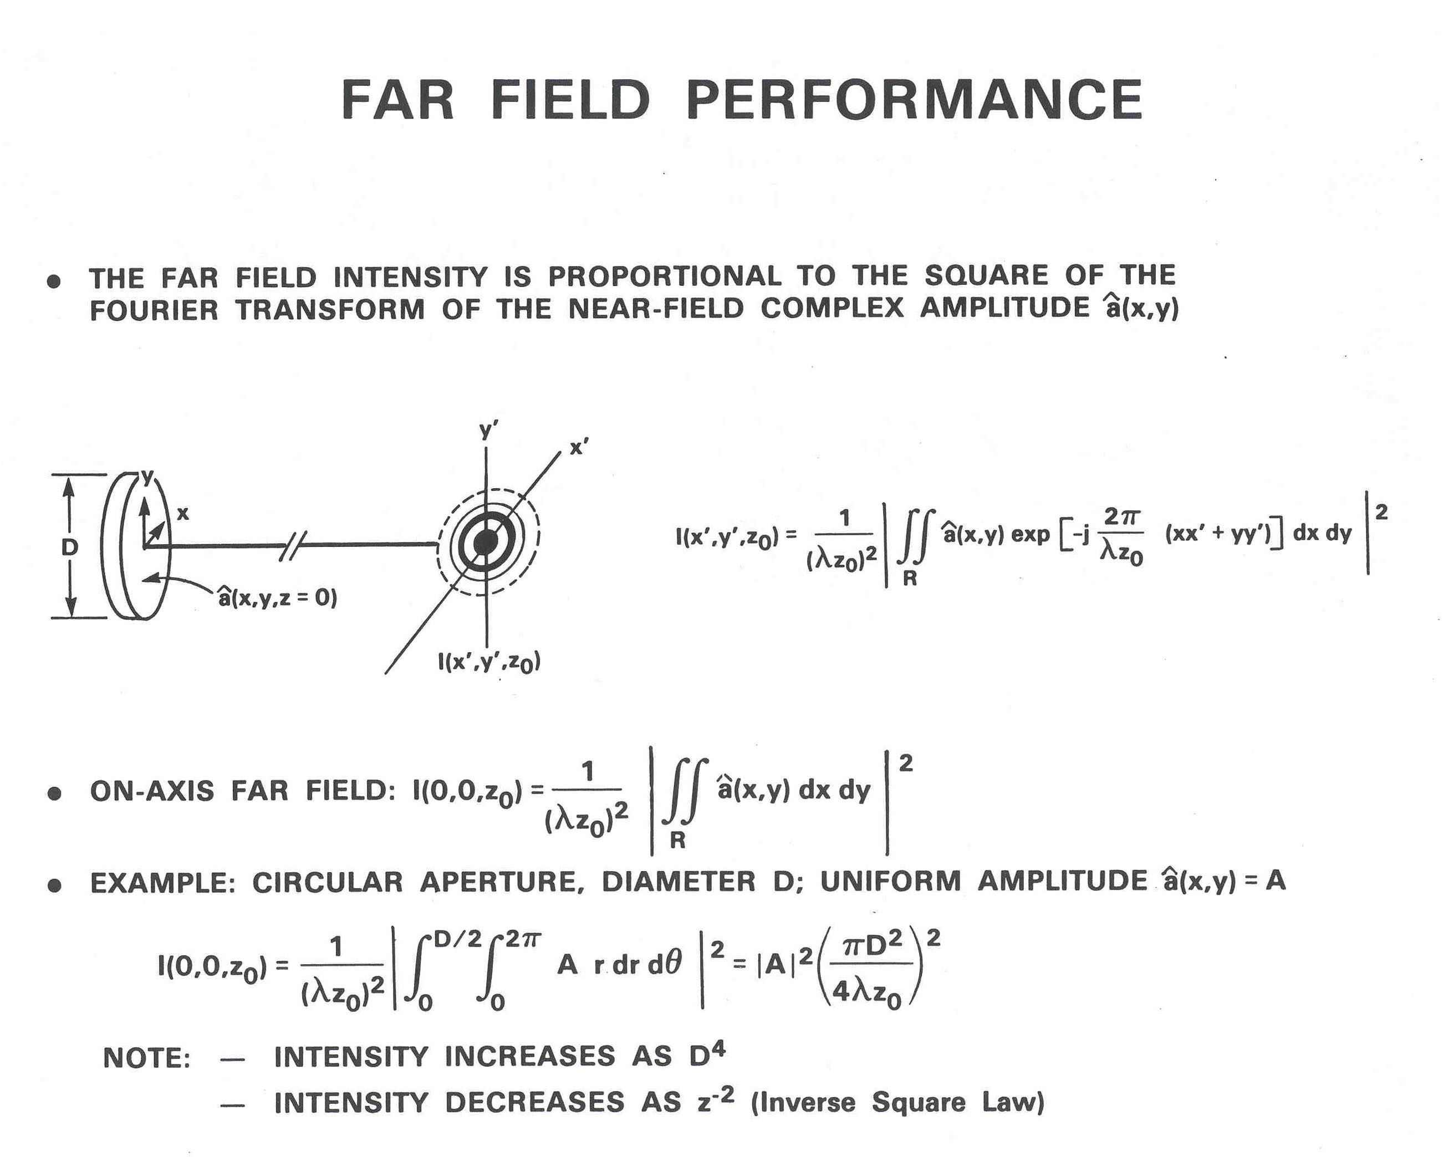

Slide 35
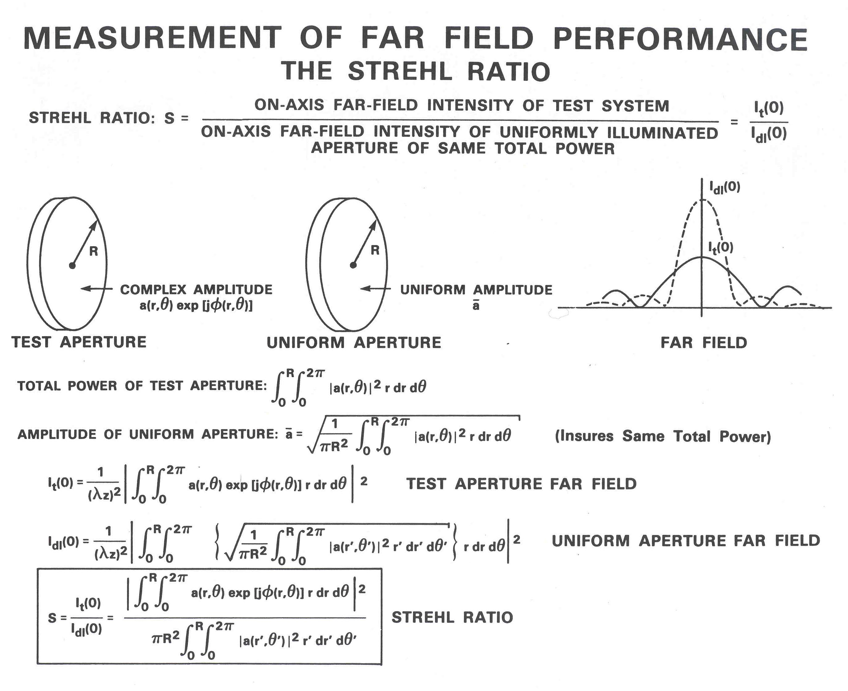
*
* Note: Strehl ratio denominator is often defined as the on-axis far-field intensity from a test distribution with uniform phase.

Slide 36
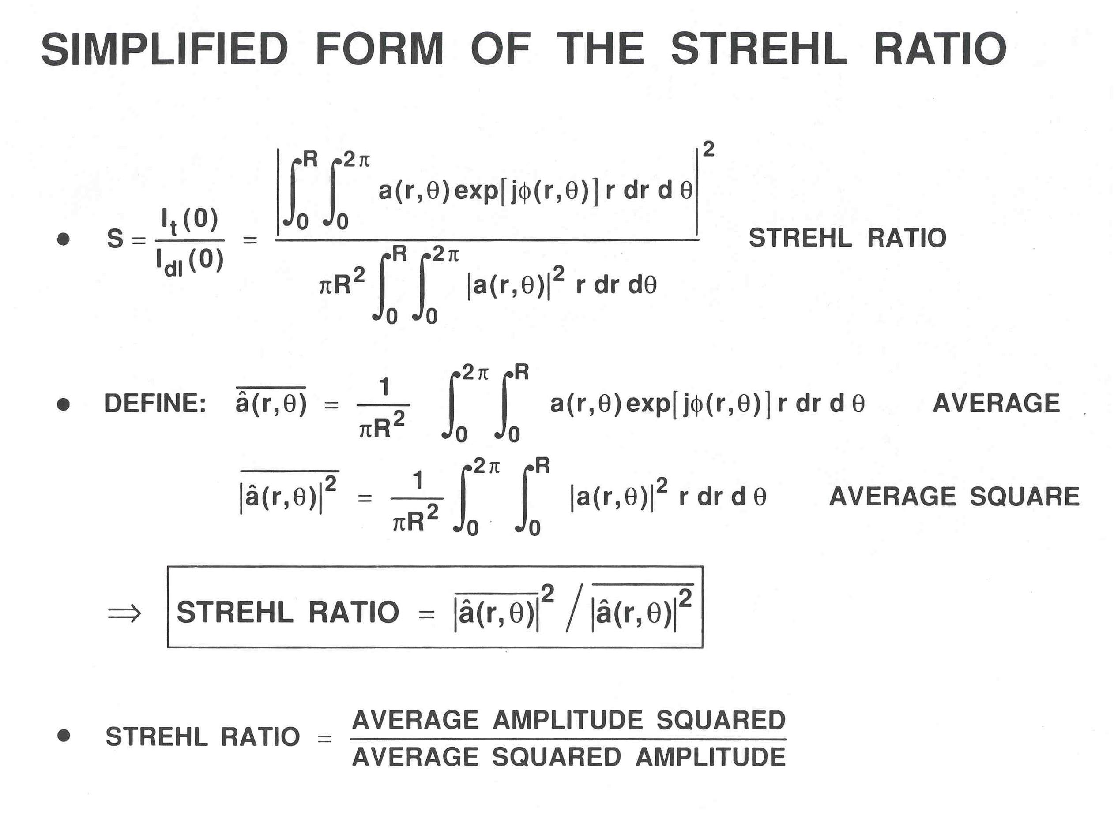

Slide 37
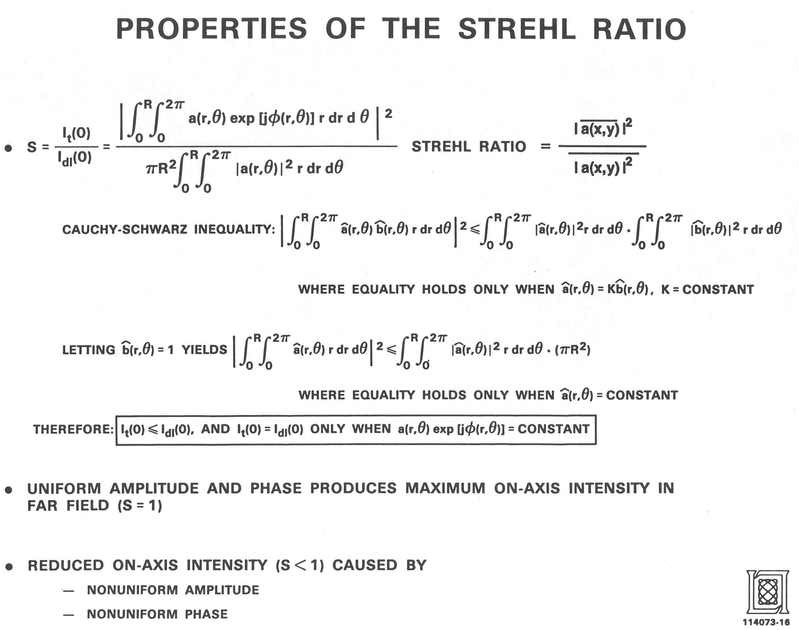

Slide 38
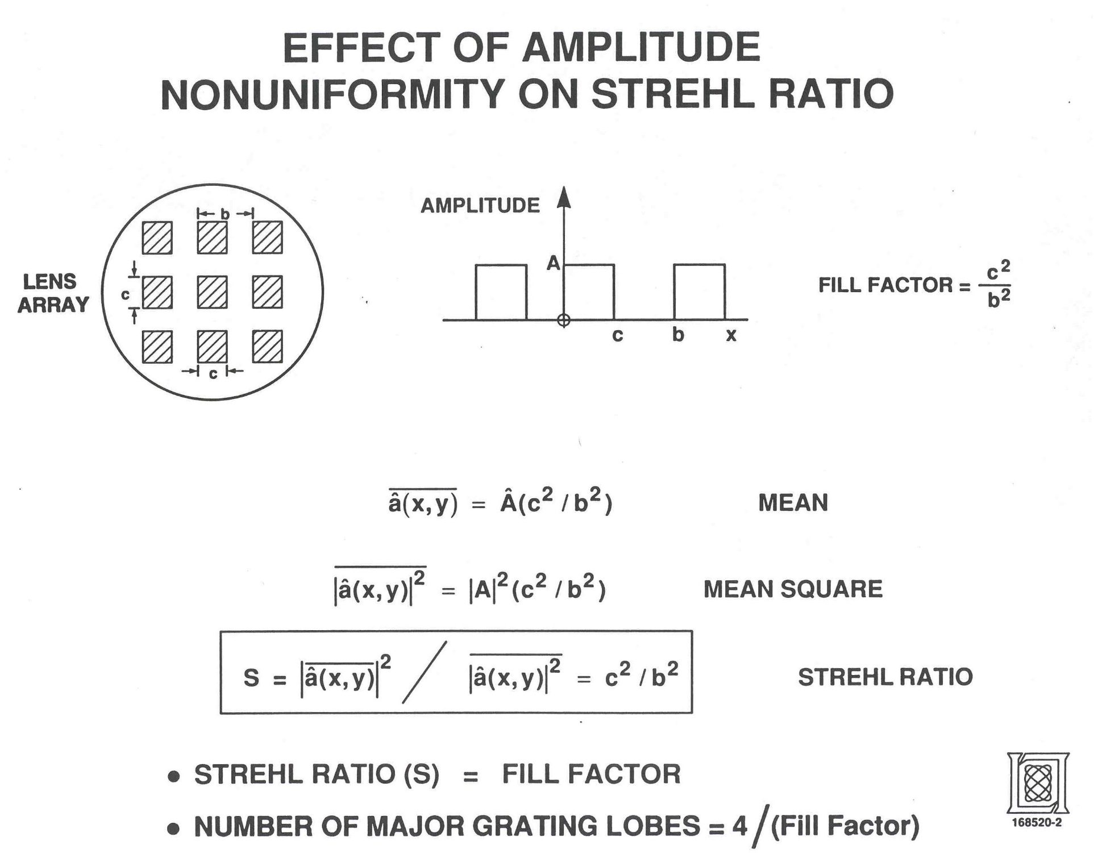

Slide 39
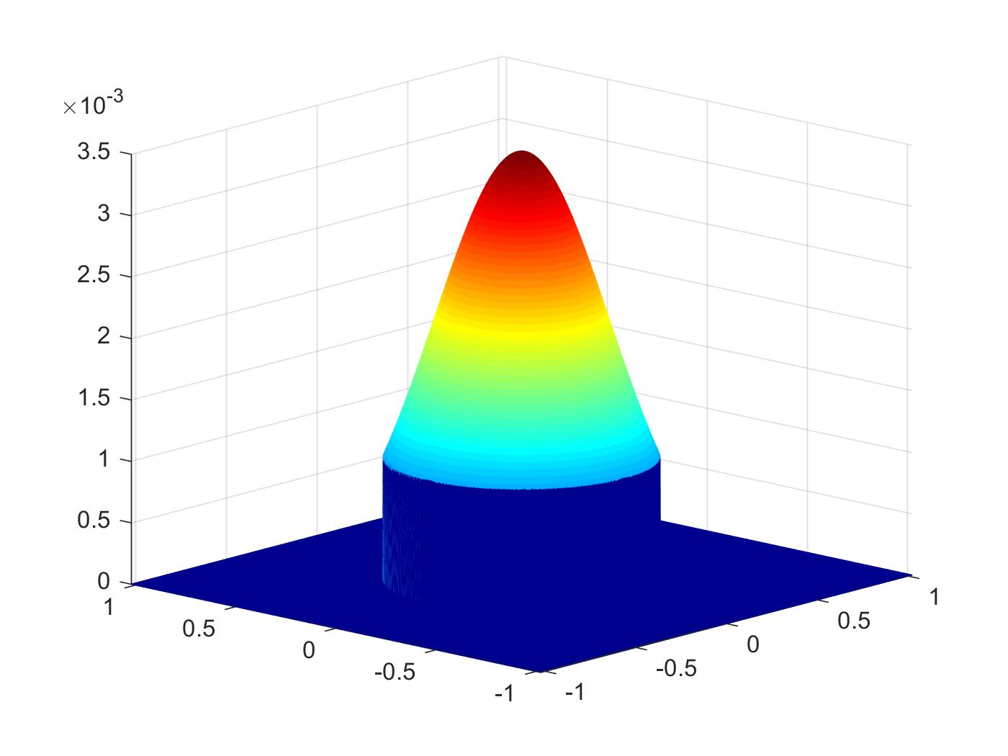
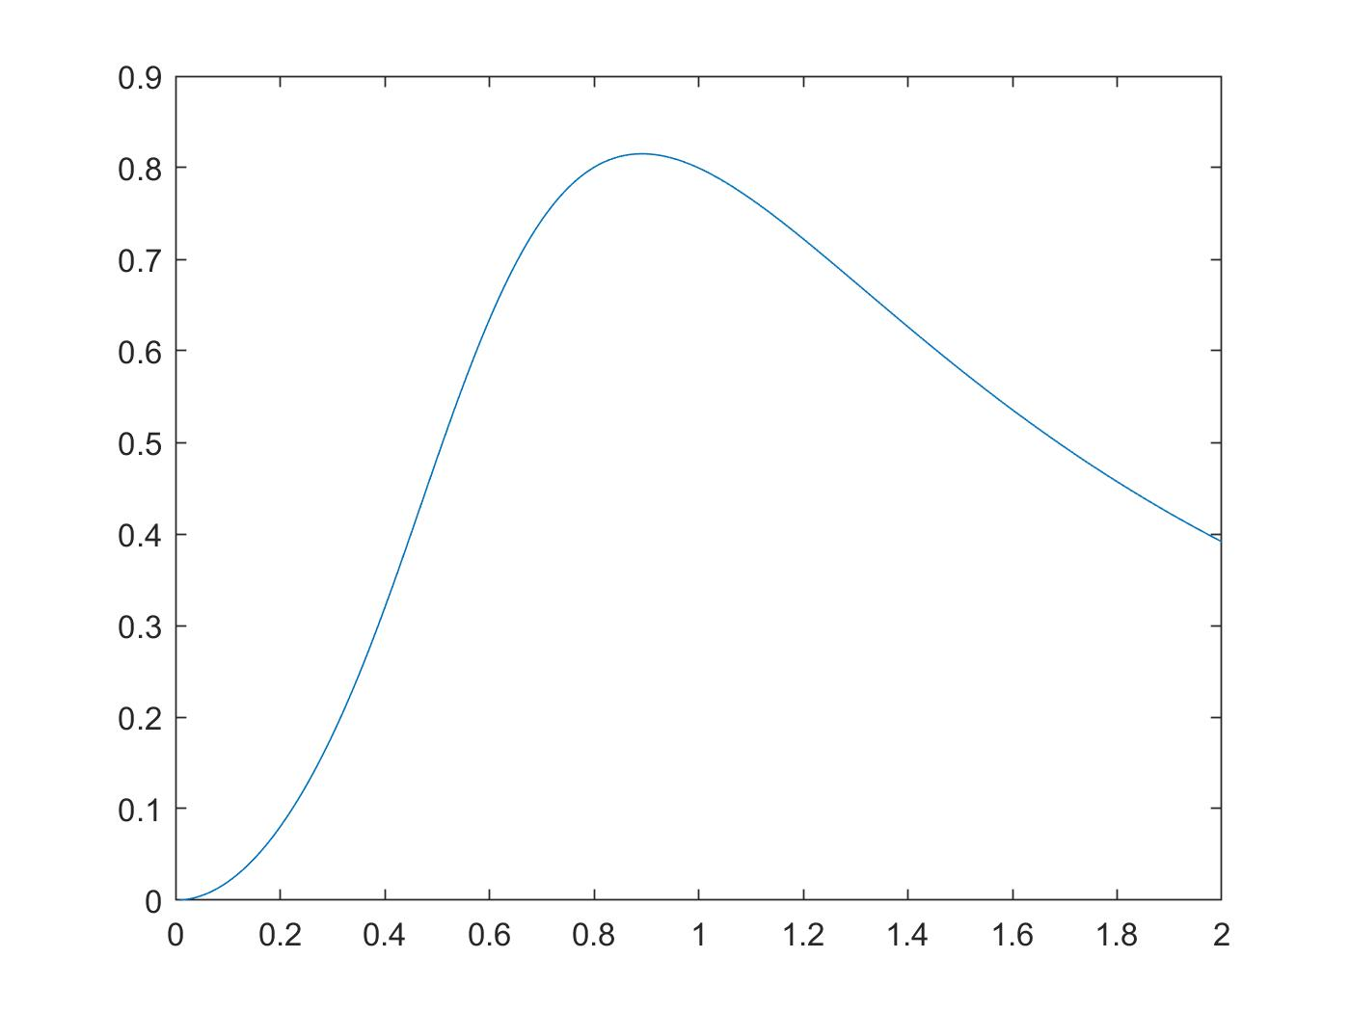
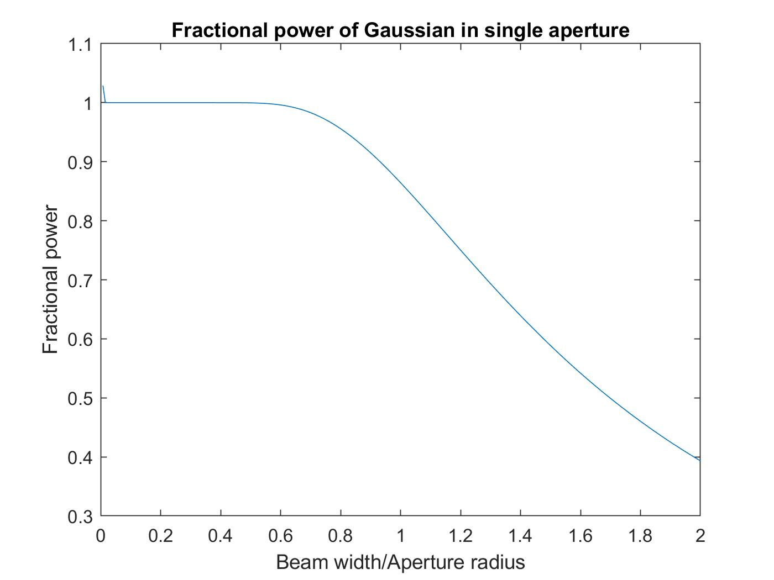

OPTIMUM GAUSSIAN ILLUMINATION OF CIRCULAR APERTURES
Amplitude
Circular
Aperture
Strehl ratio
X
Y
Gaussian illumination of circular aperture
Beam width/Aperture radius
Strehl ratio vs. Gaussian width ω₀
Fractional Power
Too small Gaussian reduces fill factor
Too large Gaussian has excessive clipping
Optimum ω₀ = 0.89 radius of circle*
Optimum Strehl ratio = 0.815
Beam width/Aperture radius
Fractional power of Gaussian beam in aperture

Slide 40
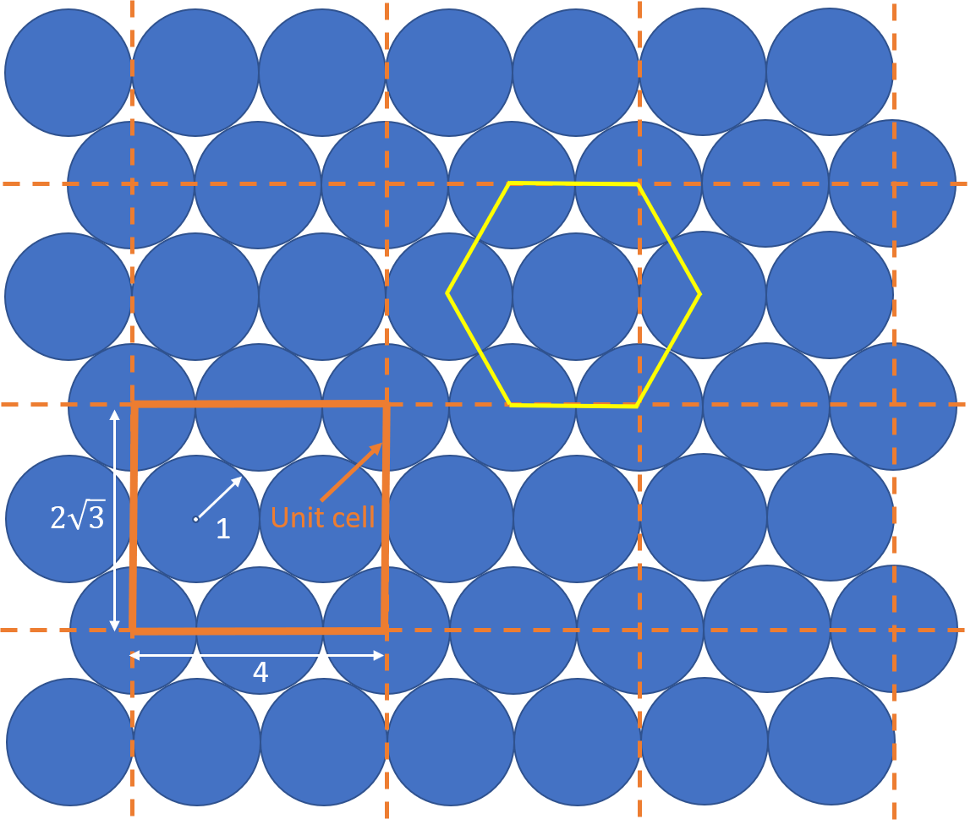
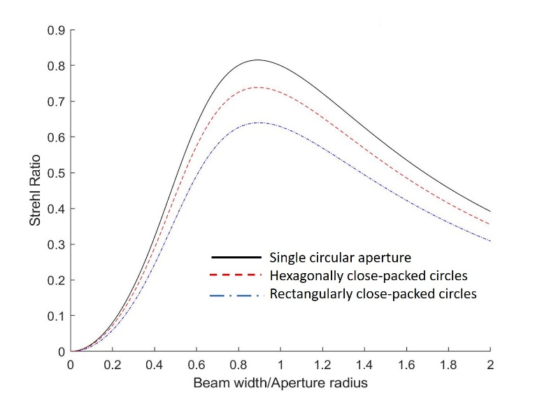
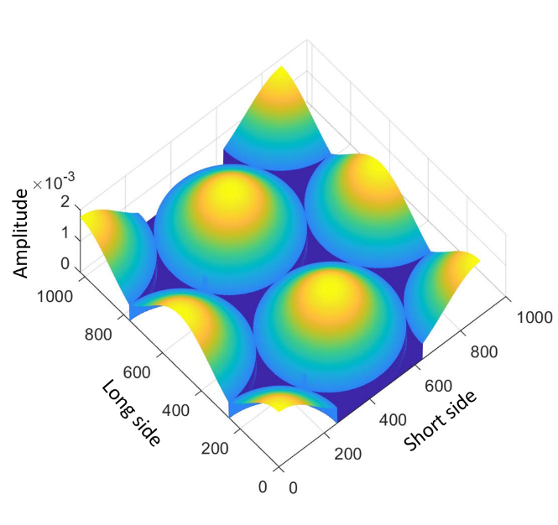
OPTIMUM GAUSSIAN ILLUMINATION OF ARRAYS
Hexagonally close-packed array
Strehl ratio vs. Gaussian beam width
Aperture type | Optimum beam radius | Maximum Strehl ratio
Single circle | 0.89 | 0.815
Hexagonally close-packed circles | 0.89 | 0.738
Rectangularly close-packed circles | 0.89 | 0.639
Optimum Strehl ratios
Gaussian illuminated unit cell

Slide 41
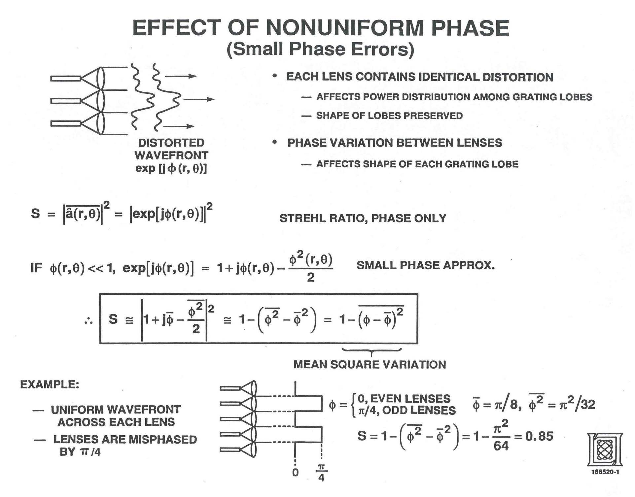

Slide 42
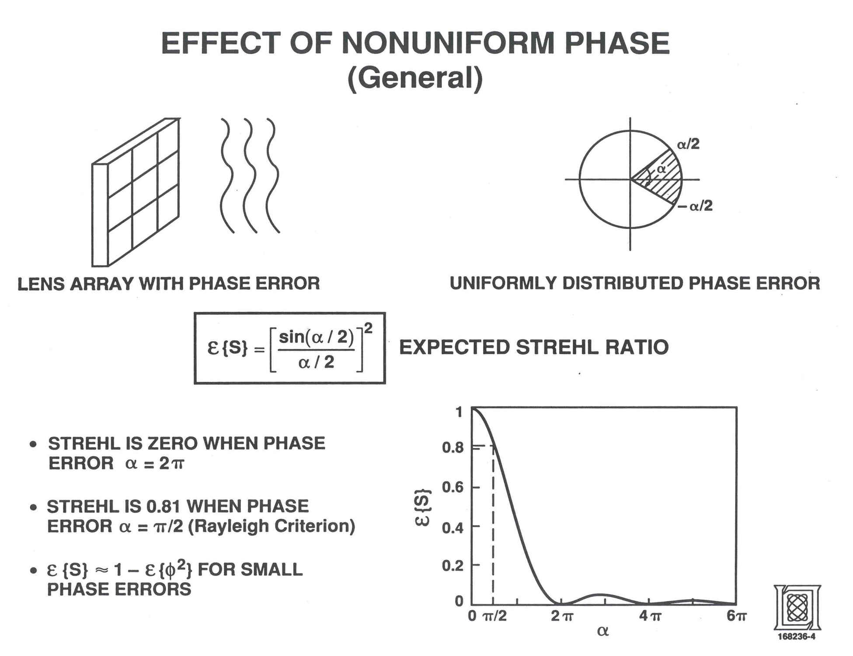

Slide 43
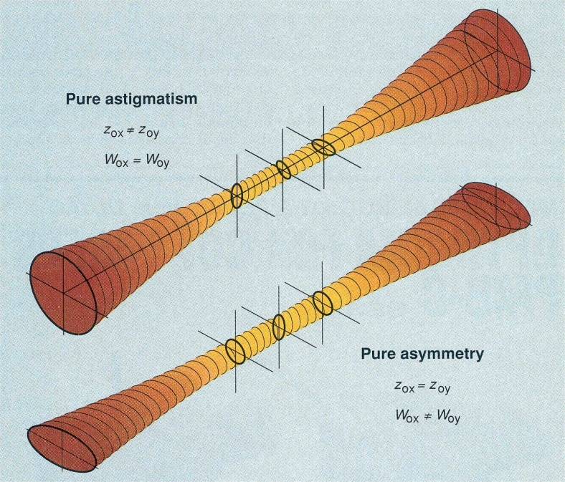
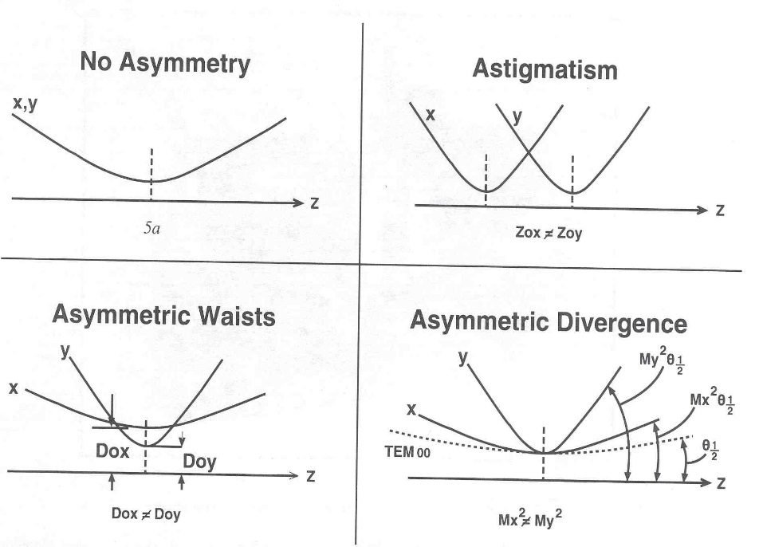
Common Laser Beam Aberrations
T. F. Johnston, Jr., Laser Focus World, 173 (1990).
M. W. Sasnet, Proceedings of the SPIE, 1414, 21 (1991)
Astigmatism: Beam waists ω_{ox} and ω_{oy} occur in different planes (z_{ox} ≠ z_{oy})
Geometrical asymmetry: Beam waists ω_{ox} and ω_{oy} have different values (ω_{ox} ≠ ω_{oy})
Pure waist asymmetry (no astigmatism at waist) can produce astigmatism through propagation:
ROC as a function of propagation distance

Slide 44
Second Moment Definition of Beam Width and Divergence
I(x)
I(θ_{x})
?
?
x
θ_{x}
Second-order moment of intensity:
Second-order moment of divergence:
Beam Size
Beam Divergence

Slide 45
Propagation Property of Second Moment
From simple Gaussian:
But divergence of a Gaussian is given by
⇒
The second-order x and y moments of any beam obey the same equation:
,

Slide 46
Definition of M²
Second order moments of Gaussian:
(Arbitrary z)
(Waist)
(Divergence)
Space-beamwidth product of Gaussian:
Definition of M² for arbitrary beam:
or

Slide 47
Propagation Property of M²
Define width of arbitrary beam by:
Since
then becomes
Propagation of arbitrary
beam width W_{x}

Slide 48
Additional Properties of M²
All beams follow Gaussian propagation law with divergence modified by M²
Beam propagation formula is valid for any aberration and coherence (single
mode, multi- mode, partially coherent, etc.)
M² is preserved upon free-space propagation and propagation through any set
of paraxial optical elements (lenses, mirrors, etc.)
Higher-order transverse modes affect M² according to
where c_{nm} is amplitude in (n,m)^{th} eigenmode, and

Slide 49
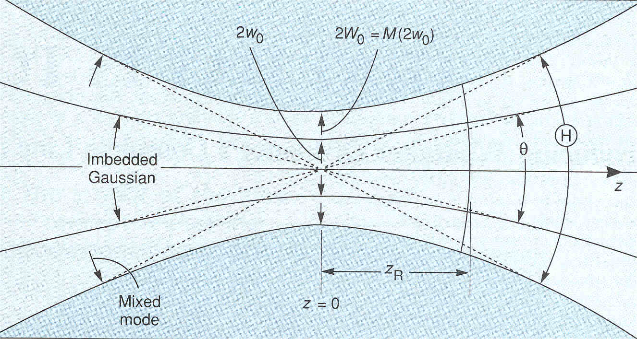
The Embedded Gaussian
T. F. Johnston, Jr., Laser Focus World, 17 (1990).
Define “embedded Gaussian” as having ω(z) = W(z)/M at all z
Divergence of embedded Gaussian is also 1/M of measured wavefront divergence
Embedded Gaussian can be used in complex optical system. W(z) = M • ω(z) always
Optics can be sized by requiring all apertures to have diameters D_{x}(z_{i}) > 3 W_{x}(z_{i})

Slide 50
Calculating Focusing Properties from Embedded Gaussian
Real laser beam
W_{L}
W_{f}
Embedded Gaussian
ω₀
ω₁
Focal spot size of real laser beam of waist W_{L}
Embedded Gaussian beam waist:
Propagate embedded Gaussian:
Convert to real beam:

Slide 51
Calculating Divergence Properties from Embedded Gaussian
T. F. Johnston, Jr., Laser Focus World, 173 (1990).
Divergence Θ of real laser beam of waist W₀
Let
(Full angle divergence of real beam)
Also
Embedded Gaussian full angle divergence
We have

Slide 52
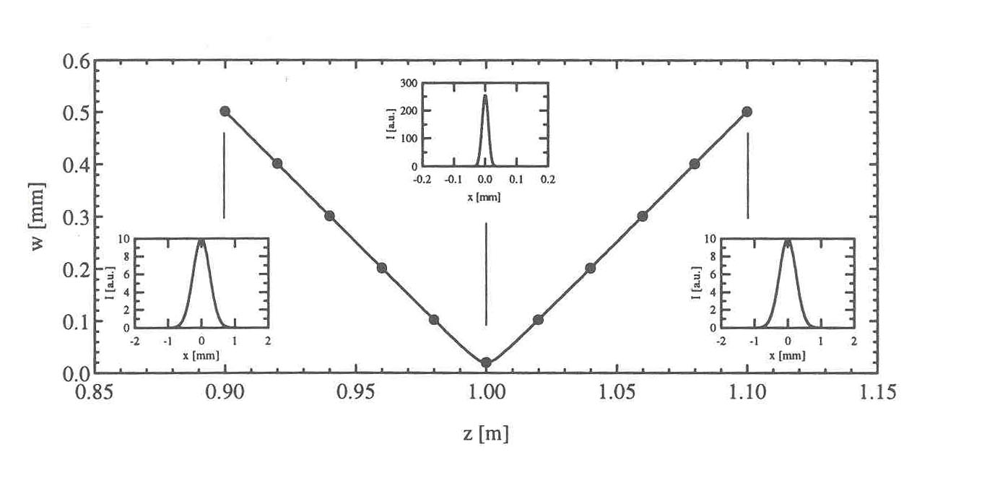
Measurement of M²
Method 1: Plot W_{x}(z) and fit to
Solve for:
R.M. Hofstra, Ph.D. thesis (1999)
Method 2:
  Measure amplitude and phase with interferometer
  Create virtual waist by removing quadratic phase
  Calculate far field by Fourier transformation
  Calculate second-order moments of near & far fields

Slide 53
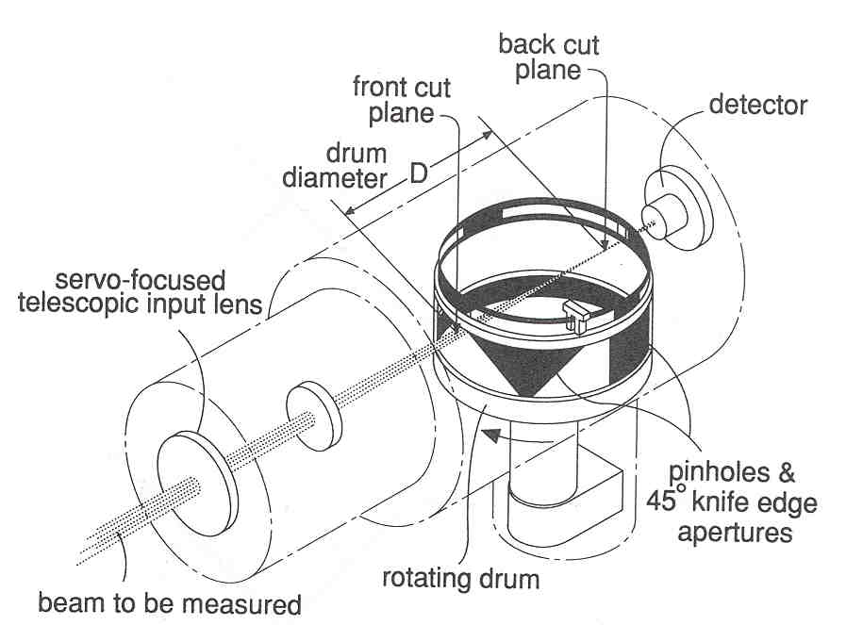
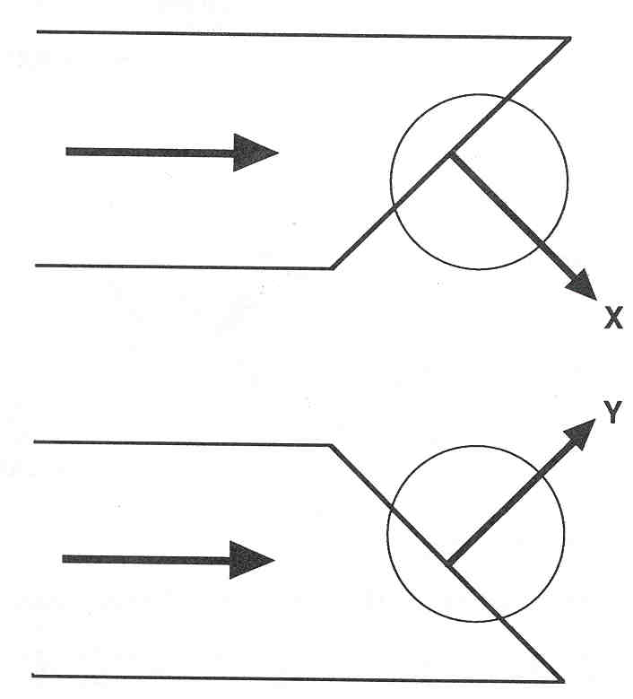
Detection Methods for Determining Second-Order Moment
CCD Camera
- Capable of CW or pulsed laser measurements
- Intensity must be measured in several planes (minimum = 3)
- Curve fitting to many planes gives better results, where several planes are close
to waist and several are far from it
- Background noise, base-line drift, and non-linearities can significantly effect the
measurement
Scanning knife-edge
- Most useful for CW lasers
- Derivative of knife-edge response
produces x or y profile ( integrated
in orthogonal direction)
- Lens scanned to measure several
planes
x
y
Coherent Inc.’s Modemaster
™

Slide 54
Advantages and Disadvantages of M²
Advantages
Method has a firm theoretical basis
Propagation properties are useful for tracing real beams through complex optics
Method applicable to partially coherent/multi-mode beams
Disadvantages
Second-order moment definition weights wings of distribution strongly
Detector background noise, base-line drift, non-linearities, etc. can significantly affect measurement
M² definition not appropriate for non-Gaussian beams (M² = infinity for flat-top)
In some applications, M² gives a misleading measure of beam quality

Slide 55



“Power-in-the-Bucket” Measurements
PIB is defined as the fraction of total power that falls within a specified aperture (the “bucket”)
Common “bucket” is defined by main lobe of the far-field diffraction pattern from a uniform amplitude/uniform phase aperture of equivalent dimensions
PIB curves show fractional power as a function of bucket size
Gaussians in
hex pattern
Coherent
Incoherent
PIB Measurement
Near-field pattern
PIB curves in far-field
R.M. Hofstra, Ph.D. Thesis (1999)
A. Siegman, OSA Annual Meeting, Long Beach, CA (1997)

Slide 56
Coupling a Coherent Beam into a Single Mode Fiber
E(x,y)
Coupling Efficiency
Fundamental fiber mode ψ(x,y) must match laser beam field in amplitude and phase for high η
Phase aberrations in laser can significantly reduce coupling efficiency

Slide 57


Aspheric Refractive Lenses to Remove Asymmetry and Astigmatism
Z. L. Liau et al., Appl. Phys. Lett. 64, 3368(1994)
Difference in divergence used to equalize beam size
Anamorphic lens placed at symmetric beam plane to collimate in both directions
Asymmetry in geometry and divergence, as well as astigmatism are removed
GaP microlens used to circularize and collimate tapered waveguide laser

Slide 58

Concentration of Incoherent Light
- Fundamental Definitions -

Slide 59


Slide 60


Slide 61


Slide 62


Slide 63


Slide 64

Optimum Coupling to Multimode Fiber

Slide 65


Slide 66


Slide 67
External Cavity Beam Shaping Categories
Degree of coherence
  Incoherent light can be shaped by imaging optics such as fly’s eye lenses
  Partially coherent light and photonic lanterns
  Coherent light can be shaped by phase plates
Near field vs. far field
  Near field beam shaping useful for uniform illumination of coherent scenes (e.g. holography, laser doppler velocimetry, etc.)
  Far-field beam shaping can be applied to spots at infinity or at the focal point of a lens
Intensity shaping vs. amplitude shaping
  Intensity shaping useful when light power is the important quantity
  Amplitude and phase shaping required for phase sensitive detection and to preserve propagation characteristics

Slide 68

Beam smoothing and shaping of partially coherent light in the near field

Slide 69


Slide 70
Photonic Lanterns
Conversion of partially coherent light into multiple coherent beams
PL converts N-dimensional multimode wavefront into N single-mode channels
Conversion must be performed adiabatically for low loss
Single-mode channels can be interfaced to coherence-sensitive devices (i.e. Bragg gratings) to increase performance without reducing throughput
Adiabatic taper from MM to SM guides
Fabrication techniques:
Heating and drawing bundle of SM fibers into a collapsed MM core
Femtosecond laser writing of individual waveguides in glass
Femtosecond laser written waveguides
Art from T.A. Birks et al., Adv. in Opt. and Photonics 7, 107-167 (2015).

Slide 71
Near-Field Beam Shaping with Prisms
- Intensity shaping of coherent light -
Gaussian
Split, shifted, and superimposed Gaussian
Bi-prism splits Gaussian beam into two halves directed along opposite angles
When beams are brought together again and overlap, uniformity improves
Two-dimensional shaping performed by applying bi-prism in both directions
Interference can be reduced by making polarization orthogonal and shifting frequency

Slide 72
Near-Field Beam Shaping With Refractive Surfaces
- Complex amplitude shaping of coherent light-
x
x
I(x)
Refractive asphere
(highly exaggerated)
I(x)
First surface of refractive asphere redistributes rays to increase uniformity
Second surface recollimates all rays and produces a planar wave
Collimated wavefront has minimum divergence
Aspheres, spherical aberration from conventional spherical lenses and holographic
optical elements have all been used

Slide 73





Gradient-Index Gaussian to Flat-Top Converter
Refractive Index (×10⁻⁴)
x (mm)
Intensity
x
x
z(mm)
Theoretical design
z
Intensity
Experimental DIC image
x
Experimental Result
Index of refraction pattern designed to perform intensity remapping
Two-dimensional waveguide fabricated by femtosecond laser writing in glass
W. Minster Kunkel and James R. Leger, “Gradient-index design for mode conversion of diffracting beams,” Opt. Exp. 24, 13480 – 13488 (2016).

Slide 74
Far-Field Beam Shaping
- The beta parameter for focused beams -
I(x)
I(x)
x
x’
Input beam Beam shaping optics Output beam
Wavelength = λ with focal length f
Geometric regime
Diffractive regime
Phase plates fail
L.A. Romero and F.M. Dickey, Appl. Opt., 13, 751 (1996).
The Beta parameter estimates the effect of diffraction on the beam shaping process
For diffraction-limited Gaussian beams, β = 1.6. It is larger for all other beams

Slide 75


Far Field Beam Shaping with Phase Plates
- Intensity Shaping -
Diffraction
Phase of beam shaper
Initial beam
Initial laser profile and beam-shaper phase
Constraint: Amplitude
Variable: Phase
Constraint: Amplitude
Variable: Phase
Near field
Far field
Far-field response
Diffraction
Gerchberg-Saxton Algorithm
Gaussian-to-Flat-Top Conversion
R.W. Gerchberg and W.O. Saxton, Optik 35, 237 (1972).
W.H. Lee, Opt. Commun. 36, 469 (1981).
G-S Algorithm solves for a phase distribution by applying intensity constraints in the near and far fields
Initial phase is chosen to be random, and then allowed to change until optimum value is reached
Final distribution has correct intensity but random phase
Method works well if β ≥ 5

Slide 76



Far-Field Beam Shaping with Phase Plates
- Amplitude Shaping -
Phase
Plate
Incident beam and beam shaper
Object Plane
Shaped Beam Profile
Initial Beam Profile
CO₂ laser
Far-field
Focal plane
Generating approx. sinc function
Controlling sidelobes by additional grating
Veldkamp, et al., Appl. Opt., 21, 3209 (1982).
Far-field consists of rectangular uniform distribution (amplitude & phase)
Near-field given by Fourier transform
sin(πx)/(πx) amplitude approximated by shape of Gaussian
π phase shifts of sin(πx)/(πx) introduced by binary plate
Additional high frequency grating helps shape beam and remove sidelobes

Slide 77


Image Kinoforms and Dammann Gratings
Image
kinoform
Diffraction
Kinoform image
I(θ)
Dammann
grating
Angular spectrum
θ
{
{
Far-field Dammann
grating response
Phase-only Intensity-only
plane plane
Kinoforms and Dammann gratings are phase-only optical elements
Only intensity of image is defined. Phase is arbitrary.

Slide 78

Generalized Cylindrical Vector Beams in Beam Shaping
- Low β and high NA -
Q. Zhan and J. Leger, Optics Express 10, 324-331 (2002).
Flat top can be achieved using generalized cylindrical vector beams, by balancing the strong z-component and transverse component
Flat top intensity is highly NA dependent
Rotation angle = 24º for NA = 0.8

Slide 79


Mode Shaping in the Propagation Direction
- High NA -
Pupil plane phase mask
Pupil plane phase mask for longitudinal beam shaping
Beam shape at focus. Depth of field has been extended by a factor of three.
W. Chen and Q. Zhan, Opt. Comm. 265, 411-417 (2006).
Transverse beam shaping is obtained by adjusting the polarization angle of a generalized cylindrical vector beam
Longitudinal beam shape can be tailored using an additional pupil plane phase mask and selecting the phases and locations of the zones properly

Slide 80




Optical Needles and Bubbles
Optical needle excitation
Optical bubble
W. Chen and Q. Zhan, Opt. Comm. 265, 411-417 (2006).
Optical bubble consists of a void surrounded by light field in 3-D
Radially polarized cylindrical vector beam is modified by three-zone binary optic phase plate
Intensity at focus
Longitudinal
Transverse
H.F. Wang et al., Nat. Photonics 2, 501-505 (2008).
Radially polarized Bessel-Gauss beam is modified by binary optic phase plate in aperture plane
Field at focus confined to longitudinal (z) direction

Slide 81


Space-Variant Polarization for Low NA Optical Systems
- Low β beam shaping -
Microscope objective
One dimensional flat-top set-up
Polarized HeNe laser
Spatial filter
Half-wave plates
Fourier transform lens
CCD
β = 2
B. Hao and J. Leger,
Appl. Opt. 46, 8211-8217 (2007)
Polarization Angle (deg)
Intensity (au)
Theory
Experiment
Vertical Distance (au)
Vertical Distance (au)
Polarization angle across plate
Output line scan
When β < 5, conventional phase plates do not produce good flat-top profiles
Space-variant polarization produces flat-tops for very small β (e.g. β = 2, above)
One-dim flat-top produced by simple half-wave plate array with 100 % efficiency
Two-dimensional flat tops with low β are also possible

Slide 82
Intra-Cavity Laser Beam Shaping
- Advantages of Top-Hat Beams -
Increased single-mode power by accessing entire gain volume by desired mode
Higher-order mode suppression by spatial hole burning
Lower fundamental mode loss from spatial filtering (because “tails” are not clipped)
Since mode has virtually no tails, smaller diameter crystals can be used for better heat extraction
Some applications require uniform plane-wave illumination (holography, laser radar, laser doppler velocimetry, etc.)

Slide 83


Amplitude Spatial Filtering Inside Resonator
Fourier filtering set-up
Experimental result from Nd:YAG laser
V. Kermene, et al., Opt. Lett., 17, 859 (1992).
Lens is placed inside optical cavity with mirrors in front and back focal planes (quasi-degenerate resonator)
Square spatial filter is placed in one mirror plane and grid filter in the other
Square, flat-top beam has lowest loss because nulls of diffraction pattern fall on absorbing grid lines

Slide 84
Generalization of Stable Resonator
- Graded phase resonator -
Output
Mirror
Conjugate
End Mirror
P.A. Belanger, R.L. Lachance, and C. Pare, Opt. Lett.17, 739 (1992)
Fundamental mode wavefront is phase-conjugate to both mirrors
Mode profile can be controlled by end mirror shape
Design strategy: Mirror shape chosen to conjugate incident mode

Slide 85

Laser Mirrors with Diffractive Optics
- Intracavity mode shaping -
    J. R. Leger, D. Chen, G. Mowry, Appl. Opt. 34, 2498 (1995).

Slide 86
Diffractive Mirror Mode Shaping
- Experimental Results -
Diffractive
End Mirror
Gain
Medium
Output
Mirror
Laser resonator for mode shaping
Square flat-top mode
Nd:YAG laser
    J. R. Leger, D. Chen, and Z. Wang, Opt. Lett. 19, (1994).
Laser mode can be tailored to any shape by diffractive end mirror
Flat-top mode increases power extraction efficiency and higher-order
mode suppression
Nd:YAG laser demonstrated with Strehl ratio = 95 %, rms flatness = 2 %

Slide 87

D. Chen, Z. Wang, and J. R. Leger, Opt. Lett. 20, 663 (1995).

Slide 88
Aberration Correction by Diffractive Optics
Laser-diode Pumped Nd:YVO₄ Experimental Results
Spherical
mirror
Diffractive
corrector
Aberrated
gain medium
Output
mirror
    S. Makki and J. R. Leger, IEEE J. Quantum Electron.. 35, 1075 (1999).
Nd:YVO₄ Crystal Aberration Laser Performance

Slide 89
Correcting Mode Aberrations with Custom Phase Plates
Phase Error From Intermediate Plane Correction
Phase
Amplitude
x
x
x
x
Diffraction
Diffraction
J.R. Leger, Photonics West 1999, San Jose, Calif. (1999).
Phase-only error directly after crystal
Diffraction introduces amplitude distortion at corrector
Diffraction from amplitude distortion creates phase aberration at end mirror

Slide 90

    S. Makki and J. R. Leger, IEEE
    J. Quantum Electron.. 35, 1075 (1999).

Slide 91

S. Makki and J. R. Leger, IEEE J. Quantum Electron.. 35, 1075 (1999).

Slide 92
Summary
Gaussian beams have useful practical and analytical properties
More complex beam shapes can have useful focal properties
There is no single measure of laser beam quality that is appropriate for all applications
Strehl ratios are useful for assessing effect of aberrations
M² is useful as a propagation parameter
Beam shaping can be performed inside and outside laser cavity

