Slide 1

Kraken2
Module 2

Slide 2
Before Kraken2….
As mentioned previously, we need to copy our dataset and tools over to our home directory.
You need to copy the following:
The dataset assigned to you (1-4)
Programs
Scripts

Slide 3
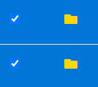
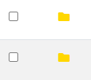
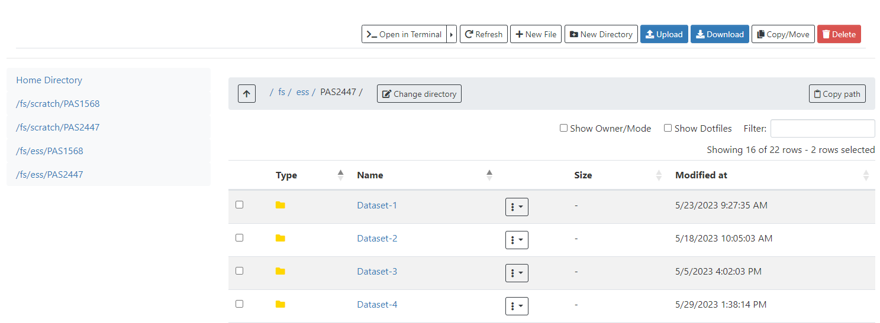
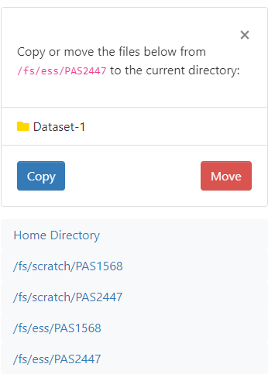
Locate the directories you need to copy and click on the small box next door

Slide 4
What is Kraken2?
“A taxonomic classification system using exact k-mer matches to achieve high accuracy and fast classification speeds.”
Kraken uses a standard database for classification. They created their own database with NCBI taxonomic data. There is no information on when this was last updated.
k-mer: glorified DNA fragment. k will determine the number of nucleotides in the fragment. Ex. ATG is a 3-mer.

Slide 5
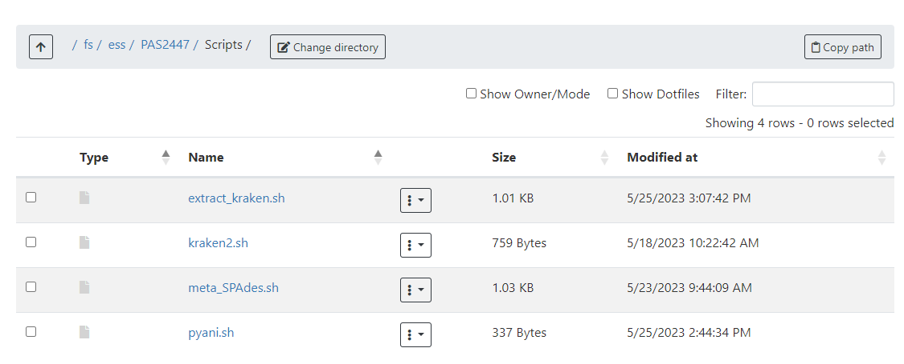

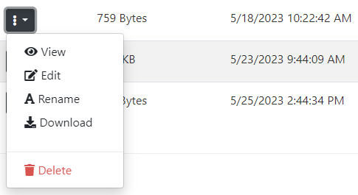

Slide 6
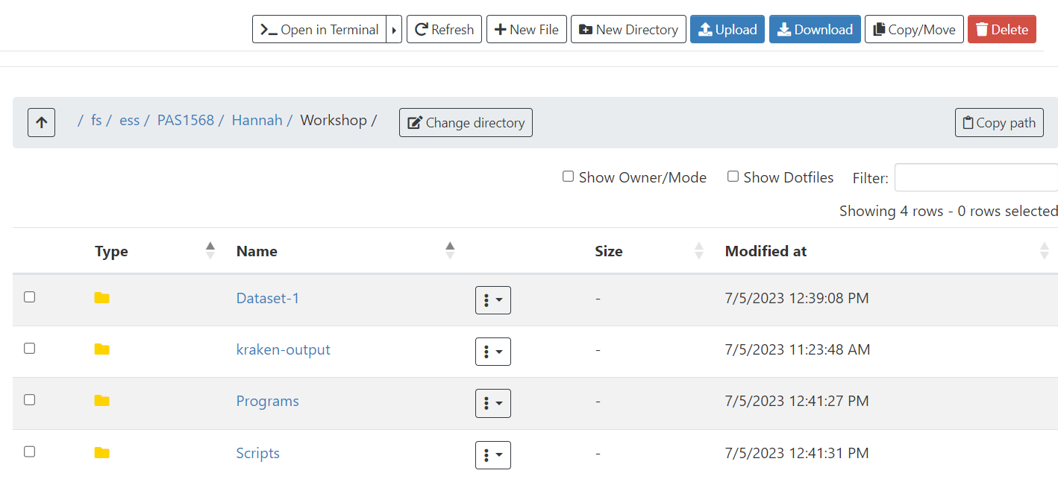
Before running, let’s checkout where we’re putting our output files
I recommend creating a different output location for each program you run. For example, I will create a “kraken-output” directory.

Slide 7
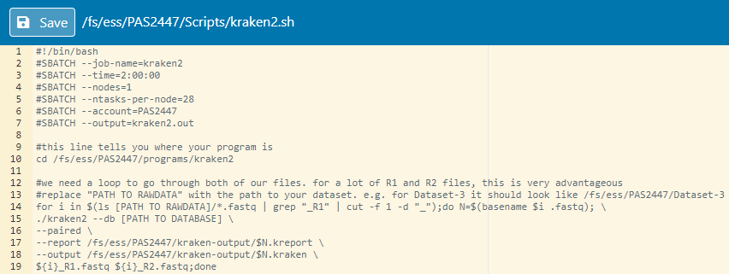
Let’s begin editing our file together.. 1 step at a time
Line 10: the path to your kraken2
Line 14: beginning of our loop! Path to your raw data files (R1 and R2)
Line 15: path to standard kraken database: k2-pluspf
Line 17 & 18: path to output folder. We want the kraken and kreport to be in the same folder

Slide 8
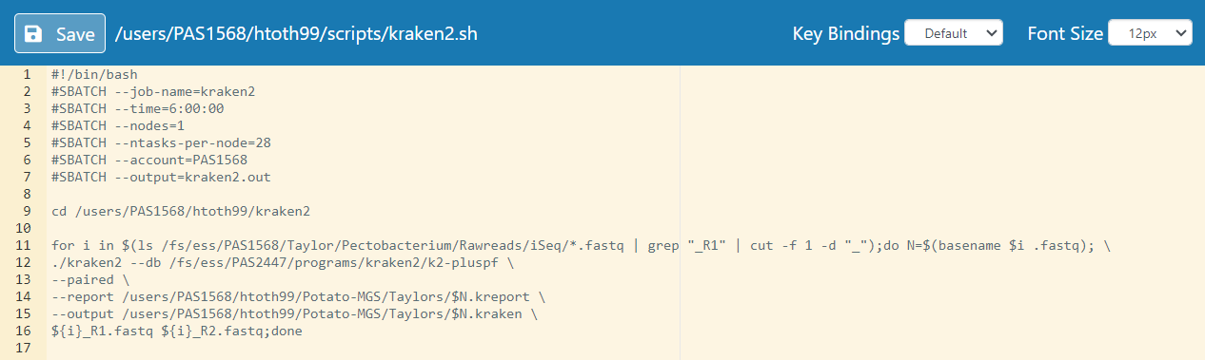
Example

Slide 9
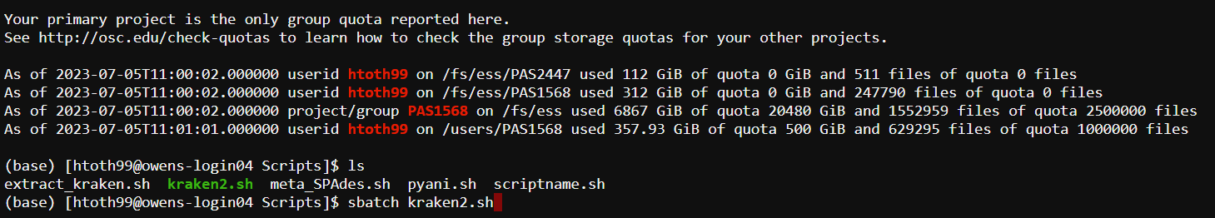
Now, we run our script!
The most important thing when you run a script in the command line, is to ensure you are in the same place as your script!
To check to see if you’re in the same place as your script, use ls and press enter. ls will list out all the files and directories in your location

Slide 10
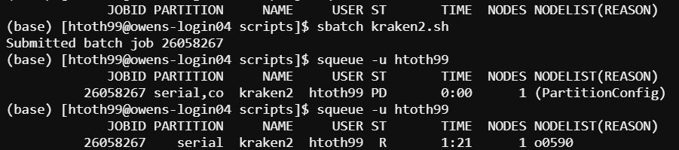
Check to see if your program is running
When you first type in squeue, you’ll get PD under ST (status). This means pending. R means running.
If you do not have any jobs in the queue, that means it either finished or an error occurred. If a job only runs for a few seconds, it means there likely was an error.

Slide 11
Limitations to Kraken
Kraken takes the taxonomy information from NCBI – if information on NCBI is incorrect, Kraken still takes the incorrect information
Reads can be assigned to the wrong bacteria because these organisms are so closely related
Although Kraken is a great tool, always be slightly skeptical of what you’re observing.

Slide 12
https://github.com/htoth99/APS-2023-MGS

