Slide 1

Introduction to OSC basics (Module 1)

Slide 2
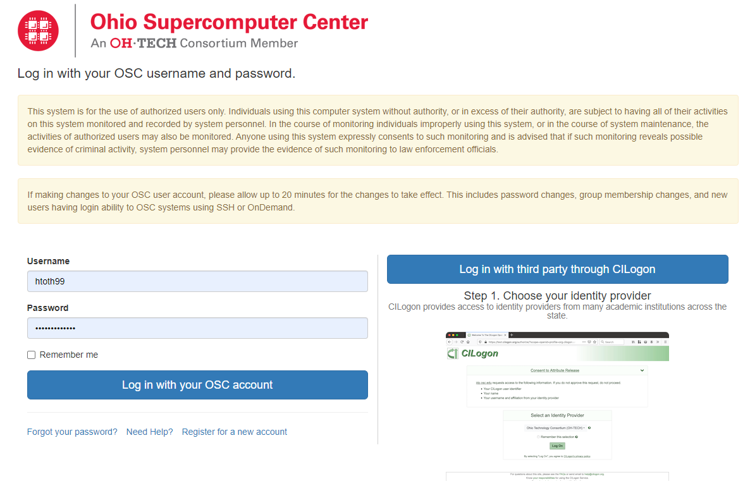
Ondemand via the Ohio Supercomputer
Enter ondemand.osc.edu into browser now!
You’ll be following along with some of this presentation
OnDemand Webpage
Notes:
Add websites underneath each one

Slide 3
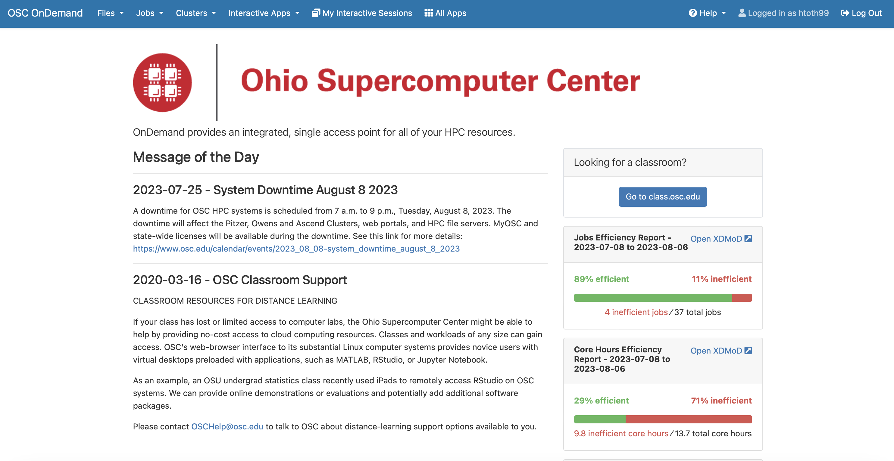
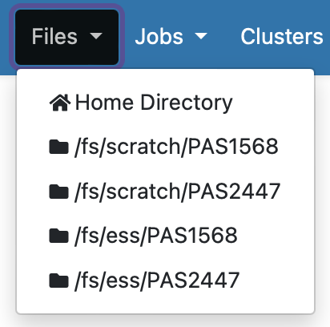
Your home, where you will be working
Shared files/directories

Slide 4
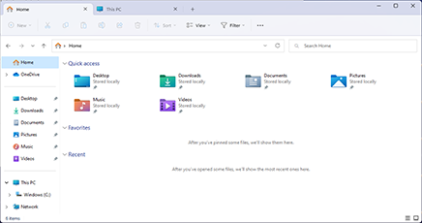
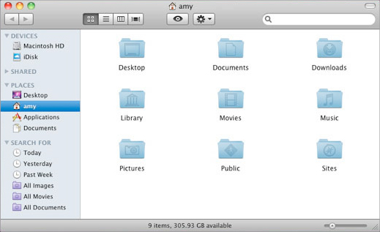
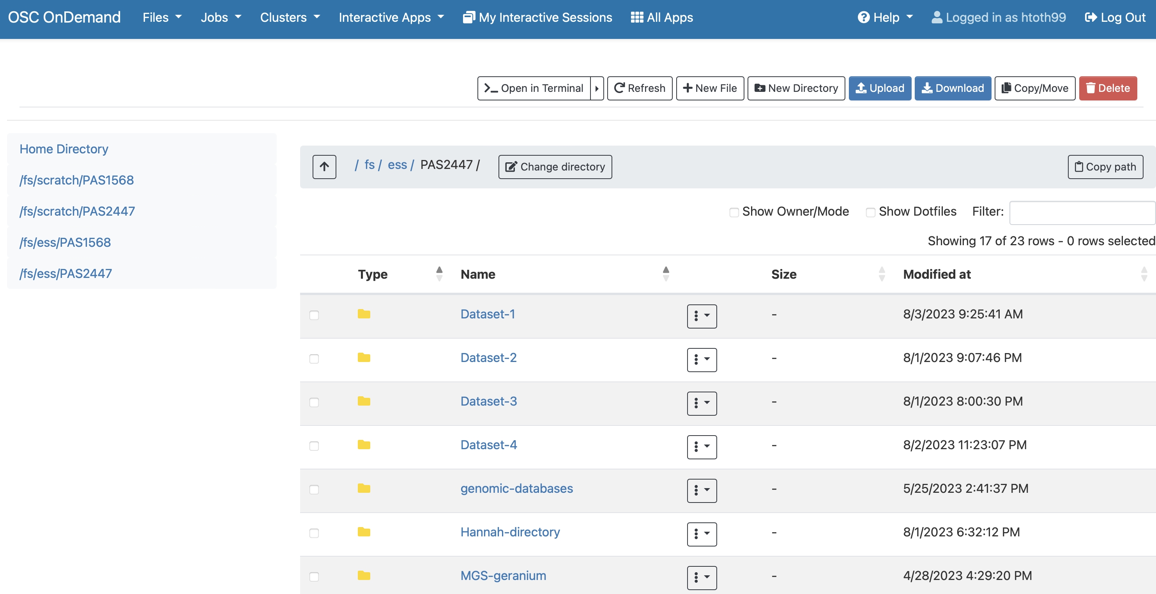
These all do the same function!

Slide 5
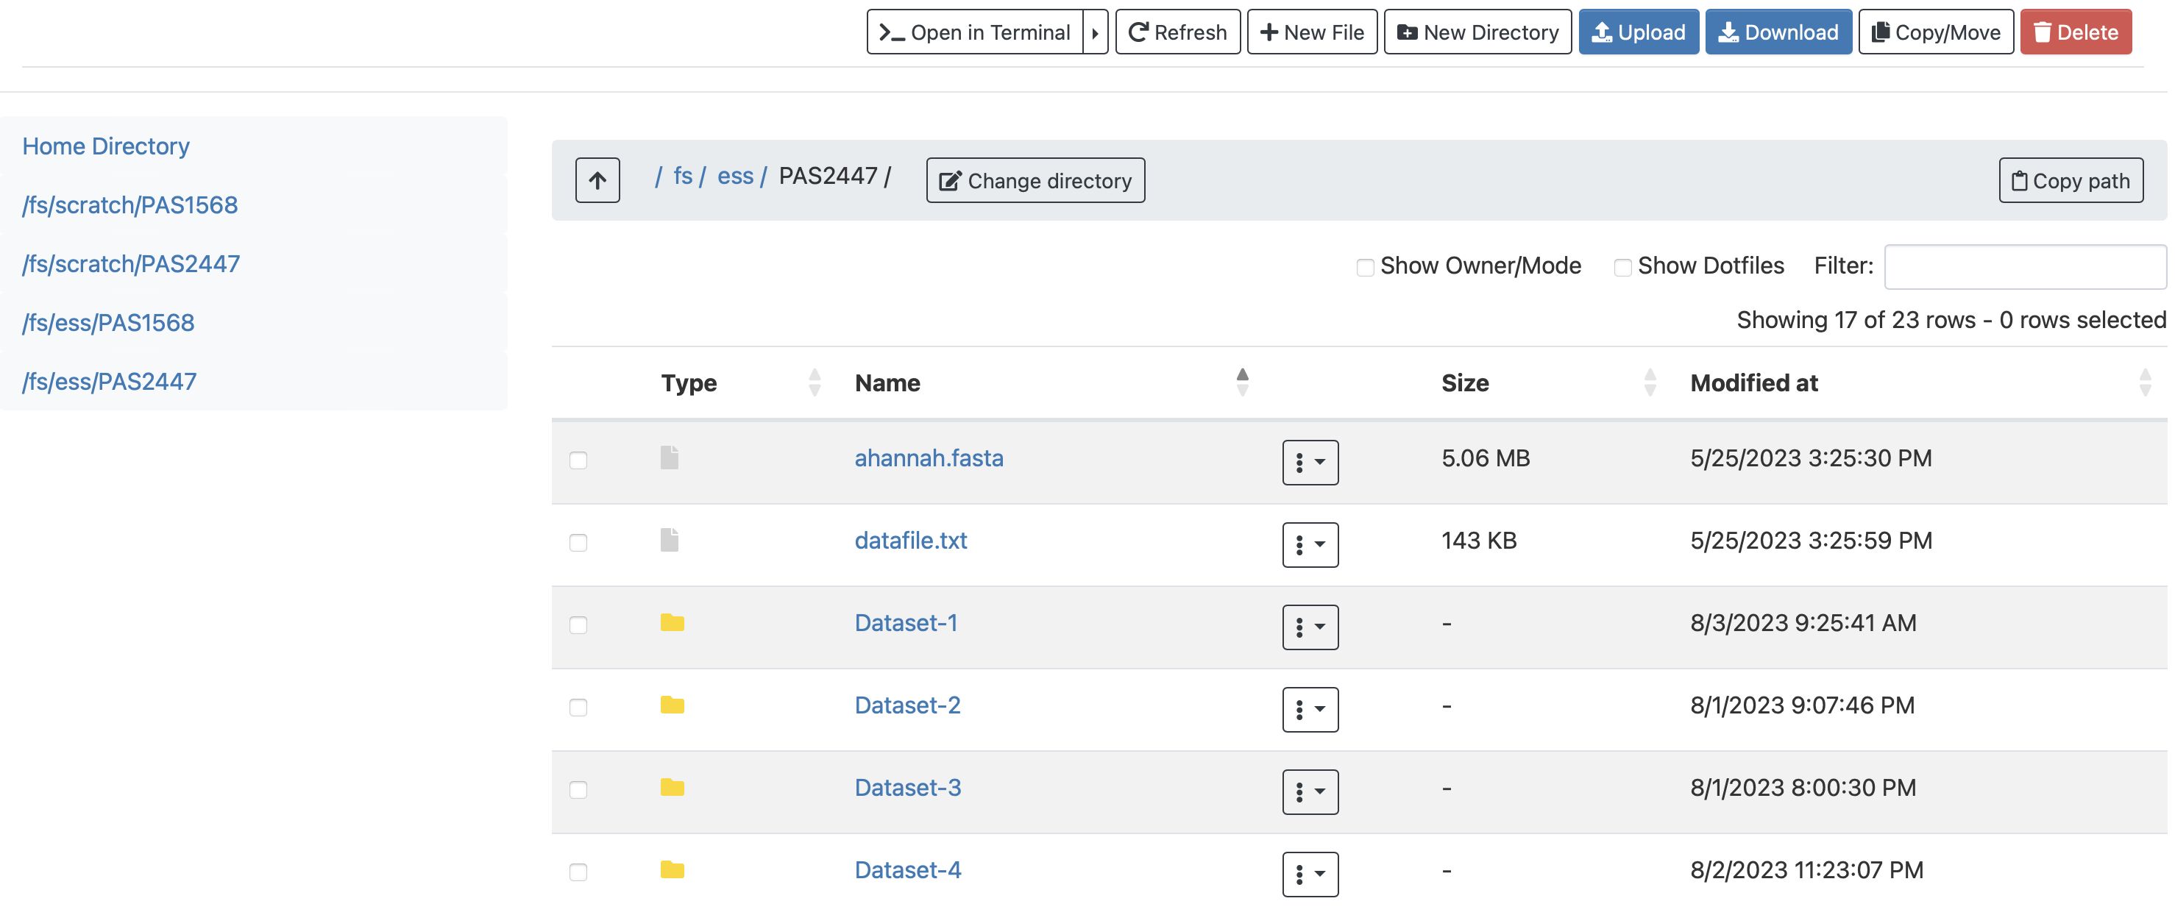

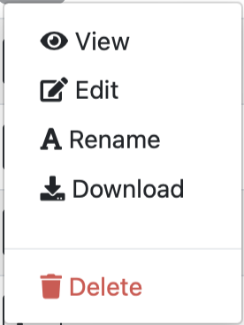
Navigating the OSC interface
file
directory

Slide 6
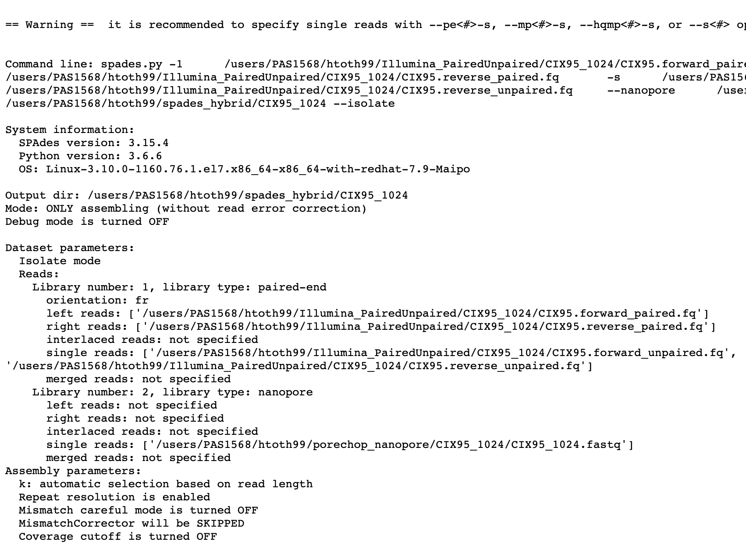
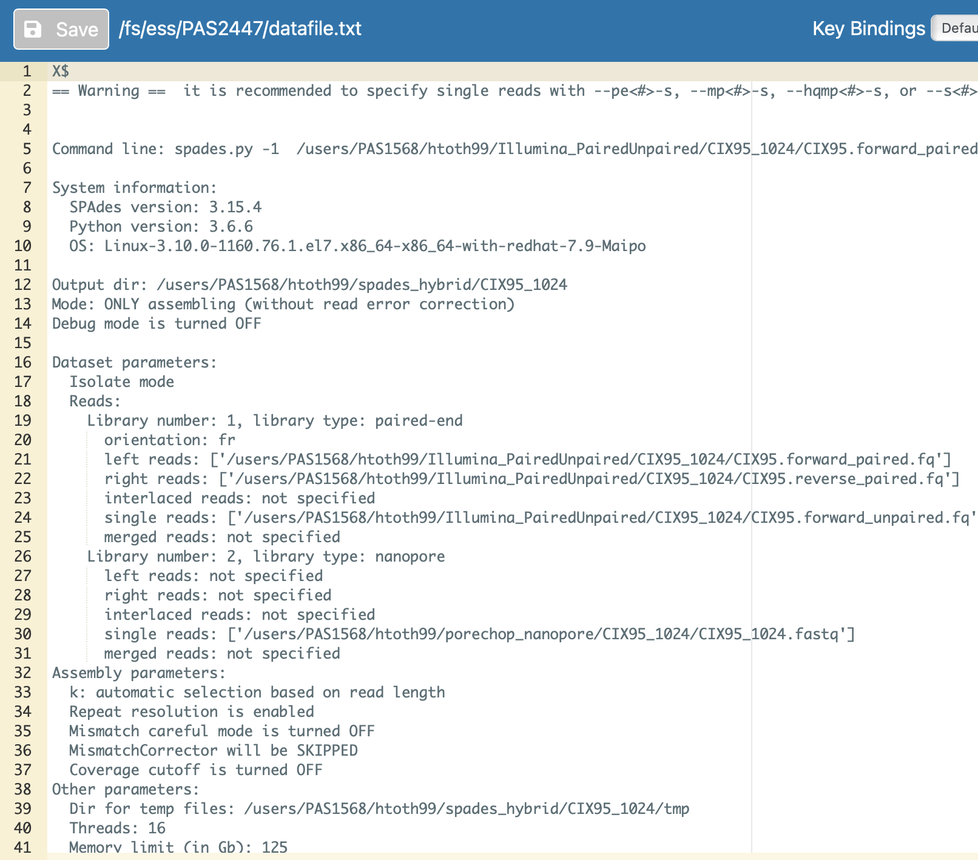
“View” file
“Edit” file

Slide 7
Navigating the OSC interface
Opens terminal
Copies current location
Your current location
file
directory

Slide 8
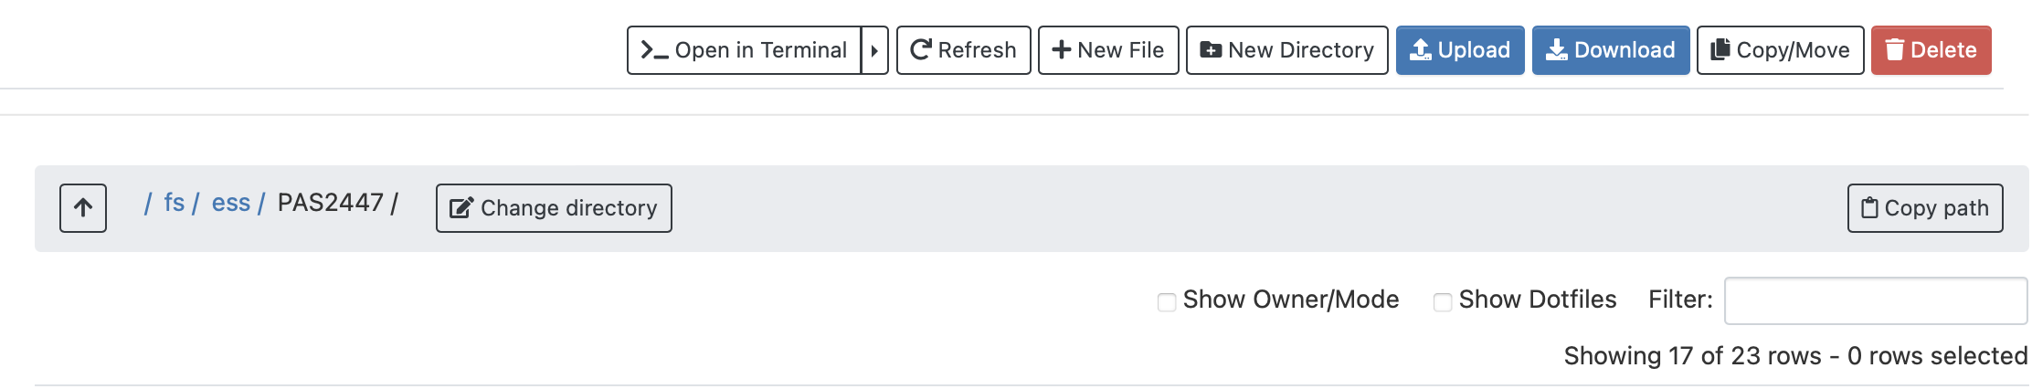
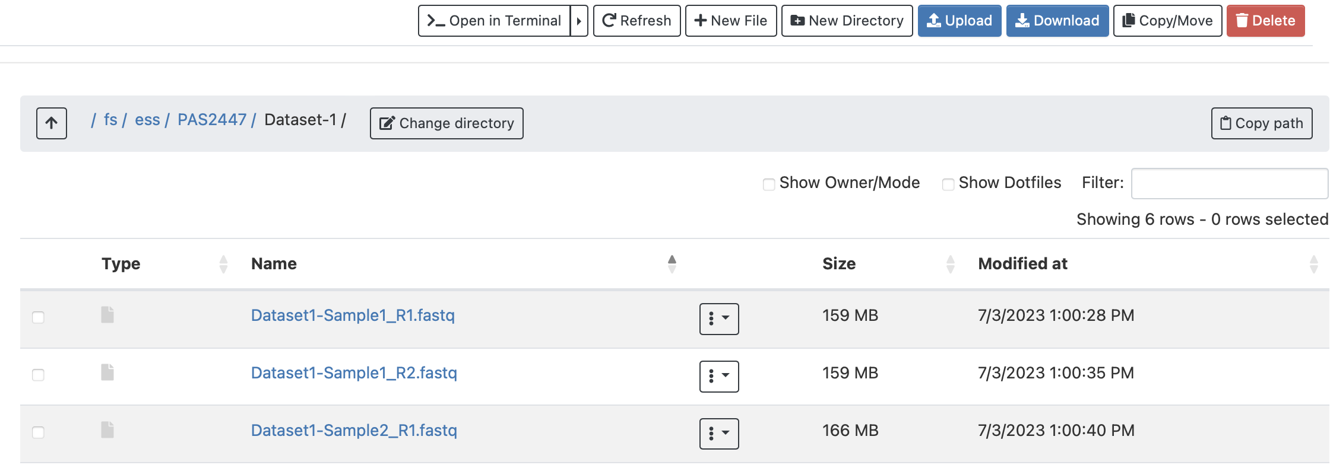
Before we continue, let’s copy our path and click through some directories!
First, open up a word doc, text file, anywhere you can paste text.
Next, go back to OSC, click the copy path button. Go to your document, and paste. Boom! Your location is there.
Now, go back to OnDemand, click on any directory.
Notice how your location changes?
Repeat the steps above. Copy your path in your new location, and paste in your word document.
Do you see the difference?

Slide 9
What is the terminal?
The terminal is a way for us to interact with the inner workings of our computer; every computer has one! The terminal we access through OnDemand is a terminal linked to the Supercomputer.
The terminal is like file explorer, finder, or the OSC interface, but text-based instead of image based. It can do all the functions of these applications, but also much more.
In the terminal, you can write commands, execute programs, run scripts, and much more.

Slide 10
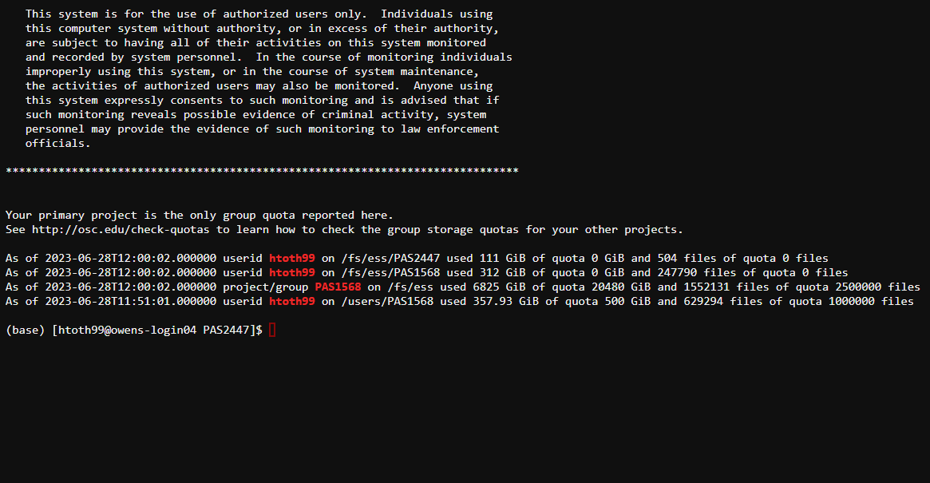
The terminal
We will interact with the terminal in a few ways, but we mostly use the terminal to submit our scripts.

Slide 11
Terminal definitions
pwd: “print working directory” prints your current location – just like how the interface has it
ls: lists all the files/directories in your current location
cd [path or directory]: “current directory” followed by a path or directory, brings you or the script to said path or directory
cd ~: brings you to your home directory

Slide 12
Scripting
A script is a set of instructions that tells the (super)computer what to do. It’s an easy way to integrate our data with the program we want to use.
Most scripts ask for the program, inputs, what you want it to do,, and outputs. Sometimes, it asks for more, but those are the basics.
We use scripts for repeatability, ease of use, higher computing capacity, and to reduce errors.
For today, I have created your scripts in your scripts directory. You will edit and submit them via the terminal.

Slide 13

What can you do with scripts?
There are 3 main interactions you can have with scripts in the terminal.
Run them. Use the term sbatch [scriptname]
Check on them. Use squeue –u [username]
Cancel them. Use scancel [JOBID]

Slide 14

Scripting definitions
Module load – these modules are already in the supercomputer, and we use this command to call it
Ex: BLAST+ is a commonly used program by many users, so the OSC staff added it to the supercomputer so we didn’t have to install it ourselves!
Source or conda activate – activating environment needed for the program to run

Slide 15
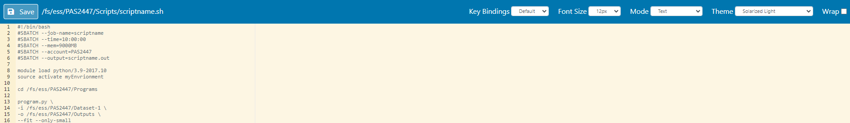
What does a script look like on OSC?
1. All (our) scripts end with .sh
2. All scripts will begin with a series of #SBATCH lines – tells the supercomputer info
These lines will contain the amount of time you think it’ll take, memory the job will use, and an out file where all of the “thinking” and “doing” of the supercomputer. The .out file is essentially a log file.

Slide 16
What info does a script contain?
-i: input or inputs. Typically a path to your inputs
Example: /fs/ess/PAS2447/Hannah-directory/Dataset2
-o: output directory. A path to where your want your results
Example: /fs/ess/PAS2447/Hannah-directory/Dataset2/output
programname.py or program: the program you run will always typically have a name, space between it and the next character. Sometimes, it has .py and sometimes it’s just a name.
--small or --trim 0.5: examples of arguments. They are the extras we add on. They are typically denoted by --wordhere.

Slide 17
Reminder slide
cd: current directory, brings you or the supercomputer to location denoted by path
ls: lists the programs in your location
Module load: loads program stored in supercomputer to your current session
Source activate or conda activate: activates environment needed for program to run

Slide 18
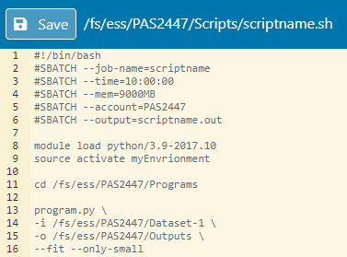
What does a script look like on OSC?
We are telling the supercomputer to load python and activate an environment here. You can do this in the terminal too!

Slide 19
What does a script look like on OSC?
cd - brings supercomputer to the directory of where the program is.

Slide 20
What does a script look like on OSC?
Runs the program with your data! Most scripts will include…
line 13: the program itself
line 14: an input (path to your data, remember, you’re cd’ing to where the program is, not the data)
line 15: an output directory
line 16: some extra arguments. Not all programs need arguments, but they’re extra things that you may need for what you’re running

Slide 21
What does a script look like on OSC?
Some Q’s
What are the “\” after each line?
They continue the statement into the next line. Technically, you could write program.py –i [input] –o [output] and so on. Just makes its easier to look at!
What are the numbers on the left side for?
Line numbers; they are for your convince! Your output file may tell you if you have an error, and then where the error is located based on the line number

