Slide 1
Extracting reads (Module 2)

Slide 2
We found some results, great!! What now?
So far, we took our unidentified MGS reads, classified them, and then visualized them. What’s next?
Kraken classifies our reads. We can utilize another toolkit, Kraken tools, to extract specific taxonomic reads and then assemble those into genomes.
Why do we want to extract specific taxonomic reads?

Slide 3
Reading pavian diagrams
In order to extract reads from kraken, we must think about what organism(s) might be present in our sample. What data can we use to determine what organism(s) might be present?
Pavian!
Take a close look at your pavian diagrams and write down or think about what your causal agent is, and other interesting taxa in your diagrams.

Slide 4
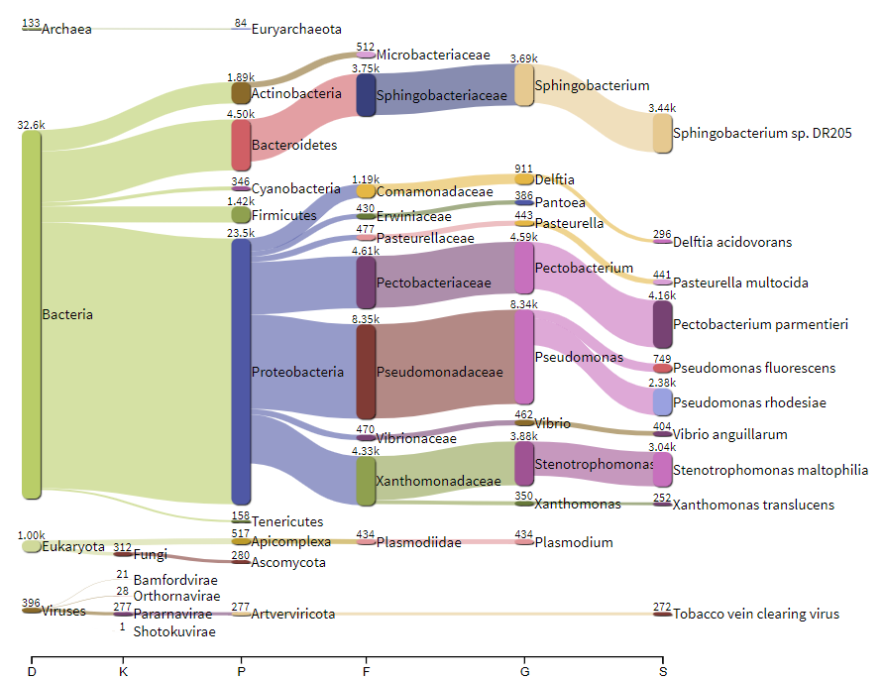
More reads does not equate to casual agent. Why?
Context! Here, we are diagnosing sick plants, not humans.
Could be a co-infection
We’re capturing DNA, not what’s currently infecting
This is metagenomic sequencing, we are not expecting the same quality genomes compared to whole genome sequencing.
Lastly, go big! In this example, you might want to choose the taxa Pectobacterium rather than P. parmentieri to obtain the most amount of reads.
Notes:
Take a look at your diagram and decide 1-2 candidates for what you think the casual agent is. We will come around a guide you

Slide 5
Remember source activate?
Navigate to you the “Programs” directory. Open the terminal in this location.
module load miniconda3
conda env create -f all-prgms.yml
conda activate all-pgrms
conda list

Slide 6
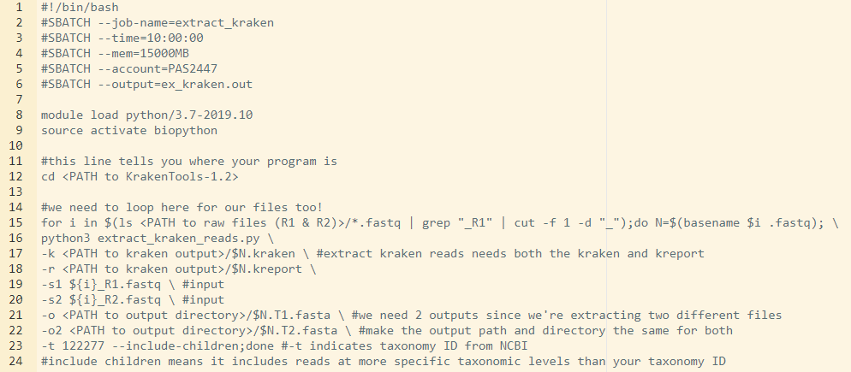
Navigate to your scripts directory and open “extract-kraken.sh”
We will go through the all the lines you need to edit in the coming slides, but let’s focus on line 23 right now. –t #### will tell extract kraken what you reads you want to extract, based off the taxonomic ID from NCBI. –include-children include all of the reads at a more specific level than you specify.

Slide 7
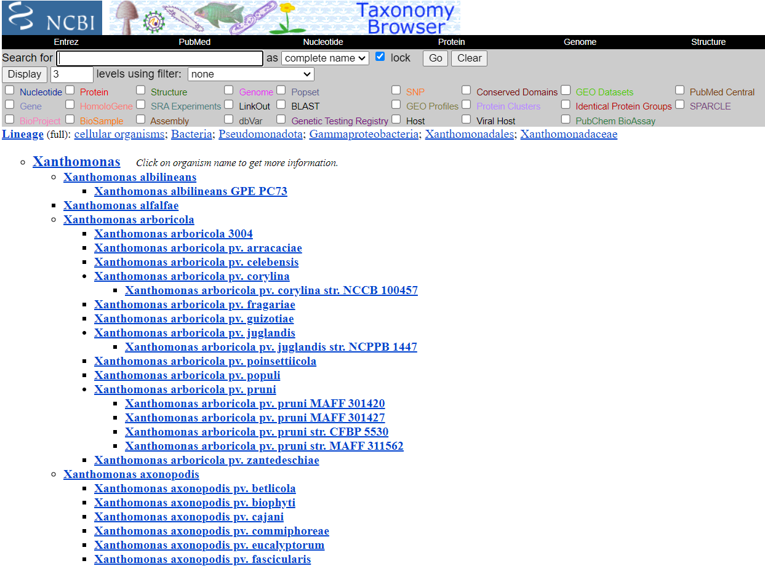
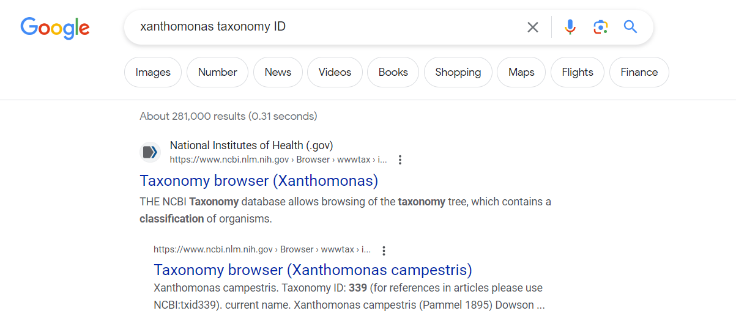
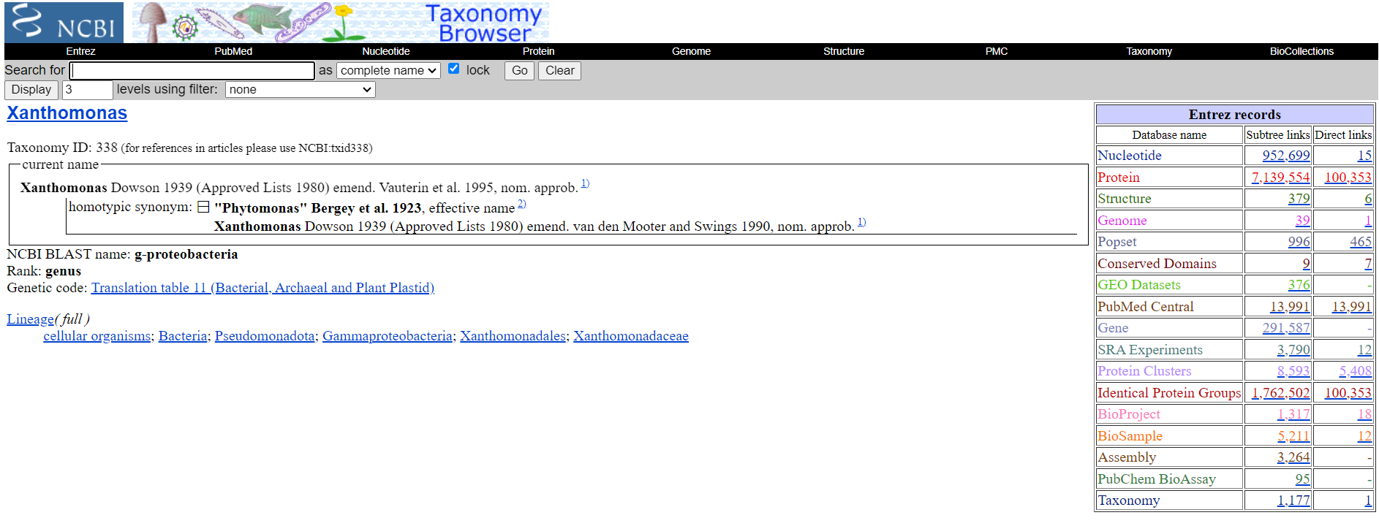
Notes:
Type in your preferred search engine “[your taxonomic classification level] taxonomy ID.” The NCBI taxonomy browser is usually the first couple results.

Slide 8
Extract reads script – extract-kraken.sh
line 9: We will create this environment shortly, however, leave as it because it will contain the same name
line 12: path to your KrakenTools-1.2 directory
line 15: path your raw data files (Dataset-# directory)
line 17 & 18: path to your kraken output folder (where your kreport and kraken files are located)
line 21 & 22: path to an output directory. I recommend creating a separate output directory for extract-kraken.
line 23: your NCBI taxonomic ID

Slide 9
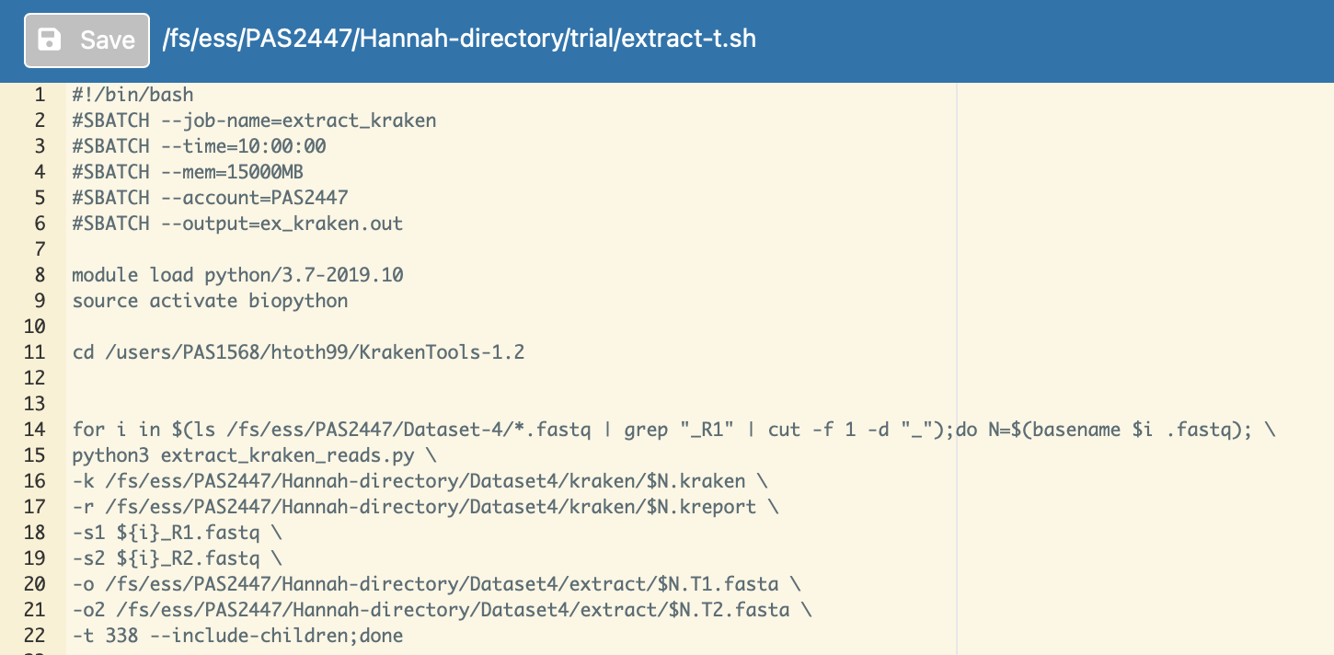

Slide 10
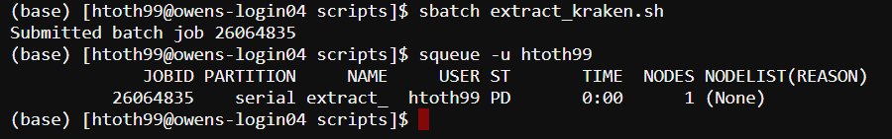
When your script is ready and all-prgms is correctly installed, you can run it! You do not need to activate your environment in the terminal because you’re already telling the script to do that.
Remember, sbatch [scriptname.sh] to run. squeue -u [username] to check status

