Slide 1
Workshop summary

Slide 2




Bioinformatics is an “art”
Bioinformatics is an ever-evolving field, and every bioinformatician conducts their work different
Every bioinformatician conducts their work differently. Today, we showed you how we do our work.

Slide 3


Bioinformatics can change fast!
We showed you how we write our code, today. Tomorrow, we may find an even better way to conduct our research.
There are always new tools coming out. Don’t be afraid to try them out!

Slide 4
Today, you learned (in no particular order)…
Module 1: Overview and metagenomic basics
Module 2: Transforming raw data into assembled genomes
Module 3: Analysis of metagenomic data and genomes
Module 4: Metagenomics for research

Slide 5
We would like to thank YOU!
Without your attendance, this workshop could not have been possible.
Please take our survey to give us feedback! Feedback is anonymous, and we would appreciate any and all comments.

Slide 6
Please answer survey!
https://forms.gle/EQcxdnHzaiKYEuXY7

Slide 7
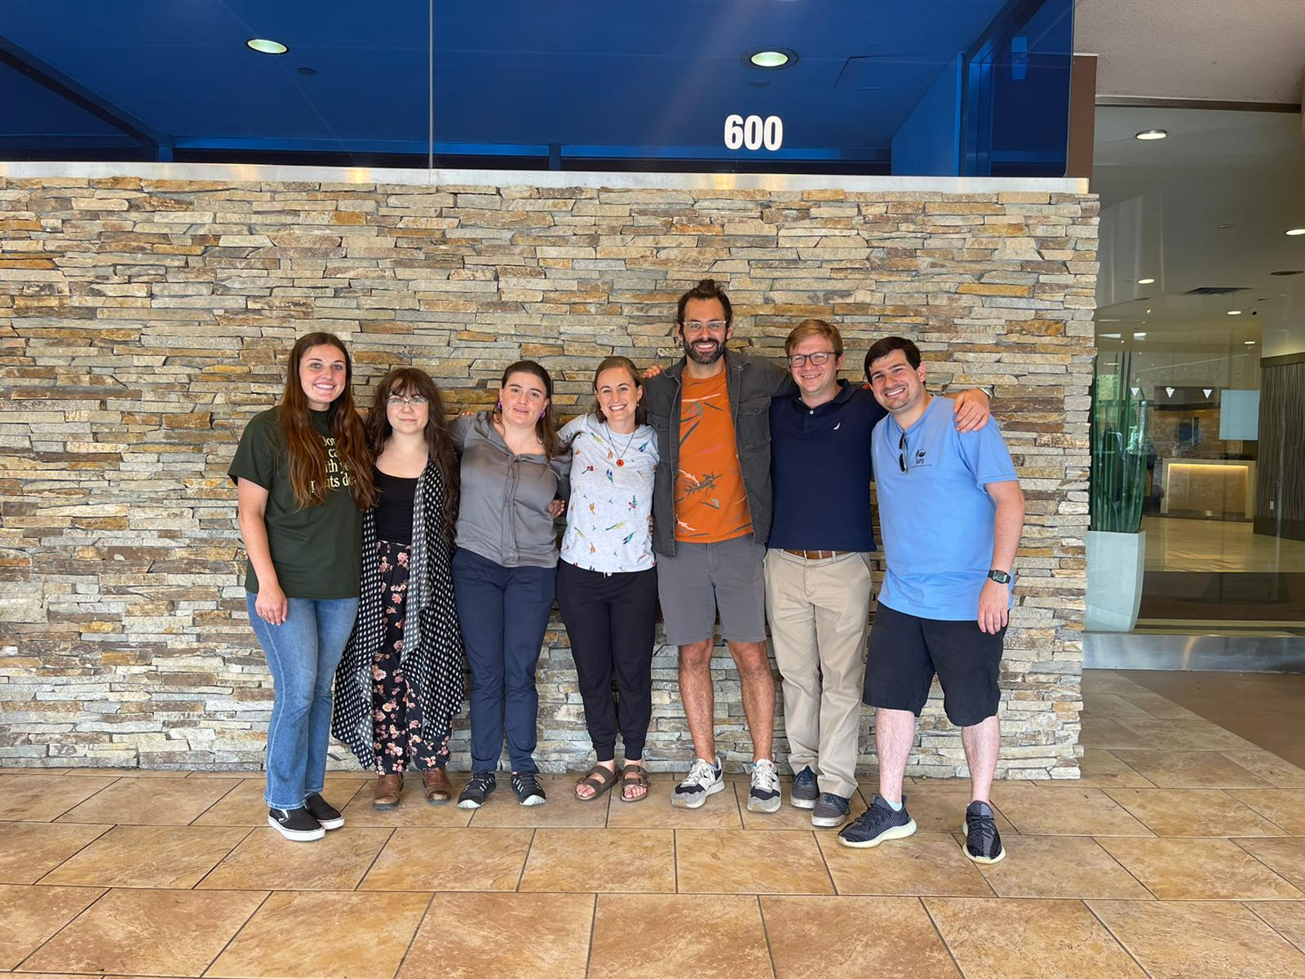
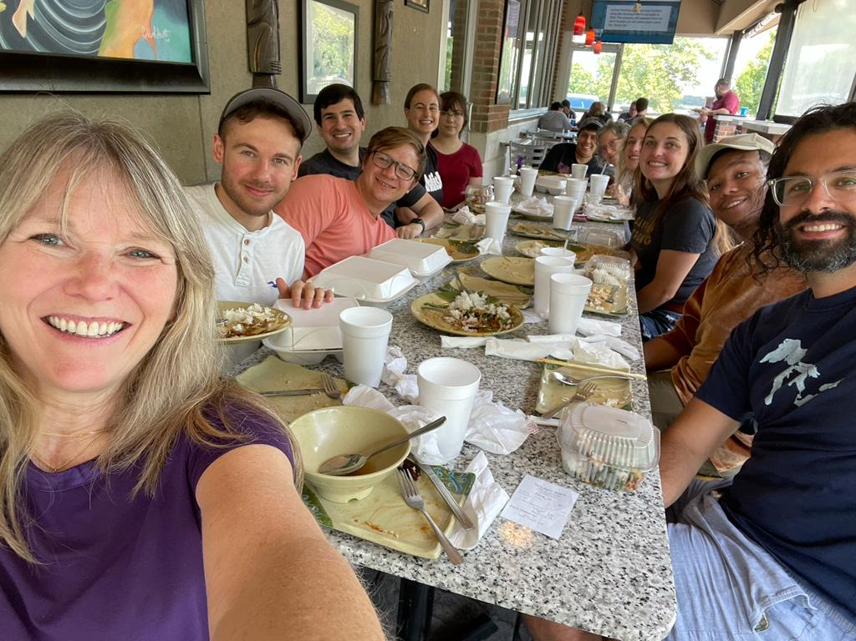
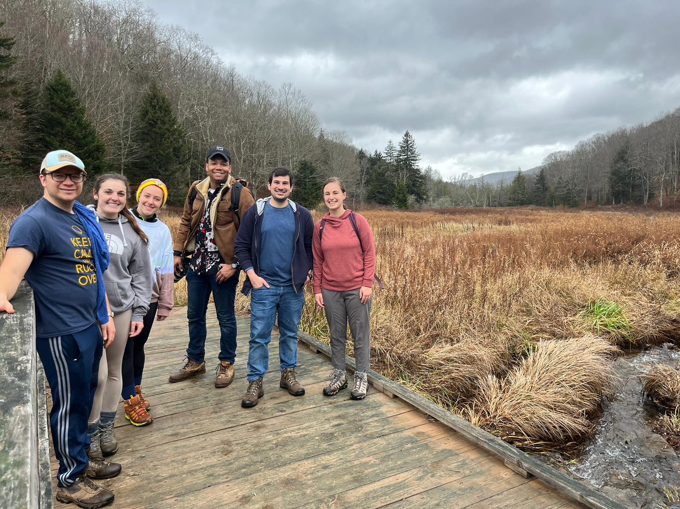
Acknowledgements
TAs:
Dr. Veronica Roman-Reyna
Dr. Marcus Merfa
Dr. Jonathan Jacobs
Taylor Klass
The entire Jacobs lab

