Slide 1
Pavian (Module 3)

Slide 2
Pavian – Kraken2 (& more) visualizer
Pavian is a program used to visual results from Kraken2 and other metagenomic classifiers, such as KrakenUniq, Centrifuge, and MetaPhlAn.
Pavian is not run in the supercomputer. Rather it can be run on a browser or R. In this workshop, we will utilize the R method
Pavian uses the .kreport produced from kraken. The .kraken files will be used later on. Please download your .kreport files now

Slide 3
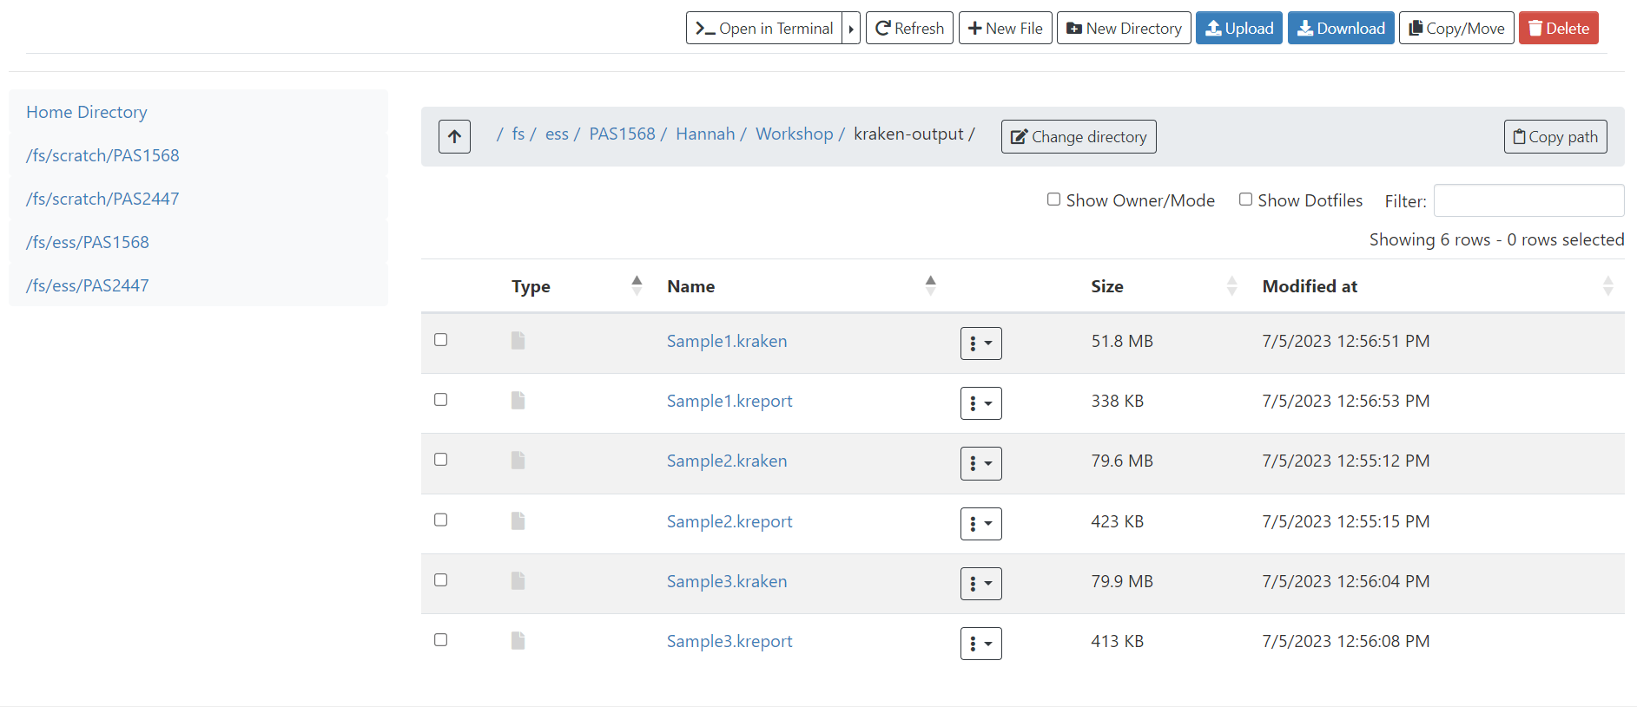

Slide 4
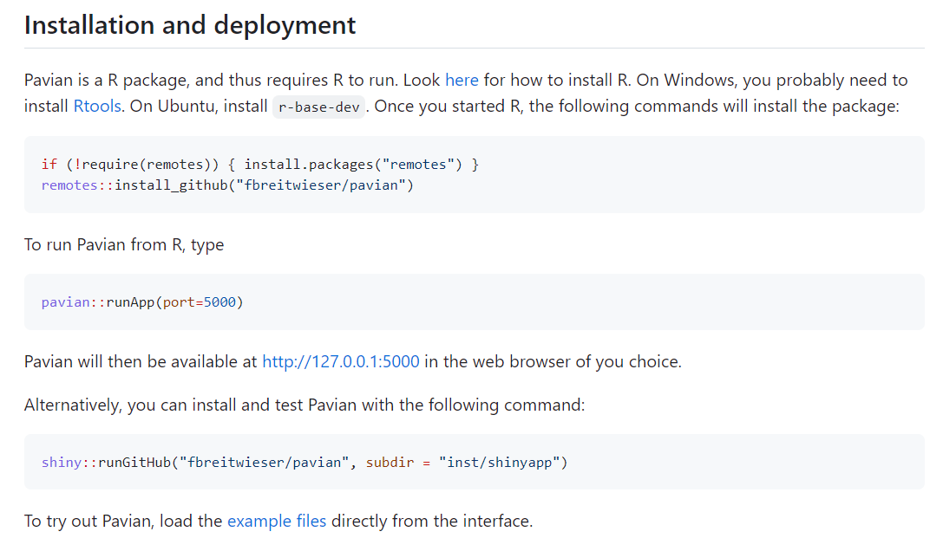
To get started, open up Rstudio on your computer
Navigate to the class github page at: https://github.com/htoth99/APS-2023-MGS. Here, you can navigate to the pavian github page, where it’ll be easier to copy and paste commands needed.
Windows users, please install Rtools if you have not done so already.
Copy and paste box 1 into R and run (highlight and run) this installs the pavian package
Copy and paste box 2 into R and run
A box should pop up with the pavian interface!

Slide 5
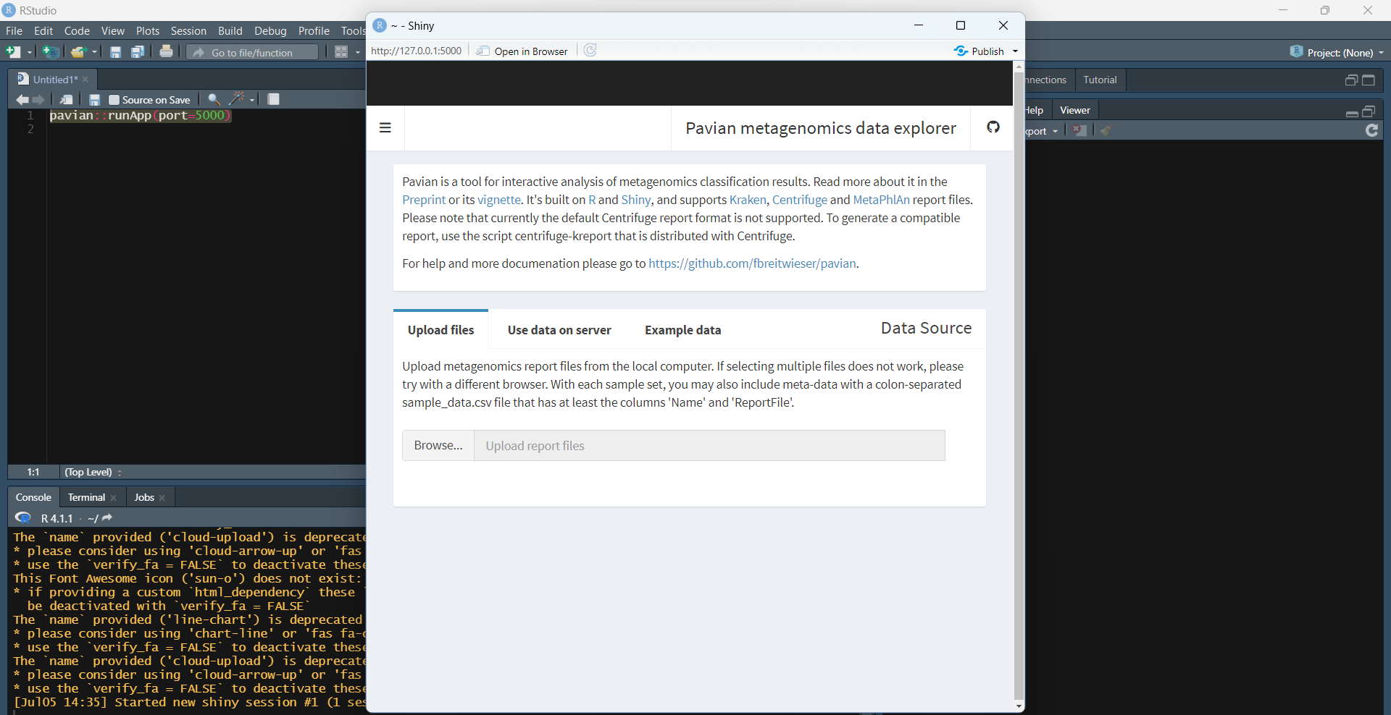
kreport files

Slide 6
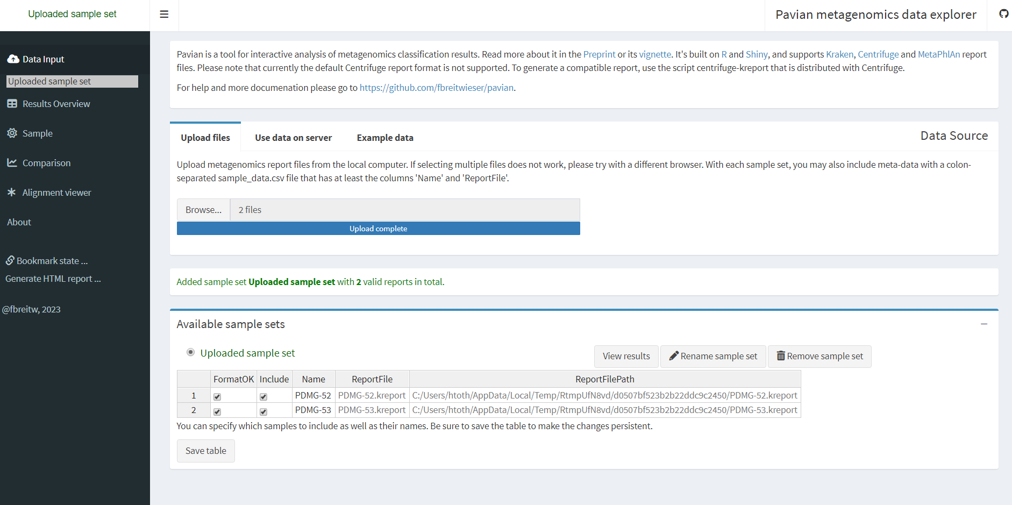
Results overview: gives raw data in the form of a table. Good for conducting numerical analysis between samples
Sample: Sankey diagram which is a great visualizer

Slide 7
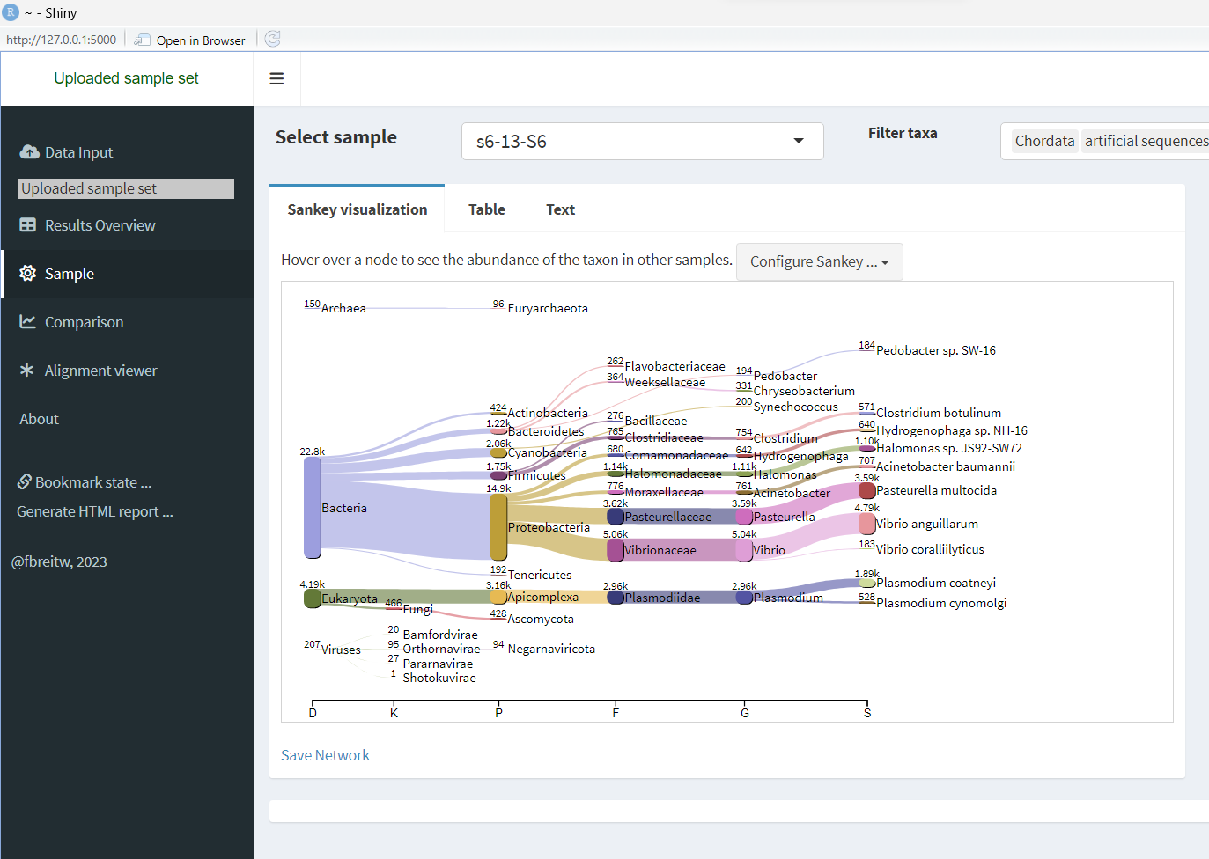
Sankey diagrams are the easiest and (coolest) way to visualize your data from pavian
Use the configure button to edit size, taxa, and other features

Slide 8
We aren’t perfect, and neither is our data
You may have noticed that you got some wonky results. One of your samples is really obvious, and the other one? Not so much.
This is the reality of metagenomic data! It’s not there to support our hypothesis; it’s there to tell us what organisms are present in our samples.
Read amount is based on sequencer. The iseq100 will give you much less reads than the Nextseq2000. Regardless of read number, the reads you do get out are important!

