Slide 1
Pyani (Module 3)

Slide 2
We have some genomes! Now what?
There are LOTS of options after you’ve obtained your genomes!
Creating phylogenetic trees
Observe evolutionary relationships across your dataset and known genomes
Studying gene content
What genes are present in our environment? What genes are not present in our environment? (think effectors, specialized proteins, etc.)
Average nucleotide identity (ANI)
A tool used to studying genome relatedness
Genome completeness
Can you recover a complete genome from metagenomics?
Diversity analysis
SNP analysis

Slide 3
Today, we will focus on ANI
Pyani is a wonderful program used for ANI. There are many other great programs out there for ANI – googling “ANI calculator” will get you many results.
We use pyani because of its simplicity and custom features.
There’s a wonderful R code that we use after we get our pyani results that can also create a tree for us.

Slide 4
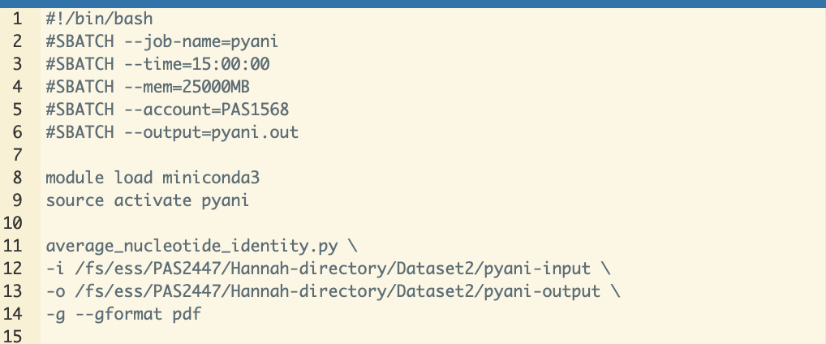
Open pyani.sh in your scripts folder
Line 12: input directory. All of your input files must be in this directory
Line 13: output directory. Pyani is weird, it wants to make its own directory. Be sure to write the last directory as one that does not exist yet.

Slide 5
