Slide 1

An Introduction to R Shiny
Haley Townsend
Msppm-da
Notes:
Who here has heard of R Shiny?
Who here has created a shiny app before?

Slide 2
AGENDA
View examples
Learn the key building blocks
Understand the importance of reactivity
Review the key components
Visit additional resources
Build one yourself!

Slide 3
Best Understood with Examples
Shiny Apps Gallery
https://gallery.shinyapps.io/shiny-salesman/
Pittsburgh (Burgh’s Eye View)
https://bit.ly/2WMOD09
Personal
https://haleytownsend.shinyapps.io/proj2app/
CVDTA App

Slide 4
Key Building Blocks
User Interface (UI)
Webpage html
Contains clickable inputs and rendered outputs
Server
Instructions in R to follow when a user changes inputs on UI
Assembles the inputs into outputs

Slide 5

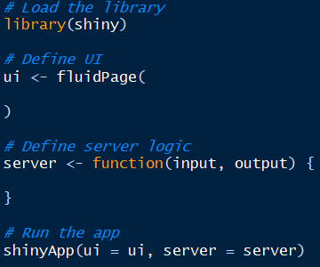
Shiny Skeleton

Slide 6
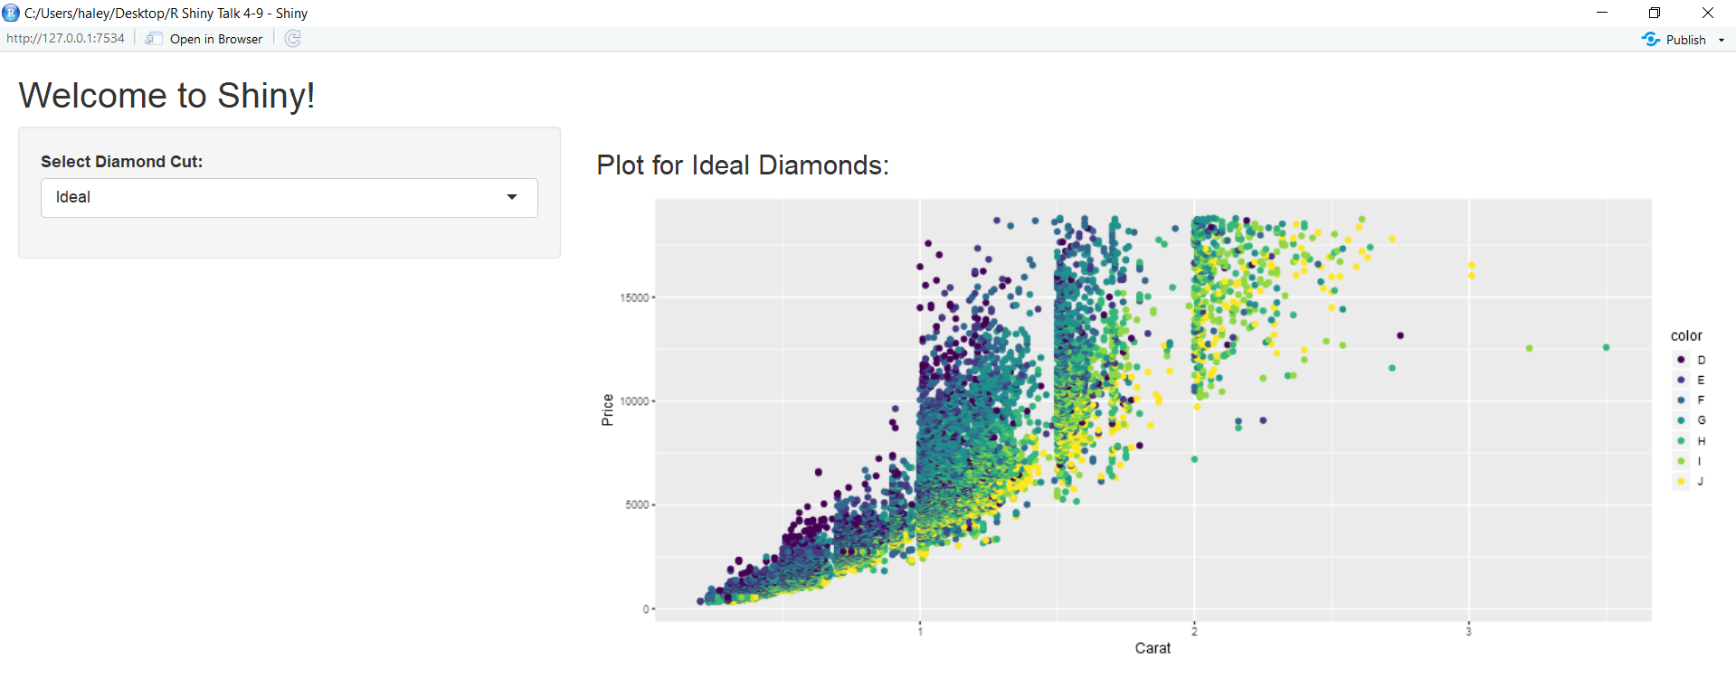

Slide 7

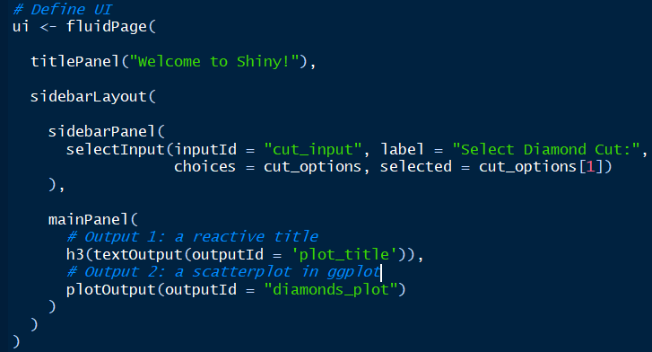
Basic UI: Code
Notes:
Designs the layout of the webpage.
Provides inputs which the user can select.
Renders outputs.

Slide 8
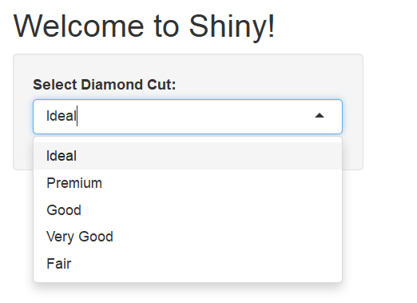
Basic UI: Result

Slide 9
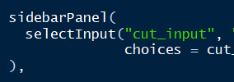
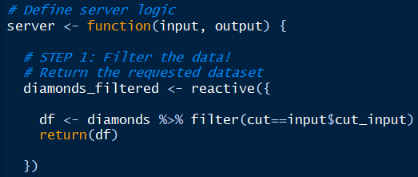

Server: Filtering the Data

Slide 10

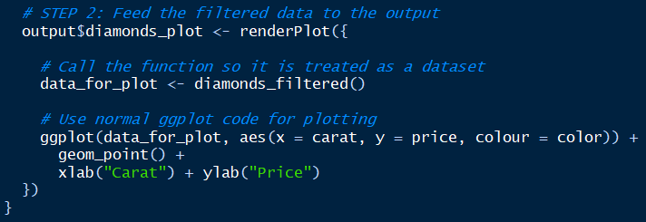
Server: Feeding the Data to the Output
Notes:
Output$diamonds_plot MUST match the name used in the UI,

Slide 11
Recapping the Key Components
User Interface
Server
Choose/design the webpage layout
Define the user inputs and choose widgets
Name the outputs and call the appropriate types with nameOutput()
Filter the data according to the selected input(s) with input$input_name
Feed that filtered data to the outputs
Set-up the outputs with output$output_name and render them with renderName({})

Slide 12
Hosting Your App
Shiny Server Open Source (runs on popular Linux distributions)
Deploy to the cloud @ shinyapps.io (free and commercial)
Shiny Server Pro (commercial)
RStudio Connect (commercial)

Slide 13
Additional Resources
For Learning
https://shiny.rstudio.com/tutorial/written-tutorial/lesson1/
https://shiny.rstudio.com/tutorial/
https://www.rstudio.com/resources/cheatsheets/#shiny
94-880 “R Shiny for Operations” with Geoffrey Arnold
For Building Cooler Apps!
https://shiny.rstudio.com/gallery/widget-gallery.html
http://rpubs.com/insight/leaflet
Shiny Dashboards, Flexdashboards
GoogleVis, leaflet

Slide 14

Give it a Try!
Install the “shiny” package in R, install.packages(“shiny”)
Begin a new R script, File → New File → R Script
Paste in the Shiny skeleton found here: https://github.com/htownsen/R_Shiny_Talk_4-9-19
Design your UI, you may want to View(diamonds) first
Make the dataset react to the inputs by filtering
Feed the filtered data to the outputs
Run your app!

Slide 15
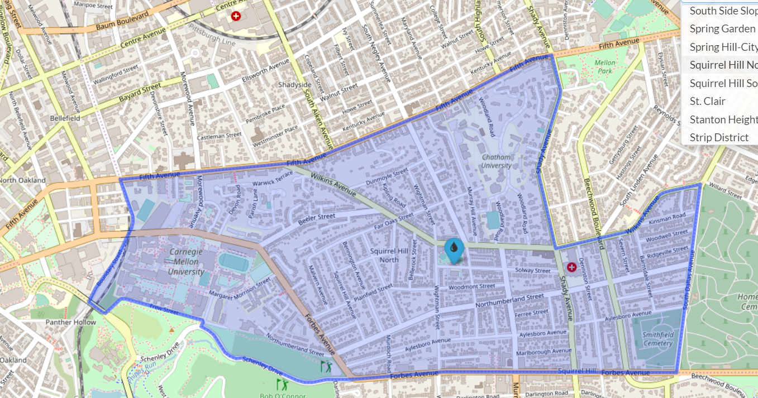
Thank you!

