Slide 1
Programming with OpenGL

Slide 2
SGI and GL
Silicon Graphics (SGI) revolutionized the graphics workstation by implementing the pipeline in hardware (1982)
To access the system, application programmers used a library called GL
With GL, it was relatively simple to program three dimensional interactive applications

Slide 3
OpenGL
The success of GL lead to OpenGL (1992), a platform-independent API that was
Easy to use
Close enough to the hardware to get excellent performance
Focus on rendering
Omitted windowing and input to avoid window system dependencies

Slide 4
Modern OpenGL
Performance is achieved by using GPU rather than CPU
Control GPU through programs called shaders
Application’s job is to send data to GPU
GPU does all rendering

Slide 5
OpenGL Libraries
OpenGL core library
OpenGL32 on Windows
GL on most unix/linux systems (libGL.a)
OpenGL Utility Library (GLU)
Provides functionality in OpenGL core but avoids having to rewrite code
Will only work with legacy code
Links with window system
GLX for X window systems
WGL for Windows
AGL for Macintosh

Slide 6
GLUT
OpenGL Utility Toolkit (GLUT)
Provides functionality common to all window systems
Open a window
Get input from mouse and keyboard
Menus
Event-driven
Code is portable but GLUT lacks the functionality of a good toolkit for a specific platform
No slide bars

Slide 7
freeglut
GLUT was created long ago and has been unchanged
Amazing that it works with OpenGL 3.1
Some functionality can’t work since it requires deprecated functions
freeglut updates GLUT
Added capabilities
Context checking

Slide 8
GLEW
OpenGL Extension Wrangler Library
Makes it easy to access OpenGL extensions available on a particular system
Avoids having to have specific entry points in Windows code
Application needs only to include glew.h and run a glewInit()

Slide 9
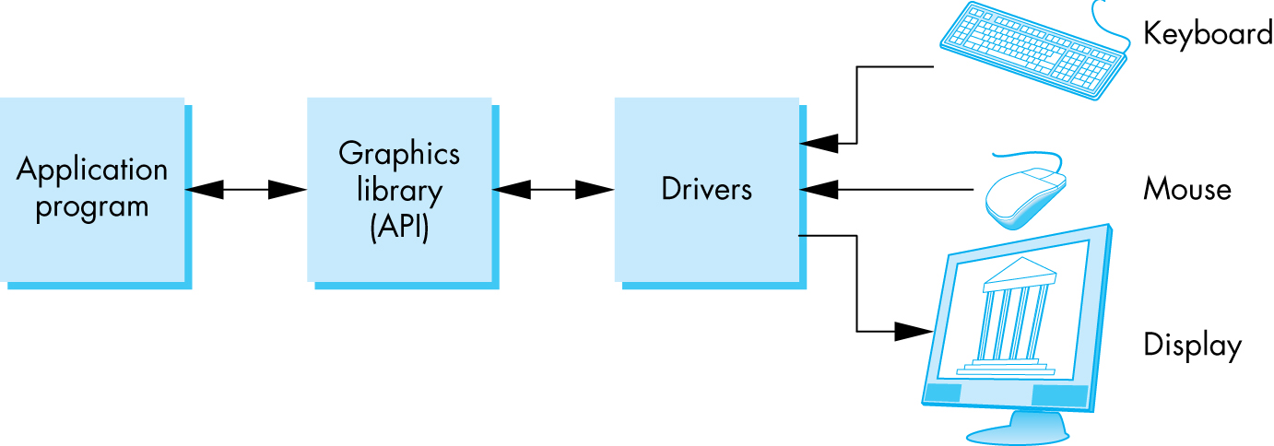
OpenGL Architecture

Slide 10
OpenGL Functions
Primitives
Points
Line Segments
Triangles
Attributes
Transformations
Viewing
Modeling
Control (GLUT)
Input (GLUT)
Query

Slide 11
OpenGL State
OpenGL is a state machine
OpenGL functions are of two types
Primitive generating
Can cause output if primitive is visible
How vertices are processed and appearance of primitive are controlled by the state
State changing
Transformation functions
Attribute functions
Under 3.1 most state variables are defined by the application and sent to the shaders

Slide 12
Lack of Object Orientation
OpenGL is not object oriented so that there are multiple functions for a given logical function
glUniform3f
glUniform2i
glUniform3dv
Underlying storage mode is the same
Easy to create overloaded functions in C++ but issue is efficiency

Slide 13
OpenGL Convention
Functions:
prefix gl + capital first letter (e.g. glClearColor)
Constants:
prefix GL + all capitals (e.g. GL_COLOR_BUFER_BIT)

Slide 14
OpenGL function format
function name
dimensions
glUniform3f(x,y,z)
x,y,z are floats
belongs to GL library
glUniform3fv(p)
p is a pointer to an array

Slide 15
OpenGL #defines
Most constants are defined in the include files gl.h, glu.h and glut.h
Note #include <GL/glut.h> should automatically include the others
Examples
glEnable(GL_DEPTH_TEST)
glClear(GL_COLOR_BUFFER_BIT)
include files also define OpenGL data types: GLfloat, GLdouble,….

Slide 16
OpenGL and GLSL
Shader based OpenGL is based less on a state machine model than a data flow model
Most state variables, attributes and related pre 3.1 OpenGL functions have been deprecated
Action happens in shaders
Job is application is to get data to GPU

Slide 17
GLSL
OpenGL Shading Language
C-like with
Matrix and vector types (2, 3, 4 dimensional)
Overloaded operators
C++ like constructors
Similar to Nvidia’s Cg and Microsoft HLSL
Code sent to shaders as source code
New OpenGL functions to compile, link and get information to shaders

Slide 18
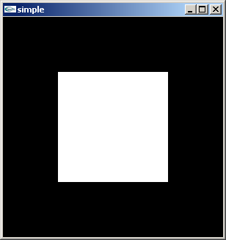
A Simple Program (?)
Generate a square on a solid background

Slide 19
It used to be easy
#include <GL/glut.h>
void mydisplay(){
glClear(GL_COLOR_BUFFER_BIT);
glBegin(GL_QUAD);
glVertex2f(-0.5, -0.5);
glVertex2f(-0.5, 0.5);
glVertex2f(0.5, 0.5);
glVertex2f(0.5, -0.5);
glEnd();
}
int main(int argc, char** argv){
glutCreateWindow("simple");
glutDisplayFunc(mydisplay);
glutMainLoop();
}

Slide 20
Event Loop
Note that the program specifies a display callback function named mydisplay
Every glut program must have a display callback
The display callback is executed whenever OpenGL decides the display must be refreshed, for example when the window is opened
The main function ends with the program entering an event loop

Slide 21
Program Structure
Most OpenGL programs have a similar structure that consists of the following functions
main():
specifies the callback functions
opens one or more windows with the required properties
enters event loop (last executable statement)
init(): sets the state variables
Viewing
Attributes
callbacks
Display function
Input and window functions

Slide 22
OpenGL Drawing Primitives
The numbers indicate the order in which the vertices have been specified.
Note that for the GL_LINES primitive only every second vertex causes a line segment to be drawn.
Similarly, for the GL_TRIANGLES primitive, every third vertex causes a triangle to be drawn.
Note that for the GL_TRIANGLE_STRIP and GL_TRIANGLE_FAN primitives, a new triangle is produced for every additional vertex. All of the closed primitives shown below are solid-filled, with the exception of GL_LINE_LOOP, which only draws lines connecting the vertices.

Slide 23
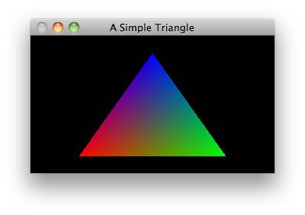
Adding colors
// Drawing is done by specifying a sequence of vertices. The way these vertices are connected (or not connected) depends on the argument to glBegin. GL_POLYGON constructs a filled polygon.
glBegin(GL_POLYGON);
glColor3f(1, 0, 0); glVertex3f(-0.6, -0.75, 0.5);
glColor3f(0, 1, 0); glVertex3f(0.6, -0.75, 0);
glColor3f(0, 0, 1); glVertex3f(0, 0.75, 0);
glEnd();

Slide 24
Transform in OpenGL
OpenGL uses stacks to maintain transformation matrices (MODELVIEW stack is the most important)
You can load, push and pop the stack
The current transform is applied to all graphics primitive until it is changed

Slide 25
General Transform Commands
Specify current matrix
void glMatrixMode(GLenum mode)
GL_MODELVIEW, GL_PROJECTION, GL_TEXTURE
Initialize current matrix
void glLoadIdentity(void)
void glLoadMatrix[f,d](const TYPE *m)
OpenGL matrices are stored in column major (this is different from C convention)

Slide 26
OpenGL functions for setting up transformations
modelling transformation (modelview matrix)
glTranslatef()
glRotatef()
glScalef()
viewing transformation (modelview matrix)
gluLookAt()

Slide 27
OpenGL functions for setting up transformations
projection transformation (projection matrix)
glFrustum()
gluPerspective()
glOrtho()
gluOrtho2D()
viewing transformation
glViewport()

Slide 28
Structure of a GLUT Program
int main(int argc, char **argv) {
glutInit(&argc, argv);
glutInitDisplayMode(GLUT_DOUBLE |
GLUT_RGB | GLUT_DEPTH);
glutInitWindowPosition(80, 80);
glutInitWindowSize(800, 600);
glutCreateWindow("Interactive rotating
cube");
glutDisplayFunc(display);
// display callback, routines for drawing

Slide 29
Structure of a GLUT Program
glutKeyboardFunc(myKeyHandler);
// keyboard callback
glutMouseFunc(myMouseClickHandler);
// mouse callback
glutMotionFunc(myMouseMotionHandler);
// mouse move callback
init();
glutMainLoop();
}

Slide 30
Structure of a GLUT Program
void display() {...}
void myKeyHandler( unsigned char key, int x, int y) {...}
void myMouseClickHandler( int button, int state, int x, int y ) {...}
void myMouseMotionHandler( int x, int y) {...}

Slide 31
Compilation on Windows
Visual C++
CodeBlocks

