Slide 1
Graphs

Slide 2
Terminology
Definition:
A set of points that are joined by lines
Graphs represent the relationships among data items
G = { V , E }; that is, a graph is a ordered pair of vertices and edges
A subgraph consists of a subset of a graph’s vertices and a subset of its edges

Slide 3
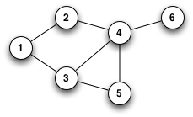
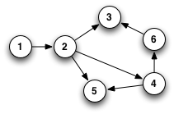
Terminology
Undirected graphs: edges do not indicate a direction
Social Network (FaceBook) can be represented as undirected graph
Directed graph, or digraph: each edge has a direction
Inter-linked web pages on the internet
Undirected graph
Directed graph

Slide 4
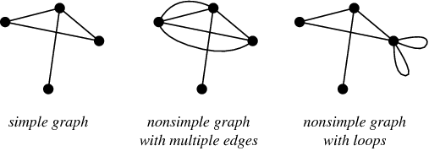
Terminology
Simple graphs has following properties:
edges has no direction
no multiple edges between two nodes
no loops
Multigraph: does allow multiple edges

Slide 5
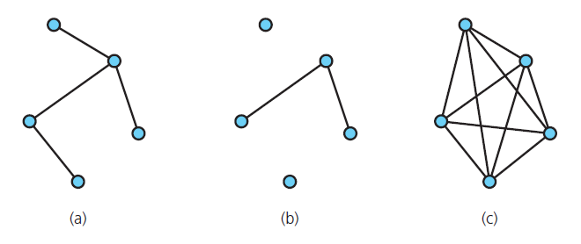
Terminology
Connected graph: each pair of distinct vertices has a path between them
Graphs that are (a) connected; (b) disconnected; and (c) complete

Slide 6
Terminology
Strongly Connected graph: each pair of distinct vertices has a path between them in a directed graph

Slide 7
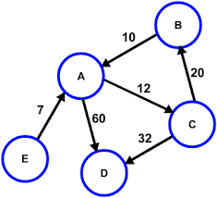
Terminology
Weighted Graph: When labels represent numeric values, graph is called a weighted graph
Weighted Graph

Slide 8
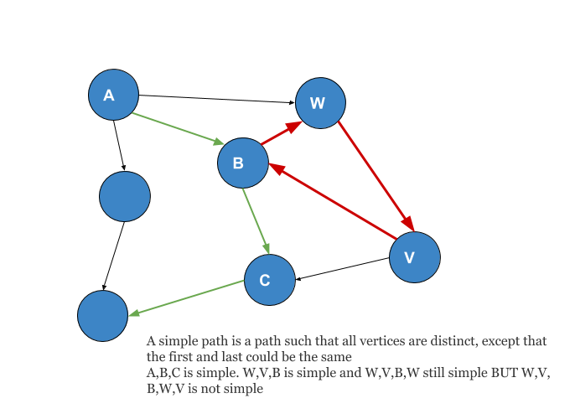
Terminology
Simple path: passes through vertex only once

Slide 9
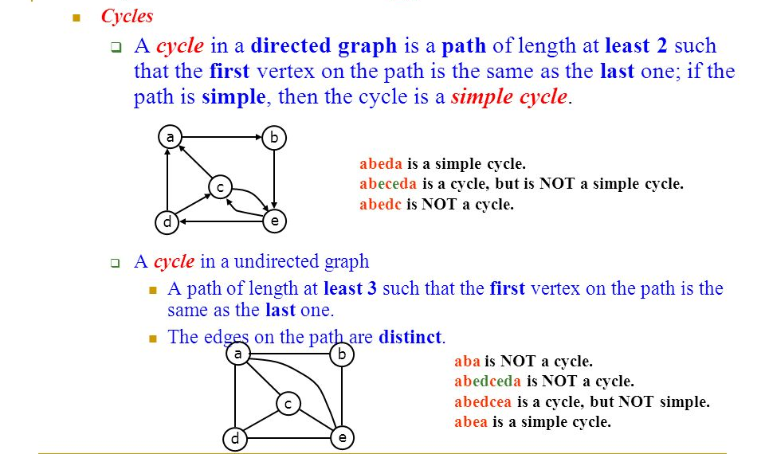
Terminology

Slide 10
Terminology
Number of Edges in a Directed Graph
If |v| = n
Then 0<= |E|<= n(n-1)
Number of Edges in an Undirected Graph
0<= |E|<= n(n-1)/2
Dense graph – too many edges
Sparse graph – too few edges

Slide 11
Graphs as ADTs
ADT graph operations
Test whether graph is empty.
Get number of vertices in a graph.
Get number of edges in a graph.
See whether edge exists between two given vertices.
Insert vertex in graph whose vertices have distinct values that differ from new vertex’s value.

Slide 12
Graphs as ADTs
ADT graph operations, ctd.
Insert edge between two given vertices in graph.
Remove specified vertex from graph and any edges between the vertex and other vertices.
Remove edge between two vertices in graph.
Retrieve from graph vertex that contains given value.

Slide 13
Graph Representation
A Graph G = (V, E) can be represented in a memory as a Edge list
We can create two lists
One for vertices
Another for edges
We can use an array of appropriate size or we can use an implementation of dynamic list such as vector in C++ or ArrayList in Java
A
B
A
B
C
D
E
F
G
H
F
C
E
D
H
G
Vertex List
Edge List

Slide 14
Graph Representation
A
B
F
C
E
struct Edge
{
char *startVertex;
char *endVertex;
}
OR
Class Edge
{
string startVertex;
string endVertex;
}
struct Edge EdgeList[MAX_SIZE]
D
A
B
H
A
C
G
A
D
B
E
A
B
C
D
E
F
G
H
B
F
C
G
D
H
E
H
F
H
G
H
Vertex List
Edge List

Slide 15
Weighted Graph Representation
5
A
B
7
10
3
2
F
C
E
struct Edge
{
char *startVertex;
char *endVertex;
int weight;
}
OR
Class Edge
{
string startVertex;
string endVertex;
int weight;
}
struct Edge EdgeList[MAX_SIZE]
D
9
4
1
11
A
B
5
G
H
6
A
C
7
A
B
C
D
E
F
G
H
A
D
3
B
E
2
B
F
10
C
G
1
D
H
11
E
H
9
Vertex List
F
H
4
G
H
6
Edge List

Slide 16
Graph Representation
However, this representation is not very efficient.
Space complexity (memory usage)
of Vertex list is O(|V|)
and for Edge list its quite high
if we store the strings.
A
B
5
A
C
7
A
B
C
D
E
F
G
H
A
D
3
B
E
2
B
F
10
C
G
1
D
H
11
E
H
9
Vertex List
F
H
4
G
H
6
Edge List

Slide 17
Graph Representation
A
B
7
10
3
2
F
C
E
struct Edge
{
int startVertex;
int endVertex;
int weight;
}
OR
Class Edge
{
int startVertex;
int endVertex;
int weight;
}
struct Edge EdgeList[MAX_SIZE]
D
9
4
1
11
0
1
5
G
H
6
0
2
7
0 | A
1 | B
2 | C
3 | D
4 | E
5 | F
6 | G
7 | H
0
3
3
1
4
2
Now, the space complexity of edge list is O(|E|)
1
5
10
2
6
1
3
7
11
4
7
9
Vertex List
5
7
4
6
7
6
Edge List

Slide 18
Graph Representation
A
B
7
10
3
2
F
C
E
One of the most frequent task on Graph would be:
To find all nodes adjacent (directly connected) to a given node.
What is the time complexity of this operation using this representation?
D
9
1
11
0
1
5
G
H
0
2
7
0 | A
1 | B
2 | C
3 | D
4 | E
5 | F
6 | G
7 | H
0
3
3
1
4
2
1
5
10
2
6
1
3
7
11
4
7
9
Vertex List
5
7
4
6
7
6
Edge List

Slide 19
Graph Representation
A
B
7
10
3
2
F
C
E
Another operation: find if two given nodes are connected
Both the cases we have to perform linear search on the edge list
Running time O(|E|)
How good or bad this complexity is?
In a simple graph
If |v| = n
Then 0<= |E|<= n(n-1) if directed
0<= |E|<= n(n-1)/2 if undirected
If |V| = n then |E| = O(n²) –costly
D
9
1
11
0
1
5
G
H
0
2
7
0 | A
1 | B
2 | C
3 | D
4 | E
5 | F
6 | G
7 | H
0
3
3
1
4
2
1
5
10
2
6
1
3
7
11
4
7
9
Vertex List
5
7
4
6
7
6
Edge List

Slide 20
Graph Representation Adjacency Matrix
A
B
F
C
E
D
G
H
 | 0 | 1 | 2 | 3 | 4 | 5 | 6 | 7
0 | 0 | 1 | 1 | 1 | 0 | 0 | 0 | 0
1 | 1 | 0 | 0 | 0 | 1 | 1 | 0 | 0
2 | 1 | 0 | 0 | 0 | 0 | 0 | 1 | 0
3 | 1 | 0 | 0 | 0 | 0 | 0 | 0 | 1
4 | 0 | 1 | 0 | 0 | 0 | 0 | 0 | 1
5 | 0 | 1 | 0 | 0 | 0 | 0 | 0 | 1
6 | 0 | 0 | 1 | 0 | 0 | 0 | 0 | 1
7 | 0 | 0 | 0 | 1 | 1 | 1 | 1 | 0
0 | A
1 | B
2 | C
3 | D
4 | E
5 | F
6 | G
7 | H
What is the time complexity of finding all adjacent nodes of a given node
Searching the vertex list to get the index, i of the given node is O(v) and scanning the i^{th} row of the matrix is O(v)
Vertex List

Slide 21
Graph Representation Adjacency Matrix
A
B
F
C
E
D
Good if Graph is Dense
G
H
 | 0 | 1 | 2 | 3 | 4 | 5 | 6 | 7
0 | 0 | 1 | 1 | 1 | 0 | 0 | 0 | 0
1 | 1 | 0 | 0 | 0 | 1 | 1 | 0 | 0
2 | 1 | 0 | 0 | 0 | 0 | 0 | 1 | 0
3 | 1 | 0 | 0 | 0 | 0 | 0 | 0 | 1
4 | 0 | 1 | 0 | 0 | 0 | 0 | 0 | 1
5 | 0 | 1 | 0 | 0 | 0 | 0 | 0 | 1
6 | 0 | 0 | 1 | 0 | 0 | 0 | 0 | 1
7 | 0 | 0 | 0 | 1 | 1 | 1 | 1 | 0
0 | A
1 | B
2 | C
3 | D
4 | E
5 | F
6 | G
7 | H
What is the time complexity of finding if two nodes are connected?
Two nodes can be given as indices or names. If the indices of the nodes are given then we need to look at value in a particular row and column which can be done in constant time.
Vertex List

Slide 22
Graph Representation Adjacency List
A
B
F
C
E
D
0 | 1 | 2 | 30
1 | 0 | 4 | 5
2 | 0 | 6
3 | 0 | 7
4 | 1 | 7
5 | 1 | 7
6 | 2 | 7
7 | 3 | 6 | 4 | 5
G
H
 | 0 | 1 | 2 | 3 | 4 | 5 | 6 | 7
0 | 0 | 1 | 1 | 1 | 0 | 0 | 0 | 0
1 | 1 | 0 | 0 | 0 | 1 | 1 | 0 | 0
2 | 1 | 0 | 0 | 0 | 0 | 0 | 1 | 0
3 | 1 | 0 | 0 | 0 | 0 | 0 | 0 | 1
4 | 0 | 1 | 0 | 0 | 0 | 0 | 0 | 1
5 | 0 | 1 | 0 | 0 | 0 | 0 | 0 | 1
6 | 0 | 0 | 1 | 0 | 0 | 0 | 0 | 1
7 | 0 | 0 | 0 | 1 | 1 | 1 | 1 | 0
0 | A
1 | B
2 | C
3 | D
4 | E
5 | F
6 | G
7 | H
OR
Vertex List

Slide 23
Graph Representation Adjacency List
A
B
F
C
E
D
0 | 1 | 2 | 30
1 | 0 | 4 | 5
2 | 0 | 6
3 | 0 | 7
4 | 1 | 7
5 | 1 | 7
6 | 2 | 7
7 | 3 | 6 | 4 | 5
G
H
0 | A
1 | B
2 | C
3 | D
4 | E
5 | F
6 | G
7 | H
int *A[8];
A[0] = new int[3];
A[1] = new int[3] ;
A[2] = new int[2];
:
:
A[7] = new int[4] ;
OR can use linked list
struct Node
{ int data;
struct Node* next;
};
struct Node *A[8];
Vertex List

Slide 24
Graph Traversals
Visits all of the vertices that it can reach
Happens if and only if graph is connected
Connected component is subset of vertices visited during traversal that begins at given vertex

Slide 25
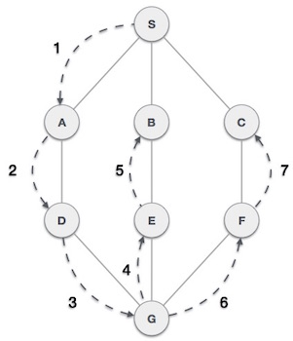
Depth-First Search
Depth First Search algorithm(DFS) traverses a graph in a depth ward motion and uses a stack to remember to get the next vertex to start a search when a dead end occurs in any iteration.
Step 1 − Visit adjacent unvisited vertex. Mark it visited. Display it. Push it in a stack.
Step 2 − If no adjacent vertex found, pop up a vertex from stack. (It will pop up all the vertices from the stack which do not have adjacent vertices.)
Step 3 − Repeat Step 1 and tep 2 until stack is empty.

Slide 26
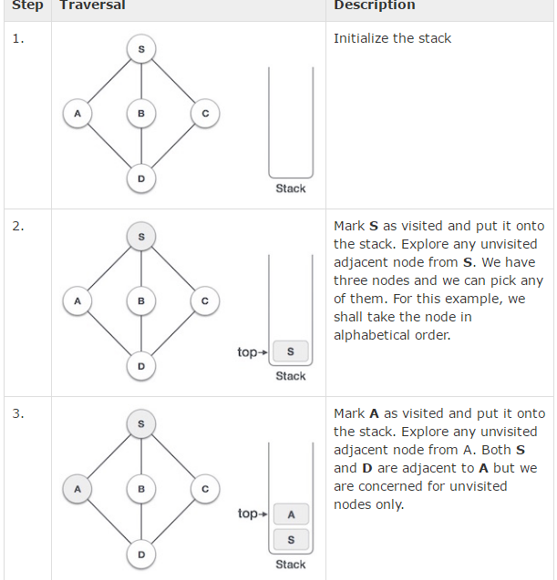
Depth-First Search

Slide 27
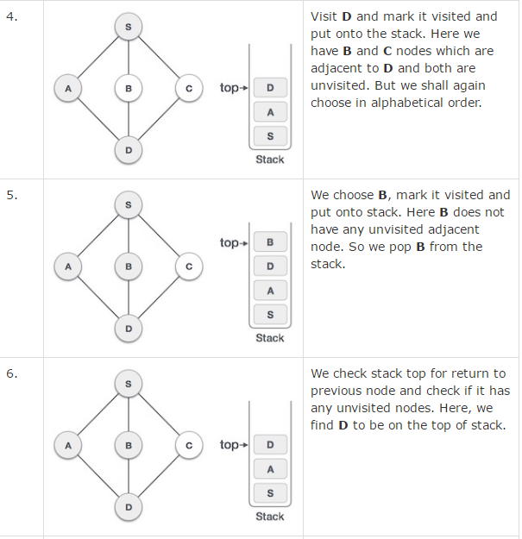
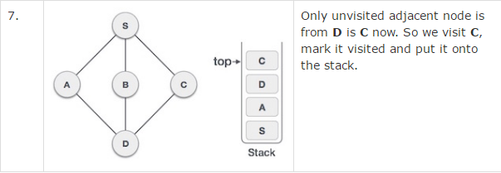
Depth-First Search

Slide 28
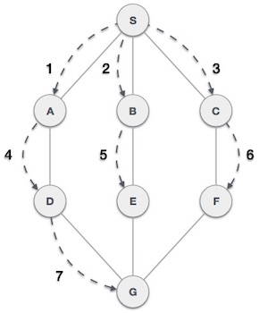
Breadth-First Search
Breadth First Search algorithm(BFS) traverses a graph in a breadth wards motion and uses a queue to remember to get the next vertex to start a search when a dead end occurs in any iteration.
Step 1 − Visit adjacent unvisited vertex. Mark it visited. Display it. Insert it in a queue.
Step 2 − If no adjacent vertex found, remove the first vertex from queue.
Step 3 − Repeat Step 1 and Step 2 until queue is empty.

Slide 29
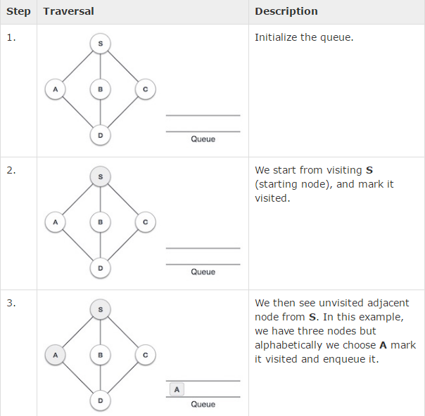
Breadth-First Search

Slide 30
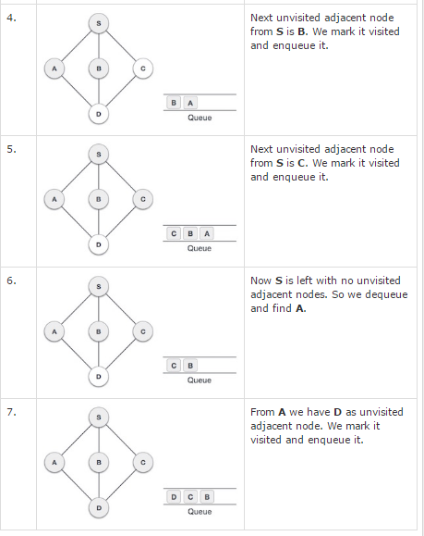
Breadth-First Search

