Slide 1
Lab-02
Disk Scheduling

Slide 2
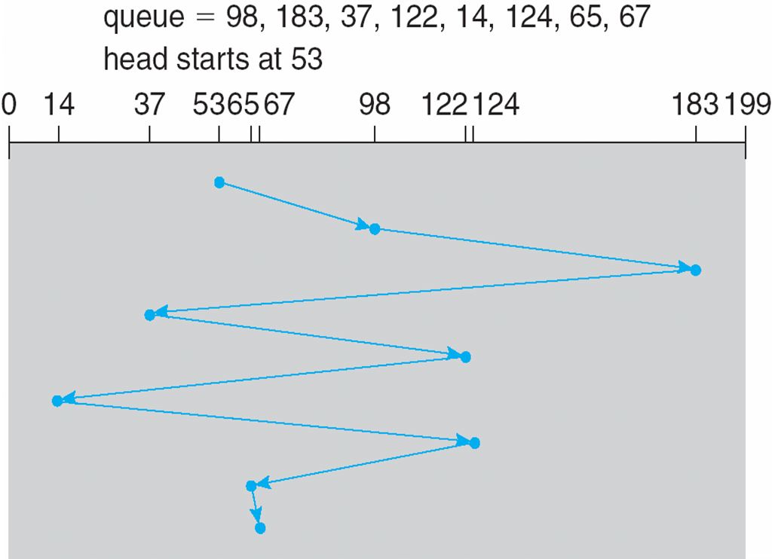
FCFS
Total distance: (98-53)+(183-98)+(183-37)+(122-37) + (122-14)+(124-14)+(124-65)+(67-65)
Path: 53 98 183 37 122 14 124 65 67
Illustration shows total head movement of 640 cylinders

Slide 3
SSTF
Selects the request with the minimum seek time from the current head position
SSTF scheduling is a form of SJF scheduling; may cause starvation of some requests
Illustration shows total head movement of 236 cylinders

Slide 4
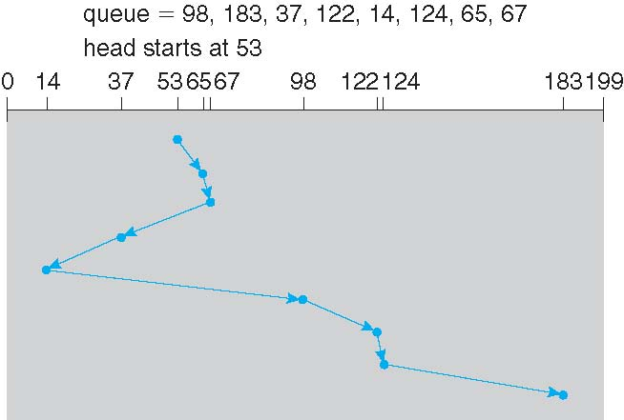
SSTF (Cont.)
Total distance: (65-53)+(67-65)+(67-37)+(37-14)+(98-14)+(122-98)+(124-122)+(183-124)
path: 53 65 67 37 14 98 122 124 183
53 65 67 37 14 98 122 124 183

Slide 5
SCAN
The disk arm starts at one end of the disk, and moves toward the other end, servicing requests until it gets to the other end of the disk, where the head movement is reversed and servicing continues.
SCAN algorithm sometimes called the elevator algorithm
Illustration shows total head movement of 208 cylinders

Slide 6
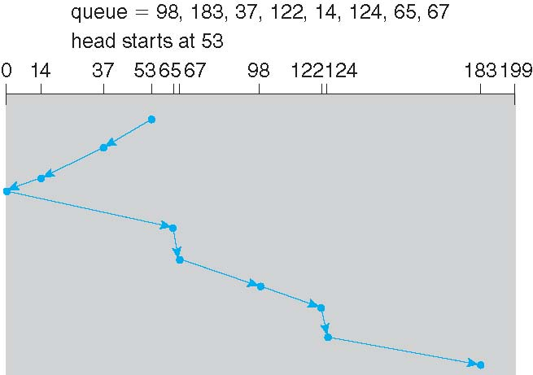
SCAN (Cont.)
53 37 14 0 65 67 98 122 124 183
(53-37)+(37-14)+(14-0)+(65-0)+(67-65)+(98-67)+(122-98)+(124-122)+(183-124)

Slide 7
C-SCAN
Provides a more uniform wait time than SCAN
The head moves from one end of the disk to the other, servicing requests as it goes
When it reaches the other end, however, it immediately returns to the beginning of the disk, without servicing any requests on the return trip
Treats the cylinders as a circular list that wraps around from the last cylinder to the first one

Slide 8
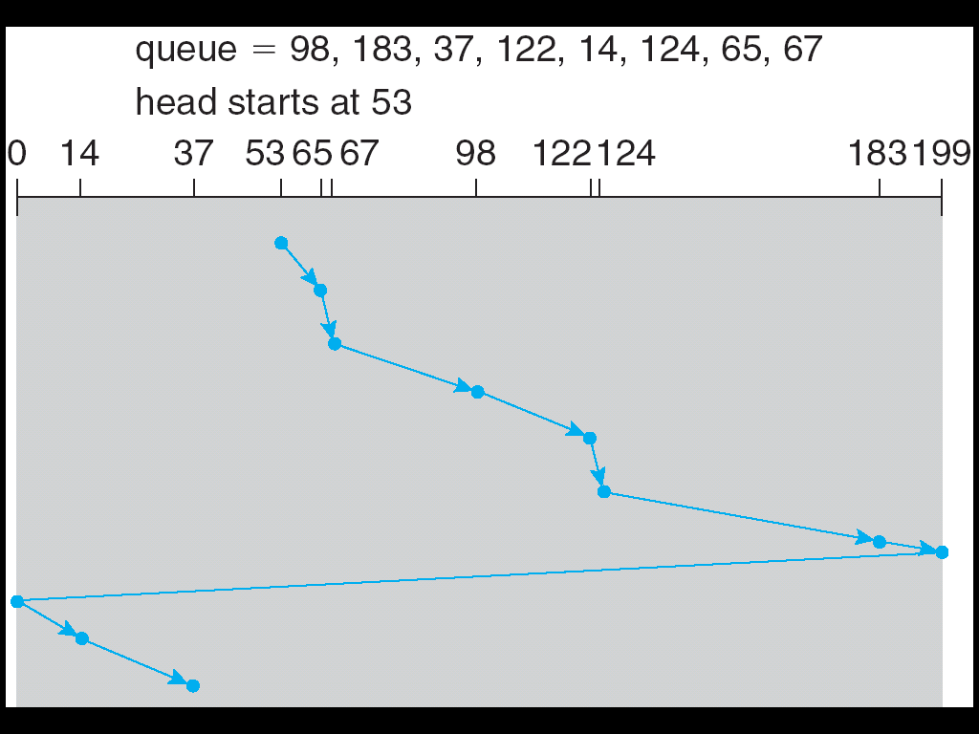
C-SCAN (Cont.)
53 65 67 98 122 124 183 199 0 14 37

Slide 9
C-LOOK
Version of C-SCAN
Arm only goes as far as the last request in each direction, then reverses direction immediately, without first going all the way to the end of the disk

Slide 10
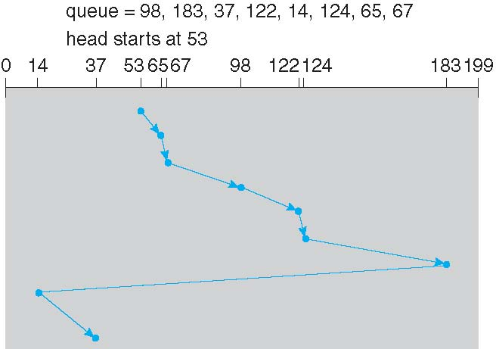
C-LOOK (Cont.)
53 65 67 98 122 124 183 14 37

