Slide 1
Operating System
Lab-01

Slide 2
Scheduling Algorithms

Slide 3
CPU has many processes running at a time.
Need to time share between them.

Slide 4
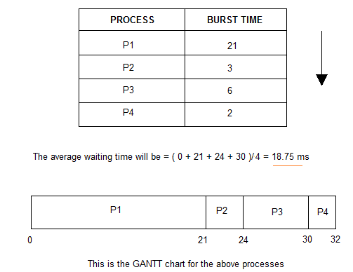
First Come First Serve
0 p1 21 p2 24 p3 30 p4 32

Slide 5
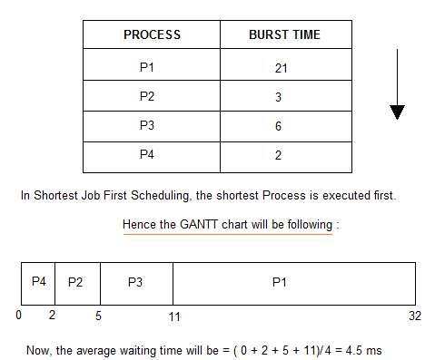
Shortest Job First
0 p4 2 p2 5 p3 11 p1 32

Slide 6
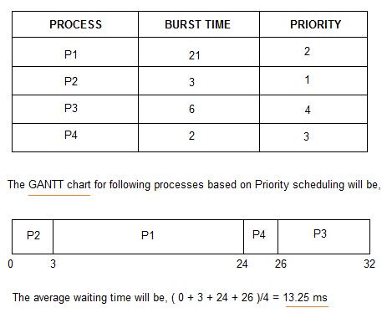
Priority Scheduling

Slide 7
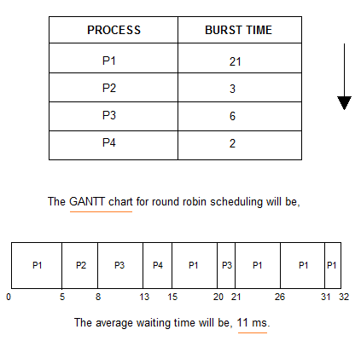
Round Robin
Here, Quantam = 5

