Slide 1
Parser

Slide 2
Parser - classification
3 types of parser
Universal
Example: Cocke-Younger-Kasami algorithm and Earley's algorithm
Can parse any grammar
But too inefficient to use for production compiler
Top-down
Create the parse tree from root to leaves
Bottom-up
Create the parse tree from leaves to root.
Note: For both top-down and Bottom-up parser, the input is scan from left to right.

Slide 3
Top-Down Parser
Create the parse tree from root to leaves
Constructs from the Grammar which is free from ambiguity and left recursion.
Uses leftmost derivation to construct a parse tree.
It allows a grammar which is free from Left Factoring.

Slide 4
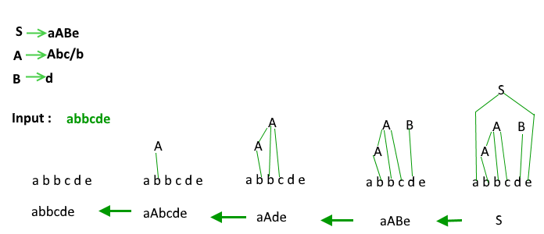
Bottom-Up Parser
Build the parse tree from leaves to root.
Reduce the input string “s” to the start symbol of grammar by tracing out the RMD of “s” in reverse.
Example- (from geeksforgeeks)

Slide 5
Parser – detailed classification
Parser
Top-Down Parser
Recursive Descent
Without Backtracking
Bottom-Up Parser
Shift-Reduce Parser
Predictive Parser
LL Parser
LR Parser
LR(0)
LALR
With Backtracking
Operator Precedence
CLR
SLR(1)

Slide 6
Recursive Descent Parser
It is a top-down parser/read input from left to right.
This parsing technique recursively parses the input to make a parse tree, which may or may not require back-tracking.
But the grammar associated with it (if not left factored) cannot avoid back-tracking.
Consists of set of procedures- one for each non-terminal.

Slide 7
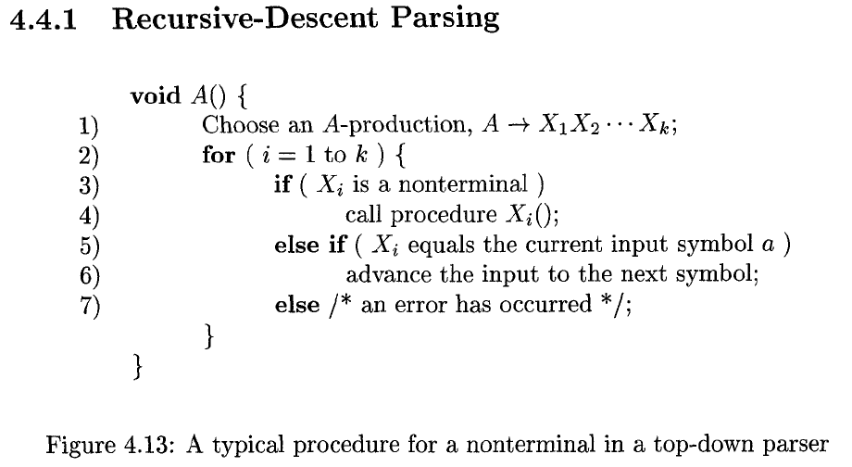
Recursive Descent Parser

Slide 8
Recursive Descent Parser
Whenever a Non-terminal appear then go with the first alternative/production and compare with the given input string
If input doesn’t match with the production, go with the second production and compare with the given I/P String.
If doesn’t match then go with the next production and so on.
Moreover, If matching occurs for at least one alternative, then the I/P string is parsed successfully.

Slide 9
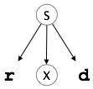
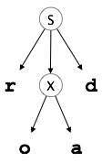
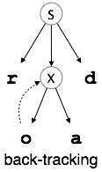
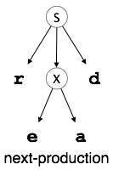
Recursive Descent Parser
Example W/ backtracking:
S → rXd | rZd
X → oa|ed
Z → ai
Now, try parsing the input “read”
A form of recursive-descent parsing that does not require any back-tracking is known as predictive parsing.

Slide 10
Predictive Parser
is a recursive descent parser, which has the capability to predict which production is to be used to replace the input string.
does not suffer from backtracking.
To avoid backtracking
uses a look-ahead pointer, which points to the next input symbols.
puts some constraints on the grammar and accepts only a class of grammar known as LL(k) grammar.
LL(k) parsing is constructed from the grammar which is free from left recursion, common prefix, and ambiguity.

Slide 11
All parser consists of 4 components
$
I/p Buffer $
Parser(Algorithm)
Parsing Table
Stack

Slide 12
Steps of Parsing
Step 1: Eliminate ambiguity, left recursion, and do left factoring
Step 2: Find First and Follow of each variable
Step 3: Construct Parsing table
Step 4: Parsing

Slide 13
First and Follow(Sec 4.2.2, Page 220)

Slide 14
First and Follow
Grammar
E → E + T | T
T → T * F | F
F → id| (E)
After elimination of Left Recursion
E → TE’
E’ → +TE’ |ε
T → FT’
T’ → * FT’| ε
F → id| (E)

Slide 15
First and Follow
Production | First | Follow
E → TE’ | { id, ε } | { $, ) }
E’ → +TE’ |ε | { +, ε } | { $, ) }
T → FT’ | { id, ε } | { +, $, ) }
T’ → * FT’| ε | { *, ε } | { +, $, ) }
F → id| (E) | { id, ( } | { *, +, $, ) }

Slide 16
Constructing Predictive Parsing Table
Row of the table contains the variable
Column contains terminal and $ sign
A rule/production is placed under the “First” of that production
The epsilon rule is placed under the “Follow” of the variable

Slide 17
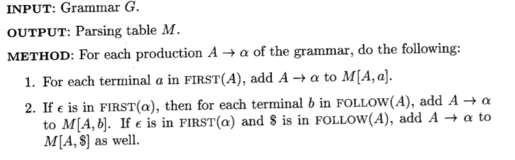

Constructing Predictive Parsing Table

Slide 18
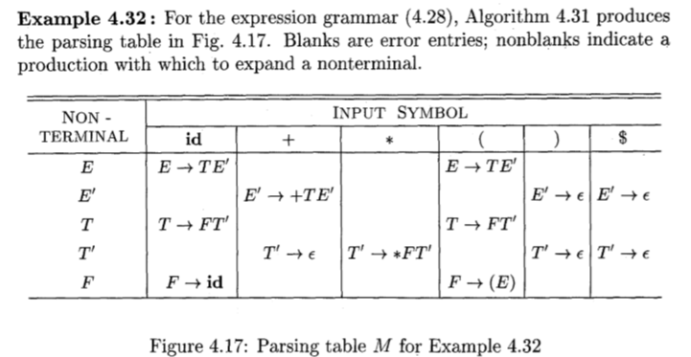
Constructing Predictive Parsing Table

Slide 19
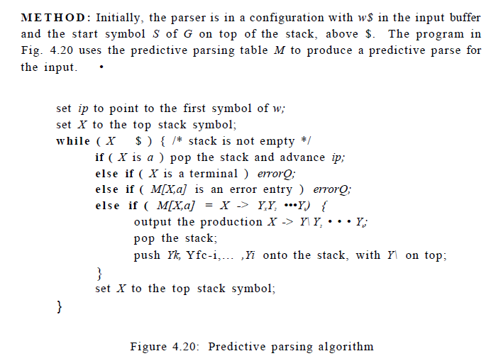
Predictive Parsing Algorithm

Slide 20
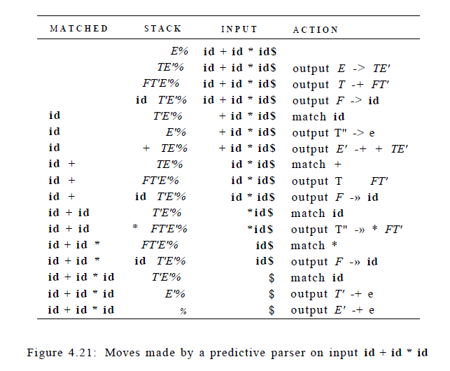
Parse example
id + id * id

Slide 21
LL(1) Grammar
Predictive parsers, that is, recursive-descent parsers needing no backtracking, can be constructed for a class of grammars called LL(1)
First L -> Scanning input from Left to Right
Second L -> stand for LMD
1 -> look ahead symbol is 1 character

Slide 22
LL(1) Grammar
A grammar G is LL(1) if and only if whenever A → α | β are two distinct productions of G, the following conditions hold:
For no terminal a do both α and β derive strings beginning with a. In other words, α and β don’t have common First.
At most one of α and β can derive the empty string.
If α →*→ε , then β does not derive any string beginning with a terminal in FOLLOW(A). Likewise, if β→*→ε, than α does not derive any string beginning with a terminal in FOLLOW(A).

Slide 23
Parser –Bottom-Up classification
Parser
Top-Down Parser
Recursive Descent
Without Backtracking
Bottom-Up Parser
Shift-Reduce Parser
Predictive Parser
LL Parser
LR Parser
LR(0)
LALR
With Backtracking
Operator Precedence
CLR
SLR(1)
Operator precedence Parser
Can parse ambiguous parser
Shift Reduce Parser
Only works for Unambiguous grammar

Slide 24
Bottom –Up Parser
Constructs the parse tree for an input string beginning at the leaves (the bottom) and working up towards the root (the top).
Scan input from left-to-right
Constructs a right-most derivation in reverse.

Slide 25
Bottom –Up Parser
We can think of bottom-up parsing as the process of "reducing" a string w to the start symbol of the grammar.
At each reduction step, a specific substring matching the body of a production (a.k.a. Handle) is replaced by the nonterminal at the head of that production.
The key decisions during bottom-up parsing are about when to reduce and about what production to apply, as the parse proceeds.

Slide 26
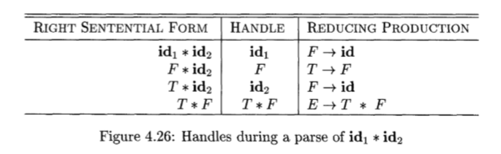
Bottom –Up Parser
Although T is the body of the production E → T,
T is not a handle in the sentential form T * id2.
Why?
If T is replaced by E, we would get E * id2, which cannot be derived from the start symbol E.

Slide 27
Shift-Reduce Parser
Shift-reduce parsing is a form of bottom-up parsing in which a stack holds grammar symbols and an input buffer holds the rest of the string to be parsed.
the handle always appears at the top of the stack just before it is identified as the handle

Slide 28


Shift-Reduce Parser
Initially, the stack is empty, and the string w is on the input
During a left-to-right scan of the input string,
the parser shifts zero or more input symbols onto the stack,
until it is ready to reduce a string β of grammar symbols on top of the stack.
It then reduces β to the head of the appropriate production.
The parser repeats this cycle
until it has detected an error or
until the stack contains the start symbol and the input is empty:

Slide 29
Shift-Reduce Parser -Operations
Four possible actions a shift-reduce parser can make: (1) shift, (2) reduce, (3) accept, and (4) error.
Primary operations are shift and reduce,
1. Shift. Shift the next input symbol onto the top of the stack.
2. Reduce. The right end of the string to be reduced must be at the top of the stack. Locate the left end of the string within the stack and decide with what nonterminal to replace the string.
3. Accept. Announce successful completion of parsing.
4. Error. Discover a syntax error and call an error recovery routine.
The use of a stack in shift-reduce parsing is justified by an important fact: the handle will always eventually appear on top of the stack, never inside.

Slide 30
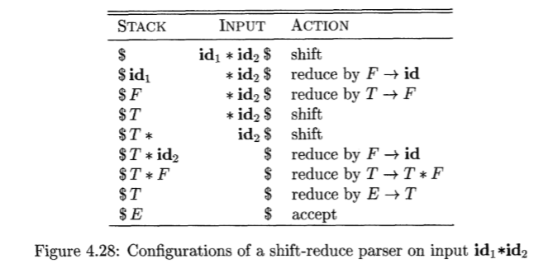
Shift-Reduce Parser

