Slide 1
About Computer Architecture
What ?
Why?
Where ?

Slide 2
What?
Since 1946 all computers have had 5 components
Processor
Input
Control
Memory
Datapath
Output

Slide 3
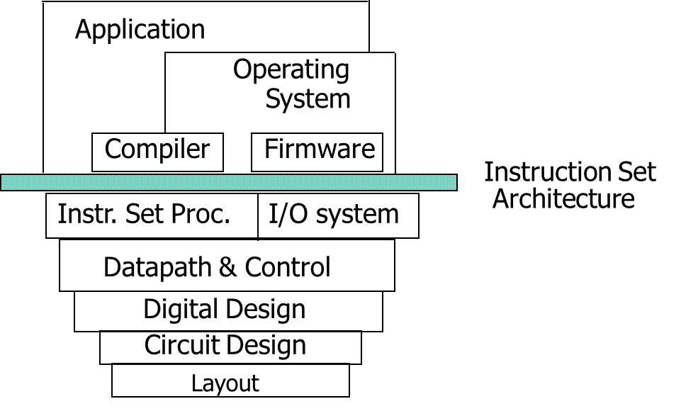
Computer Architecture
Coordination of many levels of abstraction
Under a rapidly changing set of forces
Design, Measurement, and Evaluation

Slide 4
Why?
Technology
Programming
Languages
Applications
Computer
Architecture
Cleverness
Operating
Systems
History

Slide 5
Why Computer Organization
Embarrassing if you are a BS in CS/CE and can’t
make sense of the following terms: DRAM, pipelining,
cache hierarchies, I/O, virtual memory, …
Embarrassing if you are a BS in CS/CE and can’t decide
which processor to buy: (helps us reason about performance/power), …
Obvious first step for chip designers, compiler/OS writers
Will knowledge of the hardware help you write better
and more secure programs?

Slide 6
What Does This Mean to a Programmer?
Today, one can expect only a 20% annual improvement;
the improvement is even lower if the program is not
multi-threaded
A program needs many threads
The threads need efficient synchronization and
communication
Data placement in the memory hierarchy is important
Accelerators should be used when possible

Slide 7
Challenges for Hardware Designers
Find efficient ways to
improve single-thread performance and energy
improve data sharing
boost programmer productivity
manage the memory system
build accelerators for important kernels
provide security

Slide 8
The HW/SW Interface
Application software
a[i] = b[i] + c;
Compiler
lw $15, 0($2)
add $16, $15, $14
add $17, $15, $13
lw $18, 0($12)
lw $19, 0($17)
add $20, $18, $19
sw $20, 0($16)
Systems software
(OS, compiler)
Assembler
Hardware
000000101100000
110100000100010
…

