Slide 1
COD Ch. 6 Enhancing Performance with Pipelining

Slide 2
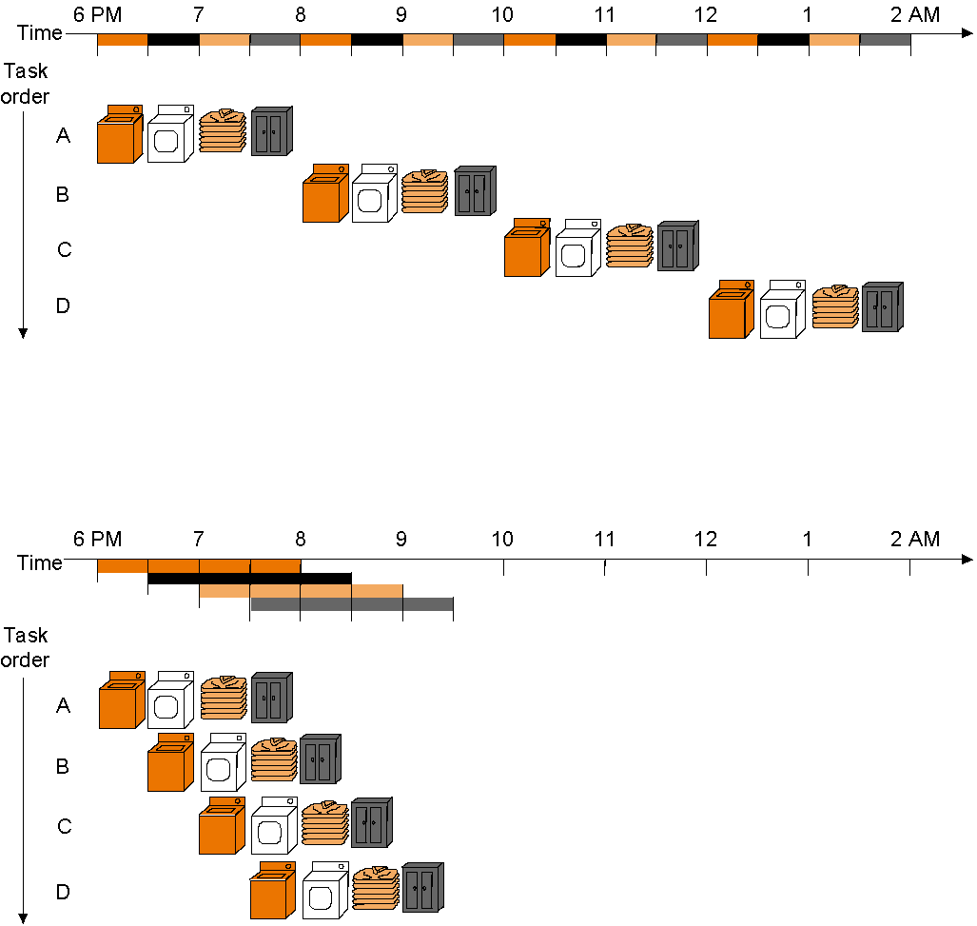
Pipelining
Start work ASAP!! Do not waste time!
Not pipelined
Assume 30 min. each task – wash, dry, fold, store – and that
separate tasks use separate hardware and so can be overlapped
Pipelined

Slide 3
Pipelined vs. Single-Cycle Instruction Execution: the Plan
P
r
o
g
r
a
m
2
4
6
8
1
0
1
2
1
4
1
6
1
8
e
x
e
c
u
t
i
o
n
T
i
m
e
o
r
d
e
r
Single-cycle
(
i
n
i
n
s
t
r
u
c
t
i
o
n
s
)
l
w
$
1
,
1
0
0
(
$
0
)
I
n
s
t
r
u
c
t
i
o
n
R
e
g
A
L
U
D
a
t
a
R
e
g
f
e
t
c
h
a
c
c
e
s
s
l
w
$
2
,
2
0
0
(
$
0
)
8
n
s
I
n
s
t
r
u
c
t
i
o
n
R
e
g
A
L
U
D
a
t
a
R
e
g
f
e
t
c
h
a
c
c
e
s
s
l
w
$
3
,
3
0
0
(
$
0
)
8
n
s
I
n
s
t
r
u
c
t
i
o
n
f
e
t
c
h
.
.
.
8
n
s
Assume 2 ns for memory access, ALU operation; 1 ns for register access:
therefore, single cycle clock 8 ns; pipelined clock cycle 2 ns.
P
r
o
g
r
a
m
2
4
6
8
1
0
1
2
1
4
e
x
e
c
u
t
i
o
n
T
i
m
e
o
r
d
e
r
(
i
n
i
n
s
t
r
u
c
t
i
o
n
s
)
I
n
s
t
r
u
c
t
i
o
n
D
a
t
a
l
w
$
1
,
1
0
0
(
$
0
)
f
e
t
c
h
R
e
g
A
L
U
a
c
c
e
s
s
R
e
g
Pipelined
l
w
$
2
,
2
0
0
(
$
0
)
2
n
s
I
n
s
t
r
u
c
t
i
o
n
R
e
g
A
L
U
D
a
t
a
R
e
g
f
e
t
c
h
a
c
c
e
s
s
I
n
s
t
r
u
c
t
i
o
n
D
a
t
l
w
$
3
,
3
0
0
(
$
0
)
2
n
s
R
a
e
g
A
f
L
U
R
e
g
e
t
c
h
a
c
c
e
s
s
2
n
s
2
n
s
2
n
s
2
n
s
2
n
s
Notes:
‹#›

Slide 4
Pipelining: Keep in Mind
Pipelining does not reduce latency of a single task, it increases throughput of entire workload
Pipeline rate limited by longest stage
potential speedup = number pipe stages
unbalanced lengths of pipe stages reduces speedup
Time to fill pipeline and time to drain it – when there is slack in the pipeline – reduces speedup

Slide 5
Example Problem
Problem: for the laundry fill in the following table when
the stage lengths are 30, 30, 30 30 min., resp.
the stage lengths are 20, 20, 60, 20 min., resp.
Come up with a formula for pipeline speed-up!
Person Unpipelined Pipeline 1 Ratio unpipelined Pipeline 2 Ratio unpiplelined
finish time finish time to pipeline 1 finish time to pipeline 2
1
2
3
4
n

Slide 6
Pipelining MIPS
What makes it easy with MIPS?
all instructions are same length
so fetch and decode stages are similar for all instructions
just a few instruction formats
simplifies instruction decode and makes it possible in one stage
memory operands appear only in load/stores
so memory access can be deferred to exactly one later stage
operands are aligned in memory
one data transfer instruction requires one memory access stage
Notes:
‹#›

Slide 7
Pipelining MIPS
What makes it hard?
structural hazards: different instructions, at different stages, in the pipeline want to use the same hardware resource
control hazards: succeeding instruction, to put into pipeline, depends on the outcome of a previous branch instruction, already in pipeline
data hazards: an instruction in the pipeline requires data to be computed by a previous instruction still in the pipeline
Before actually building the pipelined datapath and control we first briefly examine these potential hazards individually…

Slide 8
Structural Hazards
Structural hazard: inadequate hardware to simultaneously support all instructions in the pipeline in the same clock cycle
E.g., suppose single – not separate – instruction and data memory in pipeline below with one read port
then a structural hazard between first and fourth lw instructions
MIPS was designed to be pipelined: structural hazards are easy to avoid!
P
r
o
g
r
a
m
2
4
6
8
1
0
1
2
1
4
e
x
e
c
u
t
i
o
n
T
i
m
e
o
r
d
e
r
(
i
n
i
n
s
t
r
u
c
t
i
o
n
s
)
I
n
s
t
r
u
c
t
i
o
n
D
a
t
a
l
w
$
1
,
1
0
0
(
$
0
)
f
e
t
c
h
R
e
g
A
L
U
a
c
c
e
s
s
R
e
g
Pipelined
l
w
$
2
,
2
0
0
(
$
0
)
2
n
s
I
n
s
t
r
u
c
t
i
o
n
R
e
g
A
L
U
D
a
t
a
R
e
g
f
e
t
c
h
a
c
c
e
s
s
Hazard if single memory
l
w
$
3
,
3
0
0
(
$
0
)
2
n
s
I
n
s
t
r
u
c
t
i
o
n
R
e
g
A
L
U
D
a
t
a
R
e
g
f
e
t
c
h
a
c
c
e
s
s
l
w
$
4
,
4
0
0
(
$
0
)
I
n
s
t
r
u
c
t
i
o
n
R
e
g
A
L
U
D
a
t
a
R
e
g
2
n
s
f
e
t
c
h
a
c
c
e
s
s
2
n
s
2
n
s
2
n
s
2
n
s
2
n
s

Slide 9
Control Hazards
Control hazard: need to make a decision based on the result of a previous instruction still executing in pipeline
Solution 1 Stall the pipeline
P
r
o
g
r
a
m
e
x
e
c
u
t
i
o
n
2
4
6
8
1
0
1
2
1
4
1
6
o
T
i
m
e
r
d
e
r
(
i
n
i
n
s
t
r
u
c
t
i
o
n
s
)
I
n
s
t
r
u
c
t
i
o
n
R
e
g
A
L
U
D
a
t
a
R
e
g
Note that branch outcome is
computed in ID stage with
added hardware (later…)
a
d
d
$
4
,
$
5
,
$
6
f
e
t
c
h
a
c
c
e
s
s
b
e
q
$
1
,
$
2
,
4
0
I
n
s
t
r
u
c
t
i
o
n
R
e
g
A
L
U
D
a
t
a
R
e
g
2
n
s
f
e
t
c
h
a
c
c
e
s
s
l
w
$
3
,
3
0
0
(
$
0
)
b
u
b
b
l
e
I
n
s
t
r
u
c
t
i
o
n
R
e
g
A
L
U
D
a
t
a
R
e
g
f
e
t
c
h
a
c
c
e
s
s
4
n
s
2
n
s
Pipeline stall

Slide 10
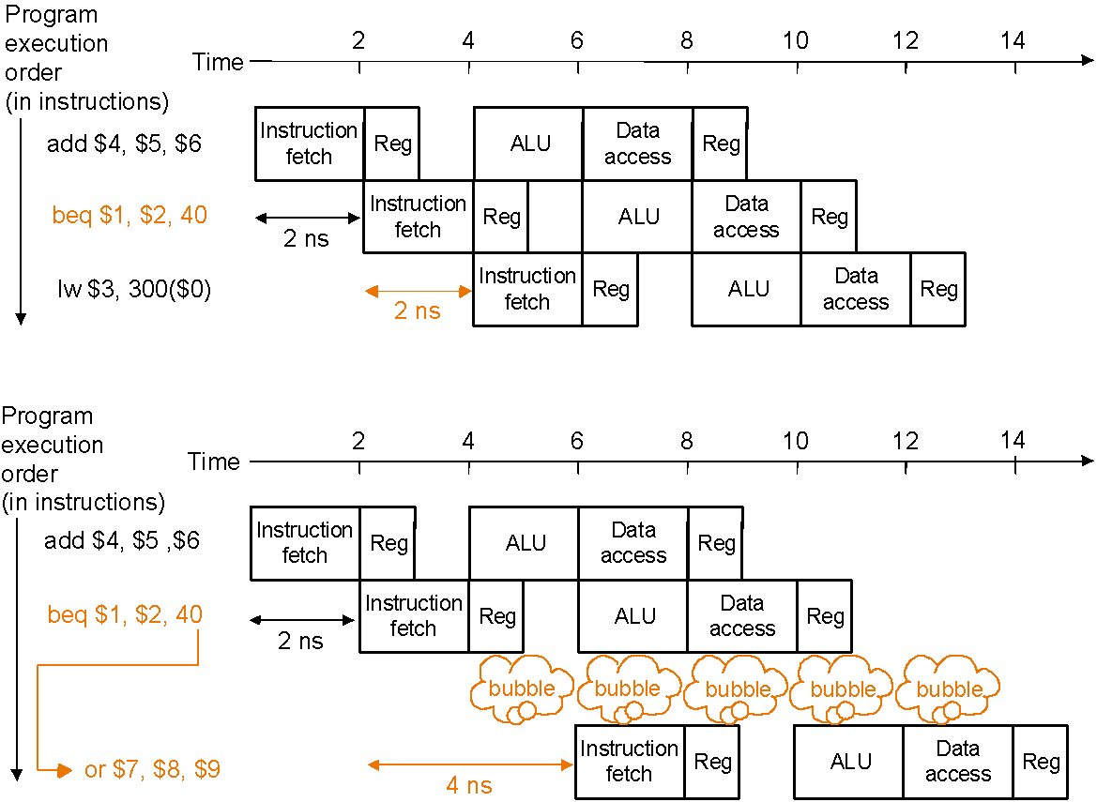
Control Hazards
Solution 2 Predict branch outcome
e.g., predict branch-not-taken :
Prediction success
Prediction failure: undo (=flush) lw

Slide 11
Control Hazards
Solution 3 Delayed branch: always execute the sequentially next statement with the branch executing after one instruction delay – compiler’s job to find a statement that can be put in the slot that is independent of branch outcome
MIPS does this – but it is an option in SPIM (Simulator -> Settings)
P
r
o
g
r
a
m
e
x
e
c
u
t
i
o
n
2
4
6
8
1
0
1
2
1
4
o
r
d
e
r
T
i
m
e
(
i
n
i
n
s
t
r
u
c
t
i
o
n
s
)
b
e
q
$
1
,
$
2
,
4
0
I
n
s
t
r
u
c
t
i
o
n
R
e
g
A
L
U
D
a
t
a
R
e
g
f
e
t
c
h
a
c
c
e
s
s
a
d
d
$
4
,
$
5
,
$
6
I
n
s
t
r
u
c
t
i
o
n
R
e
g
A
L
U
D
a
t
a
R
e
g
(
2
n
s
f
e
t
c
h
a
c
c
e
s
s
d
e
l
a
y
e
d
b
r
a
n
c
h
s
l
o
t
)
l
w
$
3
,
3
0
0
(
$
0
)
I
n
s
t
r
u
c
t
i
o
n
R
e
g
A
L
U
D
a
t
a
R
e
g
2
n
s
f
e
t
c
h
a
c
c
e
s
s
2
n
s
Delayed branch beq is followed by add that is
independent of branch outcome

Slide 12
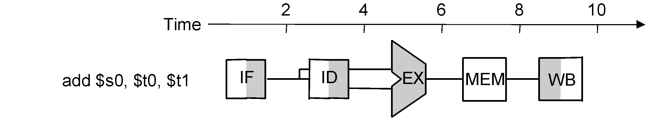
Data Hazards
Data hazard: instruction needs data from the result of a previous instruction still executing in pipeline
Solution Forward data if possible…
Instruction pipeline diagram:
shade indicates use –
left=write, right=read
P
r
o
g
r
e
x
e
c
a
m
u
t
i
o
o
n
2
4
6
8
1
0
r
d
e
r
T
i
(
m
e
i
n
i
n
s
t
r
u
c
t
i
o
n
s
)
Without forwarding – blue line –
data has to go back in time;
with forwarding – red line –
data is available in time
a
d
d
$
s
0
,
$
t
0
,
$
t
1
I
F
I
D
E
X
M
E
M
W
B
s
u
b
$
t
2
,
$
s
0
,
$
t
3
I
M
E
M
F
I
D
E
X
M
E
M
W
B

Slide 13
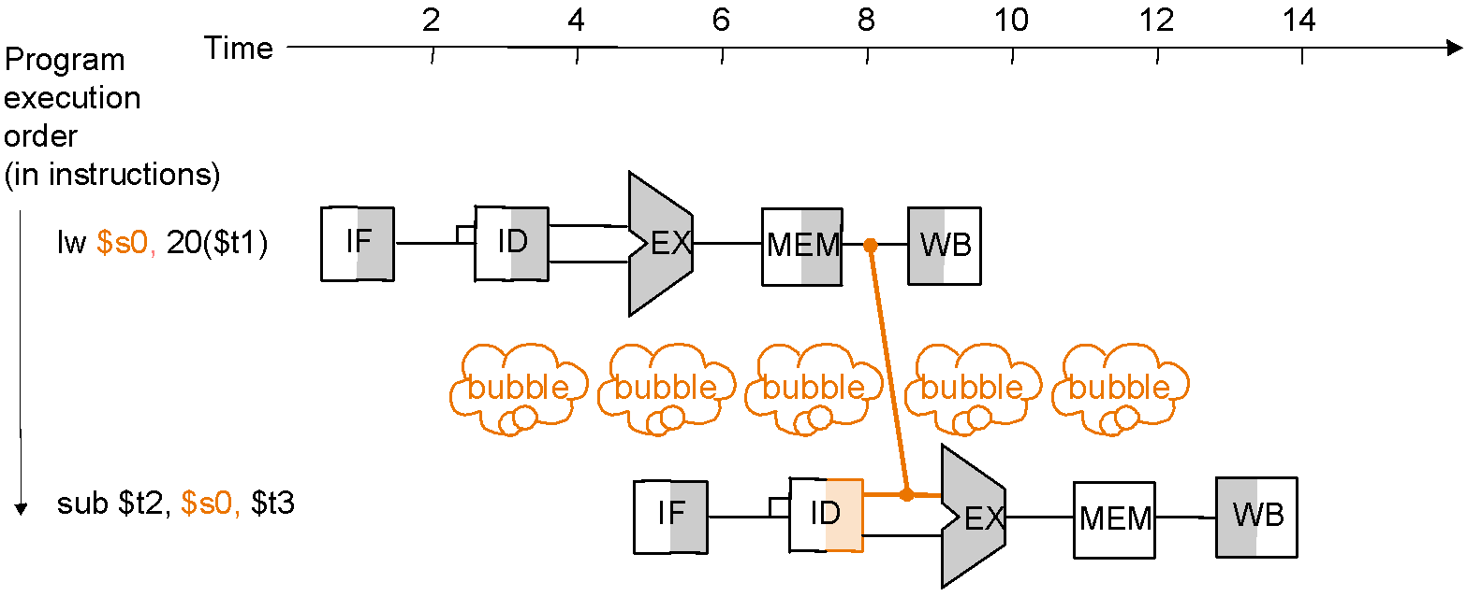
Data Hazards
Forwarding may not be enough
e.g., if an R-type instruction following a load uses the result of the load – called load-use data hazard
T
i
m
e
2
4
6
8
1
0
1
2
1
4
P
r
o
g
r
a
m
e
x
e
c
u
t
i
o
n
o
r
d
e
r
(
i
n
i
n
s
t
r
u
c
t
i
o
n
s
)
Without a stall it is impossible
to provide input to the sub
instruction in time
l
w
$
s
0
,
2
0
(
$
t
1
)
I
F
I
D
E
X
M
E
M
W
B
s
u
b
$
t
2
,
$
s
0
,
$
t
3
I
F
I
D
E
X
M
E
M
W
B
With a one-stage stall, forwarding
can get the data to the sub
instruction in time

Slide 14
Reordering Code to Avoid Pipeline Stall (Software Solution)
Example:
lw $t0, 0($t1)
lw $t2, 4($t1)
sw $t2, 0($t1)
sw $t0, 4($t1)
Reordered code:
lw $t0, 0($t1)
lw $t2, 4($t1)
sw $t0, 4($t1)
sw $t2, 0($t1)
Data hazard
Interchanged

Slide 15
Pipelined Datapath
We now move to actually building a pipelined datapath
First recall the 5 steps in instruction execution
Instruction Fetch & PC Increment (IF)
Instruction Decode and Register Read (ID)
Execution or calculate address (EX)
Memory access (MEM)
Write result into register (WB)
Review: single-cycle processor
all 5 steps done in a single clock cycle
dedicated hardware required for each step
What happens if we break the execution into multiple cycles, but keep the extra hardware?

Slide 16

Review - Single-Cycle Datapath “Steps”
ADD
4
ADD
PC
<<2
ADDR
RD
Instruction
I
Instruction
32
16
32
5
5
5
Memory
RN1
RN2
WN
Register File
RD1
ALU
Zero
WD
RD2
M
U
ADDR
X
Data
E
Memory
RD
M
16
X
32
U
T
WD
X
N
D
IF
Instruction Fetch
ID
Instruction Decode
EX
Execute/ Address Calc.
MEM
Memory Access
WB
Write Back

Slide 17
Pipelined Datapath – Key Idea
What happens if we break the execution into multiple cycles, but keep the extra hardware?
Answer: We may be able to start executing a new instruction at each clock cycle - pipelining
…but we shall need extra registers to hold data between cycles – pipeline registers

Slide 18
Pipelined Datapath
Pipeline registers
wide enough to hold data coming in
ADD
4
64 bits
128 bits
ADD
PC
<<2
97 bits
64 bits
ADDR
RD
Instruction
I
Instruction
32
16
32
5
5
5
Memory
RN1
RN2
WN
RD1
Zero
Register File
ALU
WD
RD2
M
U
ADDR
X
Data
E
Memory
RD
M
16
X
32
U
T
WD
X
N
D
IF/ID
ID/EX
EX/MEM
MEM/WB

Slide 19
Pipelined Example
Consider the following instruction sequence:
lw $t0, 10($t1)
sw $t3, 20($t4)
add $t5, $t6, $t7
sub $t8, $t9, $t10

Slide 20
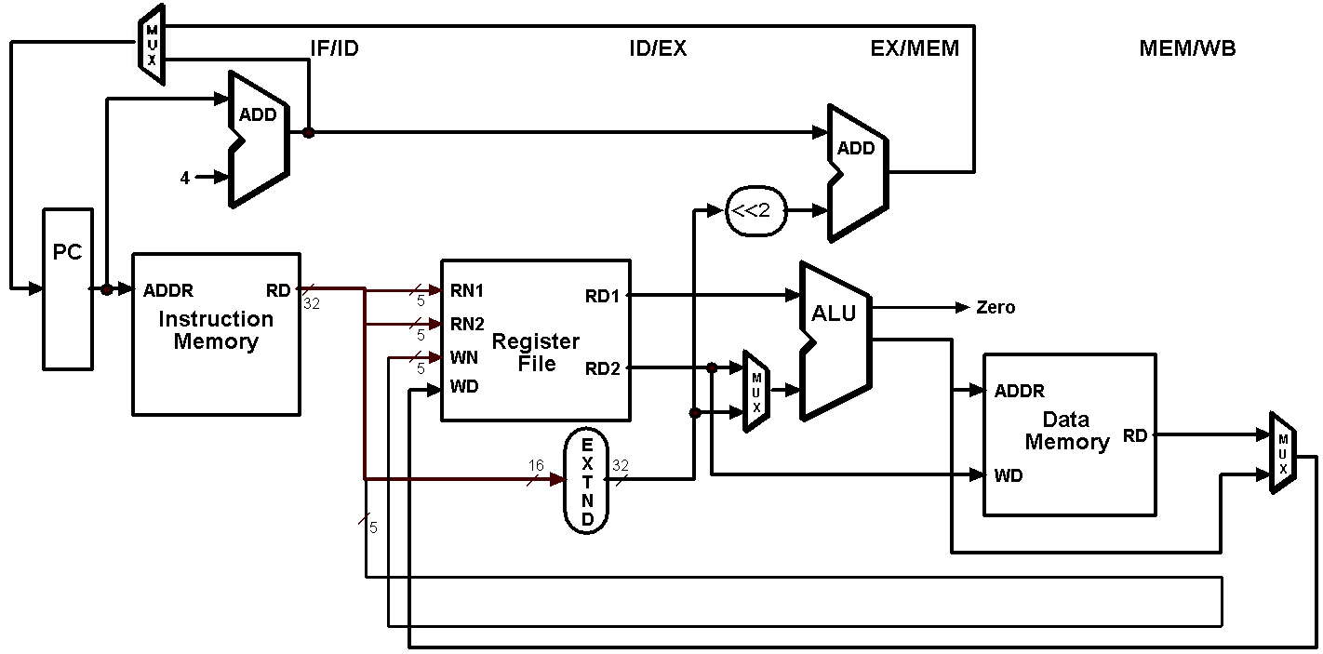
Single-Clock-Cycle Diagram: Clock Cycle 1
LW

Slide 21
Single-Clock-Cycle Diagram: Clock Cycle 2
SW
LW

Slide 22
Single-Clock-Cycle Diagram: Clock Cycle 3
ADD
SW
LW

Slide 23
Single-Clock-Cycle Diagram: Clock Cycle 4
SUB
ADD
SW
LW

Slide 24
Single-Clock-Cycle Diagram: Clock Cycle 5
SUB
ADD
SW
LW

Slide 25
Single-Clock-Cycle Diagram: Clock Cycle 6
SUB
ADD
SW

Slide 26
Single-Clock-Cycle Diagram: Clock Cycle 7
SUB
ADD

Slide 27
Single-Clock-Cycle Diagram: Clock Cycle 8
SUB

Slide 28
Alternative View – Multiple-Clock-Cycle Diagram
CC 1
CC 2
CC 3
CC 4
CC 5
CC 6
CC 7
CC 8
Time axis
lw $t0, 10($t1)
IM
REG
ALU
DM
REG
sw $t3, 20($t4)
IM
REG
ALU
DM
REG
add $t5, $t6, $t7
IM
REG
ALU
DM
REG
sub
$t8, $t9, $t10
IM
REG
ALU
DM
REG

